Slide 1
Software Defined Networking
COMS 6998-10, Fall 2014
Instructor: Li Erran Li (lierranli@cs.columbia.edu)
http://www.cs.columbia.edu/~lierranli/coms6998-10SDNFall2014/
11/21/2014: SDN Wireless Networks

Slide 2
Outline
Review of SDN Security
SDN Wireless Networks
  Motivation
  Data Plane Abstraction:
    OpenRadio
    PRAN
  Control Plane Architecture
    Radio Access Networks: SoftRAN
    Core Networks: SoftCell
    Cellular WAN: SoftMoW

Slide 3
Review of Previous Lecture: Defense Against Control Plane Attacks
Security extension to the OpenFlow data plane
  Connection migration
    To address scalability
    issue
  Actuating trigger
    To address responsiveness
    issue
Control Plane
Control Plane Interface
Connection Migration
Actuating Trigger
Flow Table Lookup
Packet Processing
Avant-Guard
Flow Table (TCAM and SRAM)
Data Plane
Source: S. Shin, et al.

Slide 4
Connection Migration – Packet Diagram
Review of Previous Lecture: Defense Against Control Plane Attacks (Cont’d)
Control Plane
(4)
(5)
Report stage
(9)
(10)
Report stage
Classification stage
Migration stage
A
(1) TCP SYN
(6) TCP SYN
B
(2) TCP SYN/ACK
A-1: A --> B: Migrate
(7) TCP SYN/ACK
(3) TCP ACK
(8) TCP ACK
Relay stage
A-2: A --> B: Relay
Relay stage
(11) TCP ACK
TCP Data
(12) TCP ACK
TCP Data
Data Plane
Source: S. Shin, et al.

Slide 5
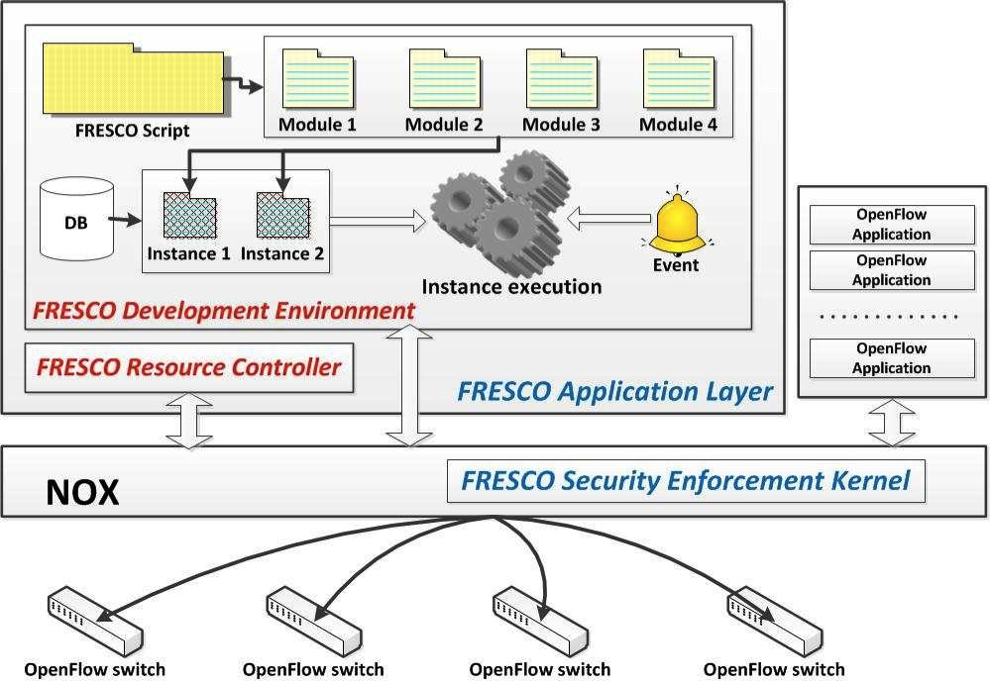
Review of Previous Lecture: Controller Security Framework (Cont’d)
Source: G. Gu, et al, Texas A&M &SRI

Slide 6
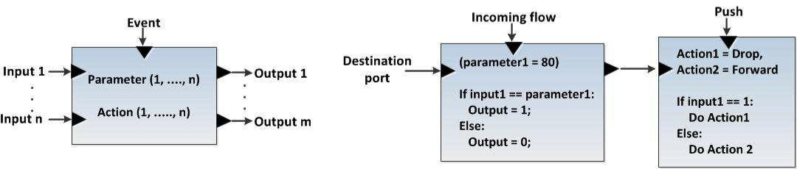
FRESCO Modular Design
Review of Previous Lecture: Controller Security Framework (Cont’d)
event
parameter
action
input
output
Module
key
values
F-DB instance
Source: G. Gu, et al, Texas A&M &SRI

Slide 7

Review of Previous Lecture: Controller Security Framework (Cont’d)
Native C
OF Apps
Separate
Process
Security Apps
PY OF
Apps
OF IPC Proxy
Actuator
Python SWIG
Directive Translator
IPC Interface
Aggregate Flow Table
FT_Send_OpenFlow_Command
Operator Rules
Role-based Source Auth
State Table Manager
OF Mod Commands
Add (conflict enforced)
Modify (conflict enforced)
Delete (priority enforced)
SECURITY Rules
Conflict Analyzer
OF App Rules
Switch Callback Tracking
FortNOX
Source: G. Gu, et al, Texas A&M &SRI

Slide 8
Outline
Review of SDN Security
SDN Wireless Networks
  Motivation
  Data Plane Abstraction:
    OpenRadio
    PRAN
  Control Plane Architecture
    Radio Access Networks: SoftRAN
    Core Networks: SoftCell
    Cellular WAN: SoftMoW

Slide 9
Wireless Data Growth
Exponential traffic growth
Question: How to substantially improve wireless capacity?
Source: CISCO Visual Networking Index (VNI) Global Mobil Data Traffic Forecast 2011 to 2016

Slide 10
Outline
Review of SDN Security
SDN Wireless Networks
  Motivation
  Data Plane Abstraction:
    OpenRadio
    PRAN
  Control Plane Architecture
    Radio Access Networks: SoftRAN
    Core Networks: SoftCell
    Cellular WAN: SoftMoW

Slide 11


OpenRadio: Access Dataplane
OpenRadio APs built with merchant DSP & ARM silicon
  Single platform capable of LTE, 3G, WiMax, WiFi
  OpenFlow for Layer 3
  Inexpensive ($300-500)
Forwarding
Dataplane
Control
CPU
Baseband &
Layer 2 DSP
Exposes a match/action interface to program how a flow is forwarded, scheduled & encoded
RF
RF
RF
Source: Katti, Stanford

Slide 12
Design goals and Challenges
Programmable wireless dataplane using off-the-shelf components
  At least 40MHz OFDM-complexity performance
    More than 200 GLOPS computation
    Strict processing deadlines, eg. 25us ACK in WiFi
  Modularity to provide ease of programmability
    Only modify affected components, reuse the rest
    Hide hardware details and stitching of modules
Source: Katti, Stanford
12
Notes:
The goal in providing flexibility is to enable implementation of a wide set of optimizations and variations, but not arbitrary modifications. The cost in providing arbitrary flexibility is loss in performance (eg. SDRs). We want to cover modifications but retain performance. This will affect the granularity of protocol decomposition and the selection of processing abstractions, as we will discuss next.

Slide 13
Wireless Basebands
OFDM Demod
Demap
(BPSK)
Deinterleave
Viterbi Decode
Descramble
CRC Check
Hdr Parse
OFDM Demod
OFDM Demod
Demap
(BPSK)
Demap
(64QAM)
Demap
(BPSK)
Demap
(64QAM)
Deinterleave
Deinterleave
(WiFi)
Deinterleave (UEP)
Decode
(1/2)
Decode
(3/4)
Decode
(1/2)
Decode
(3/4)
Descramble
CRC Check
Hdr Parse
Descramble
Descramble
CRC Check
Hdr Parse
Hdr Parse
WiFi 6mbps
WiFi 6, 54mbps
WiFi 6, 18mbps and UEP
Source: Katti, Stanford
13
Notes:
Goal: We want to understand the nature of “programmability” in the context of wireless radios.
Outline: Lets consider a PHY protocol, say WiFi and list the operations that are performed. Then, let’s look at different modes of the protocol, like different modulation schemes and different coding rates. Based on the parts that are common and the parts that need modification or need to be turned off/on from mode to mode, we can partition the sequence of operations. This gives us the natural granularity of blocks that make up wireless protocols and the level of abstraction needed for programming.
We formalize this approach by identifying that the nature of “programming” involved here is the decision of whether to use a processing block and the associated parameters. The design of the “programming interface” involves the choice of processing blocks and their granularity. It is also the tradeoff between flexibility and ease of programming. (As we will see, it is also the tradeoff between flexibility and performance).
Give examples of what we DO NOT want to program: The specific algorithm used for Fourier Transform, the specific algorithm used for ML decoding, the specific algorithm used for computing the CRC etc.
Note: The list of blocks here is not exhaustive, only an example. Also, the division is not laid out in stone. A block can always be further subdivided – you may split an OFDM Demod block into “subcarrier demapper”, “CP remove” and “FFT”. We are only using this to drive to the principle of processing and decision plane separation.

Slide 14
Modular declarative interface
Composing ACTIONS
Inserting RULES
E
J
A
A
Deinterleave (UEP)
Hdr Parse
D
I
CRC Check
Deinterleave
(WiFi)
C
H
B
Demap
(64QAM)
Descramble
B
G
B
C
Demap
(BPSK)
Decode
(3/4)
D
A
F
OFDM Demod
Decode
(1/2)
D
  Blocks
F
A
A
A
B
C
C
H
Data
flow
F
G
D
D
E
H
F
G
F
G
I
I
H
H
H
H
J
J
I
I
I
6M, 54M
Control
flow
6M
54M
UEP
6M
J
J
J
J
  Rules: Branching logic
  Actions: DAGs of blocks
Source: Katti, Stanford
Notes:
Convenient abstraction level means that declarative description of protocol is possible with blocks as units; hardware is abstracted in the blocks so that the imperative execution plan need not be specified.
Sufficient expressiveness means that most protocol variants of interest can be realized with this API.

Slide 15
State machines and deadlines
Rules and actions encode the protocol state machine
  Rules define state transitions
  Each state has an associated action
Deadlines are expressed on state sequences
Start
decoding
Finish
decoding
B
F
A
D
H
I
G
J
C
deadline
Source: Katti, Stanford
15

Slide 16
Design principle I
Judiciously scoping flexibility
Provide just enough flexibility
Keep blocks coarse
Higher level of abstraction
High performance through hardware acceleration
  Viterbi co-processor
  FFT co-processor
Off-the-shelf heterogeneous multicore DSPs
  TI, CEVA, Freescale etc.
Algorithm | WiFi | LTE | 3G | DVB-T
FIR / IIR | √ | √ | √ | √
Correlation | √ | √ | √ | √
Spreading |  |  | √
FFT | √ | √ |  | √
Channel Estimation | √ | √ | √ | √
QAM Mapping | √ | √ | √ | √
Interleaving | √ | √ | √ | √
Convolution Coding | √ | √ | √ | √
Turbo Coding |  | √ | √
Randomi-zation | √ | √ | √ | √
CRC | √ | √ | √
Notes:
Balance flexibility and performance.

Slide 17
Design principle II
Processing-Decision separation
A
B
C
D
Logic pulled out to decision plane
Blocks and actions are branch-free
  Deterministic execution times
  Efficient pipelining, algorithmic scheduling
  Hardware is abstracted out
F
G
H
I
J
6M, 54M
A
Regular compilation | OpenRadio scheduling
Instructions | Atomic processing blocks
Heterogeneous functional units | Heterogeneous cores
Known cycle counts | Predictable cycle counts
Argument data dependency | FIFO queue data dependency
B
C
D
60x
E
F

Slide 18
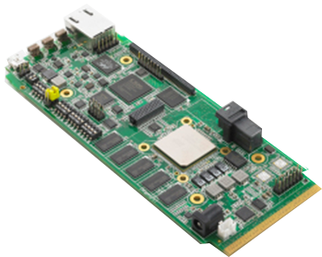
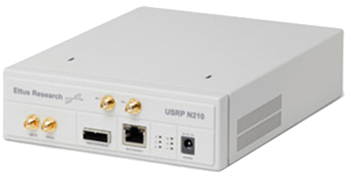

Prototype
I/Q base-
band
samples
RF signal
(Digital)
(Analog)
Baseband-processor unit (BBU)
Radio front end (RFE)
Antenna chain(AX)
Layer 1 & 2
Layer 0 & 1
Layer 0
COTS TI KeyStone multicore DSP platform
(EVM6618, two chips with 4 cores each at 1.2GHz, configurable hardware accelerators for FFT, Viterbi, Turbo)
Prototype can process 40MHz, 108Mbps 802.11g on one chip using 3 of 4 cores
Source: Katti, Stanford
18

Slide 19
OpenRadio: Current Status
OpenRadio APs with full WiFi/LTE software on TI C66x DSP silicon
OpenRadio commodity WiFi APs with a firmware upgrade
Network OS under development
Source: Katti, Stanford

Slide 20
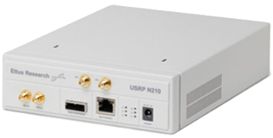
Software architecture
BBU
RFE
AX
(Digital)
(Analog)
monitor & control
OR Wireless Decision Plane
protocol state machine, flowgraph composition, block configurations, knowledge plane, RFE control logic
OR Runtime System
compute resource scheduling, deterministic execution ensuring protocol deadlines are met
OR Wireless Processing Plane
deterministic signal processing blocks, header parsing, channel resource scheduling, multicore fifo queues, sample I/O blocks
data in
data out
Bare-metal with drivers

Slide 21
Outline
Review of SDN Security
SDN Wireless Networks
  Motivation
  Data Plane Abstraction:
    OpenRadio
    PRAN
  Control Plane Architecture
    Radio Access Networks: SoftRAN
    Core Networks: SoftCell
    Cellular WAN: SoftMoW

Slide 22
PRAN Programmability
Hardware/software radio
  Not easy to program
Programmable Radio
  Flexible datapath, interfaces
Data Flow
Scheduler
Base Station Information Base
Control Flow
Control Plane
State Flow
Data Plane
Turbo
Coding
Scrambling
Scheduler
Modulation
Scheduler
Reed-Muller
Coding
Transport
Block
Down Link
I & Q
Samples
Up Link
Turbo
Decoding
Scheduler
Channel
Estimation
Demodulation
Scheduler
Reed-Muller
Decoding
Notes:
hardware to offload
Hardware offload

Slide 23




RRH
Fiber
Radio Plane
Operator1
Operator2
Data Plane
L1/L2
L1/L2
L1/L2
Scheduler
Scheduler
Scheduler
Control Plane
RAN Scheduler
RAN Scheduler
Management
Plane
Resource Manager
Cloud
Infrastructure
server
Gateway
Internet
Notes:
PRAN architecture

Slide 24
Summary
Provides programmatic interfaces to monitor and program wireless networks
  High performance substrate using merchant silicon

Slide 25
Outline
Review of SDN Security
SDN Wireless Networks
  Motivation
  Data Plane Abstraction:
    OpenRadio
    PRAN
  Control Plane Architecture
    Radio Access Networks: SoftRAN
    Core Networks: SoftCell
    Cellular WAN: SoftMoW

Slide 26
Carrier’s Dilemma
Exponential Traffic Growth
Limited Capacity Gain
Poor wireless connectivity if left unaddressed

Slide 27
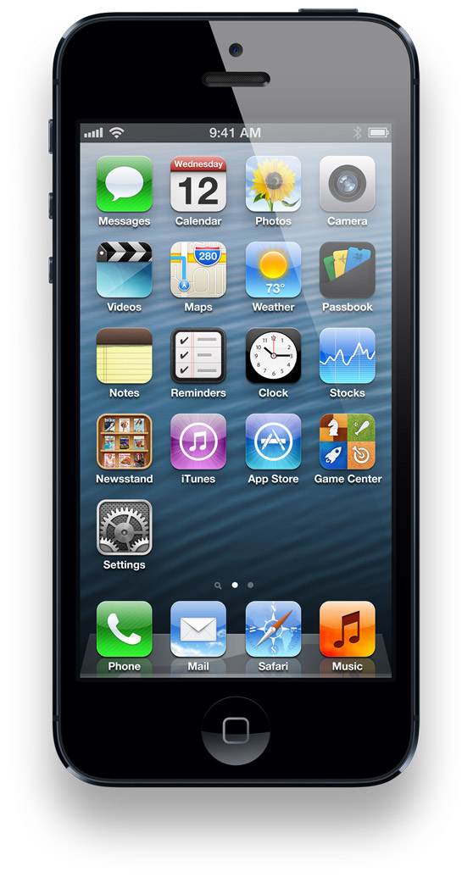
LTE Radio Access Networks
Goal: high capacity wide-area coverage
  Dense deployment of small cells
Base Station (BS)
Serving Gateway
Packet Data
Network Gateway
User Equipment (UE)
Serving Gateway
Internet
access
core
Notes:
This figure shows the architecture of today’s cellular core networks. User equipment connect to base stations via radio channels.
Base stations connect to the Internet via the cellular core network. There are two main components in the cellular core network, serving gateway and packet data network gateway.

Slide 28
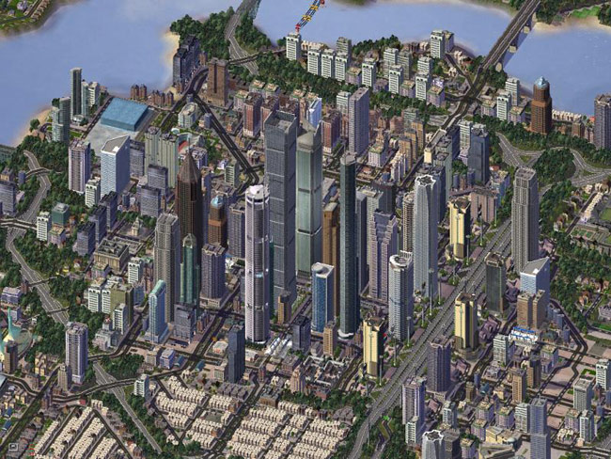

Dense and Chaotic Deployments
Dense: high SNR per user leads to higher capacity
  Small cells, femto cells, repeaters, etc

Slide 29
Problems
Current LTE distributed control plane is ill-suited
  Hard to manage inter-cell interference
  Hard to optimize for variable load of cells
Dense deployment is costly
  Need to share cost among operators
  Maintain direct control of radio resources
    Lacking in current 3gpp RAN sharing standards
29

Slide 30

SoftRAN: Big Base Station Abstraction
Big Base Station
Radio Element 1
time
controller
frequency
Radio Element 2
Radio Element 3
time
time
time
frequency
radio element
frequency
frequency
30

Slide 31
Radio Resource Allocation
Flows
3D Resource Grid
time
radio element
frequency
31

Slide 32

SoftRAN: SDN Approach to RAN
Coordination :
X2 Interface
Control Algo
Control Algo
PHY & MAC
PHY & MAC
Control Algo
PHY & MAC
BS1
BS3
Control Algo
Control Algo
BS5
PHY & MAC
PHY & MAC
BS2
BS4

Slide 33
SoftRAN: SDN Approach to RAN
Control Algo
Operator Inputs
Network OS
RadioVisor
PHY & MAC
PHY & MAC
PHY & MAC
RE3
RE1
RE5
PHY & MAC
PHY & MAC
Radio Element (RE)
RE2
RE4

Slide 34
SoftRAN Architecture Summary
CONTROLLER
RAN Information Base
Periodic Updates
Controller
API
Bytes
Rate
Queue
Size
Network
Operator
Inputs
RADIO ELEMENTS
Interference
Map
Flow
Records
QoS
Constraints
3D Resource Grid
Radio
Element API
Time
Radio Resource
Management
Algorithm
Radio Element
POWER
FLOW
Frequency
34

Slide 35
SoftRAN Architecture: Updates
Radio element -> controller (updates)
  Flow information (downlink and uplink)
  Channel states (observed by clients)
Network operator -> controller (inputs)
  QoS requirements
  Flow preferences
35

Slide 36
SoftRAN Architecture: Controller Design
RAN information base (RIB)
  Update and maintain global network view
    Interference map
    Flow records
Radio resource management
  Given global network view: maximize global utility
  Determine RRM at each radio element
36

Slide 37
SoftRAN Architecture: Radio Element API
Controller -> radio element
  Handovers to be performed
  RF configuration per resource block
    Power allocation and flow allocation
  Relevant information about neighboring radio elements
    Transmit Power being used
37

Slide 38
Refactoring Control Plane
Controller responsibilities:
  Decisions influencing global network state
    Load balancing
    Interference management
Radio element responsibilities:
  Decisions based on frequently varying local network state
    Flow allocation based on channel states
38

Slide 39
SoftRAN Advantages
  Logically centralized control plane:
  Global view on interference and load
    Easier coordination of radio resource management
    Efficient use of wireless resources
  Plug-and-play control algorithms
    Simplified network management
  Smoother handovers
    Better user-experience
39

Slide 40
SoftRAN: Evolving the RAN
Switching off radio elements based on load
  Energy savings
Dynamically splitting the network into Big-BSs
  Handover radio elements between Big-BSs
40

Slide 41
RadioVisor Design
Slice manager
  Slice configuration, creation, modification, deletion and multi-slice operations
Traffic to slice mapping at RadioVisor and radio elements
3D resource grid allocation and isolation
  Considers traffic demand, interference graph and policy
RadioVisor
3D Resource Grid
Allocation & Isolation
Slice
Manager
Traffic to Slice
Mapping

Slide 42
Slice Manager
Slice definition
  Predicates on operator, device, subscriber, app attributes
    A slice can be all M2M traffic of operator 1
Slice configuration at data plane and control plane
  PHY and scheduler: narrow band PHY for M2M slice
  Interference management algorithm
Slice algebra to support flexible slice operations
  Slice merge, split, (un)nest, duplicate

Slide 43
Resource Grid Allocation and Isolation
Slices present resource demands every time window
Max min fair allocation
Example
  Red slice entitles 2/3 and demands 2/3 RE1 only
  Blue slice entitles 1/3 and demand 1/3 RE2 and 1 RE3
Interference Edge
Radio
Element 1
Radio
Element 2
Radio
Element 3
Frequency
Time
Radio Element

Slide 44
Summary
Dense deployment calls for central control of radio resources
Deployment costs motivate RAN Sharing
We present the design of RadioVisor
  Enables direct control of per slice radio resources
  Configures per slice PHY and MAC, and interference management algorithm
  Supports flexible slice definitions and operations

Slide 45
Outline
Review of SDN Security
SDN Wireless Networks
  Motivation
  Data Plane Abstraction:
    OpenRadio
    PRAN
  Control Plane Architecture
    Radio Access Networks: SoftRAN
    Core Networks: SoftCell
    Cellular WAN: SoftMoW

Slide 46
LTE Cellular Network Architecture
Base Station (BS)
Serving Gateway
Packet Data
Network Gateway
Serving Gateway
Internet
User Equipment (UE)
access
core
Notes:
This figure shows the architecture of today’s cellular core networks. User equipment connect to base stations via radio channels.
Base stations connect to the Internet via the cellular core network. There are two main components in the cellular core network, serving gateway and packet data network gateway.

Slide 47
Cellular core networks are not flexible
Most functionalities are implemented at
Packet Data Network Gateway
  Content filtering, application identification,
  stateful firewall, lawful intercept, …
This is not flexible
Packet Data
Network Gateway
Combine functionality from different vendors
Easy to add new functionality
Only expand capacity for bottlenecked functionality
Notes:
Most functionalities are implemented at the packet gateway today, including application identification, content filtering, monitoring and billing, and so on.
It is not flexible because carriers cannot combine functionality from different vendors.
It is also not easy to add new functionality because vendors have to integrate the functionality with other functionalities that might have already exist for more than 10 years.
It is also no possible to only expand capacity for bottlenecked functionality. Carriers have to buy a new equipment in order to expand the capacity.

Slide 48


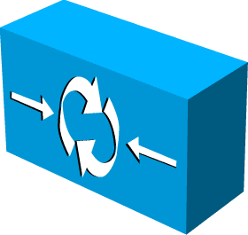
SoftCell Overview
Simple hardware
+ SoftCell software
Controller
Internet
Notes:
To be free from such control bottlenecks, we designed a new cellular network architecture called SoftCell. SoftCell applies the principle of software defined networking. Instead of using specialized data plane equipment, we will just use SDN switches. The SoftCell controller coordinates the data plane functions.
To enable direct control and flexibility, we propose a new architecture. It uses the principle of software defined networking. We will make use of commodity hardware which will be controlled by a controller. We make no changes to user equipment and the Internet.
It makes no change no user equipment, the radio access technology, or the Internet.
It only replaces the core network with commodity switches and middleboxes, controlled by a logically centralized controller.
Data Plane:
Switch: connectivity, traffic steering
Middlebox: various network services
~mix-match, combine functionality from different vendors
~easy to add new functionality
~up-/down-scale
~cheap
Control Plane:
Logically centralized controller, centralized control, rather than distributed protocol (hard to reason, debug, trouble shooting)
~Easy to manage
~Easy to change

Slide 49


SoftCell Design Goal
Fine-grained service policy for diverse app needs
  Video transcoder, content filtering, firewall
  M2M services: fleet tracking, low latency medical device updates
with diverse needs!
Notes:
Due to the diverse needs from subscriber mobile apps and M2M apps, we need to support fine-grained policies such as video transcoder, content filtering, fleet tracking.
We wan three things. First, we want unified control of data plane. Second, we would like to flexibly control routing and Internet exit points. Third,
Given the different needs of subscribers and the many user scenarios of machine type communication (also known as Internet of Things), we would like to design the network for high performance and scalable support of fine-grained policies.

Slide 50
Characteristics of Cellular Core Networks
“North south” traffic pattern
Asymmetric edge
Traffic initiated from low-bandwidth access edge
Gateway Edge
Internet
~1 million Users
~10 million flows
~400 Gbps – 2 Tbps
~1K Users
~10K flows
~1 – 10 Gbps
Access Edge
Notes:
How should we design SoftCell to support fine-grained policies? Can we just apply data center SDN solutions? Before we can answer the question, lets try to understand the characteristics of cellular networks.
First, the dominant traffic in cellular core networks are to or from the Internet, while in data centers, most traffic stays inside the data center. Second, cellular core networks have asymmetric edge. The access edge has lower bandwidth than the gateway edge. At the access, we are talking about 1K users, 10K flows and a few Gbps. At the gateway edge, we are talking about millions of Users, 10s of millions of flows and Tera bits per second. Third, traffic are initiated from low-bandwidth access edge.
First, cellular core networks have fine-grained and sophisticated policies. A cellular core network serves millions of customers with diverse needs.

Slide 51
Challenge: Scalability
Packet classification: decide which service policy to be applied to a flow
  How to classify millions of flows per second?
Traffic steering: generate switch rules to implement policy paths, e.g. traversing a sequence of middleboxes
  How to implement million of paths?
    Limited switch flow tables: ~1K – 4K TCAM, ~16K – 64K L2/Ethernet
Network dynamics: setup policy paths for new users and new flow?
  How to handle million of control plane events per second?
Notes:
SoftCell design faces key scalability challenges. First, we have to do packet classification. Given a flow, we have to decide which service policy to be applied to a flow. The challenge is how to classify millions of flows. Second, we have to generate switch rules to implement policy paths. A policy path needs to go through a sequence of middleboxes. As switches have limited flow table size, how to implement millions of paths in switches is a big challenge. Third, users and M2M devices come and go. They generate millions of control plane events per second. How to scalably handle them is challenging.

Slide 52
SoftCell Design
Scalable system design
  Classifying flows at access edge
  Offloading controller tasks to switch local agent
Intelligent algorithms
  Enforcing policy consistency under mobility
  Multi-dimension aggregation to reduce switch rule entries
Controller
LA
LA
Gateway Edge
LA
~1 million Users
~10 million flows
~up to 2 Tbps
LA
Access Edge
~1K Users
~10K flows
~1 – 10 Gbps
Notes:
We will apply the principle of design-in-the-large to address the challenges. We leverage the strength of the numerous access switches. In our system design, we move the packet classification function to the access edge. We offload controller tasks to switch local agent. For example, we can cache service policies. We do not need the controller involvement for flows which matches cached policies.
We use intelligent algorithms to enforce policy consistency under mobility and reduce the number of rules we put in switches.
We would like to move the service functions out of P-GW. To support fine-grained polices, we will need intelligent algorithms to minimizes the number of service routing entries in switch tables.

Slide 53
Multi-Dimensional Aggregation
Use multi-dimensional tags rather than flat tags
Exploit locality in network topology and traffic pattern
Selectively match on one or multiple dimensions
  Supported by the multiple tables in today’s switch chipset
Policy Tag
BS ID
User ID
Aggregate flows that share a common policy (even across Users and BSs)
Aggregate flows going to the same (group of) base stations
Aggregate flows going to the same Users.
Notes:
Let me show you the basic idea of multi-dimensional aggregation. We aggregate in three dimensions, policy tag, BS ID and UE ID. Policy tag aggregate flows that share a common policy, even across devices or base stations. BS ID aggregates flows going to the same base station. UE ID aggregates flows going to the same device. This is especially useful in UE handoff. Multi-dimensional tags allow us to exploit locality in the network. And we can selectively match on one or multiple dimensions in order to further reduce flow table size.

Slide 54
Location-Based Hierarchical IP Address
BS 1
BS 2
BS 3
BS 4

Slide 55
Location-Based Hierarchical IP Address
BS ID: an IP prefix assigned to each base station
BS 1
10.0.0.0/16
BS ID
BS 2
10.1.0.0/16
10.1.0.7
UE ID
BS 3
10.2.0.0/16
192.168.0.5
UE ID: an IP suffix unique under the BS ID
BS 4
10.3.0.0/16

Slide 56
Route to different BSs with BS ID
Forward to base station with prefix matching
Can aggregate nearby BS IDs
BS 1
10.0.0.0/16
SW 1
SW 2
SW 3
BS 2
SW 4
10.1.0.0/16
Match | Action
10.0.0.0/16 | Forward to BS 1
10.1.0.0/16 | Forward to BS 2
Match | Action
10.0.0.0/15 | Forward to Switch 3

Slide 57
MB load balancing with policy tag and BS ID
BS 1
10.0.0.0/16
SW 1
SW 2
BS 2
10.1.0.0/16
SW 3
BS 3
10.2.0.0/16
SW 4
SW 5
Transcoder 1
BS 4
10.3.0.0/16
Transcoder 2
Notes:
Cannot do with VLAN

Slide 58
MB load balancing with policy tag and BS ID
BS 1
Match | Action
tag1, 10.0.0.0/15 | Forward to Transcoder 1
10.2.0.0/15 | Forward to Switch 5
10.0.0.0/16
SW 1
SW 2
BS 2
10.1.0.0/16
SW 3
BS 3
10.2.0.0/16
SW 4
SW 5
Transcoder 1
BS 4
10.3.0.0/16
Match | Action
tag1, 10.2.0.0/15 | Forward to Transcoder 2
Transcoder 2
Notes:
Cannot do with VLAN

Slide 59
Policy Consistency
UE Mobility: frequent, unplanned
Policy consistency:
  Ongoing flows traverse the same sequence of middlebox instances, even in the presence of UE mobility
  Crucial for stateful middleboxes, e.g., stateful firewall

Slide 60
Policy Consistency
An ongoing flow traverses stateful Firewall 1 before handoff
  Use 10.0.0.7 (old IP under BS1), go via the old path
New Flow can go via stateful Firewall 2
  Use 10.1.0.11 (new IP under BS2), go via the new path
Firewall 1
Old Path
BS 1: 10.0.0.0/16
New Path
10.0.0.7
Old flow
Handoff
192.168.0.5
BS 2: 10.1.0.0/16
10.1.0.11
Old Flow
10.0.0.7
New Flow
192.168.0.5
New Flow
10.1.0.11
Firewall 2

Slide 61
Multi-Dimensional Identifier Encoding
Encode multi-dimensional identifiers to source IP and source port
Return traffic from the Internet:
  Identifiers are implicitly piggybacked in destination IP and destination port
Commodity chipsets (e.g., Broadcom) can wildcard on these bits
Policy Tag
BS ID
UE ID
Encode
Src IP
BS ID
UE ID
Src Port
Tag
Flow ID
Notes:
Don’t use flat tags
note that each UE has (say) 10 flows, so there is plenty of space in the TCP/UDP port number for the tag. even if all ten flows go to the same external service, you'd still have a ton of bits left to store the tag.
somewhere you should mention that, although OpenFlow 1.0 only does prefix matching on IP addresses and TCP/UDP port numbers, today's commodity chipsets (e.g., BroadCom Trident chipset) can wildcard on any of those bits, and as such is not limited to prefix matching.

Slide 62
Scalable Data Plane Summary
Packet classification based on service policy
Encoding results to packet headers
Traffic steering based on traffic management policy
Selectively multi-dimensional aggregation
Simple forwarding
based on multi-dimensional tags
Steering Fabric

Slide 63
Control Plane Load
Packet classification
Handle every flow
Frequent switch update
Multi-dimensional aggregation
Handle every policy path
Infrequent switch update
Internet
Notes:
Finally, let’s take a look at the control plane load.
The access edge does packet classification.
So it has to handle every flow.
The switches are updated very frequently.
In the core, it only needs to setup up policy paths.
So the switches are updated less frequently.
Handling all these switch update in one controller can overwhelm the controller.

Slide 64
Summary
SoftCell uses commodity switches and middelboxes to build flexible and cost-effective cellular core networks
SoftCell achieves scalability with
Asymmetric Edge Design
Data Plane
Multi-dimensional Aggregation
Control Plane
Hierarchical Controller Design
Exploit multi-stage tables in modern switches
  Reduce m×n rules to m+n rules
Notes:
In conclusion, CellSDN uses commodity switches and middleboxes to build flexible and cost-effective cellular core networks.
It supports fine-grained service policies and traffic management policies.
It achieves scalability with asymmetric edge design, multi-dimensional aggregation and hierarchical controller.

Slide 65
Outline
Review of SDN Security
SDN Wireless Networks
  Motivation
  Data Plane Abstraction:
    OpenRadio
    PRAN
  Control Plane Architecture
    Radio Access Networks: SoftRAN
    Core Networks: SoftCell
    Cellular WAN: SoftMoW

Slide 66
LTE Cellular Network Architecture
Base Station (BS)
Serving Gateway
Packet Data
Network Gateway
Serving Gateway
Internet
User Equipment (UE)
access
core
Notes:
This figure shows the architecture of today’s cellular core networks. User equipment connect to base stations via radio channels.
Base stations connect to the Internet via the cellular core network. There are two main components in the cellular core network, serving gateway and packet data network gateway.

Slide 67


Current Mobile WANs
Organized into rigid and very large regions
Minimal interactions among regions
Leads to poor user experience and poor resource utilization
Two Regions

Slide 68
SoftMoW Solution
Hierarchically builds up a network-wide control plane
  Lies in the family of recursive SDN designs (e.g. XBAR, ONS’13)
In each level, abstracts both control and data planes and exposes a set of “dynamically-defined” logical components to the control plane of the level above.
  Virtual Base stations (VBS), Gigantic Switches (GS), and Virtual Middleboxes (VMB)
Latency Matrix
Union of Coverage
Sum of capacities
GS
VBS
VMB
Core Net
RadioAccess Network
Policy

Slide 69
SoftMoW Solution
New Dynamic Feature: In each level, the control logic can modify its logical components for optimization purposes
  E.g., merge/spilt and move operations
Merge/Split
Move and Split

Slide 70
First Level-SoftMoW Architecture
Replace inflexible and expensive hardware devices (i.e., PGW, SGW) with SDN switches
Perform distributed policy enforcement using middle-box instances
Partition the network into independent and dynamic logical regions
A child controller manages the data plane of each regions
Bootstrapping phase:
based on location and processing capabilities of child controllers

Slide 71
Second Level-SoftMoW Architecture
A parent runs a global link discovery protocol
  Inter-region links are not detected by BDDP and LLDP
A parent participates in the inter-domain routing protocol
A parent builds virtual middlebox chains and egress-point policies, and dictates to GSs
Notes:
Add inter-domain routing protocol.

Slide 72


Controller Architecture
To Parent Controller
SoftMoW Controller
Eastbound API
Operator Applications
RecA
Agent
G-switch
Region Optimization
…
Mobility
Topology Abstraction
G-BS
Northbound API
Core Services
Path Implementation
Topology Discovery
Routing
NIB
Southbound API

Slide 73
Recursive Link Discovery Protocol

Slide 74
Path Implementation
A parent pushes a global label into each traffic group
Child controllers perform label swapping
  Ingress point: pop the global label and push some local labels for intra-region paths
  Egress point: pop the local labels and push back the global label
Push W
Pop W2
Push W
Pop W1
Web
Voice
GS Rules
Latency (P1,E2)=300
Latency (P1,E4)=100
Push W
Pop W
Push W1
Pop W
Push W2

Slide 75
Time-of-day Handover Optimization
Q: How can an operator reduce inter-region handovers in peak hours?
Abstraction update
Handover graph
coordination
GS Rule:
Move Border VBS1

Slide 76
Summary
SoftMoW:
Brings both simplicity and scalability to the control plane of very large cellular networks
  decouples control and data planes at multiple levels ( focused only on two levels here)
Makes the deployment and design of network-wide applications feasible
  E.g., seamless inter-region mobility, time-of-day handover optimization, region optimization, and traffic engineering

Slide 77
Conclusion and Future Work
Software defined cellular networks address fundamental limitations of current cellular architecture
  Control plane abstractions: 3D resource grid, big base station, virtual data plane
  Intelligent algorithms in the control plane to achieve global objects: interference management, traffic engineering
Future work on software defined cellular networks
  Security
  Scalable real-time monitoring and analytics

Slide 78
Questions?

