Slide 1
Software Defined Networking
COMS 6998-10, Fall 2014
Instructor: Li Erran Li (lierranli@cs.columbia.edu)
http://www.cs.columbia.edu/~lierranli/coms6998-10SDNFall2014/
11/17/2014: SDN Security

Slide 2
Outline
Nov 21 Friday’s class on SDN wireless networks
  Time: 4:10-6:00pm
  Place: 545 Mudd
Review on SDN Traffic Engineering
SDN Security
  Defense against Control Plane Attacks
  Security as a Service
Source: S. Shin, et al.

Slide 3
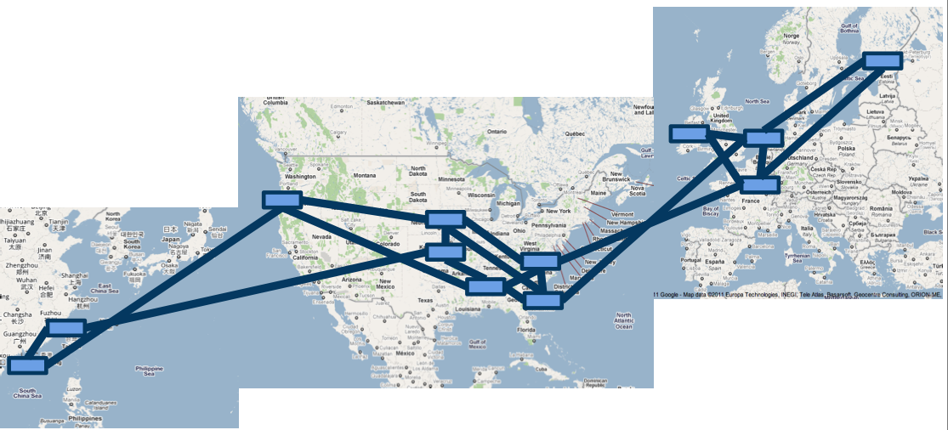
Motivation
Inter-DC WANs bandwidth demand is high
Content distribution both between servers and to end clients
Site replication for geographic locality and bandwidth efficiency
Availability zones: cross-zone replication

Slide 4
Motivation (Cont’d)
Inter-DC WANs are highly expensive

Slide 5
Two key problems
Poor efficiency
Poor sharing
average utilization over time of busy links is only 30-50%
little support for
flexible resource sharing
Why?
Source: Ming Zhang, MSR

Slide 6
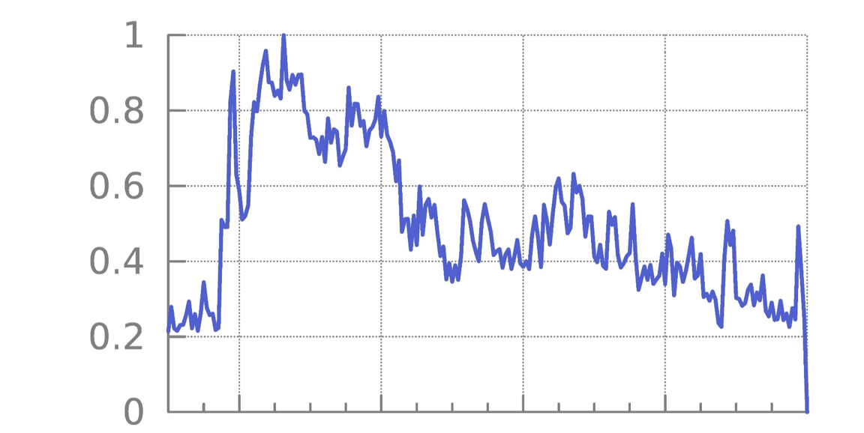
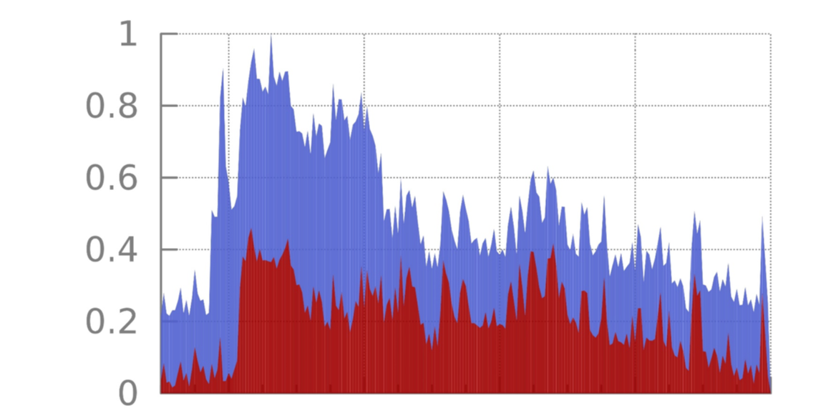
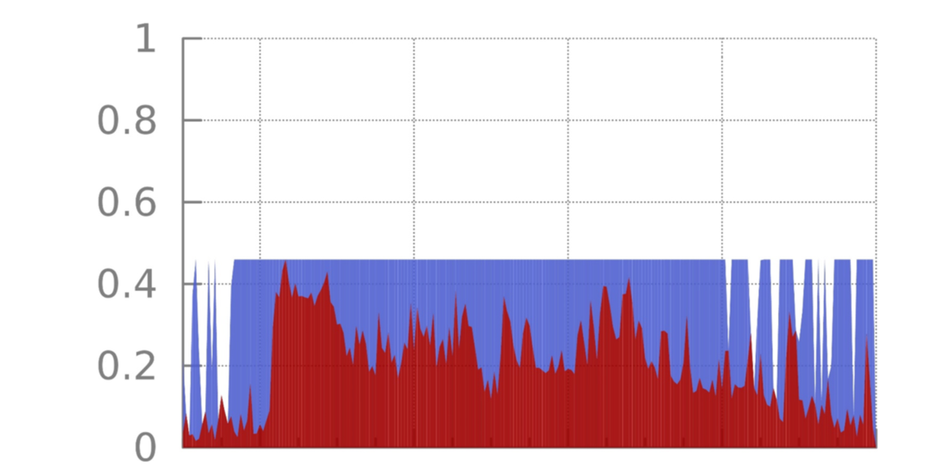
One cause of inefficiency: lack of coordination
peak before rate adaptation
Background traffic
> 50%
peak reduction
Norm.
traffic
rate
peak after rate adaptation
mean
Non-background traffic
Time (~ one day)
Source: Ming Zhang, MSR

Slide 7
Poor sharing
When services compete today, they can get higher throughput by sending faster
Mapping services onto different queues at switches helps, but # services ≫ # queues
(hundreds)
(4 - 8 typically)
Borrowing the idea of edge rate limiting, we can have better sharing without many queues

Slide 8
Why SDN
Status Quo
SDN Approach
Forwarding and control
Separate forwarding hardware
intermixed on a single box
from control software
Manage network as 1000s of
Manage network as a single
individual boxes
fabric
Decentralized, non-
Logically centralized control
deterministic protocols
with traffic engineering
All bits are created equal
Allocate resources based on
application priority
Apps regulated by per-flow
Demand measurement and
TCP “fair” share
resource shaping at the edge

Slide 9
Challenges
High performance distributed control systems
Inter-operation with legacy networks (other non-SDN sites or the Internet)
Scalable computation of max-min fair allocation among flows with different priority
Congestion-free data plane update
Working with limited switch memory

Slide 10
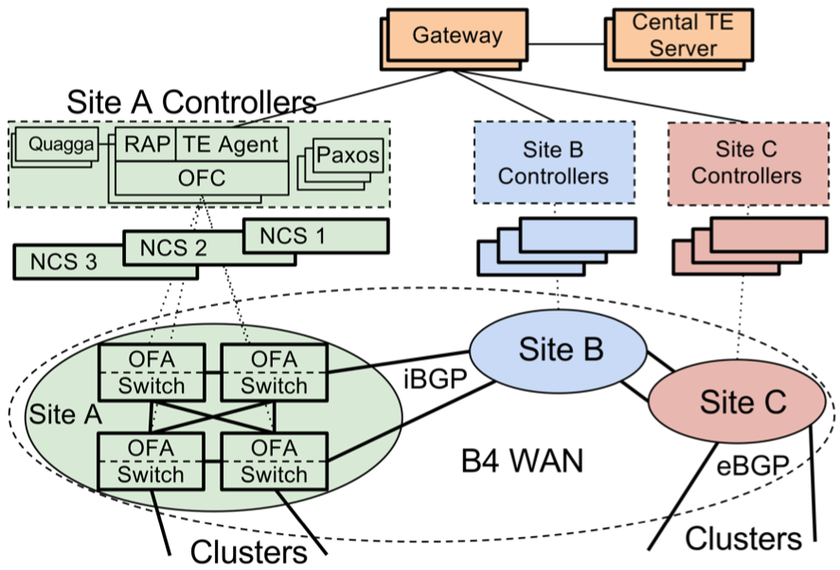
B4 Architecture
NCS: Network Control Servers
RAP: Routing Application Proxy
OFC: OpenFlow Controller
OFA: OpenFlow Agent
NCS and switches share
Out of band
control network

Slide 11
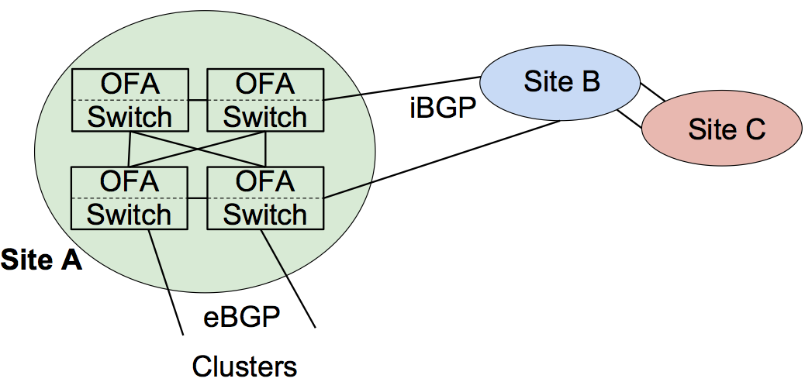
B4 Architecture: Data Plane
OFA
OFA
Site B
Switch
iBGP
Switch
Site C
OFA
OFA
Switch
Switch
Site A
OpenFlow Agent (OFA): is a user-level process running on switch hardware
  implement extended OpenFlow to manage the hardware pipeline
  Forward BGP routing packets to OFC, in turn to BGP stack.
eBGP
Clusters
Google Confidential and Proprietary

Slide 12
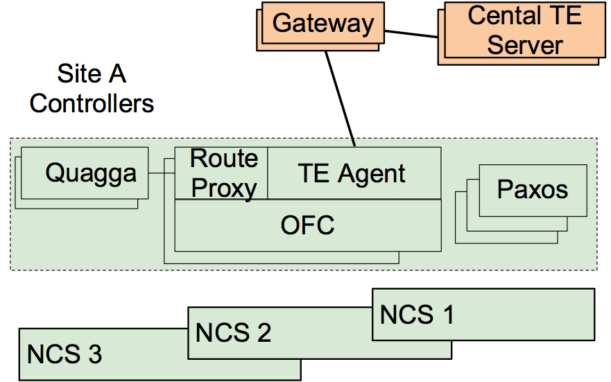
B4 Architecture: Control Plane
Gateway
Cental TE
Server
Site A
Controllers
Route Proxy: controller app to connect Quagga and OF switches
  BGP/ISIS route updates
  Routing protocol packets
  Interface updates from switches to Quagga
Rout
Quagga
TE Agent
Prox
Paxos
OFC
NCS 1
NCS 2
NCS 3
Google Confidential and Proprietary

Slide 13
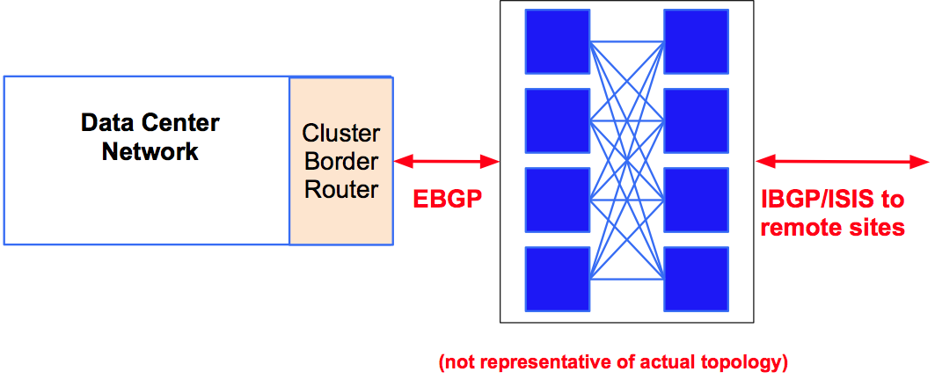
Hybrid SDN Deployment
Data Center
Network
Cluster
Border
Router
EBGP IBGP/ISIS to
remote sites
(not representative of actual topology)

Slide 14
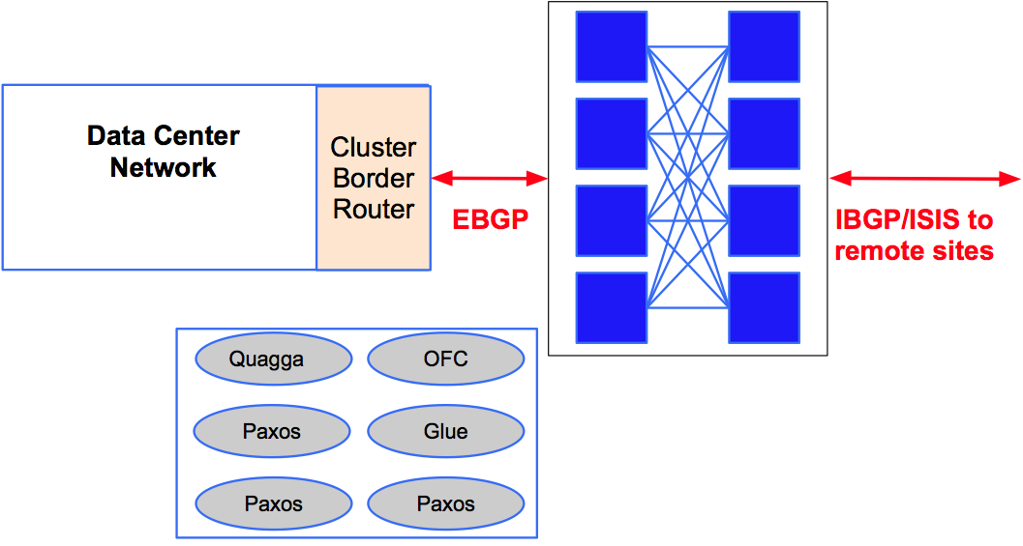
Hybrid SDN Deployment
Data Center
Network
Cluster
Border
Router
EBGP IBGP/ISIS to
remote sites
Quagga
OFC
Paxos
Glue
Paxos
Paxos

Slide 15
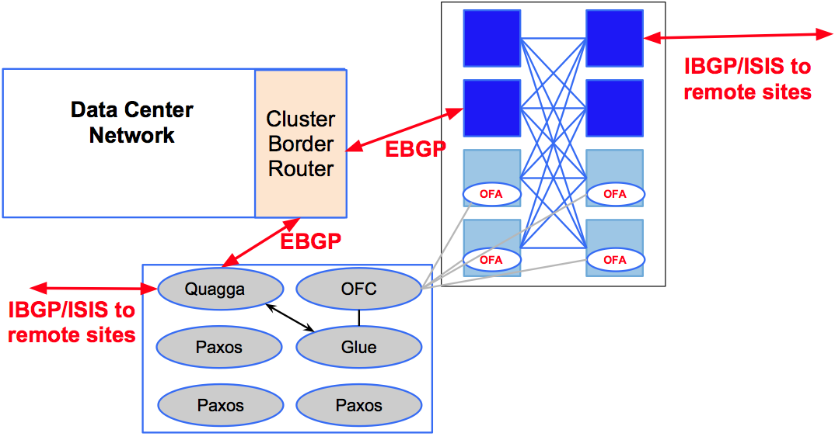
Hybrid SDN Deployment
IBGP/ISIS to
remote sites
Data Center
Network
Cluster
Border
EBGP
Router
OFA OFA
EBGP
OFA OFA
Quagga OFC
IBGP/ISIS to
remote sites
Paxos Glue
Paxos Paxos

Slide 16
Hybrid SDN Deployment
OFA OFA
Data Center
Network
Cluster OFA OFA
Border
Router
OFA OFA
EBGP
OFA OFA
Quagga OFC
IBGP/ISIS to
remote sites
Paxos Glue
Paxos Paxos
● SDN site delivers full interoperability with legacy sites

Slide 17
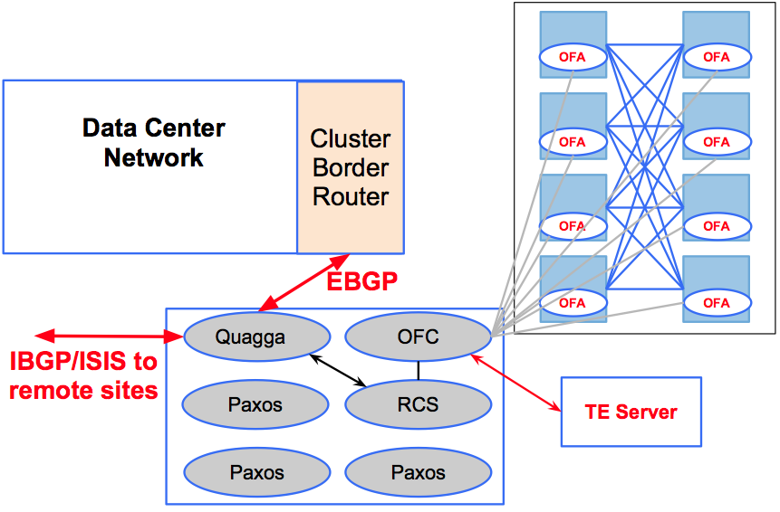
Hybrid SDN Deployment
OFA OFA
Data Center
Network
Cluster OFA OFA
Border
Router
OFA OFA
EBGP
OFA OFA
Quagga OFC
IBGP/ISIS to
remote sites
Paxos RCS
TE Server
Paxos Paxos
● Ready to introduce new functionality, e.g., TE

Slide 18
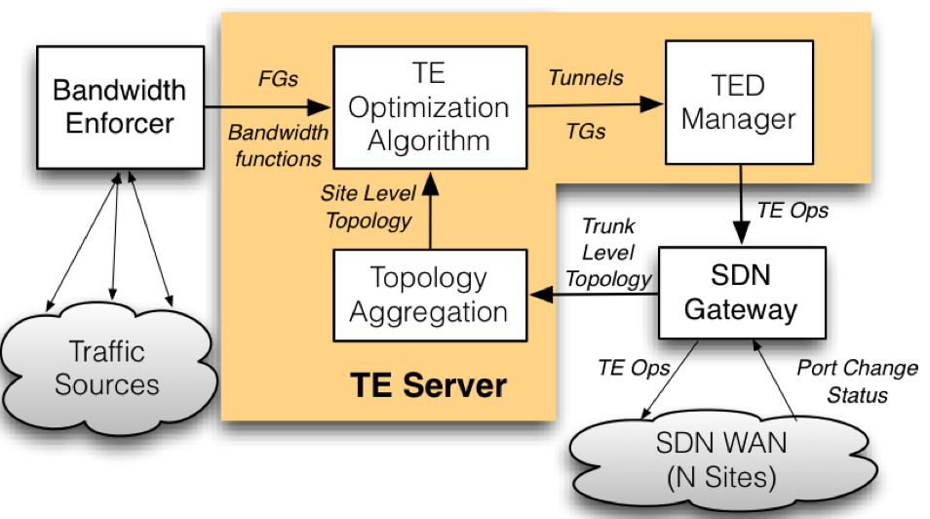
Traffic Engineering Architecture

Slide 19
TE Optimization Problem
● Max-min fair bandwidth allocation to FlowGroups
  ○ FlowGroups: {DC Pairs, priority class}
● FlowGroup’s priority represented by bandwidth function
● HW capabilities constrains solution:
○ Maximum number of paths
○ Splits quantization

Slide 20
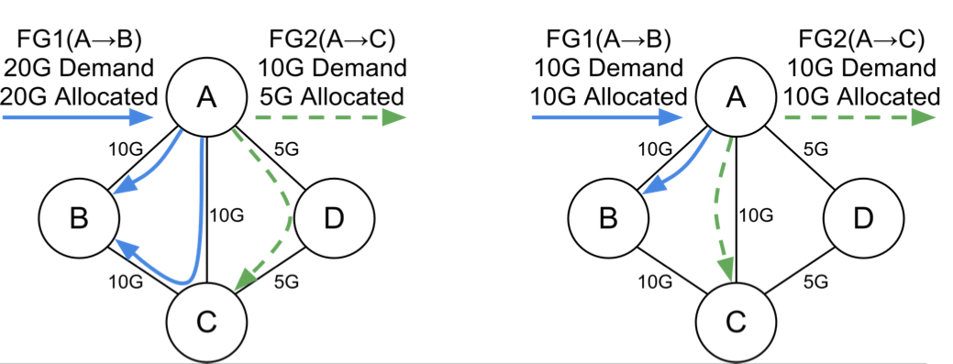
TE Optimization Algorithm
● Max-min fair bandwidth allocation to FlowGroups
● Fill higher priority along shortest paths and then move to
longer paths if needed
● Example: FG1 HIPRI, FG2 LOPRI

Slide 21
Congestion-free update Problem
How to update forwarding plane without
causing transient congestion?
See lecture 6 on congestion free updates

Slide 22
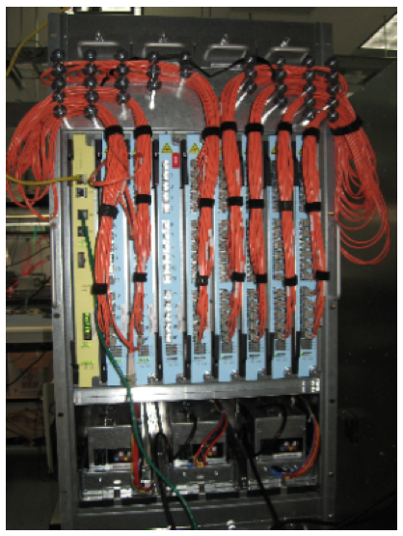
SDN Switch with legacy Routing Protocols
● Built from merchant silicon
○ 100s of ports of
nonblocking 10GE
● OpenFlow support
● Open source routing stacks for
BGP, ISIS
● Multiple chassis per site
○ Fault tolerance
○ Scale to multiple Tbps

Slide 23
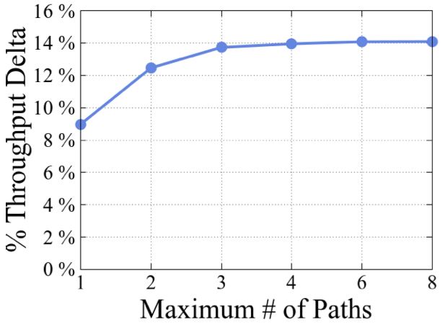
Benefits of Centralized TE
Relative to Shortest Path
Main benefit comes from reduced provisioning for
fault tolerance on high priority traffic

Slide 24
Conclusions and Future Work
● Dramatic growth in WAN bandwidth requirements
○ Existing software/hardware architectures make it
impractical to deliver necessary bandwidth globally
● Software Defined Networking: it works and at scale
○ Separation of hardware from software
○ Efficient logically centralized control/management
○ Incremental migration path
● Convergence to public facing WAN

Slide 25
Outline
Nov 21 Friday’s class on SDN wireless networks
  Time: 4:10-6:00pm
  Place: 545 Mudd
Review on SDN Traffic Engineering
SDN Security
  Defense against Control Plane Attacks
  Security as a Service
Source: S. Shin, et al.

Slide 26
Avant-Guard
Security extension to the OpenFlow data plane
  Connection migration
    To address scalability
    issue
  Actuating trigger
    To address responsiveness
    issue
Control Plane
Control Plane Interface
Connection Migration
Actuating Trigger
Flow Table Lookup
Packet Processing
Avant-Guard
Flow Table (TCAM and SRAM)
Data Plane
Source: S. Shin, et al.

Slide 27


Connection Migration - Idea
Inspired by TCP SYN Cookie
Concept
  TCP connection will stat from a SYN packet, and an initiator will wait for TCP SYN/ACK packet
  TCP-handshake does not issue any kind of data delivery
  Then, how about treating this TCP-handshake at network devices
  instead of target hosts
SYN
SYN
SYN/ACK
SYN/ACK
ACK
ACK
Source: S. Shin, et al.

Slide 28
Connection Migration – Access
Table
List of visiting clients
  Format
    Client IP address: # of TCP connection trials
      # of TCP connection trials include wrong trials (ACK, FIN, and RST)
    Simple data structure : 6 bytes (4 bytes for IP and 2 bytes for
    counter)
Overhead
  1,000,000 client IP addresses → less than 6 MB of memory
A controller application can read this table
10.0.0.1
15
12.2.0.1
1
40.0.0.4
100
IP Address
Counter
Source: S. Shin, et al.

Slide 29
Connection Migration – State
Diagram
4 state
  Classification
    Distinguish useful TCP connections
  Report
    Report to a controller
  Migration
    Migrate a TCP connection
    if it is a useful (or valid) connection
  Relay
    Relay all TCP packets between a
    connection source and a destination
Allow
Relay
Report
stage
Replay
stage
Established
TCP sessions
Allow
Migration
Success or
Failure
TCP sessions
Classification stage
Migration
stage
Failed
TCP sessions
Then, Ignore
Source: S. Shin, et al.

Slide 30
Connection Migration – Flow Chart
Flow chart
- The case of receiving TCP SYN/RST/FIN packet
Flow chart
- The case of receiving TCP ACK packet

Slide 31
Connection Migration – Packet
Diagram
Control Plane
(4)
(5)
Report stage
(9)
(10)
Report stage
Classification stage
Migration stage
A
(1) TCP SYN
(6) TCP SYN
B
(2) TCP SYN/ACK
A-1: A --> B: Migrate
(7) TCP SYN/ACK
(3) TCP ACK
(8) TCP ACK
Relay stage
A-2: A --> B: Relay
Relay stage
(11) TCP ACK
TCP Data
(12) TCP ACK
TCP Data
Data Plane
Source: S. Shin, et al.

Slide 32
Delayed Connection Migration
Concept
  Delay Connection Migration until the data plane receives (a) data
  packet(s)
Why?
  Good for reducing the effects of some advanced attacks
    E.g., fake TCP connection setup
Control Plane
(5)
(6)
Report stage
(10)
(11)
Report stage
Classification stage
Migration stage
A
(1) TCP SYN
(7) TCP SYN
B
(2) TCP SYN/ACK
A-1: A --> B: Migrate
(8) TCP SYN/ACK
(3) TCP ACK
(9) TCP ACK
(4) TCP ACK
TCP Data
A-2: A --> B: Relay
Relay stage
(12) TCP ACK
TCP Data
Data Plane

Slide 33
Actuating Trigger - Idea
Two functions
  Report the following items to the control plane
  asynchronously
    Network status
    Payload information
  Activate flow rules based on some predefined conditions
    Security application can use this feature to turn on security
    policies without delay
Source: S. Shin, et al.

Slide 34
Activating Trigger – Operations
4 main operations
  In the control plane
    Define a condition
    Register the condition
  In the data plane
    Check the condition
    When the condition is satisfied,
      Report a network
      status or payload
      Activate a flow rule
Control Plane
(1) Define condition
(2) Register condition
(4-1) Report status
Flow Rule
Condition
(3) Check condition
Host
match
(4-2) Activate a flow rule
Predefined Flow Rule
Data Plane
Source: S. Shin, et al.

Slide 35
Activating Trigger - Example
Example of reporting payload
  1) defined a condition : want to see payloads of packet from 10.0.0.1
  2) register this condition to the data plane
  3) packet is delivered from 10.0.0.1
  4) payload is delivered to the control plane
Control Plane
(1)
(4)
10.0.0.1
10.0.0.2
(2)
10.0.0.1 →*
1: Condition for payload
(3)
Data Plane
Source: S. Shin, et al.

Slide 36
Implementation
Data plane
  Implemented in the Software-based OpenFlow reference switch
    Covers OpenFlow spec. 1.0.0
Control plane
  Implemented in the POX controller
Extend OpenFlow protocols for
  Connection migration
    E.g., OFPFC_MIGRATE, …
  Actuating trigger
    E.g., OFPFC_REG_PAYLOAD, …
  Please refer to our paper for more information (Table 1)
Source: S. Shin, et al.

Slide 37
Evaluation – Use Case
Network saturation attack case
  A normal client sends HTTP requests to a web server
  An attacker tries a SYN flooding attack to a web server
Nearly 0 loss
Normal
POX Controller
OF switch
Web Server
Attacker
Normal
Modified
POX Controller
OF switch
(Avant-Guard)
Web Server
Attacker
Test Scenario
Packet delivered rate to a web server

Slide 38

Evaluation – Use Case
Detecting SYN flooding/scanning
  Approach
    SYN flooding packets are automatically rejected
    Network scanning attackers will be confused by our response
    packets
      They may think that all network hosts are alive and all network ports
      are open (a kind of White hole)
SYN
(1)
SYN/ACK
(2)
No packet delivery
SYN Flooding
SYN
(1)
SYN/ACK
No packet delivery
(2)
Network Scanner
Attacker receives SYN/ACK packets even though there are no hosts
→ White hole

Slide 39
Evaluation – Use Case
Intelligent Honeynet
  Approach
    When we try to do connection migration,
      If we can not find a real target host, we may consider this
      connection as suspicious
    Then, a security application can redirect this connection to our honeynet automatically
    Finally, this attacker will perform malicious operations inside a honenet
SYN
(1)
SYN
(4)
SYN/ACK
(2)
No host
ACK
(3)
SYN
(5)
attacker
SYN/ACK
ACK
(6)
(7)
honeynet
Source: S. Shin, et al.

Slide 40
Evaluation - Overhead
Connection migration
normal | connection migration | overhead
1608.6 us | 1618.74 us | 0,626 %
Actuating trigger
item | time
Traffic-rate based condition check | 0.322 us
Payload based condition check | = 0
Rule activation | 1.697 us
Source: S. Shin, et al.

Slide 41
Summary
Avant-Guard
  New data plane architecture for addressing the problems of OpenFlow, when devising network security applicatons
    Address the scalability issue with the connection migration scheme
    Address the responsiveness issue with the actuating trigger scheme
  Can be a new candidate architecture of the future data plane for SDN
Source: S. Shin, et al.

Slide 42
Outline
Nov 21 Friday’s class on SDN wireless networks
  Time: 4:10-6:00pm
  Place: 545 Mudd
Review on SDN Traffic Engineering
SDN Security
  Defense against Control Plane Attacks
  Security as a Service
Source: S. Shin, et al.

Slide 43
Roadmap
Security in the paradigm of SDN/OpenFlow
Security as an App (SaaA)
  New app development framework: FRESCO
  New security enforcement kernel: FortNOX
Security as a Service (SaaS)
  New security monitoring service for cloud tenants:
  CloudWatcher
Summary

Slide 44
Problems of Legacy Network Devices
Too complicated
  Control plane is implemented with complicated S/W and ASIC
Closed platform
  Vendor specific
Hard to modify (nearly impossible)
  Hard to add new functionalities
Source: G. Gu, et al, Texas A&M &SRI

Slide 45
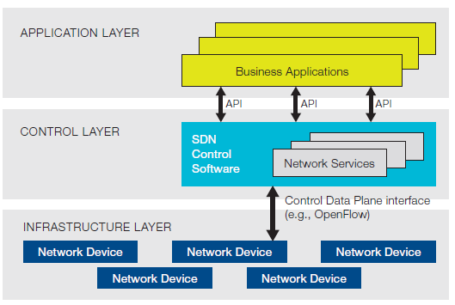
Software Defined Networking (SDN)
Three layer
  Application layer
    Application part of control layer
    Implement logic for flow control
  Control layer
    Kernel part of control layer
    Run applications to control network flows
  Infrastructure layer
    Data plane
    Network switch or router
SDN architecture from ONF

Slide 46


OpenFlow Architecture
OpenFlow Switch specification
application
OpenFlow Switch
OpenFlow
Protocol
PC
SSL
Secure
Channel
controller
sw
A controller application
can enforce any flow rules
to network switches
hw
Flow
Table
From openflow tutorial

Slide 47
Killer Applications of SDN?
Reducing Energy in Data Center Networks (load balancing)
WAN VM Migration
…
How about security?
  We are going to talk about this, more specifically:
  Security as an App (SaaA)
  Security as a Service (SaaS)
Source: G. Gu, et al, Texas A&M &SRI

Slide 48




Software App Store Today

Slide 49
Security as an App
SDN naturally has an application layer
Security functions can be apps on top of SDN/
networking OS
  Firewall
  Scan detection
  DDoS detection
  Intrusion detection/prevention
  …
Why SaaA?
  Cost efficiency
  Easy deployment/maintenance
  Rich, flexible network control
Source: G. Gu, et al, Texas A&M &SRI

Slide 50
Security as a Service
Clouds are large, complicated, and dynamic
How do tenants deploy security devices/functions?
    Tenant can use some pre-installed fixed-location security devices
      Not able to keep up with the high dynamisms in network
      configurations
    Tenant can Install security devices for themselves
      Difficult
Need a new Security Monitoring as a Service
mechanism for a cloud network
Source: G. Gu, et al, Texas A&M &SRI

Slide 51
Challenges and New Contributions
It is not easy to develop security apps
  FRESCO: a new app development framework for
  modular, composable security services
It is not secure when running buggy/vulnerable/
multiple security apps (e.g., policy conflict/bypass)
  FortNOX: a new security enforcement kernel
It is not convenient to install/use security devices for cloud tenants
  CloudWatcher: a new security monitoring service
  model based on SDN
Source: G. Gu, et al, Texas A&M &SRI

Slide 52
FRESCO:
Framework for Enabling
Security Controls in
OpenFlow networks

Slide 53
What is FRESCO?
A new framework
  Enables to compose diverse network security functions easily (with combining multiple modules)
  Enables to create own network security functions easily (without requiring additional H/Ws)
  Enables to deploy network security functions easily and dynamically (without modifying the underlying network
  architecture)
  Enable to add more intelligence to current network
  security functions
Source: G. Gu, et al, Texas A&M &SRI

Slide 54
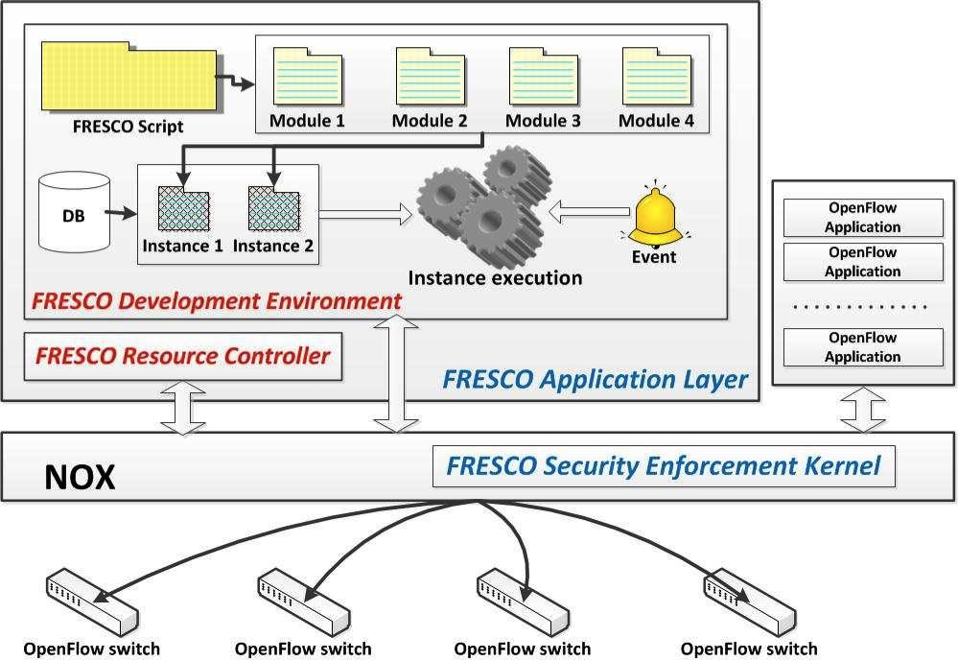
Source: G. Gu, et al, Texas A&M &SRI

Slide 55
FRESCO – Overall Operation
Create
Modules
Load Modules
Run
Modules
Monitor OpenFlow switches
Answer from NOX
Notify NOX of loading FRESCO modules
Source: G. Gu, et al, Texas A&M &SRI

Slide 56
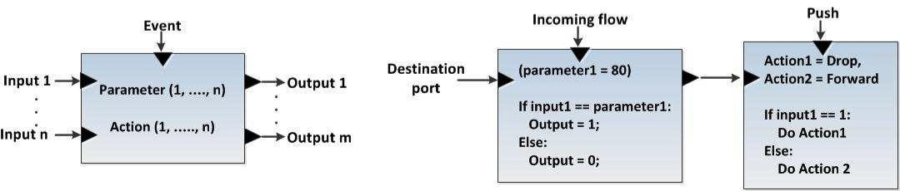
FRESCO Modular Design
event
parameter
action
input
output
Module
key
values
F-DB instance
Source: G. Gu, et al, Texas A&M &SRI

Slide 57
FRESCO – Script Language
Goal
  Define interfaces, actions, and parameters
  Connect multiple modules
  Similar to C/C++ function, start with { and end with }
Format
  Instance name (# of input) (# of output)
    denotes the module name and the number of input and output variables
  INPUT: a₁,a₂,
    denotes input items for a module a_{n} may be set of flows, packets or integer
    values
  OUTPUT: b₁,b₂,
    denotes output items for a module b_{n} may be set of flows, packets or integer
    values
  PARAMETER: c₁,c₂,
    denotes configuration values of a module c_{n} may be real numbers or strings
  EVENT: d₁,d₂,
    denotes events that will be delivered to a module d_{n} may be any predefined
    string
  ACTION : condition ; action,
    denotes actions that will be performed based on condition
Source: G. Gu, et al, Texas A&M &SRI

Slide 58
Simple Working Example:
Reflector Net
do_redirect (2) (0) {
TYPE: ActionHandler
EVENT:PUSH
INPUT:SRC_IP, scan_result
OUTPUT: -
PARAMETER: -
ACTION: scan_result == 1? REDIRECT: FORWARD
/* if scan_result equals 1, redirect; otherwise, forward */
}
find_scan (1) (2) {
TYPE: ScanDetector
EVENT:TCP_CONNECTION_FAIL
INPUT: SRC_IP
OUTPUT: SRC_IP, scan_result
PARAMETER: 5
ACTION: -
/* no actions are defined */
}
Module 1
Module 2
Source: G. Gu, et al, Texas A&M &SRI

Slide 59
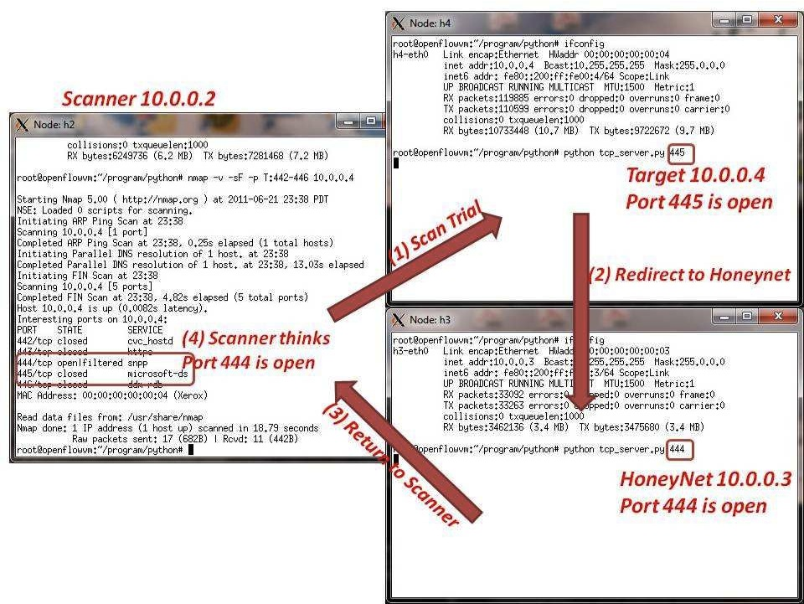
Reflector Net
Source: G. Gu, et al, Texas A&M &SRI

Slide 60
More …
Tarpits
White Holes
Scan detector
P2P detector (P2P Plotter)
Botnet detector (BotMiner)
…
Over 90% reduction in lines of code compared with their standard implementations
Already include more than 16 commonly reusable modules (expending over time)
Source: G. Gu, et al, Texas A&M &SRI

Slide 61
FortNOX:
A Security Enforcement
Kernel for OpenFlow
Source: G. Gu, et al, Texas A&M &SRI

Slide 62
New Threat
SDN apps can compete, contradict, override one another, incorporate vulnerabilities
Worst case: an adversary can use a vulnerable and deterministic SDN app to control the state of all SDN switches in the network
Source: G. Gu, et al, Texas A&M &SRI

Slide 63
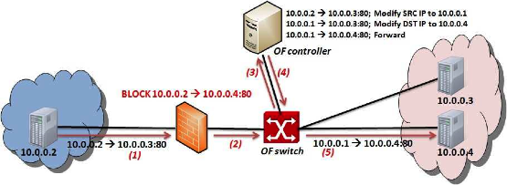
SDN/OpenFlow Evasion Scenario
  .
Dynamic Flow Tunneling
Source: G. Gu, et al, Texas A&M &SRI

Slide 64
Prerequisites for a Secure OpenFlow Platform
Must be resilient to
  Vulnerabilities in OF applications
  Malicious code in 3rd party OF apps
  Complex interaction that arise between OF app
  interactions
  State inconsistencies due to switch garbage collection or policy coordination across distributed switches
  Sophisticated OF applications that employ packet
  modification actions
  Adversaries who might directly target our security
  services to harm the network
Source: G. Gu, et al, Texas A&M &SRI

Slide 65
New Contributions
Development of a security enforcement kernel for the NOX OpenFlow controller
Role-based authorization
Rule conflict detection
Security directive translation
Source: G. Gu, et al, Texas A&M &SRI

Slide 66

Classic NOX Architecture
PY OF
Apps
Python SWIG
Native C
OF Apps
Send_OpenFlow_Command()
NOX
Source: G. Gu, et al, Texas A&M &SRI

Slide 67
FortNOX Architecture
Native C
OF Apps
Separate
Process
Security Apps
PY OF
Apps
OF IPC Proxy
Actuator
Python SWIG
Directive Translator
IPC Interface
Aggregate Flow Table
FT_Send_OpenFlow_Command
Operator Rules
Role-based Source Auth
State Table Manager
OF Mod Commands
Add (conflict enforced)
Modify (conflict enforced)
Delete (priority enforced)
SECURITY Rules
Conflict Analyzer
OF App Rules
Switch Callback Tracking
FortNOX
Switch Callback tracking
Source: G. Gu, et al, Texas A&M &SRI

Slide 68
Summary of FortNOX
FortNOX – A new security enforcement kernel for OF
networks
  Role-based Authorization
  Rule-Authentication
  Conflict Detection and Resolution
  Security Directive Translation
Ongoing Efforts and Future Work
  Prototype implementations for newer controllers (Floodlight, POX)
  Security enforcement in multicontroller environments
  Improving error feedback to OF applications
  Optimizing rule conflict detection
“A Security Enforcement Kernel for OpenFlow Networks”. HotSDN’12
Source: G. Gu, et al, Texas A&M &SRI

Slide 69
Some Demonstrations
www.openflowsec.org
  Some technical reports and publications
  DEMO videos
  Demo 1: Constraints Enforcement [high res .mov or Youtube! ]
  Demo 2: Reflector Nets [high res .mov or Youtube! ]
  Demo 3: Automated Quarantine [high res .mov or Youtube! ]
Source: G. Gu, et al, Texas A&M &SRI

Slide 70
CloudWatcher:
Network Security Monitoring Using
OpenFlow in Dynamic Cloud Networks or: How to Provide
Security Monitoring as a Service in Clouds?
Source: G. Gu, et al, Texas A&M &SRI

Slide 71
Goal
Provide Security Monitoring as a Service for a
cloud network
How to Provide
  Routing algorithms
    The algorithms guarantee that specified (static) network security
    devices can monitor (dynamic) specific network flows
  A script language
    Register security devices easily
    Create security policies easily
Source: G. Gu, et al, Texas A&M &SRI

Slide 72
CloudWatcher
A new framework
  Provide security monitoring services for large and dynamic cloud networks
  Detour network packets to be inspected by pre-installed network security devices automatically
    OpenFlow
  Provide a script to operate this framework
Source: G. Gu, et al, Texas A&M &SRI

Slide 73



Operating Scenario
Register Security Devices
{ID, TYPE, LOCATION, MODE, Func}
{1, NIDS, 8, PASSIVE, Detect HTTP}
Administrator
Create Security Policies
{FLOW CONDITON, DEVICE SET}
{10.0.0.* → *:80, {1}}
Parse Security Policies
Create Routing Rules
NIDS (ID = 1)
Translate Routing Rules into OpenFow Rules
Router (Device ID = 8)
Enforce Flow Rules into Routers
Source: G. Gu, et al, Texas A&M &SRI

Slide 74
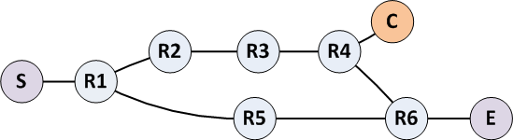
How to Control Flows
4 approaches
  Multipath naïve
  Shortest through
  Multipath shortest
  Shortest inline
- Sample network -
S: start node, E: end node
R: router, C: security device

Slide 75
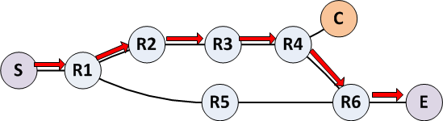
Shortest Through (algorithm 2)
Find the shortest path passing through R4
  Shortest path between S and R4
  Shortest path between R4 and E
  Path: S → R1 → R2 → R4 → R4 → R6 → E
It considers the security device without producing redundant paths
However, it may take more time to deliver packets
Source: G. Gu, et al, Texas A&M &SRI

Slide 76
Summary of CloudWatcher
CloudWatcher provides a new framework to monitor cloud networks
  With the help of the SDN technology
A cloud administrator can select algorithms based on network status
A cloud administrator can monitor his network by writing simple scripts
Source: G. Gu, et al, Texas A&M &SRI

Slide 77
Summary
SDN is a new technology, and security can be a new killer app
  SDN is impactful to drive a variety of innovations in network security
We investigate the possibilities of security as an app and security as a service
We propose key technologies to enable SaaA and SaaS
  FRESCO
  FortNOX
  CloudWatcher
Let’s contribute together to SDN and Security!
Source: G. Gu, et al, Texas A&M &SRI

Slide 78
Questions?

