Slide 1
Software Defined Networking COMS 6998-10, Fall 2014
Instructor: Li Erran Li (lierranli@cs.columbia.edu)
http://www.cs.columbia.edu/~lierranli/coms69910-8SDNFall2014/
9/8/2014: Class Overview, SDN Intro & Origins

Slide 2
Outline
Part I: Course Overview and Logistics
Part II: Brief Introduction of SDN and SDN Origins

Slide 3
Part I: Course Introduction and Logistics
Introduction
My research
Course syllabus
Course goals and structure
Example projects

Slide 4
Introduction
Researcher at Bell Labs, Alcatel-Lucent
Ph.D. from CS Dept., Cornell, 2001
Research interest: software defined networking, mobile computing, cloud computing, and security
Research Goal: improve our mobile user experience through innovation in network architecture, mobile cloud computing systems and security

Slide 5
Experiences
Relevant working experiences on Software defined networking
Software defined cellular networks
Position paper [EuroSDN’12]
SoftCell [ONS’13, ACM CoNext’13]
SoftRAN [ACM HotSDN’13]
SoftMoW [ONS’14, ACM HotSDN’14 Poster, ACM CoNext’14]
RadioVisor [ONS’14, ACM HotSDN’14 Poster]
SDN control plane and data plane interaction
Tango [ONS’14, ACM CoNext’14]
Mazu [In preparation]
SDN programming language
Compiling minimal incremental updates [ACM HotSDN’14]

Slide 6
Experiences (Cont’d)
Professional Activities
DIMACS Workshop on Software Defined Networking, Dec, 2012
ACM Workshop on Cellular Networks: Operations, Challenges, and Future Design (CellNet), 2012-2013
ACM MobiSys Workshop on Mobile Cloud Computing & Services: Social Networks and Beyond (MCS), June 2010
DIMACS Workshop on Systems and Networking Advances in Cloud Computing, Dec, 2011
Teaching
Cellular Networks and Mobile Computing (Spring 2012, Fall 2012, Spring 2013, Spring 2014)
Software Defined Networking (Fall 2013)

Slide 7
Definition of SDN
The separate of control plane from data plane
Data Plane: processing and delivery of packets
Based on state in routers and endpoints
E.g., IP, TCP, Ethernet, etc.
Fast timescales (per-packet)
Control Plane: establishing the state in routers
Determines how and where packets are forwarded
Routing, traffic engineering, firewall state, …
Slow time-scales (per control event)

Slide 8
Course Syllabus
SDN Basics and Scalability (Lecture 2, 3)
OpenFlow, Floodlight, ONOS, OpenDayLight, Mininet
Scalable control plane: hierarchical controller, logical crossbar
Scalable data plane
SDN Abstraction (Lecture 4, 5, 6)
Programming language, verification, network update
Programmable Data Plane (Lecture 7)
Protocol independent forwarding, Click modular router, SwitchBlade
SDN Application (Lecture 8, 9, 10)
Traffic management, wireless networks
SDN Virtualization and NFV (Lecture 11)
SDN Debugging, Fault Tolerance and Security (Lecture 12)

Slide 9
Course Goals and Structure
The course equips you to address the following questions:
What is software defined networking?
What are the key building blocks?
How do I use SDN to solve enterprise, carrier, and data center/cloud networking problems?
Notes:
Understanding the interplay of cellular networks and mobile computing through measurements
Cellular aware mobile application design

Slide 10
Course Goals and Structure (Cont’d)
The course emphasizes on concepts, hands-on experiences and research
Midterm will be on concepts (30% of grade)
Two programming assignments (one on Floodlight and the other on Pyretic or Frenetic) (20% of grade)
Course projects (50% of grade)
Notes:
Understanding the interplay of cellular networks and mobile computing through measurements
Cellular aware mobile application design

Slide 11
Course Goals and Structure (Cont’d)
Who benefits from the course?
Students interested in pursuing a career in networking industry and software industry
Integration of SDN and OpenStack
Students interested in networking research
Professionals transitioning to DevOps engineers
Notes:
Understanding the interplay of cellular networks and mobile computing through measurements
Cellular aware mobile application design

Slide 12
Research Project
Topic
Choose from a list of topics
Come up with your own topic
Must be related to software defined networking, ideally solves a real problem
Should contain some research elements, e.g. scalable system design, novel algorithms
Join project with Prof. Sahu’s Cloud Computing & Big Data course
Teams of 1 to 4 students
Final deliverables
Project report (research paper format, 10 to 12 pages)
Project presentation and demo

Slide 13
Research Project (Cont’d)
Precisely define the project
Understand related work
Propose novel techniques or systems
Creativity will be evaluated
System implementation
Controller platform: Floodlight, OpenDayLight, ONOS, Ryu, POX, Pyretic, Frenetic, Maple
Testing: mininet, Cbench (controller benchmark tool)

Slide 14
Research Project (Cont’d)
Evaluate your solution, e.g. performance, scalability
Thoroughness will be evaluated
Write up and present your projects
Evaluated using professional paper review criterions
Project timelines (suggested)
September 22: Form final project team
October 8: project description (2-4 pages)
December 8: final presentation and demo
December 15: final project report (10-12 pages)

Slide 15
List of Suggested Projects
Concrete modules in the following topics:
SDN to improve video applications
SDN measurement primitives
SDN testing and debugging
SDN reliability
SDN security: mitigate DDoS attacks
SDN controller design, (e.g. cellular, data centers)
Cellular network virtualization
Programming language abstraction for wireless networks/optical networks
Fast control plane and data plane interaction

Slide 16
Class Resources
Course web page: schedule, project timelines, list of potential projects, etc
Piazza page for discussion
Online resources
18-859K, CMU, Fall 2014
CSCI694b, USC, Spring 2014
COS-597E, Princeton University, Fall 2013
Coursera Software Defined Networking by Dr. Nick Feamster
SDN reading list
Open Networking Summit
For any questions or concerns: email me at lierranli@cs.columbia.edu
TAs: Jill Jermyn (jj2600), Shangjin Zhang (sz2425)

Slide 17
Brief Introduction to SDN
What is software defined networking?
Why SDN?
How has SDN been shaping networking research and industry?

Slide 18
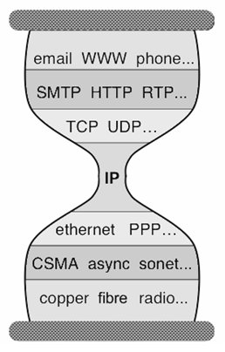
Key to Internet Success: Layers
Applications
…built on…
Reliable (or unreliable) transport
…built on…
Best-effort global packet delivery
…built on…
Best-effort local packet delivery
…built on…
Physical transfer of bits
9/8/14
Software Defined Networking (COMS 6998-10)

Slide 19
Why Is Layering So Important?
Source: Scott Shenker, UC Berkeley
Decomposed delivery into fundamental components
Independent but compatible innovation at each layer
A practical success of unprecedented proportions…
…but an academic failure
9/8/14
Software Defined Networking (COMS 6998-10)

Slide 20
Built an Artifact, Not a Discipline
Source: Scott Shenker, UC Berkeley
Other fields in “systems”: OS, DB, DS, etc.
Teach basic principles
Are easily managed
Continue to evolve
Networking:
Teach big bag of protocols
Notoriously difficult to manage
Evolves very slowly
9/8/14
Software Defined Networking (COMS 6998-10)

Slide 21
Why Does Networking Lag Behind?
Source: Scott Shenker, UC Berkeley
Networks used to be simple: Ethernet, IP, TCP….
New control requirements led to great complexity
Isolation ➔ VLANs, ACLs
Traffic engineering ➔ MPLS, ECMP, Weights
Packet processing ➔ Firewalls, NATs, middleboxes
Payload analysis ➔ Deep packet inspection (DPI)
…..
Mechanisms designed and deployed independently
Complicated “control plane” design, primitive functionality
Stark contrast to the elegantly modular “data plane”
9/8/14
Software Defined Networking (COMS 6998-10)

Slide 22
Infrastructure Still Works!
Source: Scott Shenker, UC Berkeley
Only because of “our” ability to master complexity
This ability to master complexity is both a blessing…
…and a curse!
9/8/14
Software Defined Networking (COMS 6998-10)
Notes:
Network sysadmins….

Slide 23
What Is the problem?
Source: Scott Shenker, UC Berkeley
Networking still focused on mastering complexity
Little emphasis on extracting simplicity from control plane
No recognition that there’s a difference….
Extracting simplicity builds intellectual foundations
Necessary for creating a discipline….
That’s why networking lags behind
9/8/14
Software Defined Networking (COMS 6998-10)

Slide 24
A Better Example: Programming
Source: Scott Shenker, UC Berkeley
Machine languages: no abstractions
Mastering complexity was crucial
Higher-level languages: OS and other abstractions
File system, virtual memory, abstract data types, ...
Modern languages: even more abstractions
Object orientation, garbage collection,…
Abstractions key to extracting simplicity
9/8/14
Software Defined Networking (COMS 6998-10)
Notes:
Interesting contrast. People who understand details of networks are still the recognized networking “experts”. But kernel hackers no longer king of coders. In fact, they have become somewhat anachronistic. Ruby on Rails programmers earn millions throwing together web services while kernel hackers live in their parents’ basement…..

Slide 25
“The Power of Abstraction”
Source: Scott Shenker, UC Berkeley
“Modularity based on abstraction
is the way things get done”
− Barbara Liskov
Abstractions ➔ Interfaces ➔ Modularity
What abstractions do we have in networking?
9/8/14
Software Defined Networking (COMS 6998-10)

Slide 26
Layers are Great Abstractions
Source: Scott Shenker, UC Berkeley
Layers only deal with the data plane
We have no powerful control plane abstractions!
How do we find those control plane abstractions?
Two steps: define problem, and then decompose it.
9/8/14
Software Defined Networking (COMS 6998-10)

Slide 27
The Network Control Problem
Source: Scott Shenker, UC Berkeley
Compute the configuration of each physical device
E.g., Forwarding tables, ACLs,…
Operate without communication guarantees
Operate within given network-level protocol
Only people who love complexity would find this a reasonable request
9/8/14
Software Defined Networking (COMS 6998-10)
Notes:
We think of this as normal. Everyone else thinks this is insanity!

Slide 28
Programming Analogy
Source: Scott Shenker, UC Berkeley
What if programmers had to:
Specify where each bit was stored
Explicitly deal with all internal communication errors
Within a programming language with limited expressability
Programmers would redefine problem:
Define a higher level abstraction for memory
Build on reliable communication abstractions
Use a more general language
Abstractions divide problem into tractable pieces
And make programmer’s task easier
9/8/14
Software Defined Networking (COMS 6998-10)
Notes:
Two separate issues:
Support abstractions: separation of concerns
Putting them together: programmer has less to do

Slide 29
From Requirements to Abstractions
Source: Scott Shenker, UC Berkeley
Operate without communication guarantees
Need an abstraction for distributed state
Compute the configuration of each physical device
Need an abstraction that simplifies configuration
Operate within given network-level protocol
Need an abstraction for general forwarding model
Once these abstractions are in place, control mechanism has a much easier job!
9/8/14
Software Defined Networking (COMS 6998-10)
Notes:
Why “distributed state”? Because the communication in control programs is ALL directed towards collecting/disseminating/or calculating on distributed state.
Tell you how later, but this is the purpose of the abstractions…

Slide 30
SDN in a Nutshell
Source: Scott Shenker, UC Berkeley
SDN is defined precisely by these three abstractions
Distribution, forwarding, configuration
SDN not just a random good idea…
Fundamental validity and general applicability
SDN may help us finally create a discipline
Abstractions enable reasoning about system behavior
Provides environment where formalism can take hold….
OK, but what are these abstractions?
9/8/14
Software Defined Networking (COMS 6998-10)

Slide 31
1. Distributed State Abstraction
Source: Scott Shenker, UC Berkeley
Shield control mechanisms from state distribution
While allowing access to this state
Natural abstraction: global network view
Annotated network graph provided through an API
Implemented with “Network Operating System”
Control mechanism is now program using API
No longer a distributed protocol, now just a graph algorithm
E.g. Use Dijkstra rather than Bellman-Ford
9/8/14
Software Defined Networking (COMS 6998-10)

Slide 32
Software Defined Network (SDN)
Traditional Control Mechanisms
Network of Switches and/or Routers
Source: Scott Shenker, UC Berkeley
e.g. routing, access control
Control Program
Global Network View
Distributed algorithm running between neighbors
Network OS
9/8/14
Notes:
Project 2 would have been trivial: Dijkstra on a graph.

Slide 33
Major Change in Paradigm
Source: Scott Shenker, UC Berkeley
No longer designing distributed control protocols
Design one distributed system (NOS)
Use for all control functions
Now just defining a centralized control function
Configuration = Function(view)
9/8/14
Software Defined Networking (COMS 6998-10)
Notes:
Stop. Does everyone get this. Unless I see everyone’s hands up, I am not going further.

Slide 34
2. Specification Abstraction
Source: Scott Shenker, UC Berkeley
Control program should express desired behavior
It should not be responsible for implementing that behavior on physical network infrastructure
Natural abstraction: simplified model of network
Simple model with only enough detail to specify goals
Requires a new shared control layer:
Map abstract configuration to physical configuration
This is “network virtualization”
9/8/14
Software Defined Networking (COMS 6998-10)
Notes:
Just like VMs. Virtualizing network with abstractions, rather than physical topology.

Slide 35
Simple Example: Access Control
Source: Scott Shenker, UC Berkeley
What
Abstract Network
Model
Global
Network View
How
9/8/14
Notes:
What is access control?

Slide 36
Software Defined Network: Take 2
Source: Scott Shenker, UC Berkeley
Abstract Network Model
Network Virtualization
Control Program
Global Network View
Network OS
9/8/14

Slide 37
What Does This Picture Mean?
Source: Scott Shenker, UC Berkeley
Write a simple program to configure a simple model
Configuration merely a way to specify what you want
Examples
ACLs: who can talk to who
Isolation: who can hear my broadcasts
Routing: only specify routing to the degree you care
Some flows over satellite, others over landline
TE: specify in terms of quality of service, not routes
Virtualization layer “compiles” these requirements
Produces suitable configuration of actual network devices
NOS then transmits these settings to physical boxes
9/8/14
Software Defined Networking (COMS 6998-10)

Slide 38
Software Defined Network: Take 2
Source: Scott Shenker, UC Berkeley
Specifies behavior
Control Program
Abstract Network Model
Compiles to topology
Network Virtualization
Global Network View
Transmits to switches
Network OS
9/8/14

Slide 39
Two Examples Uses
Source: Scott Shenker, UC Berkeley
Scale-out router:
Abstract view is single router
Physical network is collection of interconnected switches
Allows routers to “scale out, not up”
Use standard routing protocols on top
Multi-tenant networks:
Each tenant has control over their “private” network
Network virtualization layer compiles all of these individual control requests into a single physical configuration
Hard to do without SDN, easy (in principle) with SDN
9/8/14
Software Defined Networking (COMS 6998-10)

Slide 40
3. Forwarding Abstraction
Source: Scott Shenker, UC Berkeley
Switches have two “brains”
Management CPU (smart but slow)
Forwarding ASIC (fast but dumb)
Need a forwarding abstraction for both
CPU abstraction can be almost anything
ASIC abstraction is much more subtle: OpenFlow
OpenFlow:
Control switch by inserting <header;action> entries
Essentially gives NOS remote access to forwarding table
Instantiated in OpenvSwitch
9/8/14

Slide 41
Does SDN Work?
Source: Scott Shenker, UC Berkeley
Is it scalable? Yes
Is it less responsive? No
Does it create a single point of failure? No
Is it inherently less secure? No
Is it incrementally deployable? Yes
9/8/14
Software Defined Networking (COMS 6998-10)

Slide 42
SDN: Clean Separation of Concerns
Source: Scott Shenker, UC Berkeley
Control program: specify behavior on abstract model
Driven by Operator Requirements
Network virtualization: map abstract model to global view
Driven by Specification Abstraction
NOS: map global view to physical switches
API: driven by Distributed State Abstraction
Switch/fabric interface: driven by Forwarding Abstraction
9/8/14
Software Defined Networking (COMS 6998-10)
Notes:
Clean separation of concerns; the modularity we were seeking
independent innovation, rich ecosystem, etc.
Innovation is the true value proposition of SDN!
by enterprises
by ecosystem as a whole….
There is a tie between abstractions and innovation, and between abstractions and science.

Slide 43
We Have Achieved Modularity!
Source: Scott Shenker, UC Berkeley
Modularity enables independent innovation
Gives rise to a thriving ecosystem
Innovation is the true value proposition of SDN
SDN doesn’t allow you to do the impossible
It just allows you to do the possible much more easily
This is why SDN is the future of networking…
9/8/14
Software Defined Networking (COMS 6998-10)

Slide 44
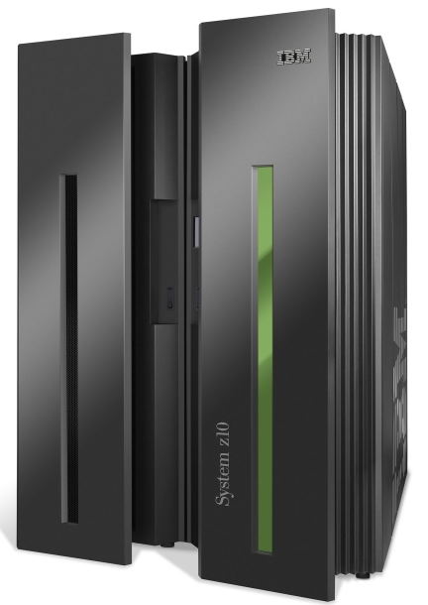
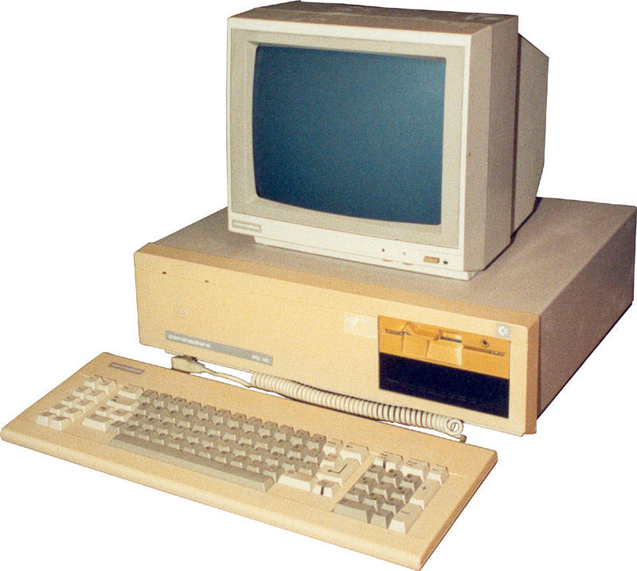
An Analogy wrt Computing
Source: Nick Mckeown, Stanford
App
App
App
App
App
App
App
App
App
App
App
Specialized
Applications
Open Interface
Windows
(OS)
Linux
Mac
OS
Specialized
Operating
System
or
or
Open Interface
Specialized
Hardware
Microprocessor
Vertically integrated
Closed, proprietary
Slow innovation
Small industry
Horizontal
Open interfaces
Rapid innovation
Huge industry
9/8/14
Software Defined Networking (COMS 6998-10)
Notes:
The mainframe industry in the 1980s was vertical and closed: it consisted of specialized hardware, operating system and applications --- all from the same company.
A revolution happened when open interfaces started to appear. The industry became horizontal. Innovation exploded.

Slide 45
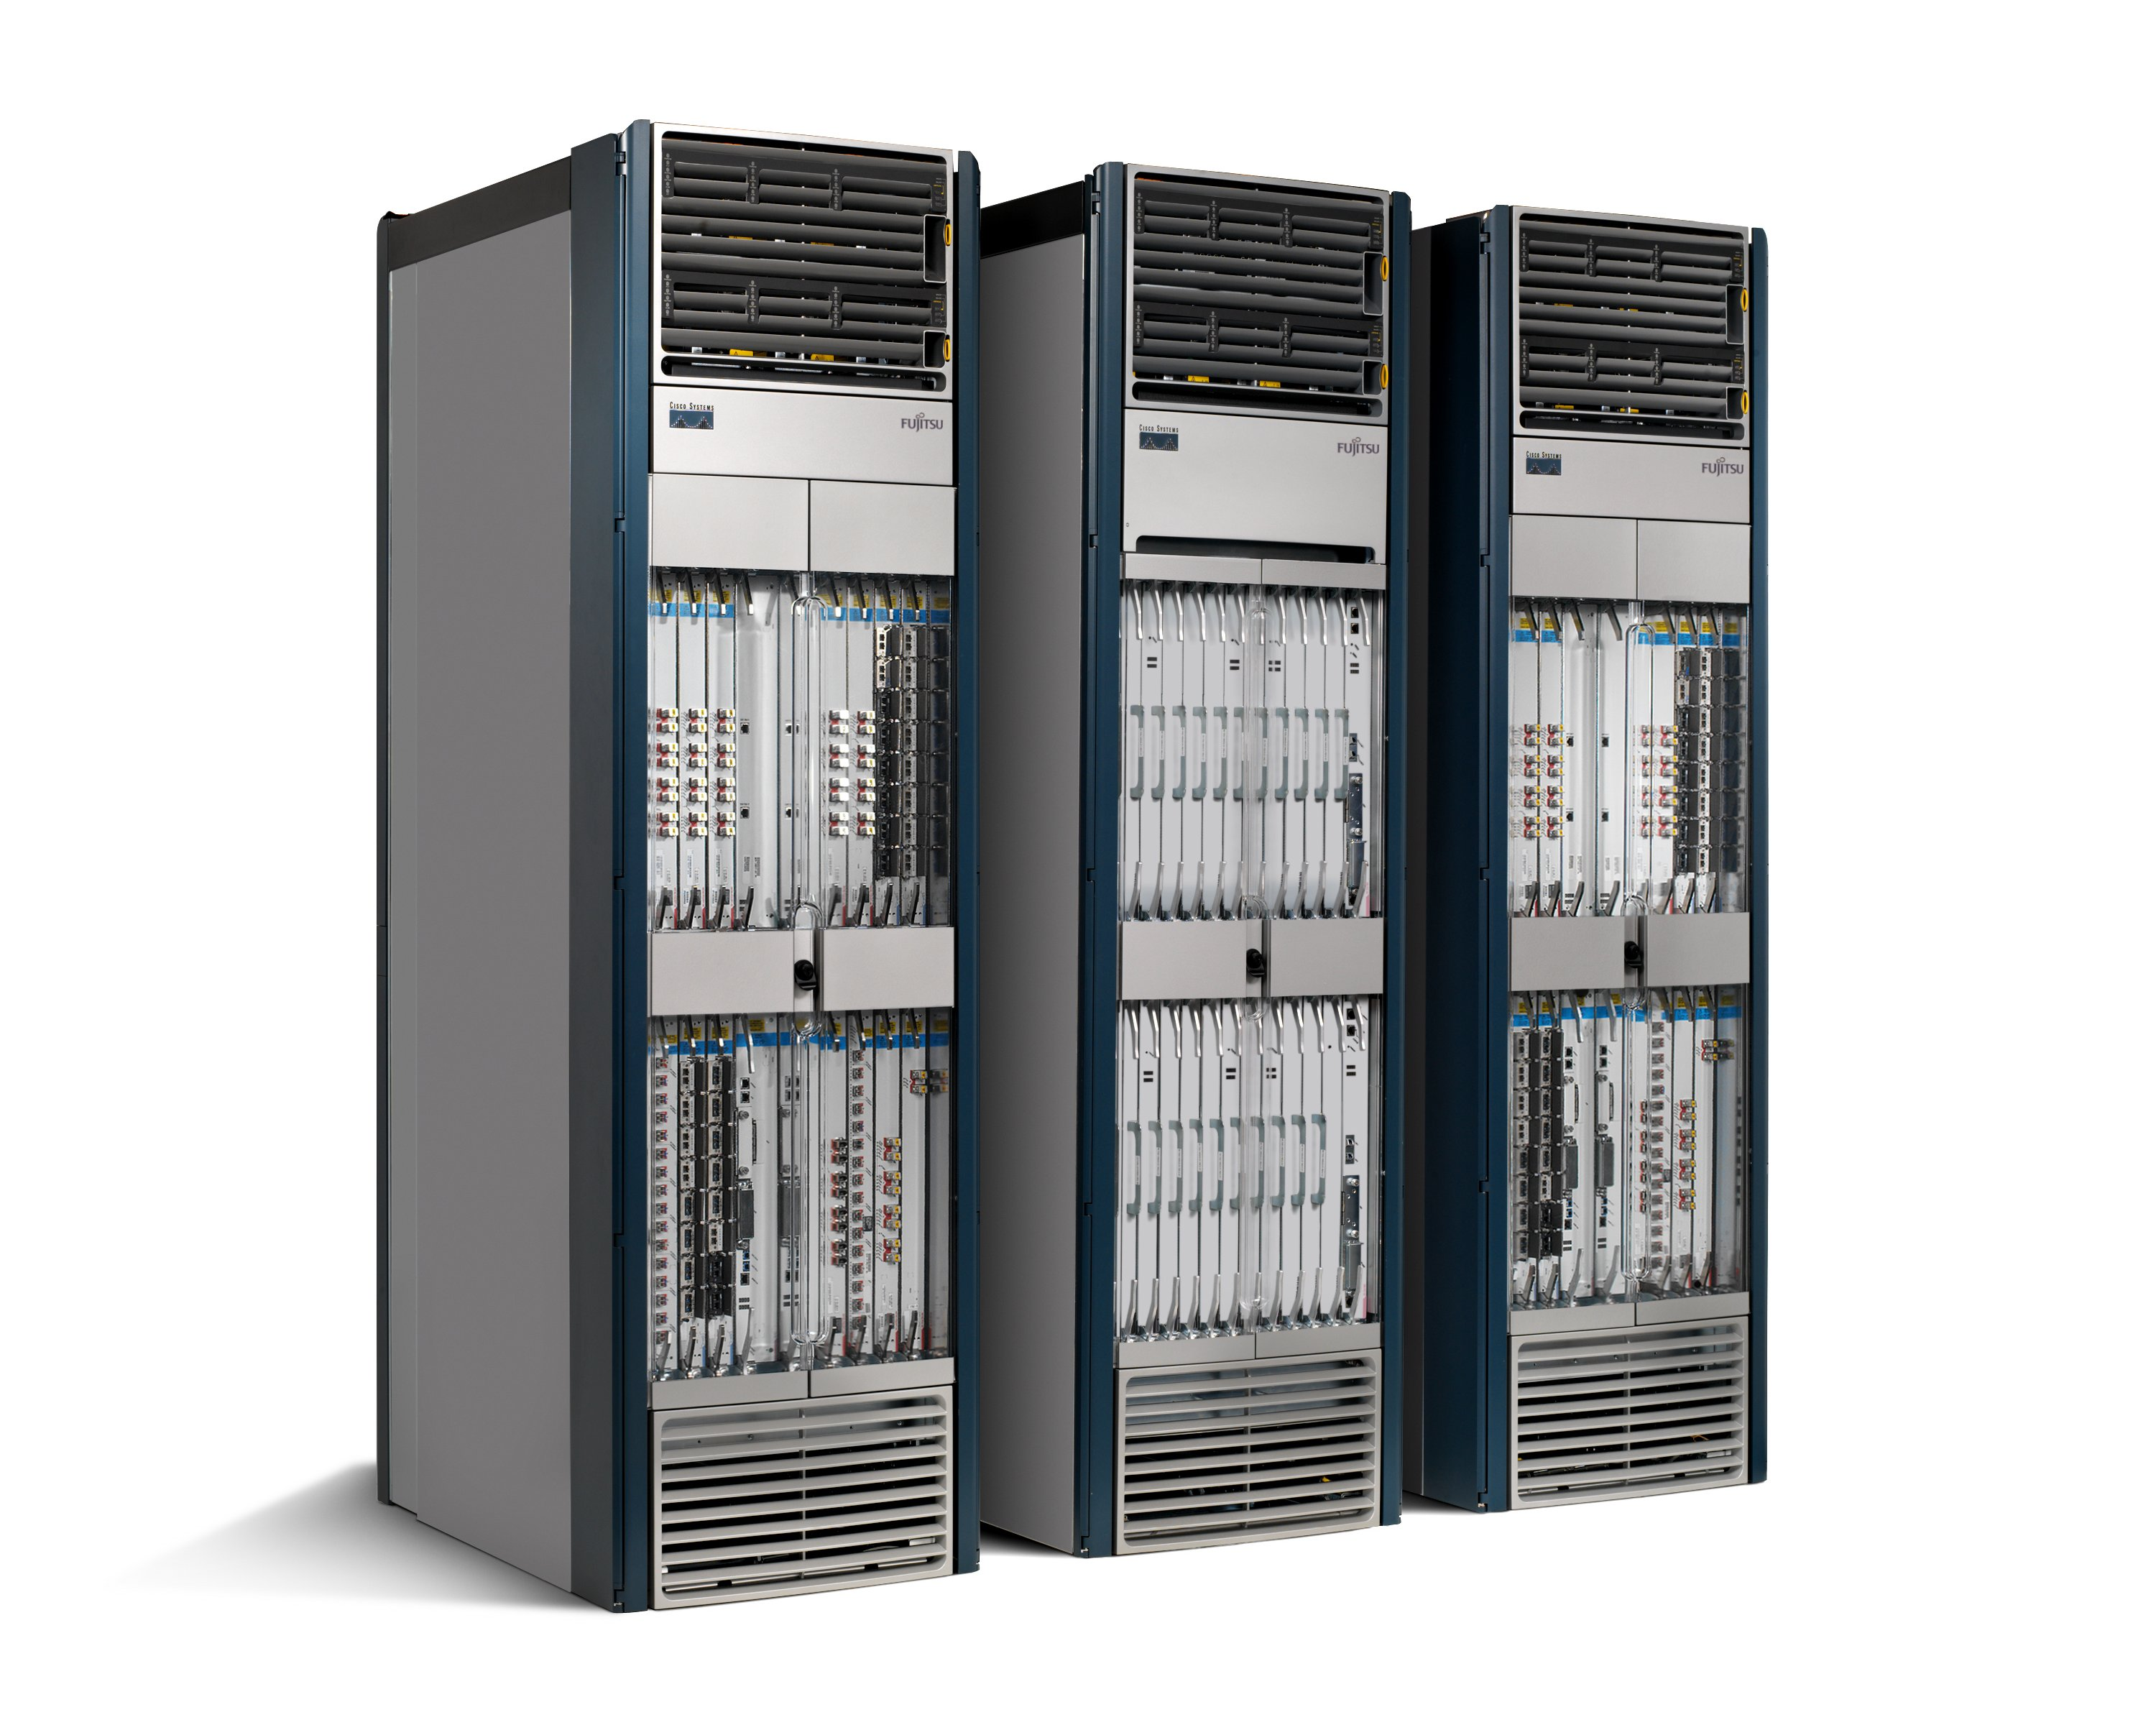
An Analogy wrt Computing (Cont’d)
Source: Nick Mckeown, Stanford
Routing, management, mobility management, access control, VPNs, …
Feature
Feature
Million of lines of source code
6,000 RFCs
OS
Custom Hardware
Billions of gates
Bloated
Power Hungry
Vertically integrated, complex, closed, proprietary
Networking industry with “mainframe” mind-set
9/8/14
Software Defined Networking (COMS 6998-10)

Slide 46
An Analogy wrt Computing (Cont’d)
Source: Nick Mckeown, Stanford
App
App
App
App
App
App
App
App
App
App
App
Specialized
Features
Open Interface
Control
Plane
Control
Plane
Control
Plane
or
or
Specialized
Control
Plane
Open Interface
Specialized
Hardware
Merchant
Switching Chips
Vertically integrated
Closed, proprietary
Slow innovation
Horizontal
Open interfaces
Rapid innovation
Software Defined Networking (COMS 6998-10)
9/8/14

Slide 47
How SDN shaping Industry?
Open Networking Foundation (ONF)
New non-profit standards organization (Mar 2011)
Defining standards for SDN, starting with OpenFlow
Board of Directors
Google, Facebook, Microsoft, Yahoo, DT, Verizon
39 Member Companies
Cisco, VMware, IBM, Juniper, HP, Broadcom, Citrix, NTT, Intel, Ericsson, Dell, Huawei, …
OpenDaylight
led by IBM and Cisco
Mission is to develop open source SDN platform

Slide 48
How SDN shaping Industry (Cont’d)
Cellular industry
Recently made transition to IP
Billions of mobile users
Need to securely extract payments and hold users accountable
IP is bad at both, yet hard to change
SDN enables industry to customize their network

Slide 49
How SDN shaping Industry (Cont’d)
Big companies
Google B4: deployed SDN to manage cross data center traffic
Microsoft SWAN: software defined WAN
Facebook: infrastructure team exploring SDN
Vmware: Nicira, overlay approach to SDN
Intel: OpenFlow switch
Cisco: OpenFlow switch
AT&T: Domain 2.0
…

Slide 50
How SDN shaping Industry (Cont’d)
Startups
Affirmed Networks: virtualized subscriber and content management tools for mobile operators
Big Switch Networks: OpenFlow-based SDN switches, controllers and monitoring tools
Embrane: layer 3-7 SDN services to enterprises and service providers
Accelera: software defined wireless networks funded by Stanford Professor Andrea Goldsmith
…

Slide 51
How SDN shaping Research?
Ease of trying new ideas
Existing tools: Floodlight, NOX, Beacon, switches, Mininet
More rapid technology transfer
GENI, FIND and many more
A stronger foundation to build upon
Provable properties of forwarding
New languages and specification tools

Slide 52
How SDN shaping Research (Cont’d)
Research activities
Open Networking Summit started in 2011
ACM HotSDN workshop started in 2012
ACM SIGCOMM, USENIX NSDI sessions

Slide 53
Part II: SDN Origins
AT&T’s Network Control Points: separation of control plane and data plane in circuit switched networks (dates back to 1980s)
Active Networks (1990s)
2004: Research on new management paradigms
Routing control platform (RCP) (2004), A clean slate 4D approach to network control and management (4D) (2005) [Princeton, CMU,….]
SANE, Ethane [Stanford/Berkeley]
Industrial efforts with similar flavor (not published)

Slide 54
Part II: SDN Origins (Cont’d)
2008: Software-Defined Networking (SDN)
NOX Network Operating System [Nicira]
OpenFlow switch interface [Stanford/Nicira]
9/8/14
Software Defined Networking (COMS 6998-10)

Slide 55
Active Networking
Use pulls
It’s too slow/hard to develop and deploy new services on the network (network ossification)
Third-party interest in value-added, fine-grain control to dynamically meet the needs of particular applications/network conditions
Researcher’s desire to experiment at scale
Unified control over middleboxes (firewalls, proxies, transcoders)
Remarkably similar to those of SDN!
9/8/14
Software Defined Networking (COMS 6998-10)

Slide 56
Contributions of Active Networking
Programmability in the network to lower barrier to innovation
Pioneered the notion of programmable networks
AN focused more on data plane programmability
Isolation of experimental traffic from normal traffic
Demux to software programs on packet headers
NodeOS, Execution Environment (EE), Active Application (AA)
Direct packets to EE: fast pattern matching on headers
Unified architecture for middlebox orchestration
Early design documents hint at it
But never fully realized
9/8/14
Software Defined Networking (COMS 6998-10)

Slide 57
Active Networking
Why not adopted?
Lack of compelling problem
Lack of clear path to deployment
No “Killer” application
Caching, content distribution, application-specific QoS, information fusion,…, but not enough
9/8/14
Software Defined Networking (COMS 6998-10)

Slide 58
Separating Control and Data Planes
Circa. 2001 to 2007
Conventional routers/switches embody a tight integration between the control and data planes
Debugging configuration problems is hard
Predicting/controlling routing behavior is hard
Why not separate control and data planes?
9/8/14
Software Defined Networking (COMS 6998-10)

Slide 59
Separating Control and Data Planes
Technology push
The Internet grows rapidly
Packet forwarding implemented in hardware
Separate from software-based control plane
Servers have more memory and processing power than control-plane processors in a router
Open interface between the control/data planes
ForCES (Forwarding and Control Element Separation)
Logically-centralize control of the network
Routing Control Platform (RCP)
4D
Ethane
9/8/14
Software Defined Networking (COMS 6998-10)

Slide 60
Separating Control and Data Planes
Compared to Active Networking:
Focused on pressing problems in network management
By and for network administrators
Programmability in the control plane (rather than data plane)
Network-wide visibility and control (rather than device-level configuration)
9/8/14
Software Defined Networking (COMS 6998-10)

Slide 61
Separating Control and Data Planes
Contributions:
Logically centralized control using an open interface to the data plane
IETF (ForCES) defined an open, standard interface to install forwarding-table entries
RCP used existing control plane protocol (BGP) to install forwarding-table entries
Distributed state management
A logically centralized controller must be replicated to cope with controller failure, but replication introduces inconsistent state across replicas
9/8/14
Software Defined Networking (COMS 6998-10)

Slide 62
Questions?

