Slide 1
Efficient Web Browsing on Handheld Devices Using Page and Form Summarization
Orkut Buyukkokten, Oliver Kaljuvee, Hector Garcia-Molina,
Andreas Paepcke and Terry Winograd
(2002)
An Overview
by
Shrenik Sadalgi

Slide 2
Introduction
A new approach for summarizing and browsing Web pages:
- Page summarization: Each Web page is broken into text units that can each be hidden, partially displayed, made fully visible, or summarized
- Form summarization: HTML forms are also summarized by displaying just the text labels that prompt the user for input

Slide 3
Page Summarization
Macro-level’ summarization by structural analysis of Web pages - expand & contract pages based on their relative structural nesting
‘Micro-level’ summarization uses information retrieval techniques to outline portions of the text for the user

Slide 4
Page Summarization – Macro Level
Partition page into ‘Semantic Textual Units’ (STU)
- STUs are page fragments – DOM Elements
The proxy uses font and other structural information to identify a hierarchy of STUs
- Nesting of STUs
Does not require special formatting at the Web sources
- significant advantage of this approach over schemes that rely on pages to be specially structured for PDAs

Slide 5
Page Summarization – Micro Level
In this two-level approach to Web browsing, users can initially get a good high-level overview of a Web page, and then “zoom into” the portions most relevant.
Simple to implement
Effectiveness is limited
- first sentence of a paragraph is not necessarily the best representation
Five methods for micro-level summarization

Slide 6
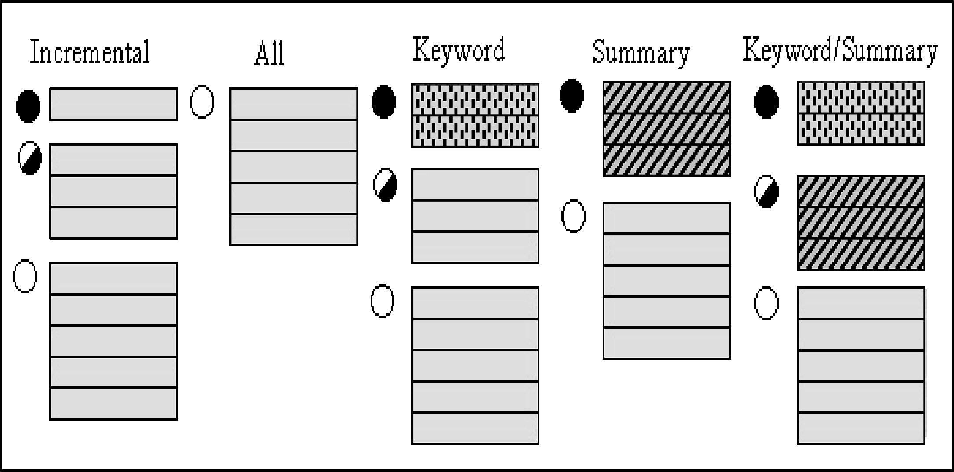
Page Summarization – Micro Level

Slide 7
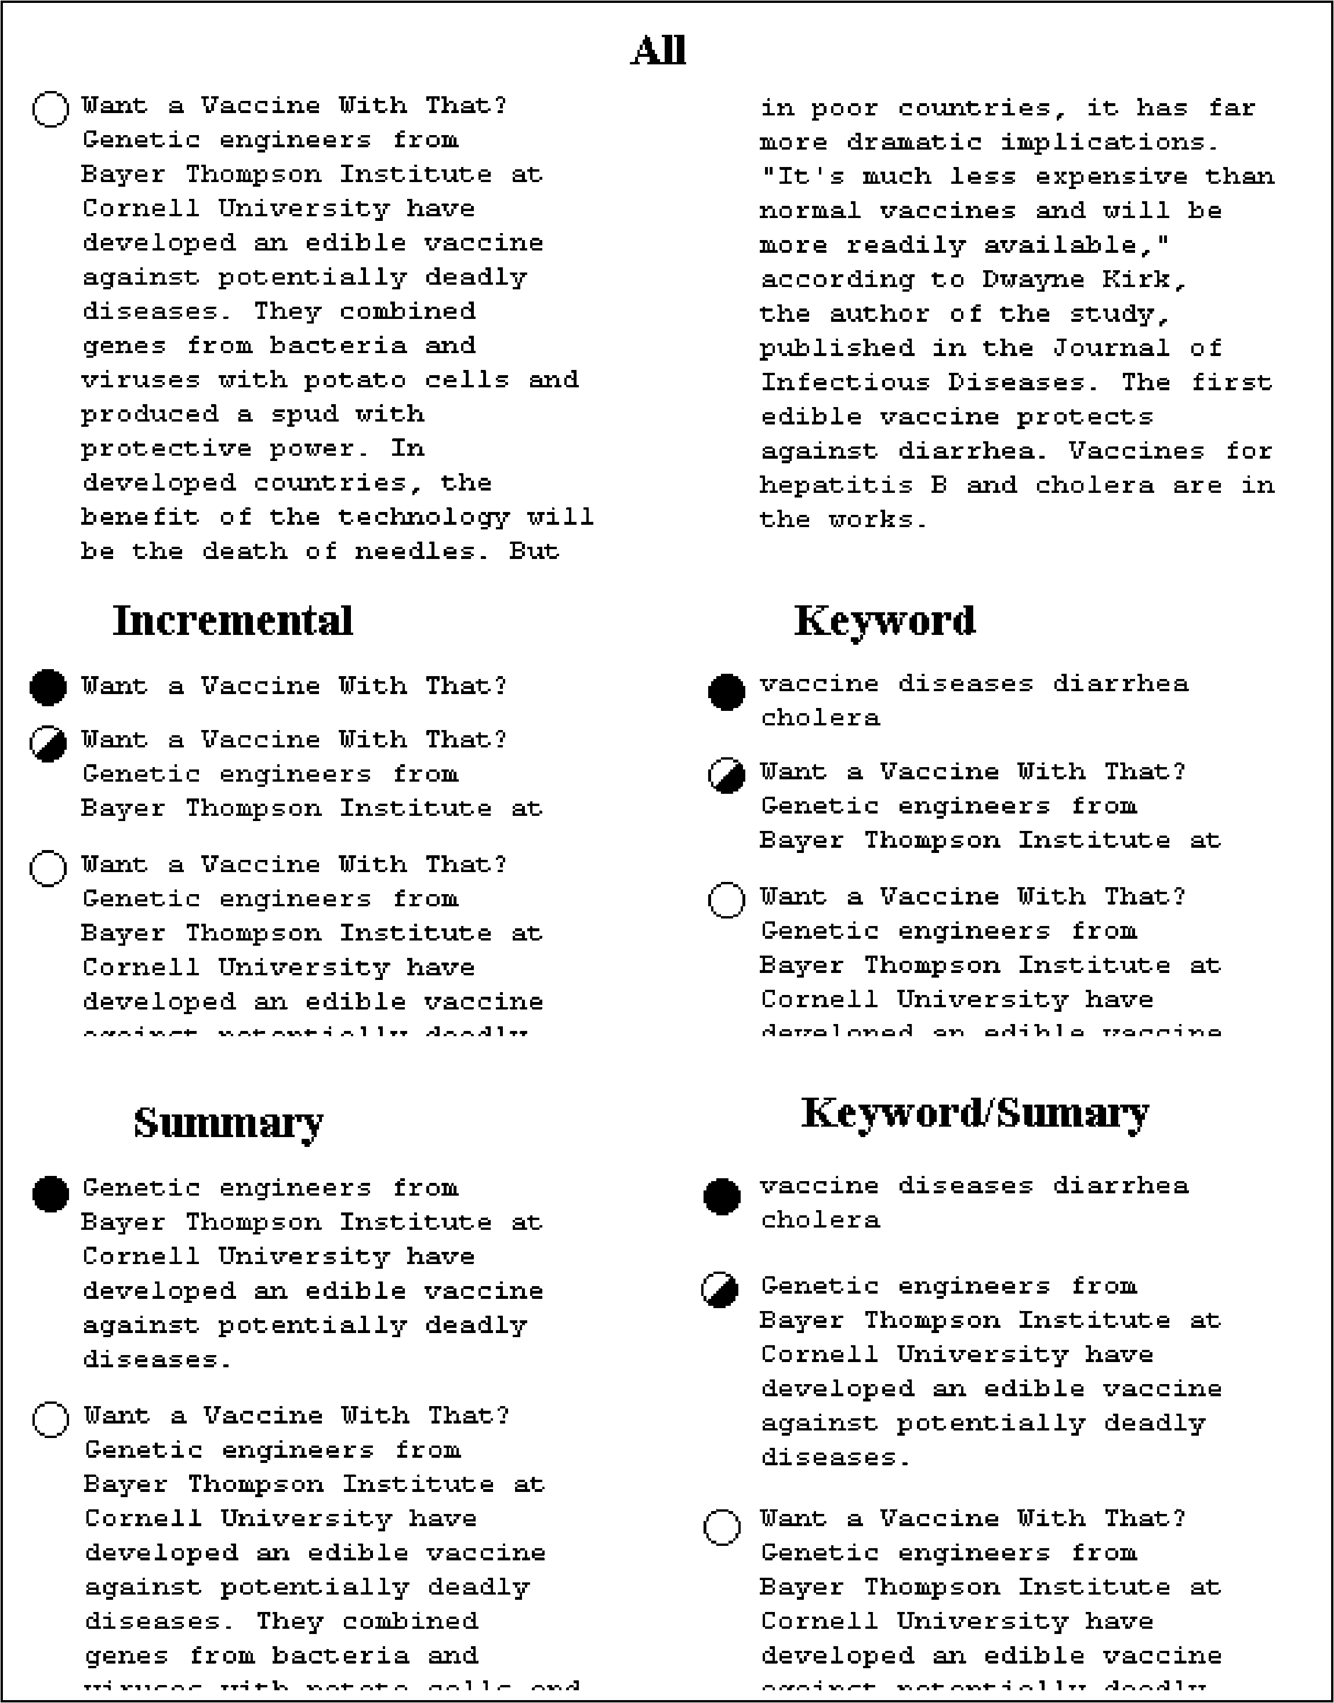

Slide 8
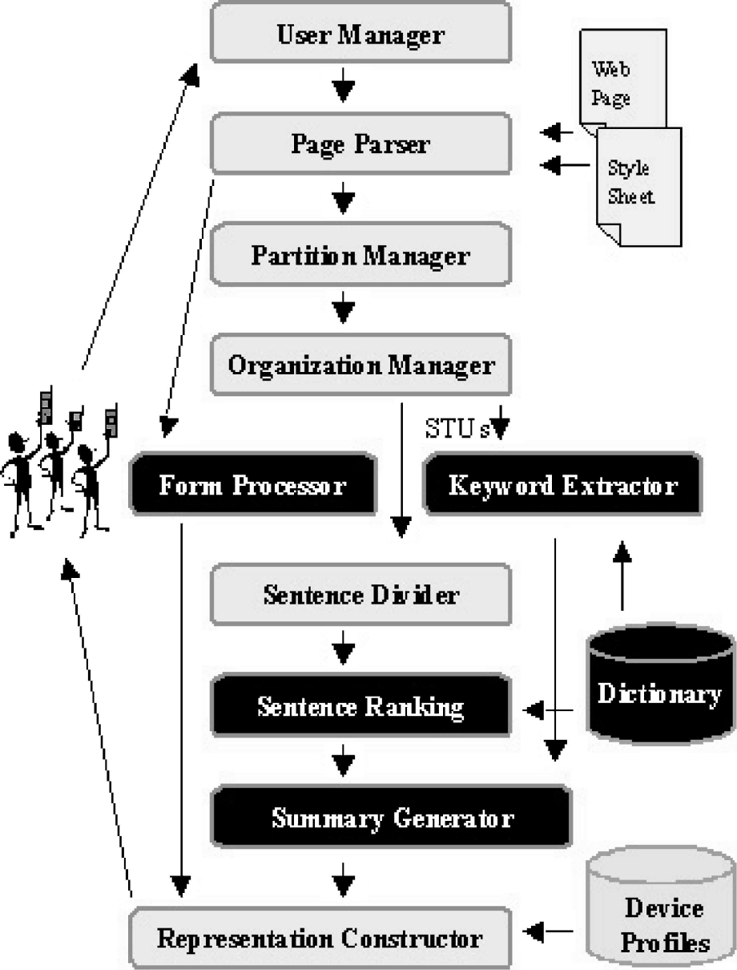
Processing a web page request from a PDA (on Proxy)

Slide 9
Extracting Keywords
Evaluate each word’s importance
- a word is important if it occurs frequently within the text and infrequently in the larger collection
W_{ij} = tf_{ij} * log₂ (N/n)
where,
W_{ij} - weight of term T_{j} in document D_{i}
tf_{ij} - frequency of term T_{j} in document D_{i}
N - number of documents in collection
n - number of documents where term T_{j} occurs at least once

Slide 10
Extracting a Summary Sentence
Each sentence (S) in an STU is assigned a significance factor
S with the highest significance factor becomes the summary sentence
Mark all the significant words in S
- word is significant if its TF/IDF weight is higher than a previously chosen weight cutoff ‘W’
find all “clusters” in S
- the sequence starts and ends with a significant word
- fewer than ‘D’ (distance cutoff) insignificant words must separate any two neighboring significant words within the sequence
Add weights of all significant words within a cluster & divide by the total number of words within the cluster

Slide 11
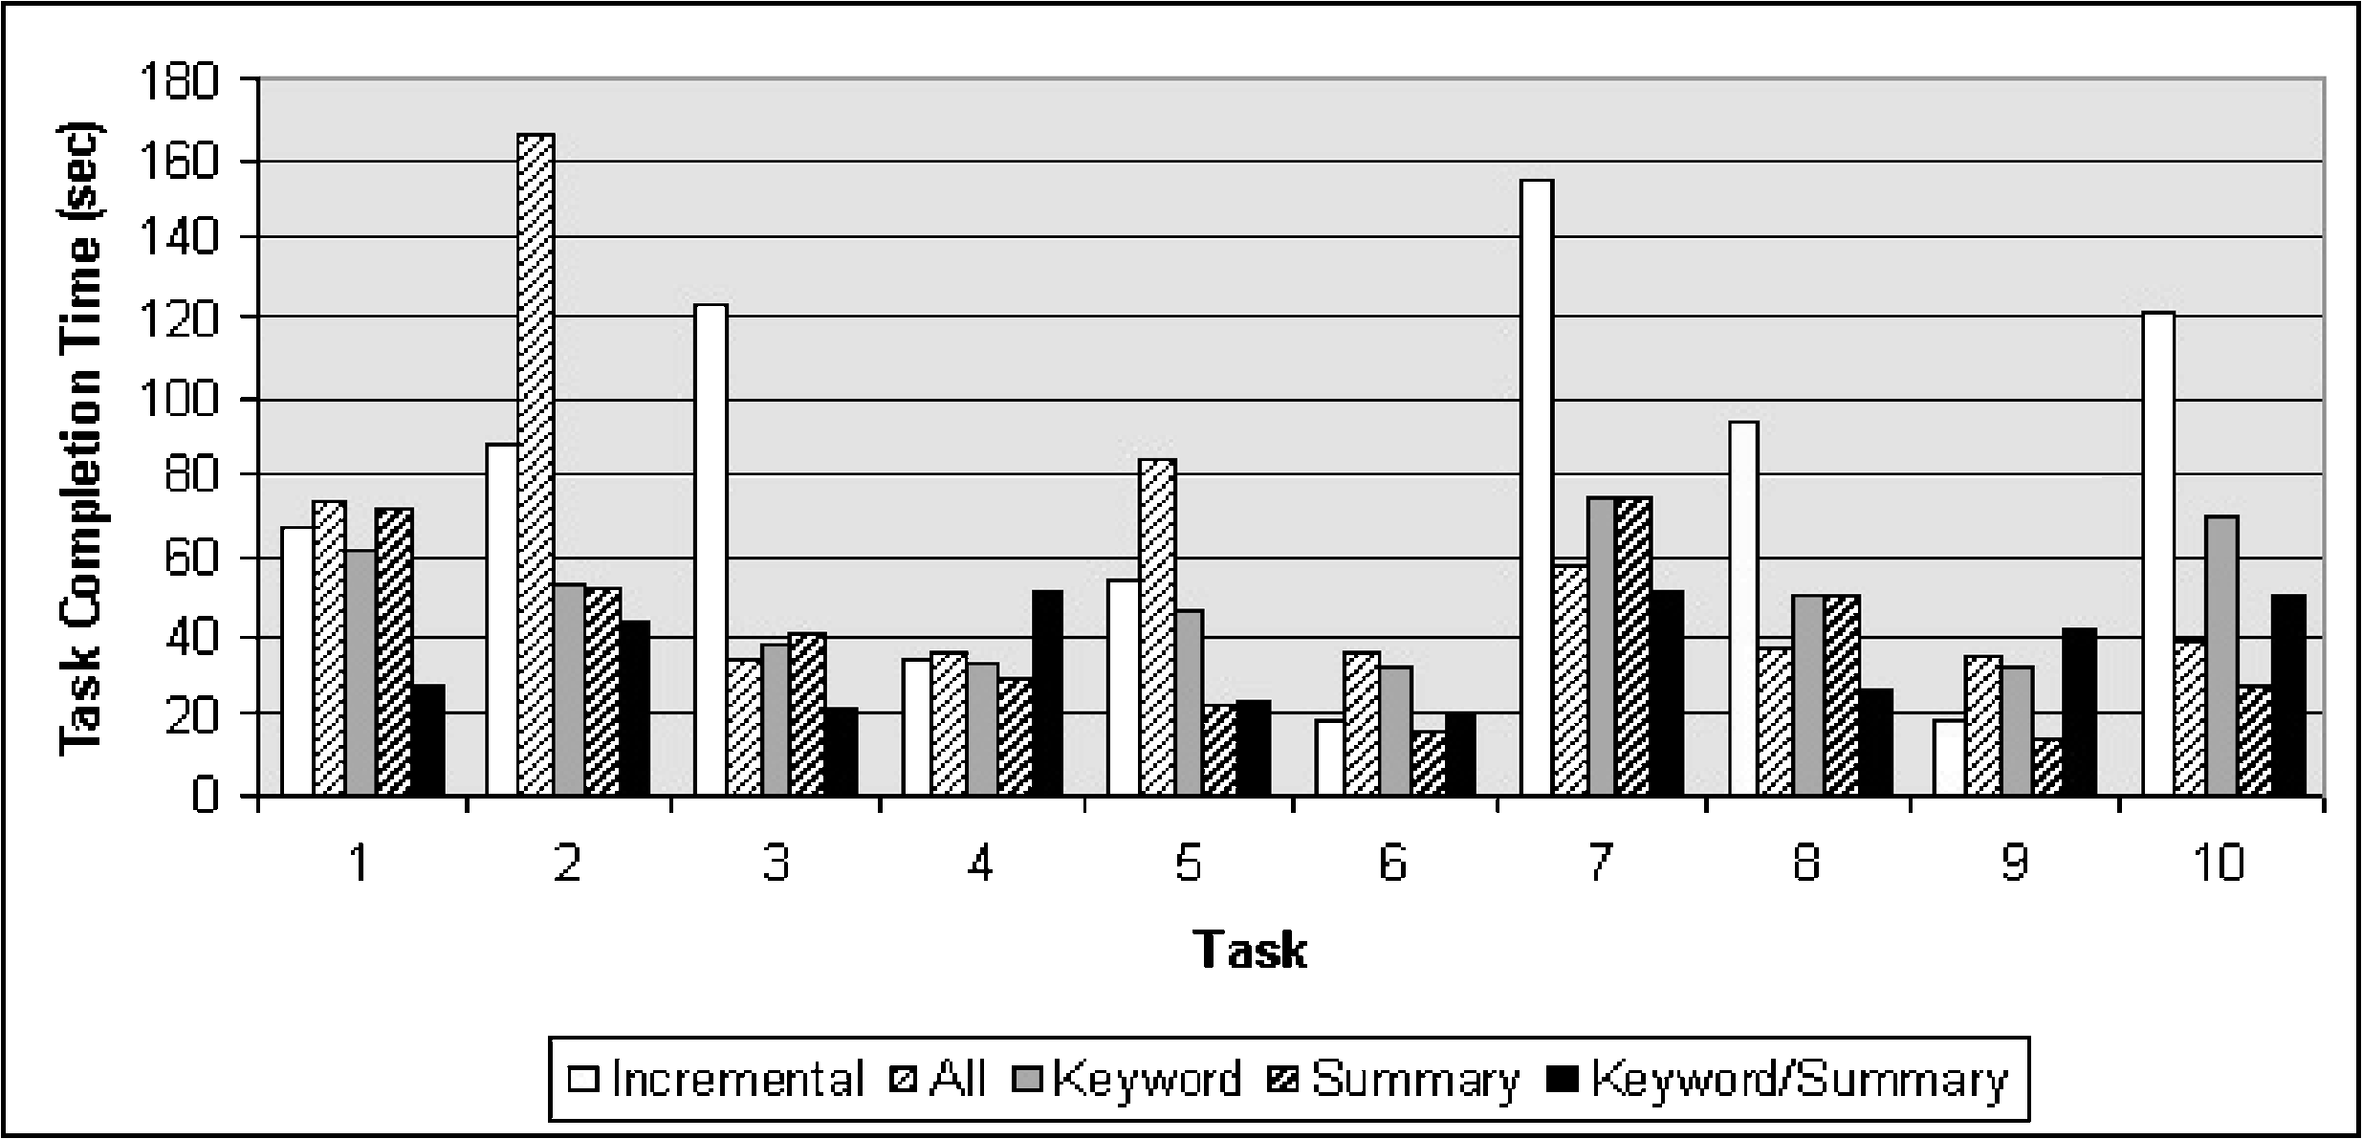
Results
Task completion times for all methods and all tasks

Slide 12
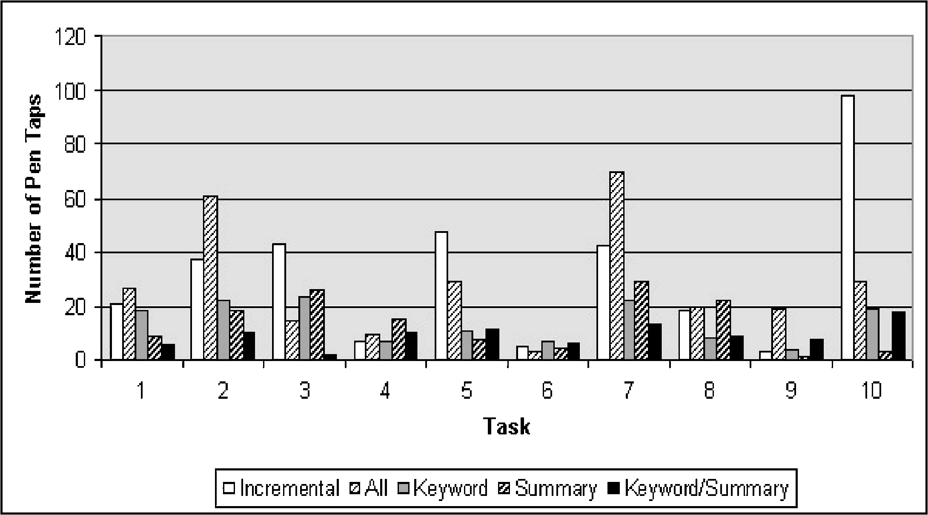
Results
I/O activity required for all methods over all tasks

Slide 13
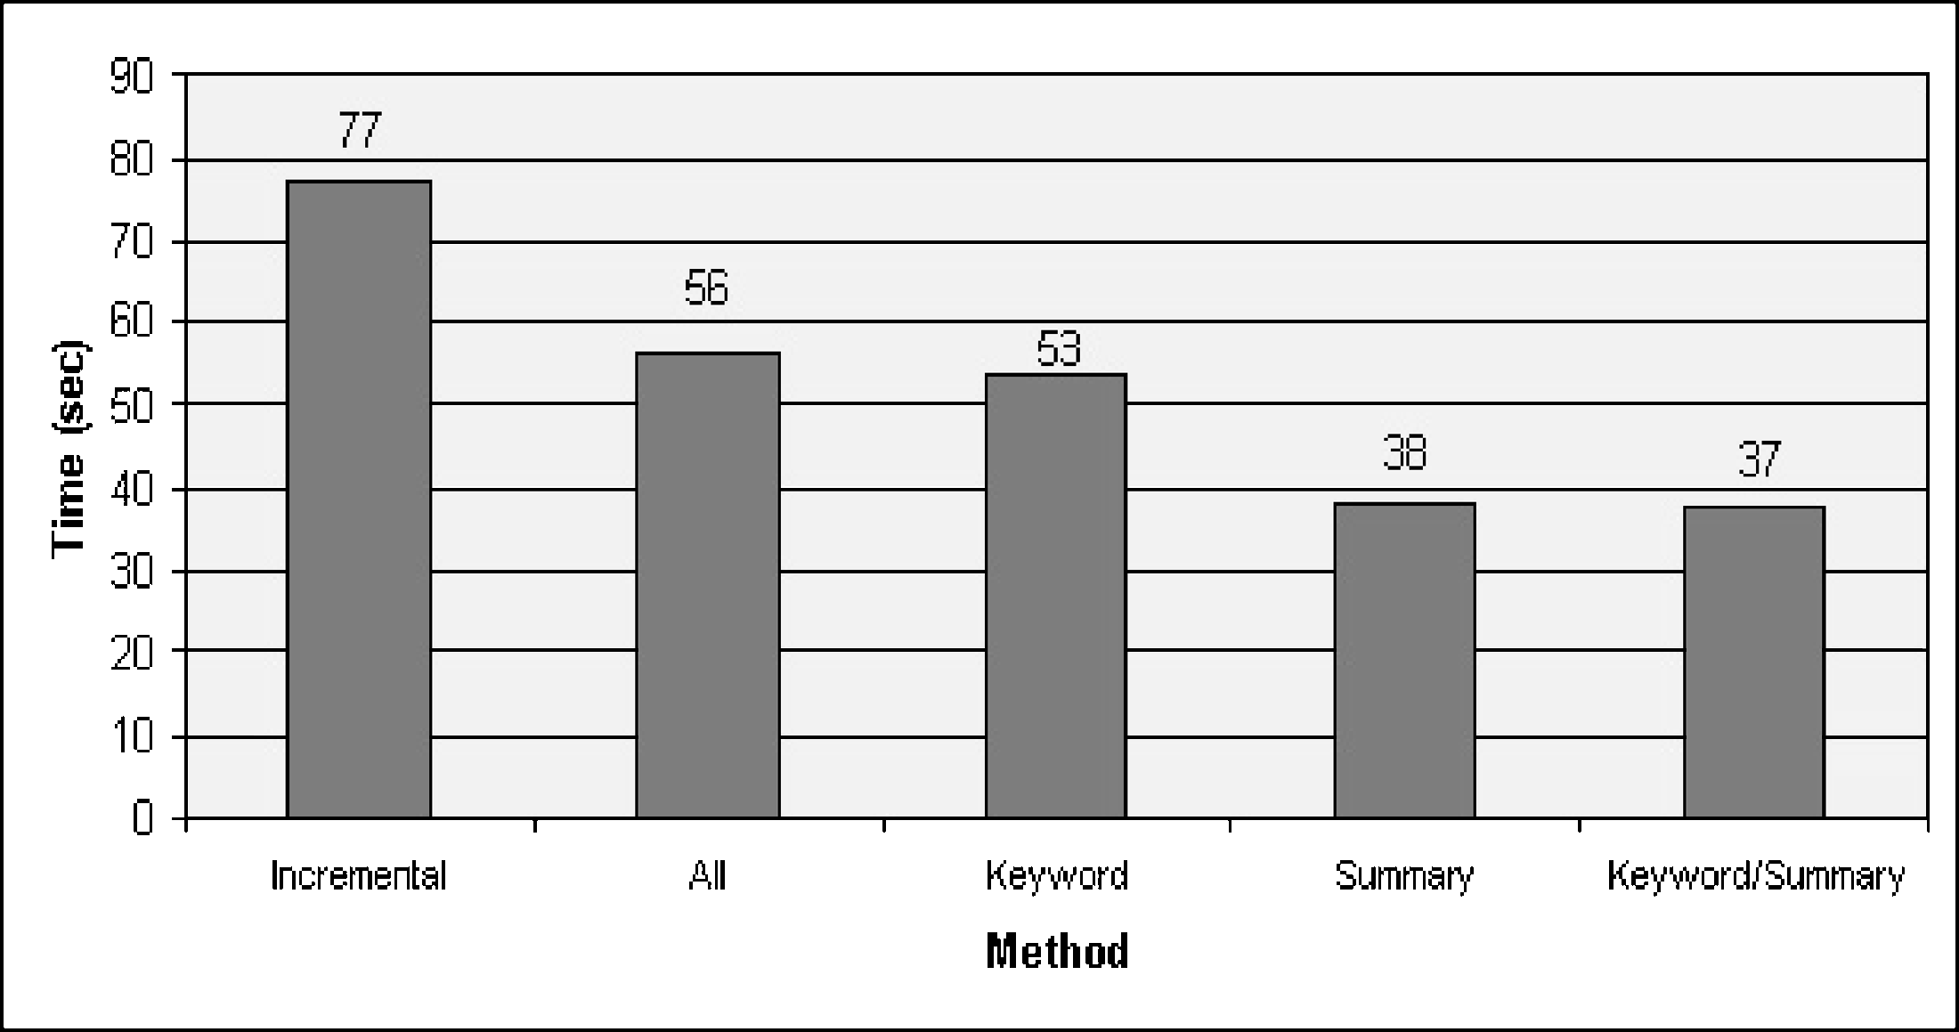
Results
Average completion time for each method across all tasks

Slide 14
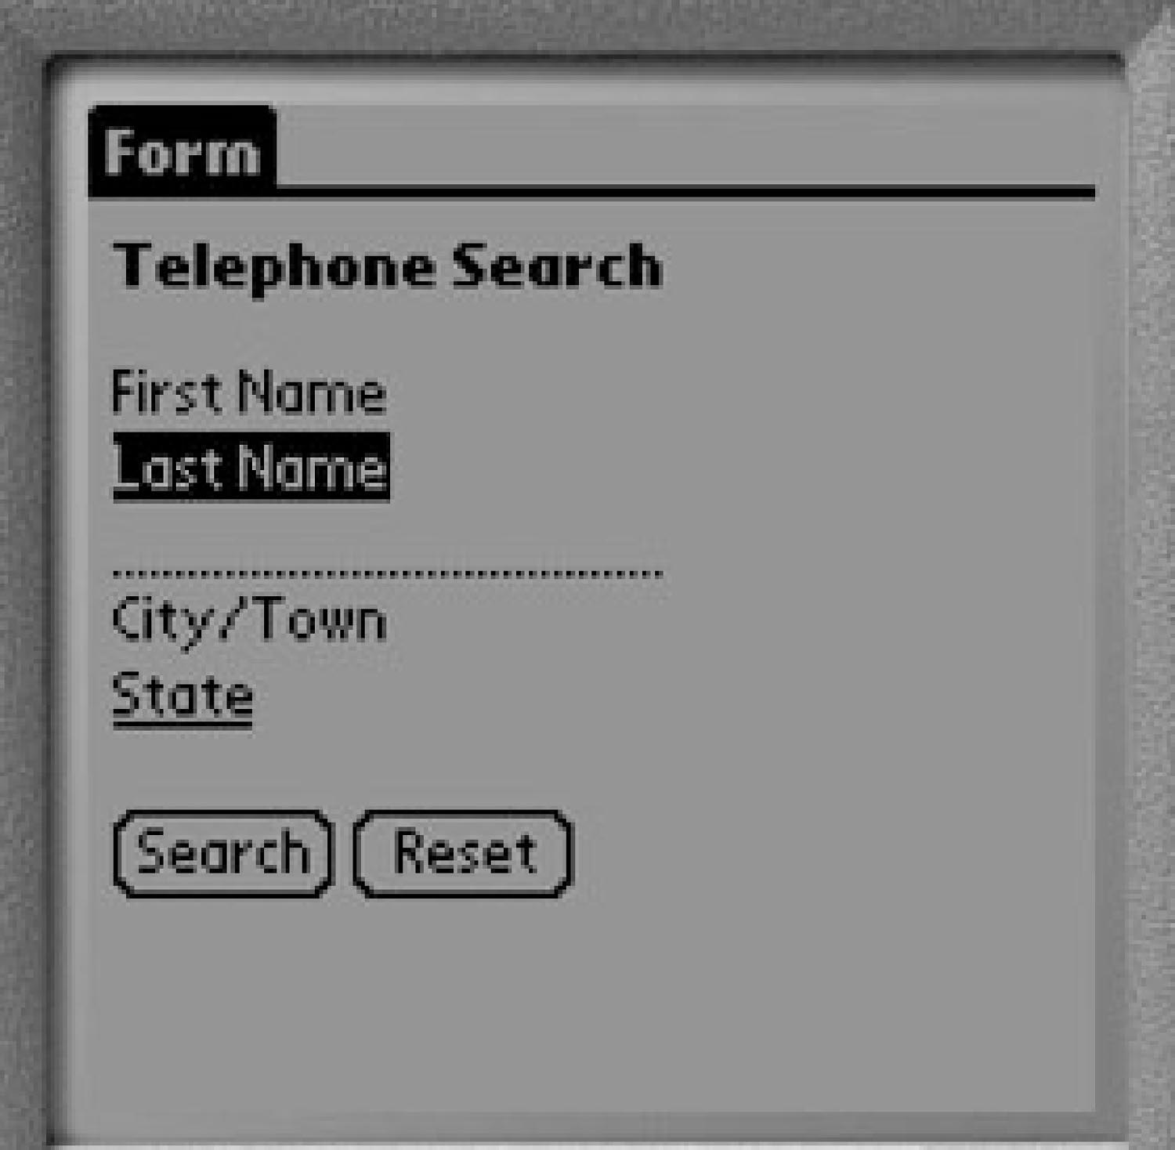
Form Summarization

Slide 15
Form Summarization Process
Algorithms for finding a matching label for form input fields from form text
Chunk Partitioning
small pieces of HTML code that are delimited by HTML tags (not the same as STU)
Label Matching
N-Gram → “ants” and “grants”
Letter/Word → “First Name” and “Fname”
Word/Letter → “PhoneWork” and “PhoneW”
Substring → “Password” and “pwd”
NULL Algorithm → takes name of input tag
Tables
Previous / Following
check_box_label

Slide 16
Results
Each Algorithm Matching 115 Input Fields
Matching Performance for Algorithm Combination over 330 Input Elements

Slide 17
Thank You

