Slide 1
Natural Language Processing for the Web
Prof. Kathleen McKeown
722 CEPSR, 939-7118
Office Hours: Wed, 1-2; Mon 3-4
TA:
Fadi Biadsy
702 CEPSR, 939-7111
Office Hours: Thurs 6-8

Slide 2
Logistics
Remaining classes
  CS Conference Room
  Except
    April 3rd, back in 223 Mudd
    Invited speakers: 7th Floor Interschool Lab
CS account: apply for one now
  http://www.cs.columbia.edu/crf/accounts
Presentations, Discussants
  Need two presenters for next week
  If you haven’t already signed up, sign up on sheet going around

Slide 3
Today
Overview
Single doc summarization systems:
  Trimmer (Zajic et al), Kathy
  Cut and Paste (Jing and McKeown), Sigfried Gold
  Statistical Sentence Compression (Knight and Marcu), Kathy
Tools
  Parsers, POS taggers, Barry Schiffman
Evaluation
  Pyramids (Nenkova and Passonneau), Joshua Nankin
  Rouge (Lin and Hovy), Kathy

Slide 4
Sentence extraction
Sparck Jones:
`what you see is what you get’, some of what is on view in the source text is transferred to constitute the summary

Slide 5
Background
Sentence extraction the main approach
Some more sophisticated features for extraction
    Lexical chains, anaphoric reference
Machine learning model for learning an extraction summarizer: Kupiec, SIGIR 95.

Slide 6
Today’s systems
How can we edit the selected text?

Slide 7
Karen Sparck Jones
Automatic Summarizing: Factors and Directions

Slide 8
Sparck Jones claims
Need more power than text extraction and more flexibility than fact extraction (p. 4)
In order to develop effective procedures it is necessary to identify and respond to the context factors, i.e. input, purpose and output factors, that bear on summarising and its evaluation. (p. 1)
It is important to recognize the role of context factors because the idea of a general-purpose summary is manifestly an ignis fatuus. (p. 5)
Similarly, the notion of a basic summary, i.e., one reflective of the source, makes hidden fact assumptions, for example that the subject knowledge of the output’s readers will be on a par with that of the readers for whom the source was intended. (p. 5)
I believe that the right direction to follow should start with intermediate source processing, as exemplified by sentence parsing to logical form, with local anaphor resolutions

Slide 9
Questions (from Sparck Jones)
Does subject matter of the source influence summary style (e.g, chemical abstracts vs. sports reports)?
Should we take the reader into account and how?
Is the state of the art sufficiently mature to allow summarization from intermediate representations and still allow robust processing of domain independent material?

Slide 10
For the next two classes
Consider the papers we read in light of Sparck Jones’ remarks on the influence of context:
  Input
    Source form, subject type, unit
  Purpose
    Situation, audience, use
  Output
    Material, format, style

Slide 11
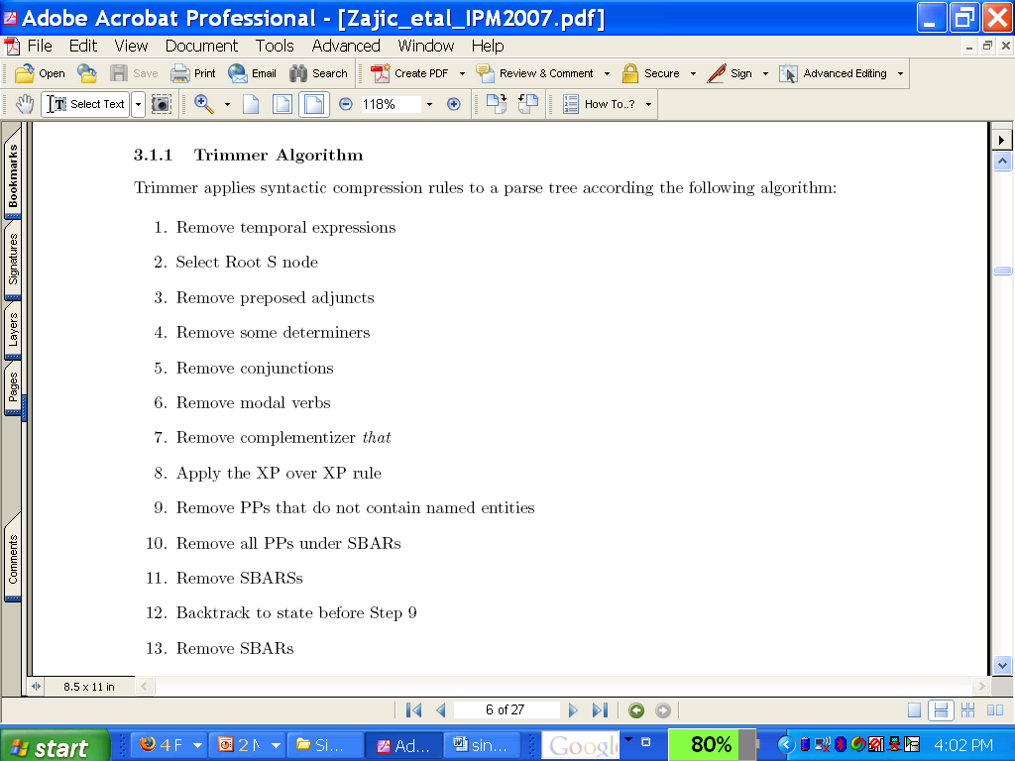
Trimmer Algorithm

Slide 12
Headline Ambiguity
Iraqi Head Seeks Arms
Juvenile Court to Try Shooting Defendant
Teacher Strikes Idle Kids
Kids Make Nutritious Snacks
British Left Waffles on Falkland Islands
Red Tape Holds Up New Bridges
Bush Wins on Budget, but More Lies Ahead
Hospitals are Sued by 7 Foot Doctors
Ban on nude dancing on Governor’s desk
Local high school dropouts cut in half

