Slide 1
Improving QA Accuracy by Question Inversion
Prager et al.
IBM T.J. Watson Res. Ctr.
02/18/2010

Slide 2
Overview
The paper presents a method to improve factoid style question answering
The aim is to do an re-ranking of candidate answers generated from a traditional QA system to filter out incorrect answers.
The Question is inverted by making an existing entity the query and substituting the candidate answer back into the question
“ What is the capital of France ?“ → “Of what country is Paris the capital of ?“
The answers of the inverted question are used to decrease the confidence of incorrect answers, and increase confidence for the correct answer

Slide 3
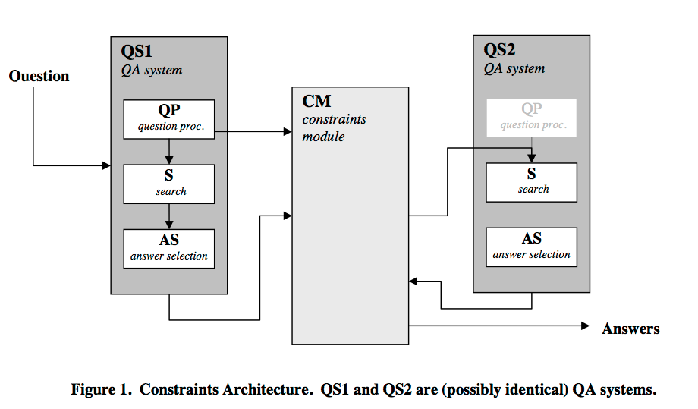
The Architecture

Slide 4
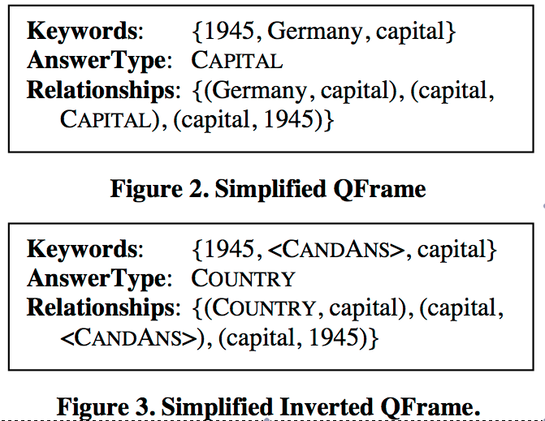
Inverting Questions
The entity being sought in the inverted question is called the pivot
The Inversion is done by transforming the QFrame, (obtained by Question Processing)
Example: “What was the capital of Germany in 1945”
Transformations:
Pivot term with <CandAns>
Original answer type with the type of the pivot term
In the relationships the pivot term with its type and the original answer type with <CandAns>

Slide 5
Experiments
Candidate answers are divided in two categories, SoftRefutation and MustConstrain (populated manually)
Scores of original answers are recomputed based on original scores, inversion results, and membership of SR or MC.
TREC-11 was used for training
Experiment focused on finding those correct answers which ranked 2^{nd,} i.e. promote them to first rank.
Also, introduce nils, i.e. say that correct answer is neither of the top 2 original answers.
Decision Trees were used (using Weka) for re-ranking results.

Slide 6
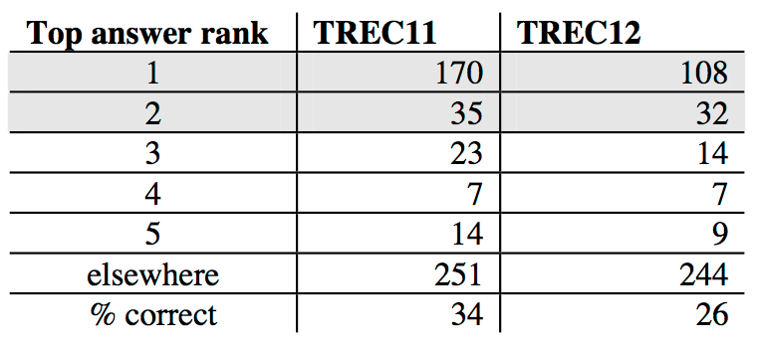
Quick look at TREC stats
Baseline Statistics for TREC-11,12

Slide 7
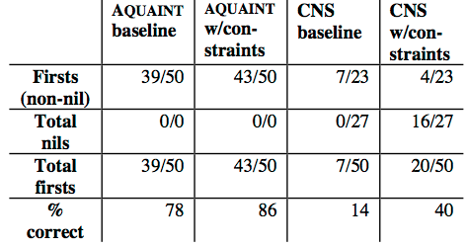
Evaluation - I
Evaluation done in 2 stages
Fixed Question and TREC12 factoid Question set
Fixed question : “What is the capital of X” tested on Aquaint Corpus (newswire) and CNS Corpus (about WMDs)
Results :

Slide 8
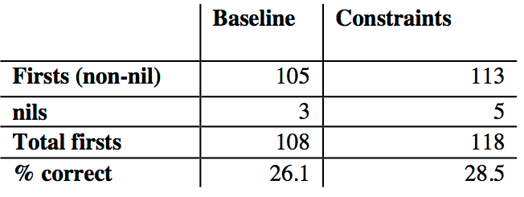
Evaluation - II
414 factoid questions from TREC12 were processed
Out of 32 questions which has correct answers ranked 2nd, 12 were promoted to first place. But 4 of previous correctly 1st ranked answers were demoted.

Slide 9
Discussion
Factors which affect performance
Answer scoring mechanism
NER System being used
Coverage of SoftRefutation and MustContraint Classes
Cases where inverted questions are too general
Invert “when was MTV started” -> “what started in 1980”
Presence of Synonymous answers (eg. UK and GB)

Slide 10
Questions

