Slide 1
Natural Language Processing for the Web
Prof. Kathleen McKeown
722 CEPSR, 939-7118
Office Hours: Tues 4-5; Wed 1-2
TA:
Yves Petinot
728 CEPSR, 939-7116
Office Hours: Thurs 12-1, 8-9

Slide 2
Today
Why NLP for the web?
What we will cover in the class
Class structure
Requirements and assignments for class
Introduction to summarization

Slide 3
The World Wide Web
Surface Web
    As of March 2009, the indexable web contains at least 25.21 billion web pages
    http://en.wikipedia.org/w/index.php?title=World_Wide_Web&action=edit
    On July 25, 2008, Google software engineers Jesse Alpert and Nissan Hajaj announced that Google Search had discovered one trillion unique URLs.
    As of May 2009, over 109.5 million websites operated.
Deep Web
    550 billion web pages (2001) both surface and deep
    At least 538.5 billion in the deep web (2005)

Slide 4
Languages on the web (2002)
English 56.4%
German 7.7%
French 5.6%
Japanese 4.9%

Slide 5
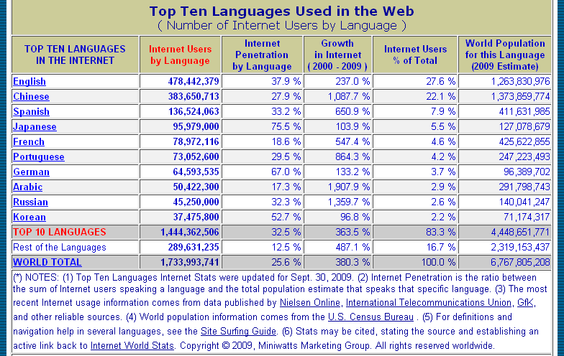
Language Usage of the Web http://www.internetworldstats.com/stats7.htm

Slide 6
Locally maintained corpora
Newsblaster
    Drawn from between 25-30 news sites
    Accumulated since 2001
    2 billion words
DARPA GALE corpus
    Collected by the Linguistic Data Consortium
    3 different languages (English, Arabic, Chinese)
    Formal and informal genres
      News vs. blogs
      Broadcast news vs. talk shows
    367 million words, 2/3 in English
    4500 hours of speech
Linguistic Data Consortium (LDC) releases
    Penn Treebank, TDT, Propbank, ICSI meeting corpus
Corpora gathered for project on online communication
    LiveJournal, online forums, blogs

Slide 7
What tasks need natural language?
Search
Asking questions, finding specific answers (google)
Browsing (http://newsblaster.cs.columbia.edu
http://emm.newsbrief.eu/NewsBrief/clusteredition/en/latest.html)
Analysis of documents
    Sentiment (http://groups.csail.mit.edu/rbg/projects/maps/desktop/#)
    Who talks to who?
    Translation (google)

Slide 8
Existing Commercial Websites
Google News
Ask.com
Yahoo categories
Systran translation

Slide 9
Exploiting the Web
Confirming a response to a question
Building a data set
Building a language model

Slide 10
Class Overview
Userid: nlpforweb
Password: nlp321

Slide 11
Guest: Livia Polanyi
Microsoft: bing.com

Slide 12
Summarization

Slide 13
What is Summarization?
Data as input (database, software trace, expert system), text summary as output
Text as input (one or more articles), paragraph summary as output
Multimedia in input or output
Summaries must convey maximal information in minimal space

Slide 14
Summarization is not the same as Language Generation
Karl Malone scored 39 points Friday night as the Utah Jazz defeated the Boston Celtics 118-94.
Karl Malone tied a season high with 39 points Friday night….
… the Utah Jazz handed the Boston Celtics their sixth straight home defeat 119-94.
Streak, Jacques Robin, 1993

Slide 15
Summarization Tasks
Linguistic summarization: How to pack in as much information as possible in as short an amount of space as possible?
    Streak: Jacques Robin
    Jan 28th class: single document summarization
Conceptual summarization: What information should be included in the summary?

Slide 16
Streak
Data as input
Linguistic summarization
Basketball reports

Slide 17
Input Data -- STREAK

Slide 18
Revision rule: nominalization
beat
hand
Jazz
Celtics
Jazz
defeat
Celtics
Allows the addition of noun modifiers like a streak (6th straight defeat)

Slide 19
Summary Function (Style)
Indicative
  indicates the topic, style without providing details on content.
  Help a searcher decide whether to read a particular document
Informative
  A surrogate for the document
  Could be read in place of the document
  Conveying what the source text says about something
Critical
  Reviews the merits of a source document
Aggregative
  Multiple sources are set out in relation, contrast to one anohter

Slide 20
Indicative Summarization – Min Yen Kan, Centrifuser

Slide 21
Centrifuser Output
Min Yen Kan, 2001
Centrifuser’s output comes in three parts:
  Navigation;
  Informative extract, based on similarities;
  Indicative generated text, based on differences.
Centrifuser can currently produce this output for documents with the same
domain and genre

Slide 22
1. Document Topic Tree
Done offline per document
Hierarchical view of the document
  Layout (Hu, et al 99)
  Lexical chains (Hearst 94, Choi 00)
High Blood Pressure
Level: 1
Style: Prose
Contents: 3 Headers, …
ð
See also in this guide
Level: 2 Order: 3
Style: Prose
Contents: 5 items, …
AHA Recommendation
Level: 2 Order: 1
Style: Prose
Contents: 1 Table, …
Related AHA publications
Level: 2 Order:3
Style: Bulleted Contents: …

Slide 23
Other Dimensions to Summarization
Single vs. Multi-document
Purpose
    Briefing
    Generic
    Focused
Media/genre
    News: newswire, broadcast
    Email/meetings

Slide 24
Summons -1995, Radev&McKeown
Multi-document
Briefing
Newswire
Content Selection

Slide 25
Summons, Dragomir Radev, 1995

Slide 26
Briefings
Transitional
Automatically summarize series of articles
Input = templates from information extraction
Merge information of interest to the user from multiple sources
    Show how perception changes over time
    Highlight agreement and contradictions
Conceptual summarization: planning operators
    Refinement (number of victims)
    Addition (Later template contains perpetrator)

Slide 27
How is summarization done?
4 input articles parsed by information extraction system
4 sets of templates produced as output
Content planner uses planning operators to identify similarities and trends
    Refinement (Later template reports new # victims)
New template constructed and passed to sentence generator

Slide 28
Sample Template

Slide 29
How does this work as a summary?
Sparck Jones:
“With fact extraction, the reverse is the case ‘what you know is what you get.’” (p. 1)
“The essential character of this approach is that it allows only one view of what is important in a source, through glasses of a particular aperture or colour, regardless of whether this is a view showing the original author would regard as significant.” (p. 4)

Slide 30
Foundations of Summarization – Luhn; Edmunson
Text as input
Single document
Content selection
Methods
  Sentence selection
  Criteria

Slide 31
Sentence extraction
Sparck Jones:
`what you see is what you get’, some of what is on view in the source text is transferred to constitute the summary

Slide 32
Luhn 58
Summarization as sentence extraction
    Example
Term frequency determines sentence importance
    TF*IDF (term frequency * inverse document frequency)
    Stop word filtering (remove “a”, “in” “and” etc.)
    Similar words count as one
    Cluster of frequent words indicates a good sentence

Slide 33
Edmunson 69
Sentence extraction using 4 weighted features:
Cue words
Title and heading words
Sentence location
Frequent key words

Slide 34
Sentence extraction variants
Lexical Chains
  Barzilay and Elhadad
  Silber and McCoy
Discourse coherence
  Baldwin
Topic signatures
  Lin and Hovy

Slide 35
Summarization as a Noisy Channel Model
Summary/text pairs
Machine learning model
Identify which features help most

Slide 36
Julian Kupiec SIGIR 95
Paper Abstract
To summarize is to reduce in complexity, and hence in length while retaining some of the essential qualities of the original.
This paper focusses on document extracts, a particular kind of computed document summary.
Document extracts consisting of roughly 20% of the original can be as informative as the full text of a document, which suggests that even shorter extracts may be useful indicative summaries.
The trends in our results are in agreement with those of Edmundson who used a subjectively weighted combination of features as opposed to training the feature weights with a corpus.
We have developed a trainable summarization program that is grounded in a sound statistical framework.

Slide 37
Statistical Classification Framework
A training set of documents with hand-selected abstracts
    Engineering Information Co provides technical article abstracts
    188 document/summary pairs
    21 journal articles
Bayesian classifier estimates probability of a given sentence appearing in abstract
    Direct matches (79%)
    Direct Joins (3%)
    Incomplete matches (4%)
    Incomplete joins (5%)
New extracts generated by ranking document sentences according to this probability

Slide 38
Features
Sentence length cutoff
Fixed phrase feature (26 indicator phrases)
Paragraph feature
  First 10 paragraphs and last 5
  Is sentence paragraph-initial, paragraph-final, paragraph medial
Thematic word feature
  Most frequent content words in document
Upper case Word Feature
  Proper names are important

Slide 39
Evaluation
Precision and recall
Strict match has 83% upper bound
  Trained summarizer: 35% correct
Limit to the fraction of matchable sentences
  Trained summarizer: 42% correct
Best feature combination
  Paragraph, fixed phrase, sentence length
  Thematic and Uppercase Word give slight decrease in performance

Slide 40
What do most recent summarizers do?
Statistically based sentence extraction, multi-document summarization
  Study of human summaries (Nenkova et al 06) show frequency is important
      High frequency content words from input likely to appear in human models
        95% of the 5 content words with high probably appeared in at least one human summary
        Content words used by all human summarizers have high frequency
        Content words used by one human summarizer have low frequency

Slide 41
How is frequency computed?
Word probability in input documents (Nenkova et al 06)
TF*IDF considers input words but takes words in background corpus into consideration
Log-likelihood ratios (Conroy et al 06, 01)
  Uses a background corpus
  Allows for definition of topic signatures
  Leads to best results for greedy sentence by sentence multi-document summarization of news

Slide 42
New summarization tasks
Query focused summarization
Update summarization
Medical journal summarization
Weblog summarization
Meeting summarization
Email summarization

Slide 43
Karen Sparck Jones
Automatic Summarizing: Factors and Directions

Slide 44
Sparck Jones claims
Need more power than text extraction and more flexibility than fact extraction (p. 4)
In order to develop effective procedures it is necessary to identify and respond to the context factors, i.e. input, purpose and output factors, that bear on summarising and its evaluation. (p. 1)
It is important to recognize the role of context factors because the idea of a general-purpose summary is manifestly an ignis fatuus. (p. 5)
Similarly, the notion of a basic summary, i.e., one reflective of the source, makes hidden fact assumptions, for example that the subject knowledge of the output’s readers will be on a par with that of the readers for whom the source ws intended. (p. 5)
I believe that the right direction to follow should start with intermediate source processing, as exemplified by sentence parsing to logical form, with local anaphor resolutions

Slide 45
Questions (from Sparck Jones)
Would sentence extraction work better with a short or long document? What genre of document?
Should it be more important to abstract rather than extract with single document or with multiple document summarization?
Is it necessary to preserve properties of the source? (e.g., style)
Does subject matter of the source influence summary style (e.g, chemical abstracts vs. sports reports)?
Should we take the reader into account and how?
Is the state of the art sufficiently mature to allow summarization from intermediate representations and still allow robust processing of domain independent material?

Slide 46
For the next two classes
Consider the papers we read in light of Sparck Jones’ remarks on the influence of context:
  Input
    Source form, subject type, unit
  Purpose
    Situation, audience, use
  Output
    Material, format, style

