Slide 1
CS 4705
N-Grams and Corpus Linguistics

Slide 2
Homework
Regular expressions for asking questions about the stock market from stock reports
Due midnight, Sept. 29th
Use Perl or Java reg-ex package
    HW focus is on writing the “grammar” or FSA for question and answer matching
The files are the kind of input you can expect. You are given files for “training” your program. When we grade, we will run your program on similar “test” files.
Questions?

Slide 3
“But it must be recognized that the notion of “probability of a sentence” is an entirely useless one, under any known interpretation of this term.” Noam Chomsky (1969)
“Anytime a linguist leaves the group the recognition rate goes up.”
Fred Jelinek (1988)

Slide 4
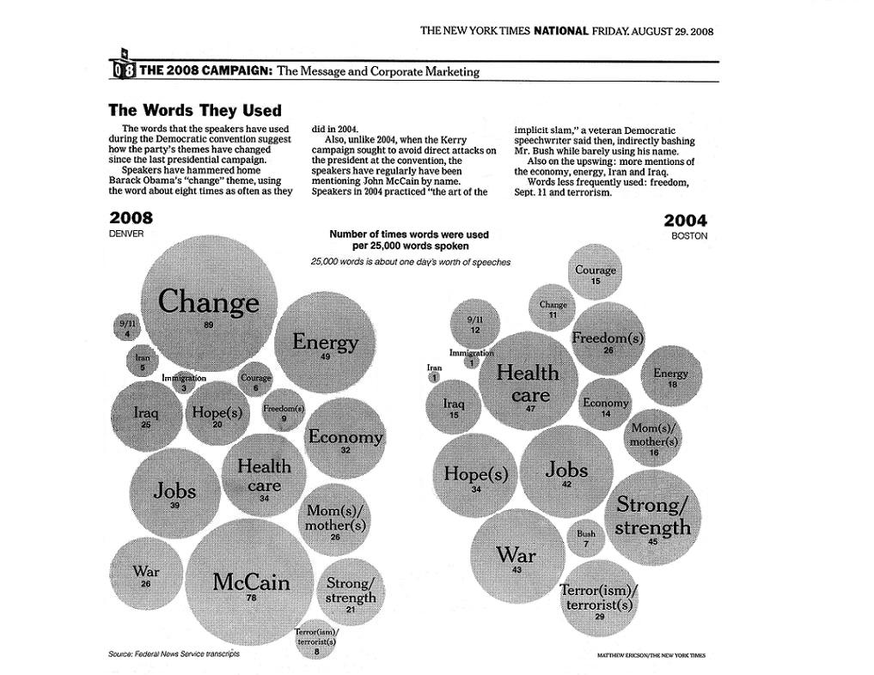

Slide 5
Next Word Prediction
From a NY Times story...
  Stocks ...
  Stocks plunged this ….
  Stocks plunged this morning, despite a cut in interest rates
  Stocks plunged this morning, despite a cut in interest rates by the Federal Reserve, as Wall ...
  Stocks plunged this morning, despite a cut in interest rates by the Federal Reserve, as Wall Street began

Slide 6
  Stocks plunged this morning, despite a cut in interest rates by the Federal Reserve, as Wall Street began trading for the first time since last …
  Stocks plunged this morning, despite a cut in interest rates by the Federal Reserve, as Wall Street began trading for the first time since last Tuesday's terrorist attacks.

Slide 7
Human Word Prediction
Clearly, at least some of us have the ability to predict future words in an utterance.
How?
  Domain knowledge
  Syntactic knowledge
  Lexical knowledge

Slide 8
More Examples
The stock exchange posted a gain
The stock exchange took a loss
Stock prices surged at the start of the day
Stock prices got off to a strong start
I set the table (American)
I lay the table (British)

Slide 9
Claim
A useful part of the knowledge needed to allow Word Prediction can be captured using simple statistical techniques
In particular, we'll rely on the notion of the probability of a sequence (of letters, words,…)

Slide 10
Applications
Why do we want to predict a word, given some preceding words?
  Rank the likelihood of sequences containing various alternative hypotheses, e.g. for ASR
  Theatre owners say popcorn/unicorn sales have doubled...
  Assess the likelihood/goodness of a sentence, e.g. for text generation or machine translation
  El doctor recommendó una exploración del gato.
  The doctor recommended a cat scan.
  The doctor recommended a scan of the cat.

Slide 11
N-Gram Models of Language
Use the previous N-1 words in a sequence to predict the next word
Language Model (LM)
  unigrams, bigrams, trigrams,…
How do we train these models?
  Very large corpora

Slide 12
Corpora
Corpora are online collections of text and speech
  Brown Corpus
  Wall Street Journal
  AP newswire
  Hansards
  DARPA/NIST text/speech corpora (Call Home, ATIS, switchboard, Broadcast News, TDT, Communicator)
  TRAINS, Radio News

Slide 13
Counting Words in Corpora
What is a word?
  e.g., are cat and cats the same word?
  September and Sept?
  zero and oh?
  Is _ a word? * ? ‘(‘ ?
  How many words are there in don’t ? Gonna ?
  In Japanese and Chinese text -- how do we identify a word?

Slide 14
Terminology
Sentence: unit of written language
Utterance: unit of spoken language
Word Form: the inflected form as it actually appears in the corpus
Lemma: an abstract form, shared by word forms having the same stem, part of speech, and word sense – stands for the class of words with stem
Types: number of distinct words in a corpus (vocabulary size)
Tokens: total number of words

Slide 15
Simple N-Grams
Assume a language has T word types in its lexicon, how likely is word x to follow word y?
  Simplest model of word probability: 1/T
  Alternative 1: estimate likelihood of x occurring in new text based on its general frequency of occurrence estimated from a corpus (unigram probability)
    popcorn is more likely to occur than unicorn
  Alternative 2: condition the likelihood of x occurring in the context of previous words (bigrams, trigrams,…)
    mythical unicorn is more likely than mythical popcorn

Slide 16
Computing the Probability of a Word Sequence
Compute the product of component conditional probabilities?
  P(the mythical unicorn) = P(the) P(mythical|the) * P(unicorn|the mythical)
The longer the sequence, the less likely we are to find it in a training corpus
    P(Most biologists and folklore specialists believe that in fact the mythical unicorn horns derived from the narwhal)
Solution: approximate using n-grams

Slide 17
Bigram Model
Approximate by
  P(unicorn|the mythical) by P(unicorn|mythical)
Markov assumption: the probability of a word depends only on the probability of a limited history
Generalization: the probability of a word depends only on the probability of the n previous words
  trigrams, 4-grams, …
  the higher n is, the more data needed to train. Thus backoff models…

Slide 18
Using N-Grams
For N-gram models
  ≈
  P(w_{n-1},w_{n}) = P(w_{n} | w_{n-1}) P(w_{n-1})
  By the Chain Rule we can decompose a joint probability, e.g. P(w₁,w₂,w₃)
    P(w₁,w₂, ...,w_{n}) = P(w₁|w₂,w₃,...,w_{n}) P(w₂|w₃, ...,w_{n}) … P(w_{n-1}|w_{n}) P(w_{n})
    For bigrams then, the probability of a sequence is just the product of the conditional probabilities of its bigrams
    P(the,mythical,unicorn) = P(unicorn|mythical) P(mythical|the) P(the|<start>)

Slide 19
Training and Testing
N-Gram probabilities come from a training corpus
  overly narrow corpus: probabilities don't generalize
  overly general corpus: probabilities don't reflect task or domain
A separate test corpus is used to evaluate the model, typically using standard metrics
  held out test set; development (dev) test set
  cross validation
  results tested for statistical significance – how do they differ from a baseline? Other results?

Slide 20
A Simple Example
  P(I want to each Chinese food) = P(I | <start>) P(want | I) P(to | want) P(eat | to) P(Chinese | eat) P(food | Chinese) P(<end>|food)

Slide 21
A Bigram Grammar Fragment from BERP
Eat on
.16
Eat Thai
.03
Eat some
.06
Eat breakfast
.03
Eat lunch
.06
Eat in
.02
Eat dinner
.05
Eat Chinese
.02
Eat at
.04
Eat Mexican
.02
Eat a
.04
Eat tomorrow
.01
Eat Indian
.04
Eat dessert
.007
Eat today
.03
Eat British
.001

Slide 22
<start> I
.25
Want some
.04
<start> I’d
.06
Want Thai
.01
<start> Tell
.04
To eat
.26
<start> I’m
.02
To have
.14
I want
.32
To spend
.09
I would
.29
To be
.02
I don’t
.08
British food
.60
I have
.04
British restaurant
.15
Want to
.65
British cuisine
.01
Want a
.05
British lunch
.01

Slide 23
P(I want to eat British food) = P(I|<start>) P(want|I) P(to|want) P(eat|to) P(British|eat) P(food|British) = .25*.32*.65*.26*.001*.60 = .000080
  Suppose P(<end>|food) = .2?
  vs. I want to eat Chinese food = .00014 * ?
Probabilities roughly capture ``syntactic'' facts, ``world knowledge''
  eat is often followed by an NP
  British food is not too popular
N-gram models can be trained by counting and normalization

Slide 24
BERP Bigram Counts
I
Want
To
Eat
Chinese
Food
lunch
I
8
1087
0
13
0
0
0
Want
3
0
786
0
6
8
6
To
3
0
10
860
3
0
12
Eat
0
0
2
0
19
2
52
Chinese
2
0
0
0
0
120
1
Food
19
0
17
0
0
0
0
Lunch
4
0
0
0
0
1
0

Slide 25
BERP Bigram Probabilities
Normalization: divide each row's counts by appropriate unigram counts for w_{n-1}
Computing the bigram probability of I I
  C(I,I)/C(all I)
  p (I|I) = 8 / 3437 = .0023
Maximum Likelihood Estimation (MLE): relative frequency of e.g.
I
Want
To
Eat
Chinese
Food
Lunch
3437
1215
3256
938
213
1506
459

Slide 26
What do we learn about the language?
What's being captured with ...
  P(want | I) = .32
  P(to | want) = .65
  P(eat | to) = .26
  P(food | Chinese) = .56
  P(lunch | eat) = .055
What about...
  P(I | I) = .0023
  P(I | want) = .0025
  P(I | food) = .013

Slide 27
  P(I | I) = .0023 I I I I want
  P(I | want) = .0025 I want I want
  P(I | food) = .013 the kind of food I want is ...

Slide 28
Approximating Shakespeare
As we increase the value of N, the accuracy of an n-gram model increases, since choice of next word becomes increasingly constrained
Generating sentences with random unigrams...
  Every enter now severally so, let
  Hill he late speaks; or! a more to leg less first you enter
With bigrams...
  What means, sir. I confess she? then all sorts, he is trim, captain.
  Why dost stand forth thy canopy, forsooth; he is this palpable hit the King Henry.

Slide 29
Trigrams
  Sweet prince, Falstaff shall die.
  This shall forbid it should be branded, if renown made it empty.
Quadrigrams
  What! I will go seek the traitor Gloucester.
  Will you not tell me who I am?

Slide 30
There are 884,647 tokens, with 29,066 word form types, in an approximately one million word Shakespeare corpus
Shakespeare produced 300,000 bigram types out of 844 million possible bigrams: so, 99.96% of the possible bigrams were never seen (have zero entries in the table)
Quadrigrams: What's coming out looks like Shakespeare because it is Shakespeare

Slide 31
N-Gram Training Sensitivity
If we repeated the Shakespeare experiment but trained our n-grams on a Wall Street Journal corpus, what would we get?
This has major implications for corpus selection or design

Slide 32
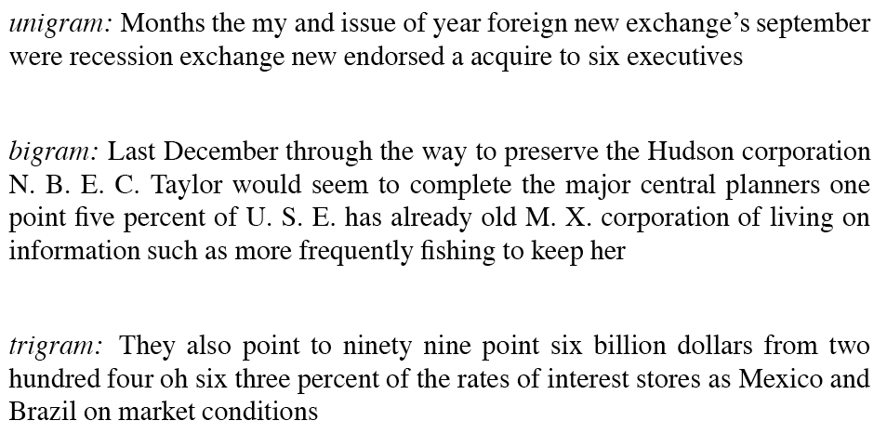
The wall street journal is not shakespeare

Slide 33
Perplexity and Entropy
Information theoretic metrics
  Useful in measuring how well a grammar or language model (LM) models a natural language or a corpus
Perplexity: At each choice point in a grammar or LM, what are the average number of choices that can be made, weighted by their probabilities of occurence? How much probability does a LM(1) assign to the sentences of a corpus, compared to another LM(2)?

Slide 34
Comparison with FSAs
How would ngram modeling be stronger than FSAs?
For what kinds of tasks would each be better?
What about the task of speech recognition?

Slide 35
Some Useful Empirical Observations
A small number of events occur with high frequency
A large number of events occur with low frequency
You can quickly collect statistics on the high frequency events
You might have to wait an arbitrarily long time to get valid statistics on low frequency events
Some of the zeroes in the table are really zeros But others are simply low frequency events you haven't seen yet. How to address?

Slide 36
Some Important Concepts
Smoothing and Backoff : how do you handle unseen n-grams?
Perplexity and entropy: how do you estimate how well your language model fits a corpus once you’re done?

Slide 37
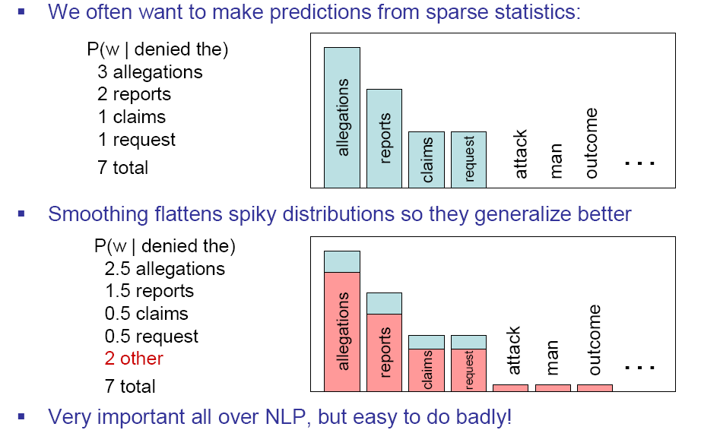
Smoothing is like Robin Hood:
Steal from the rich and give to the poor (in probability mass)
Slide from Dan Klein

Slide 38
Smoothing Techniques
Every n-gram training matrix is sparse, even for very large corpora
  Zipf’s law: a word’s frequency is approximately inversely proportional to its rank in the word distribution list
Solution: estimate the likelihood of unseen n-grams
Problems: how do you adjust the rest of the corpus to accommodate these ‘phantom’ n-grams?

Slide 39
Add-one Smoothing
For unigrams:
  Add 1 to every word (type) count
  Normalize by N (tokens) /(N (tokens) +V (types))
  Smoothed count (adjusted for additions to N) is
  Normalize by N to get the new unigram probability:
For bigrams:
  Add 1 to every bigram c(w_{n-1} w_{n}) + 1
  Incr unigram count by vocabulary size c(w_{n-1}) + V

Slide 40
  Discount: ratio of new counts to old (e.g. add-one smoothing changes the BERP bigram (to|want) from 786 to 331 (d_{c}=.42) and p(to|want) from .65 to .28)
  But this changes counts drastically:
    too much weight given to unseen ngrams
    in practice, unsmoothed bigrams often work better!

Slide 41
Witten-Bell Discounting
A zero ngram is just an ngram you haven’t seen yet…but every ngram in the corpus was unseen once…so...
  How many times did we see an ngram for the first time? Once for each ngram type (T)
  Est. total probability of unseen bigrams as
  View training corpus as series of events, one for each token (N) and one for each new type (T)

Slide 42
  We can divide the probability mass equally among unseen bigrams….or we can condition the probability of an unseen bigram on the first word of the bigram
  Discount values for Witten-Bell are much more reasonable than Add-One

Slide 43
Good-Turing Discounting
Re-estimate amount of probability mass for zero (or low count) ngrams by looking at ngrams with higher counts
  Estimate
  E.g. N₀’s adjusted count is a function of the count of ngrams that occur once, N₁
  Assumes:
    word bigrams follow a binomial distribution
    We know number of unseen bigrams (VxV-seen)

Slide 44
Backoff methods (e.g. Katz ‘87)
For e.g. a trigram model
  Compute unigram, bigram and trigram probabilities
  In use:
    Where trigram unavailable back off to bigram if available, o.w. unigram probability
    E.g An omnivorous unicorn

Slide 45
Class-based Models
Back-off to the class rather than the word
  Particularly useful for proper nouns (e.g., names)
  Use count for the number of names in place of the particular name

Slide 46
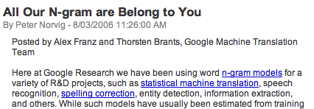

Google N-Gram Release

Slide 47
Google N-Gram Release
serve as the incoming 92
serve as the incubator 99
serve as the independent 794
serve as the index 223
serve as the indication 72
serve as the indicator 120
serve as the indicators 45
serve as the indispensable 111
serve as the indispensible 40
serve as the individual 234

Slide 48
Summary
N-gram probabilities can be used to estimate the likelihood
  Of a word occurring in a context (N-1)
  Of a sentence occurring at all
Smoothing techniques deal with problems of unseen words in corpus
Entropy and perplexity can be used to evaluate the information content of a language and the goodness of fit of a LM or grammar
Read Ch. 5 on word classes and pos

