Slide 1
Testing 1…2…3...
Gail Kaiser, Columbia University
kaiser@cs.columbia.edu
April 18, 2013

Slide 2
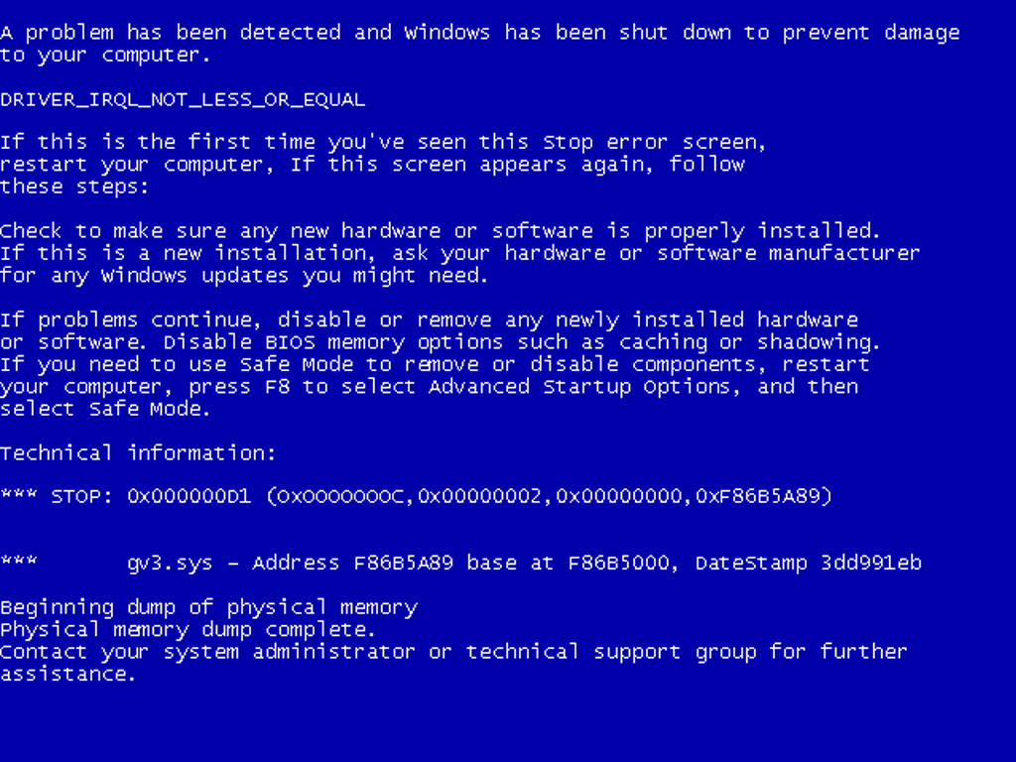
Why do we test programs?

Slide 3
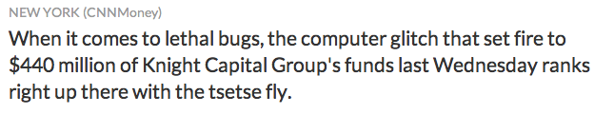
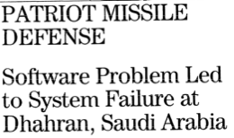
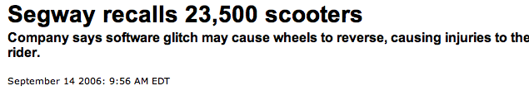
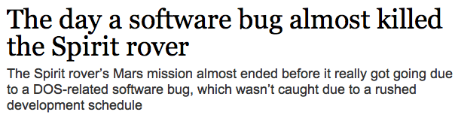
Comair cancels all 1,100 flights, cites problems with its computer
Prius hybrids dogged by software
Report: Internal computer woes reportedly cause autos to stall or shut down at highway speeds.
American Airlines grounds flights after computer outage

Slide 4
How do we know whether a test passes or fails?
2 + 2 = 4
        > Add(2,2)
        > qwertyuiop

Slide 5

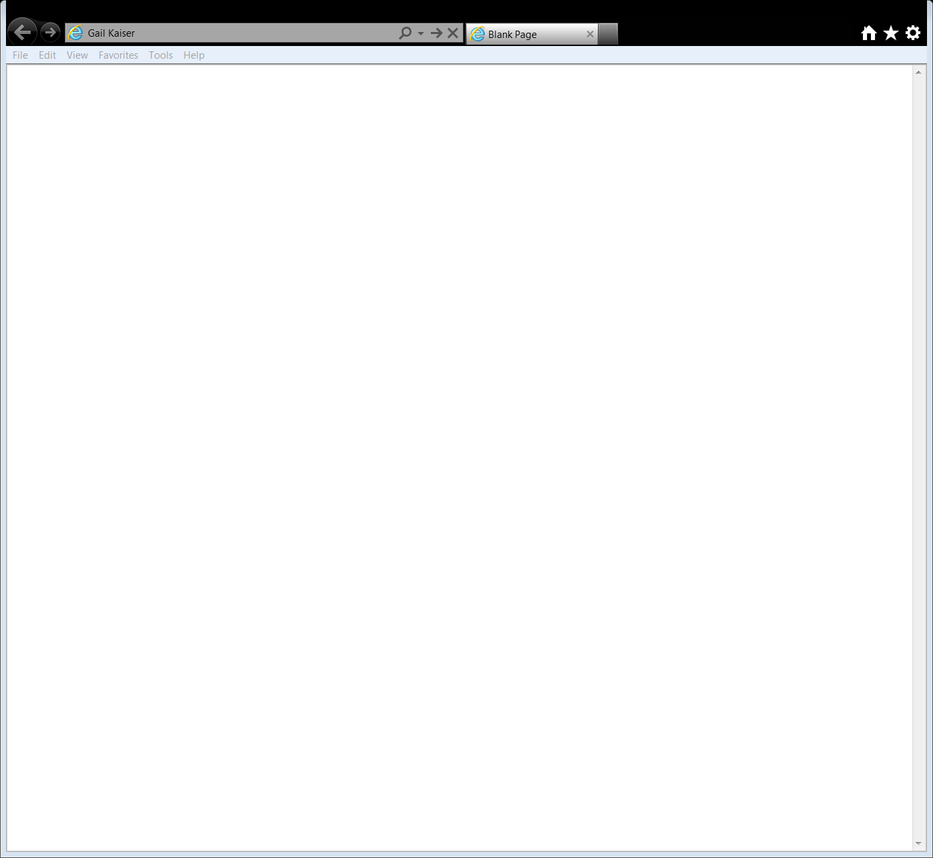
That was simple, let’s try something harder

Slide 6
Why is testing hard?
The correct answer may not be known for all inputs – how do we detect an error?
Even when the correct answer could be known for all inputs, it is not possible to check all of them in advance – how do we detect errors after release?
Users will inevitably detect errors that the developers did not – how do we reproduce those errors?

Slide 7
Problem 1: No test oracle
Conventional software testing checks whether each output is correct for the set of test inputs.
But for some software, it is not known what the correct output should be for some inputs. How can we construct and execute test cases that will find coding errors even when we do not know whether the output is correct?
This dilemma arises frequently for machine learning, simulation and optimization applications, often "Programs which were written in order to determine the answer in the first place. There would be no need to write such programs, if the correct answer were known." [Weyuker, 1982]

Slide 8
Problem 2: Testing after release
Conventional software testing checks whether each output is correct for the set of test inputs.
But for most software, the development-lab testing process can not cover all inputs and/or internal states that can arise after deployment. How can we construct and execute test cases that operate in the states that occur during user operation, to continue to find coding errors without impacting the user?
This dilemma arises frequently for continuously executing on-line applications, where users and/or interacting external software may provide unexpected inputs.

Slide 9
Problem 3: Reproducing errors
Conventional software testing checks whether each output is correct for the set of test inputs.
But for some (most?) software, even with rigorous pre and post deployment testing, users will inevitably notice errors that were not detected by the developer’s test cases. How can we construct and execute new test cases that reproduce these errors?
This dilemma arises frequently for software with complex multi-part external dependencies (e.g., from users or network).

Slide 10
Overview
Problem 1 – testing non-testable programs
Problem 2 – testing deployed programs
Problem 3 – reproducing failures in deployed programs

Slide 11
Problem 1: No test oracle
Conventional software testing checks whether each output is correct for the set of test inputs.
But for some software, it is not known what the correct output should be for some inputs. How can we construct and execute test cases that will find coding errors even when we do not know whether the output is correct?
Test oracles may exist for only a limited subset of the input domain and/or may be impractical to apply (e.g., cyberphysical systems).
Obvious errors (e.g., crashes) can be detected with various testing techniques.
However, it may be difficult to detect subtle computational defects for arbitrary inputs without true test oracles.

Slide 12
Traditional Approaches
Pseudo oracles
  Create two independent implementations of the same program, compare the results
Formal specifications
  A complete specification is essentially a test oracle (if practically executable within a reasonable time period)
  An algorithm may not be a complete specification
Embedded assertion and invariant checking
  Limited to checking simple conditions
f
f(x)
x

Slide 13
Metamorphic Testing
f
f(x)
Initial
test case
x
Transformation
function based on
metamorphic
properties of f
f(x) acts as a
“pseudo-oracle”
for f(t(x))
t
f(t(x))
t(x)
f
New
test case
If new test case output f(t(x)) is as expected, it is not necessarily correct
However, if f(t(x)) is not as expected, either f(x) or f(t(x)) – or both! – is wrong

Slide 14
Metamorphic Testing Approach
Many “non-testable” programs have properties such that certain changes to the input yield predictable changes to the output
That is, when we cannot know the relationship between an input and its output, it still may be possible to know relationships amongst a set of inputs and the set of their corresponding outputs
Test the programs by determining whether these “metamorphic properties” [TY Chen, 1998] hold as the program runs
If the properties do not hold, then a defect (or an anomaly) has been revealed

Slide 15
Metamorphic Runtime Checking
Most research only considers metamorphic properties of the entire application or of individual functions in isolation
We consider the metamorphic properties of individual functions and check those properties as the entire program is running
System testing approach in which functions’ metamorphic properties are specified with code annotations
When an instrumented function is executed, a metamorphic test is conducted at that point, using the current state and current function input (cloned into a sandbox)

Slide 16
Example
Consider a function to determine the standard deviation of a set of numbers
std_dev
Initial
input
a
b
c
d
e
f
s
std_dev
New test
case #1
c
e
b
a
f
d
s
?
std_dev
New test
case #2
2a
2b
2c
2d
2e
2f
2s
?

Slide 17
Model of Execution
Function f is
about to be executed
with input x
The metamorphic test is conducted at
the same point in the program execution
as the original function call
The metamorphic test runs in parallel with
the rest of the application (or later)
Program
continues
Create a
sandbox for
the test
Execute f(x)
to get result
Send result
to test
Transform
input to
get t(x)
Execute
f(t(x))
Compare
outputs
Report
violations
metamorphic test

Slide 18
Effectiveness Case Studies
Comparison:
  Metamorphic Runtime Checking
    Using metamorphic properties of individual functions
  System-level Metamorphic Testing
    Using metamorphic properties of the entire application
  Embedded Assertions
    Using Daikon-detected program invariants [Ernst]
Mutation testing used to seed defects
  Comparison operators were reversed
  Math operators were changed
  Off-by-one errors were introduced
For each program, we created multiple versions, each with exactly one mutation
We ignored mutants that yielded outputs that were obviously wrong, caused crashes, etc.
Goal is to measure how many mutants were “killed”

Slide 19
Applications Investigated
Machine Learning
  Support Vector Machines (SVM): vector-based classifier
  C4.5: decision tree classifier
  MartiRank: ranking application
  PAYL: anomaly-based intrusion detection system
Discrete Event Simulation
  JSim: used in simulating hospital ER
Optimization
  gaffitter: genetic algorithm approach to bin-packing problem
Information Retrieval
  Lucene: Apache framework’s text search engine

Slide 20
Effectiveness Results
Notes:
Metamorphic Runtime Checking is only outperformed in one case (MartiRank), but overall is much more effective, as shown at the bottom.

Slide 21
Contributions and Future Work
Improved the way that metamorphic testing is conducted in practice
  Classified types of metamorphic properties [SEKE’08]
  Automated the metamorphic testing process [ISSTA’09]
Demonstrated ability to detect real defects in machine learning and simulation applications
  [ICST’09; QSIC’09; SEHC’11]
Increased the effectiveness of metamorphic testing
  Developed new technique: Metamorphic Runtime Checking
Open problem: Where do the metamorphic properties come from?

Slide 22
Overview
Problem 1 – testing non-testable programs
Problem 2 – testing deployed programs
Problem 3 – recording deployed programs

Slide 23
Problem 2: Testing after release
Conventional software testing checks whether each output is correct for the set of test inputs.
But for most software, the development-lab testing process can not cover all inputs and/or internal states that can arise after deployment. How can we construct and execute test cases that operate in the states that occur during user operation, to continue to find coding errors without impacting the user?
Re-running the development-lab test suite in each deployment environment helps with configuration options but does not address real-world usage patterns

Slide 24
Traditional Approaches
Self-checking software is an old idea [Yau, 1975]
Continuous testing, perpetual testing, software tomography, cooperative bug isolation
  Carefully managed acceptance testing, monitoring, analysis, profiling across distributed deployment sites
Embedded assertion and invariant checking
  Limited to checking conditions with no side-effects

Slide 25
In Vivo Testing Approach
Continually test applications executing in the field (in vivo) as opposed to only testing in the development environment (in vitro)
Conduct unit-level tests in the context of the full running application
Do so with side-effects but without affecting the system’s users
  Clone to a sandbox (or run “later”)
  Minimal run-time performance overhead

Slide 26
In Vivo Testing
int main ( ) {
...
...
...
foo(x);
test_foo(x);
}

Slide 27
Metamorphic Model of Execution
Function f is
about to be executed
with input x
The metamorphic test is conducted at
the same point in the program execution
as the original function call
The metamorphic test runs in parallel with
the rest of the application (or later)
Program
continues
Create a
sandbox for
the test
Execute f(x)
to get result
Send result
to test
Transform
input to
get t(x)
Execute
f(t(x))
Compare
outputs
Report
violations
metamorphic test

Slide 28
In Vivo Model of Execution
Function f is
about to be executed
with input x
The in vivo test is conducted at
the same point in the program execution
as the original function call
The in vivo test runs in parallel with
the rest of the application (or later)
Program
continues
Create a
sandbox for
the test
Execute f(x)
to get result
Execute
test_f()
Report
violations
in vivo test

Slide 29
Effectiveness Case Studies
Two open source caching systems had known defects found by users but no corresponding unit tests
  OpenSymphony OSCache 2.1.1
  Apache JCS 1.3
An undergraduate student created unit tests for the methods that contained the defects
  These tests passed in “development environment”
Student then converted the unit tests to in vivo tests
  Driver simulated usage in a “deployment environment”
In Vivo testing revealed the defects, even though unit testing did not
  Some defects only appeared in certain states, e.g., when the cache was at full capacity

Slide 30
Performance Evaluation
Each instrumented method has a set probability ρ with which its test(s) will run
To avoid bottlenecks, can also configure:
  Maximum allowed performance overhead
  Maximum number of simultaneous tests
Config also specifies what actions to take when a test fails
Applications investigated
  Support Vector Machines (SVM): vector-based classifier
  C4.5: decision tree classifier
  MartiRank: ranking application
  PAYL: anomaly-based intrusion detection system

Slide 31
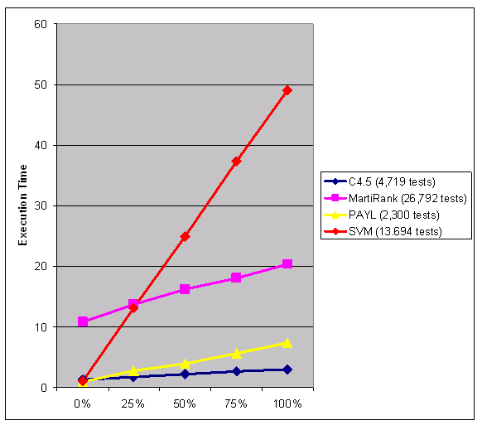
Performance Results

Slide 32
Contributions and Future Work
A concrete approach to self-checking software
  Automated the in vivo testing process [ICST’09]
Steps towards overhead reduction
  Distributed management: Each of the N members of an application community perform 1/Nth the testing [ICST’08]
  Automatically detect previously tested application states [AST’10]
Has found real-world defects not found during pre-deployment testing
Open problem: Where do the in vivo tests come from?

Slide 33
Overview
Problem 1 – testing non-testable programs
Problem 2 – testing deployed programs
Problem 3 – recording deployed programs

Slide 34
Problem 3: Reproducing errors
Conventional software testing checks whether each output is correct for the set of test inputs.
But for some (most?) software, even with rigorous pre and post deployment testing, users will inevitably notice errors that were not detected by the developer’s test cases. How can we construct and execute new test cases that reproduce these errors?
The user may not even know what triggered the bug.

Slide 35


Slide 36
Traditional Approaches
Mozilla Crash Reporter

Slide 37
Traditional Approaches

Slide 38
Traditional Approaches
Log a stack trace at the time of failure
Log the complete execution
  This requires logging the result of every branch condition
  Assures that the execution can be replayed, but has a very high overhead
Log the complete execution of selected component(s)
  Only reduces overhead for pinpoint localization
There are also many systems that focus on replaying thread interleavings

Slide 39
The Problem with Stack Traces
Writes invalid value to disk
Reads from disk
*Crashes*

Slide 40
The Problem with Stack Traces
The stack trace will only show Method 1, 3, and 4 – not 2!
How does the developer discern that the bug was caused by method 2?

Slide 41
Non-determinism in Software
Bugs are hard to reproduce because they appear non-deterministically
Examples:
  Random numbers, current time/date
  Asking the user for input
  Reading data from a shared database or shared files
  Interactions with external software systems
  Interactions with devices (gps, etc.)
Traditional approaches that record this data do so at the system call level – we do so at the API level to improve performance

Slide 42
Chronicler Approach
Chronicler runtime sits between the application and sources of non-determinism at the API level, logging the results
Many fewer API calls than system calls

Slide 43
Model of Execution
Instrument the application to log these non-deterministic inputs and create a replay-capable copy

Slide 44
Chronicler Process

Slide 45
Performance Evaluation
DaCapo real-world workload benchmark
  Comparison to RecrashJ [Ernst], which logs partial method arguments
Computation heavy SciMark 2.0 benchmark
I/O heavy benchmark – 2MB to 3GB files with random binary data and no linebreaks, using readLine to read into a string

Slide 46
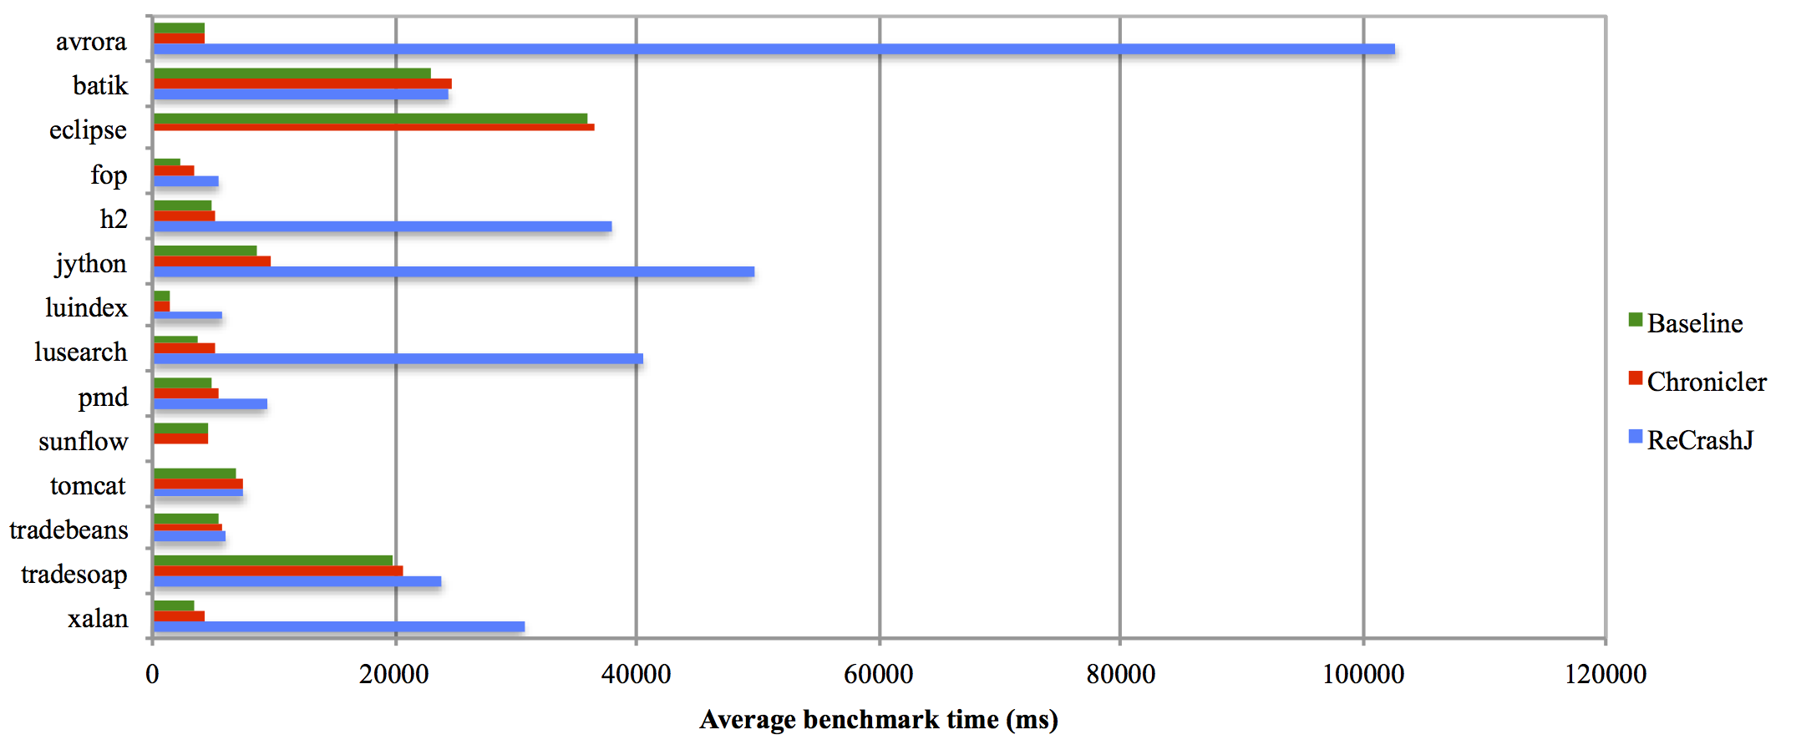
Performance Results

Slide 47
Performance Results
SciMark Benchmark Results (Best Case)
I/O Benchmark Results (Worst Case)

Slide 48
Contributions and Future Work
A low overhead mechanism for record-and-replay for VM-based languages [ICSE ’13]
A concrete, working implementation of Chronicler for Java: ChroniclerJ
  https://github.com/Programming-Systems-Lab/chroniclerj
Open problem: How do we maintain privacy of user data?

Slide 49
Collaborators in Software Reliability Research at Columbia
Software Systems Lab: Roxana Geambasu, Jason Nieh, Junfeng Yang
  With Geambasu: Replay for sensitive data
  With Nieh: Mutable replay extension of Chronicler
  With Yang: Infrastructure for testing distribution
Institute for Data Sciences and Engineering Cybersecurity Center: Steve Bellovin, Angelos Keromytis, Tal Malkin, Sal Stolfo, et al.
  With Malkin: Differential privacy for recommender systems
Computer Architecture and Security Technology Lab: Simha Sethumadhavan
  Adapting legacy code clones to leverage new microarchitectures
Bionet Group: Aurel Lazar
  Mutable record and replay for Drosophila (fruit fly) brain models
Columbia Center for Computational Learning: cast of thousands
  With Roger Anderson: Monitoring smart grid, green skyscrapers, electric cars, …

Slide 50
