Slide 1


Identifying Deceptive Speech Across Cultures
(FA9550-11-1-0120)
PI: Julia Hirschberg (Columbia University)
Co-PI: Andrew Rosenberg (CUNY)
Co-PI: Michelle Levine (Columbia University)
AFOSR Program Review:
Trust and Influence (June 16 – 19, 2014, Arlington, VA)

Slide 2
Research Goals
Initial Research Goals
  Can we detect deception from lexical and acoustic/prosodic cues automatically?
  How do these cues differ across cultures: American, Chinese?
  How do personality factors correlate with differences in ability to deceive or to detect deception?
  How do these differ across cultures?
New Goals:
  Do interviewers who entrain to/ align with interviewees have more success in deception detection?
Notes:
1. Speakers will match the previous turn more closely when they are lying.
2. Speakers will have more trouble identifying lies overall--they'll have more false negatives-- when their interlocutor has a higher overall degree of entrainment (they will trust the interlocutor more).
3. Maybe -- they will be more likely to judge something as truth if it is entrained
4. And maybe they will even be more likely to judge something as a lie if it is disentrained.

Slide 3
Progress Towards Goals (or New Goals)
All sites have IRB approval from all institutions and Air Force Surgeon General
Recorded 122 American and Mandarin speakers (male and female) deceiving and not, using “fake resume” paradigm
Currently transcribing using Amazon Mechanical Turk and aligning transcriptions automatically
Preliminary results:
  Gender, culture, and personality scores all play a role in ability to detect deception and to deceive
  Over all: Success in deception positively correlates with success in detecting deception
Notes:
All institutions had to get DoD addenda initiated or renewed
Total ~ 2.5 years to get everything done

Slide 4
Everyday Lies
Ordinary people tell an average of 2 lies per day
  I’m sorry, can I call you back? I’m talking to my son in Taiwan. (Ballston, 6/17/14).
  In many cultures white lies more acceptable than truth
  Likelihood of being caught is low
  Rewards also low but outweigh consequences of being caught
Not so easy to detect

Slide 5
‘Serious’ Lies
Lies where
  Risks and rewards high
  Emotional consequences (fear, elation) harder to control
  Greater cognitive load
Hypothesis: these are easier to detect
  By humans?
  By machines?

Slide 6
A Definition of Deception
Deliberate choice to mislead
  Without prior notification
  To gain some advantage or to avoid some penalty
Not:
  Self-deception, delusion, pathological behavior
  Theater
  Falsehoods due to ignorance/error

Slide 7
Multiple Dimensions of Deception
  Body posture and gestures (Burgoon et al ‘94)
    Complete shifts in posture, touching one’s face,…
  Microexpressions (Ekman ‘76, Frank ‘03)
    Fleeting traces of fear, elation,…
  Biometric factors (Horvath ‘73)
    Increased blood pressure, perspiration, respiration…other correlates of stress
    Odor
  Changes in brain activation
  Variation in what is said and how (Hirschberg et al ‘05, Adams ‘96, Pennebaker et al ‘01, Streeter et al ‘77)

Slide 8
Our Corpus-Based Approach to Deception Detection
Goal:
  Identify a set of acoustic, prosodic, and lexical features that distinguish between deceptive and non-deceptive speech as well or better than human judges
Method:
  Elicit and record corpora of deceptive/non-deceptive speech
  Extract acoustic, prosodic, and lexical features based on previous literature and our work in emotional speech and speaker id
  Use statistical Machine Learning techniques to train models to classify deceptive vs. non-deceptive speech

Slide 9
Our Previous Work
Columbia/SRI/Colorado Deception Corpus
  Within subject (32 Americans) 25-50m interviews
    Subjects motivated to lie or tell truth about own performance on series of tests (~15h speech)
  Recorded, transcribed, analyzed for ~250 lexical and acoustic-prosodic features
  Machine Learning classifiers ->70% accuracy
    Human performance < chance
    Performance on personality tests correlated with greater success – could this predict individual differences in deceiving behaviors?

Slide 10
Cross Cultural Cues to Deception
Cody et al (1989) compared visual and auditory deception cues of Chinese speaking Mandarin to Western English speakers, finding similarities in verbal cues: shorter responses, fewer errors, less concrete terms but no visual cues
Other cross-cultural studies (Bond et al ‘90, Bond & Atoum ‘00, Al-Simadi ’00) found subjects better able to judge deception within culture than across and some differences in utility of audio vs. visual cues
Cheng & Broadhurst ‘06 found Cantonese more likely to display audio and visual cues to deception when speaking in English
Notes:
Cody: Chinese subjects videotaped in mock interview, where they either told truths or lies (given by the experimenter) about their previous employment history.
Bond et al: Jordanians vs Americans
Bond & Atoum: Indians speaking Marathi vs. speaking english
Al-Simadi: Jordanians vs. Malaysians

Slide 11
Cross cultural studies of beliefs about deceptive behavior: but these beliefs rarely correlate with actual cues (Vrij & Semin ‘96, Zuckerman et al ’81)
Few studies of different cultures speaking common language (e.g. Bond & Atoum) and no objective analysis of differences, only perceptual
Are there objectively identifiable differences in deceptive behavior across cultures, given a common language?

Slide 12
“Fake Resume” Variant, Mandarins and Americans Speaking English
Collected
  Demographics
  Biographical Questionnaire
    Personal questions (e.g. “Who ended your last romantic relationship?”, “Have you ever watched a person or pet die?”)
  NEO FFI
Baseline recordings for each speaker
Lying game with no visual contact
  Monetary motivation, keylogging to provide ground truth, post-session survey
Notes:
Payment scheme:
Interviewers get $1 extra for every answer they judge correctly but lose $1 for each incorrect judgment
Interviewees get $1 extra for every lie they tell that interviewers judge to be true

Slide 13
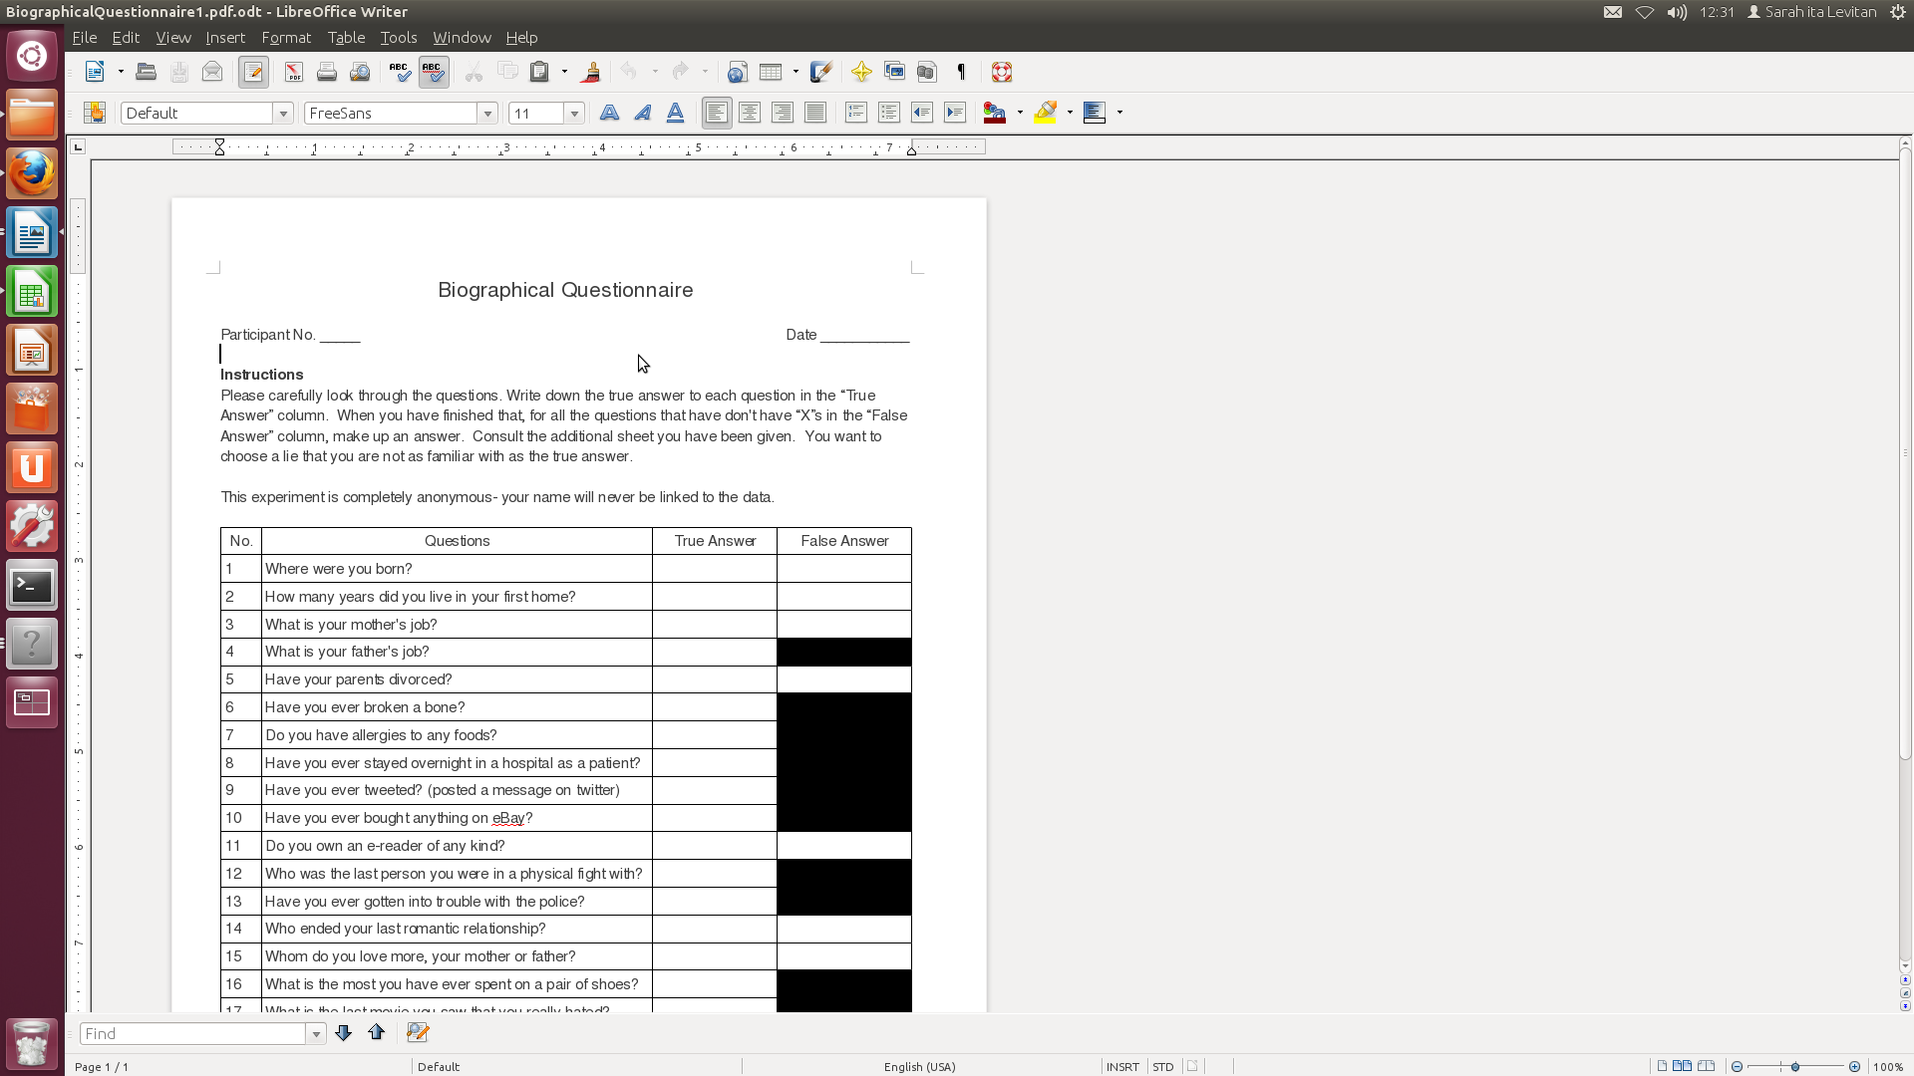
Biographical Questionnaire

Slide 14
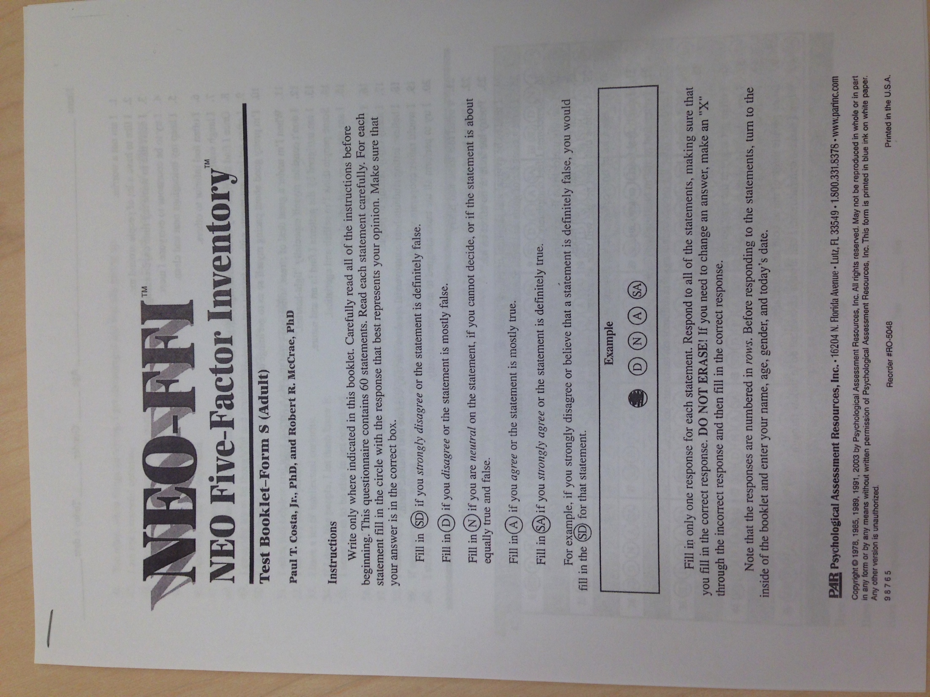
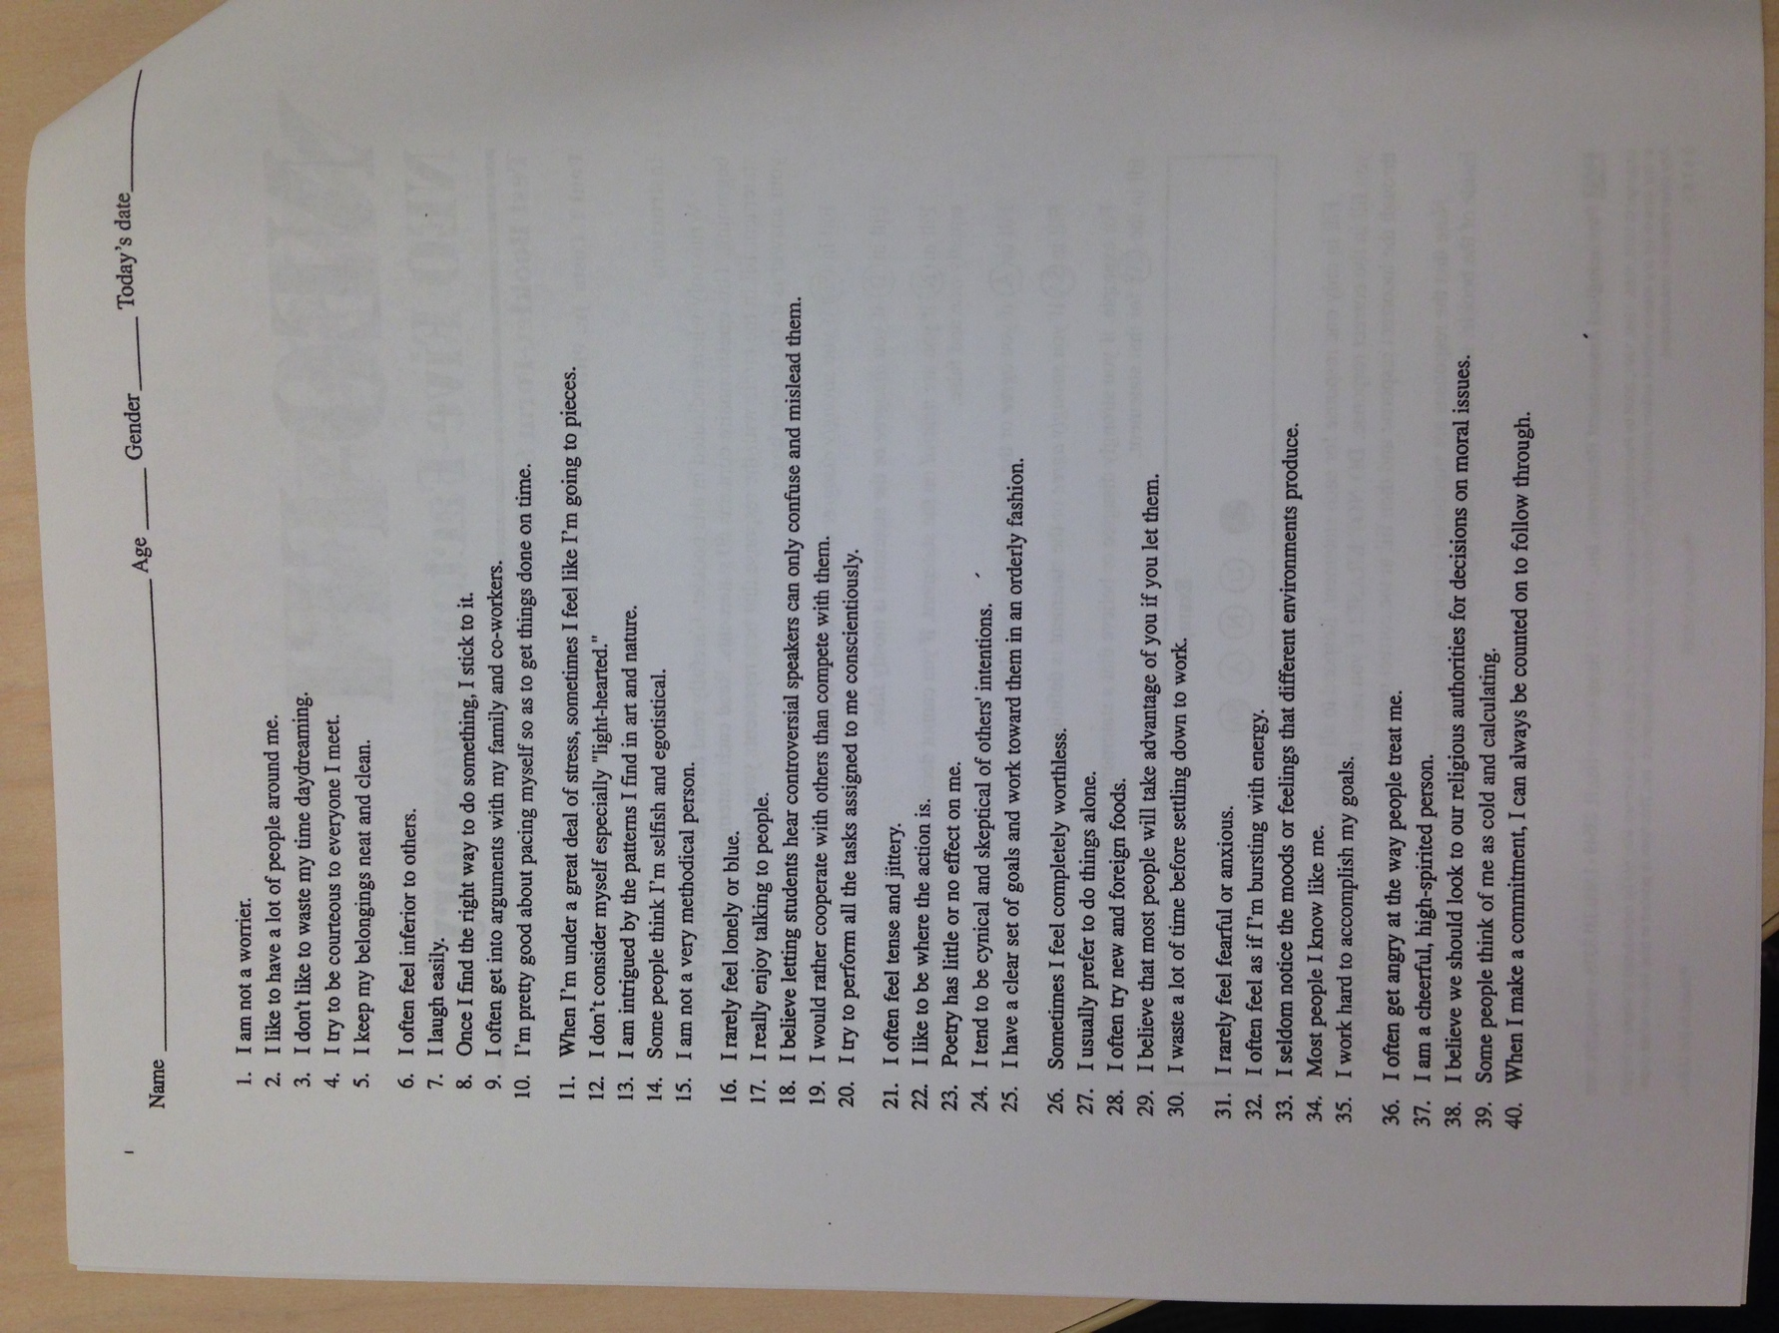
NEO-FFI
Notes:
60-item version of the NEO-PI
Descriptive statements
5 Point Rating (1=strongly disagree to 5=strongly agree)
Five Factors: Neuroticism, Extraversion, Openness, Agreeableness, and Conscientiousness

Slide 15
Five Factors
Openness to Experience: originality, curiosity, ingenuity
  I have a lot of intellectual curiosity
Conscientiousness: orderliness, responsibility, dependability
  I strive for excellence in everything I do.
Extraversion: talkativeness, assertiveness, energy
  I liked to have a lot of people around me.
Agreeableness: good-naturedness, cooperativeness, trust
  I would rather cooperate with others than compete with them
Neuroticism: upsetability, emotional instability
  I often feel inferior to others
Notes:
O: “I have a lot of intellectual curiosity” (53)
C: “I strive for excellence in everything I do.” (60)
E: “I liked to have a lot of people around me.”
A: “I would rather cooperate with others than compete with them” (16)
N: “I often feel inferior to others” (6)

Slide 16
Current status
122 pairs recorded, ~78 hours of speech
AMT orthographic transcription
  Forced alignment to speech
Data logging: T/F, detection scores, confidences
Preliminary analysis
  Significant correlations between personality traits, confidence scores, success at lying or detecting deception

Slide 17
Over All Subjects
Successful deception detection positively correlates with successful lying (n=214, r=.151, p=.028)
Post-session confidence in deception detection judgments positively correlates with successful lying (n=215, r=.158, p=.02)
C-score negatively correlates with number of times guessed T (n=215, r=-.148, p=.03) and positively correlates with number of times guessed F (n=215, r=.145, p=.034)
Notes:
Second bullet is a correlation between # of successful lies and this post-session question:
In your opinion, how many of the judgments that you made today are correct? (Choose the answer that best describes your opinion.) the choices are: 1 2 3 4 5 (almost none, a few, about half, most, almost all)

Slide 18
Across all participants, E-score positively correlates with confidence scores (N=216, r=.134, p=.049)
No difference in scores wrt whether subjects interviewed or were interviewed first

Slide 19
Results by Gender
Across all female participants, O-score negatively correlates with confidence
  n=152, r=-.180, p=.027
Women less confident over all in their judgments than men
No significant findings across all male categories so far, but data currently unbalanced for gender

Slide 20
Results Across All Mandarin Speaking Participants
  N-score negatively correlates with successful lying
    N=94, r=-.298, p=.004 and E-score positively correlates with successful lying
    N=93, r=.225, p=.03
E-score positively correlates with confidence in lies
  N=93, r=.254, p=.014
A-score positively correlates with success in detecting deception
  N=92, r=.222, p=.034
Notes:
A-score findings consistent with our previous findings on American English

Slide 21
Across Female Mandarin Speakers
N-score negatively correlates with successful lying (n=63, r=-.335, p=.007) and A-score positively correlates with successful lying (n=61, r=.274,p=.003)
E-score positively correlates with confidence in lies n=63, r=.334, p=.007
Like all Mandarin speakers in these respects

Slide 22
Across Mandarin Male
A-score negatively correlates with success in lying (n=31, r=-.336, p=.043)

Slide 23
Across Male English Participants
A-score positively correlates with confidence judgment (N=34, r=.362, p=-.036) as does C-score (N=34, r=.035, p=.046)

Slide 24
Across Female English
C-score negatively correlates with successful lying (N=88, r=-.215, p=-.045)

Slide 25
What do we currently find?
Do confidence in judgment correlate with successful judgment of truthful and untruthful statements? No but … they do correlate with success in lying
Are personality traits correlated with successful deception, or judgment of deception? Yes
Are people who are successful at lying also better at judging truthful/untruthful statements? Yes
Do differences in gender and ethnicity/culture play a role in deception production and recognition? Yes
  Differences in confidence by gender
  Differences in correlation of personality traits with success in deceiving and detecting deception
Notes:
Post session confidence in truth/lie judgments positively ocrrelate with success in lying

Slide 26
Remaining Questions
Does duration of session affect outcome? (Do follow up questions help interviewer?)
Are some questions easier to judge or to lie about? (e.g. Yes/no questions, personal questions)
What lexical and acoustic/prosodic cues correlate with deception vs. truth?
  How do these differ by gender and culture?

Slide 27
Transcription
Used Amazon Mechanical Turk to transcribe interviews
  Challenges: cost, speed, quality
  3 transcribers per speech segment
Use Rover approach to find best transcription
  1 its really fun um I go like to a place downtown yeah um
  2 its really fun i go to like a place downtown huh yeah um
  3 it's really fun um I go like to a place downtown yeah um
Result: its really fun um i go like to a place downtown yeah um
Notes:
For quality control, we inserted one quality control audio clips in each HIT. And post 3 assignments for each HIT.
For the cost control, we posted 21 audio clips in one HIT, and pay 0.7$/HIT.

Slide 28
Alignment
Align transcripts with speech using HTK-based forced alignment
  Prosodylab-Aligner: low accuracy on Mandarin speakers
  Penn Phonetics Lab Forced Aligner: picks up the background noise as speech
Currently building our own aligner: trained on native American English and non-native English speech

Slide 29
Future work
Include Arabic-speaking subjects or??
Feature extraction under way
  Acoustic/Prosodic (i.e. duration, speaking rate, pitch, pause)
  Lexico/Syntactic (i.e. laughter, disfluencies, hedges)
Machine learning experiments to identify features significantly associated with deceptive vs. non-deceptive speech
Notes:
Native pakistanis instead of arabic?

Slide 30
Publications or Transitions Attributed to the Grant
Talks at Columbia, Hong Kong University of Science and Technology, UT Dallas
Papers this summer
Many students involved
  Sarah Ita Levitan, Laura Willson, Guozhen An
  Helena Belhumeur, Nishmar Cesteros, Angela Filley, Lingshi Huang, Melissa Kaufman-Gomez,Yvonne Missry, Elizabeth Pettiti, Sarah Roth, Molly Scott, Jenny Senior, Min Sun Song, Grace Ulinski, Christine Wang

