Slide 1

Emotions in Tutoring systems
Confidence and Confusion
Detecting Certainness in Spoken Tutorial Dialogues
Liscombe, Hirschberg & Venditti
Using System and User Performance Features to Improve Emotion Detection in Spoken Tutoring Dialogs
Ai, Litman,Forbes-Riley, Rotaru, Tretreault & Purandare.
- By Satyajeet Shaligram.

Slide 2
Detecting Certainness in Spoken Tutorial Dialogues – Liscombe, Hirschberg et all.
Intelligent tutoring systems:
An intelligent tutoring system (ITS) is any computer system that provides direct customized instruction or feedback to students, i.e. without the intervention of human beings, whilst performing a task.
General trend of moving from text based interactive systems to spoken dialogue systems.
Provides an arena to apply emotion detection in speech!
- What emotions would be particularly interesting?
Auto Tutor online!
Amusement
Contempt
Contentment
Embarrassment
Excitement
Guilt
Pride-in-achievement
Relief
Satisfaction
Sensory pleasure
Shame
Anger
Disgust
Fear
Happiness
Sadness
Surprise

Slide 3
Detecting Certainness in Spoken Tutorial Dialogues – Liscombe, Hirschberg et all.
Important questions to consider:
Do human’s use such (emotional) information when tutoring students?
Does detection of certainness aid in student learning?

Slide 4
Detecting Certainness in Spoken Tutorial Dialogues – Liscombe, Hirschberg et all.
Corpus:
Human-human spoken dialogues collected for the development of ITSPOKE
141 dialogues from 17 subjects (7 female, 10 male)
Student and tutor were each recorded with different microphones and each channel was manually transcribed and segmented into turns
6778 student turns (about 400 turns per subject)
Averaging 2.3 seconds in length

Slide 5
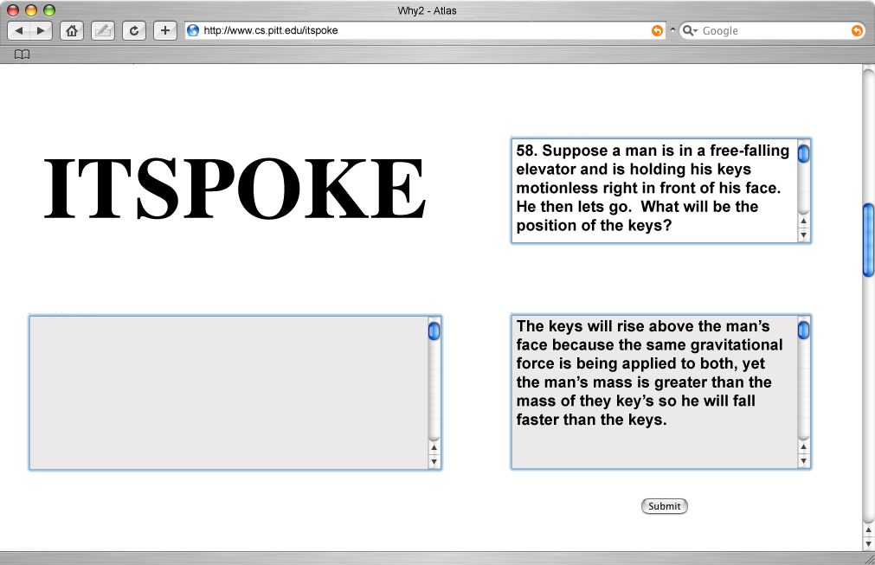

Detecting Certainness in Spoken Tutorial Dialogues – Liscombe, Hirschberg et all.

Slide 6
Detecting Certainness in Spoken Tutorial Dialogues – Liscombe, Hirschberg et all.
Annotation:
Labels used: uncertain, certain, neutral and mixed
Label distribution: 64.2% neutral,
18.4% certain,
13.6% uncertain,
3.8% mixed
Inter-labeler agreement:
Average kappa score = 0.52 (moderate agreement)
The labels used in this study are those from a single labeler?

Slide 7
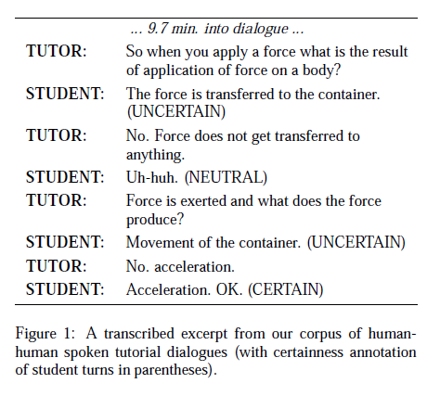

Detecting Certainness in Spoken Tutorial Dialogues – Liscombe, Hirschberg et all.
Sample annotation:

Slide 8
Detecting Certainness in Spoken Tutorial Dialogues – Liscombe, Hirschberg et all.
Tutor responses to student certainness:
Dialogue acts:
Short answer question (ShortAnsQ)
Long answer question (LongAnsQ)
Deep answer question (DeepAnsQ)
Directives (RD)
Restatements or rewordings of student answers (Rst)
Tutor hints (Hint)
Tutor answers in the face of wrong student failure (Bot)
Novel information (Exp)
Review of past arguments (Rcp)
Direct positive feedback (Pos)
Direct negative feedback (Neg)

Slide 9
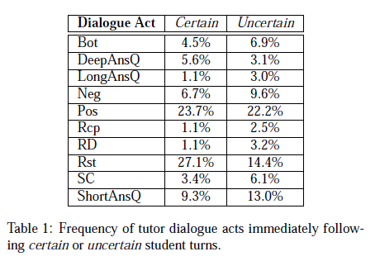
Detecting Certainness in Spoken Tutorial Dialogues – Liscombe, Hirschberg et all.
Tutor responses to student certainness:
Dialogue acts:
Short answer question (ShortAnsQ)
Long answer question (LongAnsQ)
Deep answer question (DeepAnsQ)
Directives (RD)
Restatements or rewordings of student answers (Rst)
Tutor hints (Hint)
Tutor answers in the face of wrong student failure (Bot)
Novel information (Exp)
Review of past arguments (Rcp)
Direct positive feedback (Pos)
Direct negative feedback (Neg)

Slide 10
Detecting Certainness in Spoken Tutorial Dialogues – Liscombe, Hirschberg et all.
Automatically extracted using Praat!
Features:
Turn features:
  57 acoustic-prosodic features
  t_cur – those extracted from the current turn only
    Fundamental frequency, intensity, speaking rate, turn duration etc
    15 in total
  t_cxt -
    42 features in total
    contextual information provided by dialogue history
    Tracks how student prosody changes over time
    rate of change of t_cur features between current and previous turn
    rate of change of t_cur features between current and first turn
    if t_cur features have been monotonically increasing over last 3 turns
    Total count of dialogue turns, preceding student turns etc.

Slide 11
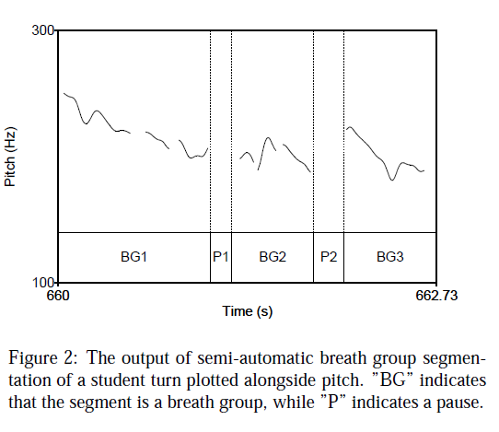
Detecting Certainness in Spoken Tutorial Dialogues – Liscombe, Hirschberg et all.
Features:
Breath group features:
Extraction of smaller, more prosodically coherent segmentation
Roughly approximates intonational phrases
Contiguous segments of speech bounded by silence with a minimum length of 200 ms
Average of 2.5 BGs per student turn
15 features extracted per BG (similar to those in the t_cur features set)

Slide 12
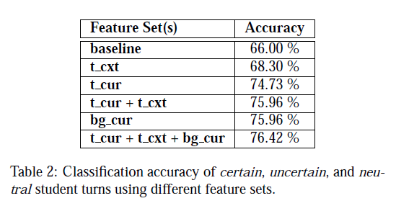
Detecting Certainness in Spoken Tutorial Dialogues – Liscombe, Hirschberg et all.
Classification Experiments:
WEKA machine learning software package
Adaboost using C4.5 decision tree learner
Training 90% (6100) and 10% (687)
Classification task: certain, neutral and uncertain

Slide 13
Detecting Certainness in Spoken Tutorial Dialogues – Liscombe, Hirschberg et all.
Conclusions:
addition of contextual features aids classification
BGs can be reliably predicted using a semi-automated algorithm
bg_cur performed better than turn_cur
Both types of features contain useful information
Future research:
Studying the relationship between the two feature sets
Annotate corpus for certainness for breath groups.
Inclusion of non-acoustic-prosodic features e.g. lexical features

Slide 14
Using System and User Performance Features to Improve Emotion Detection in Spoken Tutoring Dialogs
Ai, Litman,Forbes-Riley, Rotaru, Tretreault & Purandare.

Slide 15
Using System and User Performance Features to Improve Emotion Detection in Spoken Tutoring Dialogs – Ai et all.
Key Idea:
“In an application-oriented spoken dialog system where the user and the system complete some specific task together, we believe that user emotions are not only impacted by the factors that come directly from the dialog, but also by the progress of the task, which can be measured by metrics representing system and user performance.”
Domain or task specific features!
Features used:
Lexical
Prosodic
Identification features
Dialogue acts
Different levels of contextual features

Slide 16
Using System and User Performance Features to Improve Emotion Detection in Spoken Tutoring Dialogs – Ai et all.
Which emotions to detect?
Full blown emotions.
Oudeyer, P., “Novel useful features and algorithms for the recognition of emotions in human speech”, in Proc. Speech Prosody, 2002.
Is this always possible? Relevant?
Is collapsing emotions into simpler categories useful? Easier?

Slide 17
Using System and User Performance Features to Improve Emotion Detection in Spoken Tutoring Dialogs – Ai et all.
Corpus:
100 dialogues
2252 student turns & 2854 tutor turns
20 students (Distribution?)
Using the ITSPOKE tutoring system
Annotation:
4 tags: certain, uncertain, mixed & neutral
mixed + uncertain -> uncertain &
certain + neutral -> ‘not-uncertain’
Kappa for binary distribution = 0.68

Slide 18
Using System and User Performance Features to Improve Emotion Detection in Spoken Tutoring Dialogs – Ai et all.
Classification:
WEKA software toolkit
Adaboost with J48 decision tree
10 fold cross validation
Automatic feature extraction
Features:
Student utterances (treated as bag of words)
automatically extracted prosodic features for pitch, energy duration, tempo, pausing etc.
12 as raw features (from above)
12 as normalized features
24 as running totals and averages

Slide 19
Using System and User Performance Features to Improve Emotion Detection in Spoken Tutoring Dialogs – Ai et all.
System/User performance features:
Subtopics such as <velocity> serve as student performance indicators.
Revisit counts for subtopics
Nested subtopics, as in Grosz & Sidner theory of discourse structure
Depth of a tutoring session, average tutoring depth
Essay revisions -> helps model user satisfaction.
Quality of student answer (correct, incorrect, partially correct)
Percentage of correct answers
Key words counts
Student Pretest scores
Quality of student answers

Slide 20
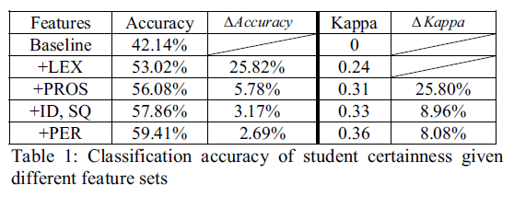
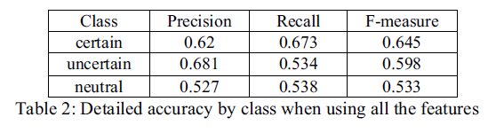
Using System and User Performance Features to Improve Emotion Detection in Spoken Tutoring Dialogs – Ai et all.
Results:

Slide 21
Using System and User Performance Features to Improve Emotion Detection in Spoken Tutoring Dialogs – Ai et all.
Results:
Ai, Litman, Riley… et all (2006)
Liscombe, Hirschberg et al. (2005)

Slide 22
Using System and User Performance Features to Improve Emotion Detection in Spoken Tutoring Dialogs – Ai et all.
Future directions:
System/user performance features can be generalized to information providing dialogue systems e.g. flight booking
dialogue progress -> Number of ‘slots’ filled
prior student knowledge -> past experience
simple sentences -> low expectation
Apply features to human-human tutoring dialogues
What is the best triggering mechanism for allowing a computer tutor to adapt its dialog?

Slide 23
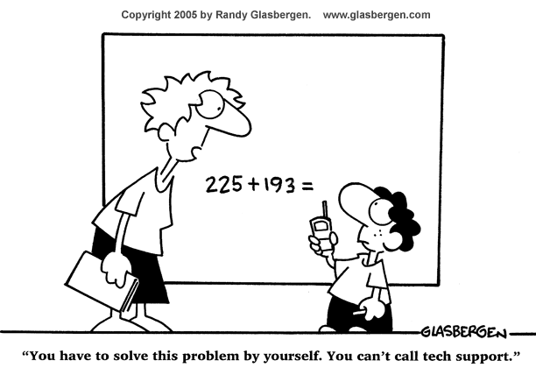
The end…well almost…

Slide 24
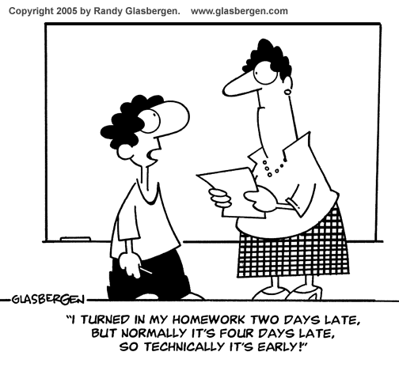
And finally…The end

