Slide 1
Measuring Entrainment in Spontaneous Code-switched Speech
Debasmita Bhattacharya, Siying Ding, Alayna Nguyen, Julia Hirschberg
Notes:
Work that I did with my undergrad collaborators
Fun fact about this work: recently accepted at NAACL so if anyone will be in Mexico City in June, you will get to hear a version of this talk a second time!

Slide 2
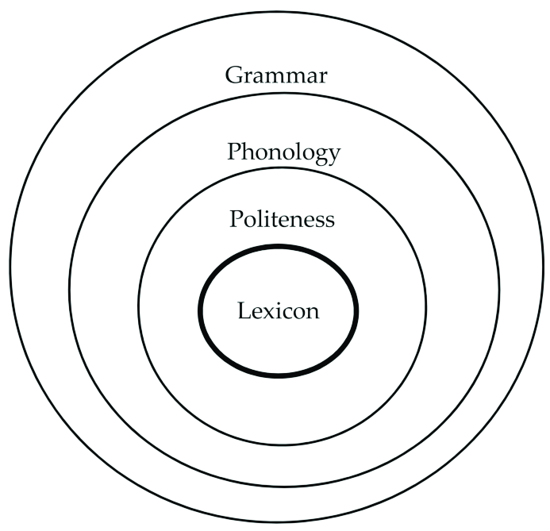
What is entrainment?
Speakers become more like their interlocutors across various dimensions
(= alignment = accommodation = coordination)
Linked to more successful conversations!
Notes:
Dimensions can be acoustic prosodic (speaking rate, loudness, variations in pitch), lexical (specific words that are used in conversation), even gestures of body language.

Slide 3
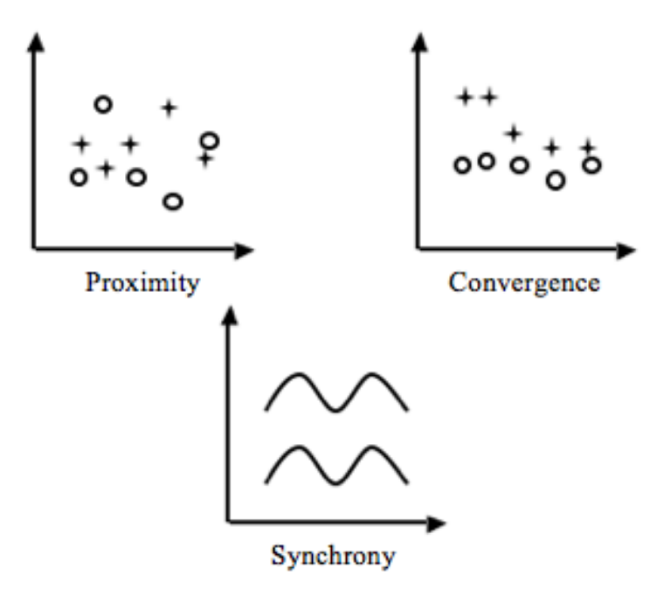
Types of entrainment

Slide 4
What is code-switching?
When a speaker alternates between one or more languages during linguistic communication
Can occur in written or spoken communication
Can involve switching between dialects of the same language
Very common among bilinguals!
puesto de interno .
Dice que le dieron ese ...
internship .
(= He said they gave him this internship.)
Notes:
Let’s start with a definition of code-switching. Code switching happens when a speaker alternates between one language and another during written or spoken linguistic communication. Although I focus on code-switching between distinct languages, it is worth noting that many speakers code-switch between different dialects of the same language, and that in general, code-switching is pretty common among bilinguals.

Slide 5
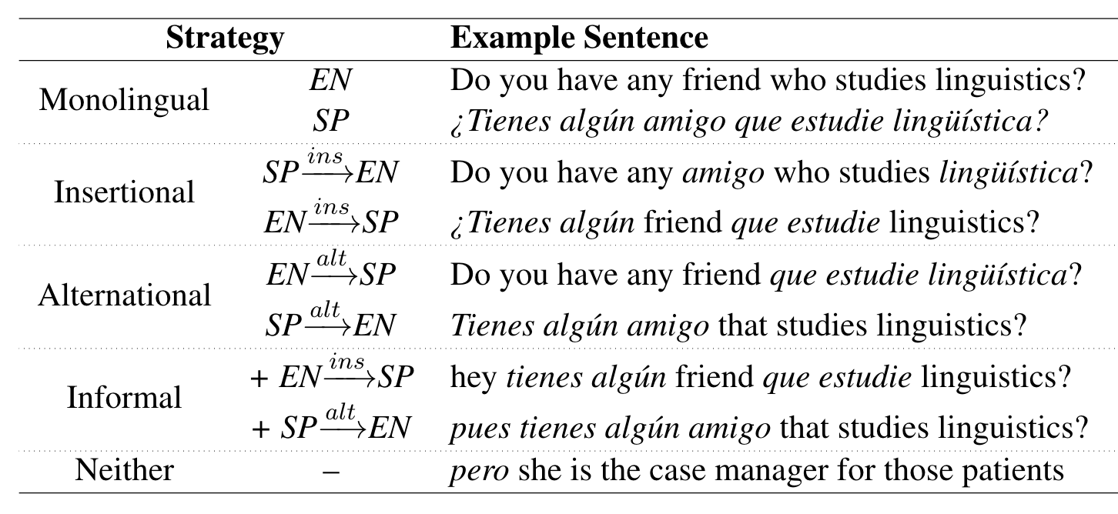
Strategies of code-switching

Slide 6
Motivation
Majority of prior work on entrainment has focused on monolingual written and spoken communication (e.g. Nenkova et al., 2008; Levitan and Hirschberg, 2011)
Couple of recent papers have considered code-switched human-machine communication (Ahn et al., 2020; Parekh et al., 2020)
What about naturalistic, code-switched speech between real people?
Notes:
Human-machine communication → when a virtual dialogue agent generates written code-switches

Slide 7
Research Questions
Do patterns of entrainment in monolingual settings generalize to code-switched settings?
Do patterns of entrainment on code-switching in text — some of which is produced by virtual dialogue agents — generalize to spontaneous code-switching in speech?
Notes:
We can unpack each of these research questions a little bit:
Is entrainment a universal phenomenon of spoken communication? i.e. do the language behaviours we expect in monolingual communication also happen in code-switched communication?
Given that we know previous studies on monolingual spoken communication have found varying degrees of entrainment on acoustic-prosodic and lexical features, and previous work on written code-switched communication (Ahn et al; Parekh et al) has found entrainment on strategies of code-switching. Do these findings, in combination, point to more generalisable truths about code-switched communication in speech?

Slide 8
Corpus
Bangor Talk: Miami corpus
Spanish-English bilingual speech + transcripts
56 conversations (39 code-switched and dyadic)
242,475 words of text
35 hours of recorded conversation

Slide 9
Method
Data annotation
Code-switching strategies: I, A, O
De-noising audio recordings
Statistical analyses to measure entrainment
Lexical features + acoustic-prosodic features + code-switching features
Count-based/probabilistic measures
Proximity v. convergence v. synchrony
Turn-level v. conversation-level
Notes:
proximity at conversation level: need to compare speaker differences with other differences
convergence at conversation level: compare mean differences in first and second half of each conversation
proximity at turn level: compare adjacent and (averaged over 10 randomly selected) non-adjacent (final-initial) turn differences between partners within each conversation
convergence at turn level: for each conversation, calculate pearson r coef for absolute difference between adjacent IPUs versus time
synchrony at turn level: for each conversation, compute pearson's correlation coef between adjacent IPUs

Slide 10
Results: lexical features
Overall language use
Including OOVs: 38 conversations (p =3.58e-19 )
Excluding OOVs: 29 conversations (p = 4.06e-13)
Word sets
Top-100 words in corpus: 39 conversations (p=4.50e-31)
Top-25 words in corpus: 38 conversations (p=3.14e-30)
Affirmative cue words: 39 conversations (p=3.21e-12)
Filler words: 38 conversations (p=2.42e-13)
Notes:
Lower perplexity == better match (train on speaker A, test on speaker B → asymmetric measure)
Prior research suggests that power differentials between speakers and other sociolinguistic factors tend to have an influence on such asymmetric entraining behavior. We suspect that L2 speaker proficiency could additionally play a role in this, although this has not yet been explored, to our knowledge, because existing data sets do not include this information. This is an interesting direction for further work, and we plan to collect the relevant demographic data for inclusion in our future studies of entrainment in code-switching between different language pairs.
Takeaway: statistically significant evidence of lexical entrainment on all word sets and on overall language use in the corpus. Aligns with prior work on entrainment in monolingual domains → promising result! Potentially suggesting that the expected entraining behaviors previously observed in monolingual conversations also occur in code-switched settings, with possible implications for the cross-lingual nature of entrainment as a linguistic phenomenon.

Slide 11
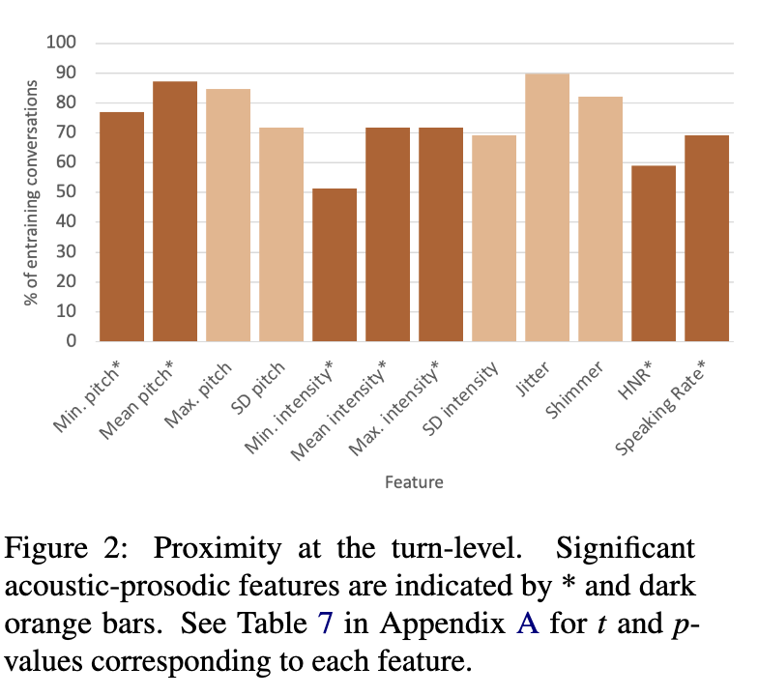
Results: acoustic-prosodic features
Notes:
Mention I am only showing positive and statistically significant results + we can break these down into proximity v. convergence v. synchrony
In terms of proximity at the turn-level, we find that the majority of conversations show statistically significant evidence of entrainment in terms of proximity on the majority of acoustic-prosodic features

Slide 12
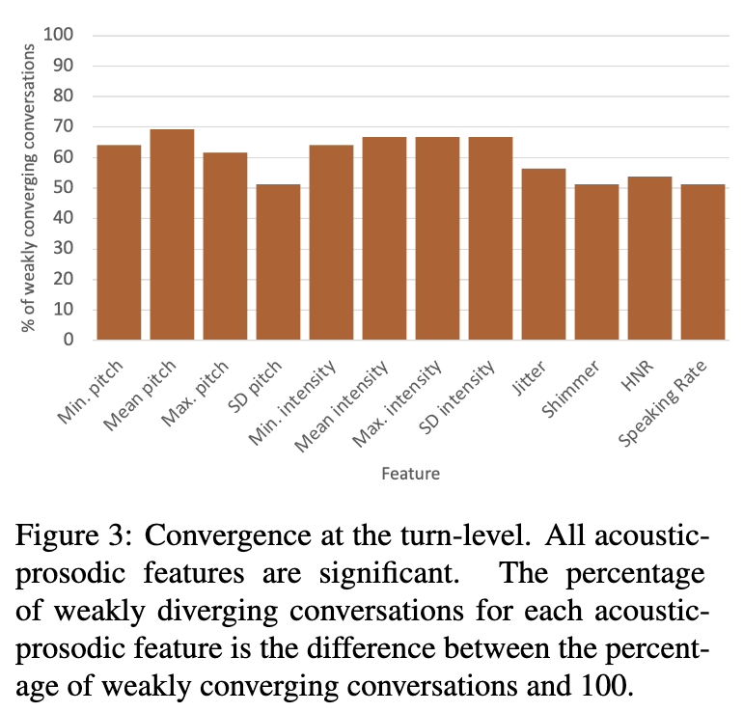
Results: acoustic-prosodic features
Notes:
Similarly, in terms of convergence at the turn-level, the majority of conversations show statistically significant evidence of entrainment in the same direction on all of the acoustic-prosodic features under investigation - note that we define weak convergence in terms of Pearson correlation value between 0 and 0.5.
Takeaway: again, statistically significant evidence of entrainment on the majority of acoustic-prosodic features, in alignment with prior work on entrainment in monolingual settings → promising result! So far, seems like the things we know about entrainment generalise to code-switched language settings.

Slide 13
Results: code-switching features
Binary presence of code-switching
Turn-level proximity: 29 conversations (p = 0.0155)
Conversation-level proximity: 32 conversations (p = 0.0011)
Turn-level synchrony: 21 conversations (p=0.0001)
Amount of code-switching
Turn-level proximity: 33 conversations (p = 0.0314)
Conversation-level proximity: 34 conversations (p = 0.0157)
Strategy of code-switching
Turn-level synchrony: 22 conversations (1.53e-05)
Insertional code-switching
Conversation-level proximity: 29 conversations (p = 0.0011)
Alternational code-switching
Notes:
But do the patterns we’ve seen so far hold true when we look specifically at measures of code-switching?
We generally find consistent evidence of proximity at the turn- and conversation-level on the CSW features of the Bangor Miami conversations. On the presence of CSW, we find turn- and conversation-level proximity and turn-level synchrony. This suggests that speakers are entraining to one another in a way that surfaces as one speaker's choice to code-switch in speech encouraging the other to choose the same and vary in turn.
These results are mirrored in our experiments on the amount of CSW, where we continue to observe that speakers seem to match one another's CSW behavior, specifically in terms of the quantity of code-switched utterances used within a turn, and the variation of the same across turns.
Finally, from our experiments on CSW strategies, we find significant synchrony at the turn-level on insertional CSW, and significant proximity at the conversation-level on alternational CSW. The first of these findings mirrors the trend we see with entrainment on the presence of CSW. Since insertional CSW is a strategy lacking strict syntactic structure, when speakers mimic their interlocutors' variation in CSW in conversation, using insertional CSW is an easy way to achieve this kind of entrainment. This finding also aligns with that of Ahn and colleagues, who similarly found this CSW strategy to show the most entrainment in human-machine written interaction. The second of these findings is more interesting, however, because alternational CSW requires knowledge of both languages' syntax and is by definition the most structured strategy for speakers to employ. This likely makes it easier for interlocutors to notice and mimic in comparison to insertional or other CSW. We particularly highlight this finding because significant evidence of entrainment on alternational CSW has not been found in previous work on written CSW, which suggests that there may be a key difference in how CSW and subsequent entrainment behaviors are produced in the spoken versus written modality.
Takeaway: evidence of proximity at turn- and conversation-level, fairly consistent across code-switching features. Generally finding evidence of proximity is in line with previous work on entrainment in monolingual domains.

Slide 14
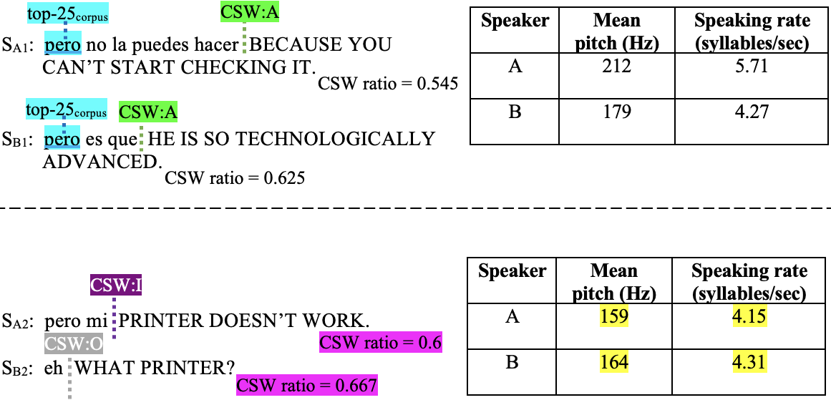
Results: entrainment x gender interaction
Lexical features
FF, MM pairs >>> FM pairs
Acoustic-prosodic features
Turn-level convergence: FF, MM pairs >>> FM pairs
Code-switching features
Conversation-level proximity: FF, MM pairs >>> FM pairs
Turn-level synchrony: FF, MM pairs >>> FM pairs
Notes:
We finally perform a qualitative analysis of our results in relation to the genders of the speakers in conversations that showed significant evidence of entrainment. We particularly distinguish between same-gender (FF or MM) conversations and mixed-gender (FM) conversations. Our comparisons are weighted to account for there being 24 same-gender conversations, but only 15 mixed-gender ones.
Across all three feature sets, we generally find that there are equal or more same-gender conversations than mixed-gender conversations among those conversations that show evidence of entrainment on all lexical features, turn-level convergence on acoustic-prosodic features, conversation-level proximity on all CSW features, and turn-level synchrony on all CSW features. An example conversation snippet from a pair of interlocutors showing some of these entraining characteristics is the interaction here between $S_{A1}$ and $S_{B1}$, who are both female, where we see lexical entrainment on a frequent word and proximity on presence and strategy of CSW.

Slide 15
Results: entrainment x gender interaction
Acoustic-prosodic features
Turn-level proximity: FM pairs >>> FF, MM pairs
Code-switching features
Turn-level proximity: FM pairs >>> FF, MM pairs
Notes:
However, the opposite is true for conversations that show evidence of turn-level proximity on acoustic-prosodic features, and turn-level proximity on CSW features. An example conversation snippet from a pair of interlocutors showing some of these entraining characteristics is the interaction here between $S_{A2}$, who is female, and $S_{B2}$, who is male, where we see proximity on acoustic-prosodic features and presence and amount of CSW.
So, our qualitative gender analysis shows a slight skew toward entrainment taking place in same-gender conversations over mixed-gender ones. Compared to prior work that has considered the role of speaker gender in entrainment behavior, earlier studies found more entrainment in mixed-gender pairs than same-gender pairs, but these were on task-oriented monolingual conversations. Our opposing results may suggest that there are linguistic differences between task-oriented and undirected spontaneous speech, which carry through to differences in entrainment behaviors in these differing conversational settings, but further work is required to confirm or refute this.

Slide 16
Takeaways
Patterns of entrainment from monolingual domains also present in a code-switched setting
Lexical & acoustic-prosodic features
Gender
Entrainment on measures of code-switching too
Exciting implications for “universal” nature of entrainment as a communication phenomenon!

Slide 17
Other CSW research completed…

Slide 18
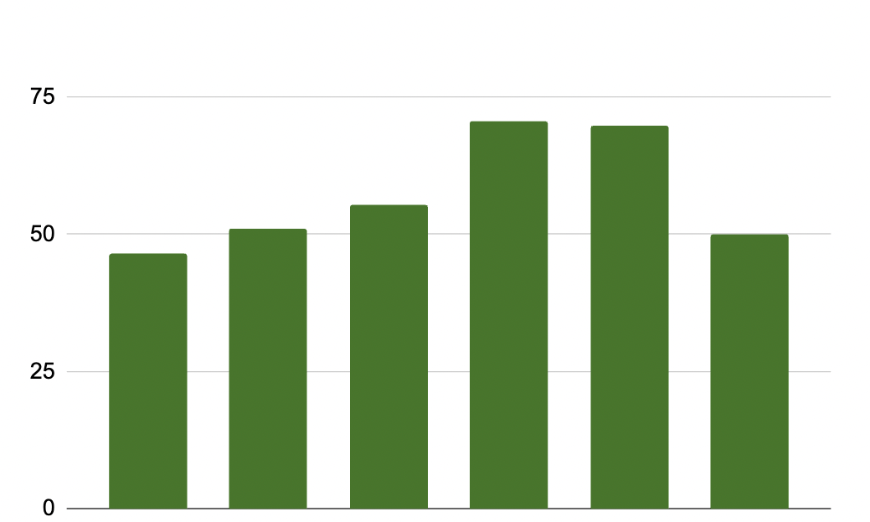
Brief look: CSW and formality
Capturing Formality in Speech Across Domains and Languages
Results: F-score generalizes to lexical representations of speech across languages
Larger F-score ⟹
More
formal
Mean F-score
TED Talks
Fitness videos
Broadcast news
Code-switched
Legal proceedings
Telephone conversations
Notes:
We began by validating F-score as a measure of written formality. We found that the metric seems to generalise when averaged across languages as its value generally increases in more formal domains.

Slide 19
Brief look: CSW and formality
Capturing Formality in Speech Across Domains and Languages
Results: patterns in monolingual data generalize to code-switched contexts
Larger F-score ⟹
More
formal
Mean F-score
TED Talks
Fitness videos
Broadcast news
Code-switched
Legal proceedings
Telephone conversations
Notes:
We largely found that the patterns from our previous sets of findings do generalise. First, the mean F-score for code-switched data is similar to that for telephone conversations, which is the most informal among the domains under consideration.

Slide 20
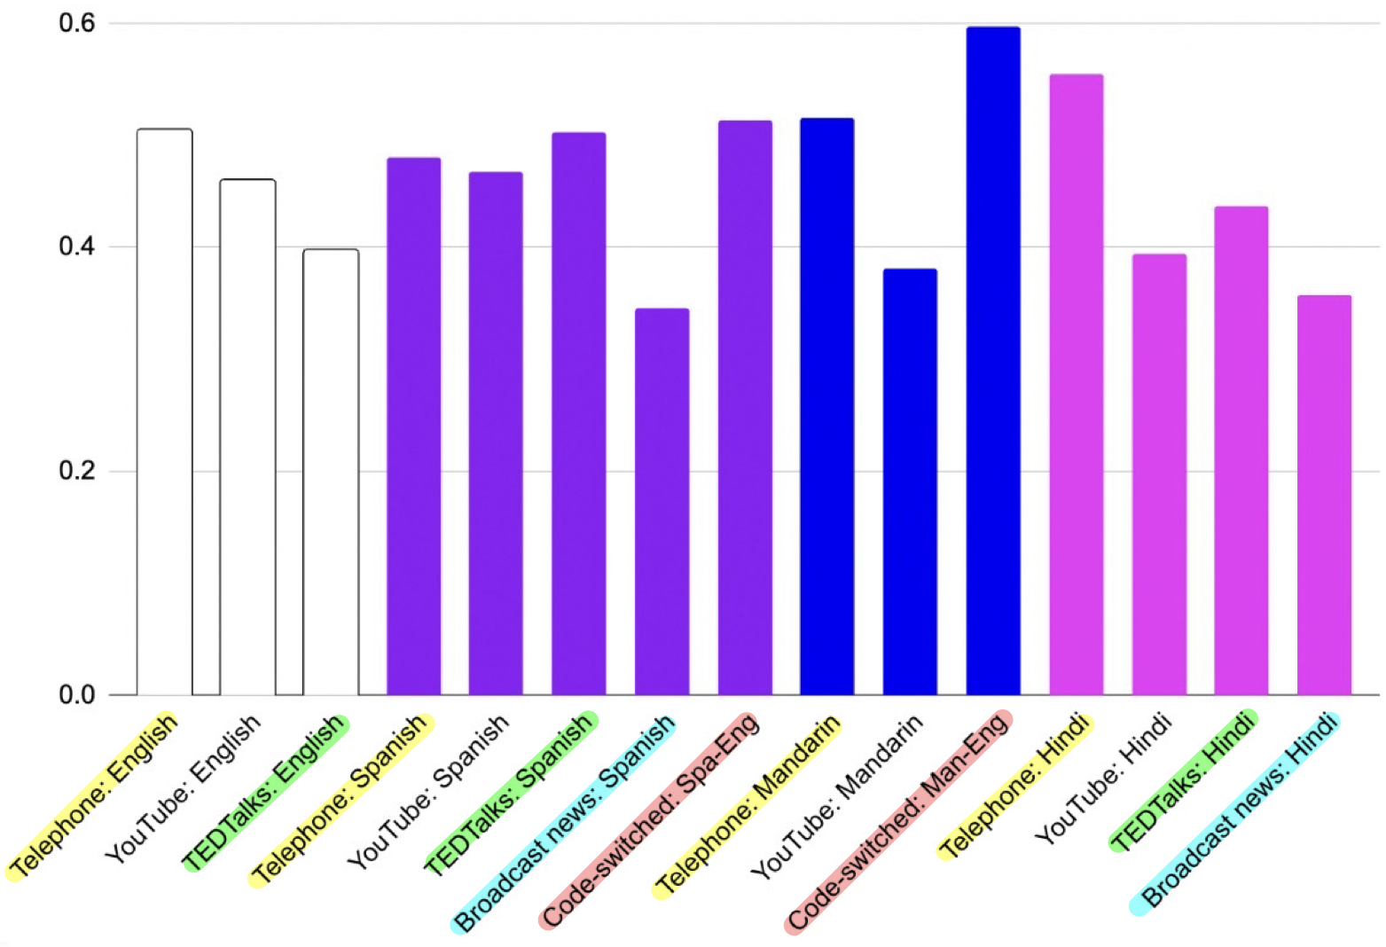
Brief look: CSW and formality
Capturing Formality in Speech Across Domains and Languages
Results: Variation in select acoustic-prosodic features may encode formality across languages
Larger
mean
⟹
More informal
Pausal duration_{mean}
Legend
English
Spanish
Mandarin
Hindi
Notes:
The final promising feature we found was the mean of number of pauses per utterance. In English, the ordering of telephone conversations above TED Talks aligns with our previously found patterns as telephone conversations are more informal than TED Talks. In Spanish, broadcast news having the lowest mean pause rate also makes sense as it is the most formal domain, however the remaining domains are similar to one another, making any distinction between them difficult to find. In Hindi, telephone conversations having the highest mean pause rate and broadcast news having the lowest value, with TED Talks in between, aligns with our expectations.
Overall, the patterns we found here are similar to, but less consistent than, those we uncovered in the written domains. However, our findings largely support previous work that has pointed to the importance of variation in speech variables in encoding formality of spoken language. In particular, we find some evidence of greater variation being linked to greater informality.

Slide 21
Brief look: CSW + formality
Capturing Formality in Speech Across Domains and Languages
Results: patterns in monolingual data generalize to code-switched contexts
Larger
mean
⟹
More informal
Pausal duration_{mean}
Legend
English
Spanish
Mandarin
Hindi
Notes:
Further, across standard deviation in speaking rate, jitter, and shimmer, and mean pause rate, values for the code-switched Spanish-English and Mandarin-English corpora are either greater than or very similar to those for telephone conversations, the most informal of the monolingual domains. For time constraints, I am showing only the slide for pause rate, but this pattern holds across the set of consistent speech features, and is what we would expect since the code-switched data sets are also conversational and are likely around the same level of formality as the telephone conversation data. Overall, we find indications that textual and spoken measures of formality generalise beyond monolingual contexts to code-switched ones.
We also looked at the correlation between text and speech measures for the code-switched corpora. As with the monolingual corpora, we found no correlation between conversation-level F-score and any of the speech variables. This reinforces our finding that patterns of formality in monolingual data generalise to code-switched contexts.

Slide 22
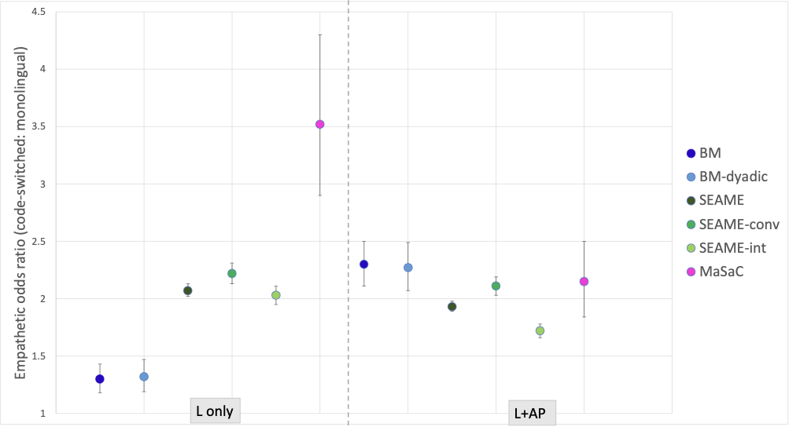
Brief look: CSW and empathy
Results: positive correlation between CSW and empathy in speech
Notes:
Odds that a CSW utterance are empathetic are X times the odds that a monolingual utterance are empathetic
True for both lexical and acoustic prosodic features of empathetic speech

Slide 23
Future CSW research directions
Which dialogue acts tend to be produced most often in CSW?
Understanding motivation for CSW
Generating appropriate and natural CSW responses in text
How does the presence of named entities influence CSW?
Improving CSW prediction
How do bilingual speakers produce intonational contours when performing CSW? Matching one language, the other, both, neither?
Generating natural CSW responses in speech

