Slide 1
Prosodic Entrainment in Dialogue: Language and Social Impact
Julia Hirschberg
Columbia University
COMS 6998

Slide 2
Please Note
The 100-200 word requirement for each reading does not include the title of the reading, i.e. “Week 7, Chapter 14: Positive” – just the paragraphs you write for each positive and for each negative aspect
Also, please remember to post any questions you have on Ed Discussion, not in email to the Tas or to me

Slide 3
Real World Example
Waiting for a long time for the elevator on our floor. Two undergrads talking. One says she is a senior (let's call her Senior) and talks about what she has done this summer and her activities here on campus. Relatively high pitch, a light pleasant voice, normal speed. Other one is younger (let's call her Junior) and is giving opinions on the other person's activities. She has vocal fry/ creaky voice and low pitch and fast speech, which seems to be the norm of the day. As the conversation goes on, Senior gets faster and faster. The last part of it that I heard before they exited the elevator, Senior was now in Junior's pitch range and starting to show vocal fry. (Maxine Eskenazi, 9/13/17)

Slide 4
Entrainment/Alignment/Adaptation: The Chameleon Effect
Speech Accommodation Theory: “In conversation, people tend to adapt their communicative behavior to that of their conversational partner.” (Giles et al ’87)
    Chameleon Effect: Non-conscious mimicry of the postures, mannerisms, facial expressions, and other behaviors of one's interaction partners (Chartrand & Bargh 1999).
    Perception-behavior link: the underlying mechanism for the Chameleon Effect --- “ Unintentional, non-conscious effects of social perception on social behavior” (Chartrand, Maddux, & Lakin, 2005)
Notes:
When we speak with others, we each tend to adapt to our conversational partners way of speaking: in syntax, word choice, pronunciation, and acoustic and prosodic production. This entrainment (also called….) is part of a larger communicative phenomenon which Howard Giles and colleagues describe in Speech Accommodation Theory
Giles, H., Mulac, A., Bradac, J.J. & Johnson, P. Speech accommodation theory: The first decade and beyond. In M. McLaughlin (ed.): Communication Yearbook, 10, Newbury Park, CA, Sage, pp. 13-48, 1987.

Slide 5
Entrainment in Multiple Dimensions
Lexical and syntactic
  Referring expressions: Brennan & Clark, 1992
  High frequency words: Nenkova et al., 2008
  Syntax: Branigan et al., 2000; Reitter et al., 2010
  Linguistic Style Matching: Niederhoffer & Pennebaker, 2002; Danescu-Niculescu-Mizil et al., 2011
  To a computer: Brennan, 1996; Stoyanchev & Stent, 2009
Acoustic/Prosodic
  Response time: Matarazzo & Wiens, 1967; Street, 1984

Slide 6
  Intensity, pitch: Natale, 1975; Gregory et al., 2003; Ward & Litman, 2007
  To a computer: Bell et al., 2003; Coulston et al., 2002
  Intensity, pitch, speaking rate, voice quality, backchannel-inviting cues, pitch contours: Levitan et al. 2011, 2012, 2014, 2015, 2016
  Phonological/Phonetic (Pardo ‘06)
Socio-cultural
  Imperial speaking style on visits to countryside (Azuma ’97)
  Co-teaching (Roth ‘05)
  Jokes and laughter (Bales ‘50, Raganath et al ‘11)

Slide 7
Body language
  Facial expression and gesture (Mauer & Tindall ‘83, Hale & Burgoon ‘84, Chartrand & Bargh ‘99)
  Posture (Condon & Ogston ‘67)
Brain activity
  Brain wave oscillation and speech amplitude (Bosker & Kösem ‘17)

Slide 8
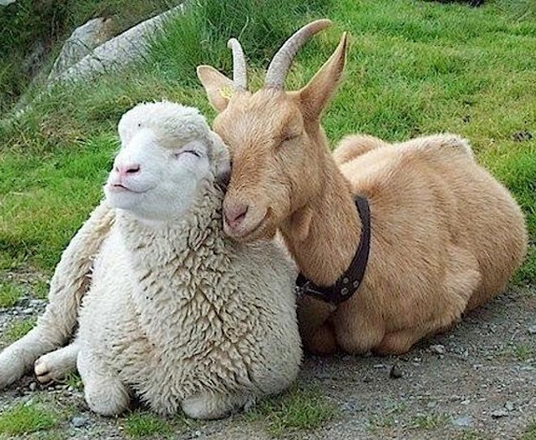
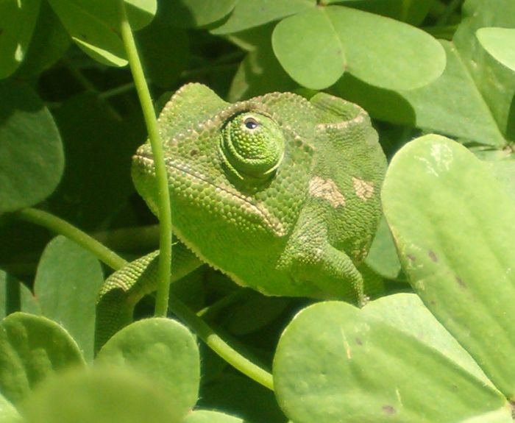
Entrainment theory
Communication Accommodation Theory (Giles et al., 1991)
Communication model (Natale, 1975)
Perception-behavior link (Chartrand & Bargh, 1999)
Interactive Alignment Theory (Pickering & Garrod, 2004)
Social
Automatic
Notes:
Speech Accommodation Theory: “In conversation, people tend to adapt their communicative behavior to that of their conversational partner.” (Giles et al ’87)
Communication mode: entrainment and social desirability: measured vocalizations, pauses, switching pauses
Chameleon Effect: Non-conscious mimicry of the postures, mannerisms, facial expressions, and other behaviors of one's interaction partners (Chartrand & Bargh 1999).
Perception-behavior link: the underlying mechanism for the Chameleon Effect --- “ Unintentional, non-conscious effects of social perception on social behavior” (Chartrand, Maddux, & Lakin, 2005)

Slide 9
Effects on Dialogue Quality
Positive interactions in married couples (Lee et al., 2010)
Score on the Map Task (Reitter and Moore, 2007)
Liking, smooth interaction (Chartrand & Bargh, 1999)
Social desirability (Natale, 1975)
Power (Danescu-Niculescu-Mizil et al., 2012)
Smooth interaction, task success (Nenkova et al, 2008)
Romantic interest (Ireland et al., 2014)
Turn taking, encouraging, trying to be liked (Levitan et al., 2012)

Slide 10
Effects of Entrainment on Social Perception
Subjects who entrain
  Perceived as more socially attractive (Putnam & Street '84, Bourhis et al '75)
  Perceived as more competent (Street '84)
  Conversation perceived as more intimate (Buller & Aune '88)
Entrainment leads subjects to like their conversational partners (and their computers) more and to perceive interactions as more successful (Nass et al ‘95, Chartrand & Bargh ‘99)
Long-term syntactic entrainment is a good predictor of actual task success in Map Task (Reitter et al ’07)
Notes:
From consequences to motivations?

Slide 11
The Columbia Games Corpus (Gravano ‘09)
Initial goal: study prosody of given/new items
  12 spontaneous task-oriented dyadic conversations (9h 8m speech)
  2 subjects play series of computer games, no eye contact (45m 39s mean session time)
  2 sessions per subject, w/different partners
  Multiple games and types
Recorded on separate channels in soundproof booth, digitized and down-sampled to 16k
Features extracted with Praat
Notes:
~73K words
https://aclanthology.org/W09-3936.pdf

Slide 12
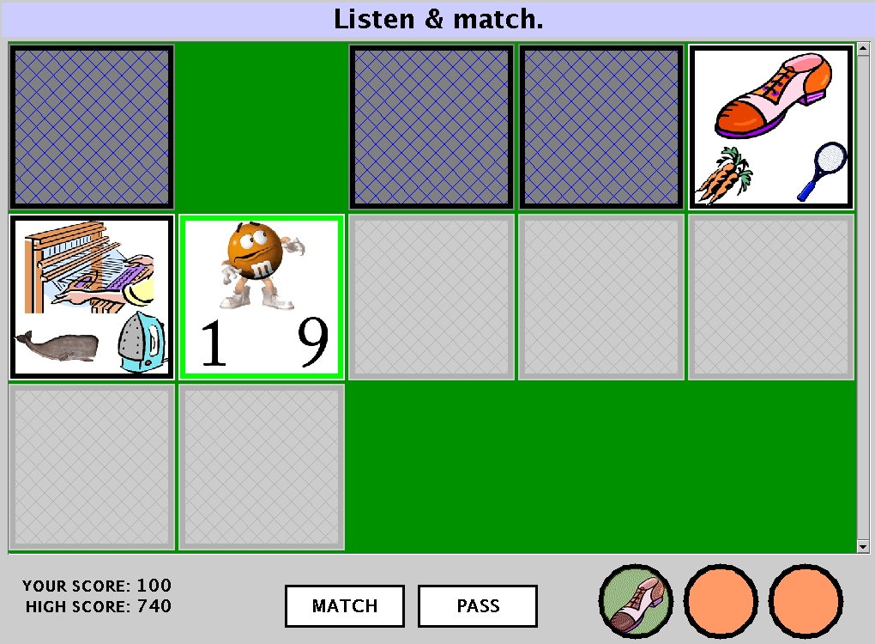
The Cards Game
Notes:
Each participant sees a slightly different version of the game: the goal is to find “cards” that match

Slide 13

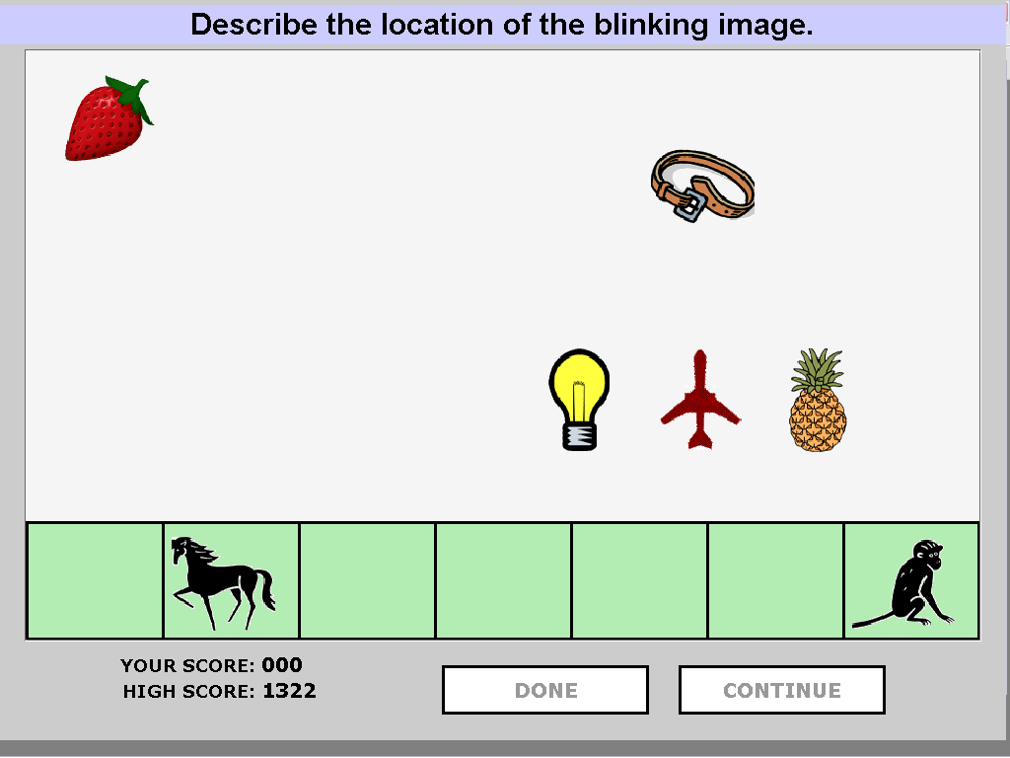
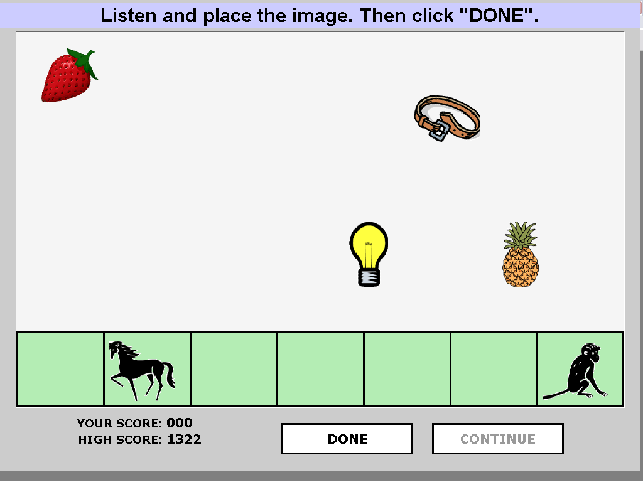

The Objects Game
Describer:
Follower:
Notes:
Speaker is now faculty at Georgia Tech

Slide 14
Units of Analysis
Inter-pausal unit (IPU): Pause-free segment of speech (50ms or more) from a single speaker
speech <silence> speech <silence> speech
Turn: Sequence of speech from one speaker without intervening speech from the other speaker.
Session: Complete interaction between two subjects on one task

Slide 15
Units of Analysis
Inter-pausal unit (IPU): Pause-free segment of speech (50ms or more) from a single speaker
Turn: Sequence of speech from one speaker without intervening speech from the other speaker.
Session: Complete interaction between two subjects on one task
IPU
IPU
IPU

Slide 16
Low Level Prosodic Features
Intensity mean
Intensity max
Intensity min
F0 mean
F0 max
F0 min
speaking rate
Notes:
explain features

Slide 17
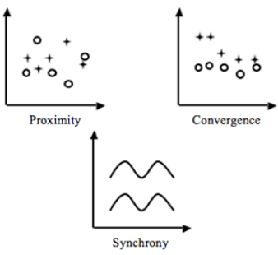
Forms of Entrainment (Levitan & Hirschberg ‘11)
Proximity ---- significant similarity of partner features
Convergence ----significant increase in similarity of partner features over time
Synchrony ---- correlated relative change in partner features
Correcting for Type 1 error (false pos)
Notes:
All significance tests correct for family-wise Type I error (false pos) by controlling the false discovery
rate (FDR) at α = 0.05. The kth smallest p value is considered significant if it is less than
k×α. We also consider a result to approach significance if its uncorrected p value is less n
than 0.05.
http://www.cs.columbia.edu/speech/PaperFiles/2011/p70791.pdf

Slide 18
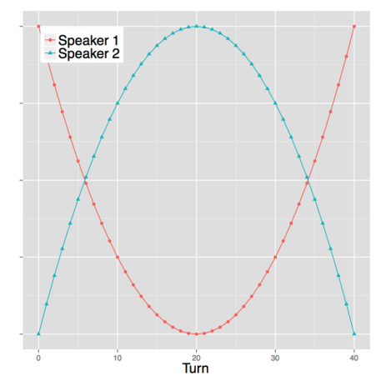
Similarity/Proximity
Global or local?
Exact or relative?
Convergent or constant?
Notes:
All significance tests correct for family-wise Type I error by controlling the false discovery
rate (FDR) at α = 0.05. The kth smallest p value is considered significant if it is less than
k×α. We also consider a result to approach significance if its uncorrected p value is less n
than 0.05.

Slide 19
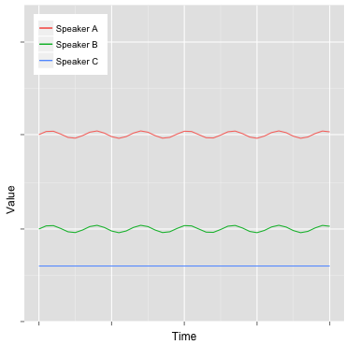
Synchrony
Global or local?
Exact or relative?
Convergent or constant?

Slide 20
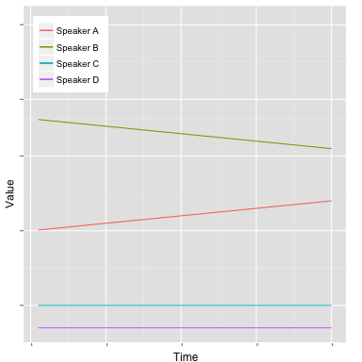
Convergence
Global or local?
Exact or relative?
Convergent or divergent or
constant?
Notes:
the technique here is to look at comparisons where we would expect to see a difference if this type of entrainment exists

Slide 21



Defining Global Pairwise Entrainment
Similarity
Synchrony: positive correlation between partners
Convergence: negative correlation between partners
Partner similarity
Non-partner similarity
Self similarity
Notes:
At the session level, we looked for evidence of proximity using paired t-tests on two sets of differences. For each speaker in a session we calculated a partner difference and an other difference across the session. e.g. for mean pitch. The partner difference was the difference between the speaker’s value for a feature and that of her partner. The other difference was the mean of the differences between the speaker’s value and the values of each of the speakers with whom she was not partnered in any session. Take absolute value and negate to get same score for 3-2 and 2-3.
X = # of All speakers not paired with speaker1 and all not paired with speaker2
We then compare ENTp and ENTx for each feature – is a speaker more similar to their partner than they are to everyone else who is like their partner?
Also measure “self-similarity”: is the speaker more similar to his/her partner than to him/herself in another conversation?
All significance tests correct for family-wise Type I error (false pos) by controlling the false discovery
rate (FDR) at α = 0.05. The kth smallest p value is considered significant if it is less than
k×α. We also consider a result to approach significance if its uncorrected p value is less n
than 0.05.

Slide 22
Local Entrainment: Proximity
IPU
IPU
t_{i}
t_{i+1}
IPU
t_{j}
IPU
t_{k}
IPU
t_{l}
Comparing to 10 random initial IPUs
Notes:
Similarity: We test for local similarity by comparing the similarity at turn exchanges between
adjacent and non-adjacent IPUs (ENTadj and ENTXadj ). If, for a given feature, turn final
IPUs are more similar to the subsequent turn-initial IPUs than to ten other turn initial
IPUs chosen randomly from the same session, we conclude that speakers entrain
locally on that feature, irrespective of their global similarity

Slide 23
Local Entrainment: Synchrony, Convergence
IPU
IPU
t_{i}
t_{i+1}
IPU
IPU
t_{i+1}
t_{i+2}
IPU
IPU
t_{i+2}
t_{i+3}
IPU
IPU
t_{i+3}
t_{i+4}
Notes:
Other ways of of looking at entrainment: synchrony or convergence: compare last IPU of one speaker’s IPU to first IPU of the other
we did these comparisons for SAE and MC
For local synchrony, we measure the Pearson’s correlation between the two sets of values, as proposed by [Edlund et al.,
2009], to test whether interlocutors’ respective acoustic features vary in synchrony even
if they are not similar.
The Pearson correlation coefficient (r) is the most common way of measuring a linear correlation. It is a number between –1 and 1 that measures the strength and direction of the relationship between two variables. When one variable changes, the other variable changes in the same direction.
To test for local convergence, an increase in similarity between interlocutors at turn
exchanges over time, we correlate the difference between adjacent IPUs at turn exchanges
with turn index; a negative correlation is evidence of local convergence

Slide 24
Tongji Games Corpus (Xia et al ’14)
Collaboration with Zihua (Shirley) Xia
  Inspired by our work, she had recorded 115 spontaneous task-oriented sessions
    70 pairs of speakers (40 female, 30 male)
    12 hours of recorded dialogue
    University students with a National Mandarin Test Certificate level 2, grade A or above
Elicited using two games: Picture Ordering (role imbalance), Picture Classifying (cooperative)
We compared entrainment in both corpora
Notes:
Arrives 2013
http://www.cs.columbia.edu/~rlevitan/papers/sp7_submission_125.pdf
Picture Ordering: 1 speaker gives the other instructions on how to order the cards; then change roles
Picture Classifying: speakers work together to decide how to classify the pictures into groups

Slide 25

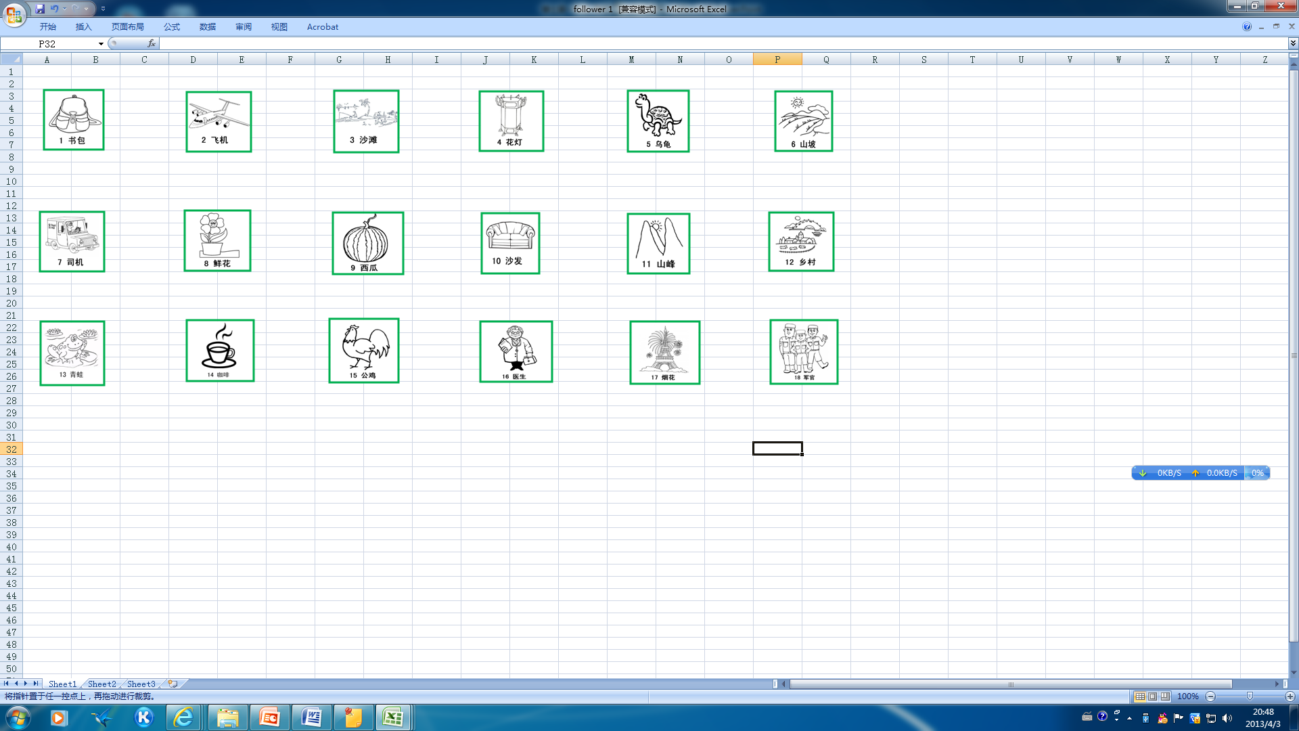

Picture Ordering Game
A
B
Notes:
Assymetric relationships

Slide 26
Picture Classifying Game
A
B
Notes:
Collaborative, symmetric relationships. Worked together to classify pictures into several categories.

Slide 27
Comparing American with Mandarin Partners (Levitan ‘14, Xia et al ‘14)
 | Global similarity |  | Local similarity |  | Synchrony |  | Global convergence |  | Local convergence
Feature | SAE | MC | SAE | MC | SAE | MC | SAE | MC | SAE | MC
Intensity mean | ✓✓ | ✓ | ✓ | ✓ | (✓) | ✓ |  |  | −
Intensity max | ✓(✓) | ✓ | ✓ | ✓ | (✓) | ✓ |  |  | −
Pitch mean |  |  |  |  | − | ✓ |  |  | − | −
Pitch max |  | ✓ |  |  | − | ✓ | ✓ |  | − | −
Jitter |  | − |  | − | − | − |  | − |  | −
Shimmer |  | − |  | − | − | − |  | − |  | −
NHR |  | − | ✓ | − | − | − | ✓ | − |  | −
Speaking rate | ✓ | ✓ |  | ✓ |  |  | ✓ |  |  | −
One check: significant difference from non-partner similarity
Two checks: also significant difference from self similarity
Notes:
One check: significant difference from non-partner similarity
Two checks: also significant difference from self similarity
Local Synchrony tested by Pearson’s correlation to see whether vocal changes are similar even if values are different time
.2-.4 is moderate signif; over .4 is signif
Local Convergence by correlation also, but here we are looking for *negative* values of similarity over
Significant results in Global and Local similarity for both (red), SAE only (blue); synchrony for MC in intensity mean and max, pitch mean and max and some tendencies for SAE; some in SAE Global convergence; less for local convergence in MC (pitch)
Did not look for Global Synchrony

Slide 28
Comparing American with Mandarin Partners (Levitan ‘14, Xia et al ‘14)
 | Global similarity |  | Local similarity |  | Synchrony |  | Global convergence |  | Local convergence
Feature | SAE | MC | SAE | MC | SAE | MC | SAE | MC | SAE | MC
Intensity mean | ✓✓ | ✓ | ✓ | ✓ | (✓) | ✓ |  |  | −
Intensity max | ✓(✓) | ✓ | ✓ | ✓ | (✓) | ✓ |  |  | −
Pitch mean |  |  |  |  | − | ✓ |  |  | − | −
Pitch max |  | ✓ |  |  | − | ✓ | ✓ |  | − | −
Jitter |  | − |  | − | − | − |  | − |  | −
Shimmer |  | − |  | − | − | − |  | − |  | −
NHR |  | − | ✓ | − | − | − | ✓ | − |  | −
Speaking rate | ✓ | ✓ |  | ✓ |  |  | ✓ |  |  | −
One check: significant difference from non-partner similarity
Two checks: also significant difference from self similarity
Notes:
One check: significant difference from non-partner similarity
Two checks: also significant difference from self similarity
Local Synchrony tested by Pearson’s correlation to see whether vocal changes are similar even if values are different time
.2-.4 is moderate signif; over .4 is signif
Local Convergence by correlation also, but here we are looking for *negative* values of similarity over
http://www.cs.columbia.edu/speech/ThesisFiles/rivka_levitan.pdf
Significant results in Global and Local similarity for both (red), SAE only (blue); synchrony for MC in intensity mean and max, pitch mean and max and some tendencies for SAE; some in SAE Global convergence; less for local convergence in MC (pitch)

Slide 29
Entrainment in Different Languages and Situations
Standard American English (SAE) vs. Mandarin Chinese (MC) showed surprising similarities on multiple metrics
Similarity
  Global : similar intensity, rate
  Local: similar intensity
Synchrony
  Stronger synchrony for MC (intensity, pitch)
Convergence
  Global for SAE only (pitch, NHR, rate)
  Stronger local convergence for MC (pitch)
Notes:
Over all…

Slide 30
Theories of Entrainment and Gender
Dominance
  Male Dominance Hypothesis
  Communication Accommodation Theory
Perception
  Perception-Behavior Link
  Female perceptual sensitivity
Notes:
Finally, we did a study of entrainment and gender differences.
The related theories are the Male Dominance Hypothesis and Communication Accommodation Theory
The male dominance hypothesis states that differences in speech between men and women occur because of men’s dominant position in society.
CAT states that when there is an imbalance of power between speakers, the less
dominant speaker will entrain more.
The Perception behavior link proposes that perceiving something makes people more likely to mimic it.
And females are known to be more sensitive to perceived differences in speech.

Slide 31
Predictions and Previous Work
  Predictions
    In MF conversations, females should entrain more.
    There should be more entrainment in FF conversations than MM conversations.
  Previous work
    Bilous and Krauss (1988)
    Namy et al. (2002)
    Pardo (2006)
Notes:
Predictions made by these theories: in MFconversations, females should entrain more. There should be more entrainment in FF conversations than MM conversations. Previous literature has found support and counter evidence for all theories

Slide 32
Partner vs. Non-Partner Differences
X = set of speakers of the same gender and role as speaker1’s partner who are never paired with speaker1.
Notes:
again, we calculate partner similarity and non-partner similarity

Slide 33
Entrainment and Gender
Feature | FF |  | MM |  | FM
 | MC | SAE | MC | SAE | MC | SAE
Intensity mean | ✓ | ✓ |  | ✓ | ✓ | ✓
Intensity max | ✓ | ✓ |  | ✓ | ✓ | ✓
Intensity min |  | -- |  | -- |  | --
F0 mean |  |  |  |  | ✓ | ✓
F0 max |  |  |  |  | ✓ | ✓
F0 min |  | -- |  | -- |  | --
Speaking rate | ✓ | ✓ | ✓ | ✓ | ✓ | ✓
Notes:
Here are the results of our analyses. More entrainment in FM than in FF and then even less in MM where there are also differences between language

Slide 34
Entrainment and Gender
Feature | FF |  | MM |  | FM
 | MC | SAE | MC | SAE | MC | SAE
Intensity mean | ✓ | ✓ |  | ✓ | ✓ | ✓
Intensity max | ✓ | ✓ |  | ✓ | ✓ | ✓
Intensity min |  | -- |  | -- |  | --
F0 mean |  |  |  |  | ✓ | ✓
F0 max |  |  |  |  | ✓ | ✓
F0 min |  | -- |  | -- |  | --
Speaking rate | ✓ | ✓ | ✓ | ✓ | ✓ | ✓
Notes:
we find that mixed-gender pairs entrain on every single feature except f0 and intensity
min; and the pattern is very similar in Mandarin and English.

Slide 35
Entrainment and Gender
Feature | FF |  | MM |  | FM
 | MC | SAE | MC | SAE | MC | SAE
Intensity mean | ✓ | ✓ |  | ✓ | ✓ | ✓
Intensity max | ✓ | ✓ |  | ✓ | ✓ | ✓
Intensity min |  | -- |  | -- |  | --
F0 mean |  |  |  |  | ✓ | ✓
F0 max |  |  |  |  | ✓ | ✓
F0 min |  | -- |  | -- |  | --
Speaking rate | ✓ | ✓ | ✓ | ✓ | ✓ | ✓
Notes:
female pairs entrain on everything except intensity min and F0 features;
and the pattern is very similar in Mandarin and English.
For the prediction that female pairs entrain the most – we don’t find support for that.

Slide 36
Entrainment and Gender
Feature | FF |  | MM |  | FM
 | MC | SAE | MC | SAE | MC | SAE
Intensity mean | ✓ | ✓ |  | ✓ | ✓ | ✓
Intensity max | ✓ | ✓ |  | ✓ | ✓ | ✓
Intensity min |  | -- |  | -- |  | --
F0 mean |  |  |  |  | ✓ | ✓
F0 max |  |  |  |  | ✓ | ✓
F0 min |  | -- |  | -- |  | --
Speaking rate | ✓ | ✓ | ✓ | ✓ | ✓ | ✓
Notes:
male pairs only entrain in speaking rate in Mandarin, while they entrain more on intensity and duration in English.

Slide 37
Conclusions
Mixed gender pairs entrain the most, in Mandarin Chinese and in SAE
Female/female pairs come next and then male/male
MM << FF << MF
Similar patterns for Mandarin Chinese and SAE
Notes:
what’s really interesting is that we find a very similar pattern in English and Mandarin: mixed-gender pairs entrain the most, then female pairs, then male pairs.
in both number of features entrained on and degree of entrainment: males entrain the least, mixed-gender entrain the most.
theories of dominance are not supported, theories of perception partially supported.

Slide 38
Social Dimensions of Entrainment (Levitan et al 2012)
Recall that subjects who entrain are
  Perceived as more socially attractive (Putnam & Street '84, Bourhis et al '75)
  Perceived as more competent (Street '84)
  Speech perceived as more intimate (Buller & Aune '88)
Entrainment leads subjects to like their conversational partners (and their computers) more and to perceive interactions as more successful (Nass et al ‘95, Chartrand & Bargh ‘99)
Long-term syntactic entrainment a good predictor of actual task success in the Map Task (Reitter et al ’07)
Notes:
http://www.cs.columbia.edu/speech/PaperFiles/2012/N12-1002.pdf

Slide 39
Annotation of Social Variables
Amazon Mechanical Turk workers labeled 168 Columbia Games Corpus object games
Answered following questions about partners
  Does s/he believe s/he is better than his/her partner?
  Making it difficult for his/her partner to speak?
  Seem engaged in the game?
  Seem to dislike his/her partner?
  Is s/he bored with the game?
  Directing the conversation?
  Frustrated with his/her partner?
Notes:
Native speakers, paid $.30 per hit. Each hit an entire objects game. Examined conversations with 5 raters rating yes or no for each question. Score is # who said “yes” to question.

Slide 40
  Encouraging his/her partner?
  Trying to dominate the conversation?
  Making him/herself clear?
  Planning what s/he is going to say?
  Polite?
  Trying to be liked
Questions about the conversation
  Does it flow naturally or is it awkward?
  Are the participants having trouble understanding each other?
  Which person do you like more?
  Who would you rather have as a partner?

Slide 41
Hypotheses from Literature
Communication Accommodation Theory
  Giving encouragement: positively correlated with entrainment
  Conversational awkwardness: negatively correlated with entrainment
Similarity-Attraction Theory
  Trying to be liked: positively correlated?
Dependency Over-Accommodation occurs when an interlocutor appears to be trying to dominate or control the conversation: excessive entrainment (West & Turner, 2009).
Notes:
Based on Communication Accommodation Theory, we would expect gives encouragement,
a variable representing a desirable social characteristic,
to be positively correlated with entrainment.
Conversely, conversation awkward should be
negatively correlated with entrainment. We note that
trying to be liked is negatively correlated with the
like more variable in our data – that is, annotators
were less likely to prefer speakers whom they perceived
as trying to be liked. This reflects the intuition
that someone overly eager to be liked may
be perceived as annoying and socially inept. However,
similarity-attraction theory states that similarity
promotes attraction, and someone might therefore
entrain in order to obtain his partner’s social
approval. This idea is supported by Natale’s finding
that the need for social approval is predictive
of the degree of a speaker’s convergence on intensity
(Natale, 1975). We can therefore expect trying
to be liked to positively correlate with entrainment.
Speakers who are perceived as trying to dominate
may be overly entraining to their interlocutors in
what is sometimes called “dependency over-accommodation.”
Dependency over-accommodation causes
the interlocutor to appear dependent on the speaker
and gives the impression that the speaker is controlling
the conversation (West & Turner, 2009).

Slide 42
Findings vs. Hypotheses
From Communication Accommodation Theory
  Perceiving to be giving encouragement: positively correlated with entrainment
  Perceived conversational awkwardness: (in fact, a weak positive correlation)
Based on Similarity-Attraction Theory
  Perceived as trying to be liked: positively correlated (but raters dis-preferred these speakers)
  No correlation between perceived dominance and entrainment: no Dependency-Over-Accommodation?
Notes:
Based on Communication Accommodation Theory, we would expect gives encouragement,
a variable representing a desirable social characteristic, to be positively correlated with entrainment.
Conversely, conversation awkward should be negatively correlated with entrainment. We note that
trying to be liked is negatively correlated with the like more variable in our data – that is, annotators
were less likely to prefer speakers whom they perceived as trying to be liked. This reflects the intuition
that someone overly eager to be liked may be perceived as annoying and socially inept. However,
similarity-attraction theory states that similarity promotes attraction, and someone might therefore
entrain in order to obtain his partner’s social approval. This idea is supported by Natale’s finding
that the need for social approval is predictive of the degree of a speaker’s convergence on intensity
(Natale, 1975). We can therefore expect trying to be liked to positively correlate with entrainment.
Features entrained on differed to some extent based on gender of speakers…Speakers who are perceived as trying to dominate
may be overly entraining to their interlocutors in what is sometimes called “dependency over-accommodation.”
Dependency over-accommodation causes the interlocutor to appear dependent on the speaker
and gives the impression that the speaker is controlling the conversation (West & Turner, 2009).

Slide 43
Entrainment in Higher Level Prosodic Features (Gravano et al ‘14)
ToBI annotation of Columbia Games Corpus
  Three expert labelers using the ToBI conventions:
  Tonal tier: targets in the F0 contour
    Pitch accents: H*, L*, L+H*, L*+H, H*+L, downstep
    Phrase accents: H-, L-, !H-
    Boundary tones: H%, L%.
  Orthographic tier: time-aligned words
  Break index tier: degrees of juncture (0-4)
  Misc tier: laughs, disfluencies, etc.

Slide 44
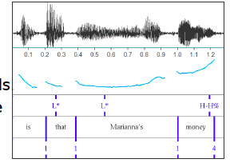

Slide 45
Entrainment on Pitch Contours and Social Variables (Gravano et al ’14, ‘15)
Measures of contour similarity between speakers: when I use contour X are you more likely to do the same?
  Perplexity of language models of sequences trained on Speaker A and used to model prosodic sequences of Speaker B: low perplexity indicates greater similarity
  Levenshtein distance of similar intonational phrase contours used by Speaker A and Speaker B: low values show similar contours are uttered closer together
  Kullback-Leibler divergence between contours of Speaker A and Speaker B: low values show that one is a subset of the other
How similar are Speaker A’s contours to Speaker B’s?
Notes:
http://www.cs.columbia.edu/speech/paperFiles/2014/entrain-final-submission.pdf
Low perplexity indicates similarity – less difference between prosodic contours
Levenshtein distance represents similarity of contours uttered one after the other
Kullback-Leibler divergence also shows similarity of contours uttered one after the other

Slide 46
ε1 Measure: N-Gram Perplexity
How well does a prosodic model trained on A predict B’s prosody?
  SpkrA: L* L-H% H* H-L% ...
  SpkrB: H* !H* H- L* H-H% ...
  TRAIN TRIGRAM
  MODEL TEST ε1(A, B) = −(Perplexity of A's model on B's productions)
  Lower perplexity means more similar
Notes:
perplexity is a measurement of how well a probability distribution or probability model predicts a sample

Slide 47
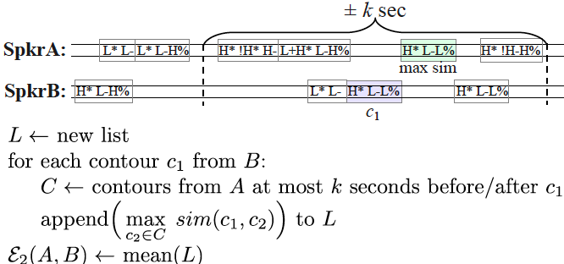
ε2 Measure: Levenshtein Distance
Given B’s production of contour c (sequence of tones) how close is A’s production of the same contour (sequence of tones?

Slide 48
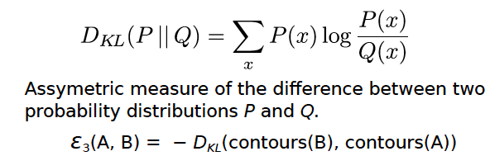
ε3 Measure: Kullback-Leibler Divergence
Notes:
Again, smaller divergence means more similar

Slide 49
Experiments
Built 24D vectors (one for each speaker) with the value of each of the 3 metrics for each member of each speaker pair
Built similar vector for each social variable v (e.g., bored-with-game) where Aj, Bj are the two speakers from the same session j
Ran Pearson's correlation tests between entrainment vectors and social variable vectors
Notes:
E1 = E1(A1, B1), E1(B1, A1), E1(A2, B2), E1(B2, A2), . . . , E1(A12, B12), E1(B12, A12) , where Ai, Bi are the two speakers from session i.

Slide 50
Correlations for Different Prosodic Similarity Metrics with Social Variables
Social Variable | Perplexity | Levenshtein Dist | KL Divergence
Making-self-clear | pos | pos
Giving encouragement |  | pos | pos
Engaged-in-game | neg | pos | pos
Contributes-to-successful-task-completion | pos | pos | pos
Trying-to-be-liked |  |  | pos
Planning-what-to-say | pos | pos
Dislikes-partner |  | neg
Making-it-difficult-for-partner-to-speak |  | pos | pos
Bored-with-game | neg | neg | neg
Notes:
Pos for difficult-to-speak is interesting…

Slide 51
Conclusions
3 novel metrics of entrainment on intonational contours annotated within the ToBI framework.
Findings: correlations of prosodic entrainment with perceived levels of
  speaker engagement
  positive partner-oriented features of social behavior (giving encouragement, making self clear, etc.)
Future work: Automate computation of our measures using automatic prosodic labeling tools (e.g., AuToBI).

Slide 52
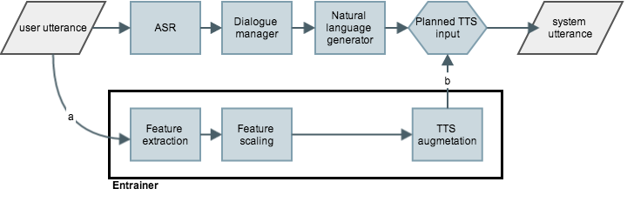
Entraining on Rate and Intensity to Users in Spoken Dialogue Systems (Levitan et al ‘16)
Notes:
Entrained, default, random on intensity and speaking rate
Timing:
default: 1.04 s
entrained: 1.73 s (Praat extract: 0.70)
ASR: 2.19 s
Entrained vs. random:
Global entrainment:
volume: 1.72 dB vs 6.12 dB ✓
rate: 1.03 vs 2.26 ✓
Local entrainment
similarity: 19/19, volume & rate
synchrony: volume: strong; rate: moderate (16/19)

Slide 53
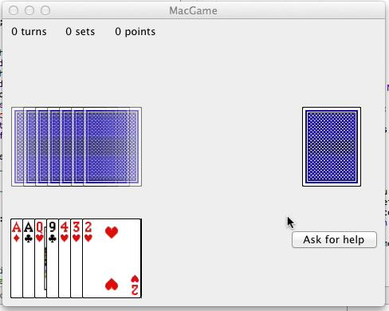
Go Fish: Do Users Prefer an Entraining System?
Notes:
describe gameplay: Goal: collect as many cards of the same # as possible by asking partner for theirs, e.g. give me all your Aces
Had to ask for advice from one of 2 avatars (one entrains and the other does not) before each request:
“Bobby and Freddy can see the system’s hand and will tell you which rank to ask for. They will usually give you good advice, but sometimes they will give you bad advice. One will give you bad advice more often than the other. Your role in this game is to decide who to trust.”
Forced alternation for 3 turns, then they can choose
hypothesis
implicit and explicit trust
postgame survey

Slide 54
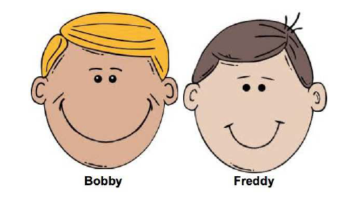
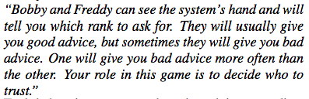
Go Fish Helpers
Notes:
Each gives the same quality of advice
One entrains to subject in intensity and rate, the other is given random values for these features within natural ranges
Entrainment is turn by turn
15 turns per game and 3 games

Slide 55
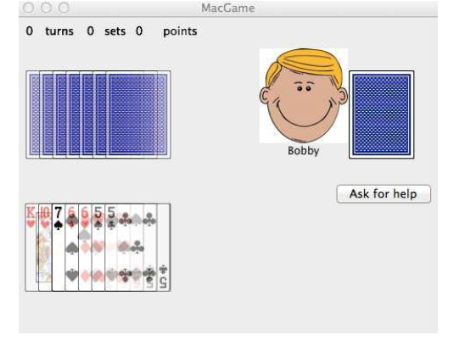
Notes:
Goal: collect as many cards of the same # as possible by asking partner for theirs

Slide 56
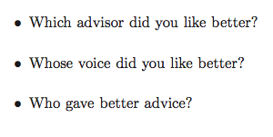
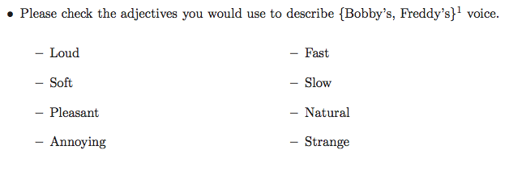
Do Users Prefer an Entraining System?

Slide 57
Method
19 participants:
  9 female, 10 male
  Ages 20—35
Each session: ~45 user turns (entraining + control)
  ~9 minutes
  Acoustic-prosodic features extracted by Praat
  Advice logged
Notes:
Control: disentraining

Slide 58
User Preferences for Entraining Helpers
Trust
  “Who gave better advice?” N.S.
  Implicit trust (whose advice was followed?) Entraining
Liking
  “Which advisor did you like better?” Entraining
Voice
  “Whose voice did you like better?” Entraining
  “Strange” Non-Entraining
  “Annoying” Non-Entraining
Notes:
effect size of entrainment in trust model is small but significant
Liking voice approaches significance (p<.053)
Implicit trust measured in how often the user asks for the help, weighted by index in the game (later turns weighted more heavily)

Slide 59
Entrainment in Deceptive Speech (Levitan et al 2018)
CxC Corpus
  340 native speakers of English and Chinese, balanced by gender and native language as described in our deceptive speech talk
  Taking turns as interviewer/interviewee with interviewer trying to detect deception
Is there entrainment in lexical and acoustic/prosodic features in these conversations?
  Some evidence that speakers become more similar to partner than to their own norming data in high frequency words, pitch, voice quality and intensity but..
  More pairs exhibited divergence over time than they do convergence… not too surprising given the task…to deceive
  Interviewers guessed lying better when there was lexical entrainment between them and interviewees
Notes:
Deception:
Here are the results from comparing how similar a speaker is to their partner with how similar they were to themselves. The complete results are in partner_self_results.txt. The following features were significant:
High Frequency 100: more similar to partner than self (this makes sense because some of the words in the top 100 were specific to the questions that were asked, High Frequency 25 was not significant)
p-value < 2.2e-16
http://www.cs.columbia.edu/speech/PaperFiles/2018/levitan_speech_prosody18.pdf
Mean Pitch: more similar to partner than self
p-value < 2.2e-16
Max Pitch: more similar to partner than self
p-value = 9.732e-05
Max Intensity: more similar to self than partner
p-value = 0.0003149
Jitter: more similar to partner than self
p-value = 4.497e-12
Shimmer: more similar to self than partner
p-value = 0.00206
NHR: more similar to partner than self
p-value < 2.2e-16
The following features were significant, and for all of them interviewers were more similar to their partners than interviewees were.
High Frequency 100: p-value = 2.024e-14
Mean Intensity: p-value = 0.0004933
NHR: p-value = 5.643e-06

Slide 60
What We Still Do Not Know…
How much? (effect size)
How significant are different types of entrainment (feature, measure)?
What is the influence of speaker traits/identity?
What is the influence of dialogue context?

Slide 61
Later Research
Entrainment and trust:
  GoFish, NavGame (Harry Potter like adventure game), GuessWho (aka TwentyQuestions) games developed and tested for Slovak and Spanish
Entrainment in code-switching:
  Miami Bangor Corpus (Sp/Eng) shows significant evidence of entrainment in CSW
Research on individual differences:
  Differences in gender, native language (e.g. Spanish, Slovak, Hebrew), culture, and personality may explain entrainment differences

