Slide 1
Tools for Speech Analysis
Julia Hirschberg
CS6998
Fall 2022
Thanks to Jean-Philippe Goldman, Fadi Biadsy, and many more...

Slide 2
Please note
We will not ask you for writing assignments on weeks when a HW assignment is due – just check the Assignments link in Courseworks2
For Assignments: please provide 100-200 words for each positive and each negative response for each assigned paper; this will give us a better chance to assess the quality of your responses

Slide 3
A Speech Analysis Tool: Praat
Developed by Paul Boersma and David Weenink at the Institute of Phonetic Sciences, University of Amsterdam
General purpose speech tool : editing, segmentation and labeling, prosodic manipulation and analysis, many tutorials, large user community, Praat-Users-List
Today: you can do many things with Praat (see Praat intro and many tutorials on line) but today we will go through some basics
Notes:
first aim of Praat was to give students and scientists of Phonetics a handy tool for manipulating speech data and for creating stimuli for perception experiments,

Slide 4
Today
We’ll go through some exercises recording and analyzing files through Praat
First, make sure you have the latest version of Praat, 6.2.19 from 9/12/22 for Mac or 6.2.20 from PC
Put on your headphones and adjust the microphone so that it is slightly to one side of your mouth
If you cannot record yourself, please download these files from Courseworks2 -> Files -> Wav files
Might be good to download these now as a backup
mama-jh.wav will be your first wavefile today
Notes:
https://drive.google.com/drive/folders/1sy_kMnP1O1-ciHENKFuHkz-s6ADAzjb9?usp=sharing

Slide 5
Notes:
This is what one form of a well-annotated speech file looks like in Praat, with wav file, spectrogram, and (here) phones and words. Now we’re going to find out how to produce one of these.

Slide 6
How do we Record and Manage Files?
Open Praat on your laptop
You’ll see 2 windows, an Objects window and a Picture window
Today we’ll focus on the first
Recording files and saving them
In the New menu in Objects:
Record a mono file “My mama lives in Memphis”, as a statement, stop recording, play it to see if you like it, name it as “<your name>-mama” and Save-to-list-&-close
If you cannot record yourself, in Praat Objects select Open -> Read from file and select the downloaded file mama-jh.wav from Courseworks
Notes:
Picture window basically let’s you save results in a more legible way

Slide 7
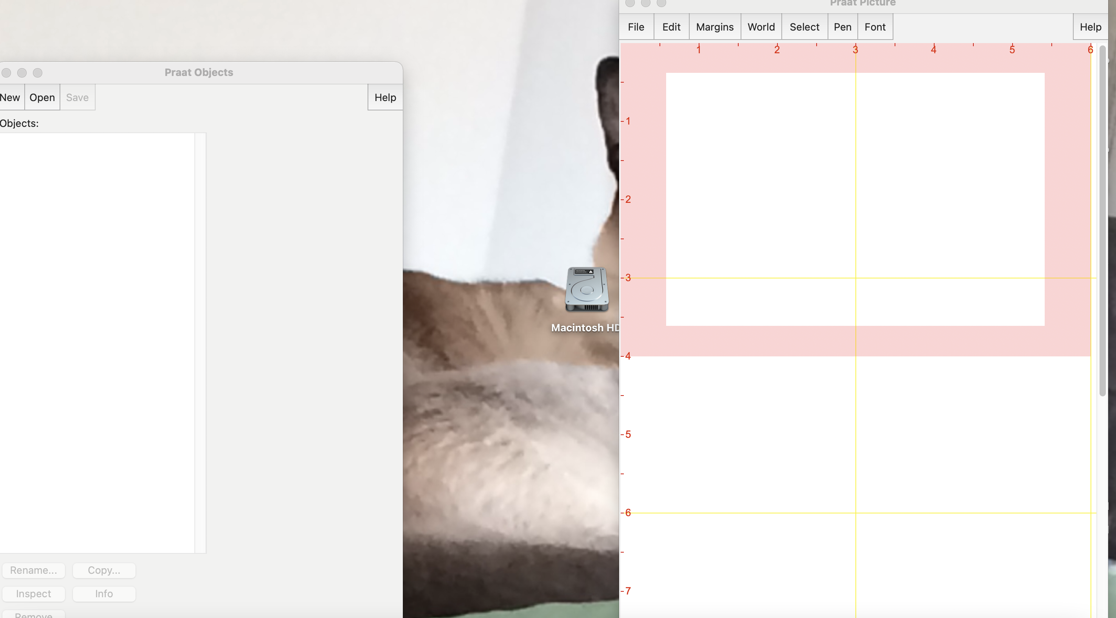
Notes:
To record your voice in Praat:
Select “New” in Praat Objects on the left

Slide 8
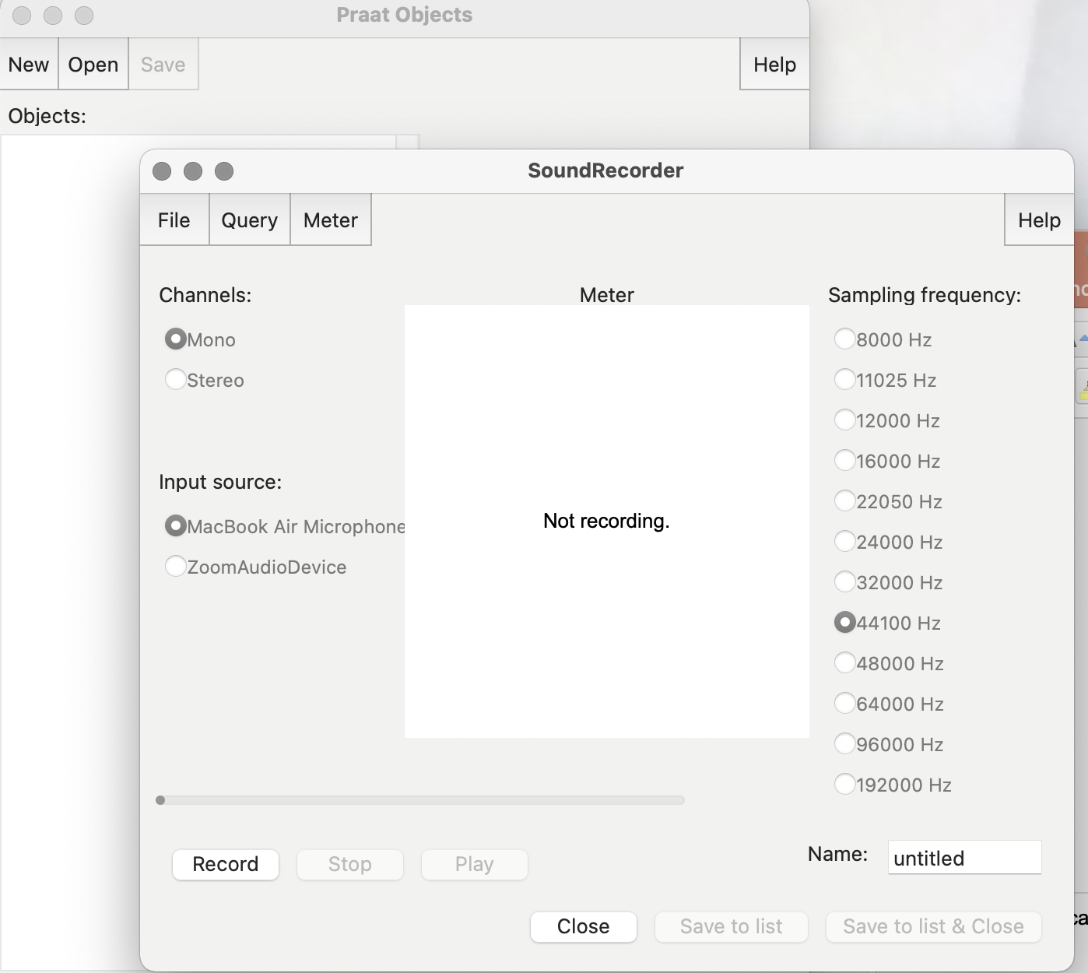
Notes:
This window will pop up. Use Mono as your channel, and whatever Mic you have as the input source and 44100 Hz sampling frequency. Select Record on the bottom left and hit Stop when you’re finished. Then select Save to list and close. You’ll see the file appear as Sound untitled in you Praat Objects window. Select Rename at the bottom left and chose a name like mama-<your-uni>.

Slide 9
Now select the file in the Objects window and click Save at the top left and choose Save as WAV file and place it where you can find it on your machine
Now select the file and click Remove from the bottom of the Objects window
Now we’ll see how to open files from disk
Select Open from the Objects window, Choose “Read from file” and open “<your name>-mama” or “mama-jh.wav” in Praat again (we’ll just call either file mama)
Select this file in the Objects window and you’ll see many options on the right of the Objects window
Select View and Edit

Slide 10
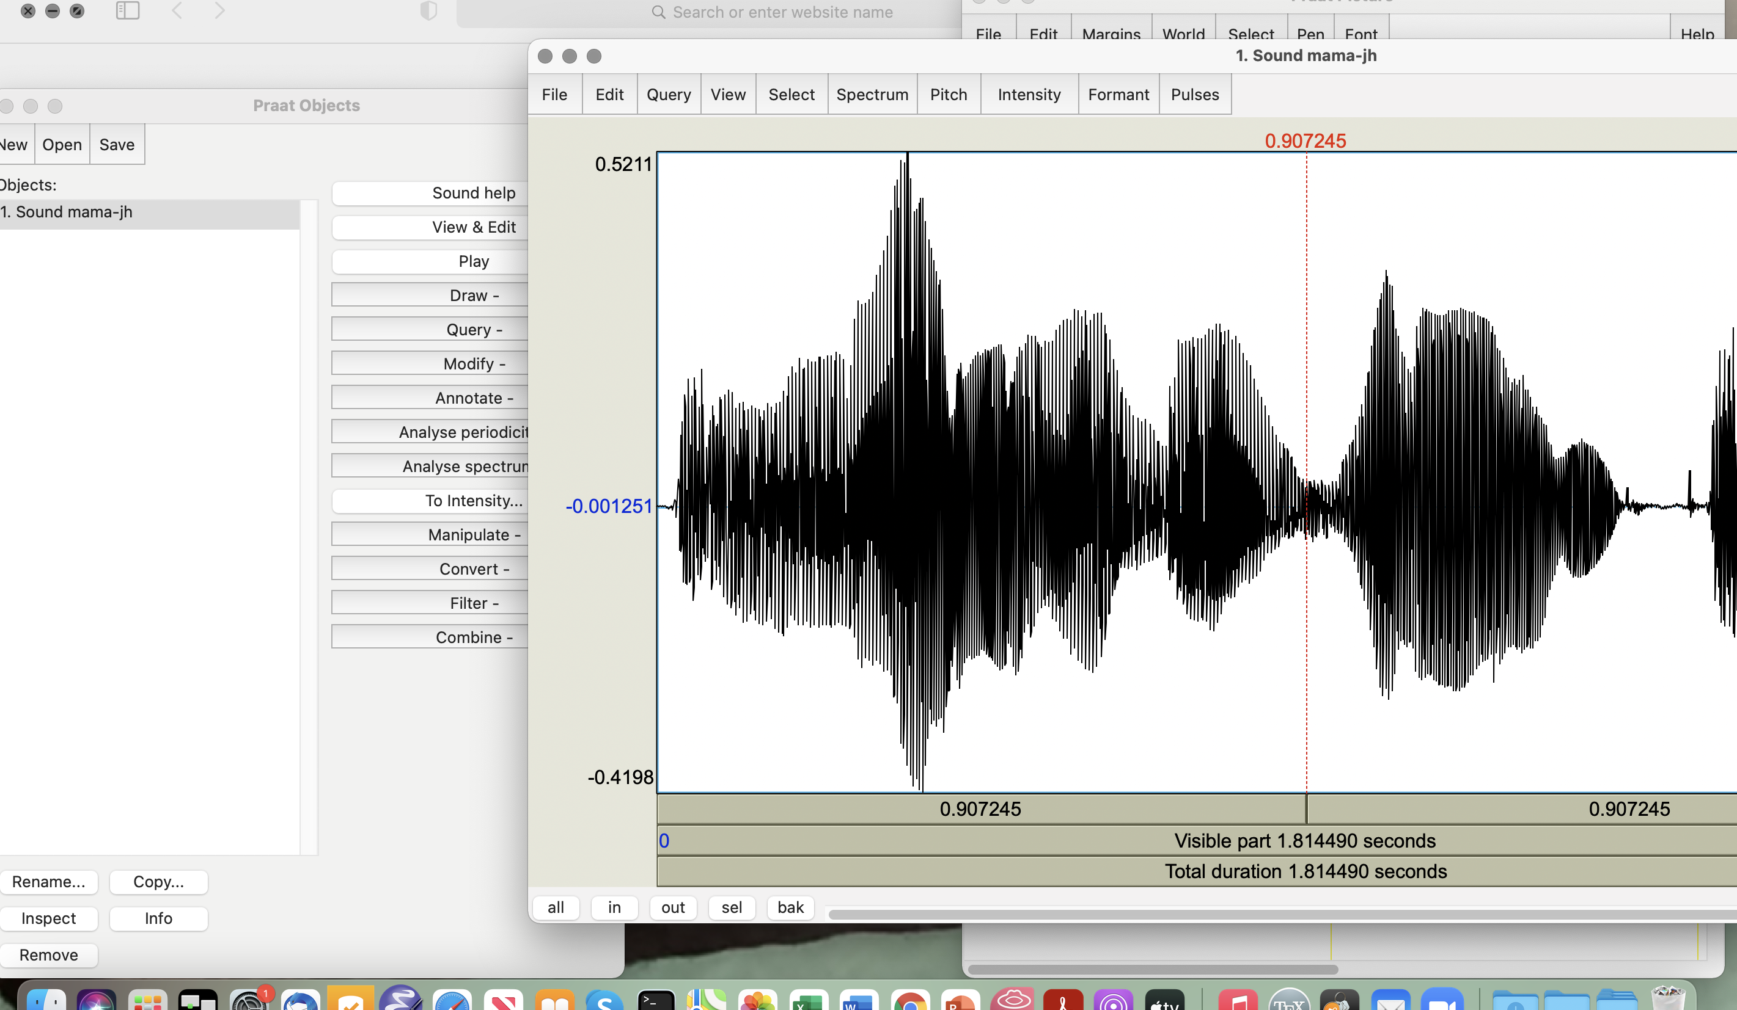

Slide 11
Display Options from Objects File
In the window you see with the waveform, highlight only the speech portion of the file (not silence or noise) and click “sel” on the bottom left to select that portion
From the menus at the top of your sound file we’ll now find some Praat annotation choices
Spectrum:
If you do not already see your spectrogram select Spectrogram → Show spectrogram
Select a point in your sound file and choose Spectrogram → View spectral slice to see the frequencies in Hz (x axis) and the sound pressure in db (y axis)
Try to play words one by one by selecting the correct portion of the spectrogram for each word and play by clicking on the top row at the bottom
Notes:
X to the left; y to the sky

Slide 12
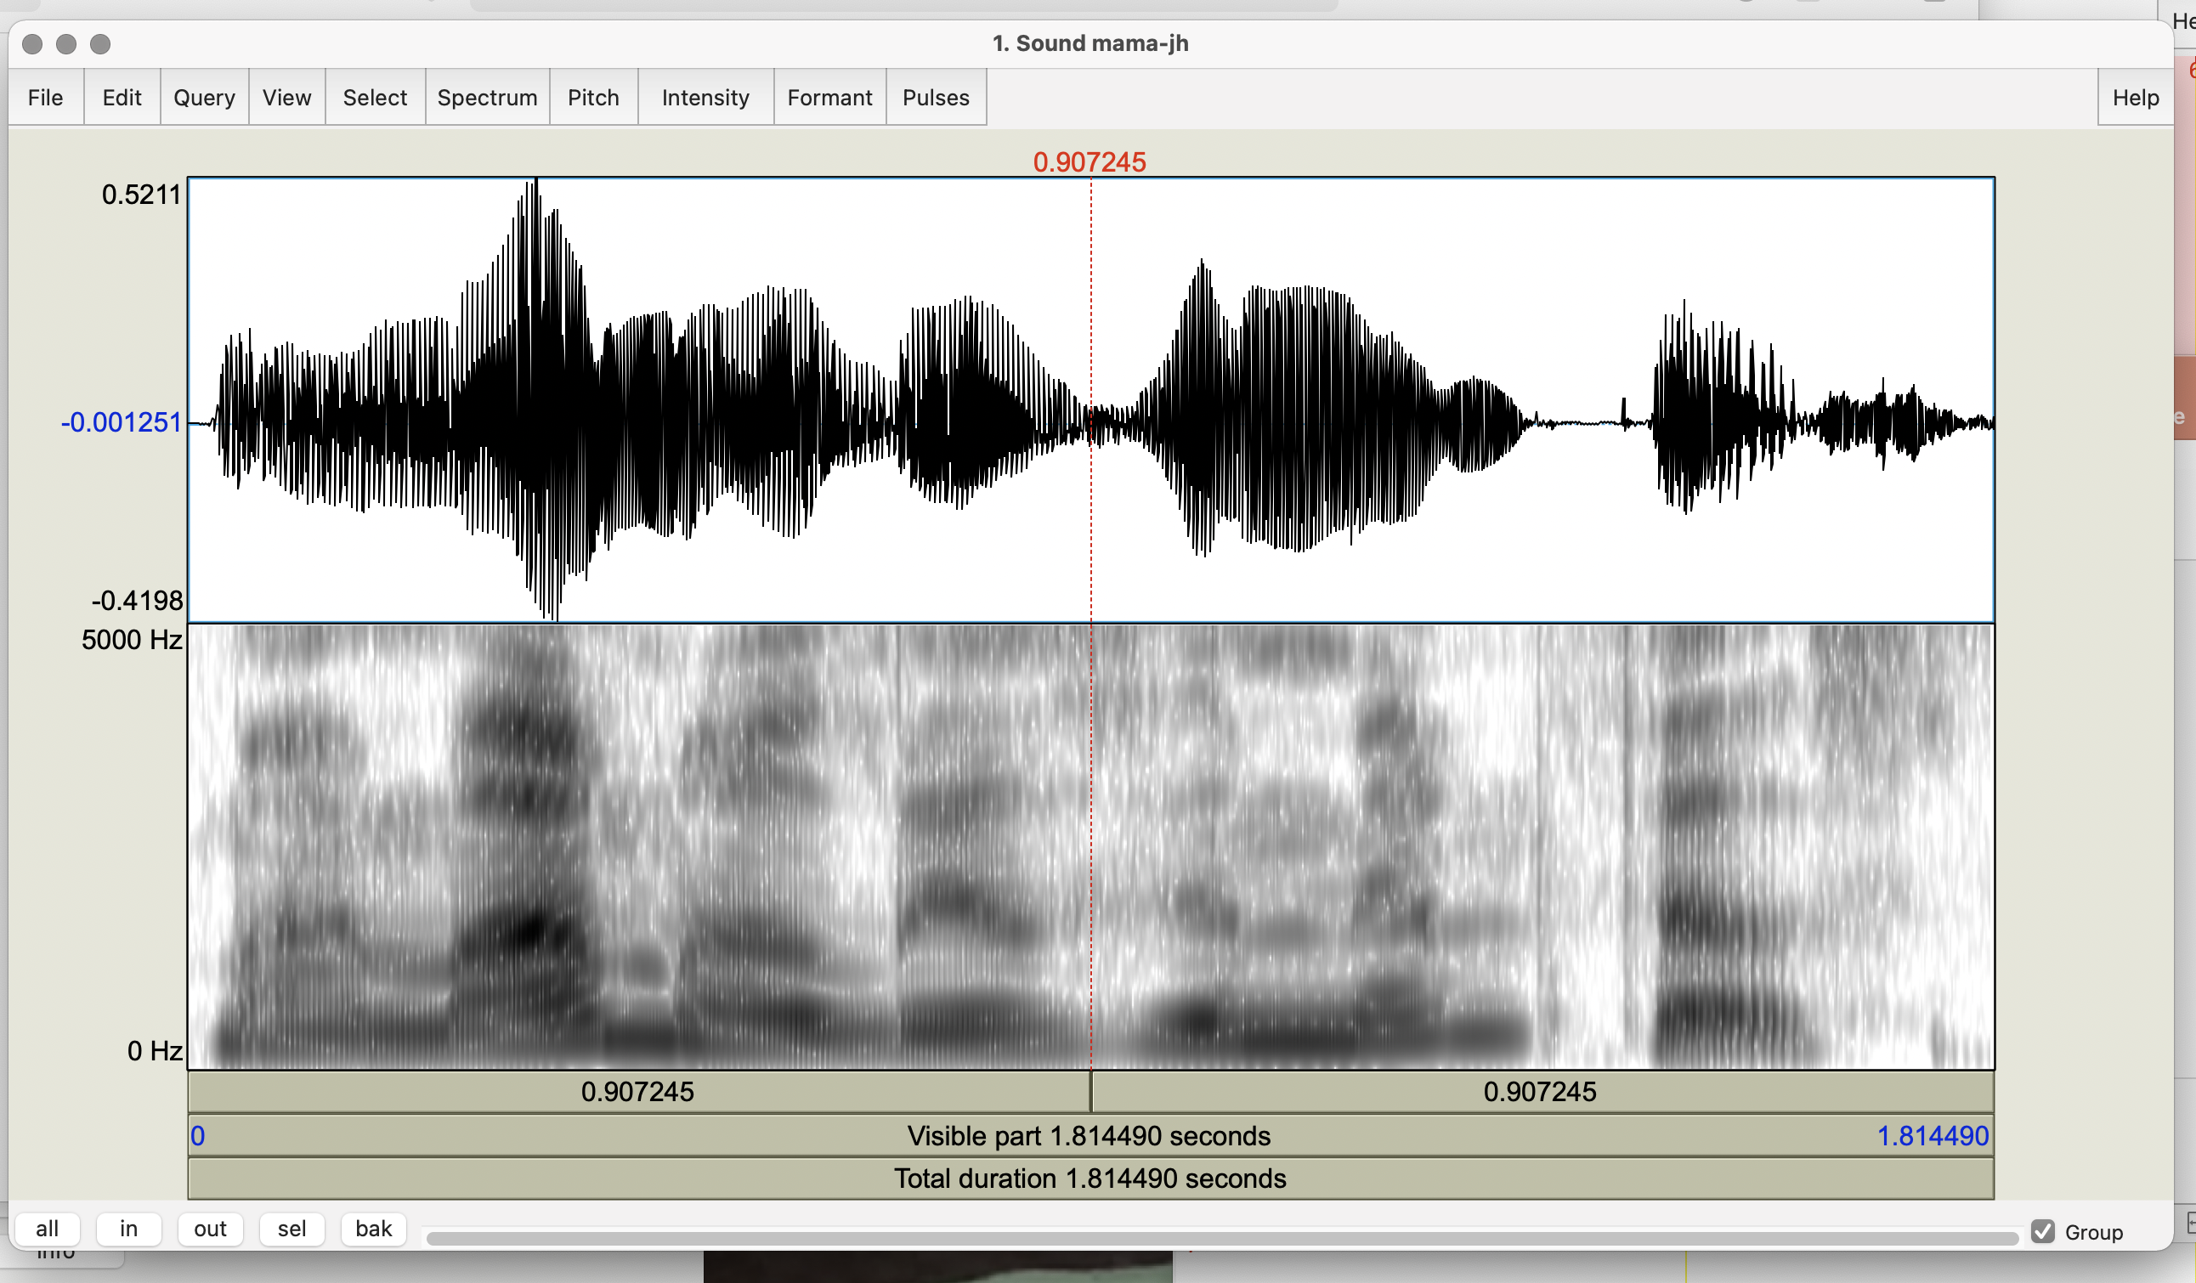

Slide 13
At the bottom, Row 1: selected portion; Row 2: all the visible file; Row 3: the total duration of the file
Pitch
Pitch → Show pitch
Find your mean, min, and max, pitch with Pitch → Get pitch, → Get minimum pitch, → Get maximum pitch
Can you describe the pitch contour you see? Try Pitch → Draw pitch to picture window in Praat Picture
Intensity:
Intensity → Show intensity
Intensity → Get intensity, Get minimum intensity, Get maximum intensity
Check Intensity → Intensity settings
Notes:
Show pitch file after Pitch
Show intensity file after Intensity

Slide 14
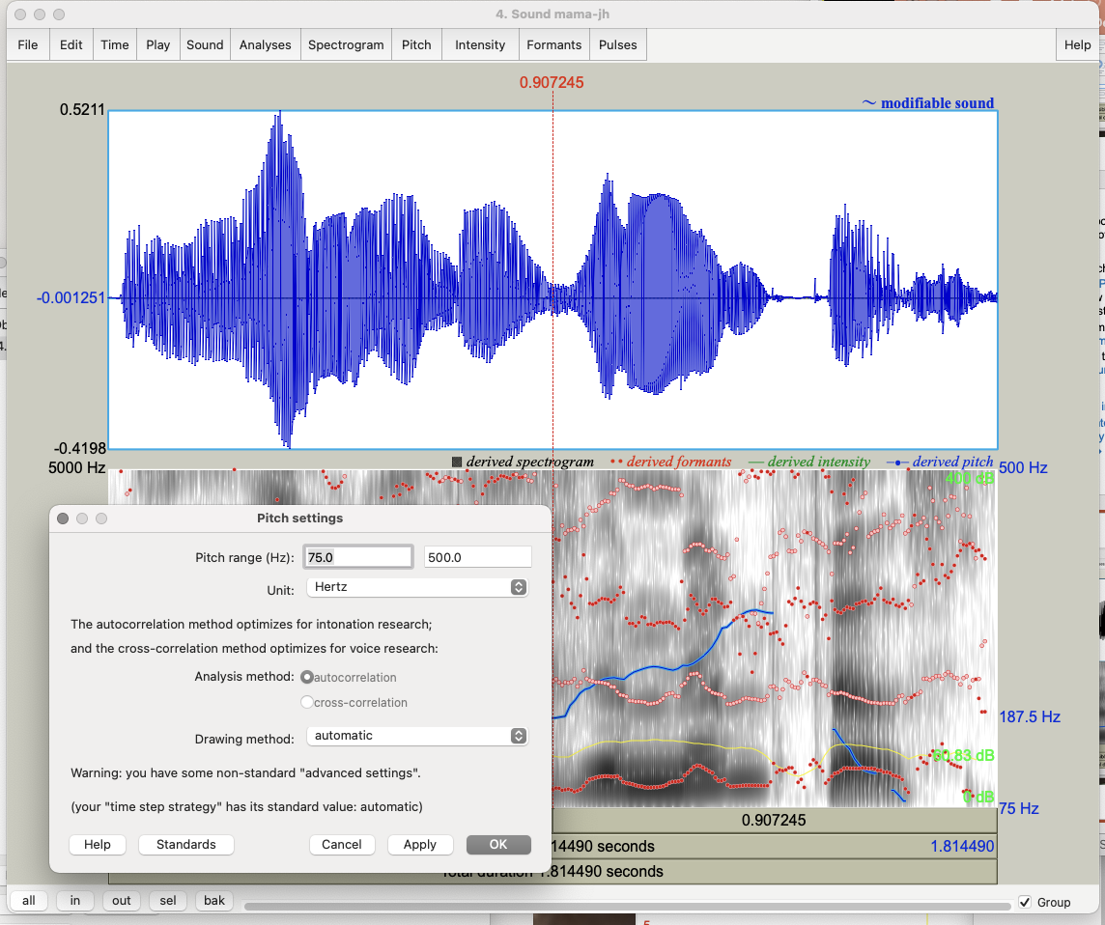

Slide 15
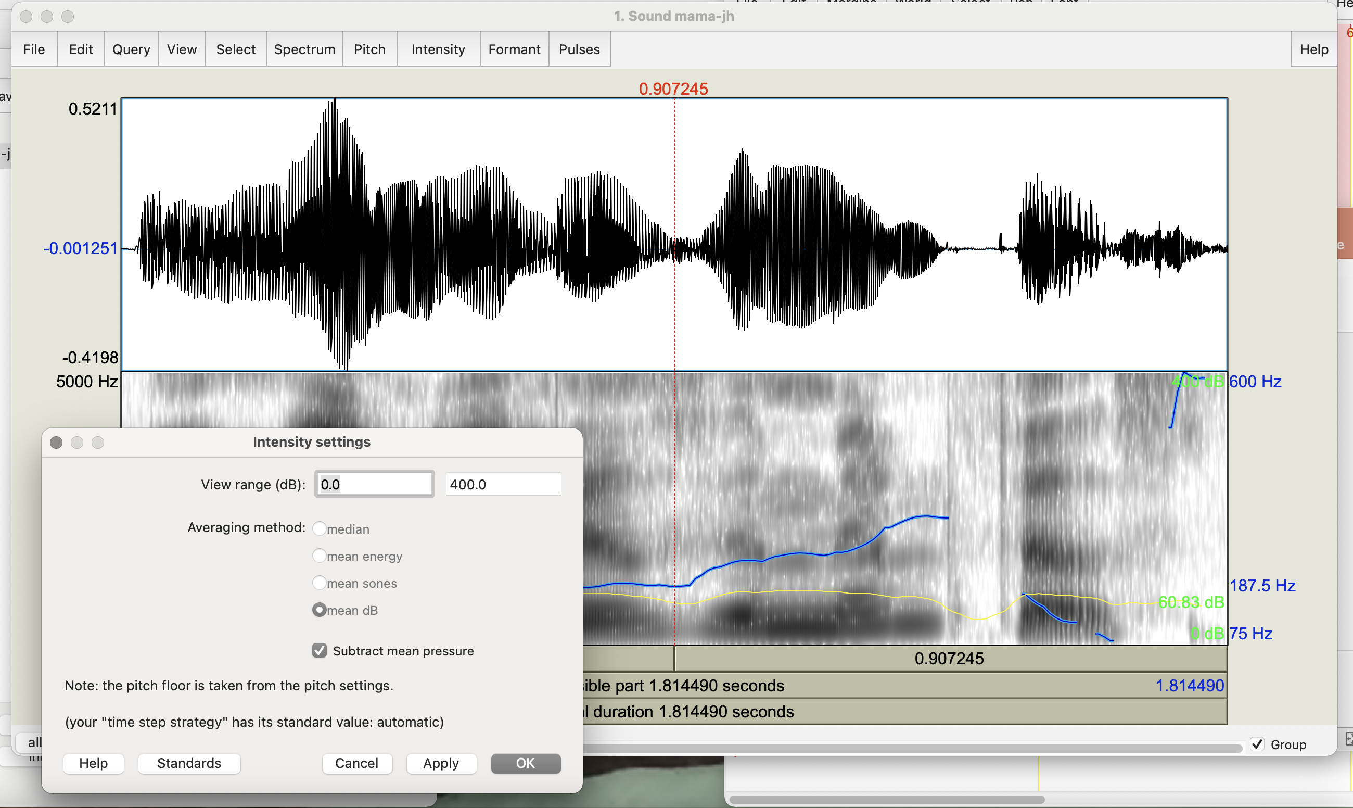

Slide 16
Pulses represent the vocal fold vibrations over time:
Pulses → Show pulses
Select a segment in your speech file
Pulses → Voice report – this gives you an overall summary (not always precise) of the pitch, pulses, voiced/unvoiced frames, jitter, shimmer, and HNR using many types of analysis
Formant:
Formant → Formant settings: Number of formants = 4.0 or 5.0; Dynamic range – 50.0
Formant → Show formants
Do the formant values match those you expect for vowels [aj] as in my, [ɑ] as in mama, [ɪ] as in lives, [ɛ] as in memphis?
,
Notes:
Show next slide after Pulses
Show second next slides after Formant

Slide 17
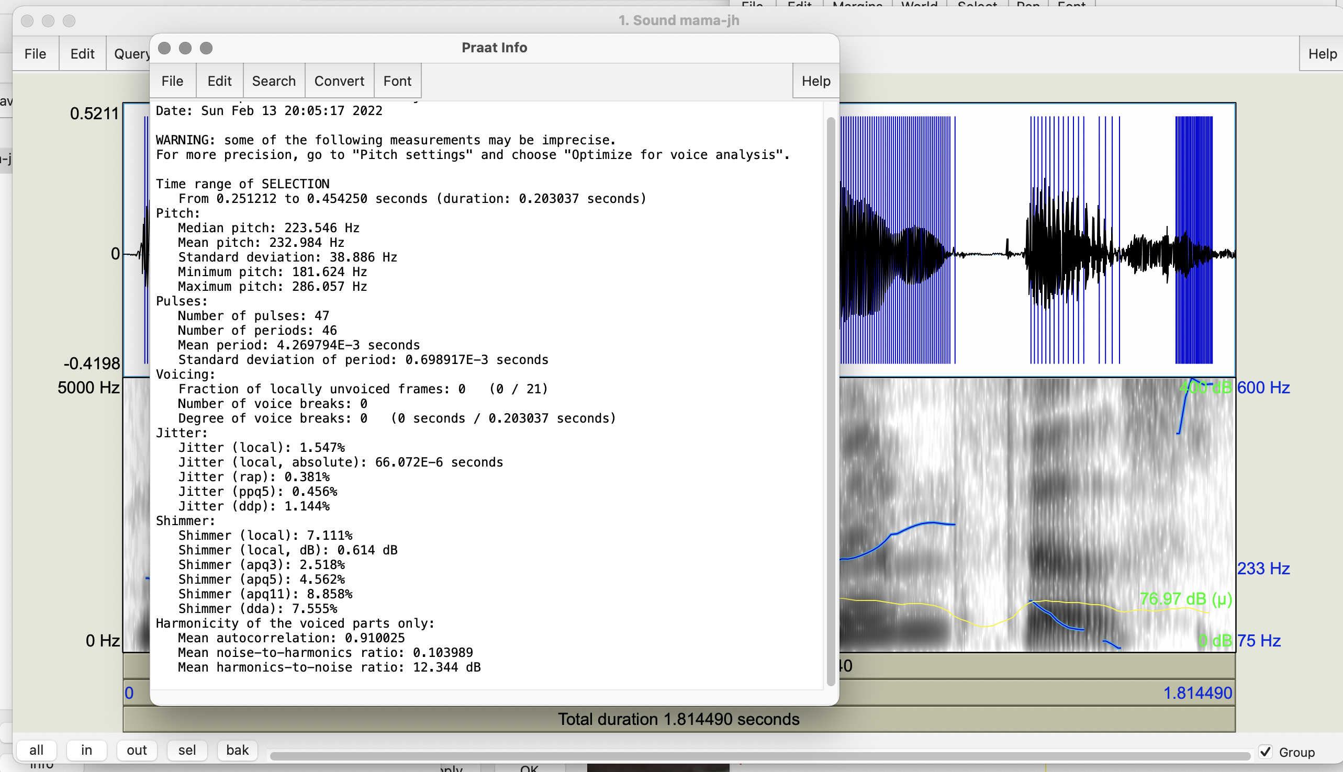
Notes:
Pulses

Slide 18
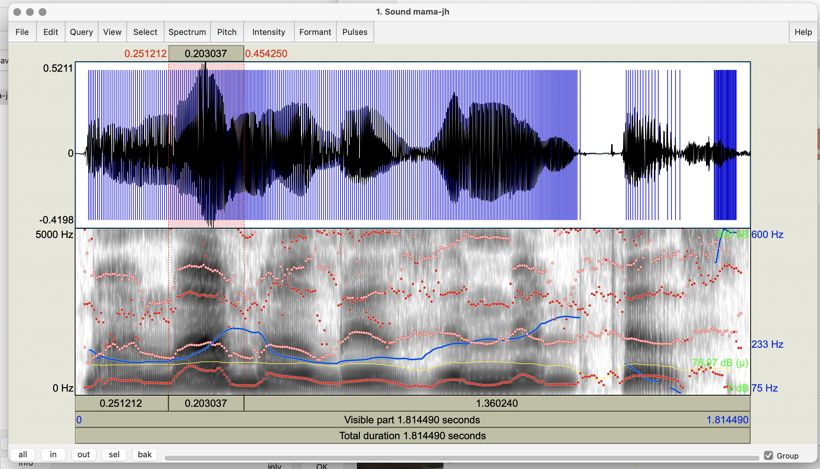
Notes:
Formants

Slide 19
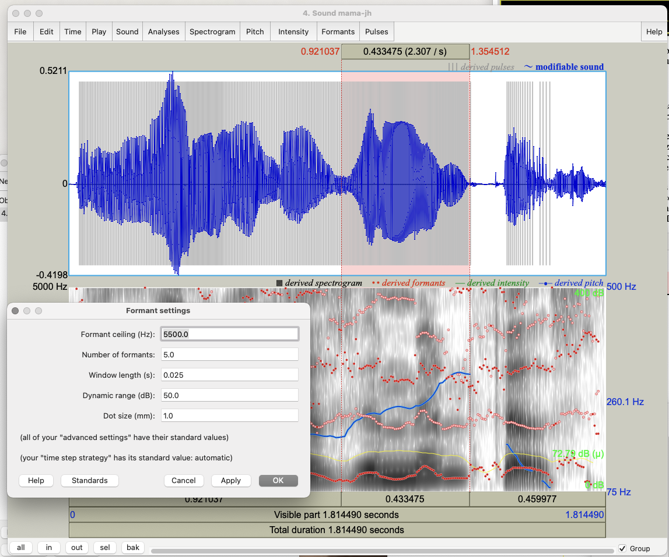

Slide 20
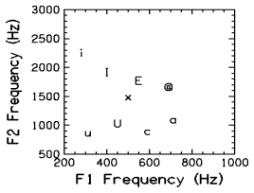
[i] - as in heed
[I] - as in hid
[E] - as in head
[@] - as in had
[a] - as in ha
[c] - as in hawed
[U] - as in hood
[u] - as in who'd
[x] - as in hud

Slide 21
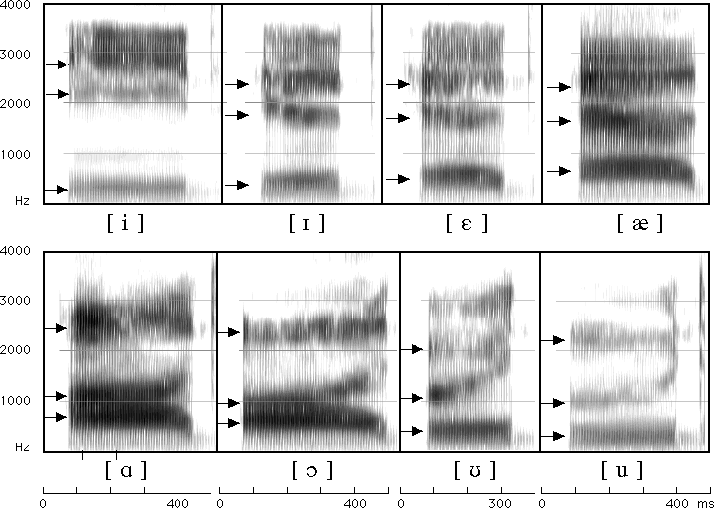
Match your Vowels to Formants for English Vowels
Notes:
My (a i/5 1) mama (a/5) lives in (I/2) Memphis (E I/3 2).

Slide 22
How to Set Praat Parameters
Select the speech segment from Sound mama
For pitch extraction:
Open Pitch menu on Sound mama
Select Show pitch and then Pitch settings
Set Pitch --> Pitch settings to min 75 max 500 (standard) for now but experiment with your own voice: try to find your highest and lowest pitch
For jitter (local only):
In Objects window select Sound mama
On right select Analyze periodicity
Select To PointProcess cc
Again set pitch max (500) and min (75)
Notes:
After pitch extraction show next slide
After jitter go to 2nd slide after this one

Slide 23
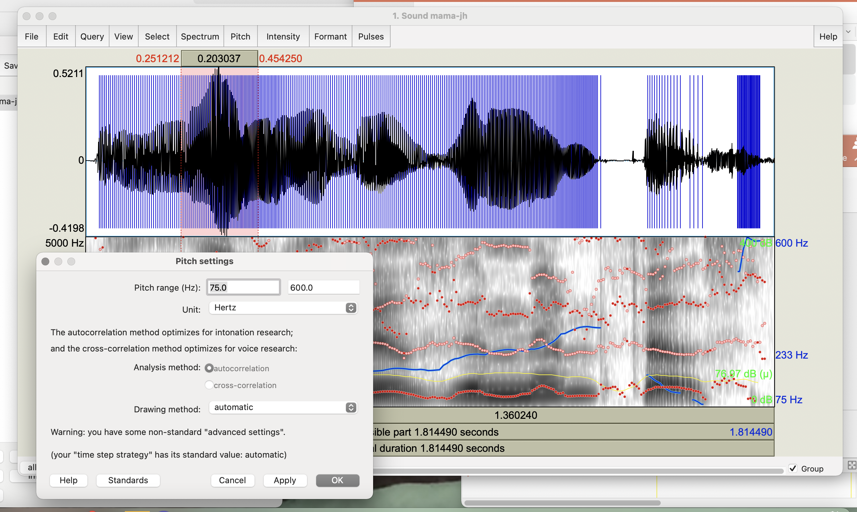

Slide 24
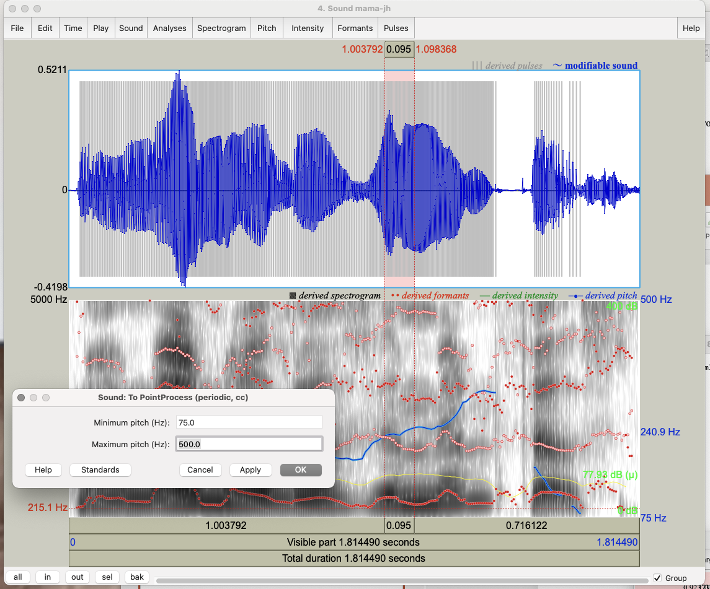

Slide 25
In Objects window Select PointProcess mama
Choose Query → Get jitter (local) and set parameters in seconds: Shortest period = 0.0001; Longest period = 0.02, max period factor = 1.3
For shimmer (local only):
Select both Sound and PointProcess files from Objects
Choose Query → Get shimmer (local) and set period floor to 0.0001s, period ceiling to 0.02s, max period factor to 1.3, and max amplitude factor to 1.6

Slide 26
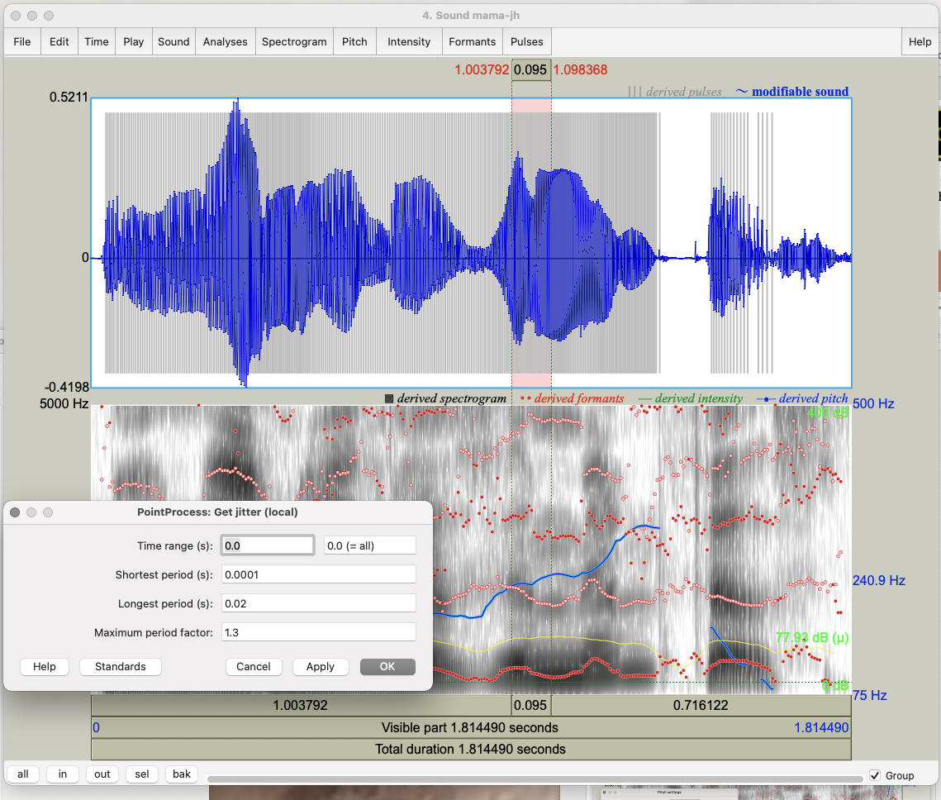

Slide 27
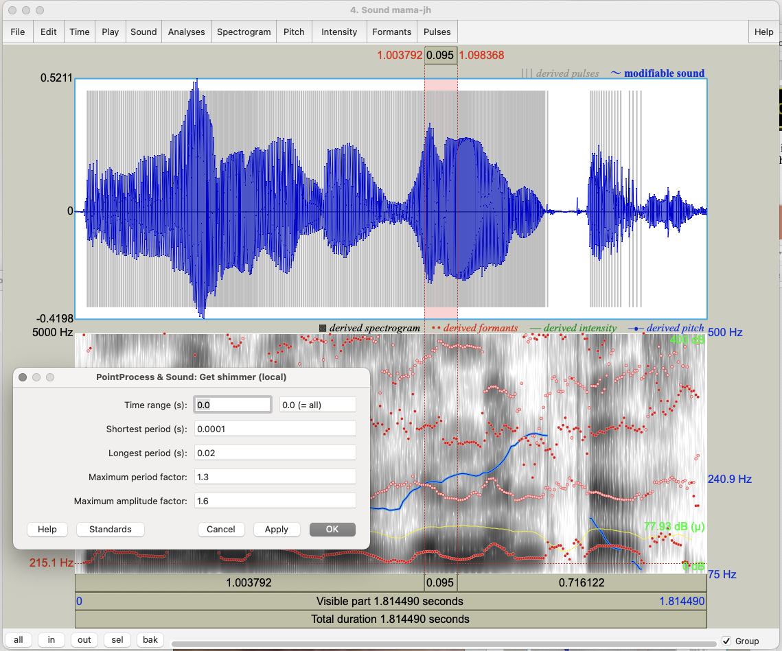

Slide 28
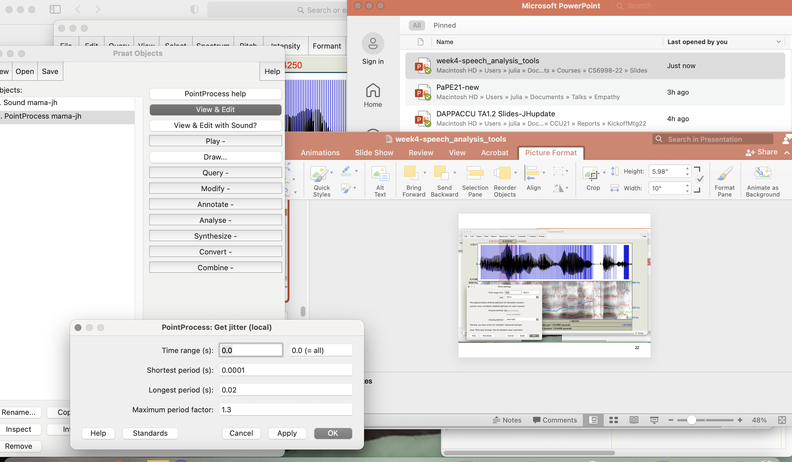
Notes:
Point-process OK and Query → Get jitter

Slide 29
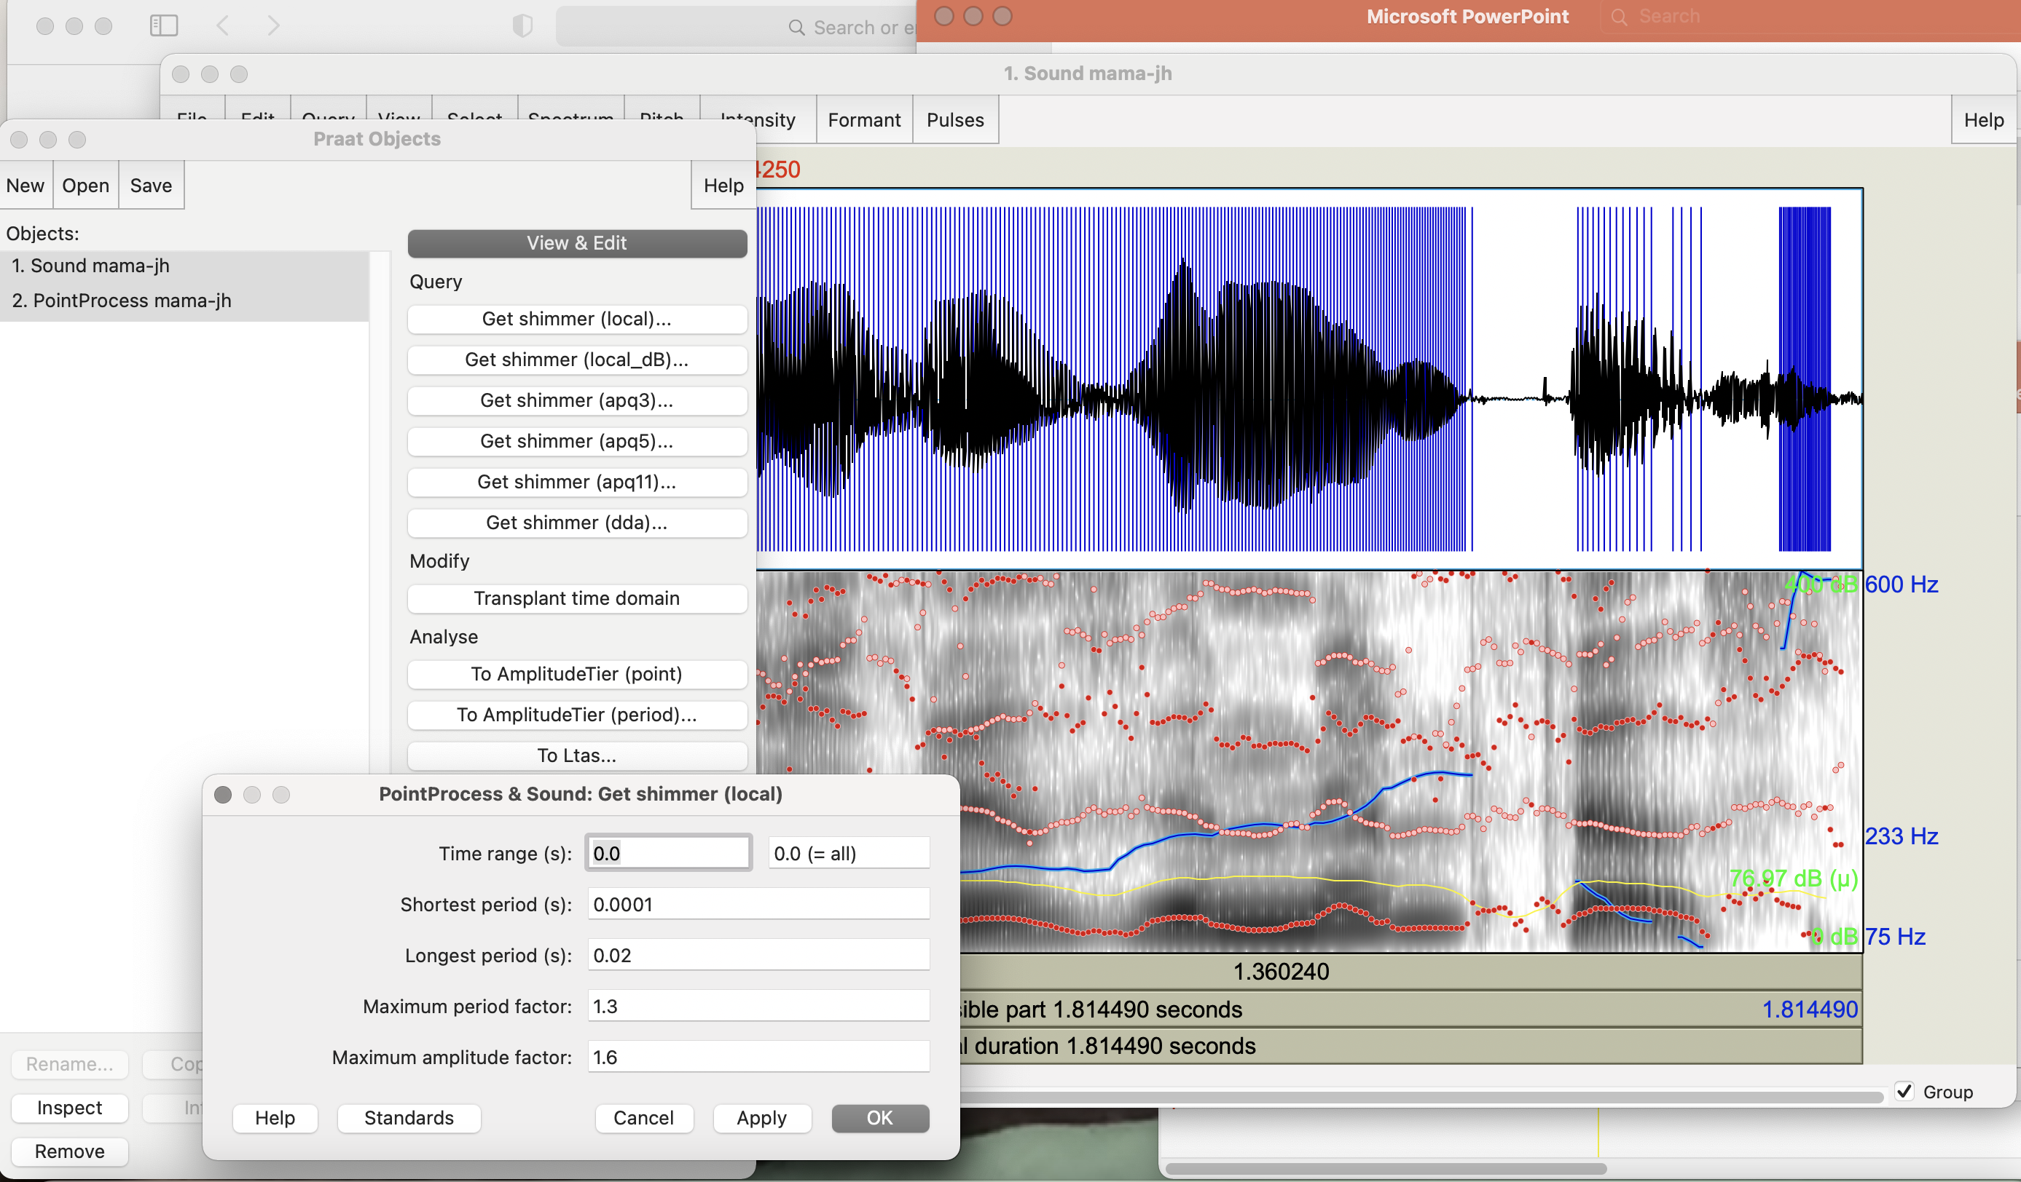
Notes:
Select both Sound and PointProcess files from Objects
Choose Query → Get shimmer (local

Slide 30
For HNR:
In Objects window select Sound mama
On right select Analyze periodicity
Select To harmonicity (cc) and set time step to 0.01, min pitch to 75Hz, silence threshold to 0.1, and periods per window to 1.0
Speaking rate: Divide #words or syllables by utterance duration (or use a Praat script or parselmouth script)
To identify silences:
Select Annotate → To TextGrid (silences); click OK
Select Sound mam and TextGrid file created
Choose View and Edit on the right
Notes:
Go to next slide after HNR
Go to second next slide after identify silences

Slide 31
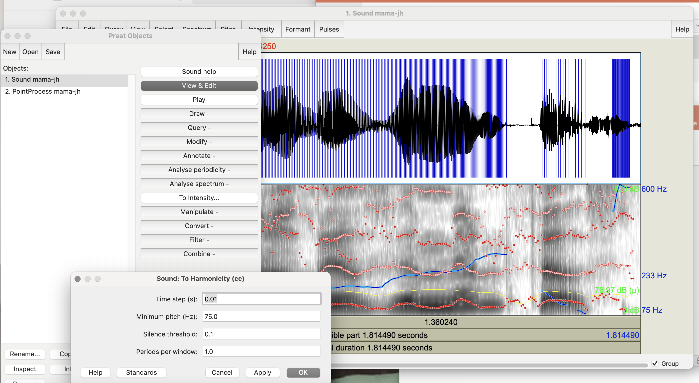
Notes:
On right select Analyze periodicity
Select To harmonicity (cc)

Slide 32
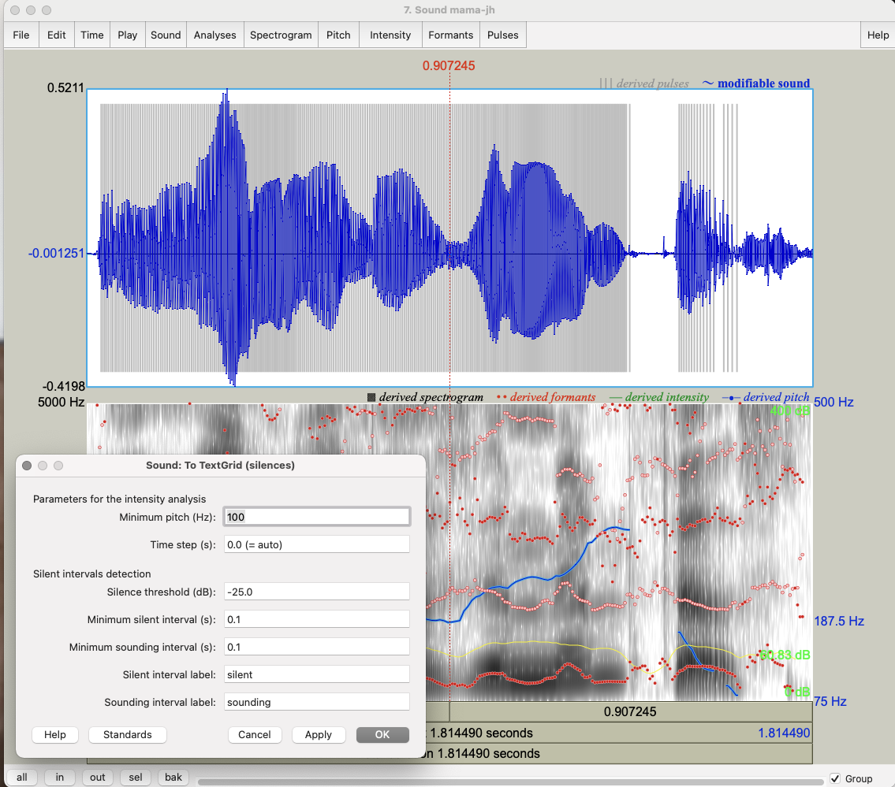
Notes:
Annotate → To TextGrid (silences); click OK

Slide 33
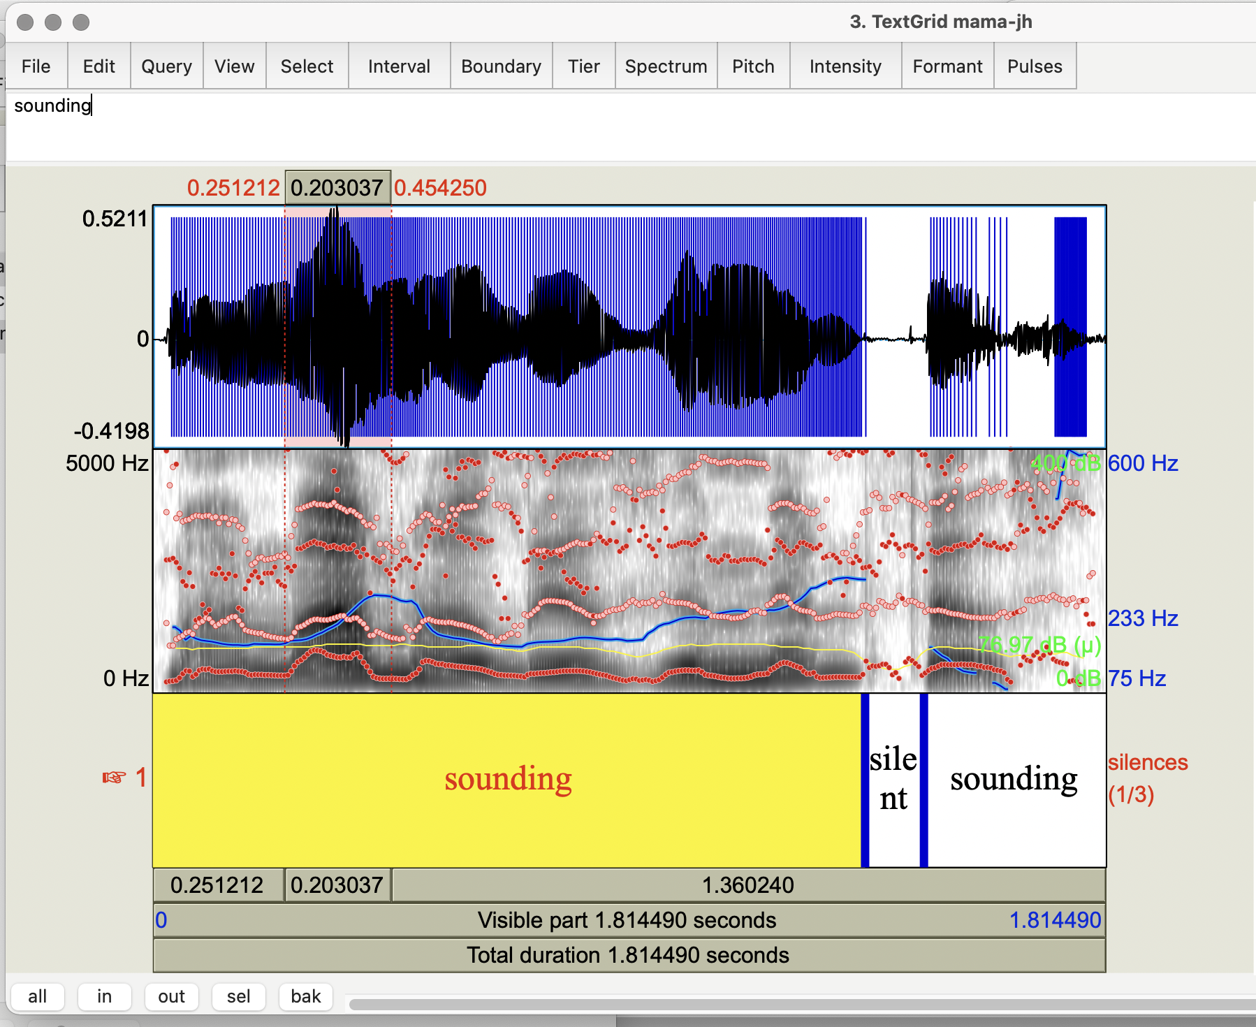
Notes:
Results

Slide 34
Task 1
Open your mama file in Praat; select View & Edit on right
Select the most prominent word and find a single cycle in the waveform using “in” on the bottom left
Select the cycle -- what is the frequency (1/cycle length) noted at the top of the cycle selected?
Select the entire contour again using “all” at the bottom left and selecting only the waveform
Select Pitch → Show Pitch and Intensity → Show intensity
What is the minimum pitch? Maximum? Mean? the minimum intensity? Maximum? Mean?
Notes:
Show cycles in next slide
Show pitch and intensity in following 2 slides

Slide 35
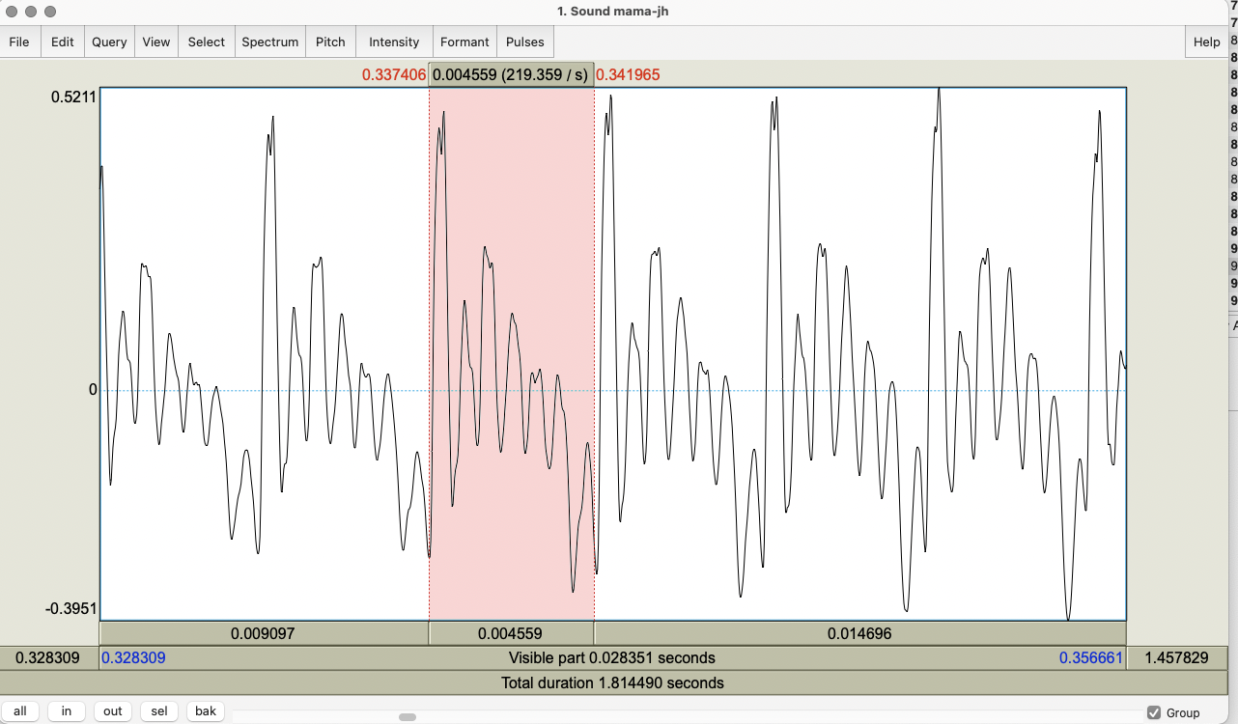
Notes:
From first syllable of Mama

Slide 36
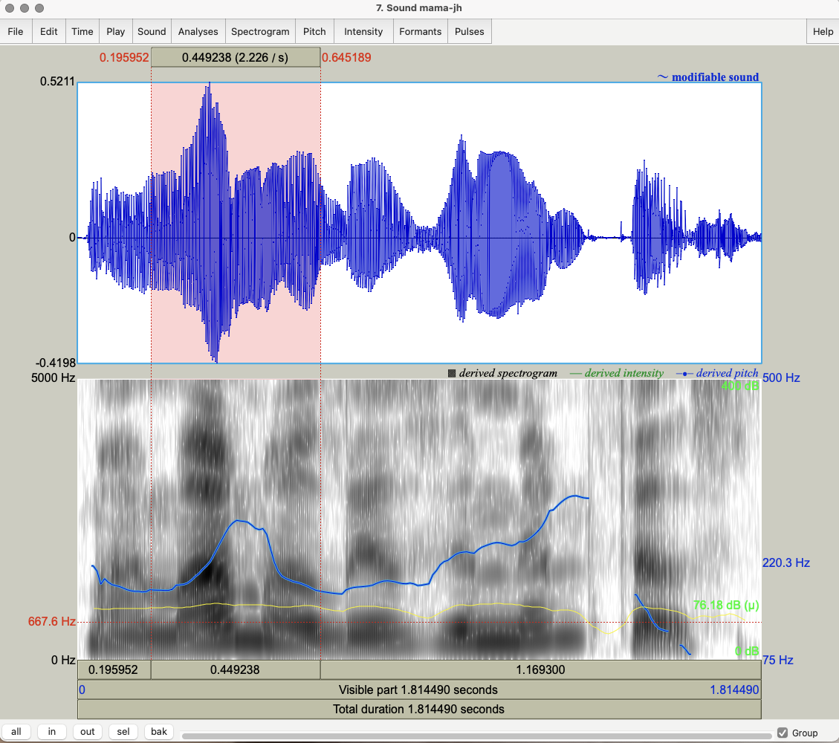

Slide 37
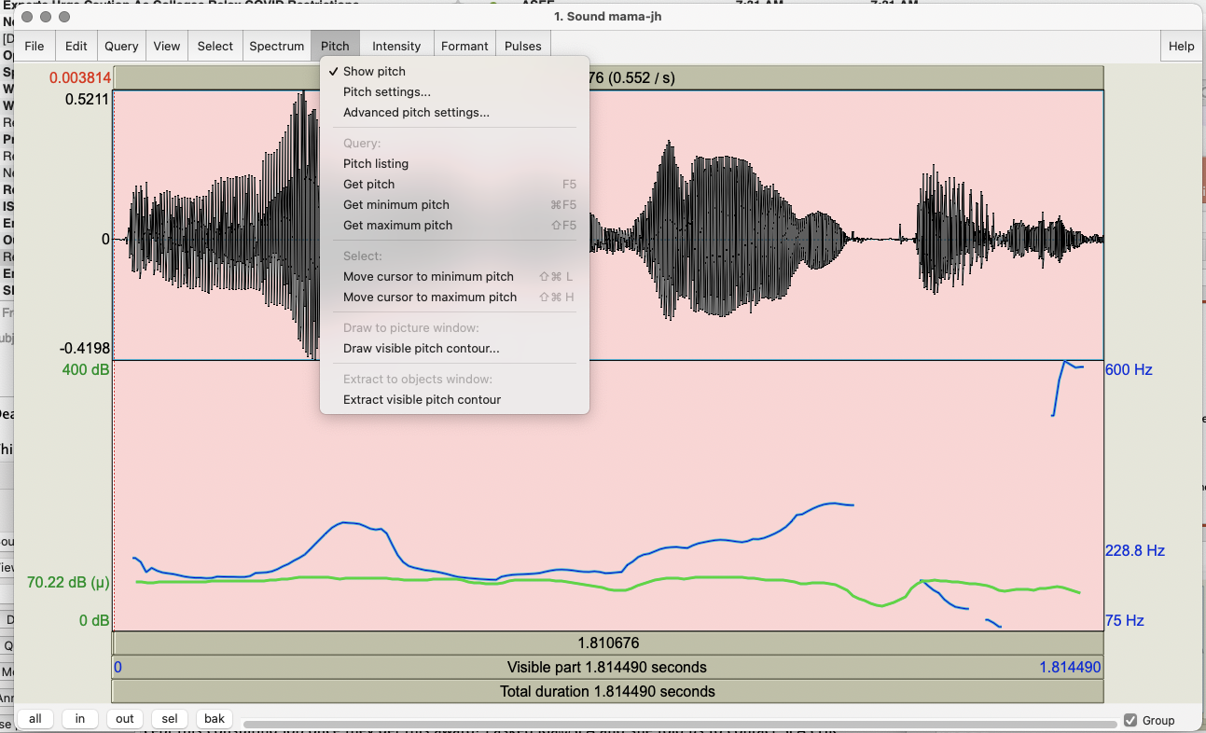
Notes:
You can remove Spectrograph → Show spectrogram if you want to see pitch and intensity more clearly

Slide 38
Task 2: Voice Quality
Record “My mama lives in Memphis”
in a whisper
in a creaky voice
Add to Praat Objects and View & Edit each
Study the pitch contours in normal vs. whisper vs. creaky. What do you notice?
Now select Pulses -> Show pulses and select the whole waveform
Analyze jitter, shimmer and HNR of your 3 files using Pulses → Voice report
Notes:
Compare your normal, whisper and creaky and compare the differences in jitter, shimmer, HNR for each
Show next 2 slides for whisper
Show next 2 slides after for creaky

Slide 39
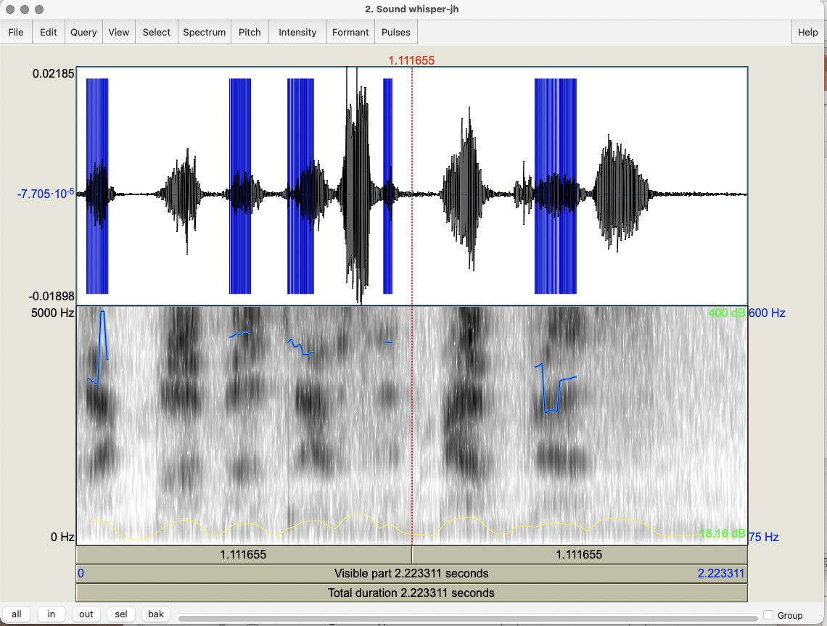
Notes:
Showing spectrogram for whisper

Slide 40
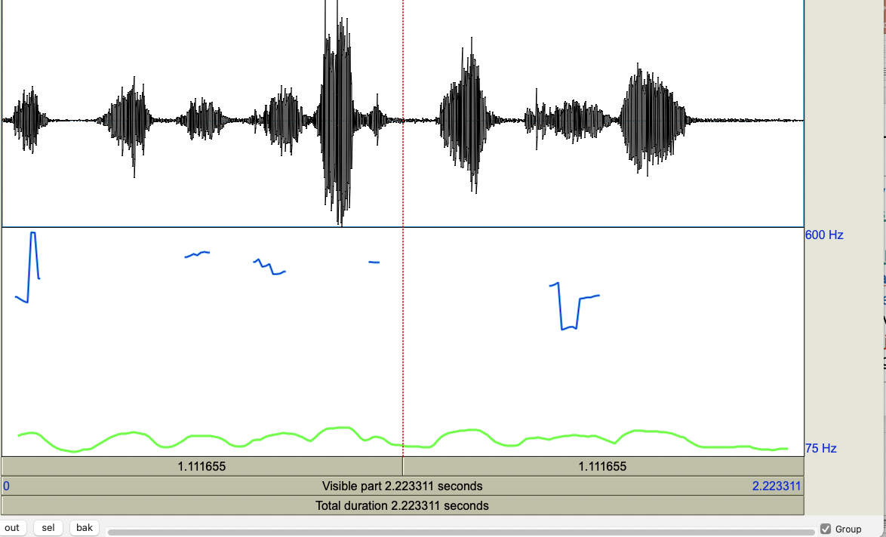
Notes:
Only pitch and intensity for whisper

Slide 41
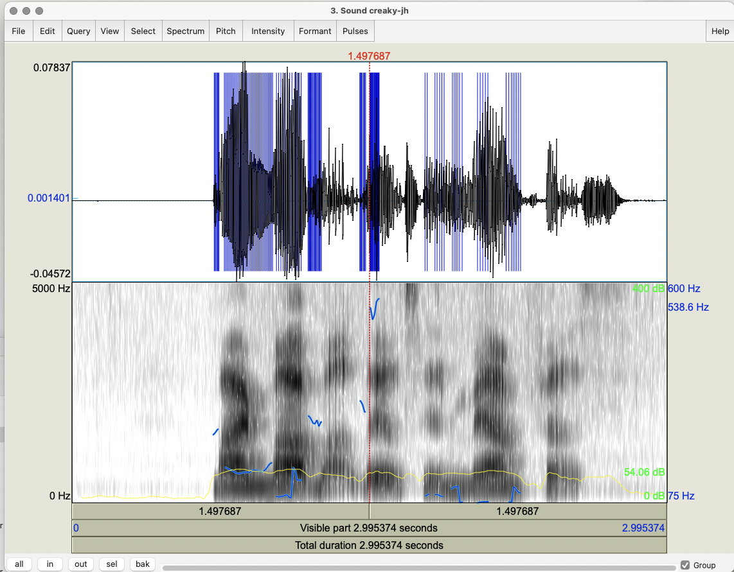
Notes:
With spectrogram for creaky

Slide 42
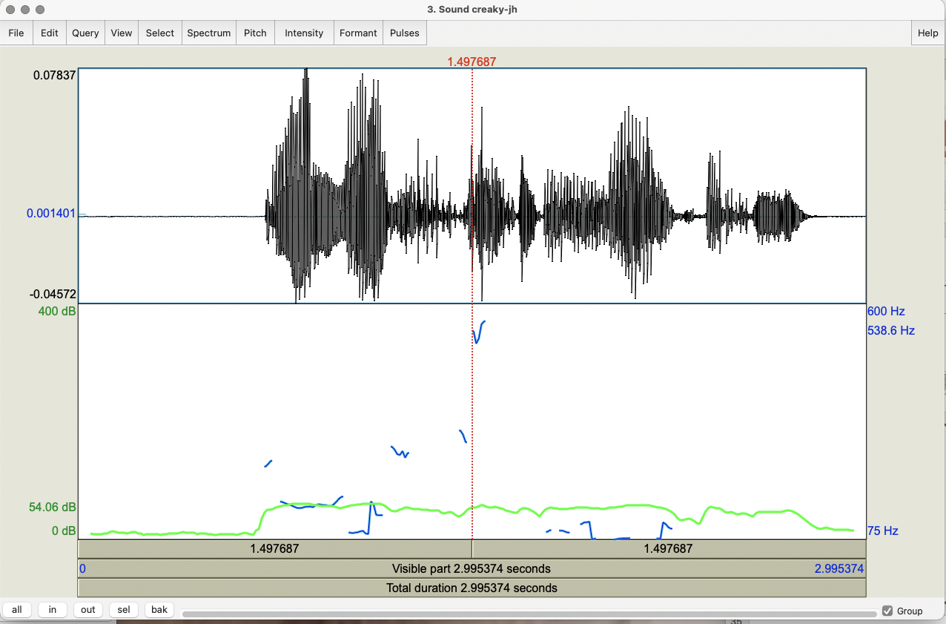
Notes:
Without spectrogram for Creaky voice

Slide 43
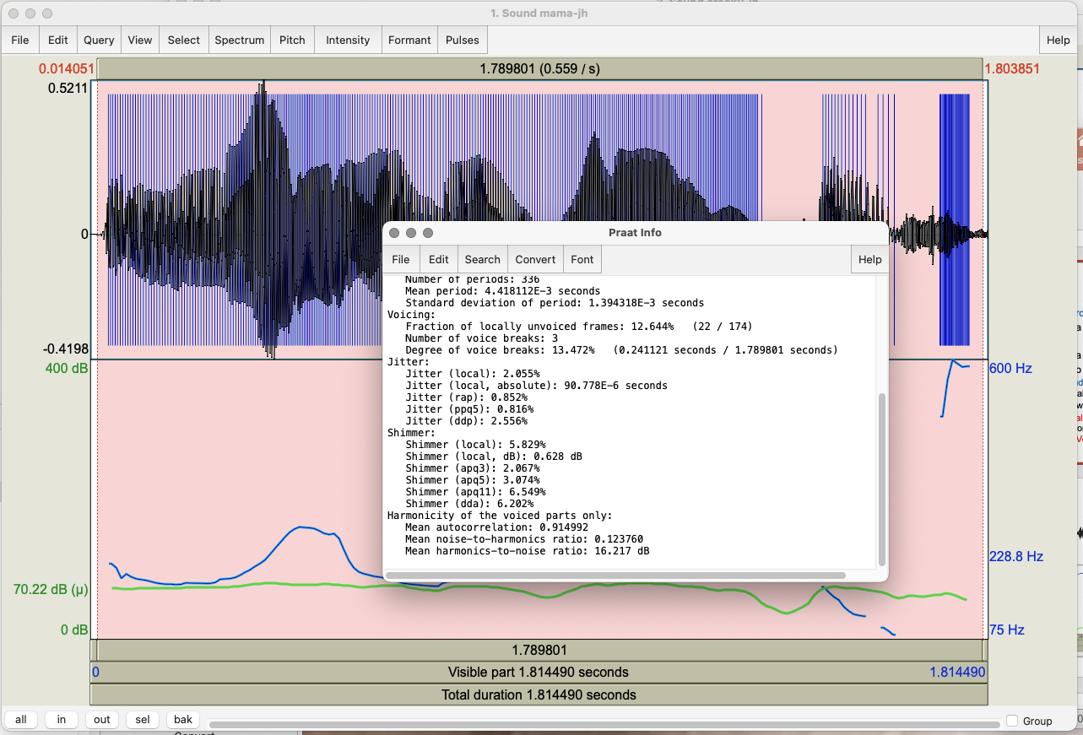
Notes:
Normal voice:
Compare to Whisper and then compare to Creaky: next 2 sides for each

Slide 44
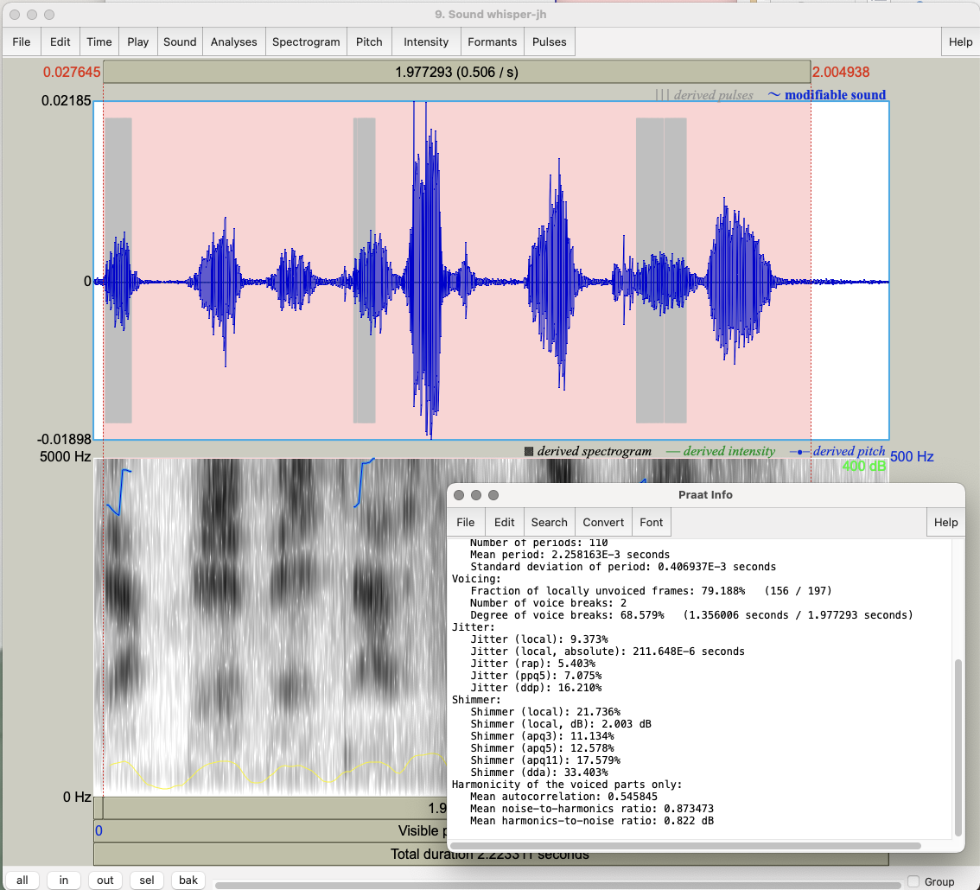
Notes:
Voice report for whisper: less voicing, less jitter, more shimmer, lower harmonicity (HNR)

Slide 45
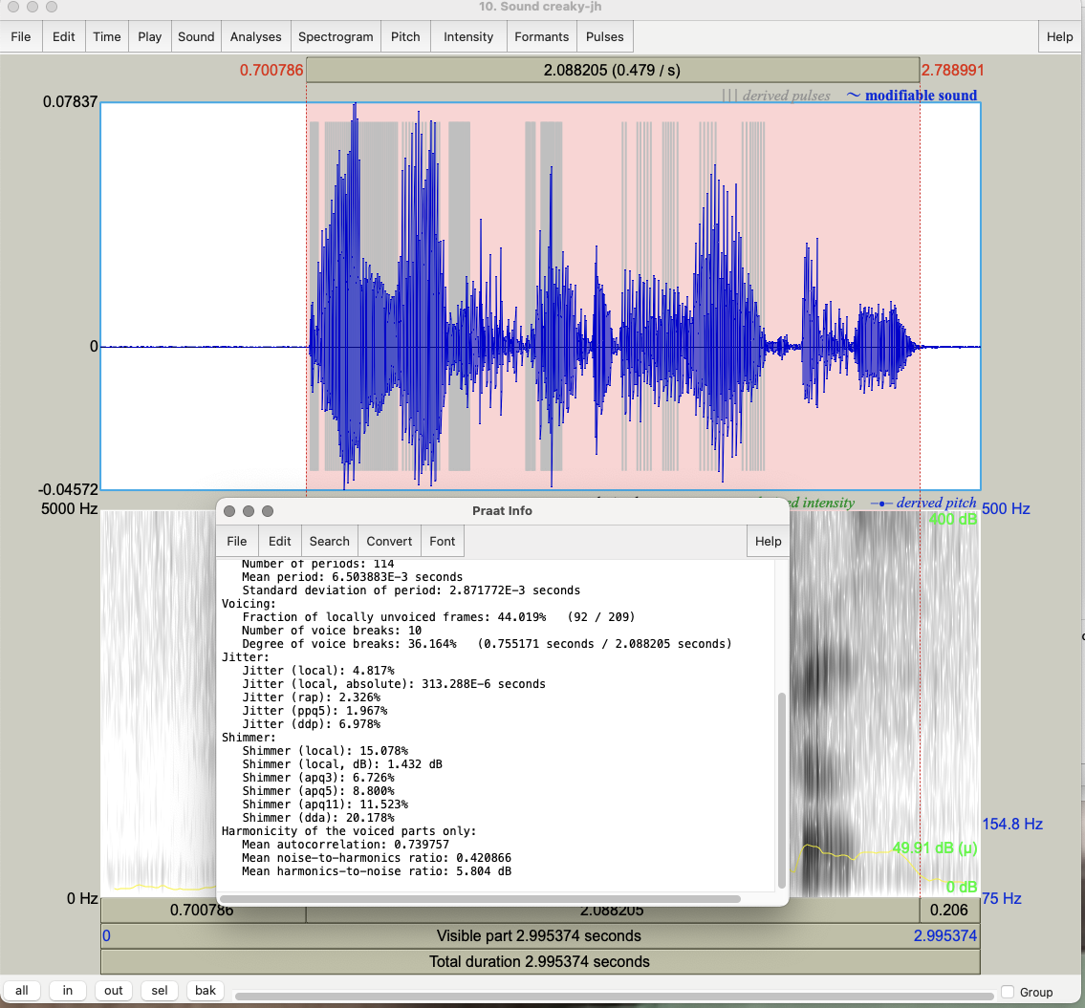
Notes:
Voice report for creaky: less voicing, more jitter, more shimmer, lower HNR ratio

Slide 46
Task 3: Contours
Record “My mama lives in Memphis” as a yes-no question
Compare to your Mama statement
What are the similarities in F0? Differences?
Now record a wh-question: “Where does my mama live?”
Which of the other 2 contours is most similar?

Slide 47
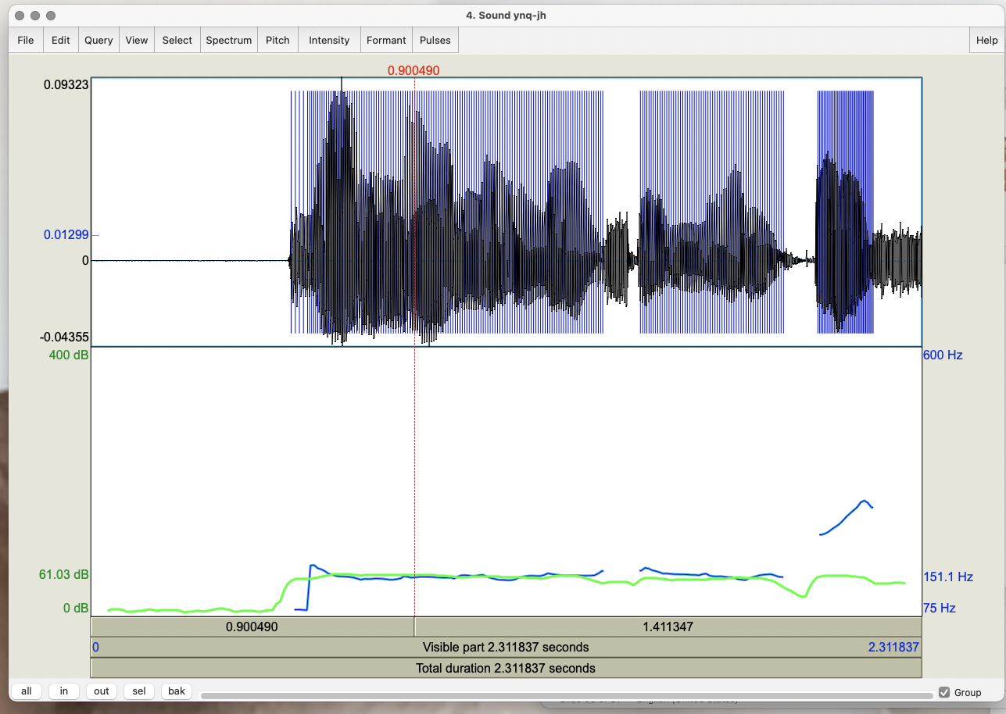
Notes:
Ynq contour goes up at the end

Slide 48
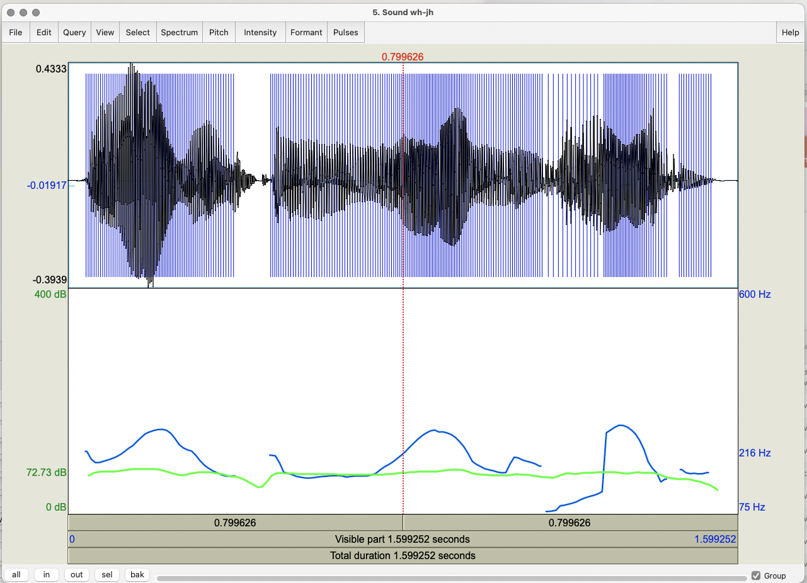
Notes:
Version 1 of whq

Slide 49
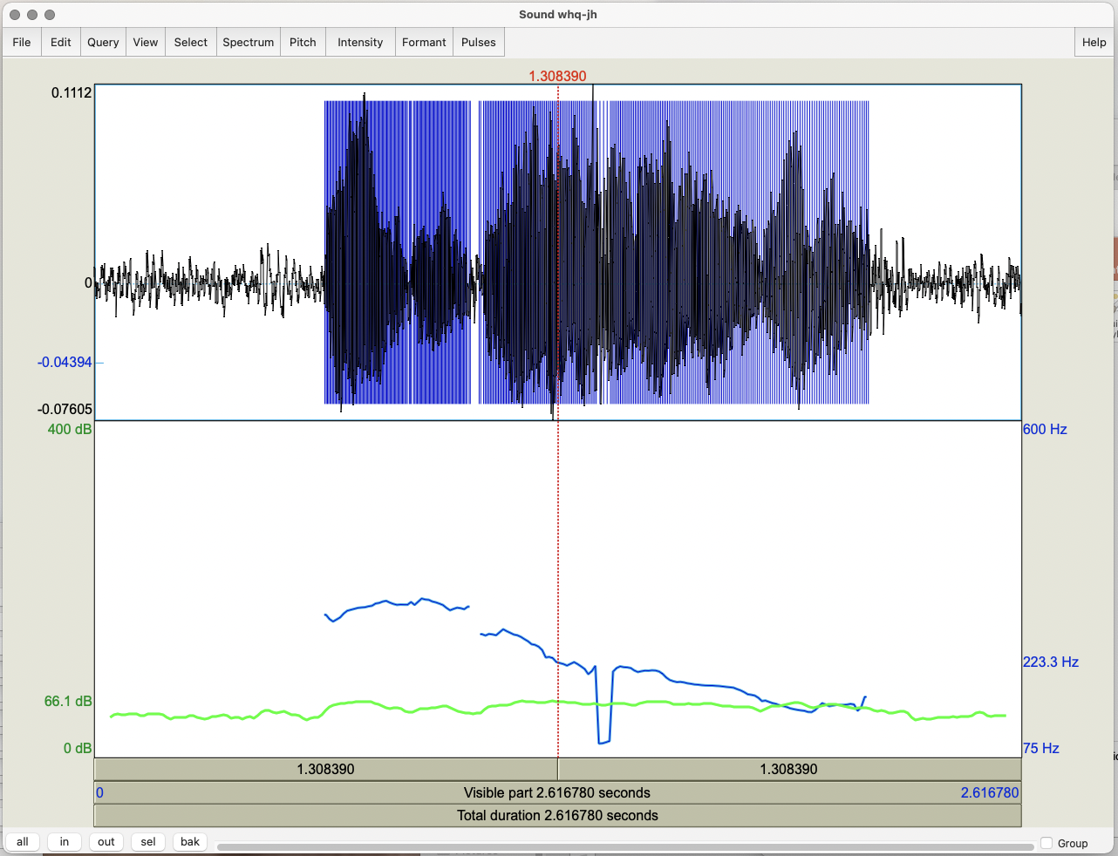
Notes:
Wh version 2 --
What difference do you see? What’s the difference in interpretation?

Slide 50
Task 4: Emotional Speech
Record “My mama lives in Memphis” again
As angry speech
As sad speech
As happy speech
For each token, do you see any differences in:
Mean pitch? Maximum?
Mean intensity? Maximum?
Voice quality?
Duration?
F0 contour?

Slide 51
Task 5: Changing the Pitch Contour
Take the statement version of your mama file
Modify it to produce a rising intonational contour
Go to Manipulate → To manipulation – in the menu that pops up click OK
In Objects select Manipulation <filename>
Go to View & Edit
In the Manipulation window:
Go to Pitch → Stylize pitch (2st)
Modify pitch by dragging points up and down
Turn your statement into a question by lowering earlier pitch and raising final pitch

Slide 52
Play the result
To save go to File -> Publish resynthesis
Compare it to the yes-no question version you recorded
Now modify the duration:
Place cursor at a point in the duration manipulation band where you want to change the duration
Dur → Add duration point at cursor
Drag points up (slower) and down (faster) to change rate
Play the result
Notes:
File --> Publish resynthesis is at the top left of the window you see
Dur → Add duration point at cursor is at the top of the window in the middle

Slide 53
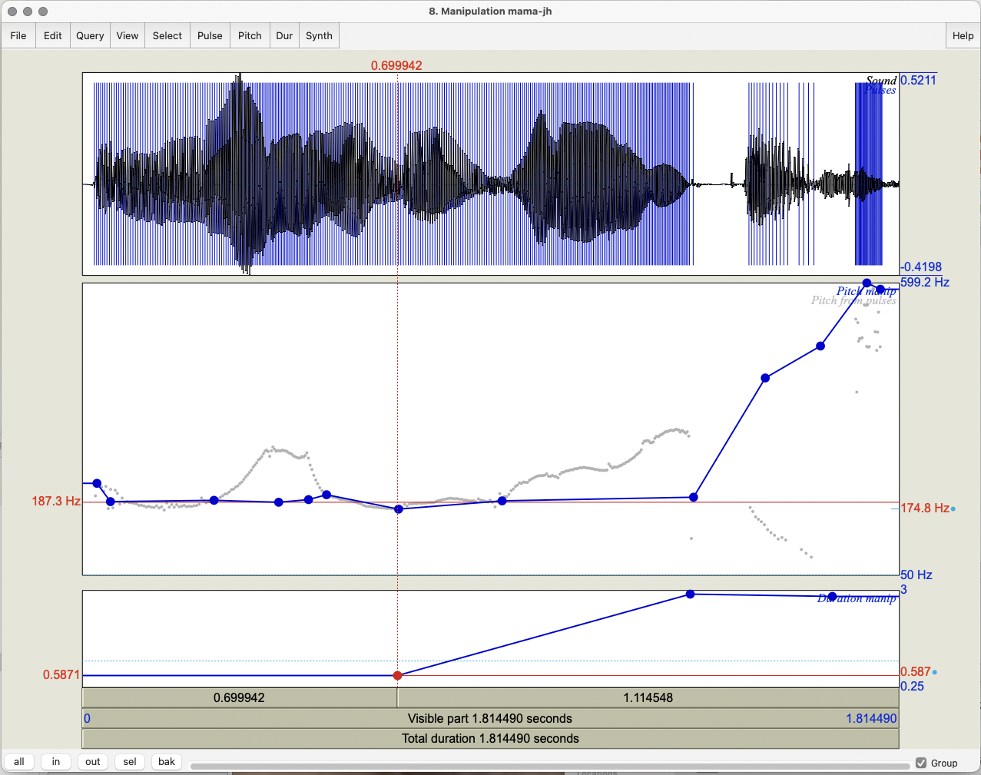

Slide 54
Task 6: Modifying Emotion
Take your very happy version of mama
Go to Manipulate → To manipulation and click OK
Go to View & Edit with Manipulation object
Go to Pitch → Stylize pitch (2st)
Modify Pitch by dragging points up and down
Modify Dur by dragging points up and down
Turn your happy speech into sad speech; play the result
To save: File -> Publish resynthesis to get a new sound file “Sound from ManipulationEditor
Notes:
Show next slide

Slide 55
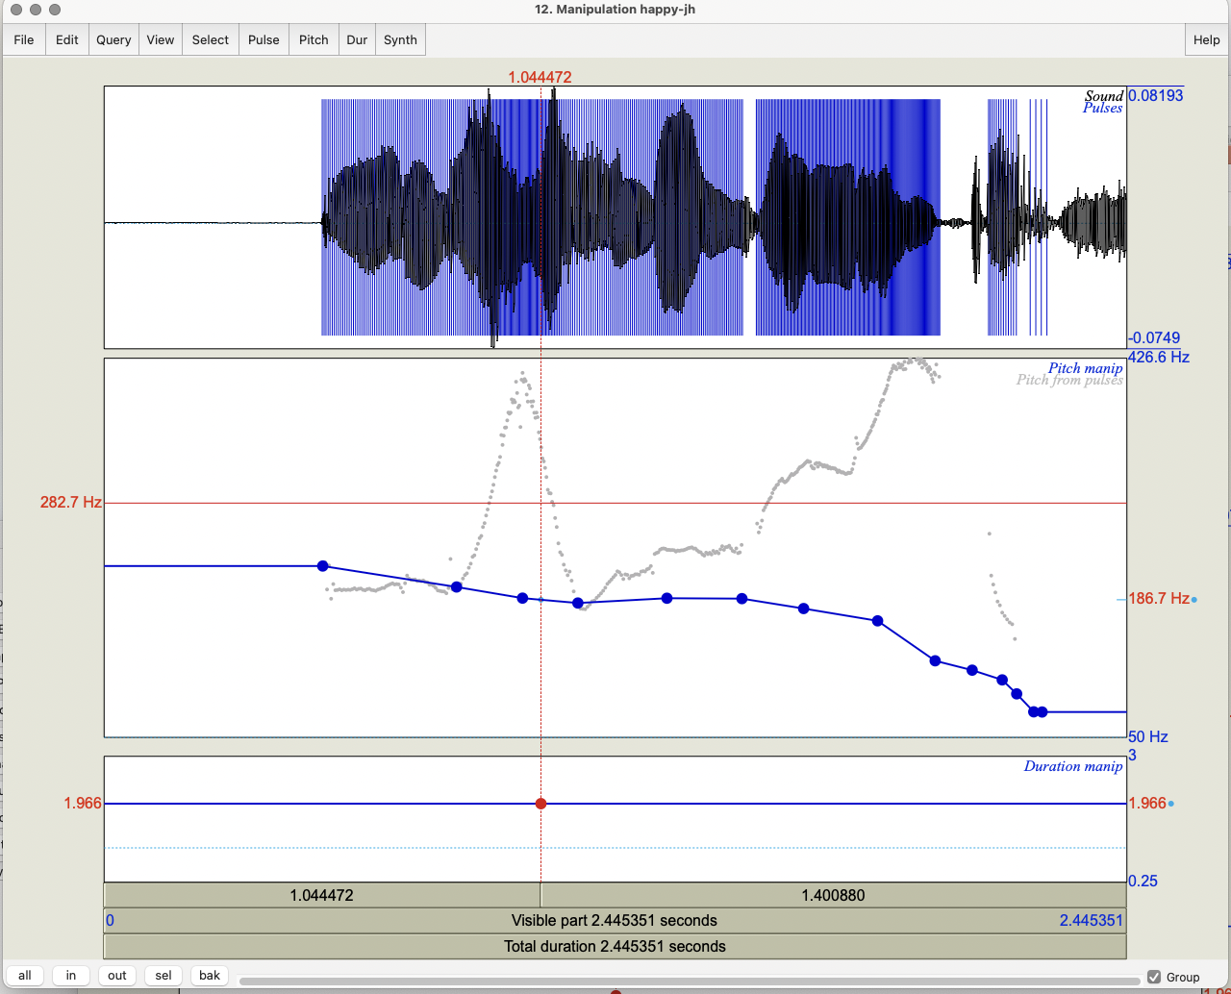
Notes:
How we changed the f0 of the happy file

Slide 56
Task 7: Pitch Contour Cloning
Record a sad version of mama and read both the happy.wav and sad.wav versions into Praat
Create a manipulation object for happy.wav
Select Extract pitch tier on right
Create a manipulation object for sad.wav
Select the pitch tier of happy.wav and the manipulation object for sad.wav and click Replace pitch tier
Select the manipulation object for sad.wav and click Get resynthesis…
View & Edit the new version of sad.wav
Notes:
Use Manipulate → To manipulation to create a manipulation object and click OK

Slide 57
Compare the original sad.wav file and the new sad.wav
Compare the new sad.wav and the original happy.wav
Notes:
Original sad to new modified sad
Original happy to new sad2happy version

Slide 58
Task 8: Clipping
Record a short phrase in a very loud voice, to produce clipping, and see what the waveform looks like
How do you identify clipping?
Input signal amplitude is greater than the range that can be represented in
Avoid it?
Increase the resolution (sampling rate)
Decrease the amplitude

Slide 59
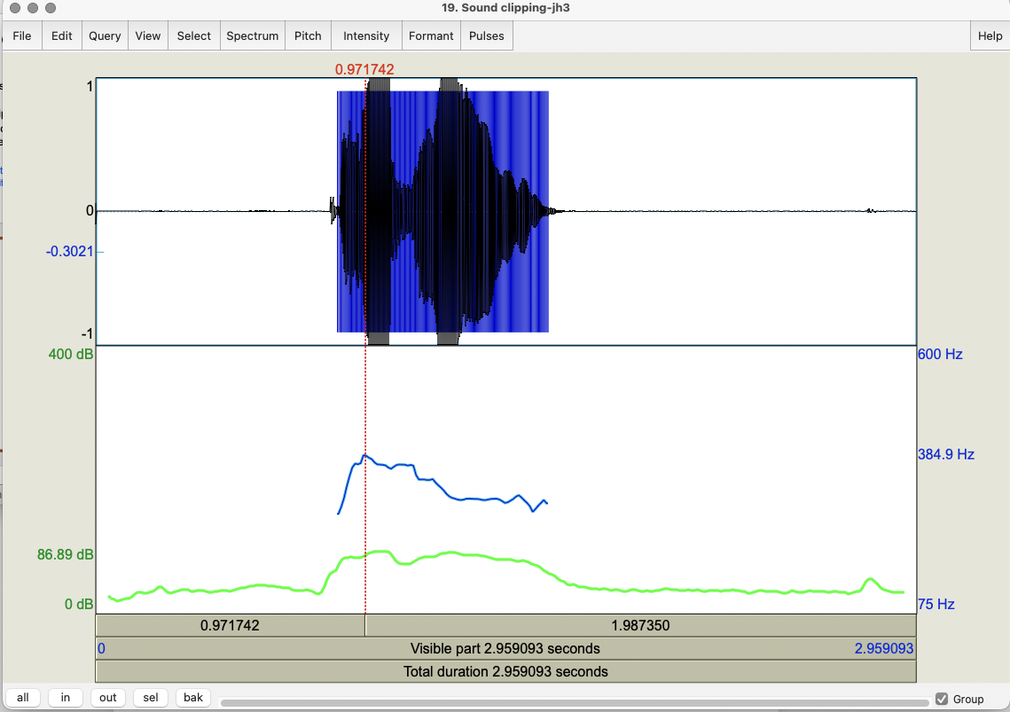

Slide 60
Task 9: Formant Analysis
Extract F1 and F2 values for the vowels in your mama file
Formant -> Show formants
For each, select the vowel in the wavefile
Formant → Get first formant
Formant → Get second formant
You can submit yours results here if you wish:
https://goo.gl/forms/ZIOvmXOP5ubIq1rS2

Slide 61
Task 10: Annotation using Textgrids
Select file in Objects window
Select View & Edit
Select Spectrogram -> Show spectrogram
Annotate → To Textgrid
Select Sound mama and Textgrid mama and select View & Edit
Point vs. interval tiers
Tier → Add point tier called PartofSpeech and Tier → Add interval tier called Words in Tier and insert some labels
NB: Remember to select the correct interval or point circle first in the waveform or spectrogram before trying to insert a label
Notes:
For the point tier you click on the right location for the point
For the interval tier you select the beginning and ending time at the top of all textgrids but click on the circle at the top of the desired tier.

Slide 62
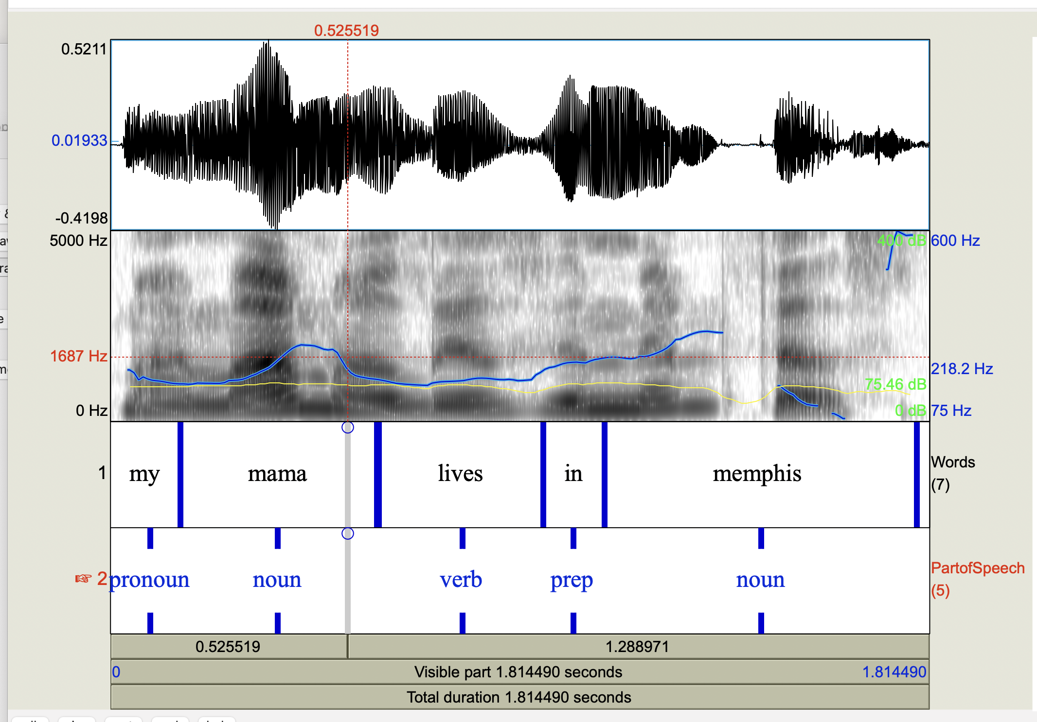

Slide 63
Task 11: Masking
Select original mama file each time
Select Convert → Change gender; OK
Select Filter →filter (pass) Hann band; OK
Retains only a specified range through
Find a pass band that masks the words but retains the intonation
Find a pass band that masks the intonation but retains the words
Modify → Reverse
Notes:
Filter: keeping lower bands keeps intonation; higher bands (e.g. 500-1000) keep words
Modify Formant Shift Ratio (lower is male; 1.0 is no change; higher is female); New Pitch Median can also be reset to a lower or higher value for male vs. female
To change female to male try things like 0.8 or 0.9 for formant shift and 65 for pitch median…

Slide 64
Scripting
From what you’ve just done in Praat:
Praat → New Praatscript → Edit → Paste history
Save the script, which you’ll see is everything you’ve done today if you’ve kept Praat open
To use again, select Praat -> Open Praat Script
When the script opens, choose Run (you can run all or part of the script)
You can also write scripts or modify existing scripts

Slide 65
Sample Praat Script
# This script will create a new text-grid for a wav file
form Make a text-grid for a .wav file
comment Source Directory?
sentence Directory C:\Documents and Settings\julila\My Documents\
comment File name?
sentence Filename
comment Tier Name?
sentence Tier
endform
Read from file... 'directory$‘ ‘filename$'
stem$ = left$(filename$,length(filename$)-4)
select Sound 'stem$'
To TextGrid... 'tier$' 'tier$‘ # tier names, which tiers are point tiers
Write to text file... 'directory$'\'stem$'.TextGrid
Remove

Slide 66
Help
Online Praat help, FAQ, manual
Links from http://www.praat.org
UCLA resources
Parselmouth vs. Praat Scripting
There are more Tasks you can look at in today’s slides…
Notes:
For a quick check, you can use Praat → New Praat Script --> Edit → Paste history

Slide 67
Next Class
Readings:
ToBI Conventions
AuToBI
Prosody and Meaning
*Guidelines for ToBI Labeling
Post 5 on these due next Monday (10/3/22) at 11:59 pm
HW 1 assigned: due 10/11/22 at 4:10 pm
Questions?

