Slide 1
Personality
PMichelle Levine
November 15, 2022

Slide 2
Agenda
What is personality?
Can we automatically detect personality?
Does big data help improve predictions?

Slide 3
Think about someone you know well.
Write down how you would describe this person to others. Use as many words/phrases as necessary to fully describe the person.
Notes:
Ask the class, how may words did you think of? Do we need them all or can we eliminate/combine some to come up with a much smaller/basic set of traits, ie personality traits?

Slide 4
What is Personality?
This is about who you are – your characteristic style of behaving, thinking, and feeling.
How can we assess differences in personality?
  4 main approaches in psychology:
    Trait
    Psychodynamic
    Humanistic
    Social-Cognitive
Notes:
Go to next slide to highlight trait approach

Slide 5
What is Personality?
This is about who you are – your characteristic style of behaving, thinking, and feeling.
How can we assess differences in personality?
  4 main approaches in psychology:
    Trait
    Psychodynamic
    Humanistic
    Social-Cognitive
Notes:
For the research we will be discussing today, we will focus on the trait approach.
The other approaches look at personality as a more fluid concept, but the work we are looking at, and the prevalent modern day theory, rests heavier on the trait approach because these are the models that most effectively predict how people act.
Notes for if students ask:
Psychodynamic – believes personality in terms of unconscious psychological processes that you may not even be fully aware of
Humanistic – views people in steps of self-actualization with personal worth as a central theme; so this line of reasoning views personality through the eyes of the person doing the behaving and that it links to inner feelings and self-image
Social-cognitive – personality shaped by interacting factors

Slide 6
Trait Approach
Personality = a combination of traits
Assumes:
  People differ from each other in (relatively) stable ways.
  Traits are consistent ways of behaving and therefore can predict future actions.
Attempts to find a taxonomy (classification scheme) for core traits that define personality.
Notes:
Personality = a combination of traits
Assumes:
After first point add:
Examples: honest, dependable, moody, impulsive
After last comment:
Traits allow us to summarize something about a person usually in a single word(s) and then predict from that how they will act.

Slide 7
Dimensions of Personality
Traits are grouped into dimensions of personality
  Thus, personality is thought of as a combination of separate dimensions (as opposed to types).
How were the dimensions determined?
  18,000 words for potential traits (Allport & Odbert, 1936)
  Goal: sorted words into underlying groups/dimensions
  Used both self-report and informant data to measure personality.
Notes:
Why dimensions of personality vs types of personality? allows for infinite variations in personality, rather than a few basic types.
Some research it may be helpful to create types by using clusters or categories (hi, med, low)
But for trait theory the
goal is to compress the vast range of human traits into dimensions which then the dimensions together (ie, the big 5 dimensions) make up different facets of a person’s personality.
18,000 English dictionary personality-relevant terms

Slide 8
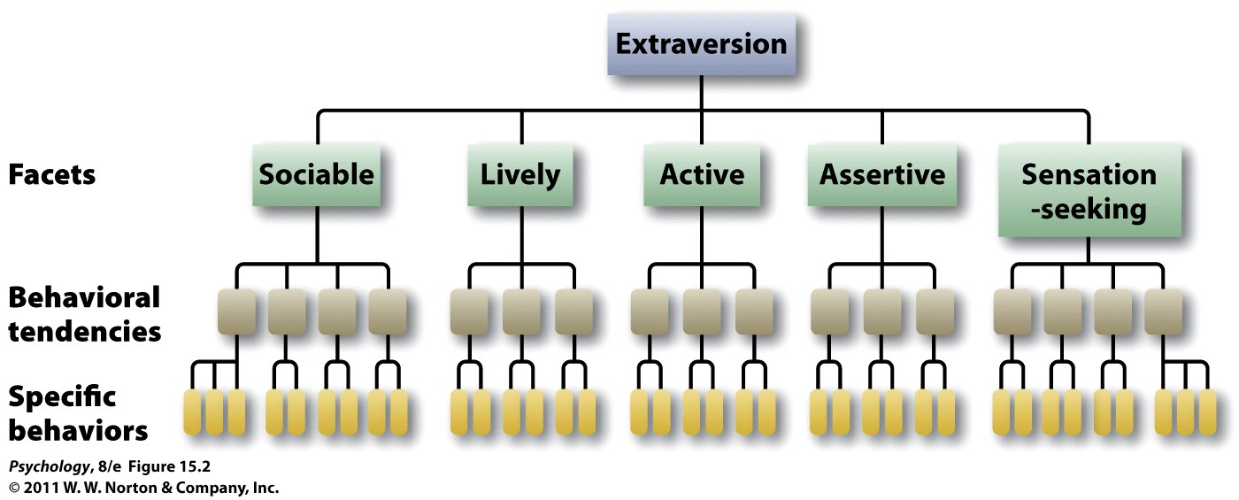
Determining Core Traits
Notes:
15.2 The hierarchical organization of personality One of the Big Five personality traits, extraversion, encompasses a broad summary of many, more specific, facets of personality, each of which is defined by particular behavioral tendencies and still more specific behaviors.

Slide 9
The Big Five
Openness to experience
Conscientiousness
Extraversion
Agreeableness
Neuroticism
Notes:
People such as Cattell would see which words overlapped and were used most often and were able to eventually yield 16 primary personality dimensions.
Then further research by others showed even more overlap in his 16 dimensions
At one point down to 2 or 3.
Now much consensus around 5.

Slide 10
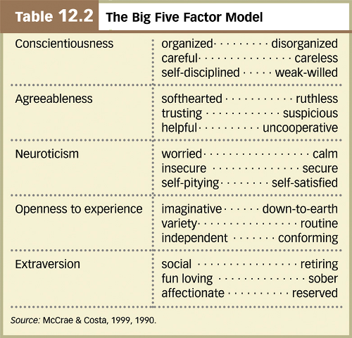
Notes:
Costa & McCrae (1992) NEO-FFI Personality Measures
Openness to Experience: intellect/imagination, originality, curiosity, ingenuity, imaginative, insightful
“I have a lot of intellectual curiosity.”
Conscientiousness: orderliness, responsibility, dependability, organized, thorough, planful
“I strive for excellence in everything I do.”
Extraversion: talkativeness, assertiveness, energy
“I like to have a lot of people around me.”
Agreeableness: good-naturedness, cooperativeness, sympathetic, kind, affectionate, trust
“I would rather cooperate with others than compete with them.”
Neuroticism: anxiety, emotional instability,intense, moody,
“I often feel inferior to others.”
(opposite of this is emotional stability)

Slide 11
Questions About The Big Five
How stable are the traits?
  Change over development
  Stable in adulthood
How heritable are they?
  ~50% for each trait (.40 to .55 heritability)
    Influence of temperament?
    Other factors, ie, in extraversion
How about other cultures?
  Traditionally traits are thought to be common across cultures
  But research has shown cultural differences in personality
Notes:
HEREDITY:
adopted children: zero correlation between adopted children and their adoptive siblings
identical twins: strong correlation between identical twins reared together or apart
E.g., Temperament may play a role:
There is growing evidence that personality traits develop from an individual’s temperament, which is evident from an early age and thought to be genetically determined.
Twin studies of the Big Five dimensions confirm a high heritability
extraversion—genetic influences depend on level of central nervous system reactivity, with introverts more reactive than extraverts
- sensation seeking and inhibited temperament
Culture can influence personality, as evidenced by the observation of national character and the fact that different cultures vary in average levels of the Big Five traits.
If asked about temperament:
- it is personality you are born with (innate aspects of your personality)
Then your personality evolves and stabilizes as you reach adulthood

Slide 12
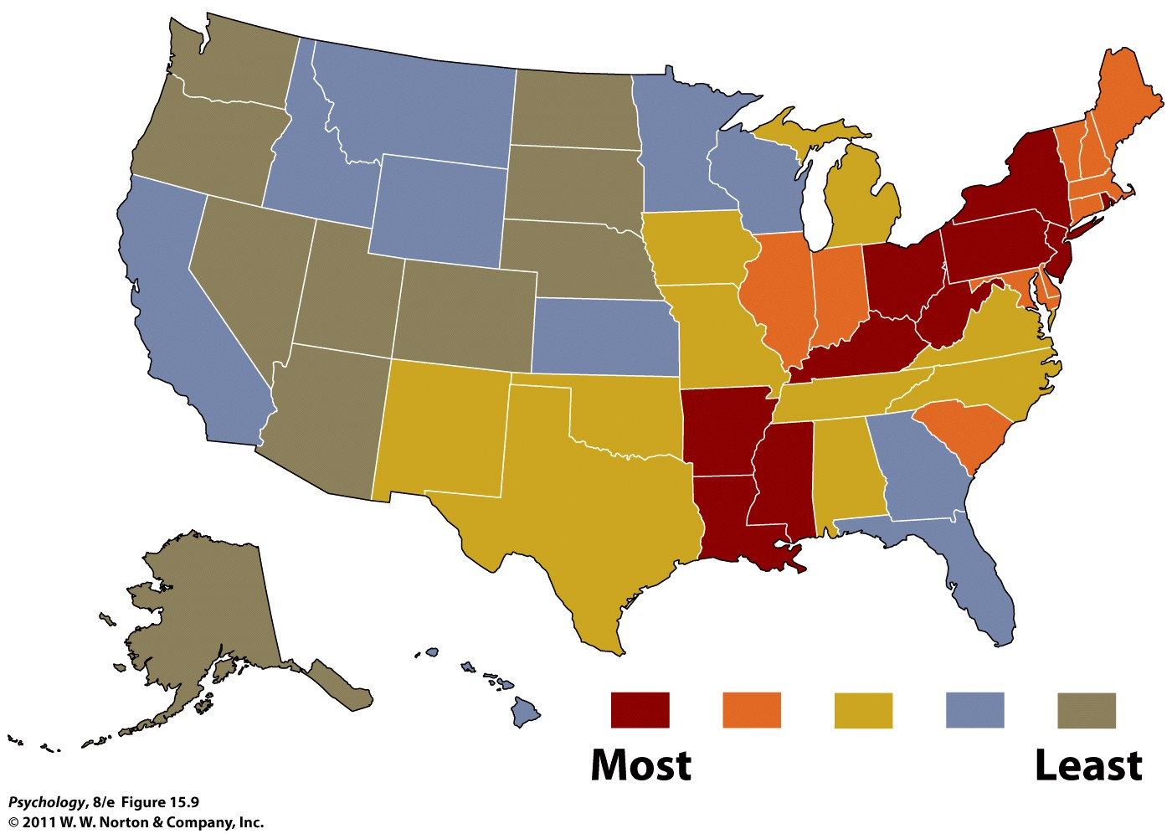
Where are the more “neurotic” places to live?
Notes:
15.9 Map of neuroticism in the United States According to these data, the eastern side of the country is a more “neurotic” place to live than the western side (Rentfrow, Gosling, & Potter, 2008).

Slide 13
Are Traits Truly Constant?
Personality paradox: people often behave less consistently than expected
  Person-Situation Controversy (e.g., Mischel 1968; 1984; 2004)
    Part of the explanation for this paradox is the power of the situation
Counter-argument:
  Trait theorists argue that behaviors from a situation may be different, but average behavior remains the same
  Therefore, traits matter
One solution? Consistency of behavior as a trait
  Interaction between personality and situations
    Situations interact with individual differences
  Some people are more consistent in their behaviors—the Self-Monitoring Scale
Notes:
Person-situation controversy: points out that traits may be enduring, but the resulting behavior in various situations is different. Therefore, traits are not good predictors of behavior.
Critics of the trait approach (e.g., Mischel) argue that there is no such thing as stable personality traits because behaviors appear to vary considerably from one situation to the next. In other words, they argue that there is no consistent expression of a trait across different situations.
1) Both personality and situations matter, usually in interaction.
At end say all the following,
Overall:
Consistency of behavior, in and of itself, appears to be a trait that varies from person to person and is mediated by the degree to which individuals self-monitor their behavior to fit the situation.
Although some strong situations producing nearly uniform behavior among different individuals,
It turns out, however, that some degree of cross-situational consistency can be observed if we look at specific types of situations.
Thus, for example, someone might be consistently helpful with friends and consistently not helpful with strangers, and thus appear inconsistent in helpfulness if we combine these different types of situations.

Slide 14
Traits vs states
Personality traits = consistent; stable
Personality states = transient; variable
States are linked to traits but range based on other factors
  Ie, extraverted behavior vs extraversion
  Ie, anger vs hot-headed
Where do emotions play a role?
  This gets tricky as emotions are transient but also often called a state!
  Focus of research is on how personality impacts emotions
Notes:
Trait vs State
Trait – relatively stable pattern that characterizes an individual
State – fluctuations based on the moment and the situation
ie, someone is in an anxious state at the moment for a specific reason vs an overall anxious person
ie, being in a state of anger at this particular moment vs the trait of being generally hot-headed
Think of states as behaviors, thoughts and feelings at a particular moment
Thus, for example, someone might be consistently helpful with friends and consistently not helpful with strangers, and thus appear inconsistent in helpfulness if we combine these different types of situations.

Slide 15
Assessing Traits
Personality inventories: questionnaires (often with true-false or agree-disagree items) designed to gauge a wide range of feelings and behaviors assessing several traits at once
The Minnesota Multiphasic Personality Inventory (MMPI) is the most widely researched and clinically used of all personality tests.
Notes:
The MMPI-2 is a 567 item, true/false self-report measure of a person's psychological state.
Takes around 1.5 hours to complete.

Slide 16
NEO-FFI
Short questionnaire to assess the big 5 traits
Widely used in research
60 items (12/trait)
Likert scale
  SD (strongly disagree) — SA (strongly agree)
  0 - 4
Example questions:
  When I’m under a great deal of stress, sometimes I feel like I’m going into pieces.
  I usually prefer to do things alone.
Notes:
11 – neuroticism
27 – extraversion (reverse-scored)

Slide 17
TIPI
Newer, even shorter questionnaire to assess the big 5 traits
Starting to be used in research
10 items (2/trait)
Likert scale
  1 - 7
  1 = Disagree strongly; 7 = Agree strongly
Notes:
11 – neuroticism
27 – extraversion (reverse-scored)

Slide 18
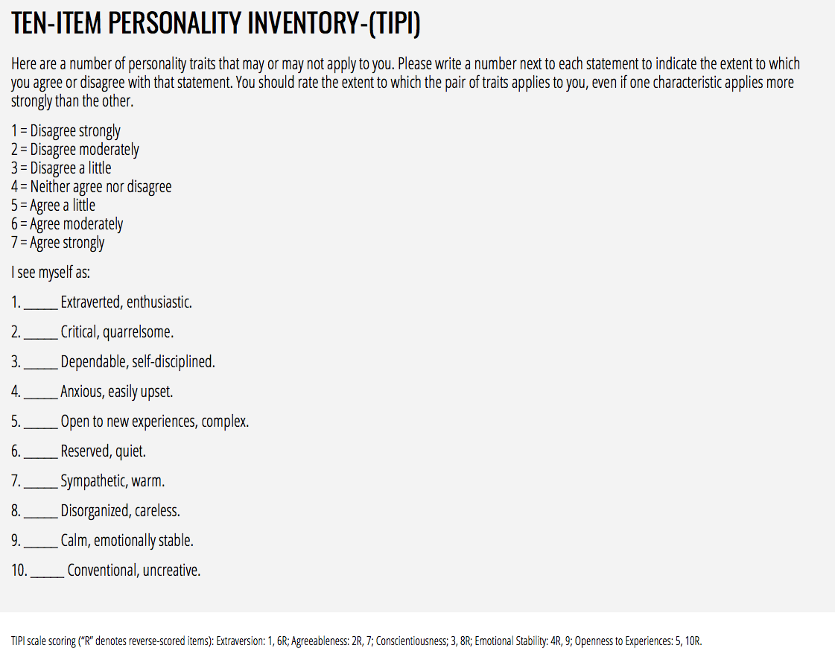

Slide 19
IPIP
International Personality Item Pool
Public and open source of personality inventory items
Ie, For testing for the 5 factors, IPIP-NEO has a 300 items and a120 item version

Slide 20
Assessing personality states
Traditionally scores gathered using daily diary or experience sampling
  But no gold-standard measurement to date
  Although recent research has shown advancements using using digital traces from wearable devices, smartphone sensor data, etc

Slide 21
Automatic Personality Detection
Automatic Personality Detection (APD)
Research has examined a multitude of cues for determining traits:
  Written language
  Nonverbal vocal behaviors
  Spoken/conversational language
And from a multitude of sources:
  Facebook, Twitter, blogs, general language use
Useful for:
  Marketing, adaptive/personalized systems, detecting deception/sarcasm/irony, predicting task/job success
Notes:
**look up spoken/conversational language from lecture from following week

Slide 22
Detection with Written Language
Written language use → personality
Pennebaker and King (1999), Linguistic styles: Language use as an individual difference
  Stream-of-conscious essays
  Big 5 personality assessment
  Lexical features (LIWC)
  Findings, ie.,
    Agreeableness
      more positive emotion words
      fewer negative emotion words
      fewer articles
      more first-person
Notes:
One of the original studies on this looked at whether language use reflects personality style.
They did many different experiments in this article but let’s focus on the one about LIWC and five factors of personality

Slide 23
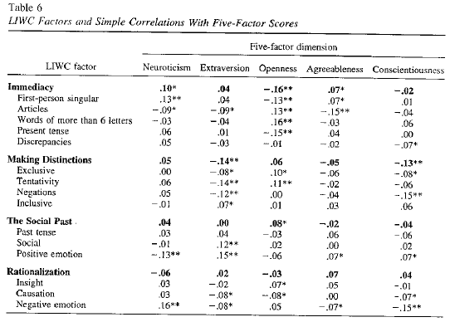
Notes:
Correlations between the 2 variables: negative and positive
Patterns that emerge:
Openness to experience and immediacy
Extroversion and making distinctions
Conscientiousness and making distinctions

Slide 24
Detection with Spoken language
Can we assess personality from what is said and/or how it is said?
E.g., Mairesse & Walker (2006)
  Can personality be recognized automatically in conversation?
  Data (previously collected by Mehl & Pennebaker):
    Daily life conversations, collected and transcribed
    Personality ratings from 5-7 independent observers
  Features/analyses:
    5-7 judges of personality
    LIWC (linguistic features)
    MRC psycholinguistic database
    Utterance type (ie, commands, back-channels)
    Praat (pitch, intensity, speech rate)
Notes:
Psychologists would argue that a person’s personality is shown in the way they behave, which includes in the way they speak.
**So now looking at what is said and how it is said
96 participants wore ear recorder for 2 days
Corpus:
97,468 words and 15,269 utterances
Research has shows that speech factors help, such as:
Fundamental frequency
Voice quality
Intensity
Frequency and duration of silence pauses

Slide 25
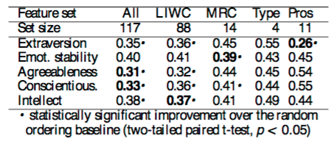
Results
Notes:
Table 3: Ranking errors over a 10 fold cross- validation for different feature sets (Type=utterance type, Pros=prosody). Best models are in bold.
**go through each column
What about specific features?
Go to next slide

Slide 26
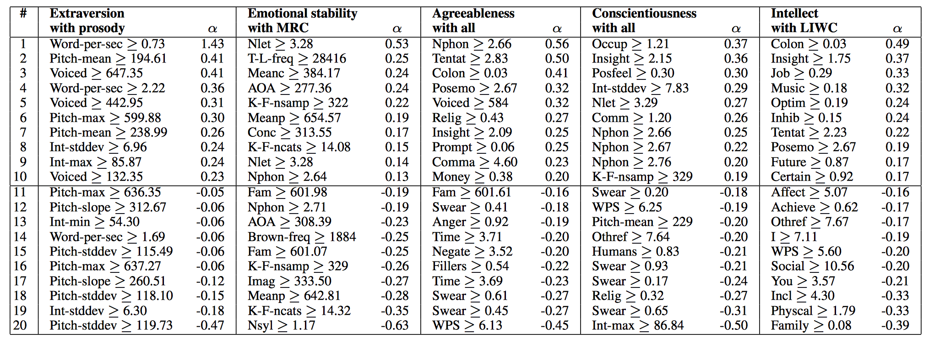
Results: Specific Features
Notes:
Table 4: Best RankBoost models for each trait. Rows 1-10 represent the rules producing the highest score increase, while rows 11-20 indicate evidence for the other end of the scale, e.g. introversion.
e.g., for extraversion, confirmed previous findings that they are more likely to have a higher speech rate, longer conversations, and now also see:
Higher pitch compared to introverts

Slide 27
Personality and Social Media
Recent work focuses on personality detection from:
  Blogs, Twitter, Facebook
  Instagram, Snapchat
  Browser history, transactional data, wearable devices
Must consider:
  Source of data: purpose of platform; purpose of user
  Ethics: consent; user-expectations
    Ie, Cambridge Analytica
Notes:
Cambridge Analytica:
A political data-analysis firm had worked on the 2016 Trump campaign
Exposed in 2018
Had used the personal data from 50 million (now thought to be 87 million?) FB users without consent to target political advertising
And info of friends linked to those people
Data was acquired through “thisisyourdigitallife” third-party app created by Aleksandr Kogan, psychology professor at University of Cambridge
- He had FB users sign up to be part of a study where they do a questionnaire that helps him predict their behavior based on personality but once they logged in to complete it, he had access to all of their friends who he otherwise wouldn’t have had.
It is a FB feature called “friend permission” – you are giving permission for your friends
Kogan has been quoted saying things like the attitude was that everyone knows and no one cares – but this isn’t true

Slide 28
Computer vs Human Judgments
Computer models from meta-data are found to be more accurate than human judgments (even better than close friends!)
E.g., Youyou, Kosinski & Stillwell (2015)
  Assessed accuracy of personality judgments by humans vs computers using 3 different criteria:
    Self-other agreement
    Interjudge agreement
    External validity
  And compared it to scores on the IPIP
Why?
  More information → increased accuracy
  Statistical modeling → fewer biases
Notes:
Youyou example:
Assessed accuracy of personality judgments by humans vs computers and compared it to scores on the IPIP
Overall findings: computer judgments more accurate than ones made by close others and acquaintances (ie, only needed 100 facebook likes to get better results than humans)
-- -- -- --
Background info if people ask:
Compared using 3 different criteria:
self-other agreement
Interjudge agreement
External valiidy
Self-other agreement – personality inventory & Likes on FB versus personality inventory & judgments of friends/family/spouse
Found:
Computer models only need 100 likes to outperform an average human judge
Likes-based models are more diagnostic of some traits, such as openness
Interjudge agreement – is it better accuracy between human judges or computer judges?
Used agreement of judgments of two friends VS agreement between two models each using half of the FB Likes
found: consensus across computer models was much higher than for human judges
External validity – personality scores, humans’ judgments and computers’ judgments ability to predict 13 life outcomes and traits linked to personality
- found: external validity of computer judgments was higher than that of human judges in 12/13 outcomes/traits
ASK CLASS -- Why?
Personality ratings more accurate with more information. Computers can store more information can more readily access it/recall it.
Statistical modeling optimizes accuracy vs humans are affected by biases (although one can argue that advantage of human flexiblity may capture the nuances of persanlity better)

Slide 29
Meta-analysis
Azucar, Marengo & Settanni (2017). Predicting the Big 5 Personality Traits from Digital Footprints on Social Media: A Meta-Analysis
  Digital footprints → personality traits?
  Goals:
    1) Determine average predictive power of digital footprints on each factor
    2) Assess impact of different types of data on accuracy
  Overall findings:
    Digital footprints are able to predict personality
    Better when data from multiple sources, but different sources for different traits
  Sources:
    Private vs public platforms
    Demographics
    User activity stats
    Language/text vs pictures
Notes:
**Assigned reading
Activity stats helped for extraversion
Demographics helped for agreeableness, neuroticism and marginally for openness

Slide 30
Traits (& states?) → marketing
Matz, S.C. & Netzer, O. (2017)
Research question: Can big data help predict psychological traits and states and thus help marketing strategy?
Hypothesis: Now that vast amount of consumer information is available, consumers’ general tendency to think (traits) and how they feel in a particular context (states) can be inferred and thus targeted marketing can improve.
Notes:
. Using Big Data as a Window into Consumers’ Psychology
Consumer information has been around for awhile. Now with new analytical techniques we can find out psychological states and traits that can be used to help marketing strategy. This helps both businesses and consumers.
In past, this type of information was based on focus groups, interviews, observations by store employees, and others such measures.
Now have historical purchasing data, credit card records, search queries, browsing histories, social media profiles, etc
** can inform us what consumer has done, when and with whom
**Need to know both traits and states for best marketing

Slide 31
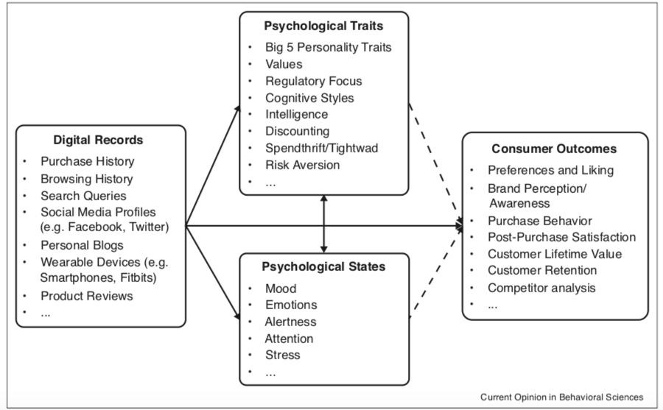

Slide 32
“We expect both researchers and practitioners to go beyond the understanding and prediction of psychological states and traits and towards real-time ‘optimization’ of marketing actions on the basis of these predictions.”

Slide 33
Most recent work
Focus on combination of features and type of classification model to improve predictions
  Ie, word embedding; deep learning models such as BERT
  Ie, stylistic features
Any other ideas?
Questions?
Notes:
Style:
Indirect vs direct
Use of humor
Pace
Use of pauses
Use of punctuation (if written text)

