Slide 1
Spoken Dialogue Systems
Sarah Ita Levitan and Julia Hirschberg
Advanced Topics in Spoken Language Processing
March 29, 2019
*Thank you to Svetlana Stoyanchev for the original slides

Slide 2
What is Natural Language Dialogue?
Communication involving
  Multiple contributions
  Coherent interaction
  More than one participant
Interaction modalities
  Input: Speech, typing, writing, gesture
  Output: Speech, text, graphical display, animated face/body (embodied virtual agent)

Slide 3
When is automatic dialogue system useful?
When hands-free interaction is needed
  In-car interface
  In-field assistant system
  Command-and-control interface
  Language tutoring
  Immersive training
When speaking is easier than typing
  Voice search interface
  Virtual assistant (Siri, Google Now)
Replacing human agents (cutting cost for companies)
  Call routing
  Menu-based customer help
  Voice interface for customer assistance

Slide 4
Visions of dialogue from science fiction
Hal “2001: A Space Odyssey” (1968)
  Naturally conversing computer
Star Trek (original 1966)
  Natural language command and control
Her (2013)
  A virtual partner with natural dialogue capabilities

Slide 5
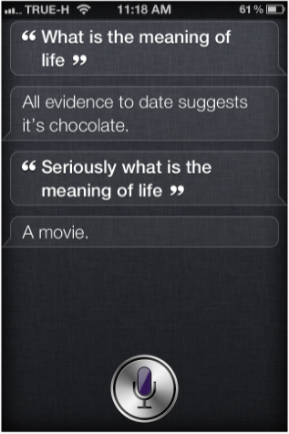
Examples of modern Virtual Assistant dialogue systems
Apple Siri (2010)
  Supports questions in a set of domains
  Answers open-end questions
  Cute “Easter egg” responses

Slide 6
Examples of modern Virtual Assistant dialogue systems
Android Google Now (2013)
  Predictive search assistant
Windows Cortana (2014)
  Works across different Windows devices
  Aims to be able to “talk about anything”

Slide 7
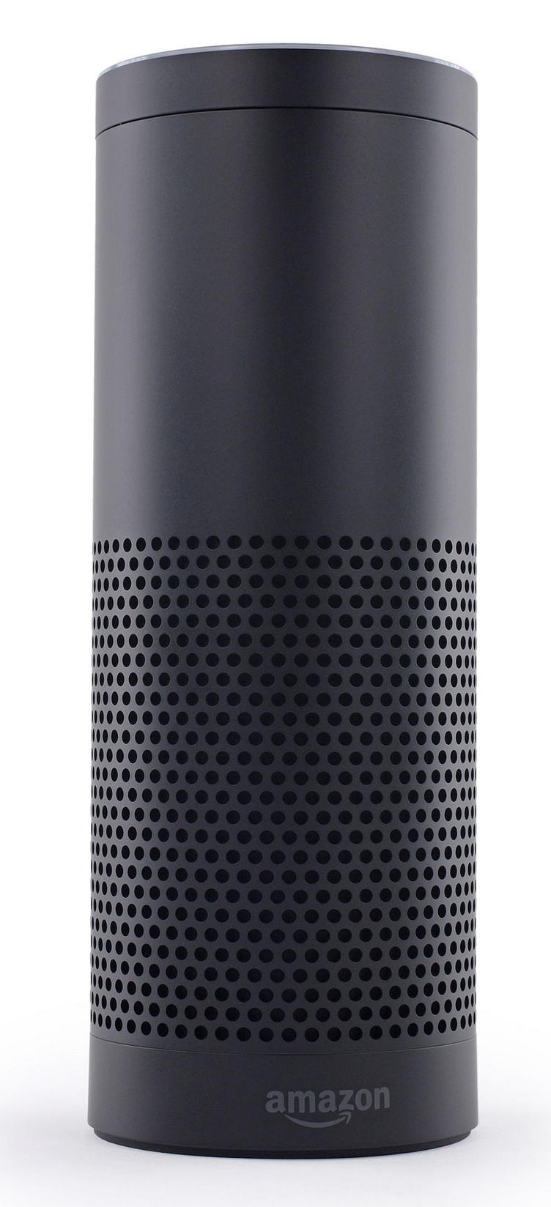
Embedded devices with dialogue capabilities
Amazon Echo (2014) – home assistant device
  Plays music
    With voice commands
  Question answering
    Get weather, news
    More complex questions, like
      “how many spoons are in a cup?”
  Setting timer
  Manages TODO lists

Slide 8
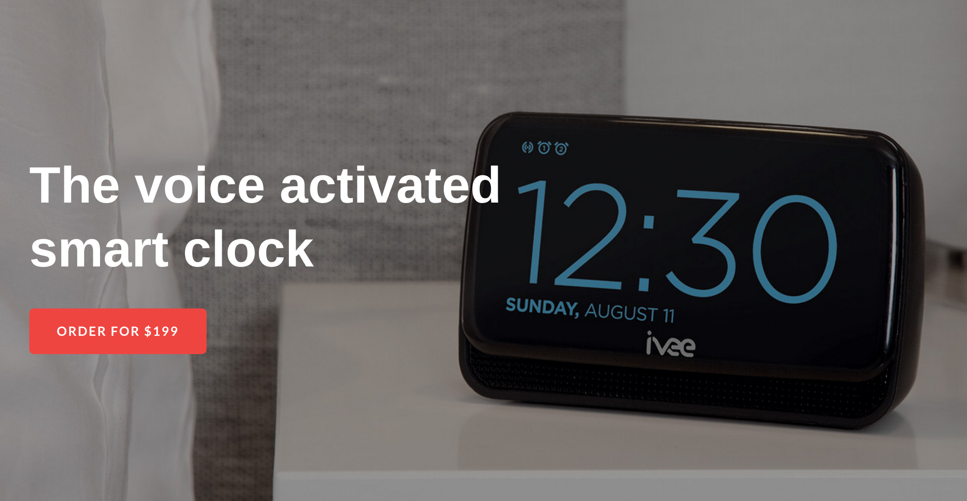
Embedded devices with dialogue capabilities
Answers questions
Sets time
Device control and queries:
  Thermostat
  Etc.
Uses Wolfram Alfa engine on the back-end to answer questions

Slide 9
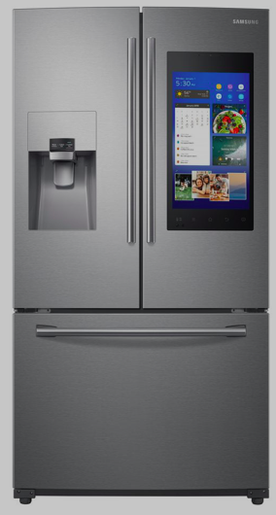
Embedded devices with dialogue capabilities
Control ice machine
Manage shopping list
Stream music and TV
Alexa compatible

Slide 10
When do you use dialogue systems?

Slide 11
Research Dialogue Systems
Research systems explore novel research questions in speech recognition/language understanding/generation/dialogue management
Research systems
  Based on more novel theoretical frameworks
  Open-domain speech recognition
  Focus on theory development
Transition from research to commercial
  Siri came out of a DARPA-funded research project

Slide 12
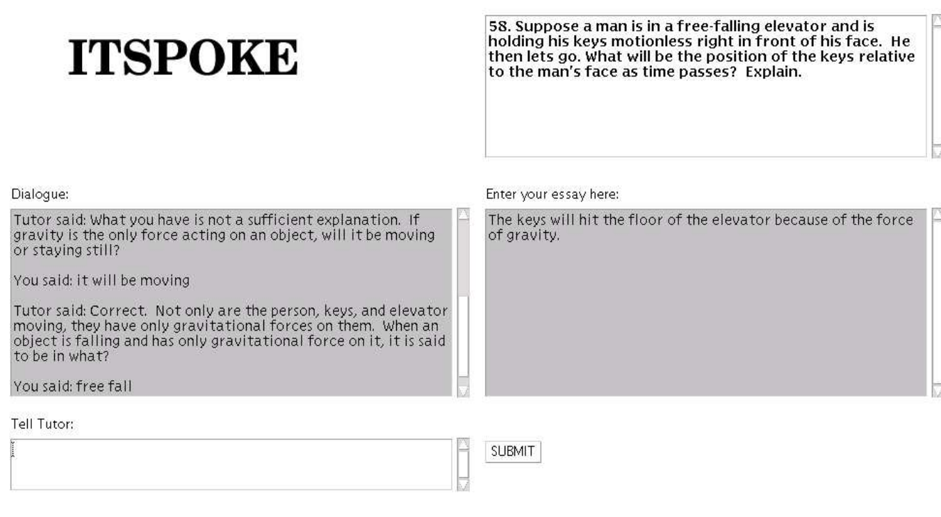
Tutoring (Litman & Silliman,2004),
U. Pittsburgh

Slide 13
CMU Bus Information
Bohus et al. (deployed in 2005) CMU
Telephone-based bus information system
Deployed by Pittsburgh Port Authority
Receives calls from real users
Noisy conditions
Speech recognition word error rate ~ 50%
Use collected data for research
Provide a platform to allow other researchers to test SDS components

Slide 14
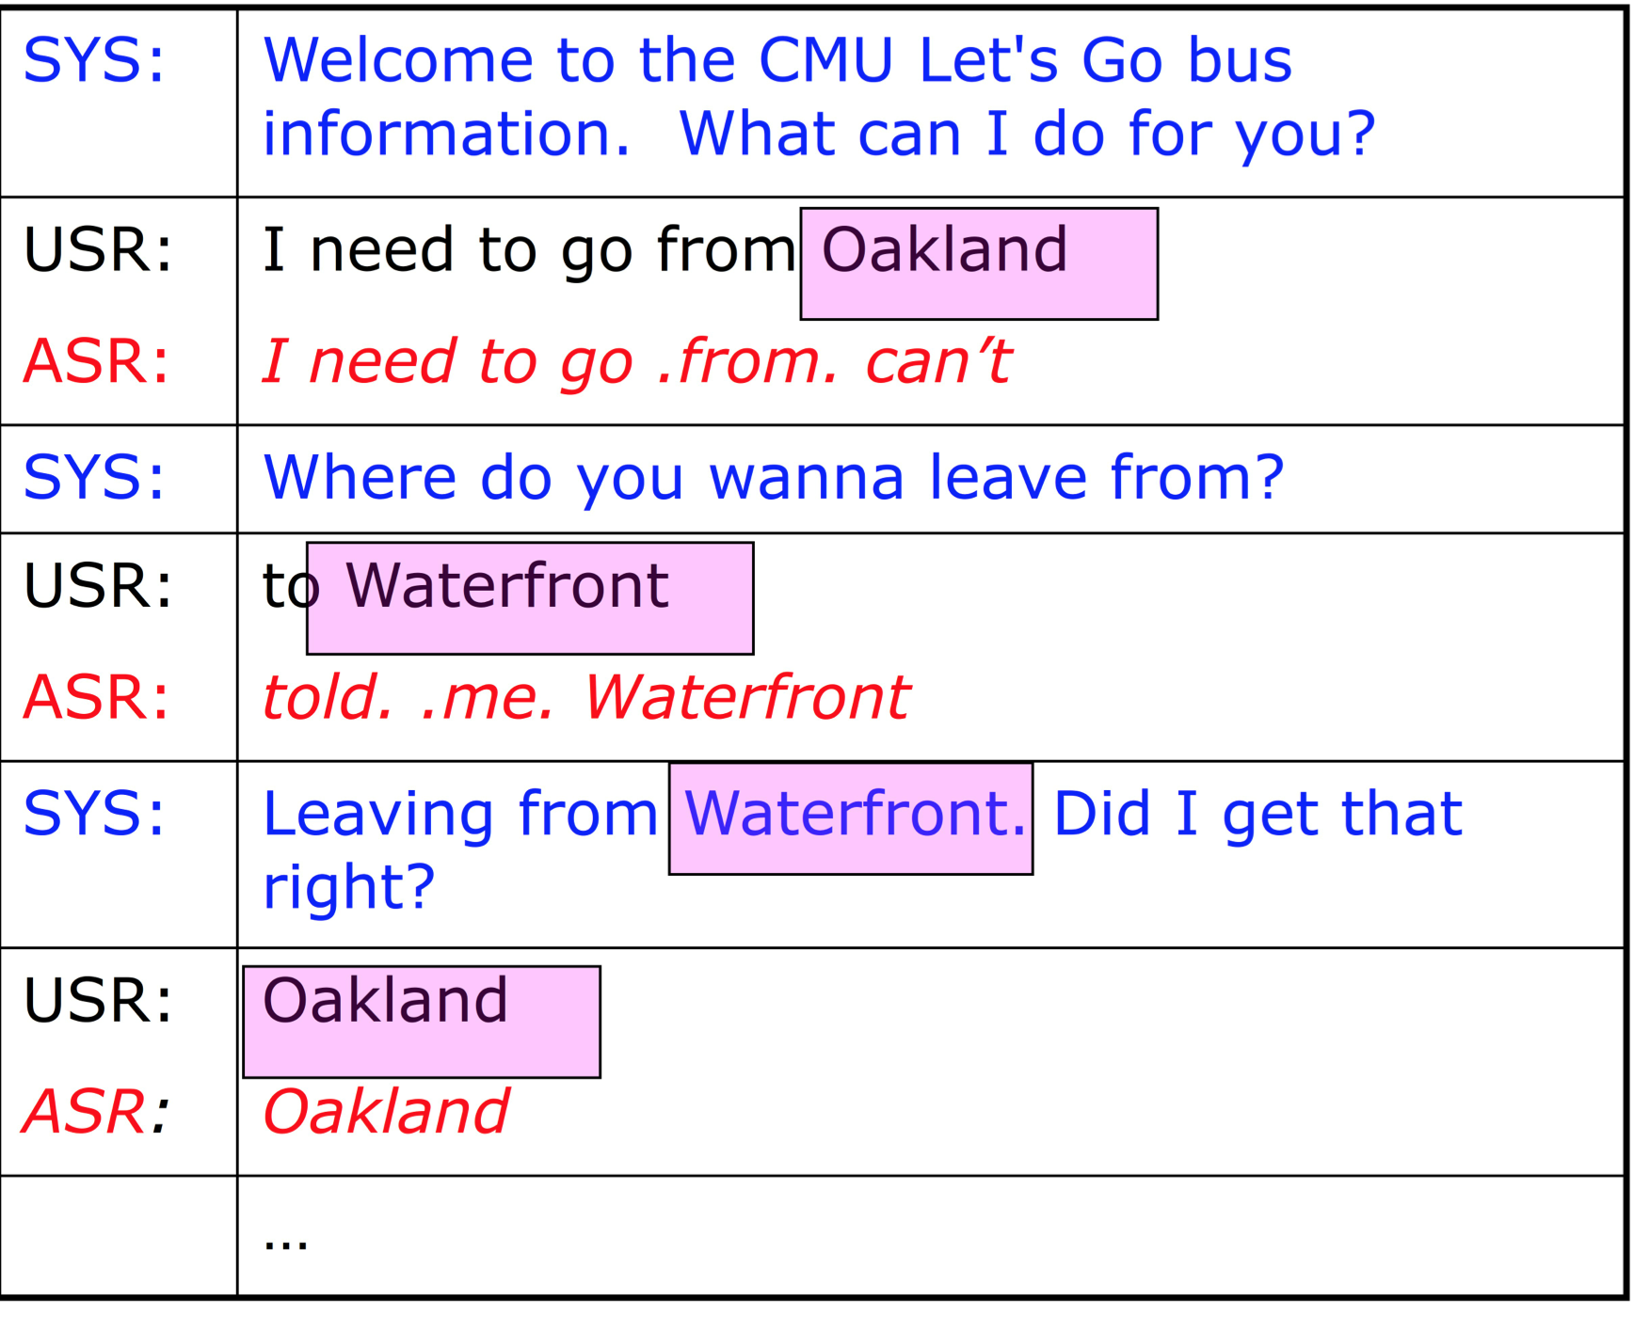
CMU LetsGo Dialogue Example

Slide 15
Commercial vs. Research dialogue systems
Goal
      System Flexibility
Ability to accept varied input
Support multiple wide range
of queries
Multiple domains
User initiative
Research
Commercial
System Reliability

Slide 16
Chatbots vs. Task-oriented dialogue systems
Chatbots
Designed for extended conversations
Mimic unstructured human-human interaction
Task-oriented dialogue systems
Designed for a particular task
Short conversations to get information from a user to help complete the task

Slide 17
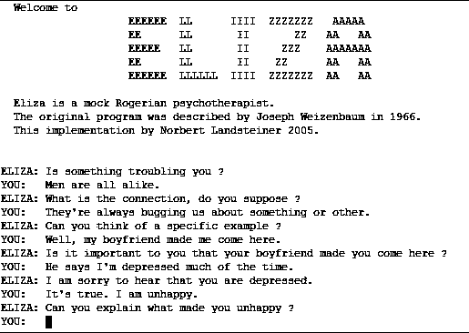
Rule-based chatbots: ELIZA

Slide 18
Rule-based chatbots: ELIZA
Eliza (text only) (Joseph Weizenbaum, MIT, 1966)
A “psychologist” system
Example conversation: http://www.masswerk.at/elizabot/
  ELIZA: Is something troubling you ?
  YOU: I am worried about teaching
  ELIZA: How long have you been worried about teaching ?
  YOU: For couple weeks
  ELIZA: Do you feel strongly about discussing such things ?
  YOU: yes
  ELIZA: You seem to be quite positive.
  YOU: I am concerned about choosing course content
  ELIZA: Do you believe it is normal to be concerned about choosing course content ?

Slide 19
Corpus-based chatbots
Information retrieval
Machine learning
Corpora:
Twitter
Movies
Chat platforms

Slide 20


IR-based
Simple methods:
Return the response to the most similar turn
Return the most similar turn

Slide 21
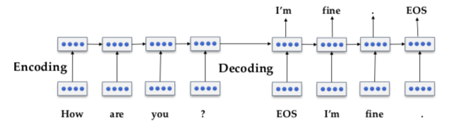
ML-based
Sequence to sequence models (encoder-decoder)

Slide 22
How do we evaluate chatbots?
Human evaluation
Adversarial evaluation

Slide 23
What is involved in NL dialogue
Understanding
  What does a person say?
    Identify words from speech signal
      “Please close the window”
  What does the speech mean?
    Identify semantic content
      Request ( subject: close ( object: window))
  What were the speaker’s intentions?
    Speaker requests an action in a physical world

Slide 24
What is involved in NL dialogue
Managing interaction
  Internal representation of the domain
  Identify new information
  Identifying which action to perform given new information
    “close the window”, “set a thermostat” -> physical action
    “what is the weather like outside?” -> call the weather API
  Determining a response
    “OK”, “I can’t do it”
    Provide an answer
    Ask a clarification question

Slide 25
What is involved in NL dialogue
Access to information
To process a request “Please close the window” you (or the system) needs to know:
  There is a window
  Window is currently opened
  Window can/can not be closed

Slide 26
What is involved in NL dialogue
Producing language
  Deciding when to speak
  Deciding what to say
    Choosing the appropriate meaning
  Deciding how to present information
    So partner understands it
    So expression seems natural

Slide 27
Types of dialogue systems
Command and control
  Actions in the world
  Robot – situated interaction
Information access
  Database access
    Bus/train/airline information
    Librarian
    Voice manipulation of a personal calendar
  API access
IVRs – customer service
  Simple call routing
  Menu-based interaction
  Allows flexible response “How may I help you?”
Smart virtual assistant
  Helps you perform tasks, such as buying movie tickets, trouble shooting
  Reminds you about important events without explicit reminder settings

Slide 28
Aspects of Dialogue Systems
Which modalities does the system use
  Voice only (telephone/microphone & speaker)
  Voice and graphics (smartphones)
  Virtual human
    Can show emotions
  Physical device
    Can perform actions
Back-end
  which resources (database/API/ontology) it accesses
How much world knowledge does the system have
  Hand-built ontologies
  Automatically learned from the web
How much personal knowledge does it have and use
  Your calendar (google)
  Where you live/work (google)
  Who are your friends/relatives (facebook)

Slide 29
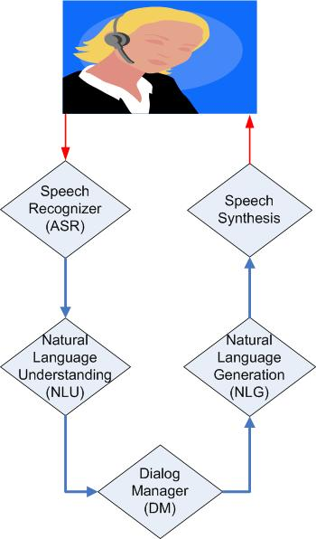
Dialog system components
Voice input
Speech
Language Model/Grammar
Acoustic model
Hypothesis (automatic
transcription)
Text
Generation templates/
rules
Grammar/Models
Logical form
of user’s input
Logical form
of system’s output

Slide 30
Dialog system components
Voice input
Speech
Language Model/Grammar
Acoustic model
Hypothesis (automatic
transcription)
Text
Generation templates/
rules
Grammar/Models
Logical form
of user’s input
Logical form
of system’s output

Slide 31
Speech recognition
Convert speech signal into text
Most SDS use off-the-shelf speech recognizers
  Research systems are highly configurable:
    Kaldi – most used research recognizer
    Sphinx/pocket sphinx (java API)
  Industry (free cloud version), not configurable
    Google
    Nuance
    AT&T Watson

Slide 32
Speech recognition
Statistical process
Use acoustic models that maps signal to phonemes
Use language models (LM)/grammars that describe the expected language
Open-domain speech recognition use LM built on large corpora

Slide 33
Speech recognition
Challenges: recognition errors due to
  Noisy environment
  Speaker accent
  Speaker interruption, self correction, etc.

Slide 34
Speech recognition
Speaker-dependent/independent
Domain dependent/independent

Slide 35
Speech recognition
Grammar-based
  Allows dialogue designer to write grammars
    For example, if your system expects digits a rule:
    S -> zero | one | two | three | …
  Advantages: better performance on in-domain speech
  Disadvantages: does not recognize out-of-domain
Open Domain – large vocabulary
  Use language models built on large diverse dataset
  Advantages: can potentially recognize any word sequence
  Disadvantages: lower performance on in-domain utterances (digits may be misrecognized)

Slide 36
Dialog system components
Voice input
Speech
Language Model/Grammar
Acoustic model
Hypothesis (automatic
transcription)
Text
Generation templates/
rules
Grammar/Models
Logical form
of user’s input
Logical form
of system’s output

Slide 37
Natural Language Understanding
Convert input text into internal representation. Example internal representation in wit.ai:
{
"msg_body": "what is playing at Lincoln Center",
"outcome": {
"intent": "get_shows",
"entities": {
"Venue": {
"value": "Lincoln Center",
}
},
"confidence": 0.545
},
"msg_id": "c942ad0f-0b63-415f-b1ef-84fbfa6268f2"
}

Slide 38
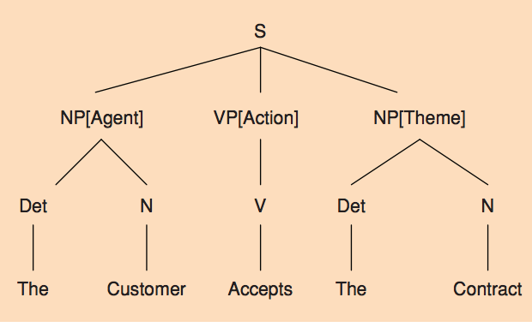
NLU approaches
Can be based on simple phrase matching
  “leaving from PLACE”
  “arriving at TIME”
Can use deep or shallow syntactic parsing

Slide 39
NLU approaches
Can be rule-based
  Rules define how to extract semantics from a string/syntactic tree
Or Statistical
  Train statistical models on annotated data
    Classify intent
    Tag named entities

Slide 40
Dialog system components
Voice input
Speech
Language Model/Grammar
Acoustic model
Hypothesis (automatic
transcription)
Text
Generation templates/
rules
Grammar/Models
Logical form
of user’s input
Logical form
of system’s output

Slide 41
Dialogue Manager (DM)
Is a “brain” of an SDS
Decides on the next system action/dialogue contribution
SDS module concerned with dialogue modeling
  Dialogue modeling: formal characterization of dialogue, evolving context, and possible/likely continuations

Slide 42
DM approaches
Rule-based
  Key phrase reactive
  Finite state/Tree based
    model the dialogue as a path through a tree or finite state graph structure
  Information-state Update
Statistical (learn state transition rules from data or on-line)
Hybrid (a combination of rules and statistical method)

Slide 43
Dialog system components
Voice input
Speech
Language Model/Grammar
Acoustic model
Hypothesis (automatic
transcription)
Text
Generation templates/
rules
Grammar/Models
Logical form
of user’s input
Logical form
of system’s output

Slide 44
NLG approaches
Presenting semantic content to the user
Template-based
  In a airline reservation system:
  User: “Find me a ticket from New York to London”
  System: “What date do you want to travel?”
  User: “March 10”
  System: “There is a United flight from Newark airport to London Heathrow on March 10 leaving at 9:15 AM”
    Template: There is a AIRLINE flight from AIRPORT to AIRPORT on DATE leaving at TIME

Slide 45
Natural language generation (NLG)
Content selection
  User asks “Find me restaurants in Chelsea”
  System finds 100 restaurants
  NLG decides how to present a response and which information to present
    “I found 100 restaurants, the restaurant with highest rating is …”
    “I found 100 restaurants, the closest to you is …”
    “I found 100 restaurants, I think you would like …”

Slide 46
Dialog system components
Voice input
Speech
Language Model/Grammar
Acoustic model
Hypothesis (automatic
transcription)
Text
Generation templates/
rules
Grammar/Models
Logical form
of user’s input
Logical form
of system’s output

Slide 47
Frame-based dialogue system
Architecture introduced in GUS travel planning system (Bobrow et al., 1977)
This architecture is used in most modern commercial digital assistants
Based on a domain ontology, which defines frames (collections of slots) and values that each slot can take

Slide 48
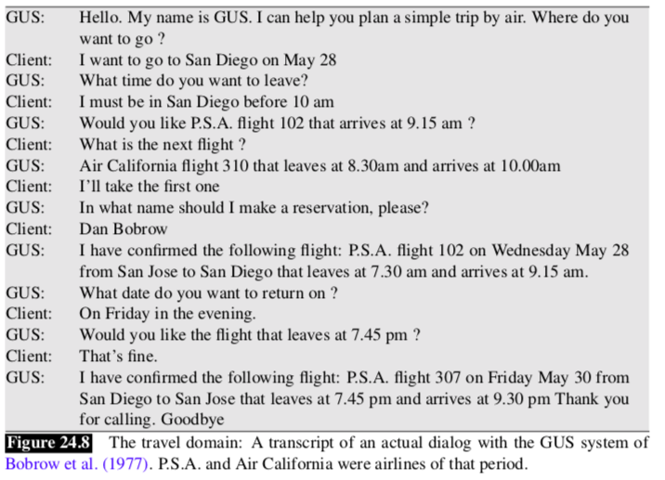

Slide 49
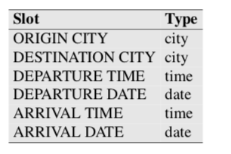
Slots define what the system needs to know
Slot values are constrained to types

Slide 50
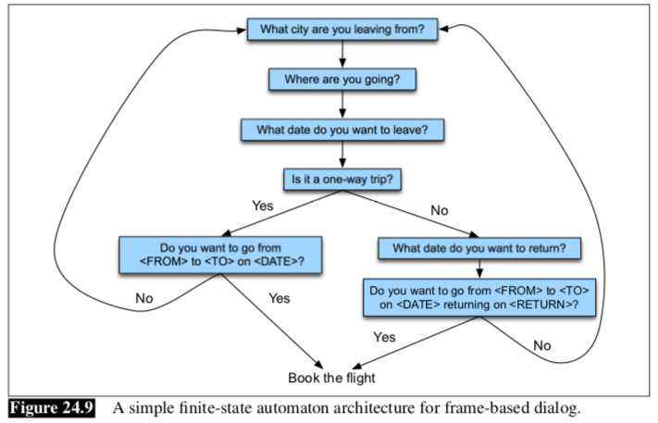
Control structure for frame-based dialogue

Slide 51
GUS architecture
Mixed initiative
Can fill slots in any order
Condition-action rules attached to slots
Production rule system

Slide 52
NLU for filling slots
Domain classification
Intent determination
Slot filling
“Show me morning flights from Boston to San Francisco on Tuesday”
DOMAIN: AIR-TRAVEL
INTENT: SHOW-FLIGHTS
ORIGIN-CITY: Boston
ORIGIN-DATE: Tuesday
ORIGIN-TIME: morning
DEST-CITY: San Francisco

Slide 53
Dialogue-state architecture
Capable of understanding and generating dialogue acts
  Dialogue acts: utterance in the context of a dialogue that serves a function in the dialogue
  e.g. question, statement, request for action, acknowledgment
Dialogue policy – decide what to say
Dialogue state tracker – maintain the current state of the dialogue

Slide 54
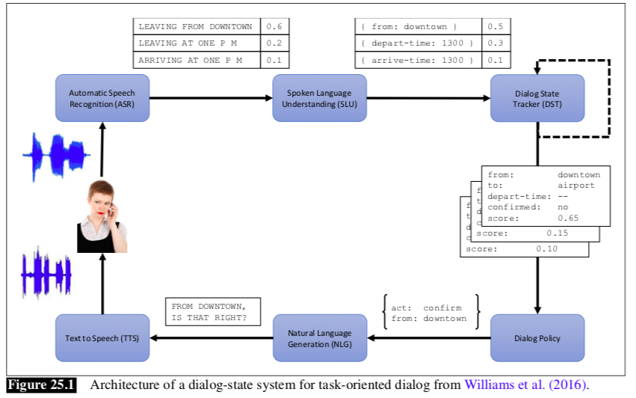

Slide 55
Dialogue acts
4 major classes:
Constantives
Directives
Commissives
Acknowledgments

Slide 56
Common ground
Dialogue is a collective act performed by speaker and hearer; they must constantly establish common ground – the set of things that are mutually believed by both speakers
Principle of closure – agents performing an action require evidence that they have succeeded in performing it

Slide 57
Grounding methods
Continued attention
Next contribution
Acknowledgment
Demonstration
Display

Slide 58
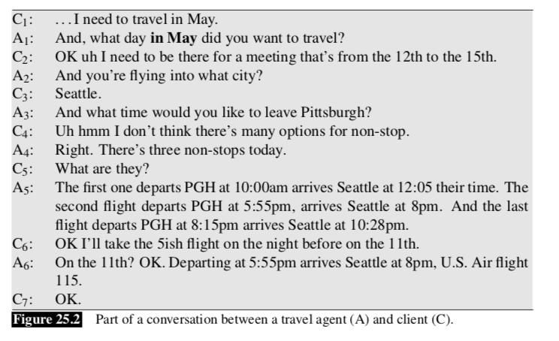

Slide 59
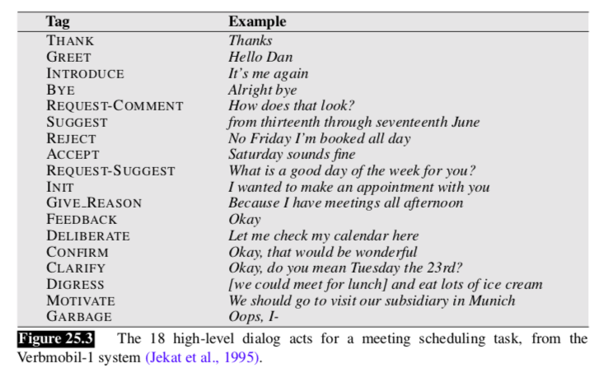

Slide 60
Natural language generation (NLG)
2 stages:
Content planning – what to say
Sentence realization – how to say it

Slide 61
SDS Evaluation
Task success
  E.g. did the system book the correct flight?
Performance of SDS components
  ASR (WER)
  NLU (slot error rate)
  DM/NLG (appropriate response)

Slide 62
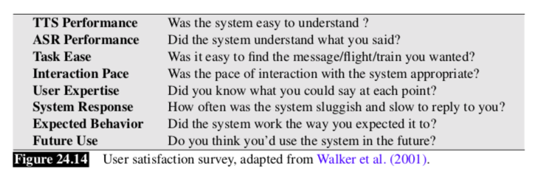
SDS Evaluation
User satisfaction rating

Slide 63
Performance evaluation heuristics
Efficiency
  System turns
  User turns
Dialogue quality
  Timeouts (when a user did not respond)
  Rejects (when the system confidence is low leading to “I am sorry I did not understand”)
  Help – number of times the system believes that a user said ‘help’
  Cancel - number of times the system believes that a user said ‘cancel’
  Barge-in

Slide 64
Dialogue System Design
User-centered design: (Gould & Lewis, 1985)
Study the user and task
Build simulations and prototypes
  Wizard-of-Oz system
Iteratively test the design on users

Slide 65
Ethical Issues
Bias
Microsoft Tay chatbot
Privacy
Stereotypes
Impersonating humans
Google duplex

Slide 66
Tools for building SDS
OpenDial – DM framework; Pierre Lison (2014)
Wit.ai – A tool for building ASR/NLU for a system

Slide 67
OpenDial
Pierre Lison’s PhD thesis 2014
DM components can run either synchronously or asynchronously
ASR/TTS: OpenDial comes with support for commercial off-the shelve ASR (Nuance & AT&T Watson)
NLU: based on probabilistic rules
  XML NLU rules
DM: rule-based. Dialogue states triggered with rules
  XML DM rules
NLG: template-based
  XML NLG rules

Slide 68
Wit.AI
2013 start up bought by Facebook
Web-based GUI to build a hand-annotated training corpus of utterances
  Developer types utterances corresponding to expected user requests
Builds a model to tag utterances with intents
Developer can use API using python, javascript, ruby, and more
  Given speech input, output intent and entity tags in the output

Slide 69
Specialty Topics for Dialogue Systems
turn-taking
mixed-initiative
referring in dialogue
grounding and repair
dialogue act modeling
dialogue act recognition
error recovery in dialogue
prosody and information structure
Argumentation & persuasion
incremental speech processing
multi‐modal dialogue
multi-party dialogue (3 or more
participants)
tutorial dialogue
multi‐task dialogue
embodied conversational agents
human-­‐robot dialogue interaction
dialogue tracking in other language-­‐processing systems (machine translation, summarization/extrac.on)
non-­‐cooperative dialogue systems (negotiation, deception)
affective dialogue systems
dialogue with different user populations (children, elderly, differently abled)
dialogue “in the wild”
long‐term Dialogue Companions
user behavior, including entrainment in dialogue

Slide 70
Specialty Topics for Dialogue Systems
turn-taking
mixed-initiative
referring in dialogue
grounding and repair
dialogue act modeling
dialogue act recognition
error recovery in dialogue
prosody and information structure
Argumentation & persuasion
incremental speech processing
multi‐modal dialogue
multi-party dialogue (3 or more
participants)
tutorial dialogue
multi‐task dialogue
embodied conversational agents
human-­‐robot dialogue interaction
dialogue tracking in other language-­‐processing systems (machine translation, summarization/extrac.on)
non-­‐cooperative dialogue systems (negotiation, deception)
affective dialogue systems
dialogue with different user populations (children, elderly, differently abled)
dialogue “in the wild”
long‐term Dialogue Companions
user behavior, including entrainment in dialogue

Slide 71
Homework #3
Dialogue Act Recognition (DAR)

