Slide 1
SDS Architectures
Julia Hirschberg
COMS 4706
(Thanks to Josh Gordon for slides.)

Slide 2
SDS Architectures
Software abstractions that coordinate the NLP components required for human-computer dialogue
Conduct task-oriented, limited-domain conversations
Manage levels of information processing (e.g., utterance interpretation, turn-taking) needed for dialogue
  In real-time, under uncertainty

Slide 3
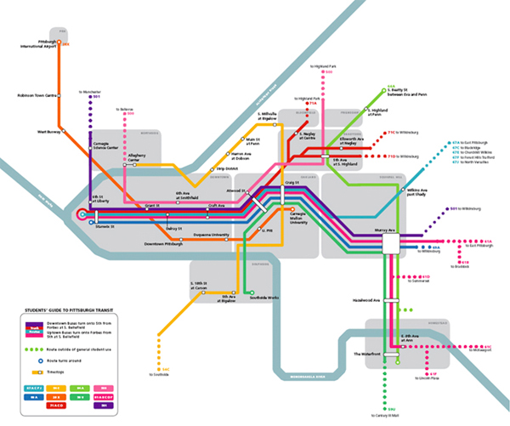

Examples: Information-Seeking, Transactional
Most common
CMU – Bus route information
Columbia – Virtual Librarian
Google – Directory service
Let’s Go Public

Slide 4

Examples: USC Virtual Humans
Multimodal input / output
Prosody and facial expression
Auditory and visual clues assist turn taking
Many limitations
  Scripting
  Constrained domain
http://ict.usc.edu/projects/virtual_humans

Slide 5
Examples: Interactive Kiosks
Multi-participant conversations
Surprises and challenges passersby to trivia games
[Bohus and Horvitz, 2009]
Notes:
Dan built Ravenclaw at CMU

Slide 6
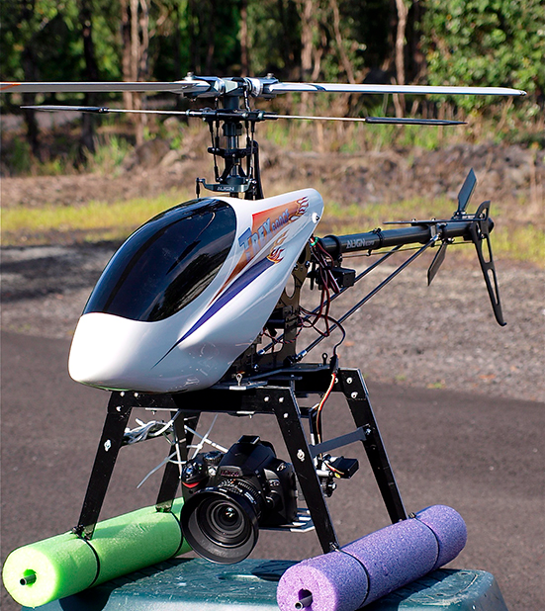
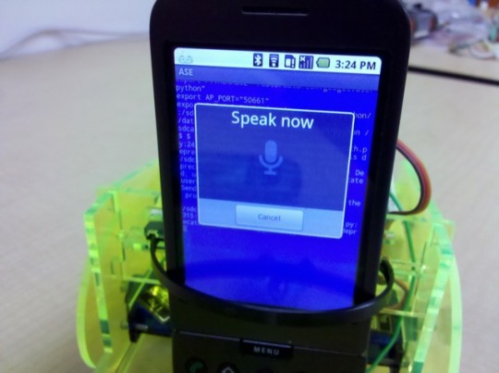
Examples: Robotic Interfaces
www.cellbots.com
Speech interface to a UAV
[Eliasson, 2007]

Slide 7
Conversational Skills
SDS Architectures tie together:
  Speech recognition
  Turn-taking
  Dialogue management
  Utterance interpretation
  Grounding mutual information
  Natural language generation
And increasingly include
  Multimodal input / output
  Gesture recognition

Slide 8
Research Challenges
Speech recognition: Accuracy in interactive settings, detecting emotion
Turn-taking: Fluidly handling overlap, backchannels
Dialogue management: Increasingly complex domains, better generalization, multi-party conversations
Utterance interpretation: Reducing constraints on what the user can say, and how they can say it. Attending to prosody, emphasis, speech rate.

Slide 9
Real-World SDS
CMU Olympus
  Open source collection of dialogue system components
  Research platform used to investigate dialogue management, turn taking, spoken language interpretation
  Actively developed
Many implementations
  Let’s go public, Team Talk, CheckItOut
www.speech.cs.cmu.edu

Slide 10
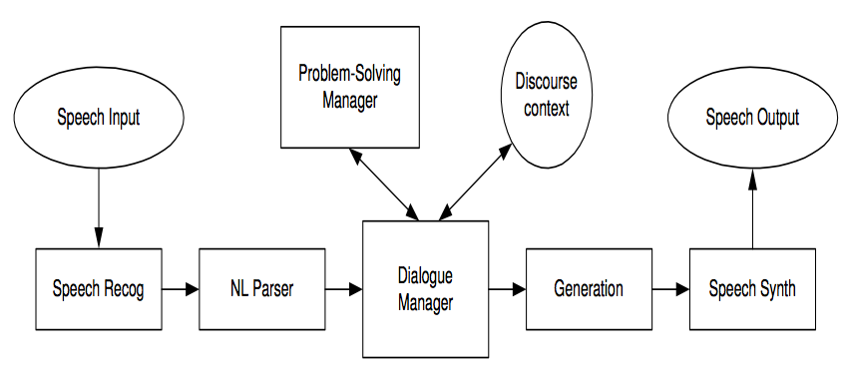
Conventional SDS Pipeline
Speech signals to words. Words to domain concepts. Concepts to system intentions. Intentions to utterances (represented as text). Text to speech.

Slide 11
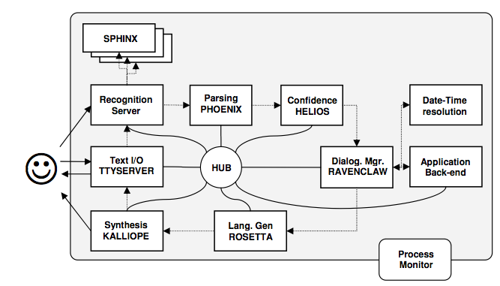
Olympus under the Hood: Provider Components
Notes:
Ravenclaw: Dan Bohus thesis

Slide 12
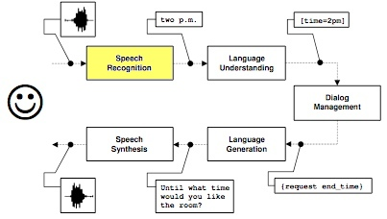
Speech recognition
Notes:
DM asks for information

Slide 13
The Sphinx Open Source Recognition Toolkit
Pocket-sphinx
  Continuous speech, speaker independent recognition system
  Includes tools for language model compilation, pronunciation, and acoustic model adaptation
  Provides word level confidence annotation, n-best lists
  Efficient – runs on embedded devices (including an iPhone SDK)
Olympus supports parallel decoding engines / models
  Typically runs parallel acoustic models for male and female speech
http://cmusphinx.sourceforge.net/

Slide 14
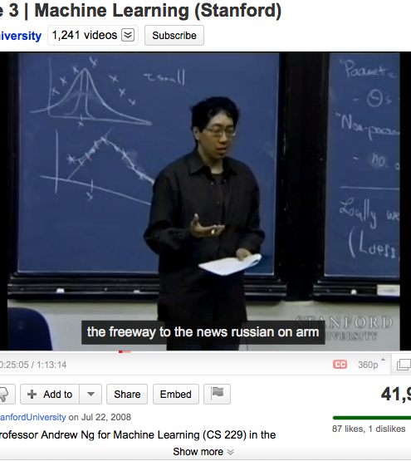
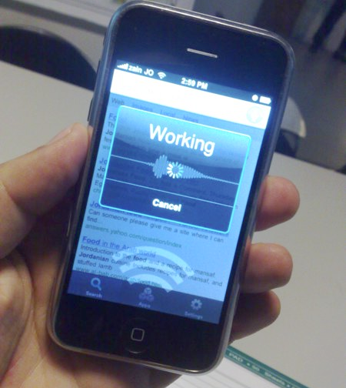
Speech recognition challenge in interactive settings
Notes:
Noisy conditions

Slide 15
Spontaneous Dialogue Hard for ASR
Poor in interactive settings compared to one-off applications like voice search and dictation
Performance phenomena: backchannels, pause-fillers, false-starts…
OOV words
Interaction with an SDS is cognitively demanding for users
  What can I say and when? Will the system understand me?
  Uncertainty increases disfluency, resulting in further recognition errors

Slide 16
Sample Word Error Rates
Non-interactive settings
  Google Voice Search: 17% deployed (0.57% OOV over 10k queries randomly sampled from Sept-Dec, 2008)
Interactive settings:
  Let’s Go Public: 17% in controlled conditions vs. 68% in the field
  CheckItOut: Used to investigate task-oriented performance under worst case ASR - 30% to 70% depending on experiment
  Virtual Humans: 37% in laboratory conditions

Slide 17
Examples of (worst-case) Recognizer Error
S: What book would you like?
U: The Language of Sycamores
ASR: THE LANGUAGE OF IS .A. COMING WARS
ASR: SCOTT SARAH SCOUT LAW

Slide 18
Error Propagation
Recognizer noise injects uncertainty into the pipeline
Information loss occurs when moving from an acoustic signal to a lexical representation
  Most SDSs ignore prosody, amplitude, emphasis
Information provided to downstream components includes
    An n-best list, or word lattice
    Low level features: speech rate, speech energy…

Slide 19
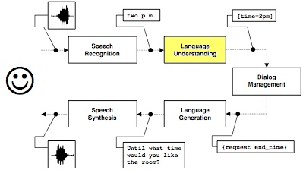
Spoken Language Understanding

Slide 20
SLU maps from words to concepts
Dialog acts (the overall intent of an utterance)
Domain specific concepts (like a book, or bus route)
Single utterances vs. SLU across turns
Challenging in noisy settings
Ex. “Does the library have Hitchhikers Guide to the Galaxy by Douglas Adams on audio cassette?”
Dialog Act | Book Request
Title | The Hitchhikers Guide to the Galaxy
Author | Douglas Adams
Media | Audio Cassette

Slide 21
Semantic Grammars
Domain independent concepts
  [Yes], [No], [Help], [Repeat], [Number]
Domain specific concepts
  [Book], [Author]
[Quit]
(*THANKS *good bye)
(*THANKS goodbye)
(*THANKS +bye)
;
THANKS
(thanks *VERY_MUCH)
(thank you *VERY_MUCH)
VERY_MUCH
(very much)
(a lot)
;

Slide 22
Grammars Generalize Poorly
Useful for extracting fine-grained concepts, but…
Hand engineered
  Time consuming to develop and tune
  Requires expert linguistic knowledge to construct
Difficult to maintain over complex domains
Lack robustness to OOV words, novel phrasing
Sensitive to recognizer noise

Slide 23
SLU in Olympus: the Phoenix Parser
Phoenix is a semantic parser, intended to be robust to recognition noise
Phoenix parses the incoming stream of recognition hypotheses
Maps words in ASR hypotheses to semantic frames
  Each frame has an associated CFG Grammar, specifying word patterns that match the slot
  Multiple parses may be produced for a single utterance
  The frame is forwarded to the next component in the pipeline

Slide 24
Statistical Methods
Supervised learning is commonly used for single utterance interpretation
  Given word sequence W, find the semantic representation of meaning M that has maximum a posteriori probability P(M|W)
Useful for dialogue act identification, determining broad intent
Like all supervised techniques…
  Requires a training corpus
  Often is domain and recognizer dependent

Slide 25
Belief updating

Slide 26

Cross-utterance SLU
U: Get my coffee cup and put it on my desk. The one at the back.
Difficult in noisy settings
Mostly new territory for SDS
[Zuckerman, 2009]

Slide 27
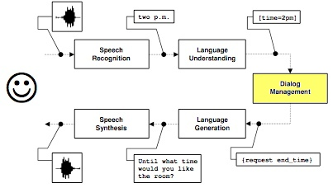
Dialogue Management

Slide 28
The Dialogue Manager
Represents the system’s agenda
  Many techniques
  Hierarchal plans, state / transaction tables, Markov processes
System initiative vs. mixed initiative
  System initiative means less uncertainty about the dialog state, but is time-consuming and restrictive for users
Required to manage uncertainty and error handing
  Belief updating, domain independent error handling strategies

Slide 29
Task Specification, Agenda, and Execution
[Bohus, 2007]
Notes:
System for conference room scheduling.

Slide 30
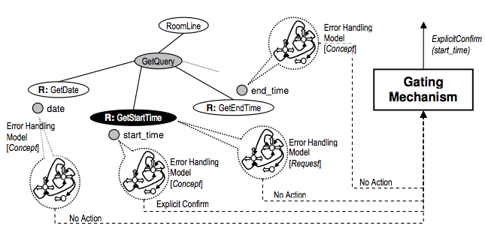
Domain Independent Error Handling
[Bohus, 2007]
Notes:
Parameterized for different concepts: outputs decision to confirm and how or to request repetition

Slide 31
Error Recovery Strategies
Error Handling Strategy (misunderstanding) | Example
Explicit confirmation | Did you say you wanted a room starting at 10 a.m.?
Implicit confirmation | Starting at 10 a.m. ... until what time?
Error Handling Strategy (non-understanding) | Example
Notify that a non-understanding occurred | Sorry, I didn’t catch that .
Ask user to repeat | Can you please repeat that?
Ask user to rephrase | Can you please rephrase that?
Repeat prompt | Would you like a small room or a large one?

Slide 32
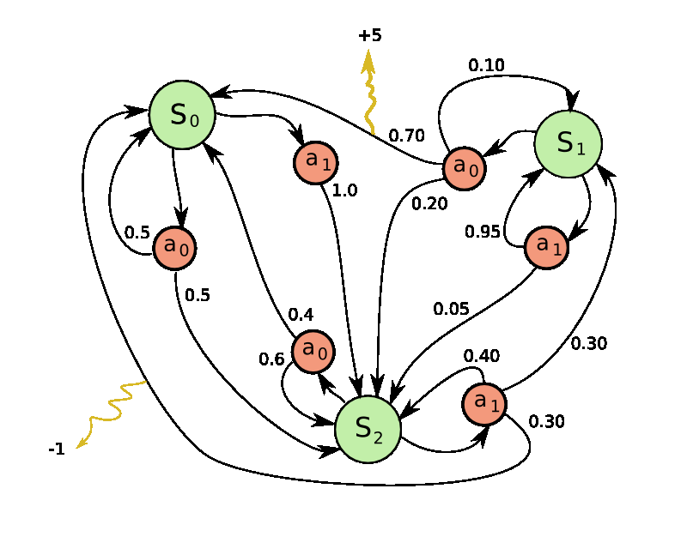
Statistical Approaches to Dialogue Management
Learning management policy from a corpus
Dialogue can be modeled as Partially Observable Markov Decision Processes (POMDP)
Reinforcement Learning is applied (either to existing corpora or to user simulation studies) to learn an optimal strategy
Evaluation functions typically reference the PARADISE framework

Slide 33
Interaction Management

Slide 34
The Interaction Manager
Mediates between the discrete, symbolic reasoning of the Dialogue Manager, and the continuous real-time nature of user interaction
Manages timing, turn-taking, and barge-in
  Yields the turn to the user on interruption
  Prevents the system from speaking over the user
Notifies the Dialogue Manager of
  Interruptions and incomplete utterances

Slide 35
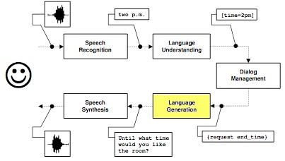
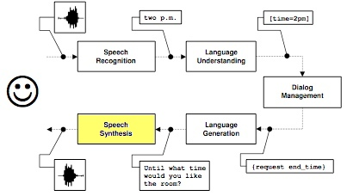
Natural Language Generation and Speech Synthesis

Slide 36
NLG and Speech Synthesis
Template based, e.g., for explicit error handling strategies
  Did you say <concept>?
  More interesting cases in disambiguation dialogs
A TTS system synthesizes the NLG output
  The audio server allows interruption mid utterance
Production systems incorporate
  Prosody, intonation contours to indicate degree of certainty
Open source TTS frameworks
  Festival - http://www.cstr.ed.ac.uk/projects/festival/
  Flite - http://www.speech.cs.cmu.edu/flite/

Slide 37
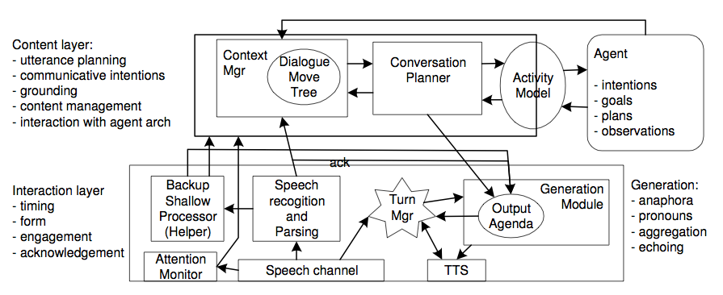
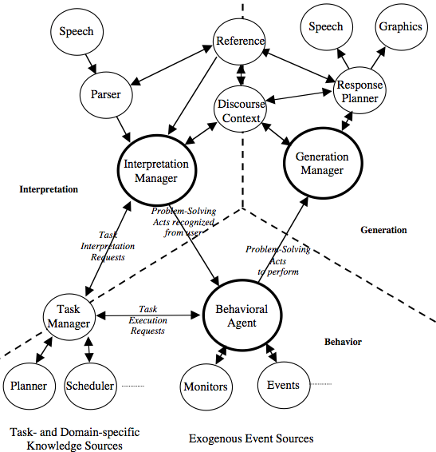
Asynchronous Architectures
Lemon, 2003
Backup recognition pass enables better
discussion of OOV utterances
Blaylock, 2002
An asynchronous modification of TRIPS,
most work is directed toward best-case speech recognition

Slide 38
Next
Dialogue management problems and strategies

