Slide 1
Representing Intonational Variation
Julia Hirschberg
CS 4706

Slide 2
Today
How can we represent differences in how people produce speech that influence interpretation?
  Expanded vs. compressed pitch range?
  Louder vs. softer speech?
  Faster vs. slower speech?
  Differences in intonational prominence?
  Differences in intonational phrasing?
  Differences in pitch contours?

Slide 3
Joseph Steele, 1775
Notes:
Figure 1. Transcription of Pope’s Happiness (Steele, 1775, p. 13)
Since speech is composed of slides, and not stable, discrete pitches, he developed note heads which were lines, curves, and circumflex notes that could cover several pitches. To these curved heads, he then added a tail which marked the duration of the syllable in a number of beats within a musical bar.

Slide 4
Limitations
Hard to representations similarities between contours
Too tied to particular instances

Slide 5
Language Learning Approaches
A simpler approach
  / IS it INteresting /
  / d’you feel ANGry? /
  / WHAT’S the PROBlem? / (McCarthy, 1991:106)
Too general
  Doesn’t capture differences beyond rising and falling contours, accented and unaccented words

Slide 6
Goal
Capture sufficient variation to explain both similarities and differences in prosodic meaning
How much detail do we need to capture?

Slide 7

Prosodic Prominence
Terms: Prominence, emphasis,
[pitch] accent, stress.
Prominence is an acoustic excursion use to make a word or syllable “stand out” from its surroundings
Used to draw a listeners attention to some quality of an utterance.
  Topic, Contrast, Focus, Information Status
there’s ALSO some SHOPPING
BDC h1s9
Notes:
We have made no comment about how this is done. What acoustic excursion is necessary.
Examples

Slide 8
Prosodic Phrasing
An acoustic “perceived disjuncture” between words.
Physiologically necessary – a speaker cannot produce sound indefinitely.
Used to structure the information in an utterance, grouping words into regions.
  Phrasing structure may be related to syntactic structure.
finally we will get off - - at Park Street - and get on the Red Line - -
BDC h1s9
Notes:
Again, we will return to acoustic correlates of phrasing later. Now let’s just get a sense of what’s going on.
Examples

Slide 9
Prosodic Phrasing
An acoustic “perceived disjuncture” between words.
Physiologically necessary – a speaker cannot produce sound indefinitely.
Used to structure the information in an utterance, grouping words into regions.
  Phrasing structure may be related to syntactic structure.
finally we will get off - - at Park Street - and get on the Red Line - -
BDC h1s9
Notes:
Again, we will return to acoustic correlates of phrasing later. Now let’s just get a sense of what’s going on.
Examples

Slide 10
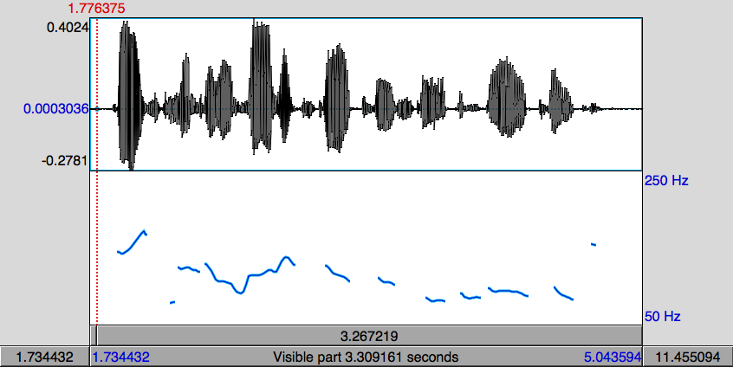
Pitch Contour Example
DoublingError
Halving Error
Pitch (fundamental frequency) is estimated by finding the length of the period of the speech signal.
  If a cycle is missed, the period appears to be twice as long (pitch halving)
  If an extra cycle is found, the period appears to be half as long (pitch doubling)

Slide 11
Tone Sequence Models
Intonation generated from sequences of categorically different, phonologically distinctive tones
Basic unit of intonational description: intonation phrase (tone unit, breath group)
  Delimited by pauses, phrase-final lengthening, pitch
Syllables may be stressed or accented
  Accent aligned with primary stress -- telephone
  Indicated by F0, duration, intensity, voice quality
Notes:
O’Connor and Arnold 1972:
Earliest textbook for English instruction that tells user which contour appropriate in which context

Slide 12
Pierrehumbert 1980
Contours = pitch accents, phrase accents, boundary tones
Pitch Accents*
Phrase Accents*
Boundary Tone
H* L*
L*+H L+H*
H*+L H+L*
L- H-
L% H%
Notes:
Jd

Slide 13
ToBI (Tones and Break Indices)
Based on Pierrehumbert’s “intonational phonology”
Silverman et al. 1992
Prosody is described by high (H) and low (L) tones that are associated with prosodic events (pitch accents, phrase accents, and boundary tones) and break indices which describe the degree of disjuncture between words.
  ToBI is inherently categorical in its description of prosody
ToBI variants exist for at least American English, German, Japanese, Korean, Portuguese, Greek, Catalan

Slide 14

ToBI Accenting
Words are accented or not
5 possible pitch accent types (in SAE).
High tones can be produced in a compressed pitch range – catathesis, or “downstepping”
H*
L*
L*+H
L+H*
H+!H*
Notes:
Examples!!!!

Slide 15
ToBI Phrasing
ToBI describes phrasing as a hierarchy of two levels.
  Intermediate phrases contain one or more words.
  Intonational phrases contain one or more intermediate phrases
Word boundaries are marked with a degree of disjuncture, or break index
  Break indices range from 0-4
  >3 intermediate phrase boundary
  4 intonational phrase boundary
Notes:
Examples!!!!

Slide 16
ToBI Phrase Ending Types
Intermediate Phrase boundaries have associated Phrase Accents describing the pitch movement from the last accent to the phrase boundary
  Phrase Accents: H-, !H- or L-
Intonational phrase boundaries have Boundary Tones describing the pitch movement immediately before the boundary
  Boundary Tones: H% or L%
L-L%
L-H%
H-H%
H-L%
!H-L%
Notes:
Examples!!!!

Slide 17
ToBI Example (in Praat)
Notes:
Include audio example

Slide 18
L-L%
L-H%
H-L%
H-H%
H*
L*
L*+H

Slide 19
L-L%
L-H%
H-L%
H-H%
L+H*
H+!H*
H* !H*

Slide 20
Online training material,available at: http://anita.simmons.edu/~tobi/index.html
Evaluation
  Good inter-labeler reliability for expert and naive labelers: 88% agreement on presence/absence of tonal category, 81% agreement on category label, 91% agreement on break indices to within 1 level (Silverman et al. ‘92,Pitrelli et al ‘94)

Slide 21
Superpositional models
Pitch pattern of intonation modeled with two components: phrase component and accent component.
Phrase has basic shape, and pitch movements for individual accents are superimposed over basic shape:
plus
=
Apples, oranges and tomatoes

Slide 22
Fujisaki model
Superpositional view of intonation Fujisaki & Hirose 1982
Prosody is described by a phrase command which is modified by accent commands.
In the Fujisaki model, this is an additive process in log Hz space.

Slide 23
Fujisaki model

Slide 24
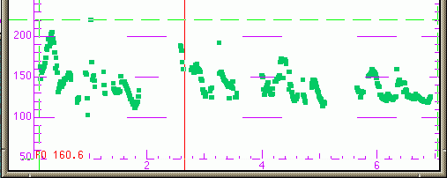
Good for modeling utterance-level trends
Declination: downtrend in f0 over the course of an utterance
Successful in speech synthesis for languages like Japanese (little variation in accent type, e.g.)
Lily and Rosa thought this was divine.
Prince William was gorgeous
and he was looking for a bride.
They dreamed of wedding bells.

Slide 25
Superpositional vs. Sequential
Superpositional models require identification of a phrase signal.
Sequential models describe one prosodic event – phrasing or prominence – at a time.
Similarities
  Both describe phrasing and accenting
  If the phrasal context can be accommodated by a sequential model, there are no analytical reasons to suspect that
Differences
  Categorical vs. continuous accent types
  Superpositional model is tightly coupled with pitch

Slide 26
F0 Modeling for TTS
Generation or DB Retrieval (event detection)
  ToBI
  Fujisaki
  TILT
  Tonal Center of Gravity
  Quantized Contour Modeling

Slide 27
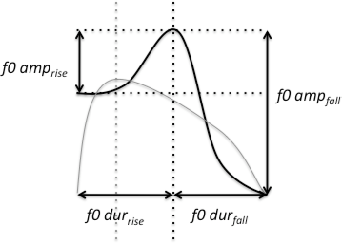
TILT
Describes an F0 excursion based as a single parameter (Taylor 1998)
Compact representation: TILT parameters allow generation/db retrieval
Notes:
Tilt=+1 all rise
Tilt= -1 all fall
In betw, some of each

Slide 28
Tonal Center of Gravity (ToG)
A measure of the distribution of the area under the F0 curve within a region
Perceptually robust
Better classification of pitch accent types than peak timing measures
(Veilleux et al. 2009, Barnes et al. 2010)
Notes:
X is F0

Slide 29
Quantized Contour Modeling
A Bayesian approach to simultaneously model contour shape and classify prosodic events
(Rosenberg 2010)
Specify a number of time, M, and value, N, bins
Represent a contour as an M dimensional vector where each entry can take one of N values.
For extension to higher dimensions, allow values to be multidimensional vectors

Slide 30
Types of Tone-sequence Models
Type 1: based on pitch movements
a
t
r
g
Type 2: based on pitch levels
e
t
H
The British School The Dutch School
a
t
r
g
L
e
t
The American School

Slide 31
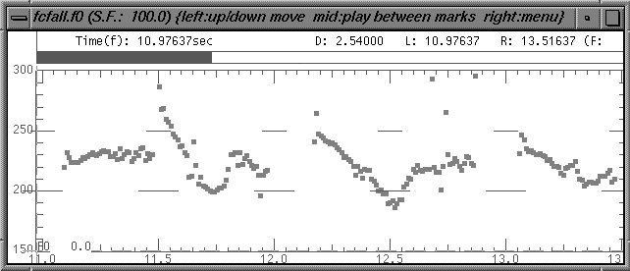
An example
and I think it’s HOrriblerrible
...a POINT where
you have to CLEAN it
There’s a point where you have to clean it and I think it’s horrible...

Slide 32
Intonation Phrases
Internal structure
  Determined by location of accents in an IP
  Each accent defines the beginning of a prosodic constituent

Slide 33
British School
Prenuclear accent unit
Nuclear accent unit
Prehead
‘Head’
‘Nucleus’
Stressed syllable
But
JOHN’s never BEEN to Jamaica
Notes:
Two types of accent unit in the British School:
Prenuclear accent units; also called the Head
Nuclear accent units; also called the Nucleus
The nuclear accent unit is the last accent unit in the IP
The head comprises all prenuclear accent units

Slide 34
Six nuclear choices in English
m
a
a
a
i
c
J
c
i
a
a
a
J
m
falling
rising
m
a
a
a
i
i
J
c
a
a
c
J
m
a
rising-falling
falling-rising
i
a
i
m
a
c
a
c
a
a
a
J
J
m
a
Rising-falling-rising
level

Slide 35
The American School
American school-type models make a distinction between accents (what makes a particular word prominent) and boundary tones (how a phrase ends)
Autosegmental metrical or two-tone models
Only two tones, which may be combined
  H = high target
  L = low target

Slide 36
Price, Ostendorf et al
Break indices: degree of juncture between words
0 → 8 (none to ‘a lot’)
  What I’d like is a nice roast beef sandwich.

Slide 37
To(nes and)B(reak)I(ndices)
Developed by prosody researchers in four meetings over 1991-94
Putting Pierrehumbert ’80 and Price, Ostendorf, et al together
Goals:
  devise common labeling scheme for Standard American English that is robust and reliable
  promote collection of large, prosodically labeled, shareable corpora

Slide 38
ToBI standards also proposed for Japanese, German, Italian, Spanish, British and Australian English,....
Minimal ToBI transcription:
  Recording of speech
  F0 contour
  ToBI tiers:
    orthographic tier: words
    break-index tier: degrees of junction (Price et al ‘89)
    tonal tier: pitch accents, phrase accents, boundary tones (Pierrehumbert ‘80)
    miscellaneous tier: disfluencies, non-speech sounds, etc.

Slide 39
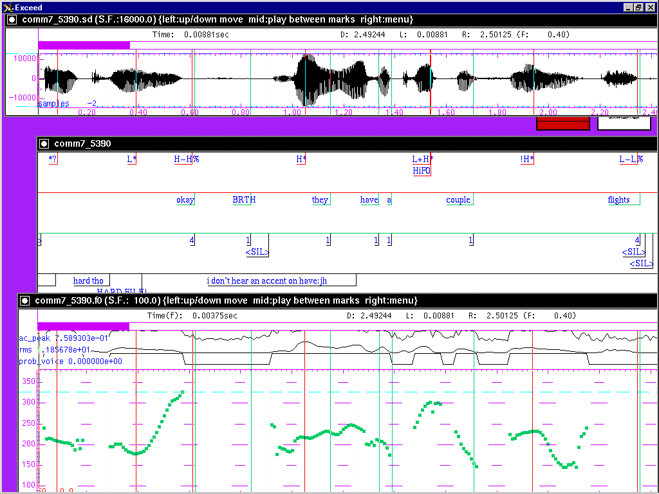
Sample ToBI Labeling

Slide 40
Pitch Accent/Prominence in ToBI
Which items are made intonationally prominent and how: tonal targets/levels not movement
Accent type:
  H* simple high (declarative)
  L* simple low (ynq)
  L*+H scooped, late rise (uncertainty/ incredulity)
  L+H* early rise to stress (contrastive focus)
  H+!H* fall onto stress (implied familiarity)

Slide 41
Downstepped accents:
  !H*,
  L+!H*,
  L*+!H
Degree of prominence:
  within a phrase: HiF0 (~nuclear accent)
  across phrases ??

Slide 42
Prosodic Phrasing in ToBI
‘Levels’ of phrasing:
  intermediate phrase: one or more pitch accents plus a phrase accent, H- or L-
  intonational phrase: 1 or more intermediate phrases + boundary tone, H% or L%
ToBI break-index tier
  0 no word boundary
  1 word boundary

Slide 43
  2 strong juncture with no tonal markings
  3 intermediate phrase boundary
  4 intonational phrase boundary

Slide 44
ToBI exercises
NB: you will be submitting these exercises for the take-home part of the midterm, so save them!

Slide 45
Next Class
Predicting prosodic assignments from text

