Slide 1
Human Speech Recognition
Julia Hirschberg
CS4706
(thanks to John-Paul Hosum for some slides)

Slide 2
Linguistic View of Speech Perception
Speech is a sequence of articulatory gestures
Many parallel levels of description
Phonetic, Phonologic
Prosodic
Lexical
Syntactic, Semantic, Pragmatic
Human listeners make use of all these levels in speech perception

Slide 3
Lexical Access
Frequency sensitive
We access high-frequency words faster and more accurately – with less information – than low frequency
Access in parallel
We access multiple hypotheses simultaneously
Based on multiple cues

Slide 4
Today: How Do Humans Identify Speech Sounds?
Perceptual Critical Point
Perceptual Compensation Model
Phoneme Restoration Effect
Perceptual Confusability
Non-Auditory Cues
Cultural Dependence
Categorical vs. Continuous

Slide 5
How Much Information Do We Need to Identify Phones?
Furui (1986) truncated CV syllables from the beginning, the end, or both and measured human perception of truncated syllables
Identified “perceptual critical point” as truncation position where there was 80% correct recognition
Findings:
10 msec during point of greatest spectral transition is most critical for CV identification
Crucial information for C and V is in this region
C can be mainly perceived by spectral transition into following V
Notes:
Where both initial and final sections of the syllable were truncated, a minimum duration of 40 msec.
Interesting parallels with diphone synthesis…

Slide 6
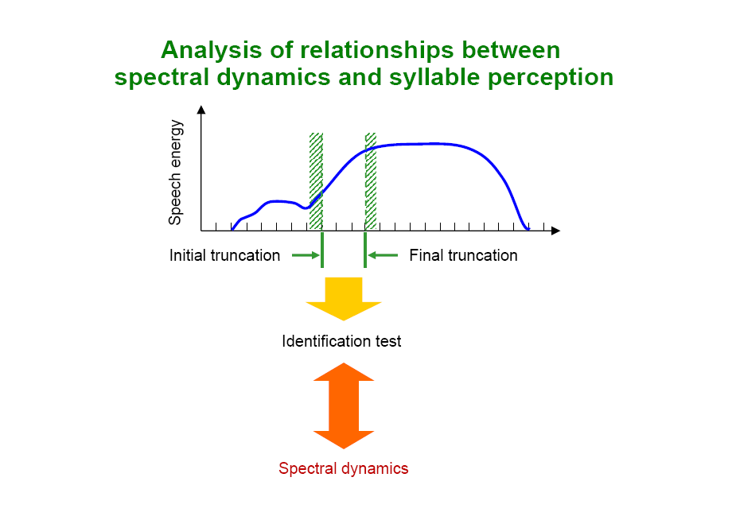

Slide 7
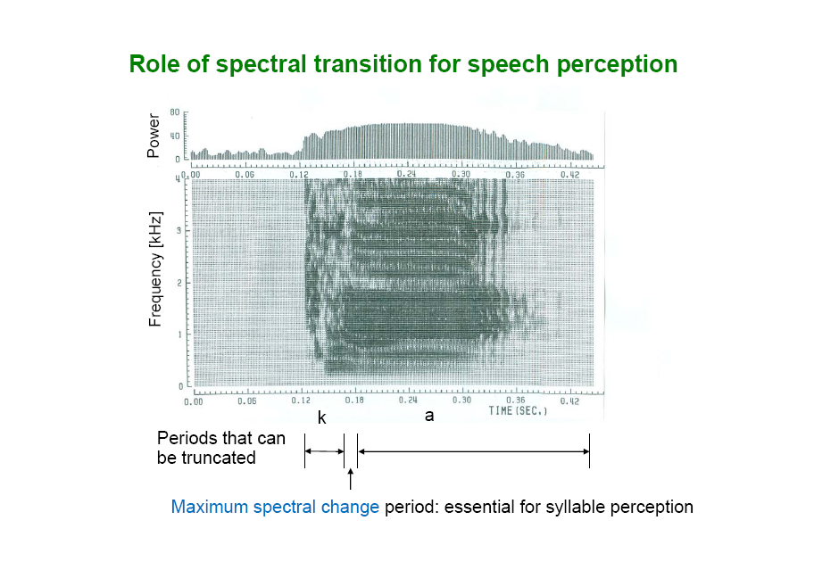
Notes:
Tekieli and Cullinan (1979) showed that (a) Given first 10 msec of isolated vowel, Place and Height can be distinguished at levels above chance; the tense-lax feature requires 30 msec. (b) Place of articulation in CV can be identified based on 10 msec after release, but voicing feature requires 20-30 msec. In short, timing information is critical for tense-lax and voiced-unvoiced distinctions, and making these distinctions requires about 30 msec of speech; other features can be identified in 10 msec.
Also
Acoustic cues to perception of place of articulation reside primarily in spectral transitions between phonemes (with some exceptions, notably weak /f, th/ vs. strong /s, sh/)
In perceptual experiments with two synthetic formants, different bursts can be heard by changing the slope of the initial part of F2; a locus of 720 Hz causes perception of /b/, a locus of 1800 Hz causes perception of /d/, and a locus of 3000 Hz often causes perception of /g/.
Different plosives can also be perceived based on the shape of the burst (see next slide).

Slide 8
Target Undershoot
Vowels may or may not reach their ‘target’ formant due to coarticulation
Amount of undershoot depends on syllable duration, speaking style,…
How do people compensate in recognition?
Lindblom & Studdert-Kennedy (1967)
Synthetic stimuli in wVw and yVy contexts with V’s F1 and F3 same but F2 varying from high (/ih/) to low (/uh/) and with different transition slopes from consonant to vowel
Subjects asked to judge /ih/ or /uh/

Slide 9
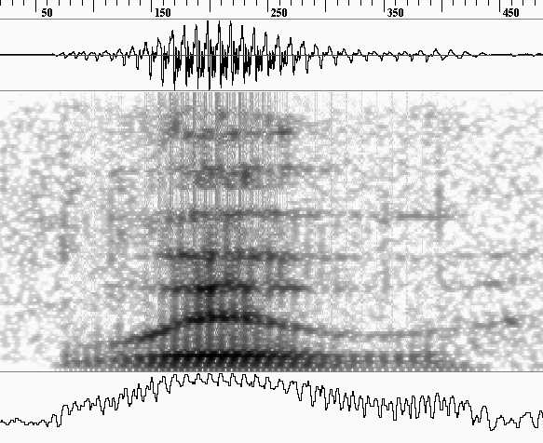
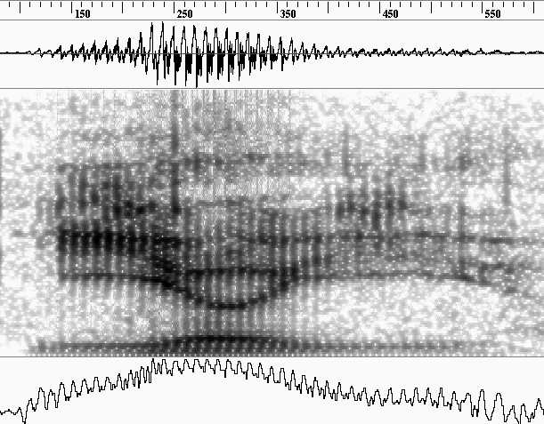
Boundary for perception of /ih/ and /uh/ (given the varying F2 values) different in the wVw context and yVy context
In yVy contexts, mid-level values of F2 were heard as /uh/, and in wVw contexts, mid-level values of F2 heard as /ih/
/w ih w y uh y
Notes:
W pulls down the vowel formants, Y raises, so same F2 is heard as lower in Y contexts and higher in W. Listeners compensate for normal Y and W effects.
So, a speech recognizer has to be sensitive to context in identifying vowels too.

Slide 10
Perceptual Compensation Model
Conclusion: Subjects rely on direction and slope of formant transitions to classify vowels
Lindblom’s PCM: We “normalize” formant frequencies based on formants of the surrounding consonants, canonical vowel targets, syllable duration
Consequences for ASR?
Determining characteristic formants of vowels is non-trivial – they must be sensitive to consonantal concepts → triphones

Slide 11
Phoneme Restoration Effect
Warren 1970 presented subjects with
“The state governors met with their respective legislatures convening in the capital city.”
Replaced first [s] in legislatures with a cough
Task: find any missing sounds
Result: 19/20 reported no missing sounds (1 thought another sound was missing)
Conclusion: much speech processing is top-down rather than bottom-up
For ASR: do you need to recognize all the phones?

Slide 12
Perceptual Confusability Studies
Hypothesis: Confusable consonants are confusable in production because they are perceptually similar
E.g. [dh/z/d] and [th/f/v]
Experiment:
Embed syllables beginning with targets in noise
Ask listeners to identify
Look at confusion matrix
What consonants are most likely to be confused with what?

Slide 13
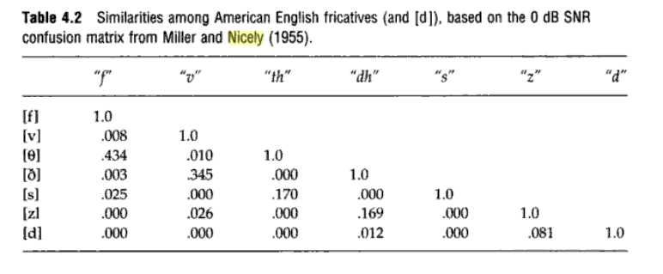
Is there confusion between voiced and voiceless sounds?
Shepard’s similarity metric
Notes:
Metric: probability of confusing x with y and y with x divided by the probably of getting each of them right
Conclusion: voiceless sounds with voiceless sounds close place of articulation are confusable and so are voiced.
Can this help someone building an ASR system?

Slide 14
Speech and Visual Information
How does visual observation of articulation affect speech perception?
McGurk Effect (McGurk & McDonald 1976)
Subjects heard simple syllables while watching video of speakers producing phonetically different syllables (demo)
What do they perceive?
Conclusion: Humans have a perceptual map of place of articulation – different from auditory
Could this help ASR?
Notes:
Hear [da] while watching [ga] when [ba]
Play audio and video
Play audio (eyes closed)
Watch video with sound off

Slide 15
Speech/Somatosensory Connection
Ito et al 2008 show that stretching mouth can influence speech perception
Subjects heard head, had, or something on a continuum in between
Robotic device stretches mouth up, down, or backward
Upward stretch leads to ‘head’ judgments and downward to ‘had’ but only when timing of stretch imitates production of vowel
What does this mean about our perceptual maps?
Is there any way this could help ASR?
Notes:
In the study, a specially designed robotic device stretched the mouths of volunteers slightly up, down or backward while they listened to a computer-generated continuum of speech verbalizations that sounded like “head” or “had,” or something in between. When the subjects’ mouths were stretched upward, closer to the position needed to say “head,” they were more likely to hear the sounds as “head,” especially with the more ambiguous output. If the subjects’ mouths were stretched downward, as if to say “had,” they were more likely to hear “had,” even when the sounds being generated were closer to “head.” Stretching subjects’ mouths backward had no effect, implying a position-specific response. Moreover, the timing of the stretch had to match that of the sounds exactly to get an effect: the stretch altered speech perception only when it mimicked realistic vocalizations.

Slide 16
Is Speech Perception Culture-Dependent?
Mandarin tones
High, falling, rising, dipping (usually not fully realized)
Tone Sandhi: dipping, dipping → rising, dipping
Why?
Easier to say
Dipping and rising tones perceptually similar so high is appropriate substitute
Comparison of native and non-native speakers tone perception (Huang 2001)

Slide 17
Determine perceptual maps of Mandarin and American English subjects
Discrimination task, measuring reaction time
Two syllables compared, differing only in tone
Task: same or different?
Averaged reaction times for correct ‘different’ answers
Faster discrimination → less similarity
Results:
For Mandarin speakers: dipping tone similar to high (both realized as level)
For American English speakers: dipping tone similar to falling (both end low)

Slide 18
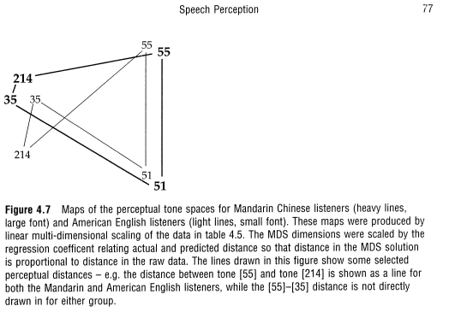
Mandarin |  |  |  |  | American
 | High [55] | Rising [35] | Dipping [214] | Falling [51] | High [55] | Rising [35] | Dipping [214] | Falling [51]
High [55]
Rising [35] | 563 |  |  |  | 615
Dipping [214] | 579 | 683 |  |  | 536 | 706
Falling [51] | 588 | 548 | 545 |  | 600 | 592 | 608
Notes:
For mandarin speakers: dipping tone similar to high (both realized as level)
For american english speakers: dipping tone similar to falling (both end low)

Slide 19
Is Human Speech Perception Categorical or Continuous?
Do we hear discrete symbols, or a continuum of sounds?
What evidence should we look for?
Categorical: There will be a range of stimuli that yield no perceptual difference, a boundary where perception changes, and another range showing no perceptual difference, e.g.
Voice-onset time (VOT)
If VOT long, people hear unvoiced plosives
If VOT short, people hear voiced plosives
But people don’t hear ambiguous plosives at the boundary between short and long (30 msec).

Slide 20
Non-categorical, sort of
Barclay 1972 presented subjects with a range of stimuli between /b/, /d/, and /g/
Asked to respond only with /b/ or /g/.
If perception were completely categorical, responses for /d/ stimuli should have been random, but they were systematic, clustering in the middle
Perception may be continuous but have sharp category boundaries, e.g.

Slide 21
Could Human Speech Perception be Modeled by Machine?
Identifying phonemes
What information do humans use?
How much do they need?
What about target undershoot?
Restoring missing phonemes
Perceptual confusability information
Categorical vs. continuous distinction
Visual information
Cultural differences
Notes:
How could a machine make use of human behavior?

Slide 22
Next Class
Automatic Speech Recognition Overview

