Slide 1
Advanced Topics in Spoken Language Processing
Julia Hirschberg and Sarah Ita Levitan
CS 6998

Slide 2
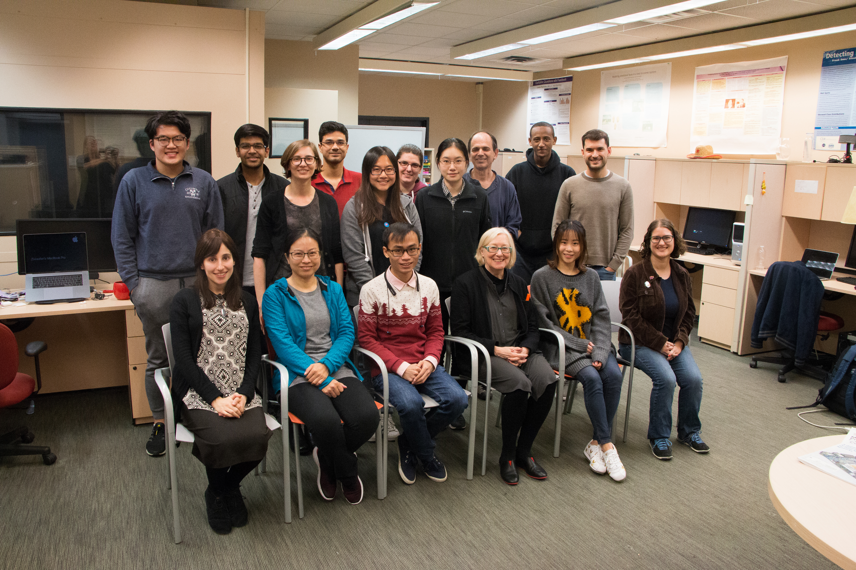
Columbia Speech Lab

Slide 3
Getting to know each other

Slide 4
Speech Processing
How do you produce sounds that other people interpret as language?
How does your hearer decode what you are trying to convey?
In a conversation, how do you know when it’s your turn to talk?
Once you decide what you want to say, how do you decide how to say it?:
How do you decide where to pause in the sentence?
How do you decide what words to emphasize?
How do you decide what intonational contour to use?
How do you convey your own feelings and emotions?
Notes:
Angry, sad, happy

Slide 5
Different languages can convey this information in different ways but most use intonation or sometimes word order in the process – and of course facial expression and body gesture also play a role in communication
How do you ask a question in your native language? How do you make a statement?
What we’ll be learning in this class is a wide range of the information speech can convey to others and what we in turn can learn about others from their speech

Slide 6
What Can We Convey and Learn from Speech
What speech can convey
What else we can learn from speech
Emotion
Sarcasm
Speech Acts
Humor
Empathy
Trust
Likability
Deception
Mental health
Physical health
Autism Spectrum
Entrainment
Charisma
Vocal Attractiveness
Age and gender
Personality

Slide 7
Applications for Speech Technologies are Everywhere
Basic technologies
Speech synthesis (TTS): Wavenet, demo
Speech recognition (ASR): Nuance, Kaldi, Google, IBM
Speech analysis: Praat, Sox, WaveSurfer, Adobe Audition
Applications
Speech to Speech Translation: Google Translate
Speech Search: Google Voice Search
Governments: Deception Detection, Dialect and Language ID, and Speaker ID, trust, aids for first responders in Low Resource Languages
Notes:
Wavenet: demo down toward the bottom
TTS:
Charles St. West is the home of Mr. St. Clair.
The city hall parking lot was chock full of cars.
Jorge Posada catches for the Yankees.

Slide 8
Accessibility: Web access for visually or manually challenged, TTS’d audio books
Spoken Dialogue Systems:
Over-the-phone (Siri, Android)
Alexa, Cortana, Google Home, Echo
Tutoring systems: Duolingo (use Chrome to talk)

Slide 9
Other Major Speech Applications: Recognizing Speaker State
Recognizing or generating emotion, e.g.
Recognizing anger/frustration in SDS
Generating excitement/fear in games
Recognizing other speaker states
Confidence vs. uncertainty in tutoring systems
Medical diagnosis e.g. depression, schizophrenia
Degree of interest e.g. for salespeople
Sleepiness for drivers
Drunkenness for drivers
Deception for police, military, social services

Slide 10
What We Want You to Learn
By the end of the course, we hope you will:
Be able to analyze acoustic and prosodic features of speech
Be able to analyze corpora using these feature to discover interest information about speakers
Be able to evaluate research on speech

Slide 11
Syllabus Overview
Course website
Part 1: basic concepts, tools, analysis approaches
Acoustics, prosody, tools, TTS, ASR, dialogue systems
Part 2: speech analysis applications
Entrainment, emotion, sentiment, deception, trust, sarcasm, humor, charisma, personality, mental state

Slide 12
Grade breakdown
5% Attendance and participation
15% Weekly posts
15% HW 1
15% HW 2
25% HW 3
25% HW 4

Slide 13
Weekly readings
Textbook
Required: Speech and Language Processing, Jurafsky & Martin (3rd edition draft)
Optional: Acoustic and Auditory Phonetics, Keith Johnson (3rd edition)
Conference and journal articles

Slide 14
Weekly posts
For each required reading, post:
One positive and one negative aspect
OR
2 questions
Deadline: Thursday 11:59am
Grading 0-3
Late policy

Slide 15
Homework assignments
Praat recording and analysis
ToBI labeling
Emotional speech
Dialogue acts

Slide 16
Teaching Assistants
Rose Sloan
Zixiaofan Yang

Slide 17
Teaching Assistants
Rose Sloan
Zixiaofan Yang

Slide 18
Say this sentence 7 different ways…
“I never said she stole my money”

Slide 19
Prosody
Properties of speech beyond phonetics
Intonation, phrasing, accent, etc.
Can be very important to meaning and naturalness
Often not included or included poorly in TTS systems
Can be labeled using the ToBI labeling system

Slide 20
A Better Approach to TTS
If we know where phrase breaks and pitch accents are, we can include them as features for training and synthesis
Often don’t have this labeled
Can we derive these features from text to synthesize new sentences?

Slide 21
Types of Features
N-grams
Part of speech
Punctuation
Position in sentence/utterance
Syntactic parse features
Dependency parse features
Word embeddings
…and more

Slide 22
Some Results
Conversational speech:
83% accurate on pitch accent
90% accurate on phrase boundaries
News data:
82% accurate on pitch accent
91% accurate on phrase boundaries

Slide 23
Teaching Assistants
Rose Sloan
Zixiaofan Yang

Slide 24
About me
Zixiaofan Yang (杨子小帆) or Brenda
Email: brenda@cs.columbia.edu
4th year PhD student
Emotional speech, incident detection in low-resource languages, humor detection

Slide 25
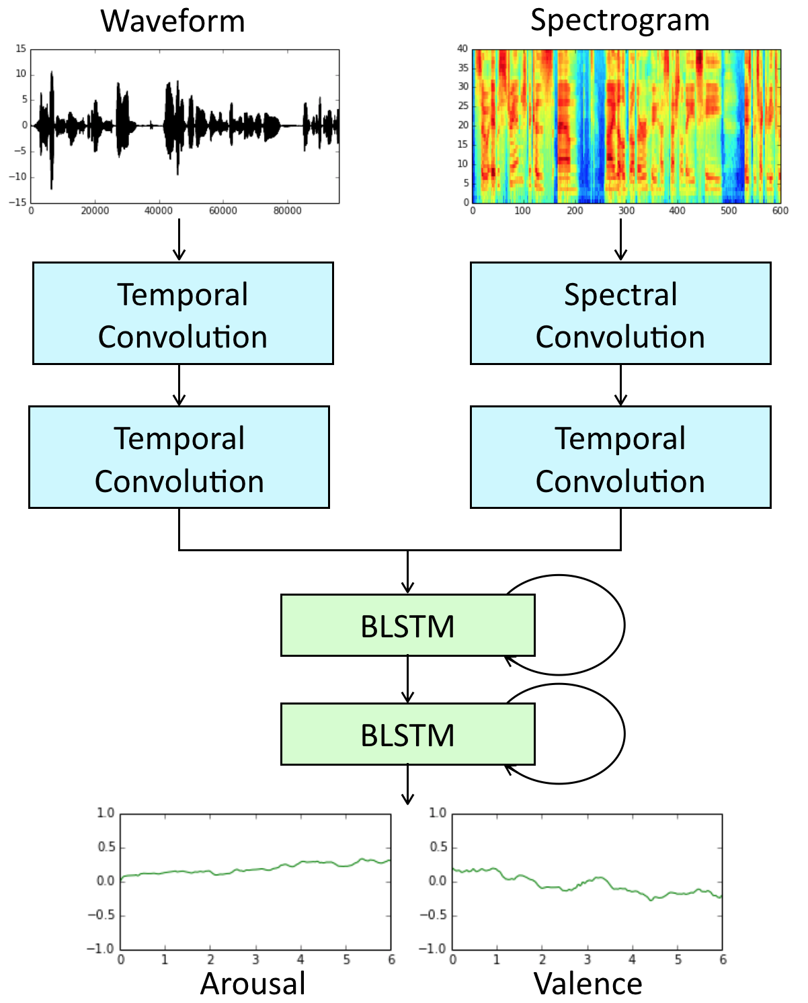
Emotion Recognition in Speech
Recognize emotion in Arousal-Valence space
Deep learning model
Arousal
Valence

Slide 26
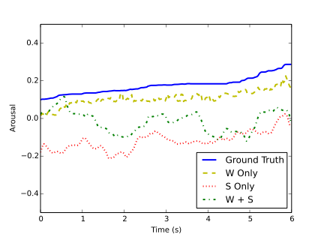
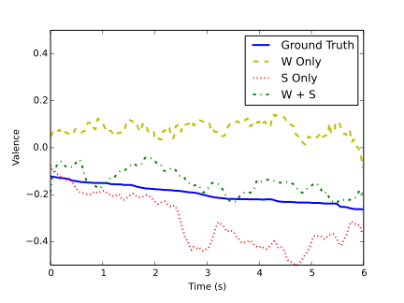
Emotion Recognition in Speech
Arousal
Valence
“…cos she’s so frigging superior"

Slide 27
LORELEI Project
Low Resource Languages for Emergent Incidents (LORELEI)
Develop language technologies quickly to help first responders understand text and speech information
Using acoustic features to detect whether the speaker is talking about an incident
Keyword search in low-resource languages

Slide 28
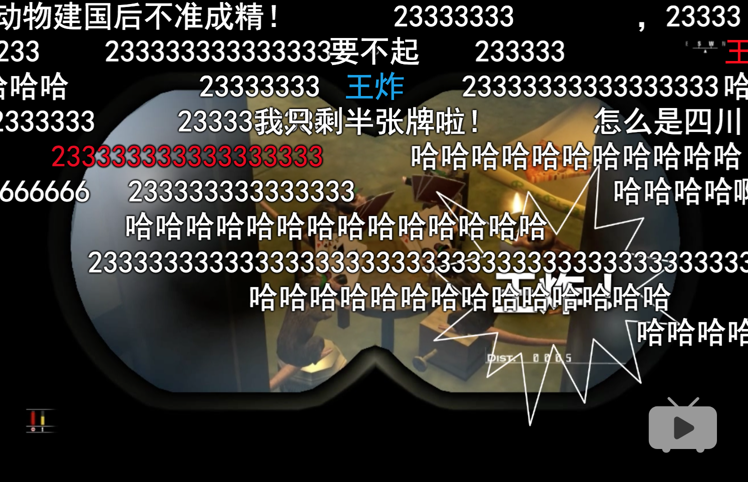
Predicting Humor in Videos
Learning from time-aligned user comments

Slide 29
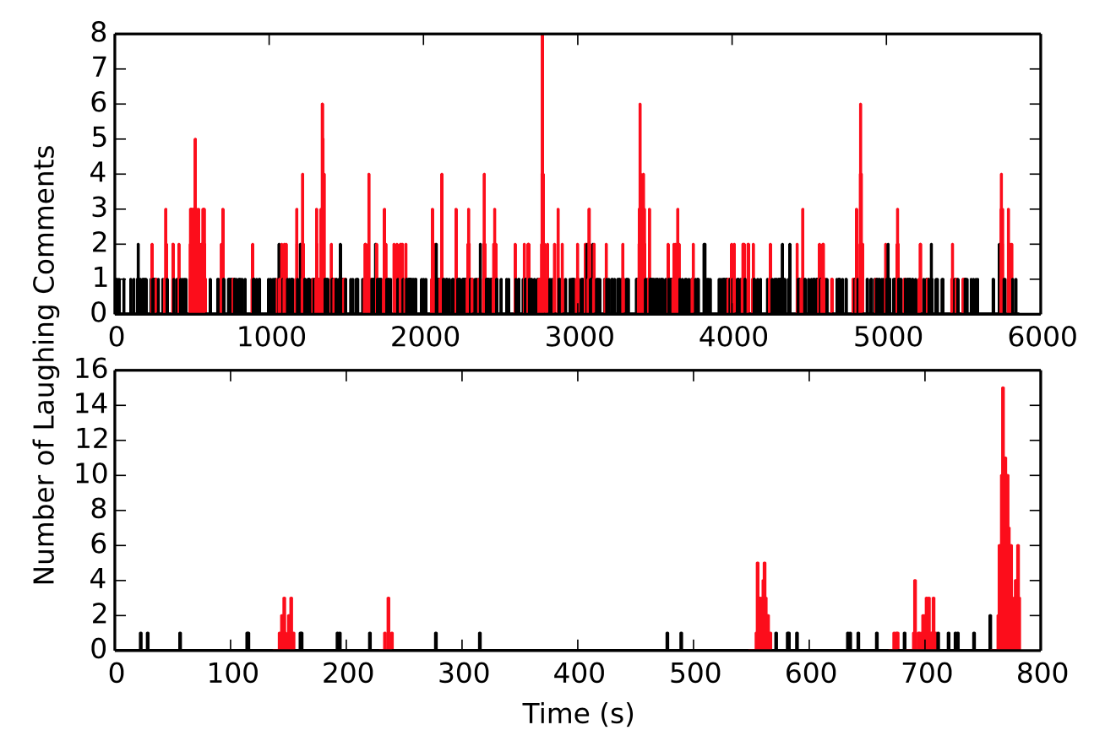
Predicting Humor in Videos

Slide 30
Survey
Are you enrolled in this class?
What is your background in NLP and or speech processing?
Why do you want to take this course? What do you hope to learn?

Slide 31
For next week
Reading: J&M Chapter 7 (7.1-7.3)
Post on Courseworks before Thurs 11:59am

Slide 32
Honor policy on syllabus
Julia Hirschberg office hours: CEPSR 705
Sarah Ita Levitan office hours: CEPSR 701
Rose Sloan: office hours, CEPSR 7LW3 (Speech Lab)
Zixiaofan Yang: office hours, CEPSR 7LW3 (Speech Lab)

Slide 33
Questions?

