Slide 1
Intonation and Computation: Charisma
LSA 2017
Julia Hirschberg
julia@cs.columbia.edu

Slide 2
Perceptions of Social Characteristics from Speech and Text
How likable is the speaker? (Samantha)
How engaged, flirtatious, awkward is a conversation? (Ty)
How charismatic is a speaker?

Slide 3
“Would You Buy a Car From Me?” – On the Likability of Telephone Voices
Felix Burkhardt, Björn Schuller, Benjamin Weiss, Felix Weniger

Slide 4
Problem
Speech based classification: “attempts to categorize people based solely on on their voice and way of speaking. The categories may be relatively invariant like age, gender or dialect, or time changing like emotional state.”

Slide 5
Database
Agender database
940 speakers of mixed and age and gender
Recorded over telephone (landlines and cell phones)
Drawbacks:
Signal less clear (limited bandwidth)
Short responses
Not great for likability ratings
However, more real-world like
“e.g. if a call center agent would like to test the likability of his/her own voice.”

Slide 6
Data Selection
All German speakers in Germany, no balance of dialects
One sentence for each speaker, commands
Longest sentence spoken by speaker
“mach weiter mit der Liste” (continue with the list)
“ich hätte gerne die Vermittlung bitte” (I’d like an operator please)

Slide 7
Judging Likability
32 participants
15 female, 17 male; aged 2—42
Participants rated half of the 800 utterances
Therefore, each utterance from the database rated 16 times
Told to rate likability; ignore quality of recording and lexical content
7 point scale
No significant effect of participants’ age or gender on ratings

Slide 8
Automatic Analysis

Slide 9
Automatic Analysis
LLDs and functionals combined to make 3996 features
Plus other pitch and voice quality features (360)
Plus functionals applies to pitch contour (12)

Slide 10
Results
Divided features into cepstral (CEPS), auditory spectral (AUSP), prosodic (PROS), and voice quality (VOQU) features
“Cepstral features do not enable robust regression or classification - in fact, the mean UA for classification is near chance level (52%). In contrast, auditory spectral features seem to contribute the most to reliable automatic likability analysis for regression as well as classification, followed by prosodic and voice quality features.”
Though raters might not have agreed on likability, robust results for automatic evaluation.

Slide 11
Extracting Social Meaning: Identifying social meaning in conversational style
Jurafsky, Raganath and McFarland, 2009

Slide 12
Defining Charisma
Compelling attractiveness or charm that can inspire devotion in others
The ability to attract, and retain followers by virtue of personality as opposed to tradition or laws == not traditional or political office . (Weber)
Or….Speech that encourages listeners to perceive the speaker as “charismatic”

Slide 13
Some Samples from the Class
A
B
C
D

Slide 14
Which of these speakers sound charismatic?
1 | 2 | 3 | 4

Slide 15
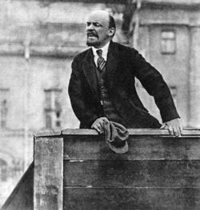
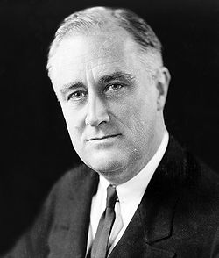
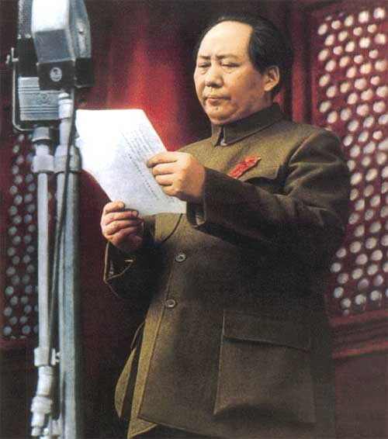
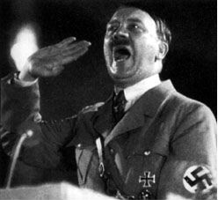
1. Vladimir Lenin
2. Franklin D. Roosevelt
3. Mao Zedong
4. Adolf Hitler

Slide 16
What makes an individual charismatic?
Message?
Personality?
Speaking style?
What aspects of speech might contribute to the perception of a speaker as charismatic?
Content of message?
Lexico-syntactic features?
Acoustic-prosodic features?

Slide 17
What makes a speaker credible?
Christopher Tuppen, “Dimensions of communicator credibility: An oblique solution”, Speech Monographs(41), 1974.
101 subjects read a booklet containing ten character sketches.
Student, professor, ad exec, farmer, unethical businessman, doctor, ret. Army officer, man of religion, hippie, TV personality
Topics: how much sleep you need, marijuana and health, duration of US envolvement in SE Asia, and tuition at State Colleges
The subjects rated each communicator on 64 scales.
28 bipolar adjective, 36 seven-point Likert scales.

Slide 18
Subject ratings grouped using cluster analysis
Cluster 1: “Trustworthiness”
Trustworthy, honest, safe, dependable, reputable, etc.
Cluster 2: “Expertise”
Qualified, skilled, informed, experienced, etc.
Cluster 3: “Dynamism”
Bold, active, aggressive, strong, emphatic, etc.

Slide 19
Cluster 4: “Co-orientation”
Created a favorable impression, stood for a group whose interests coincided with the rater, represented acceptable values, was someone to whom the rater would like to listen.
Cluster 5: “Charisma”
Convincing, reasonable, right, logical, believable, intelligent, whose opinion is respected, whose background is admired, in whom the reader has confidence.

Slide 20
Forcefulness, Persuasion and Social Influence
M. Hamilton & B. Stewart, “Extending an Information Processing Model of Language Intensity Effects”, Communication Quarterly (41:2), 1993
“How forceful should my language be in order to maximize my social influence?”
I.e., what is the relationship between language intensity and persuasion?
Notes:
The information processing model of persuasion was used as the basis for a mathematical model of language intensity effects. The model proposes that attitude change is a product of message discrepancy, source evaluation, and message strength. The results show strong support for the model. The salient source evaluation dimension was perceived trustworthiness. Language intensity enhanced attitude change directly, by acting as a multiplier of message strength, and indirectly, by increasing message discrepancy. These effects held for female as well as male sources. Path analysis indicated the presence of source evaluation heuristics. Intensity enhanced source ratings through a positively linked causal chain from intensity to dynamism to expertise to trustworthiness. Intensity also had negative effects on post‐message expertise and trustworthiness unmediated by dynamism.

Slide 21
Intensity manipulated by varying two language features: emotionality and specificity
Emotionality: degree of affect present in the language, ranging from stolid displays to histrionics
Specificity: degree to which precise reference is made to attitude objects
Attitude change is a product of message discrepancy, perceived source credibility and message strength
a - attitude, f - force, s - source credibility
d - discrepancy, c - counterargument
α - impact parameter

Slide 22
518 subjects presented with a “persuasive message” with manipulated intensity
Message’s language evaluated on 11 terms using a 7-point bipolar adjective scale
Intense, strong, active, extreme, forceful, emotional, vivid, vigorous, powerful, assertive, potent
Perceived source competence, trustworthiness and dynamism were assessed

Slide 23
Correlations between subject ratings and manipulated features were calculated using a causal modeling program, PATH.
Extremity of
position
.42
“charisma sequence”
-.32
Manipulated
intensity
Perceived
intensity
Source
dynamism
Source
competence
Source
trustworthiness
.64
.78
.52
.73
-.18
Notes:
Results show strong support for the model.
The salient source evaluation dimension was perceived trustworthiness.
Language intensity enhanced attitude change directly, by acting as a multiplier of message strength, and indirectly, by increasing message discrepancy.
These effects held for female as well as male sources.
Path analysis indicated the presence of source evaluation heuristics: Intensity enhanced source ratings through a positively linked causal chain from intensity to dynamism to expertise to trustworthiness. Intensity also had negative effects on post‐message expertise and trustworthiness unmediated by dynamism.

Slide 24
Some Empirical Studies of Charismatic Speech and Text
Cross-cultural dimensions
Is charisma in L1 perceived differently by L1, L2, and Lx speakers?
Is the judgment of charisma correlated with different features for different speakers? Hearers?
How important is the content of the message vs. they way it is spoken?

Slide 25
Cross-cultural Charisma Perception
Within culture differences
Cross-culture perception
SAE, Palestinian Arabic, Swedish

Slide 26
Experimental Design
Listen to speech tokens in native language via web form
Rate each token with 26 questions, 5-pt Likert scale:
The speaker is:
charismatic, angry, spontaneous, passionate, desperate, confident, accusatory, boring, threatening, informative, intense, enthusiastic, persuasive, charming, powerful, ordinary, tough, friendly, knowledgeable, trustworthy, intelligent, believable, convincing, reasonable

Slide 27
American English Experiment
12 native SAE speakers, 6 male/6 female
45 speech segments (mean duration = 10s)
2004 primary Democratic presidential candidates (9 candidates)
5 tokens per speaker, 1 per topic:
Healthcare, Iraq, tax plan, reason for running, content-neutral

Slide 28
American English Experiment
Data: 45 2-30s speech segments, 5 each from 9 candidates for Democratic nomination for U.S. president in 2004
Liberman, Kucinich, Clark, Gephardt, Dean, Moseley Braun, Sharpton, Kerry, Edwards
2 ‘charismatic’, 2 ‘not charismatic’
Topics: greeting, reasons for running, tax cuts, postwar Iraq, healthcare
4 genres: stump speeches, debates, interviews, ads
8 subjects rated each segment on a Likert scale (1-5) 26 questions in a web survey
Duration: avg. 1.5 hrs, min 45m, max ~3hrs

Slide 29
Palestinian Arabic Experiment
12 native Palestinian Arabic speakers (6 male/6 female)
44 speech tokens (mean duration=14s)
Tokens selected from Al-Jazeera News Channel in 2005
Topics: assassination of Hamas leader, debate among Palestinian groups, Intifada, Israeli separation wall, Palestinian Authority, calls for reform
22 male speakers, 2 segments each

Slide 30
Cross-Subject Agreement
Weighted kappa statistic
English: mean k=0.207
Arabic: mean k=0.225

Slide 31
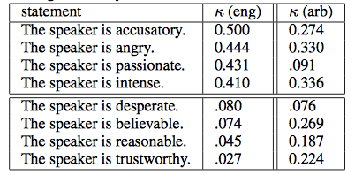
Cross-Subject Agreement on Judgments

Slide 32
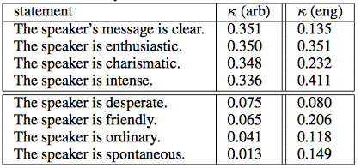
Cross-Subject Agreement on Judgments

Slide 33
Within-Subject Correlation of Ratings
Which attributes are correlated with charisma ratings?
English:
Enthusiastic (k=0.62)
Persuasive (k=0.58)
Charming (k=0.58)
Passionate (k=0.54)
Convincing (k=0.50)
Not boring (k=-0.51)
Not ordinary (k=-0.40)

Slide 34
Within-Subject Correlation of Ratings
Which attributes are correlated with charisma ratings?
Arabic:
Tough (k=0.69)
Powerful (k=0.69)
Persuasive (k=0.68)
Charming (k=0.66)
Enthusiastic (k=0.65)
Not boring (k=-0.45)
Not desperate (k=-0.26)

Slide 35
Influences on Charisma Ratings
Speaker identity significantly influences subjects’ ratings of charisma
English: p=2.2e-16
Arabic: p=0.0006

Slide 36
Influences on Charisma Ratings
Recognition of speaker identity
English:
Mean speakers recognized = 5.8 (of 9)
Recognized speakers were rated as more charismatic
Arabic:
Mean speakers recognized = 0.55 (of 22)
No correlation between charisma rating and recognition

Slide 37
Influences on Charisma Ratings
Topic
Affected charisma perception in both English and Arabic
Stronger effect in Arabic

Slide 38
Acoustic/Prosodic Analysis
Features: duration, pitch, intensity, speaking rate
Results:
Duration – positive correlation across cultures
Speaking rate
Positive correlation for English (faster is better)
Negative correlation for Arabic (fast is worse)
Fastest IPUs only – positive correlation across culture

Slide 39
Acoustic/Prosodic Analysis
Higher pause to word ratio
Positive correlation for Arabic
Greater standard deviation of pause length
Negative correlation for English
Positive correlation for Arabic
Notes:
Why? What would these sounds like?

Slide 40
Acoustic/Prosodic Analysis
Mean f0
Positive correlation across cultures
Min f0
Positive correlation for English
Negative correlation for Arabic
Max f0, stdev f0
Positive correlation for Arabic

Slide 41
Acoustic/Prosodic Analysis
Mean, stdev intensity
Positive correlation across cultures
Max intensity
Positive correlation for Arabic

Slide 42
Lexical Analysis
Number of words per token
Positive correlation across cultures
Disfluency rate
Negative correlation across cultures
Ratio of repeated words
Positive correlation across cultures

Slide 43
Lexical Analysis
First person plural pronouns
Positive correlation for English
Third person pronouns
Plural
Negative correlation for English
Positive correlation for Arabic
Singular - positive correlation for English

Slide 44
Lexical Analysis
Parts of speech
Arabic: negative correlations with ratio of adverbs, prepositions, nouns
English: negative correlations with adverbs, adjectives

Slide 45
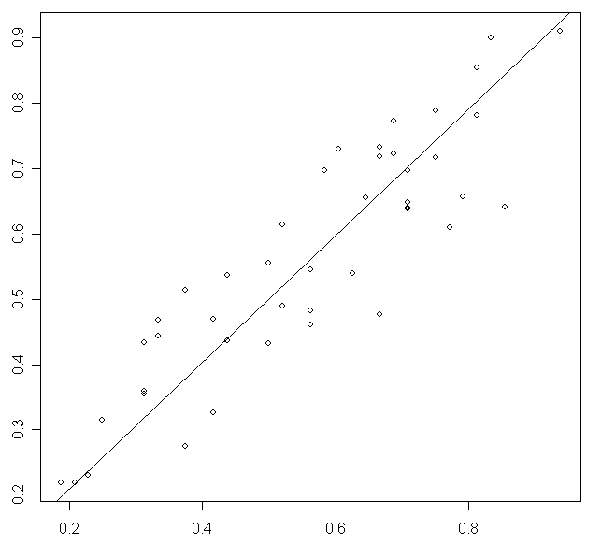
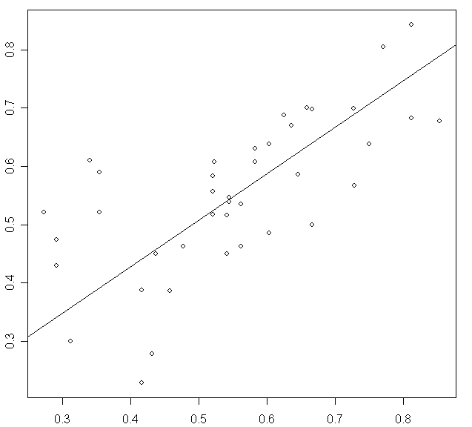
The Prediction of Charisma
Arabic English

Slide 46
Summary
Shared functional definition of charisma across English and Arabic
Persuasive, charming, enthusiastic, not boring
Cultural differences in charisma perception
English – passionate, convincing
Arabic – tough, powerful
Similarities and differences in acoustic/prosodic and lexical correlates of charisma

Slide 47
Cross-cultural Perception of Charisma
“A Cross-Cultural Comparison of American, Palestinian, and Swedish Perception of Charismatic Speech” (Biadsy et al., 2008)

Slide 48
Inter-rater Agreement
American subject agreement was higher when rating Arabic than English
Arabic subject agreement was higher when rating Arabic than English
Speaker affects subject judgments across studies
Topic affects subject judgments:
Americans rating SAE
Palestinians rating Arabic
Palestinians rating English
Swedish rating English

Slide 49
Acoustic/Prosodic Analysis
Correlation with rated charisma in all 5 studies:
Mean pitch
Mean and stdev intensity
Token duration
Pitch range
Disfluency

Slide 50
Language-Specific Indicators
Rating SAE
All groups – min f0
Swedish – max & stdev intensity
SAE & Swedish – speaking rate
Rating Arabic
Palestinian – min f0, speaking rate
All groups – stdev f0, max & stdev intensity

Slide 51
Lexical Features
Rating SAE
American and Swedish – third person plural pronouns
All groups – First person plural pronouns, third person singular pronouns, repeated words
Rating Arabic
Both groups – third person plural pronouns, nouns

Slide 52
Charisma Perception across Cultures
American vs. Palestinian ratings of SAE tokens
Mean ratings are not different across groups
Charisma ratings are positively correlated
Swedish vs. Palestinian ratings of SAE tokens
Mean ratings are not different across groups
Charisma ratings are positively correlated
Swedish vs. American ratings of SAE tokens
Mean ratings are different across groups
Charisma ratings are positively correlated
Palestinian vs. American ratings of Arabic tokens
Mean ratings are different across groups
Charisma ratings are positively correlated

Slide 53
Differences Across Cultures
Rating Arabic
Greater charisma perception by SAE group: faster speaking rate, smaller stdev speaking rate, greater mean & stdev intensity
Greater charisma perception by Palestinian group: lower pitch peaks, high stdev f0
Rating SAE
Greater charisma perception by Swedish group: more compressed pitch range, greater min f0, lower stdev f0

Slide 54
Summary
Some cues are cross-cultural, some are language-specific
Cross-cultural charisma judgments are more conservative
Native and non-native judgments of a given target language are correlated
Even when the judges don’t speak the target language

Slide 55
Charisma and Politics
Analysis of Speech Transcripts to Predict Winners of U.S. Presidential and Vice Presidential Debates, (Kaplan & Rosenberg, 2012)
Corpus of political speech
Determine lexical and acoustic correlates of political success
Characterize similarities and differences between parties

Slide 56
Corpus collection
25 debates spanning 9 election cycles (1976-80)
Each between one Republican and one Democrat
Democrats won 68%; Republicans 32%
Binary labels based on post-debate polling
Goal: predict the winner
Notes:
We construct data sets from this set of transcripts in two ways. In one experimental paradigm, each debate is a data point, where the label is whether the Democratic or Republican participant won. In a second paradigm, we extract a feature vector for every 20 speaker turns in the debate, ensuring that no two feature vectors from the same debate appear in a training and test set. Democrats won 65% of the split sections, with Republicans winning 35%.

Slide 57
Features
Total # words
Word usage (stemmed):
Indicators of friendliness and formality: personal pronouns, # questions asked, pleasantries, contractions, numbers, refs to opponent, refs to both running mates
Words affiliated with common political topics: god, health, religion, tax, war and synonyms using WordNet
Affective content: DAL
Named entities: using Stanford tagger, # and rate of usage
Tf*idf values for top 10K words for each debater
Notes:
Analysis using Weka’s SVM (SMO)
Relative value of each speaker using Weka’s chi squared feature analysis

Slide 58
Turn length: absolute and mean # syls, words, sentences in each turn
Complexity: Flesch-Kincaid grade level readability formula
Notes:
F-K formula: The formula defines the grade level of text as (0.39*words per sentence) + (11.8*syllables per word)-15.59

Slide 59
Classification
Train on all preceding debates to predict winner of current year
Debate-level: which party won using data from both speakers
Speaker-level: which speaker won, including features only for each speaker w/out ref to opponent

Slide 60
Predicting Poll Results
By-debate: use data for both speakers
By-debater: use data for each speaker in turn
Unsplit: one data-pt per debate
Split: one data-pt every 20 spkr turns
Notes:
Predict Accuracy (baseline for debate: democrats win/# datapoints; for debater: 50/50) and significance (p value)
Not so great but small data

Slide 61
Feature Analysis
First person plural possessives (“our”) used by Democrats
Negatively correlates with Democratic wins
Grade level readability of Democrats
Lower complexity in Democratic wins
Second person singular object pronouns (“you”) used by Republicans
Negatively correlates with Republican wins altho correlates with individualism
“atomic”, “unilateral”, “soviets”
important political topics
“achieve”, “disagreements,” “advocate”, “achieve”
Politically active words important
Notes:
When candidates sound too “typical” they are less successful

Slide 62
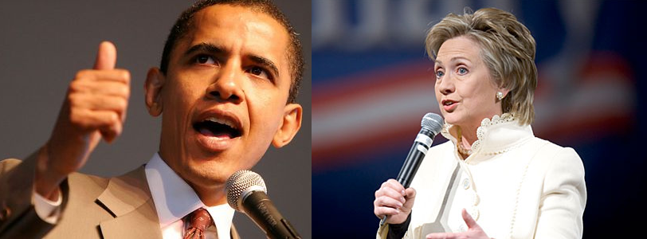
More Recent Debates
Can we predict the Winners?
or
The Losers?

Slide 63
Similar Goals and Research Questions
Investigate emotion and charisma in political discourse
Collect a corpus of political speech: debates
Determine lexical and acoustic correlates of political success: correlate with subsequent polls
Characterize similarities and differences between Democrats and Republicans

Slide 64
Corpus Collection
Democratic primaries from 2008:
Joe Biden, Hillary Clinton, Chris Dodd, John Edwards, Mike Gravel, Dennis Kucinich, Barak Obama, Bill Richardson
New Hampshire MSNBC Debate, September 26, 2007
Fall 2011 Republican primaries:
Michelle Bachmann, Herman Cain, Newt Gingrich, Jon Huntsman, Gary Johnson, Ran Paul, Rick Perry, Mitt Romney, Rick Santorum
Fox News / Google Debate, September 22, 2011
Interviews for all candidates
Notes:
Different primaries since incumbent for the party or not

Slide 65
Gallup Poll Results
Democrats | Poll Results | Republicals | Poll Results
Clinton | 47% | Romney | 20%
Obama | 26% | Cain | 18%
Edwards | 11% | Perry | 15%
Richardson | 4% | Paul | 8%
Biden | 2% | Gingrich | 7%
Dodd | 1% | Bachmann | 5%
Kucinich | 1% | Santorum | 3%
Gravel | 0.5% | Huntsman | 2%
 |  | Johnson | 0%

Slide 66
Lexical Features
For Debate speech only
Word Count
Laughter, applause, and interruptions
Number of speaker turns
Average number of words per turn
Syllables per word
Disfluencies per word
Linguistic Inquiry and Word Count (LIWC) features

Slide 67
Acoustic Features
Debates and Interviews: mean, min, max, and standard deviation of f0
Difference for these values between debates and interviews

Slide 68
Results: Correlates with Post-Debate Poll Standing
Features | Democracts | Republicans
Word Count Laughs Applause Turns Interruptions Avg Words Per Turn Avg Syllables Per Word Disfluencies Per Word Mean-f0 Difference Min-f0 Difference | 0.804 0.084 0.194 0.846 0.052 0.199 0.015 -0.805 0.059 0.002 | 0.582 0.780 0.350 0.381 0.247 0.406 -0.768 -0.130 0.479 0.105

Slide 69
LIWC Positive Correlates for Democrats
Feature | Examples | Correlates
Insight | Think, know consider | 0.74
Inclusive | And, with, include | 0.680
Cognitive | Cause, know, ought | 0.679
Words per sentece |  | 0.661
Common verbs | Walk, went, see | 0.657
Positive emotion | Love, nice, sweet | 0.632
Pronouns | I, them, itself | 0.626
Nonfluencies | Er, hmm, umm | 0.611

Slide 70
LIWC Features: Negative Correlates for Democrats
Features | Examples | Correlation
Articles | A, an, the | -0.684
All Punctuation |  | -0.653
Periods | . | -0.639
Dashes | - | -0.595
Numerals | 12, 38, 156 | -0.581
Questions marks | ? | -0.578
Ingestion | Dish, eat, pizza-0.575 | -0.575
Money | Audit, cash, owe | -0.548
2nd Person Pronouns | You, your | -0.506

Slide 71
LIWC Features: Correlates for Republicans
Features | Examples | Correlation
Leisure | Cook, chat, movie | 0.869
Past tense | Went, ran, had | 0.732
“Other” punctuation | !”:%$ | 0.665
Dictionary words |  | 0.541
Personal pronouns | I, them, her | 0.525
6+ letters | Abandon, abrupt, absolute | -0.741
Home | Apartment, kitchen, family | -0.513

Slide 72
General Party Differences
Democrat audiences laughed more
Republican audience applauded more
Democrats got interrupted more
Republicans had more words per turn
Both had about the same number of syllables per word
Democrats' debate speech was more different from their interviews, but Republicans responded slightly more positively to these differences.

Slide 73
Conclusions
Democrats: Talk more, use fewer disfluencies, and use more Insight words
Republicans: Make the audience laugh, use Leisure-related words, and avoid longer words

Slide 74
More to Do in Politics
Investigate additional acoustic features (intensity, speaking rate, voice quality)
Higher level prosodic features (intonational contours, phrasing)
More complicated / interesting lexical features
Cross-cultural similarities and differences
Entrainment

Slide 75
Next Class
Identifying Personality from Speech and Text
Assignment: Turn in 2-3pp description of your project/projects you are considering

