Slide 1
Turn-Taking in Spoken Dialogue Systems
CS4706
Julia Hirschberg

Slide 2
Joint work with Agustín Gravano
In collaboration with
  Stefan Benus
  Hector Chavez
  Gregory Ward and Elisa Sneed German
  Michael Mulley
With special thanks to Hanae Koiso, Anna Hjalmarsson, KTH TMH colleagues and the Columbia Speech Lab for useful discussions

Slide 3
Interactive Voice Response (IVR) Systems
Becoming ubiquitous, e.g.
  Amtrak’s Julie: 1-800-USA-RAIL
  United Airlines’ Tom
  Bell Canada’s Emily
  GOOG-411: Google’s Local information.
Not just reservation or information systems
  Call centers, tutoring systems, games…

Slide 4

Current Limitations of IVR Systems
Automatic Speech Recognition (ASR) + Text-To-Speech (TTS) account for most users’ IVR problems
  ASR: Up to 60% word error rate
  TTS: Described as ‘odd’, ‘mechanical’, ‘too friendly’
As ASR and TTS improve, other problems emerge, e.g. coordination of system-user exchanges
    How do users know when they can speak?
    How do systems know when users are done?
    AT&T Labs Research TOOT example

Slide 5
Commercial Importance
http://www.ivrsworld.com/advanced-ivrs/usability-guidelines-of-ivr-systems/
  11. Avoid Long gaps in between menus or information
  Never pause long for any reason. Once caller gets silence for more than 3 seconds or so, he might think something has gone wrong and press some other keys! But then a menu with short gap can make a rapid fire menu and will be difficult to use for caller. A perfectly paced menu should be adopted as per target caller, complexity of the features. The best way to achieve perfectly paced prompts are again testing by users!
Until then….http://www.gethuman.com
Notes:
Need bad example instead – at&t? Check cmu files for others
http://www.ivrsworld.com/advanced-ivrs/usability-guidelines-of-ivr-systems/
11. Avoid Long gaps in between menus or information
Never pause long for any reason. Once caller gets silence for more than 3 seconds or so, he might think something has gone wrong and press some other keys! But then a menu with short gap can make a rapid fire menu and will be difficult to use for caller. A perfectly paced menu should be adopted as per target caller, complexity of the features. The best way to achieve perfectly paced prompts are again testing by users!

Slide 6
Turn-taking Can Be Hard Even for Humans
Beattie (1982): Margaret Thatcher (“Iron Lady” vs. “Sunny” Jim Callahan
  Public perception: Thatcher domineering in interviews but Callaghan a ‘nice guy’
  But Thatcher is interrupted much more often than Callaghan – and much more often than she interrupts interviewer
Hypothesis: Thatcher produces unintentional turn-yielding behaviors – what could those be?
Notes:
Interruptions come at end of syntactic clause when there is a drawl on stressed syllable in clause and falling intonation

Slide 7
Turn-taking Behaviors Important for IVR Systems
Smooth Switch: S1 is speaking and S2 speaks and takes and holds the floor
Hold: S1 is speaking, pauses, and continues to speak
Backchannel: S1 is speaking and S2 speaks -- to indicate continued attention -- not to take the floor (e.g. mhmm, ok, yeah)

Slide 8
Why do systems need to distinguish these?
System understanding:
  Is the user backchanneling or is she taking the turn (does ‘ok’ mean ‘I agree’ or ‘I’m listening’)?
  Is this a good place for a system backchannel?
System generation:
  How to signal to the user that the system system’s turn is over?
  How to signal to the user that a backchannel might be appropriate?

Slide 9
Our Approach
Identify associations between observed phenomena (e.g. turn exchange types) and measurable events (e.g. variations in acoustic, prosodic, and lexical features) in human-human conversation
Incorporate these phenomena into IVR systems to better approximate human-like behavior

Slide 10
Previous Studies
Sacks, Schegloff & Jefferson 1974
  Transition-relevance places (TRPs): The current speaker may either yield the turn, or continue speaking.
Duncan 1972, 1973, 1974, inter alia
  Six turn-yielding cues in face-to-face dialogue
    Clause-final level pitch
    Drawl on final or stressed syllable of terminal clause
    Sociocentric sequences (e.g. you know)
Notes:
DUNCAN (1972) identified six turn-yielding cues in conversation.13 Five are verbal or paralinguistic and transmitted via the auditory channel. These include:
A) intonation: the use of any pitch-level-terminal juncture combination other than at the end of a phonemic clause refers to a phonemic clause ending on a sustainded intermediate pitch level
B) drawl on the final syllable, or on the stressed syllable, of a terminal clause
C) sociocentric sequences: the appearance of one of several stereotyped expressions, typically following a substantive statement, e.g. "but ah", "you know", etc.
D) pitch / loudness: a drop in paralinguistic pitch and / or loudness in con- junction with one of the sociocentric sequences. When used, these expres- sions typically followed a terminal clause, but did not often share the same paralanguage
E) syntax: the completion of a grammatical clause involving a subject-predicate combination.14
The sixth turn-yielding cue involves gesticulation and is therefore transmitted via the visual channel.

Slide 11
    Drop in pitch and loudness plus sequence
    Completion of grammatical clause
    Gesture
  Hypothesis: There is a linear relation between number of displayed cues and likelihood of turn-taking attempt
Corpus and perception studies
  Attempt to formalize/ verify some turn-yielding cues hypothesized by Duncan (Beattie 1982; Ford & Thompson 1996; Wennerstrom & Siegel 2003; Cutler & Pearson 1986; Wichmann & Caspers 2001; Heldner&Edlund Submitted; Hjalmarsson 2009)

Slide 12
Implementations of turn-boundary detection
  Experimental (Ferrer et al. 2002, 2003; Edlund et al. 2005; Schlangen 2006; Atterer et al. 2008; Baumann 2008)
  Fielded systems (e.g., Raux & Eskenazi 2008)
  Exploiting turn-yielding cues improves performance

Slide 13
Columbia Games Corpus
12 task-oriented spontaneous dialogues
  13 subjects: 6 female, 7 male
  Series of collaborative computer games of different types
  9 hours of dialogue
Annotations
  Manual orthographic transcription, alignment, prosodic annotations (ToBI), turn-taking behaviors
  Automatic logging, acoustic-prosodic information

Slide 14
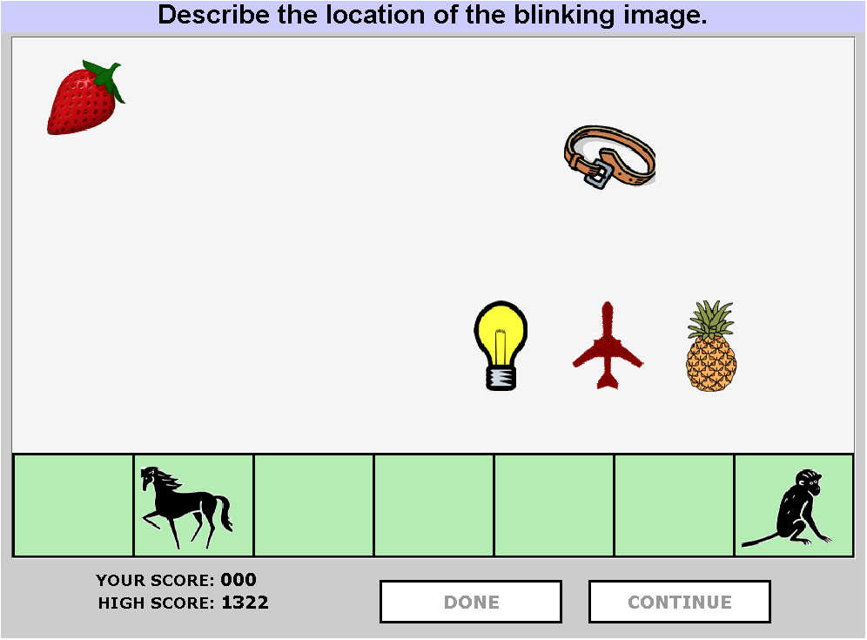
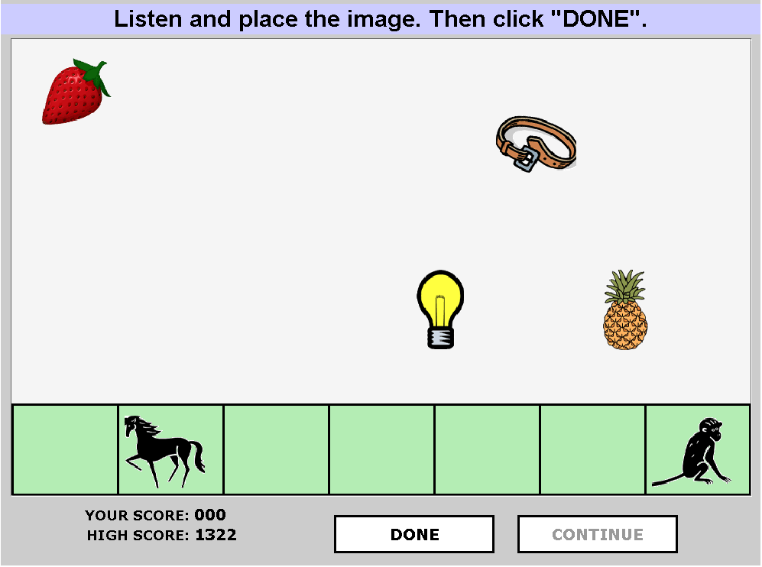
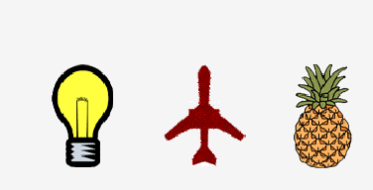

Objects Games
Player 1: Describer
Player 2: Follower
Notes:
In an Objects games, each player saw a board with 5-7 objects.
The boards were almost identical, with one object misplaced.
One of the players had to describe the position of the target object to the other player, who had to move it to the correct position.

Slide 15
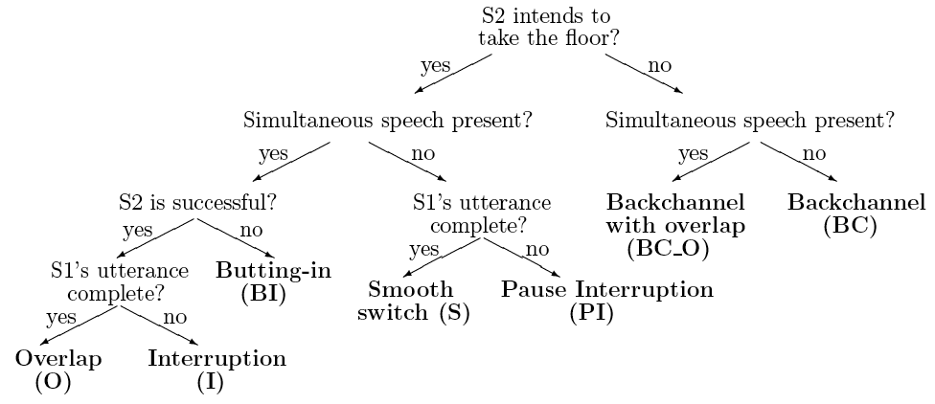
Turn-Taking Labeling Scheme for Each Speech Segment
Notes:
Trained annotators distinguished Smooth Switches from Interruptions and Backchannels using a scheme based on Ferguson 1977, Beattie 1982

Slide 16
Turn-Yielding Cues
Cues displayed by the speaker before a turn boundary (Smooth Switch)
Compare to turn-holding cues (Hold)

Slide 17
Method
IPU (Inter Pausal Unit): Maximal sequence of words from the same speaker surrounded by silence ≥ 50ms (n=16257)
Hold
Smooth Switch
IPU1
IPU2
Speaker A:
IPU3
Speaker B:
Hold: Speaker A pauses and continues with no intervening speech from Speaker B (n=8123)
Smooth Switch: Speaker A finishes her utterance; Speaker B takes the turn with no overlapping speech (n=3247)

Slide 18
Method
Hold
Smooth switch
IPU1
IPU2
Speaker A:
IPU3
Speaker B:
Compare IPUs preceding Holds (IPU1) with IPUs preceding Smooth Switches (IPU2)
Hypothesis: Turn-Yielding Cues are more likely to occur before Smooth Switches (IPU2) than before Holds (IPU1)

Slide 19
Individual Turn-Yielding Cues
Final intonation
Speaking rate
Intensity level
Pitch level
Textual completion
Voice quality
IPU duration

Slide 20
1. Final Intonation
 | Smooth Switch | Hold
H-H% | 22.1% | 9.1%
[!]H-L% | 13.2% | 29.9%
L-H% | 14.1% | 11.5%
L-L% | 47.2% | 24.7%
No boundary tone | 0.7% | 22.4%
Other | 2.6% | 2.4%
Total | 100% | 100%
(χ² test: p≈0)
Falling, high-rising: turn-final. Plateau: turn-medial.
Stylized final pitch slope shows same results as hand-labeled

Slide 21
2. Speaking Rate
*
*
z-score
*
*
Smooth Switch
Hold
(*) ANOVA: p < 0.01
Entire IPU
Final word
Note: Rate faster before SS than H (controlling for word identity and speaker)
Notes:
Rate faster before turn boundaries over IPU and word, but slower in both SS and H over final word – same final lengthening
IPU final bigrams and trigrams before SW and H examined for Note.

Slide 22
3/4. Intensity and Pitch Levels
*
*
*
z-score
*
*
*
Smooth Switch
Hold
(*) ANOVA: p < 0.01
Intensity
Pitch
Lower intensity, pitch levels before turn boundaries

Slide 23
5. Textual Completion
Syntactic/semantic/pragmatic completion, independent of intonation and gesticulation.
  E.g. Ford & Thompson 1996 “in discourse context, [an utterance] could be interpreted as a complete clause”
Automatic computation of textual completion.
  (1) Manually annotated a portion of the data.
  (2) Trained an SVM classifier.
  (3) Labeled entire corpus with SVM classifier.
Notes:
Duncan 1972, Sacks 1974, Ford & Thompson 1996; Wennerstrom & Siegel 2003, e.g.
F

Slide 24
5. Textual Completion
(1) Manual annotation of training data
  Token: Previous turn by the other speaker + Current turn up to a target IPU -- No access to right context
    Speaker A: the lion’s left paw our front
    Speaker B: yeah and it’s th- right so the {C / I}
  Guidelines: “Determine whether you believe what speaker B has said up to this point could constitute a complete response to what speaker A has said in the previous turn/segment.”
  3 annotators; 400 tokens; Fleiss’ κ = 0.814

Slide 25
5. Textual Completion
(2) Automatic annotation
  Trained ML models on manually annotated data
  Syntactic, lexical features extracted from current turn, up to target IPU
    Ratnaparkhi’s (1996) maxent POS tagger, Collins (2003) statistical parser, Abney’s (1996) CASS partial parser
Majority-class baseline (‘complete’) | 55.2%
SVM, linear kernel | 80.0%
Mean human agreement | 90.8%
Notes:
Lexical id, pos tag of w
simplified pos tag of w
pos tags of ipu-final bigram
# words in ipu, is it a fragment?
Size and type of largest and smallest phase ending in w
Binary flags for whether largest and smallest phrases are NP, VP, PP, Adjp, Advp
Binary flags for whether w is head of largest and smallest phrase

Slide 26
5. Textual Completion
(3) Labeled all IPUs in the corpus with the SVM model.
18%
Incomplete
47%
53%
82%
Complete
(χ² test, p ≈ 0)
Smooth switch
Hold
Textual completion almost a necessary condition before switches -- but not before holds

Slide 27
5a. Lexical Cues
 | S | H
Word Fragments | 10 (0.3%) | 549 (6.7%)
Filled Pauses | 31 (1.0%) | 764 (9.4%)
Total IPUs | 3246 (100%) | 8123 (100%)
No specific lexical cues other than these
Notes:
Affirmative cue words (e.g. okay) are overloaded, so occur with varied turn phenomena.

Slide 28
6. Voice Quality
*
*
*
*
*
*
*
*
*
z-score
Smooth Switch
Hold
Jitter
Shimmer
NHR
(*) ANOVA: p < 0.01
Higher jitter, shimmer, NHR before turn boundaries
Notes:
Computed in Praat:
Jitter
Variability in the frequency of vocal-fold vibration (measure of harshness)
Shimmer
Variability in the amplitude of vocal-fold vibration (measure of harshness)
Noise-to-Harmonics Ratio (NHR)
Energy ratio of noise to harmonic components in the voiced speech signal (measure of hoarseness)

Slide 29
7. IPU Duration
*
*
z-score
Smooth Switch
Hold
(*) ANOVA: p < 0.01
Longer IPUs before turn boundaries

Slide 30
Combining Individual Cues
Final intonation
Speaking rate
Intensity level
Pitch level
Textual completion
Voice quality
IPU duration

Slide 31
Defining Cue Presence
2-3 representative features for each cue:
Final intonation | Abs. pitch slope over final 200ms, 300ms
Speaking rate | Syllables/sec, phonemes/sec over IPU
Intensity level | Mean intensity over final 500ms, 1000ms
Pitch level | Mean pitch over final 500ms, 1000ms
Voice quality | Jitter, shimmer, NHR over final 500ms
IPU duration | Duration in ms, and in number of words
Textual completion | Complete vs. incomplete (binary)
Define presence/absence based on whether value closer to mean value before S or to mean before H

Slide 32
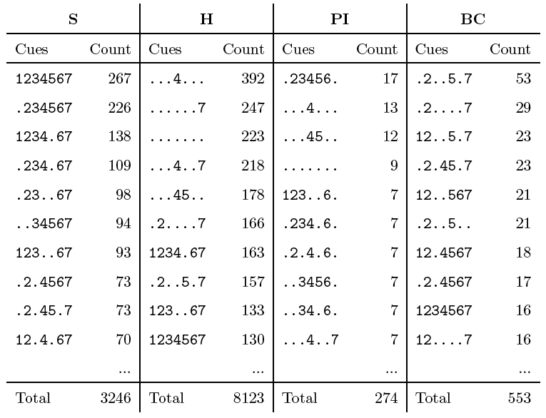
Presence of Turn-Yielding Cues
1: Final intonation
2: Speaking rate
3: Intensity level
4: Pitch level
5: IPU duration
6: Voice quality
7: Completion
Notes:
Distribution of Turn-Yielding cues for IPUs with several labels
PI: pause interruption (S2 intends to take floor, interrupts with no simultaneous speech but bf S1 completes turn

Slide 33
Likelihood of TT Attempts
Percentage of turn-taking attempts
r ² = 0.969
Number of cues conjointly displayed in IPU
Notes:
S+PI / S+PI+H+BC (excludes overlapping speech cases) –
Likelihood of TT attempt for IPUs with each # of cues displayed.

Slide 34
Sum: Cues Distinguishing Smooth Switches from Holds
Falling or high-rising phrase-final pitch
Faster speaking rate
Lower intensity
Lower pitch
Point of textual completion
Higher jitter, shimmer and NHR
Longer IPU duration

Slide 35
Backchannel-Inviting Cues
Recall:
  Backchannels (e.g. ‘yeah’) indicate that Speaker B is paying attention but does not wish to take the turn
  Systems must
    Distinguish from user’s smooth switches (recognition)
    Know how to signal to users that a backchannel is appropriate
In human conversations
  What contexts do Backchannels occur in?
  How do they differ from contexts where no Backchannel occurs (Holds) but Speaker A continues to talk and contexts where Speaker B takes the floor (Smooth Switches)

Slide 36
Method
Hold
Backchannel
IPU1
IPU2
IPU4
Speaker A:
IPU3
Speaker B:
Compare IPUs preceding Holds (IPU1) (n=8123) with IPUs preceding Backchannels (IPU2) (n=553)
Hypothesis: BC-preceding cues more likely to occur before Backchannels than before Holds

Slide 37
Cues Distinguishing Backchannels from Holds
Final rising intonation: H-H% or L-H%
Higher intensity level
Higher pitch level
Longer IPU duration
Lower NHR
Final POS bigram: DT NN, JJ NN, or NN NN
Notes:
All differ significantly between BC and H preceding IPUs

Slide 38
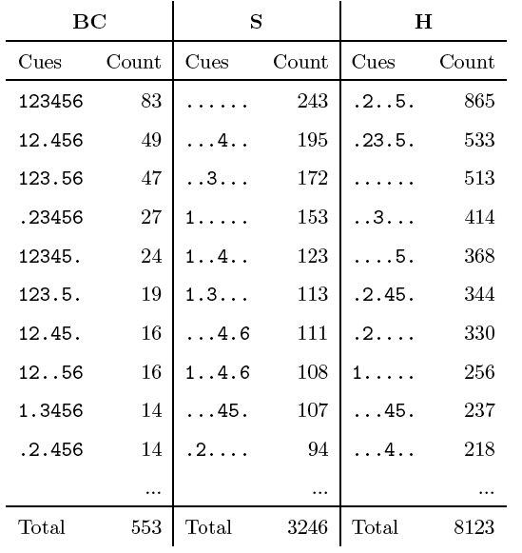
Presence of Backchannel-Inviting Cues
1: Final intonation
2: Intensity level
3: Pitch level
4: IPU duration
5: Voice quality
6: Final POS bigram
Notes:
Distribution of BC cues across other IPU types

Slide 39
Combined Cues
Percentage of IPUs followed by a BC
r ² = 0.812
r ² = 0.993
Number of cues conjointly displayed
Notes:
Quadratic model is better fit – ANOVA shows difference at p<.001

Slide 40
Smooth Switch and Backchannel vs. Hold
Falling or high-rising phrase-final pitch: H-H% or L-L%
Faster speaking rate
Lower intensity
Lower pitch
Point of textual completion
Higher jitter, shimmer and NHR
Longer IPU duration
Fewer fragments, FPs
Final rising intonation: H-H% or L-H%
Higher intensity level
Higher pitch level
Longer IPU duration
Lower NHR
Final POS bigram: DT NN, JJ NN, or NN NN
Notes:
How do SS and BC differ from H?

Slide 41
Smooth Switch and Backchannel vs. Hold: Same Differences
Falling or high-rising phrase-final pitch: H-H% or L-L%
Faster speaking rate
Lower intensity
Lower pitch
Point of textual completion
Higher jitter, shimmer and NHR
Longer IPU duration
Fewer fragments, FPs
Final rising intonation: H-H% or L-H%
Higher intensity level
Higher pitch level
Longer IPU duration
Lower NHR
Final POS bigram: DT NN, JJ NN, or NN NN
Notes:
Similar differences – and thus similar features of SS and BC

Slide 42
Smooth Switch and Backchannel vs. Hold: Different Differences
Falling or high-rising phrase-final pitch: H-H% or L-L%
Faster speaking rate
Lower intensity
Lower pitch
Point of textual completion
Higher jitter, shimmer and NHR
Longer IPU duration
Fewer fragments, FPs
Final rising intonation: H-H% or L-H%
Higher intensity level
Higher pitch level
Longer IPU duration
Lower NHR
Final POS bigram: DT NN, JJ NN, or NN NN
Notes:
Different differences – and thus differences from each other

Slide 43
Smooth Switch, Backchannel, and Hold Differences

Slide 44
Summary
We find major differences between Turn-yielding and Backchannel-preceding cues – and between both and Holds
  Objective, automatically computable
  Should be useful for task-oriented dialogue systems
    Recognize user behavior correctly
    Produce appropriate system cues for turn-yielding, backchanneling, and turn-holding

Slide 45
Future Work
Additional turn-taking cues
  Better voice quality features
  Study cues that extend over entire turns, increasing near potential turn boundaries
Novel ways to combine cues
  Weighting – which more important? Which easier to calcluate?
Do similar cues apply for behavior involving overlapping speech – e.g., how does Speaker2 anticipate turn-change before Speaker1 has finished?
Notes:
Overlap cues found in second-to-last ips: 767/1067 exhibit partial overlap
Higher speaking rate.
Lower intensity.
Higher jitter, shimmer, NHR.
All cues match the corresponding cues found in (non-overlapping) smooth switches.
Cues seem to extend further back in the turn, becoming more prominent toward turn endings

Slide 46
Next Class
Entrainment in dialogue

Slide 47
EXTRA SLIDES

Slide 48
Overlapping Speech
Hold
Overlap
ipu1
ipu2
ipu3
Speaker A:
Speaker B:
95% of overlaps start during the turn-final phrase (IPU3).
We look for turn-yielding cues in the second-to-last intermediate phrase (e.g., IPU2).

Slide 49
Overlapping Speech
Cues found in IPU2s:
  Higher speaking rate.
  Lower intensity.
  Higher jitter, shimmer, NHR.
All cues match the corresponding cues found in (non-overlapping) smooth switches.
Cues seem to extend further back in the turn, becoming more prominent toward turn endings.
Future research: Generalize the model of discrete turn-yielding cues.

Slide 50
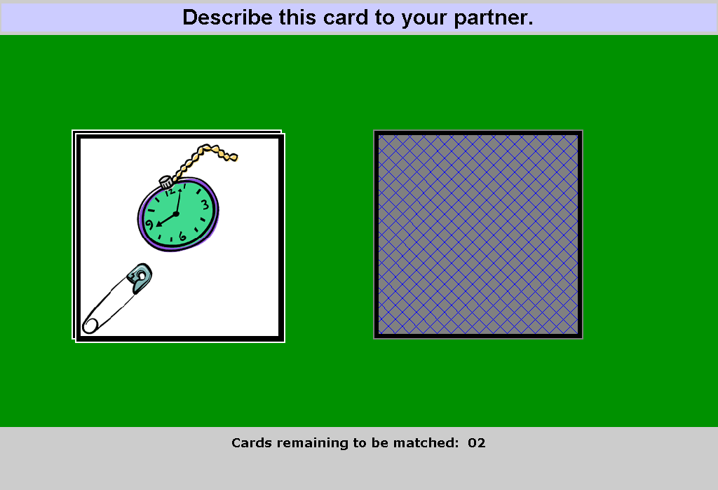
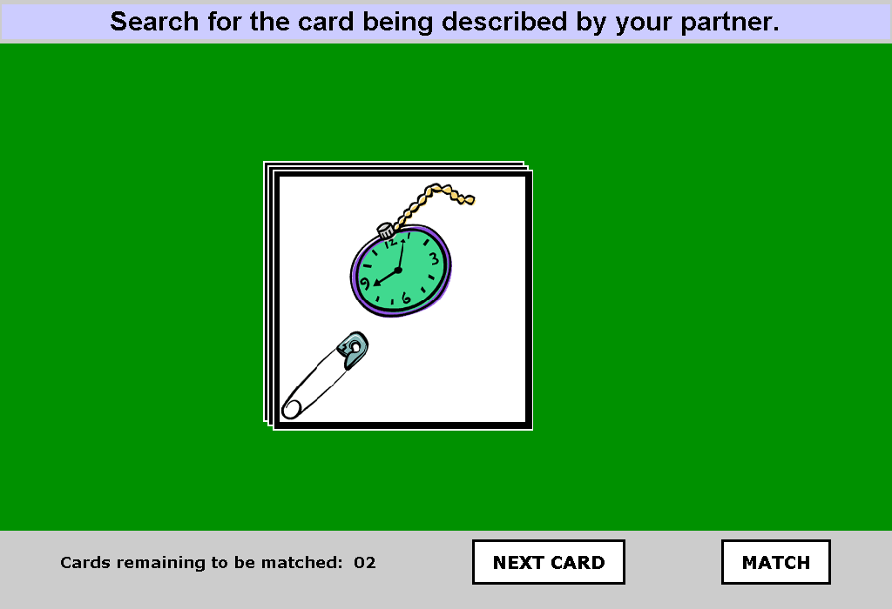

Cards Game, Part 1
Columbia Games Corpus
Player 1: Describer
Player 2: Searcher
Notes:
In the first part of the Cards game, each player’s screen displayed a pile of 10 cards.
One of the players was asked to describe the cards on their pile, one by one,.
The other player was asked to search through the cards in their own pile.

Slide 51
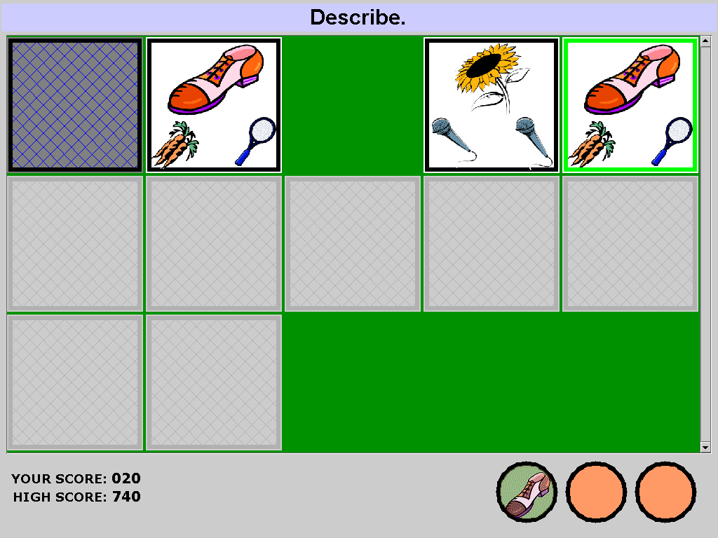
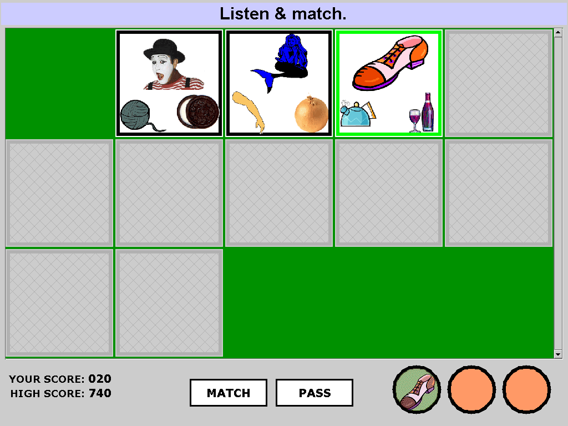
Cards Game, Part 2
Columbia Games Corpus
Player 1: Describer
Player 2: Searcher
Notes:
The second Cards game is a matching game.
Each player saw a board of cards like these, and they had to describe to each other the cards, as they were turned face up. Their common goal was to match as many cards having at least one image in common as possible.

Slide 52
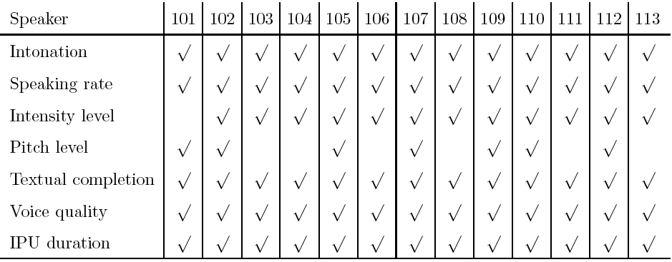
Speaker Variation
Turn-Yielding Cues
Display of individual turn-yielding cues:

Slide 53
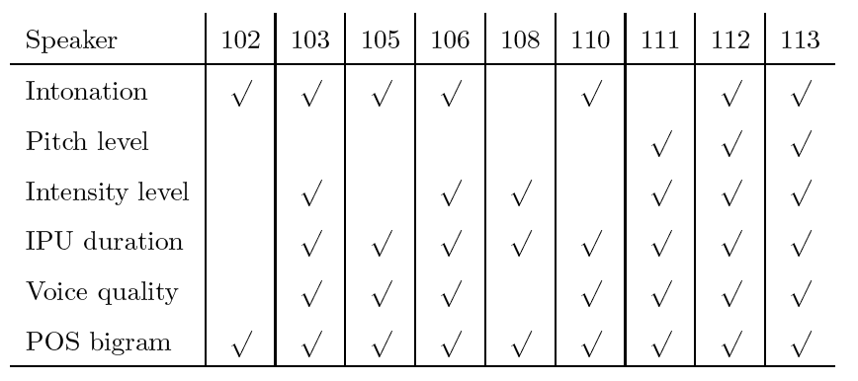
Speaker Variation
Backchannel-Inviting Cues
Display of individual BC-inviting cues:

Slide 54
6. Voice Quality
Turn-Yielding Cues
Jitter
  Variability in the frequency of vocal-fold vibration (measure of harshness)
Shimmer
  Variability in the amplitude of vocal-fold vibration (measure of harshness)
Noise-to-Harmonics Ratio (NHR)
  Energy ratio of noise to harmonic components in the voiced speech signal (measure of hoarseness)

Slide 55
Speaker Variation
Turn-Yielding Cues
102
111
103
101
112
104
105
106
109
107
113
108
110

Slide 56
Speaker Variation
Backchannel-Inviting Cues
105
112
113
110
111
103
108
106
102

