Slide 1
From Sounds to Language
CS 6998
Julia Hirschberg and Sarah Ita Levitan

Slide 2
Linguistic Sounds
What is the sound inventory of a language X?
How are these sounds produced?
What sounds are shared by languages X and Y? Which are different?
How do particular sounds in a given language vary in different contexts?
Why do we need to know all this to study a language?

Slide 3
A Tale of Discounts
A burger costing $4.59 is on sale for $2.33 at Mel’s
Close your eyes and repeat the sale price to yourself 3 times
A taco costing $4.53 is on sale for $2.22 at Noche Mexicana
Repeat the sale price to yourself 3 times
Which is the better deal?
Notes:
Saving 2.26 vs. 2.31

Slide 4
Coulter & Coulter 2010
Notes:
Sounds produced in the back of the mouth (“uw”) seem larger than sounds produced at the front (“ee”)
Comparing two languages: $7.88 sounds “big” in english and $7.01 sounds small; but the opposite is true in Chinese; and Coulter and Coulter found that English speakers and Chinese speakers had opposite opinions of these two prices.

Slide 5
How do we represent speech sounds?
Why do we need abstract representations?
  Translating between sounds and words (ASR, TTS, MT, keyword search), learning pronunciation, talking about language similarities and differences…
How should we represent sounds?
  Regular orthography
  Special-purpose symbol sets
  Abstract sound classes based upon sound similarities

Slide 6
Orthographic Representation?
A single letter may have many different acoustic realizations, e.g., in English
  o comb, tomb, bomb oo blood, food, good
  c court, center, cheese s reason, surreal, shy
A single sound may be represented differently in orthography
  [i] sea, see, scene, receive, thief [s] cereal, same
  [u] true, few, choose, lieu, do [ay] prime, buy, rhyme
Is orthography a good choice for English?
For Japanese? Spanish? Chinese?

Slide 7
Phonetic Symbol Sets
International Phonetic Alphabet (IPA)
  Single character for each sound
  Represents all sounds of the world’s languages but is quite large and requires special fonts
  Interactive IPA chart: http://www.ipachart.com
ARPAbet, TIMIT, …
  Ascii but multiple characters for sounds
  English specific, so new symbol sets required for each new language to be represented
Notes:
From IPA play clicks and others

Slide 8
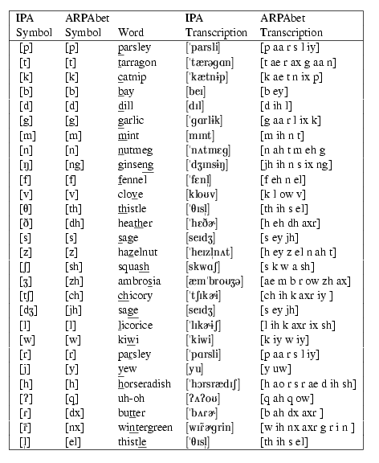
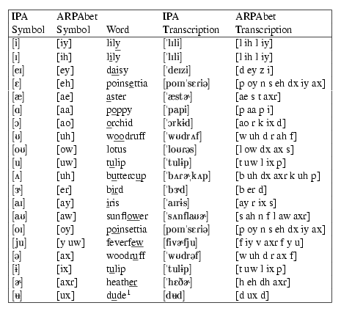
Figures 7.1 and 7.2:
Jurafsky & Martin
Exercise:
Write your first name in English
Orthography, in ARPAbet, and in IPA.
Notes:
Julia/ Jh uw l iy uh/ jh u l I ^
What are the differences

Slide 9
Articulatory Phonetics: How do people produce speech?
How articulation works:
  Air passes from lungs through windpipe (trachea) leaving via mouth (mostly) and nose (nasals) (e.g. [m], [n])
  Air passing thru trachea goes thru larynx, which contains vocal folds – space between them is the glottis
  When vocal folds vibrate, we get voiced sounds (e.g. [v]); o.w. voiceless (e.g. [f])
Notes:
Say puff; say mama

Slide 10
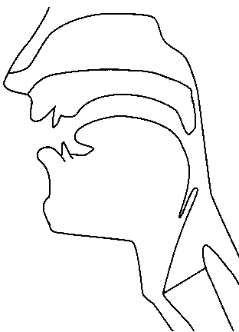
Places of articulation
alveolar
post-alveolar/palatal
dental
velar
uvular
labial
pharyngeal
laryngeal/glottal
http://smu-facweb.smu.ca/~s0949176/sammy/
Notes:
Labial: p, b, m, w
Dental: f, v
Alveolar: t, d, s, z, n, l, r
Palatal: sh, zh, ch, jh, y
Velar: k, g, ng
Glottal: q, h

Slide 11

Vocal Fold Vibration
[UCLA Phonetics Lab demo]

Slide 12
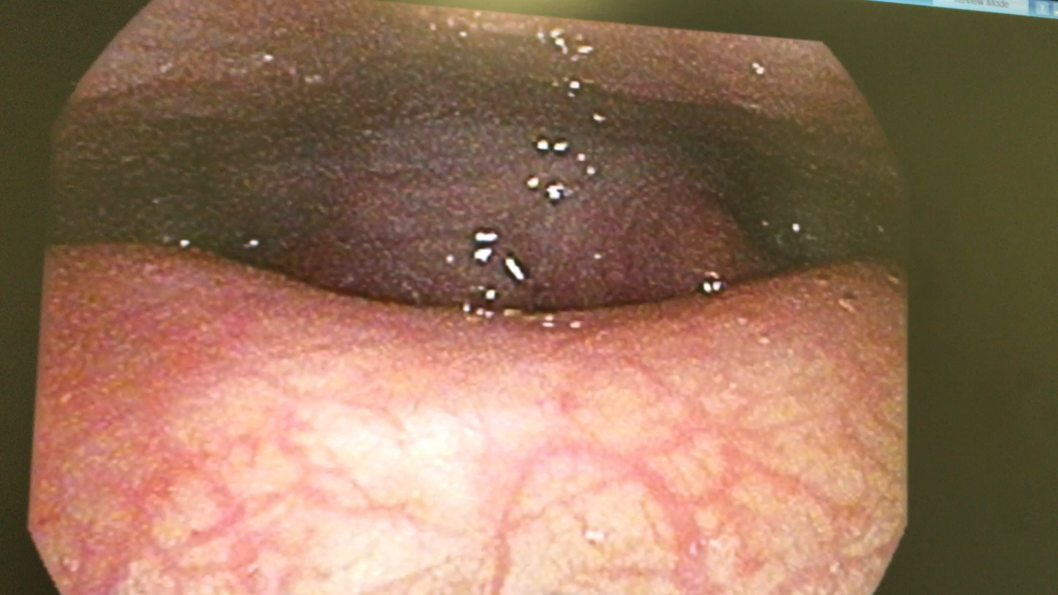
Less Thank Perfect

Slide 13
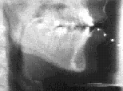
Articulators in action
(Sample from the Queen’s University / ATR Labs
X-ray Film Database)
Examples
Notes:
French Canadian subjects from the early 1970s
Play 1, 3, 4

Slide 14
How do we capture articulatory data?
X-ray/pellet film archive
X-Ray Microbeam Database
  Sample output slides
Electroglottography: Vocal range phonetogram
Electromagnetic articulography (EMA)
  3 transmitters on helmet produce alternating magnetic fields at different frequencies, forming equilateral triangle
  Creates alternating current in 5-15 sensors to calculate sensor positions via XY coordinates
  MOCHA-TIMIT corpus
Notes:
Sample output: show some slides from url
https://www.google.com/url?sa=t&rct=j&q=&esrc=s&source=web&cd=1&cad=rja&uact=8&ved=2ahUKEwitttjh9Y7gAhWpmOAKHQwtBo8QFjAAegQICRAC&url=http%3A%2F%2Fttic.uchicago.edu%2F~klivescu%2FSPASR2013%2Fslides%2Frichmond.pdf&usg=AOvVaw2LkXp16R5PMgC-AaMcs6Dj

Slide 15
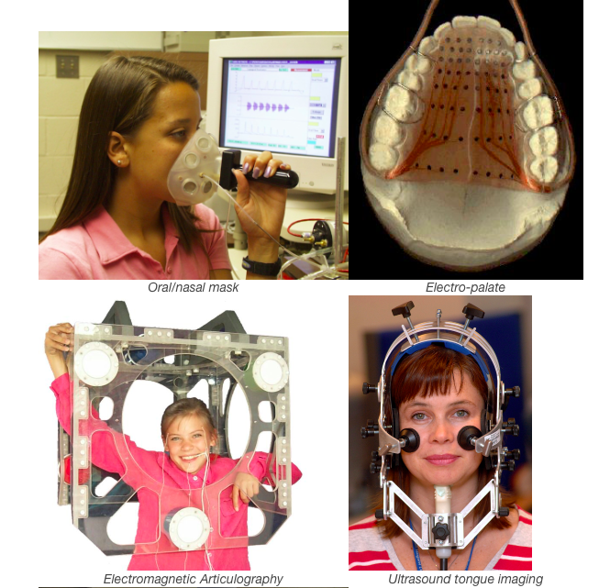

Slide 16
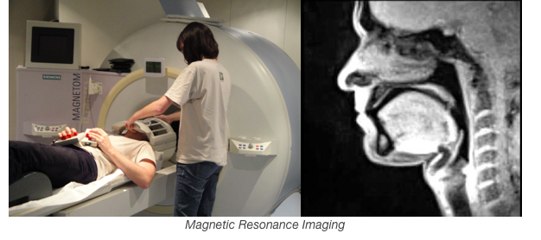

Slide 17
Phones vs. Phonemes vs. Allophones
Phones: any distinct sound in a language, whether it conveys meaning or not
  English: n vs nnnn does not convey meaning
  Quantity languages: sound length matters
Phonemes: collections of sounds that convey the same meaning and can change the meaning of a word if exchanged with another phoneme
  /t/ in top, stop, butter, winter
  /t/ → /m/ top → mop
Allophones: the different realizations of a phoneme
Notes:
Qnatity languages: some Arabic dialects, Finnish, Japanese, Estonian

Slide 18
Consonants and vowels:
  Consonants:
    Restriction/blockage of air flow (e.g. [s])
    Voiced or voiceless [s] vs. [z]
  Vowels:
    Generally voiced, less restriction (e.g. [u]
  Semivowels (glides): [w], [y]
Notes:
Say s, z, f, g, b

Slide 19
Consonants: Place of Articulation
What is the point of maximum (air) restriction?
  Labial: bilabial [b], [p]; labiodental [v], [f]
  Dental: [θ], [δ] thief vs. them
  Alveolar: [t], [d], [s], [z]
  Palatal: [∫], [t∫] shrimp vs. chimp
  Velar: [k], [g]
  Glottal: [?] glottal stop
Notes:
Two things are used to define consonant types: place of articulation and manner of articulation

Slide 20
Consonants: Manner of Articulation
How is the airflow restricted?
  Stop: [p],[t],[g],… aka plosive
    Airflow completely blocked (closure), then released (release)
    Glottal stop, e.g. before word-initial vowels in English after pause (extra)
  Nasal: air released thru nose [m],[ng],…
  Fricative: [s], [z], [f] air forced thru narrow channel
  Affricates [t∫] begin as stops and end as fricatives (chimp)
Notes:
Say p, extra, mmmm, s, z v, ch

Slide 21
  Approximant: [w],[y]
    2 articulators come close but don’t restrict much
    Between vowels and consonants
    Lateral: [l] (lab)
  Tap or flap: [ ] e.g. butter
Notes:
Say you, why (with your hand touching your lips
Say lab
Say butter

Slide 22
 | Standard American English PLACE OF ARTICULATION
 |  | bilabial |  | labio-dental |  | inter-dental |  | alveolar |  | palatal |  | velar |  | glottal
 | stop | p | b |  |  |  |  | t | d |  |  | k | g | q
 | fric. |  |  | f | v | th | dh | s | z | sh | zh |  |  | h
 | affric. |  |  |  |  |  |  |  |  | ch | jh
 | nasal |  | m |  |  |  |  |  | n |  |  |  | ng
 | approx |  | w |  |  |  |  |  | l/r |  | y
 | flap |  |  |  |  |  |  | dx
MANNER OF ARTICULATION
VOICING:
voiceless | voiced
Notes:
Ma mama married Manny often used for voice analysis – fully voiced and sonorant.
Think of a sentence in any language which is fully voiced and sonorant.

Slide 23
Vowels
All voiced
Vowel height
  How high is the tongue? high or low vowel
  Where is its highest point? front or back vowel
How rounded are the lips?
Mono- [eh] vs. diphthong, e.g. [ey]
  1 vowel sound or 2?

Slide 24
American English Vowel Space
HIGH
iy
uw
ih
ix
ux
uh
oy
ey
ow
ax
FRONT
BACK
eh
ah
aw
ao
ay
ae
aa
LOW
Notes:
Touch your tongue when you say iy, uw, ae, aa

Slide 25
Compare to British English, Indian English, Swedish, Spanish, Japanese, Mandarin

Slide 26
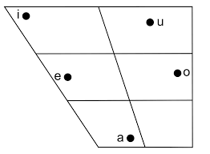
Japanese Vowel Space

Slide 27
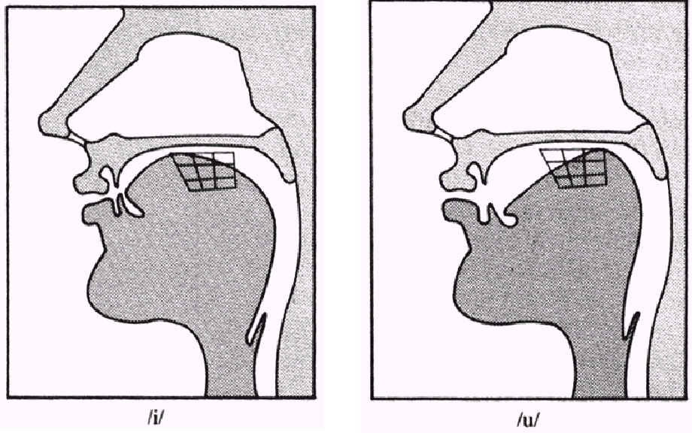
[iy] vs. [uw]
(From a lecture given by Rochelle Newman)

Slide 28
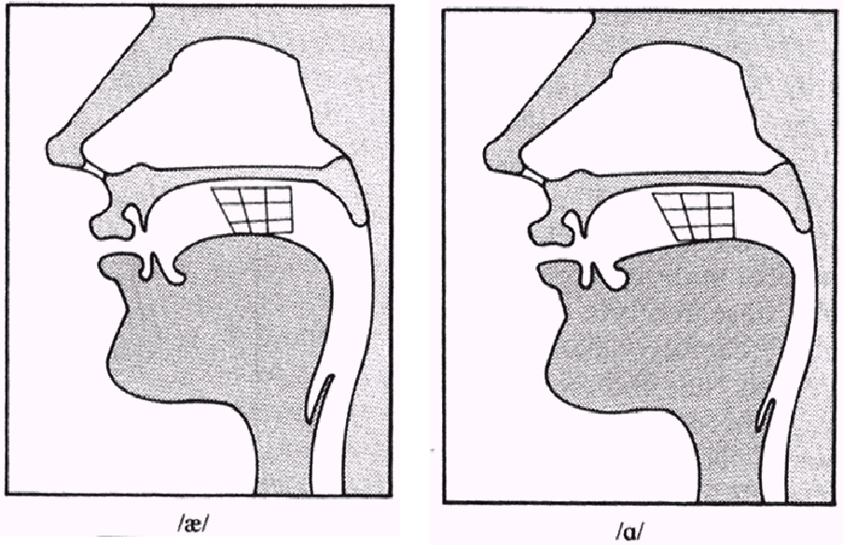
[ae] vs. [aa]
(From a lecture given by Rochelle Newman)

Slide 29
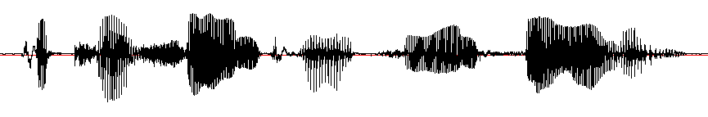

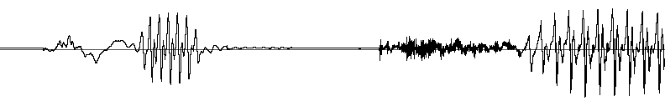
Acoustic Landmarks in a .wav File
[p]
[ix]
[t]
[ih]
[sh]
[ax]
[n]
[p]
[ae]
[t]
[s]
[iy]
[n]
[s]
[ae]
[l]
[iy]
“Patricia and Patsy and Sally”
[p]
[ix]
[t]
[ih]

Slide 30
A Problem: Coarticulation
The Same phone is produced differently depending on phonetic context
Occurs when articulations overlap as articulators are moving in different timing patterns to produce different adjacent sounds
  Eight vs. Eighth
    Place of articulation moves forward as /t/ is dentalized
  Met vs. Men
    Vowel is nasalized
Notes:
A major issue in speech recognition!!

Slide 31
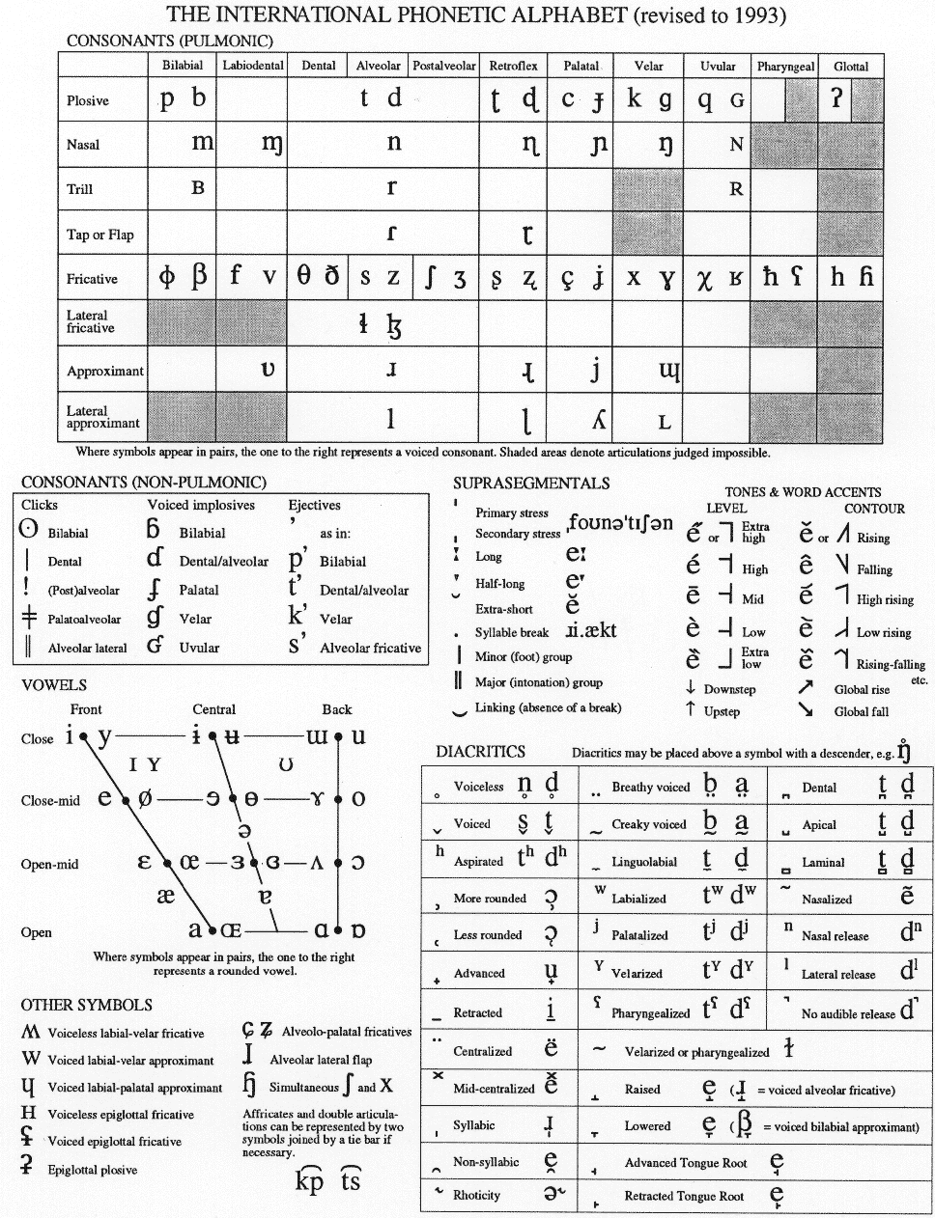
IPA Consonants
(Distributed by the International Phonetics Association.)
Notes:
https://easypronunciation.com/en/american-english-pronunciation-ipa-chart
https://en.wikipedia.org/wiki/Help:IPA/Mandarin
http://www.ipachart.com

Slide 32
IPA vowels
(Distributed by the International Phonetics Association.)

Slide 34
Other IPA Charts
Albanian
Amharic
Bengali
Cantonese
Catalan
Farsi
Finnish
French
German

Slide 35
Gujarati
Hebrew
Hindi and Urdu
Japanese
Korean
Malayalam
Mandarin
Marathi
Punjabi
Portuguese
Russian

Slide 36
Spanish
Tamil
Thai

Slide 37
Representations for Sounds
Now we have ways to represent the sounds of a language (IPA, Arpabet…) and to classify similar sounds and compare sounds in different languages
Why is this important?
  Automatic speech recognition
  Speech synthesis
  Machine translation
  Keyword search

Slide 38
  Speech pathology, language Id, speaker Id
  Basic representations critical for any speech research or application
But…how can we recognize these sounds automatically?
  What are the acoustic correlates of these differences in sound that allow us to recognize speech?
  How can we use the relationship between representation and acoustics to identify speech automatically?
  Can our brain help?

Slide 39
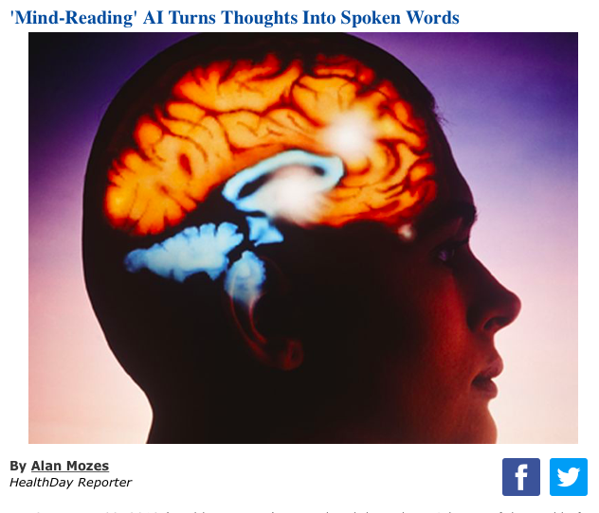

Slide 40
Engineers translate brain signals directly into speech
Advance marks critical step toward brain-computer interfaces that hold immense promise for those with limited or no ability to speak
  Nima Mesgarani: in a scientific first, neuroengineers have created a system that translates thought into intelligible, recognizable speech. This breakthrough, which harnesses the power of speech synthesizers and artificial intelligence, could lead to new ways for computers to communicate directly with the brain.

Slide 41
Next Class
Readings: J&M 7.4-7
Remember to record your names in Courseworks!

