Slide 1
Emotion and Sentiment Detection
COMS 6706: Advanced Spoken Language Processing
Fall 2025

Slide 2
Outline
Emotion in speech
  Emotion theory
  Emotional speech corpora
  Features for emotional speech
  Models for emotion recognition
  Expressive synthetic speech
Sentiment and emotion in text

Slide 3
Emotion in Speech

Slide 4
Outline
Emotion in speech
  Emotion theory
  Emotional speech corpora
  Features for emotional speech
  Models for emotion recognition
  Expressive synthetic speech
Sentiment and emotion in text

Slide 5
What is Emotion?
Two families of theories of emotion
  Categorical approach
    Emotions are categories
    Limited number of basic emotions
  Dimensional approach
    Emotions are dimensions
    Limited number of labels but unlimited number of emotions

Slide 6
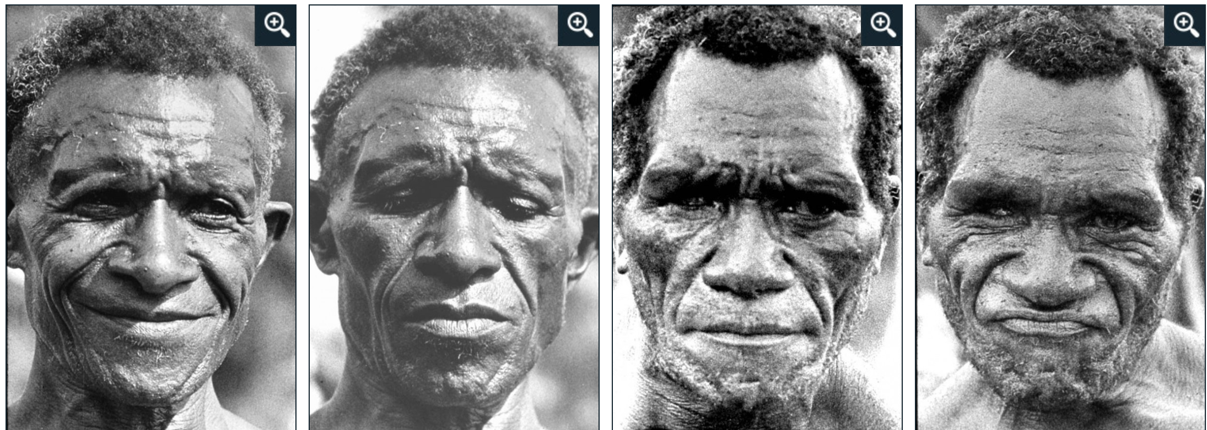
Emotion - Categorical Approach
(Ekman et al., 1987)
Discrete ‘basic emotions’
Originate from facial expressions
?
Anger Sadness Disgust Happiness

Slide 7
Emotion - Categorical Approach
(Ekman et al., 1987)
Discrete ‘basic emotions’
Originate from facial expressions
?
Anger Sadness Disgust Happiness

Slide 8
Emotion - Dimensional Approach
(Russell and Barrett, 1999)
Continuous multi-dimensional space
Common physiological system

Slide 9
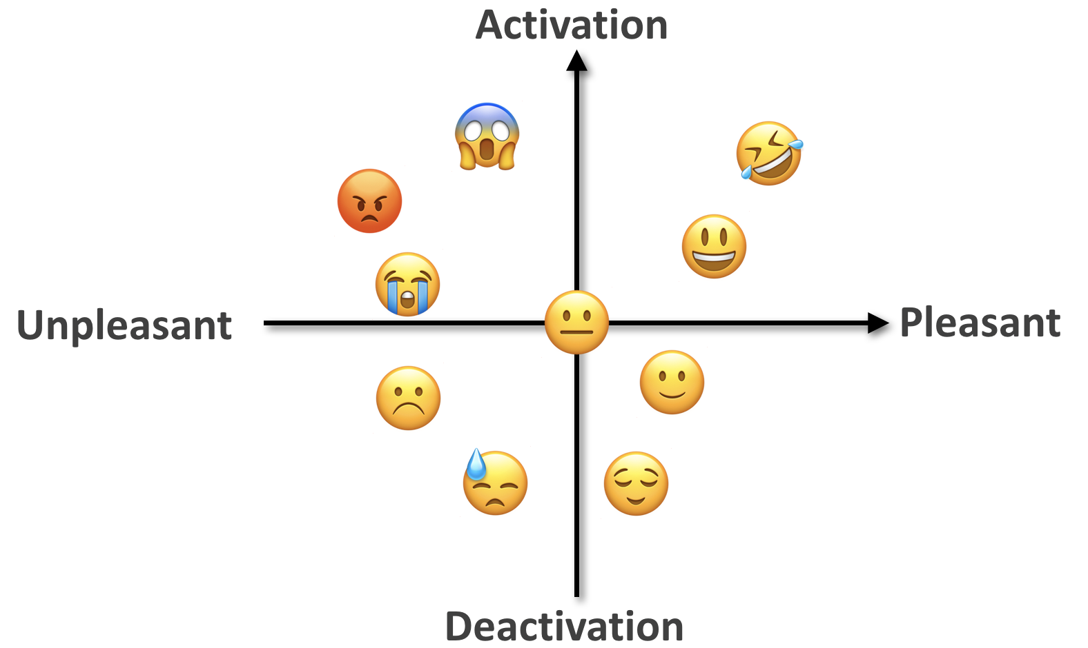
Emotion - Dimensional Approach
(Russell and Barrett, 1999)
Continuous multi-dimensional space
Common physiological system
Arousal-Valence space

Slide 10
Why Study Emotional Speech?
Recognition
  Customizing virtual assistants
  Anger/frustration in call centers
  Confidence/uncertainty in online tutoring systems
  “Hot spots” in meetings
Generation
  TTS for virtual assistants, computer games, etc.
Other applications: Speaker state identification
  Deception, charisma, sleepiness, interest, humor…
Some emotional clues are only in speech

Slide 11
Outline
Emotion in speech
  Emotion theory
  Emotional speech corpora
  Features for emotional speech
  Models for emotion recognition
  Expressive synthetic speech
Sentiment and emotion in text

Slide 12

Emotion in Speech
Acted speech
  Easier to collect & control
  Extreme emotions
Mostly categorical approach
Examples: (Emotional Prosody Speech)
  Which emotion do you hear?
Spontaneous speech
  Harder to collect & annotate
  Subtle changes in emotion
Both categorical & dimensional approach

Slide 13
Emotion in Speech
Acted speech
  Easier to collect & control
  Extreme emotions
Mostly categorical approach
Examples: (Emotional Prosody Speech)
  Happy, Sad, Angry, Bored
Spontaneous speech
  Harder to collect & annotate
  Subtle changes in emotion
Both categorical & dimensional approach

Slide 14
Emotion in Speech
Acted speech
  Easier to collect & control
  Extreme emotions
Mostly categorical approach
Examples: (Emotional Prosody Speech)
  Happy, Sad, Angry, Bored
Spontaneous speech
  Harder to collect & annotate
  Subtle changes in emotion
Both categorical & dimensional approach
Example: (AT&T “How May I Help You?” System)
  Categorical emotion(s)?
  Arousal and Valence?

Slide 15
Emotion in Speech
Acted speech
  Easier to collect & control
  Extreme emotions
Mostly categorical approach
Examples: (Emotional Prosody Speech)
  Happy, Sad, Angry, Bored
Spontaneous speech
  Harder to collect & annotate
  Subtle changes in emotion
Both categorical & dimensional approach
Example: (AT&T “How May I Help You?” System)
  Neutral -> frustrated -> angry
  Arousal ↑, Valence ↓

Slide 16
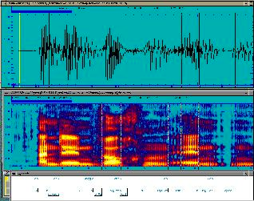
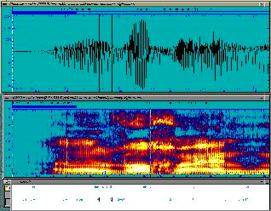
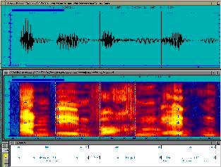
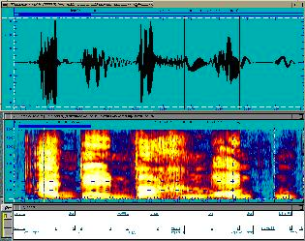
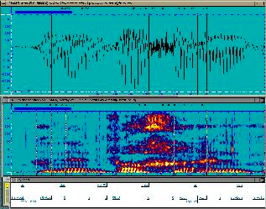
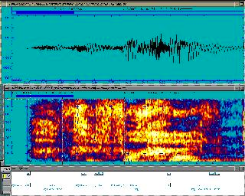
Emotional Speech Corpora - Acted & Categorical
(EmoDB, German)
Neutral
Bored
Angry
Happy
Sad
Frightened

Slide 17
Acted & Categorical Speech: Actors vs Students
(Emotional Prosody Speech) (Mandarin Affective Speech)
Anger
Elation
Neutral
Panic
Sadness
Sad
Happy
Angry
Bored
Interested

Slide 18
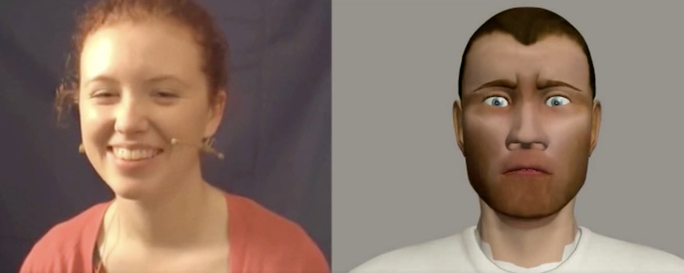
Spontaneous Speech with Dimensional Annotations
(SEMAINE database)
The goal of the Sensitive Artificial Listener operator (right) is to engage the user (left) in emotional conversations
    “Anything nice happened this week?” “It’s all rubbish.”
6-8 annotators. Annotations range from -1 to 1 with 20ms intervals.
  Valence score : -0.88
  Valence score : 0.58
  Valence score : 0.83

Slide 19
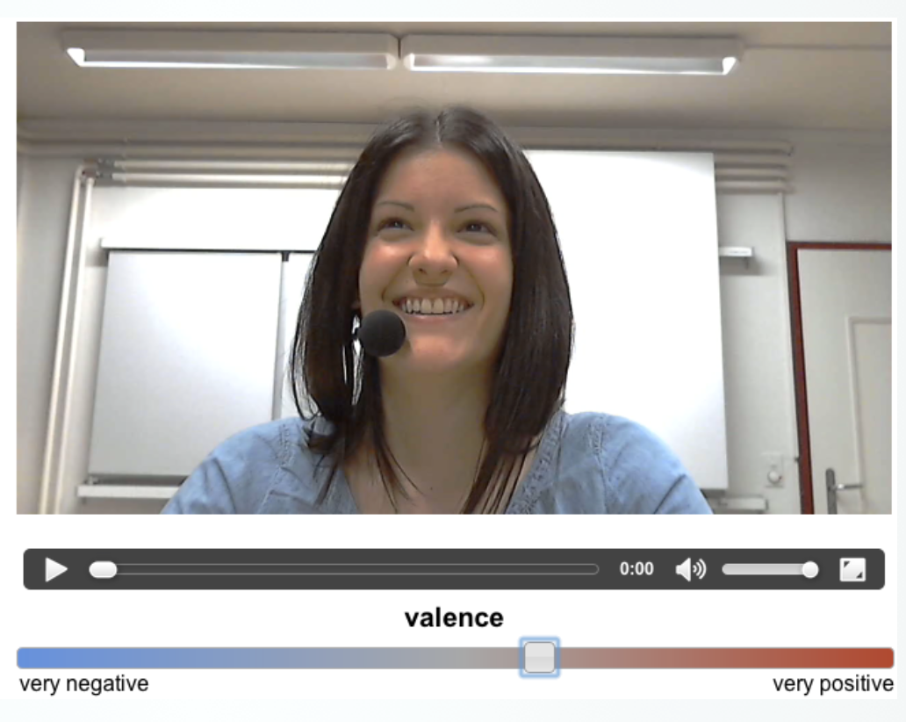
Spontaneous Speech with Dimensional Annotations
(RECOLA database)
3 hours of audio, visual, and physiological recordings of between 46 French speaking participants
Participants were asked to reach consensus on how to survive in a disaster scenario
6 annotators. Annotations range from
-1 to 1 with 40ms intervals.

Slide 20


Spontaneous Speech with Dimensional Annotations
(RECOLA database)
Arousal
Valence
Arousal
Valence

Slide 21
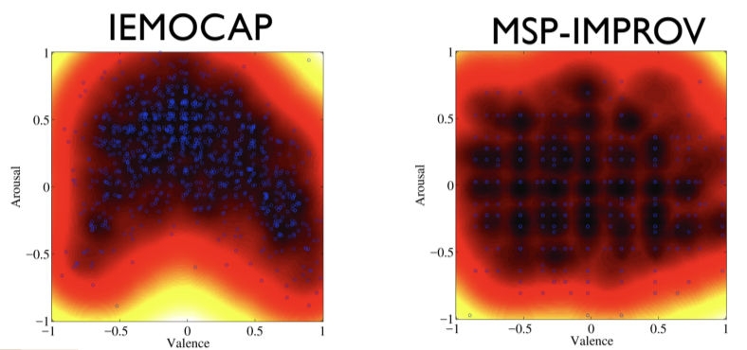
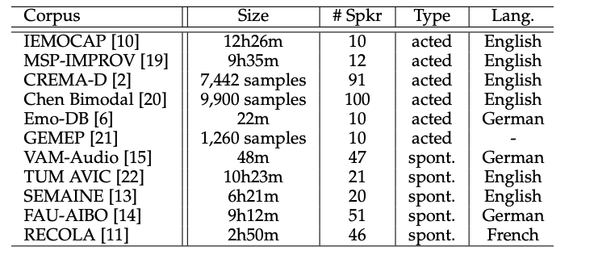
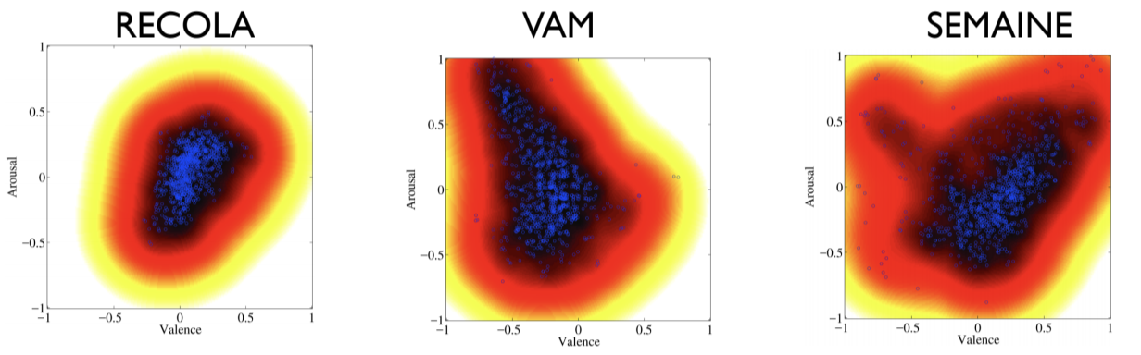
Partial List of Existing Emotion Corpora
Lack of naturalness (acted)
Unbalanced emotional content (spontaneous)
Limited in size, limited number of speakers
Acted
Spontaneous

Slide 22
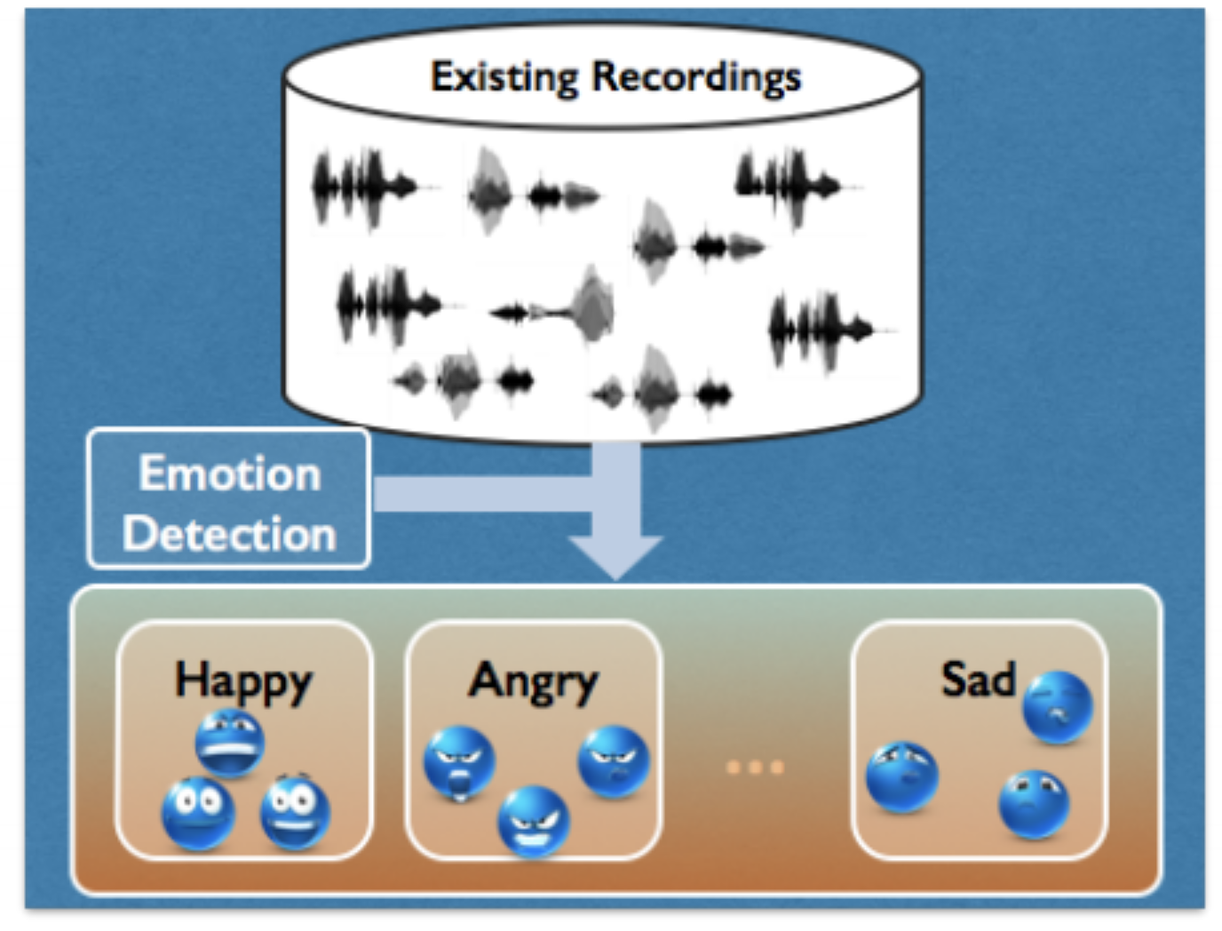
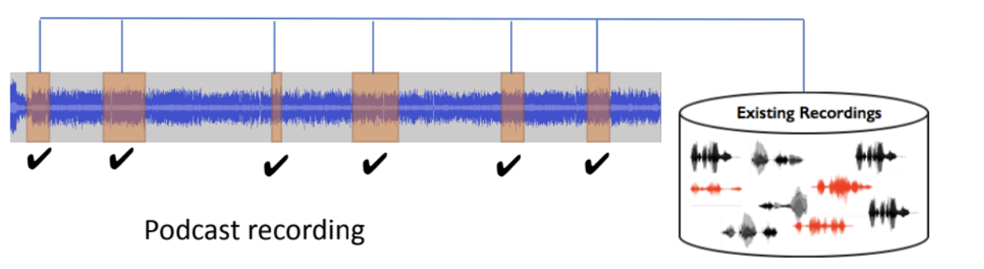
MSP-Podcast Corpus
Use existing podcast recordings, divided into speaker turns
Emotion retrieval to balance the emotional content
Annotate using crowdsourcing framework
62K speaking turns, ~100 hours of speech

Slide 23
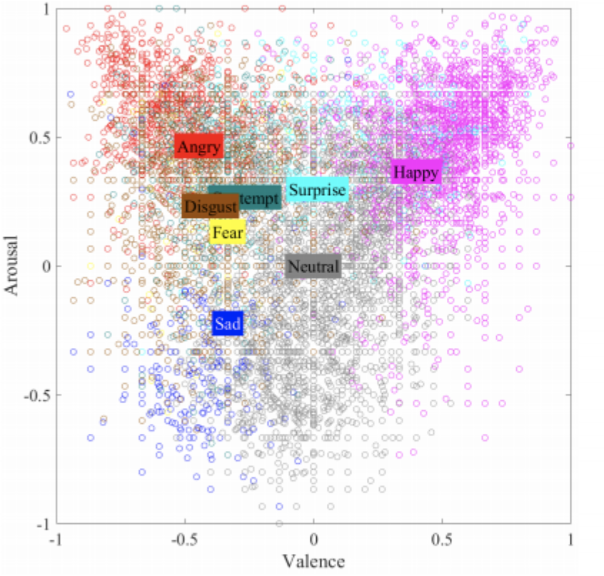
MSP-Podcast Corpus
Annotations
  Dimensional: activation, valence, dominance
  Categorical: anger, happiness, sadness, disgust, surprised, fear, contempt, neutral and other
Emotion distribution
in arousal/valence space
Rater disagreement per emotion category

Slide 24
Leveraging Emotional Speech Data in the Wild
MSP-Podcast Corpus
CMU-MOSEI dataset
  23K sentence utterance videos from more than 1000 online YouTube speakers
  Categorical: Happiness, sadness, anger, disgust, surprise, fear
  Dimensional: valence
MELD: Multimodal EmotionLines Dataset
  1400 dialogues and 13000 utterances from Friends TV series
  Categorical: Anger, Disgust, Sadness, Joy, Neutral, Surprise, Fear
  Dimensional: valence

Slide 25
LLM for Data Annotation
(Santoso et al., 2024)
Use LLM to annotate emotional speech
  Conversation transcription + textual acoustic feature descriptors
IEMOCAP dataset
LLMs can outperform human annotation with lower annotation costs

Slide 26
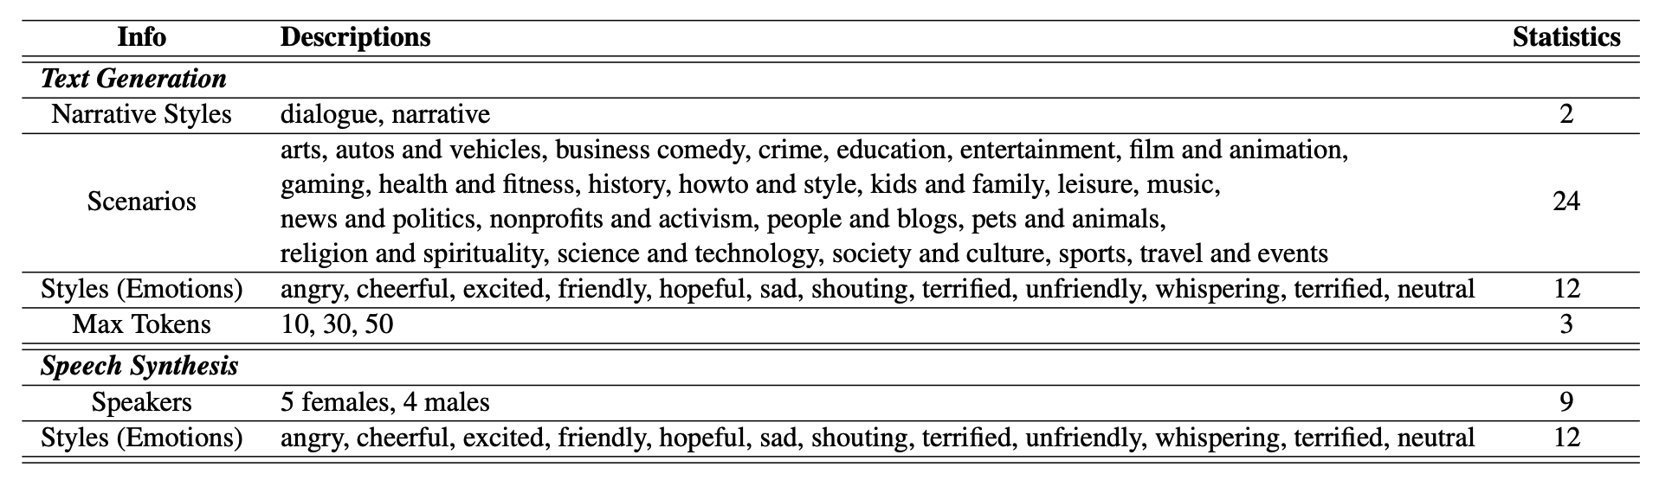
Emotional Synthetic Speech for Data Augmentation
(Ma et al., 2024)
LLM + Emotional TTS to generate synthetic emotional speech
+4% accuracy on IEMOCAP dataset

Slide 27
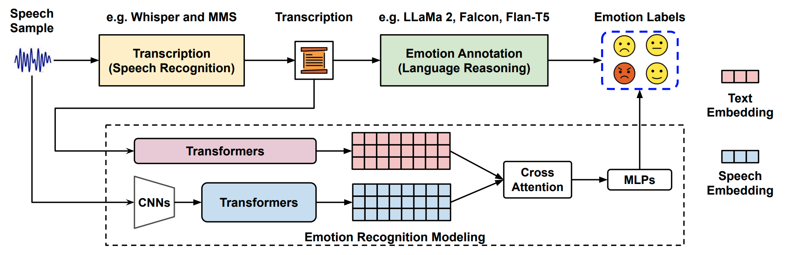
Foundation Models for
Transcribing, Annotating, Augmenting
(Feng and Narayanan, 2024)
✅ Foundational models can generate transcriptions to enhance the performance of speech emotion recognition systems
❓ Annotating emotions from transcribed speech remains a challenging task

Slide 28
Outline
Emotion in speech
  Emotion theory
  Emotional speech corpora
  Features for emotional speech
  Models for emotion recognition
  Expressive synthetic speech
Sentiment and emotion in text

Slide 29
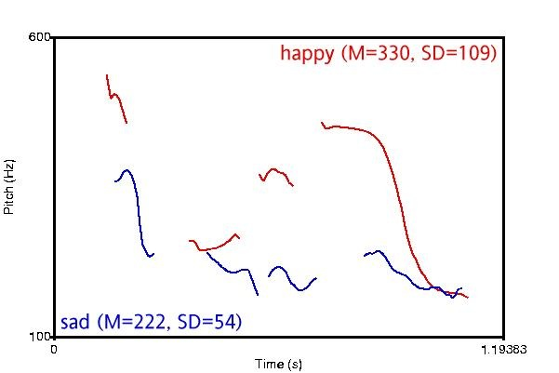
Features for Emotional Speech - Pitch
Different Valence / Different Arousal

Slide 30
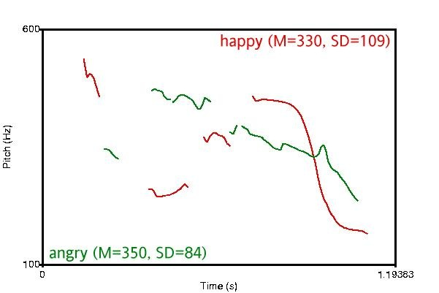
Features for Emotional Speech - Pitch
Different Valence / Same Arousal

Slide 31
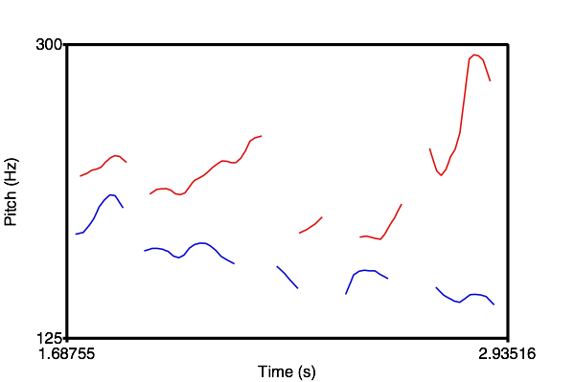
Pitch Contour Differences
Very Frustrated
Somewhat Frustrated

Slide 32
Features for Emotional Speech

Slide 33
Outline
Emotion in speech
  Emotion theory
  Emotional speech corpora
  Features for emotional speech
  Models for emotion recognition
  Expressive synthetic speech
Sentiment and emotion in text

Slide 34
Emotion Recognition in Speech
Categorical Approach
Discrete ‘basic emotions’
Classification problem
Dimensional Approach
Continuous Arousal - Valence space
Regression problem

Slide 35
Emotion Recognition - Categorical
(Dellaert et al., 1996)
Emotions: happiness, sadness, anger, fear, normal
Data: 5 speakers * 5 emotions * 50 utterances = 1250
Human performance on 4-way classification: 82% (anger easiest, fear hardest)
Features: rhythm, smoothed pitch, individual voiced parts
Best model (KNN with majority voting of specialists): 79.5%

Slide 36
Emotion Recognition - Categorical
(Petrushin, 1999)
Dataset 1
  Emotions: happiness, anger, sadness, fear, and normal
  Data: (30+5) speakers * 5 emotions * 4 utterances = 700
  Human performance: 63.5% (anger easiest, fear hardest)
  Features: F0, energy, speaking rate, first three formants and their bandwidths
  Best model: feature selection + ensembles of 15 neural networks
    Normal: 60-75%, happiness: 60-70%, anger: 70-80%, sadness: 70-85%, fear: 35-55%
    Average: ~70%

Slide 37
Emotion Recognition - Categorical
(Petrushin, 1999)
Dataset 2 (call centers)
  Distinguish between two states (arousal):
    “Agitation”: anger, happiness and fear
    “Calm”: normal state and sadness
  Data: 56 telephone messages (15~90 seconds)
    Automatically split into 1-3 second chunks
  Model: feature selection + ensembles of neural networks
  Average accuracy: 77%

Slide 38
Emotion Recognition - Categorical
(Liscombe et al., 2003)
10 emotions and neutral
  ‘Positive’ valence: confident, encouraging, friendly, happy, interested
  ‘Negative’ valence: angry, anxious, bored, frustrated, sad
Subset: 4 speakers * (10+1) emotions = 44
Human rating: Emotions in the same valence group are positively correlated; vise versa
Features: Pitch, energy, speaking rate; nuclear accent, pitch contour
Results:
  Pitch, energy, and speaking rate are correlated with arousal
  Spectral tilt and pitch contour are correlated with valence

Slide 39
Emotion Recognition - Categorical
(Liscombe et al., 2003)
Full dataset (EPSaT): 1760 utterances
Acoustic-prosodic features:
  Pitch, energy, speaking rate; nuclear accent, pitch contour
Accuracy: ~75%
Feature selection:
  Some single features performed as well or better than the entire feature set

Slide 40
Emotion Recognition - Categorical
(Jin et al., 2015)
Emotions: happy, angry, sad, and neutral
Data (USC-IEMOCAP): 5531 utterances
Features:
  Acoustic: openSMILE (intensity, F0, jitter, shimmer and MFCCs)
  Lexical: emotion vector (eVector), Bag-of-Words (BoW)
Best model: SVM, late fusion of acoustic and lexical features
Accuracy: 69.2%

Slide 41
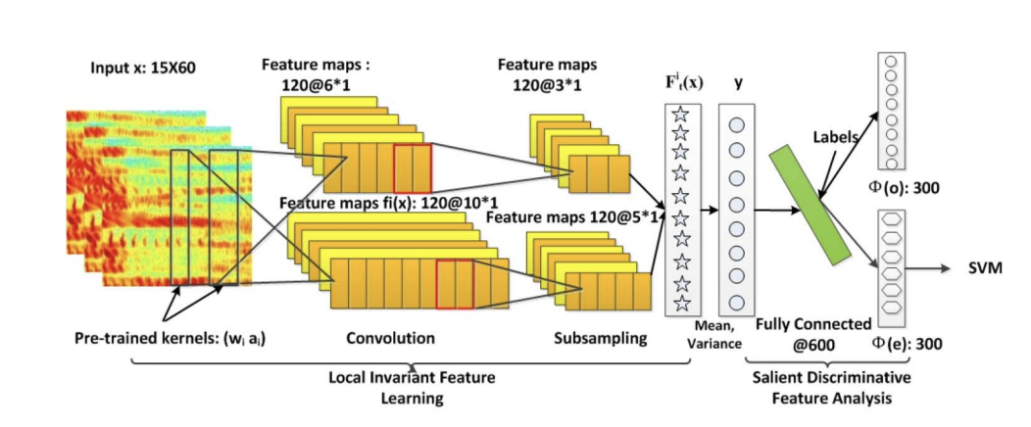
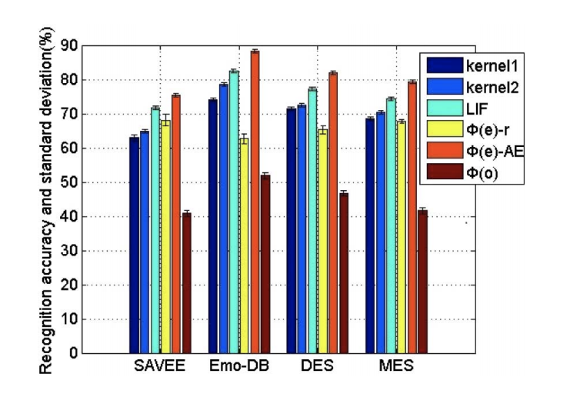
Emotion Recognition - Categorical
(Mao et al., 2014)
Using neural networks on spectrograms
Evaluation on 4 datasets:
  anger, disgust, fear, happiness, sadness, surprise, and neutral
  anger, disgust, fear, joy, sadness, boredom, and neutral
  anger, joy, surprise, sadness, and neutral
  anger, joy, surprise, sadness, and disgust

Slide 42
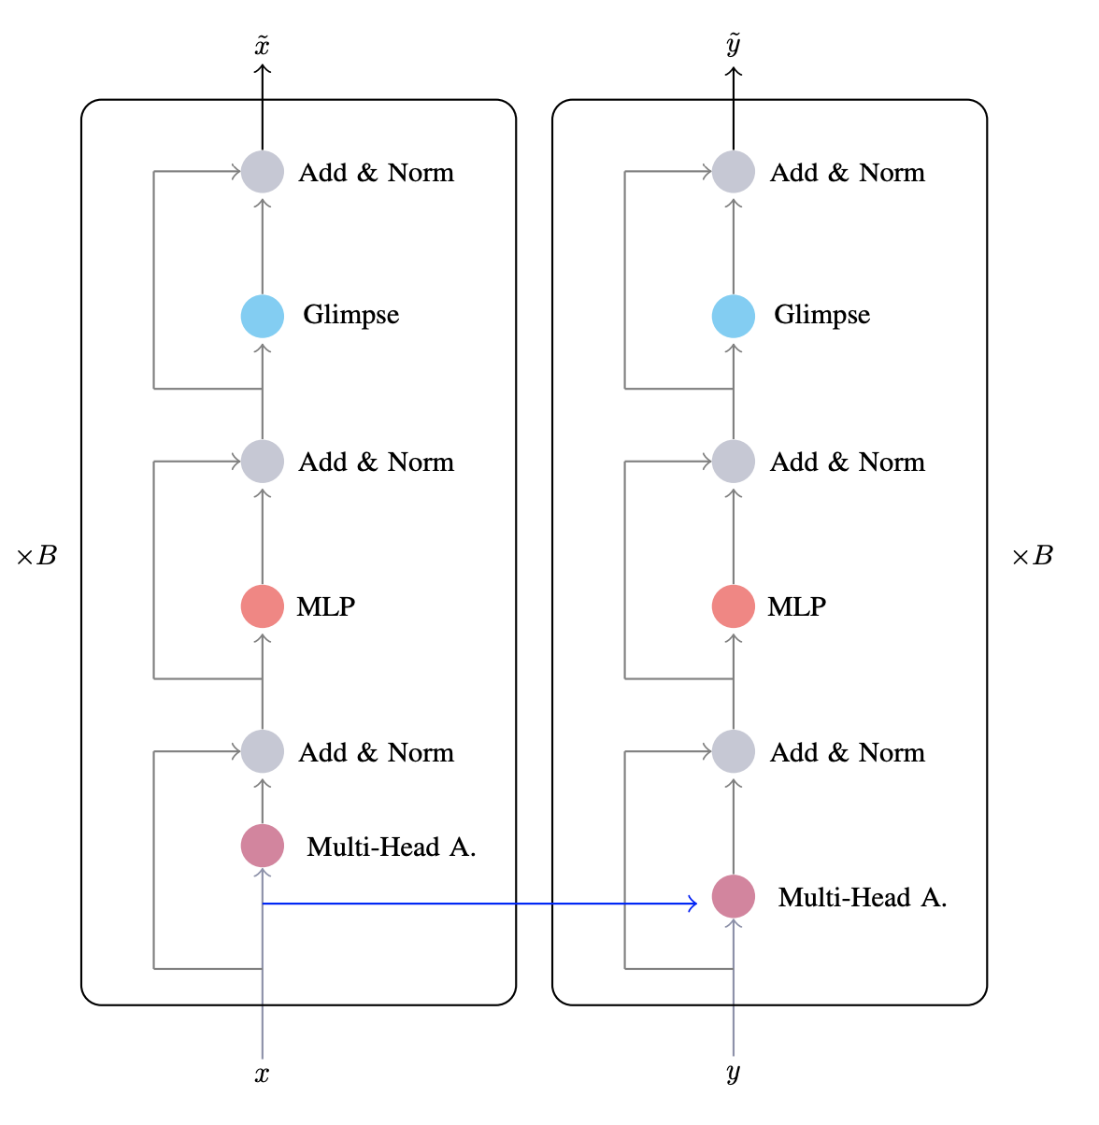
Emotion Recognition - Categorical
(Delbrouck et al., 2020)
Transformer-based multimodal joint-encoding
Dataset: CMU-MOSEI (Youtube video segments)
Modalities:
  Linguistic: GloVe word vector
  Acoustic: mel-spectrograms
  Visual: a pre-trained CNN

Slide 43
Emotion Recognition in Speech
Categorical Approach
Discrete ‘basic emotions’
Classification problem
Dimensional Approach
Continuous Arousal - Valence space
Regression problem

Slide 44
Emotion Recognition - Dimensional
(Karadogan and Larsen, 2012)
Emotion: arousal, valence (discrete value 1~9 for each dimension)
Data: 59 short movie clips (5~25 seconds)
Features and models:
  Acoustic: openSMILE, feature selection, support vector regression
  Lexical: affective norms for English words (ANEW) for keywords with arousal & valence scores + latent semantics analysis (LSA) to generate emotion scores for other words
Results (mean absolute error): arousal: 1.28, valence: 1.40
Semantic features-> valence, acoustic features -> arousal

Slide 45
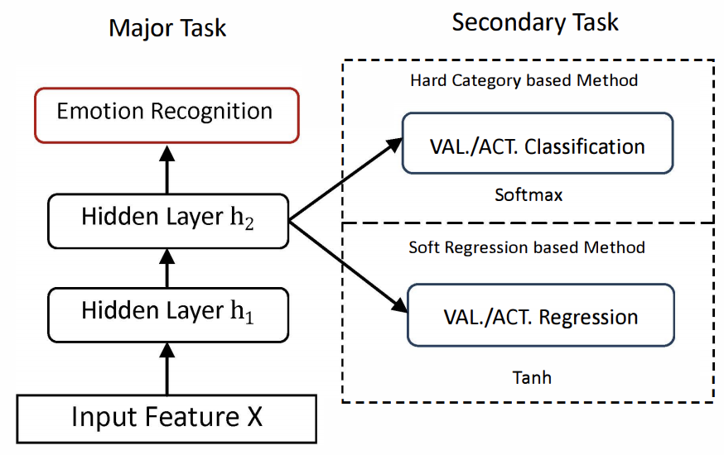
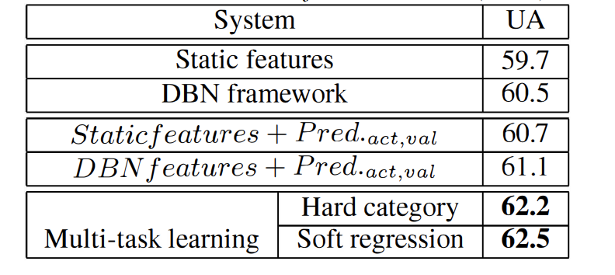
Emotion Recognition - Dimensional
(Xia and Liu, 2015)
Major task: angry, happy, sad, and neutral
Secondary task: valence, activation
  Classification
    map the continuous labels into low, medium, high
  Regression
    project the continuous labels into [-1,1] range
Data (USC-IEMOCAP): 5531 utterances
Features: openSMILE
Model: Deep Belief Network (DBN) + SVM

Slide 46
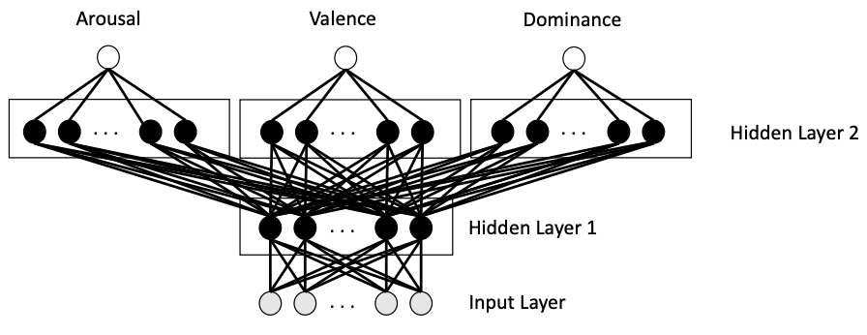
Emotion Recognition - Dimensional
(Parthasarathy and Busso, 2017)
Emotion: arousal, valence, dominance (discrete value 1~7 scaled to [-1,1])
Data (MSP-PODCAST): 12,621 speech segments (2~11 seconds)
Features: openSMILE
Best multi-task learning model: shared first layer, individual second layer
Results: A: 0.7635, V: 0.2894, D: 0.7130
Multi-task learning helps
  Dominance > valence > arousal
  Learn better representations

Slide 47
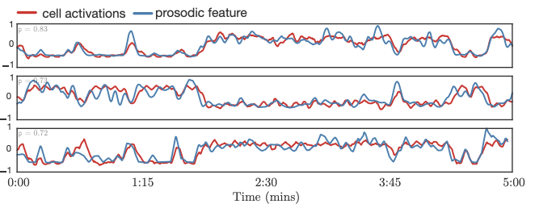
Emotion Recognition - Dimensional
(Trigeorgis et al., 2016)
Emotion: arousal, valence (continuous value [-1,1])
Data (RECOLA): 46 French conversations, 5 min each
Feature: raw waveforms
Model: convolutional recurrent neural networks
Results (Concordance correlation coefficient): arousal: 0.686, valence: 0.261
Some cells learn acoustic features automatically
  Range of RMS energy (ρ = 0.81)
  Loudness (ρ = 0.73)
  Mean of fundamental frequency (ρ = 0.72)

Slide 48
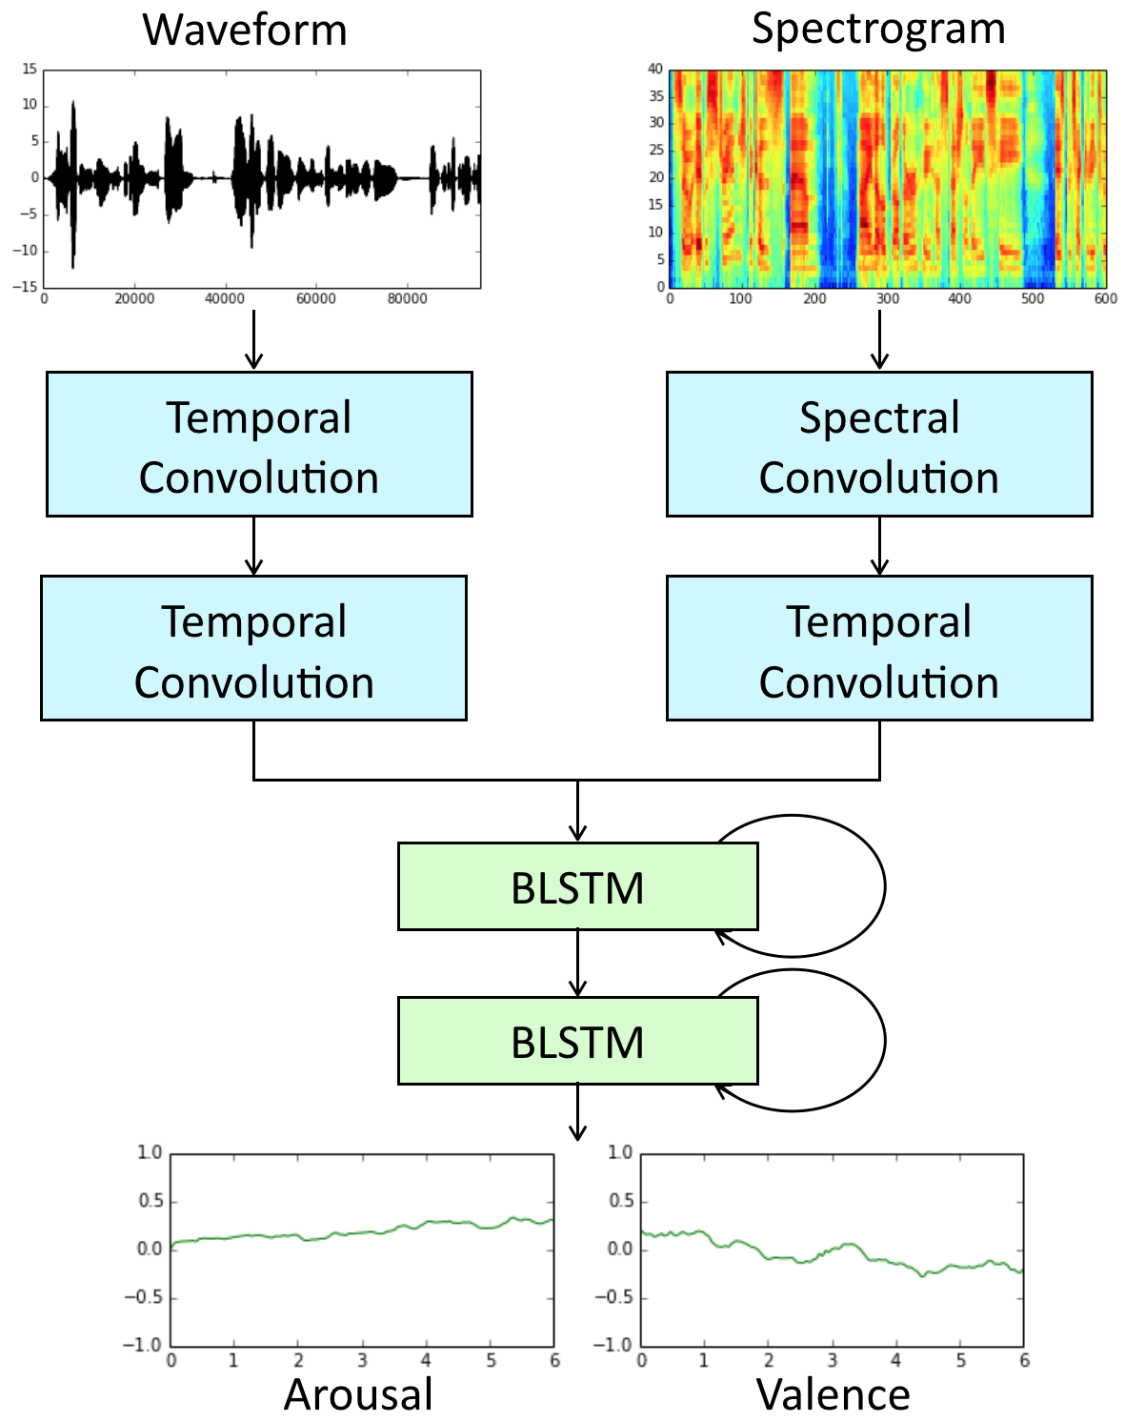
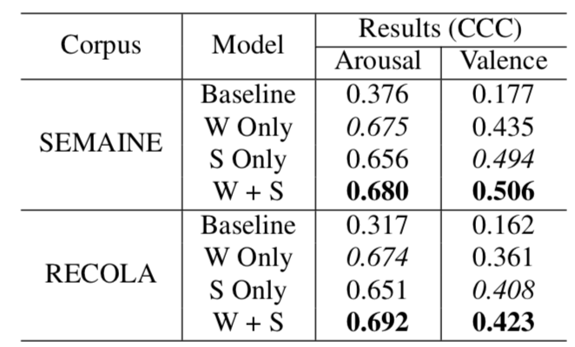
Emotion Recognition - Dimensional
(Yang and Hirschberg, 2018)
Input: raw waveform and spectrogram
Model: convolutional recurrent neural networks
Task: Predict arousal and valence
  Continuous in both time and value
Results:

Slide 49
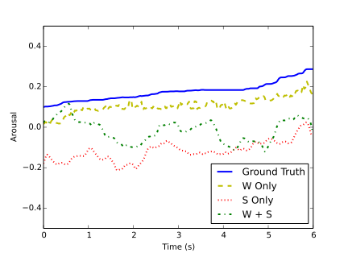
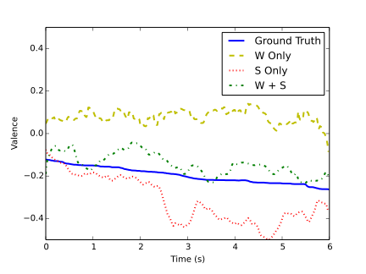
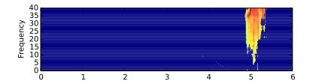
Example Analysis - Dimensional
Arousal
Valence
Local
Interpretable
Modelagnostic
Explanations
(LIME)
“…cos she’s so frigging superior"

Slide 50
LLM for Speech Emotion Recognition
(Liu et al,. 2024)
Multi-task affective analysis instruction dataset (AAID)
  234K data samples based on various classification and regression tasks
Instruction fine-tune LLMs on AAID

Slide 51
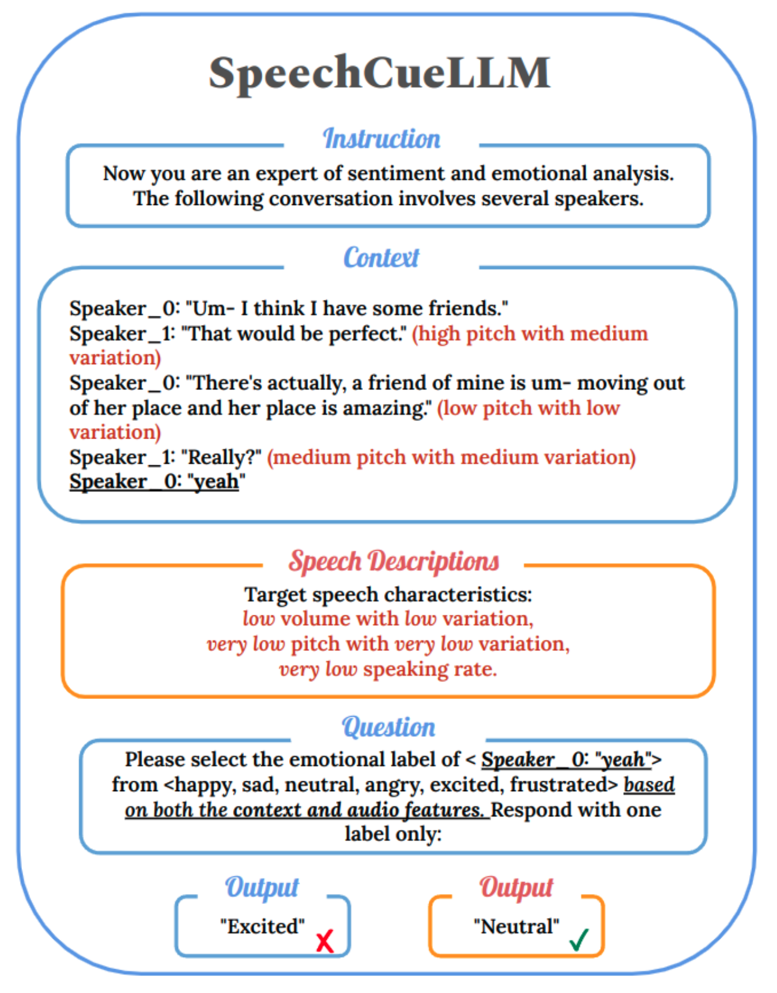
LLM for Speech Emotion Recognition
(Wu et al,. 2024)
Translates speech characteristics into text descriptions
Fine-tune LLMs directly on inputs that combine textual data with speech descriptions
Data: IEMOCAP and MELD
+2% F1 on IEMOCAP

Slide 52
Outline
Emotion in speech
  Emotion theory
  Emotional speech corpora
  Features for emotional speech
  Models for emotion recognition
  Expressive synthetic speech
Sentiment and emotion in text

Slide 53
Expressive Synthetic Speech
http://emosamples.syntheticspeech.de/
Murtaza Bulut (2005): neutral anger
Greg Beller (2005): neutral sad
Acapela (2013): neutral happy sad
bad guy from afar
Laughters: Greg Beller(2009)
                Shiva Sundaram(2007)

Slide 54

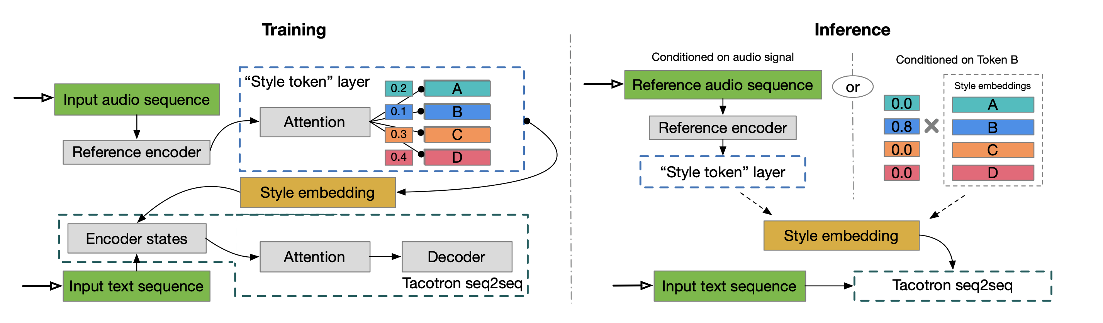
Expressive Synthetic Speech
Tacotron (/täkōˌträn/): An end-to-end speech synthesis system by Google
Tacotron + Style Tokens (Wang et al. 2018)
“United Airlines five six three from Los Angeles to New Orleans has Landed.”
  Different “styles”:

Slide 55
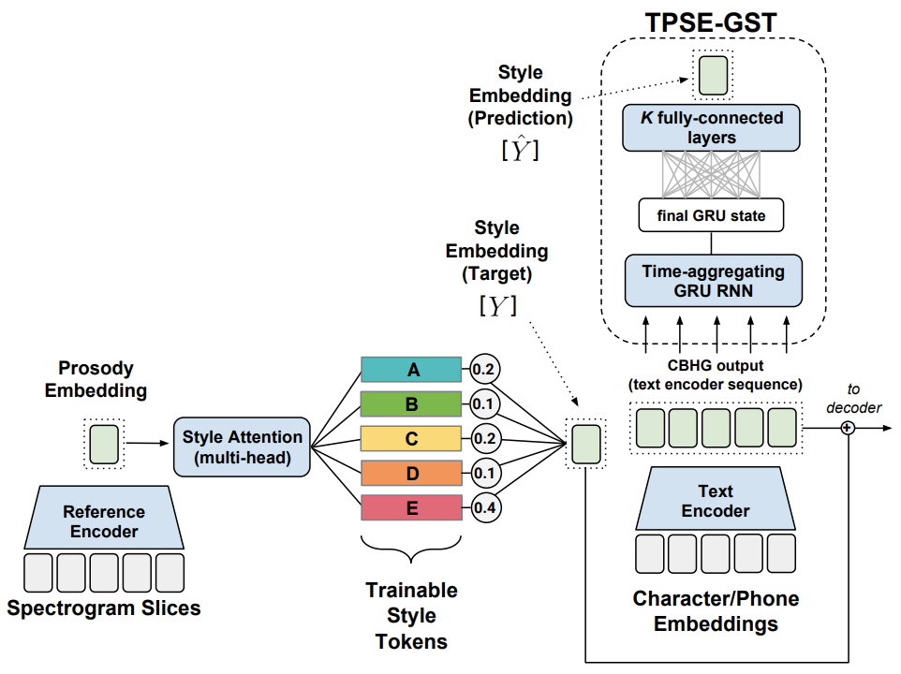
Expressive Synthetic Speech
Tacotron (/täkōˌträn/): An end-to-end speech synthesis system by Google
Tacotron + predicting Style Tokens from text (Stanton et al. 2018)
"Thirty-six," he said, looking up at his mother and father. "That's two less than last year." "Darling, you haven't counted Auntie Marge's present, see, it's here under this big one from Mommy and Daddy.”
Tacotron
Tacotron + predicted style token

Slide 56
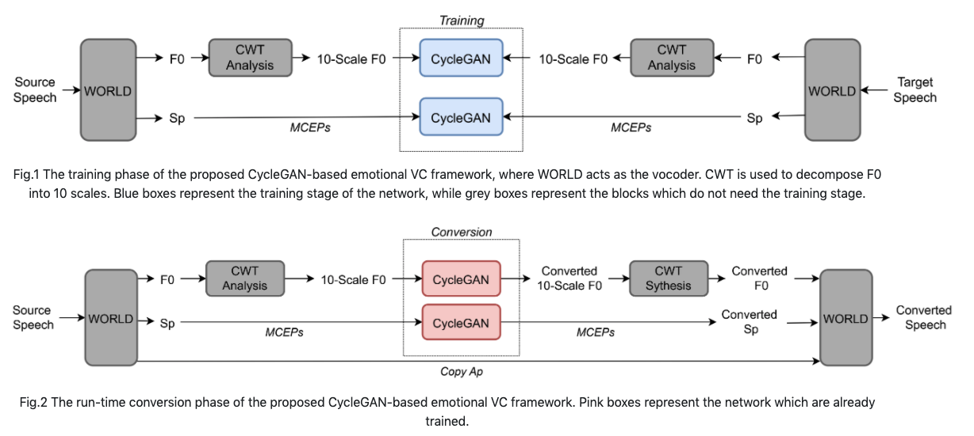

Emotional Voice Conversion
(Zhou et al., 2020)
Neutral
Anger
Converted
Neutral
Sad
Converted

Slide 57
Expressive Synthetic Speech
(IndexTTS2, 2025)
Precise speech duration control
Emotionally expressive generation
Disentanglement of emotional expression and speaker identity
https://index-tts.github.io/index-tts2.github.io/ex6/Empresses_in_the_Palace_1.mp4

Slide 58
Sentiment and Emotion in Text

Slide 59
English Sentiment Lexicon
The General Inquirer (Stone et al. 1966)
  Positive (1915), Negative (2291), Strong vs Weak, Pleasure, Pain, etc.
LIWC (Linguistic Inquiry and Word Count)
  Negative emotion (anxiety, anger, sadness); Positive emotion
MPQA Subjectivity Cues Lexicon
  2718 positive, 4912 negative
Bing Liu Opinion Lexicon
  2006 positive, 4783 negative
SentiWordNet
  WordNet synsets automatically labeled with positivity, negativity, and objectiveness

Slide 60
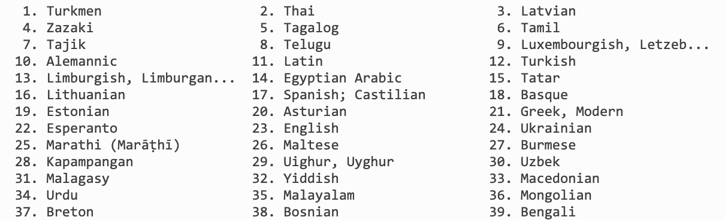
Polyglot (Multilingual text processing toolkit )
Sentiment polarity lexicons for 136 languages
  7,741,544 high-frequency words from 136 languages in Wikipedia
  Use Bing Liu Opinion Lexicon (English) as seed
  Wiktionary + Google Translation + Transliteration + WordNet to generate edges between words
  Propagate sentiment labels through the edges

Slide 61
Emotion Theory:
Plutchik’s wheel of emotion
8 basic emotions in four opposing pairs
  joy–sadness
  anger–fear
  trust–disgust
  anticipation–surprise

Slide 62
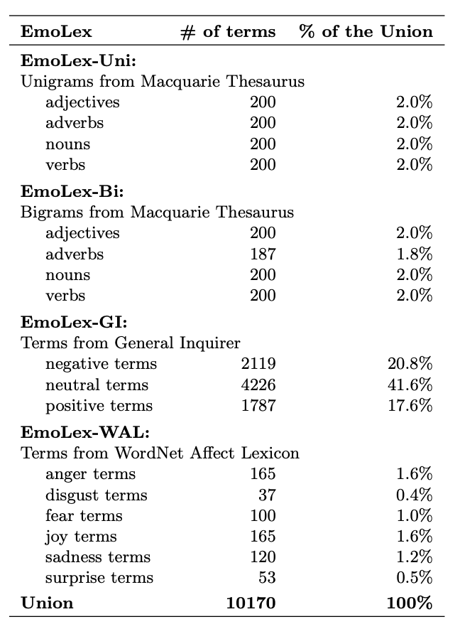
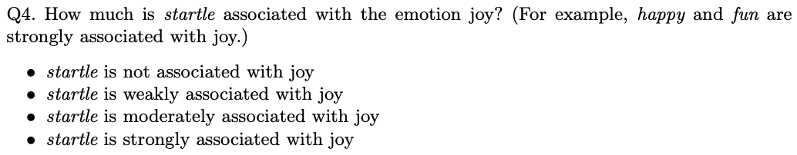
NRC Word-Emotion Association Lexicon
(Mohammad and Turney 2011)
Categorical approach of emotion
10k words chosen mainly from earlier lexicons
Labeled by Amazon Mechanical Turk
  Joy, sadness, anger, fear, trust, disgust, anticipation, surprise; positive, negative

Slide 63
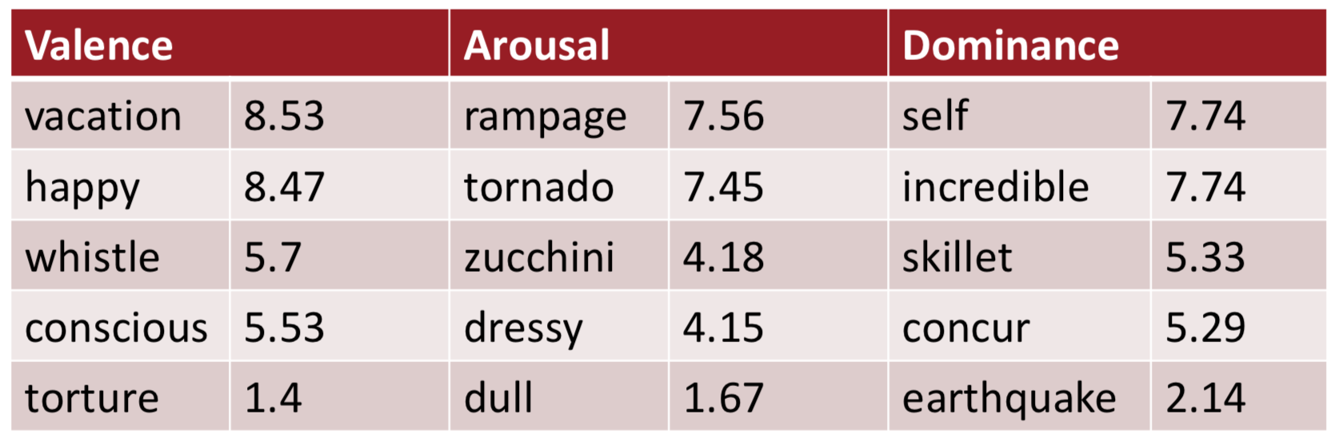
Lexicon of Valence, Arousal, and Dominance
(Warriner at al. 2013)
Dimensional approach of emotion
AMT Ratings for 14,000 words for emotional dimensions
  Valence (the pleasantness of the stimulus)
  Arousal (the intensity of emotion provoked by the stimulus)
  Dominance (the degree of control exerted by the stimulus)
Examples: (range 1-9)

Slide 64
Detecting Sentiment/Emotion in Text
Simplest unsupervised method
  Sum the weights of each positive word in the document
  Sum the weights of each negative word in the document
  Choose whichever value (positive or negative) has higher sum
Simplest supervised method
  Use “counts of lexicon categories” as features (e.g. LIWC)
  Baseline: use all unigram/bigram counts + POS tags
  Hard to beat, but only works if the training and test sets are very similar

Slide 65
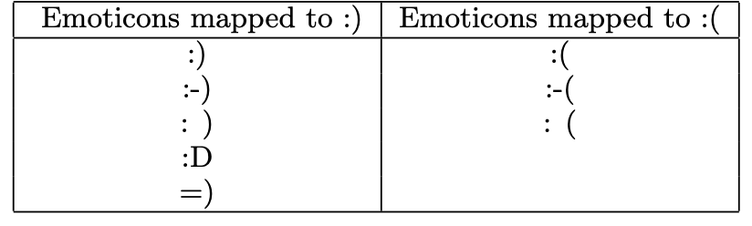
Sentiment in Twitter :) (Go et al. 2009)
Use emoticons to find tweets with sentiment
Training set:
  800k tweets with positive emoticons, and 800k tweets with negative emoticons
  Seed emoticons are stripped off before training
Test set: 359 tweets manually annotated
Accuracy: ~80%

Slide 66
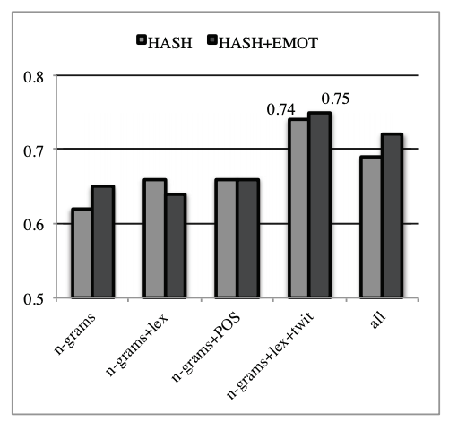
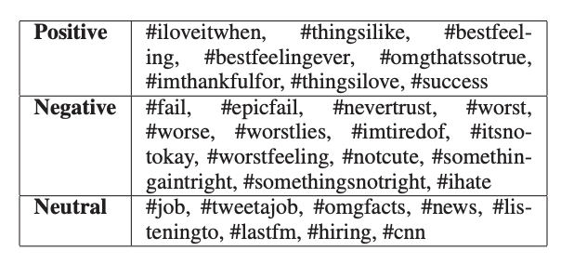
Sentiment in Twitter #thingsilike (Kouloumpis et al. 2011)

Slide 67
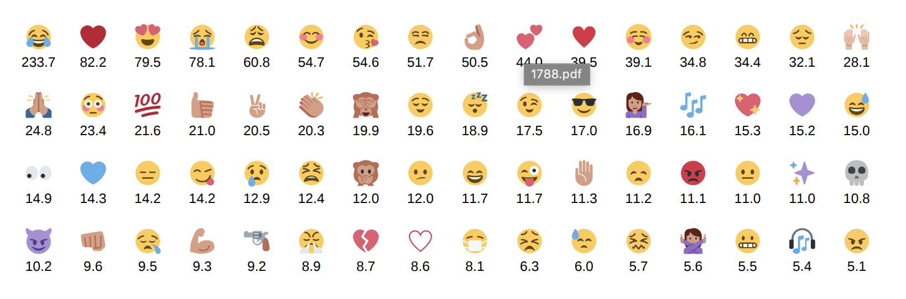
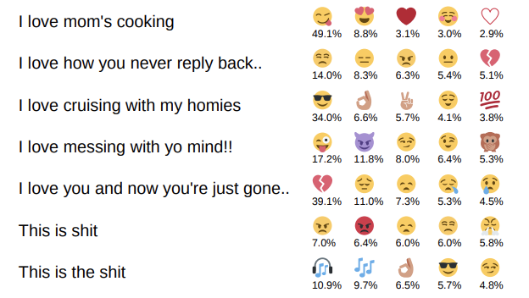
Emoji in Twitter (Felbo et al. 2017)
Number of training data (in millions)
Output: probability of emoji labels

Slide 68
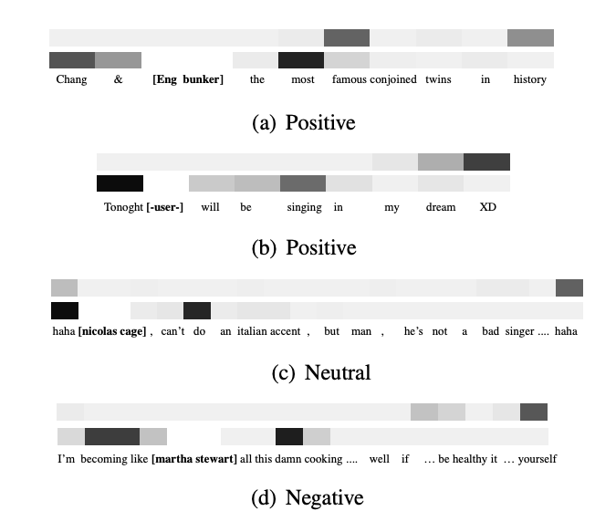
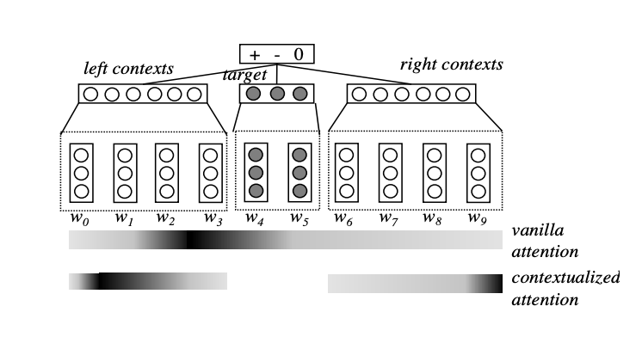
Attention Modeling for Targeted Sentiment
(Liu and Zhang 2017)
Targeted Sentiment
  “She began to love miley ray cyrus since 2013 :)”
  “#nowplaying lady gaga - let love down”

Slide 69
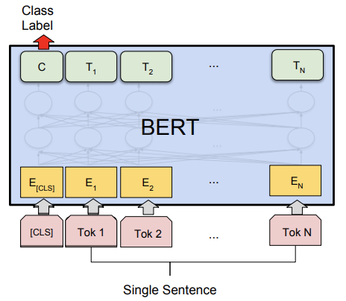
BERT in Sentiment Analysis
BERT: Bidirectional Encoder Representations from Transformers
Fine-tuning for single sentence classification task
  Add a classification layer on the output of [CLS] token
Accuracy on the Stanford Sentiment Treebank dataset: 94.9%

Slide 70
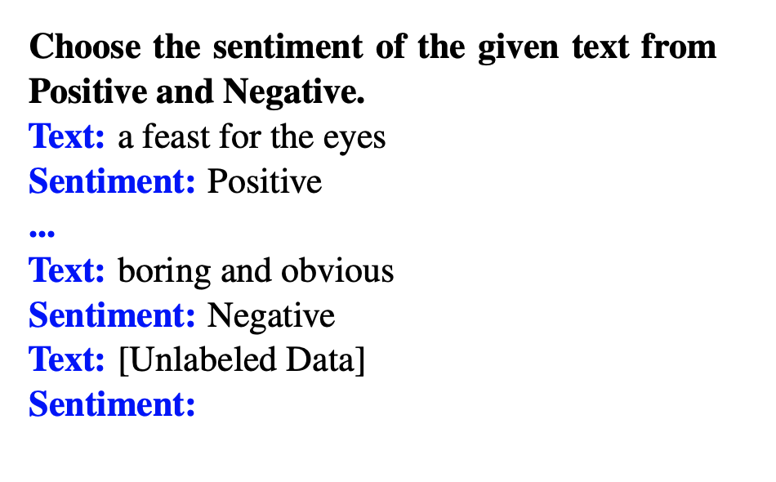

LLM for Sentiment Analysis
Few-shot / zero-shot sentiment prediction
Low-cost data annotation

Slide 71
Text Sentiment Analysis Dataset
Product reviews on Amazon
  Multidomain sentiment analysis dataset
  Amazon product data, 143 million reviews
Movie reviews on IMDB
  Cornell movie review data, labeled with sentiment polarity, scale, and subjectivity
  Large Movie Review Dataset v1.0, 25k movie reviews
  IMDB Movie Reviews Dataset, 50k movie reviews
  Bag of Words Meets Bags of Popcorn, 50k movie reviews
Reviews from Rotten Tomatoes
  Stanford Sentiment Treebank, 11k reviews

Slide 72
Text Sentiment Analysis Dataset
Tweets with emoticon
  Sentiment140, 160k tweets
Twitter data on US airlines
  Twitter US Airline Sentiment, with negative reasons (e.g. “rude service”)
Paper reviews
  Paper Reviews

Slide 73
Thank you!
Questions?

