Slide 1
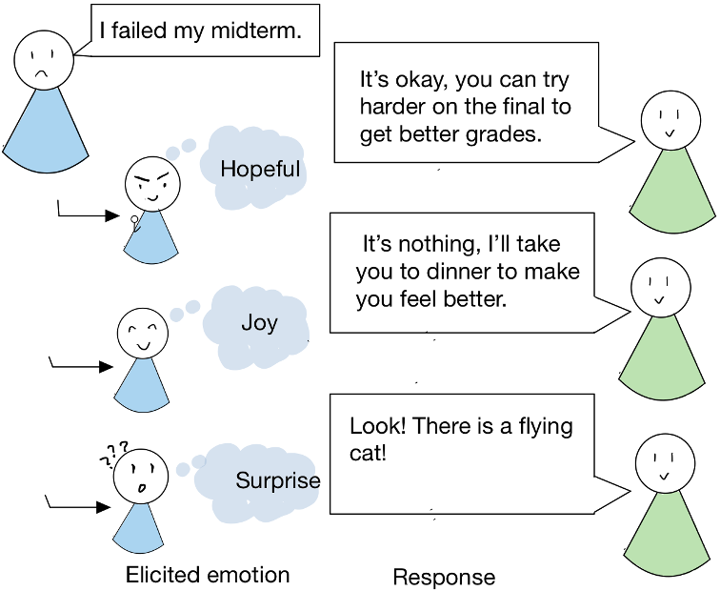
Eliciting Rich Positive Emotions
in Dialogue Generation
Sara Gong, Nov 1st 2022

Slide 2
Related Work
Emotion Elicitation
statistical response generator (Hasegawa et al., 2013)
Hierarchical Recurrent Encoder Decoder model (Serban et al.,2016) extended with a separate layer of emotion modules (Lubis et al., 2018)
encoder-decoder adversarial model with two discriminators to increase emotion-awareness or empathetic dialogue generation (Li et al., 2020)
Style Transfer
control text over multiple styles in generation while preserving the original content
Using Variational Autoencoder (VAE) and wake-sleep learning procedure (Fu et al., 2018;Tikhonov et al., 2019; Fei et al., 2020)
Conditional Variational Autoencoder
CVAE is an extension of VAE, which has been used for dialogue generation (Chen et al., 2019) by introducing a latent variable to capture discourse-level variations (Zhao et al., 2017).
Notes:
Different from above work, we are the first to model the elicitation of rich positive emotions using one neural network

Slide 3
Motivations
Key factors to a conversation (in human communication theory):
intentionality (intention of speakers) and effectiveness (effects of conversations) (Littlejohn and Foss, 2010; Lindquist et al.,2015; Morick, 1971),
both exhibited by emotions (Dezecache et al., 2013).
Current work on emotion elicitation focuses on positive sentiment
However, positive sentiment can include more fine-grained emotions such as “Hopeful”, “Joy” and “Surprise”, which can further serve to deepen the model’s understanding of effect, if not intention.
Small-scale human annotated datasets, which limits the capacity of eliciting various emotions.
Notes:
intentionaliy (intention of speakers) and effectiveness (effects of conversations)

Slide 4
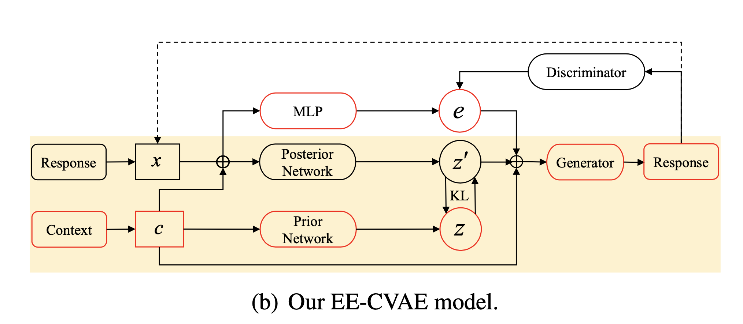
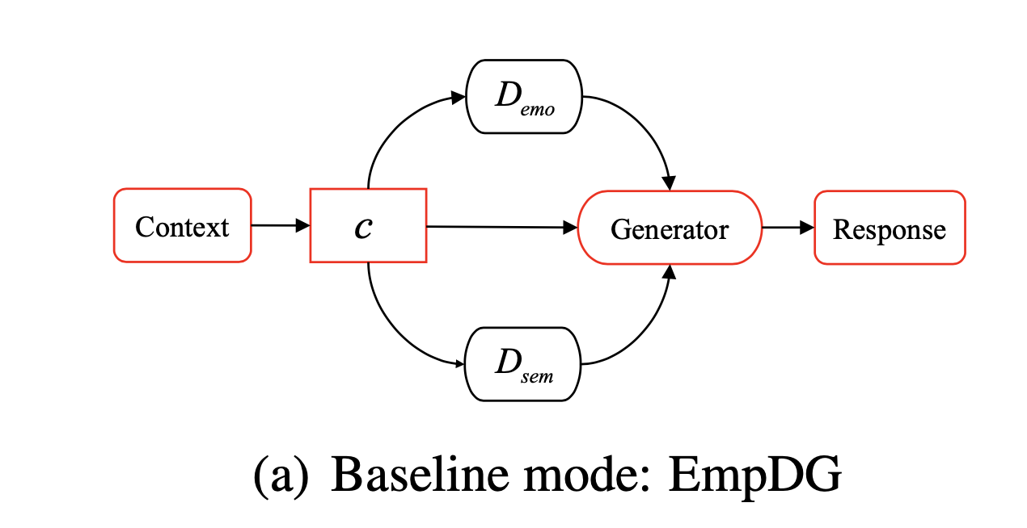
Model Comparison
Single emotion category
Multiple emotion categories

Slide 5
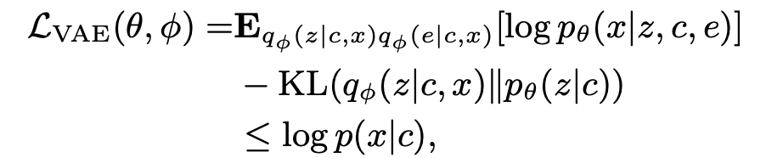

Model Detail
CVAE for Dialogue Generation (yellow background)
Adding Emotion Elicitation Function
augment CVAE with a latent variable e, which is used to control the generation of a response together with the unstructured variable z.
a discriminator D is used to force the generator to produce coherent emotions
Similarly, the variational encoder is reused to separate unrelated attributes from e by forcing them to be fully captured by z. It can be considered as another discriminator E :
Combining, we have
Training illustration of our model. Red components are used for testing. CVAE in yellow background. Dashed arrow denotes a discriminator.

Slide 6
Dataset
Reconstructed the multi-modal MEmoR dataset (Shen et al., 2020) to fit our emotion elicitation task and conducted human evaluation to validate the usability in a single modality. (annotator agreement of 80% accuracy (Cohen’s  = 0.491) )
The reconstructed corpus has 22,732 utterances
Split the data in training (18,943), dev (1,894), and test (1,894).
Pretrain: we use more than 200k utterances from the Friends (Zahiri and Choi, 2017) and Open Subtitles2 datasets
Notes:
We reconstructed the multi-modal MEmoR dataset 201
(Shen et al., 2020) to fit our emotion elicitation 202
task and conducted human evaluation to validate 203
the usability in a single modality. MEmoR con- 204
tains video, audio, and text information of clips 205
from the TV show The Big Bang Theory, with 206
emotion labels given on each character in every 207
clip. We use only the textual data and consider non-
208 speakers’ emotions to be the elicited emotions by
209 an utterance. Manual decision is made on whether
210 a target emotion can be elicited using text context
211 only, in order to filter dialogues. Our reconstructed
212 dataset has a annotator agreement of 80% accuracy
213 (C ohen0 s  = 0.491). The reconstructed corpus
214 has 22,732 utterances and we split the data in train-
215 ing (18,943), dev (1,894), and test (1,894).
For both EmpDG and EE- 218
CVAE, we use more than 200k utterances from the 219 Friends (Zahiri and Choi, 2017) and Open Subti- 220 tles2 datasets for pre-training the generator mod- 221 ule, and the reconstructed MEmoR dataset to train 222 the discriminators. Since one EmpDG model can 223 only be trained with a single emotion category, we 224 split the dataset according to different emotion cat- 225 egories to train different models.

Slide 7
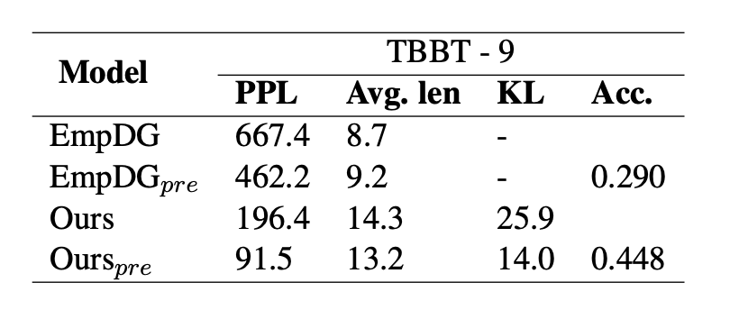
Results
Table 1: Results of models generation in comparison. "-" indicates not applicable, the average length for Em- pDG is not reported because the generation results are unacceptable for most emotion categories.
Comparison of accuracy across 9 emotions.

Slide 8
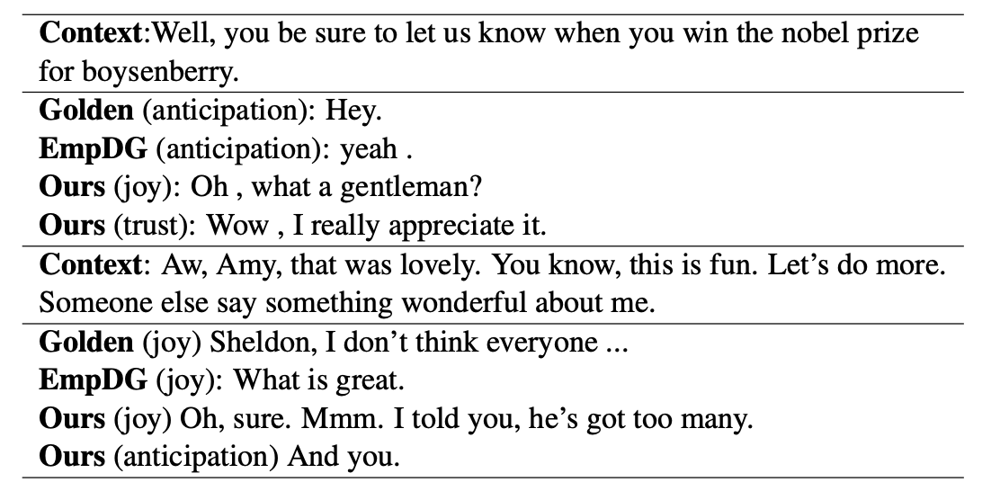
Sample generations

Slide 9
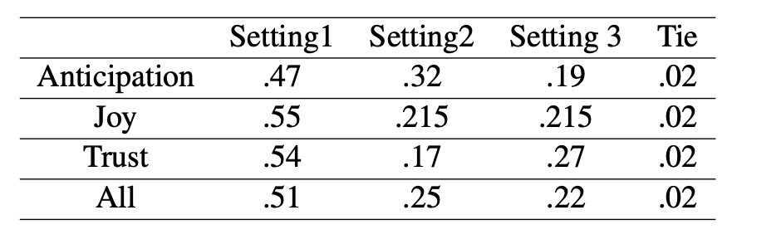
The Effect of Modeling Negative Emotions
Results comparing three settings with the percentage of times one model is considered the best when eliciting different positive emotions.
Setting 1: modeling all emotions in pretraining and fine-tuning.
Setting 2: modeling all emotions in pretraining, fine-tuning with only positive emotions.
Setting 3: modeling only positive emotions in pretraining and fine-tuning.
Using all emotions in pretraining and finetuning produces the best performance in eliciting positive emotions.

Slide 10
Conclusions and Future Directions
Using all emotions in pretraining and finetuning produces the best performance in eliciting positive emotions.
Results show the advantage of using a latent variable for modeling rich emotions, compared to hard-coding one emotion in a multi-encoder model.
The effectiveness of our model in pretraining.
Our results show that rich emotion elicitation is a challenging task
for current neural models and there is a need for more effective
few-shot learning.

Slide 11
Thank you!
Notes:
Questions?

