Slide 1
Spoken Dialogue System in Healthcare
Yu-Wen Chen

Slide 2
Medical consultation
- ChatGPT
- ChatDoctor: A Medical Chat Model Fine-Tuned on a Large Language Model Meta-AI (LLaMA) Using Medical Domain Knowledge
https://arxiv.org/abs/2303.14070
- Med-PaLM2: a large language model (LLM) designed to provide high quality answers to medical questions.
https://sites.research.google/med-palm/
- Mental health support
Notes:
Palm

Slide 3
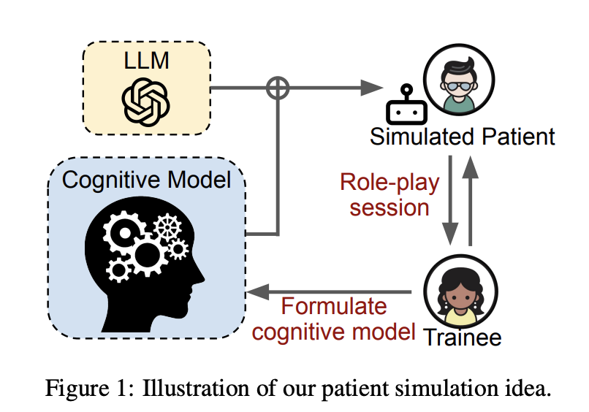
Training Mental Health Professionals
PATIENT-Ψ: Using Large Language Models to Simulate Patients for Training Mental Health Professionals
The framework has the potential to transform mental health professional training and be generalized to broader training protocols and therapy paradigms.
Notes:
Perceived interaction. For LLM, and set up what kind of patient (behavior of the patient. Different style) better for patient and trainee

Slide 4







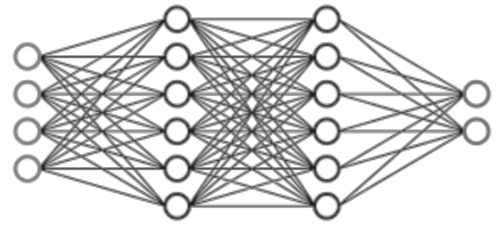
Diagnostic Support
/
Help healthcare providers review and validate the information
Spoken dialogue system
Provide healthcare professionals with data-driven insights

Slide 5
hi. how are you ?
good.
good good.
your blood pressure seems to be under control.
great.
your depression , you know , it sounds like you're doing well with that, but again, I'm happy to start on a medical regiment or ...
mm-hmm
refer you to psychotherapy , if you think that that would be helpful.
mm-hmm
would you like that ?
u- u- um , maybe not necessarily.

Slide 6
hi. how are you ?
good.
good good.
your blood pressure seems to be under control.
great.
Summarize the conversation
your depression , you know , it sounds like you're doing well with that, but again, I'm happy to start on a medical regiment or ...
mm-hmm
refer you to psychotherapy , if you think that that would be helpful.
mm-hmm
would you like that ?
u- u- um , maybe not necessarily

Slide 7
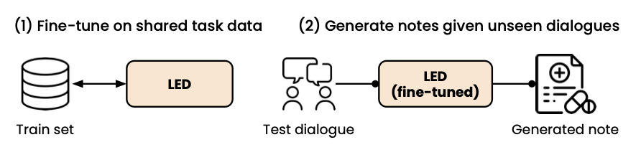
Model for medical note generation
Overview of the MEDIQA-Chat 2023 Shared Tasks on the Summarization & Generation of Doctor-Patient Conversations
(Ben Abacha et al., ClinicalNLP @ ACL 2023 )
Fine-tuning LM-based method.
LED: Longformer: The Long-Document Transformer
WangLab at MEDIQA-Chat 2023: Clinical Note Generation from Doctor-Patient Conversations using Large Language Models

Slide 8
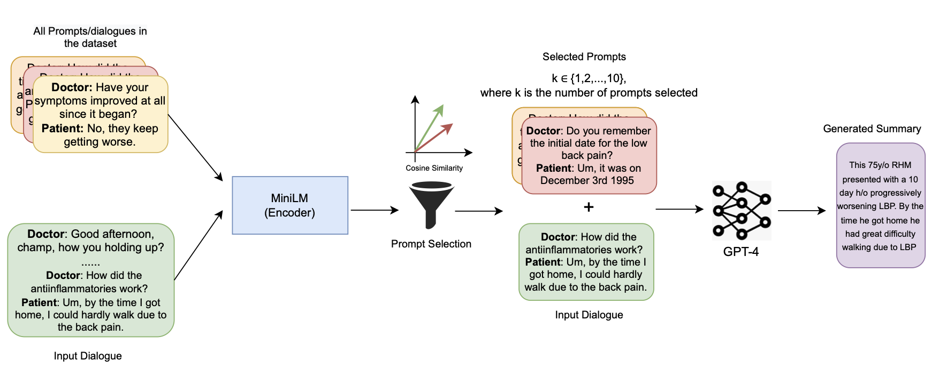
Model for medical note generation (Cont.)
GPT-based methods
Learn the format
SummQA at MEDIQA-Chat 2023: In-Context Learning with GPT-4 for Medical Summarization

Slide 9
Doctor: Hello, how are you today?
Patient: I am doing well.
Doctor: Great. What would you like to bring up today?
Patient: I have some questions about my liver.
Doctor: Alright. Let's start with the basics. Do you drink? Excessive drinking can cause issues with the liver.
Patient: No, I do not. I take a lot of Tylenol for pain and I am worried it is effecting my liver.
Doctor: Okay, that is a common concern. We can address that today. Do you happen to smoke?
Patient: No, I do not smoke.
Summary:
The patient is a nonsmoker. No history of alcohol abuse. Tylenol use is noted to be problematic.
Fine-tune T5:
https://huggingface.co/wanglab/ task-a-flan-t5-large-run-2

Slide 10
Doctor: Hello, how are you today?
Patient: I am doing well.
Doctor: Great. What would you like to bring up today?
Patient: I have some questions about my liver.
Doctor: Alright. Let's start with the basics. Do you drink? Excessive drinking can cause issues with the liver.
Patient: No, I do not. I take a lot of Tylenol for pain and I am worried it is effecting my liver.
Doctor: Okay, that is a common concern. We can address that today. Do you happen to smoke?
Patient: No, I do not smoke.
The patient is a nonsmoker. No history of alcohol abuse. Tylenol use is noted to be problematic.

Slide 11
https://huggingface.co/wanglab/ task-a-flan-t5-large-run-2
Doctor: Hello, how are you today?
Patient: I am doing well.
Doctor: Great. What would you like to bring up today?
Patient: I have some questions about my liver.
Doctor: Alright. Let's start with the basics. Do you drink? Excessive drinking can cause issues with the liver.
Patient: No, I do not. I take a lot of Tylenol for pain and I am worried it is effecting my liver.
Doctor: Okay, that is a common concern. We can address that today. Do you happen to smoke?
Patient: No, I do not smoke.
The patient is a nonsmoker. No history of alcohol abuse. Tylenol use is noted to be problematic.
Does the summary include all important information?
How well will the model perform on out-of-domain data?

Slide 12
Important information in medical dialogue
SOAP notes
Subjective: information reported by the patient
e.g., History of illness
Objective: factual, measurable, and objective observations
e.g., Exam, lab results
Assessment*: doctor’s evaluation (Clinician’s interpretation of the results)
Plan: future care plan
SOAP is widely utilized by healthcare providers to document a patient’s progress
Notes:
An organized framework that reduces communication confusion among healthcare professionals.

Slide 13
Open-sourced dataset
MTS-Dialog
ACI-BENCH
Doctor: Good afternoon, sir. My chart here says that you are a fifty one year old white male, is that correct? Patient: Good afternoon, doctor. Yes, all of that is correct.
...
Doctor: Finally, your ECOG score is one according to the nurse, is that correct? Patient: Yes, doctor. That's correct.
Doctor: hi. how are you? Patient: hey, good to see you. Doctor: i'm doing well, i'm doing well.
…
Doctor: let me know if your symptoms worsen and we can talk more about it, okay? Patient: you got it. Doctor: all right. hey, dragon. finalize the note.
~1800 tokens
~150 tokens
(Subjective)
CHIEF COMPLAINT Upper respiratory infection. HISTORY OF PRESENT ILLNESS The patient is a 59-year-old male with a past medical history significant for depression, …
RESULTS
ASSESSMENT AND PLAN ..
(Subjective)
Section header: HISTORY of PRESENT ILLNESS
Section text: A 51-year-old white male diagnosed with PTLD in latter half of 2007. He presented with symptoms of increasing adenopathy, abdominal pain, weight loss, and anorexia. ….
(Subjective)
(Objective)
(Assessment and Plan)
Notes:
Here are examples of the datasets used in this study. mts dialog and aci-bench. Both of them have the corresponding SOAP category of the summary.

Slide 14
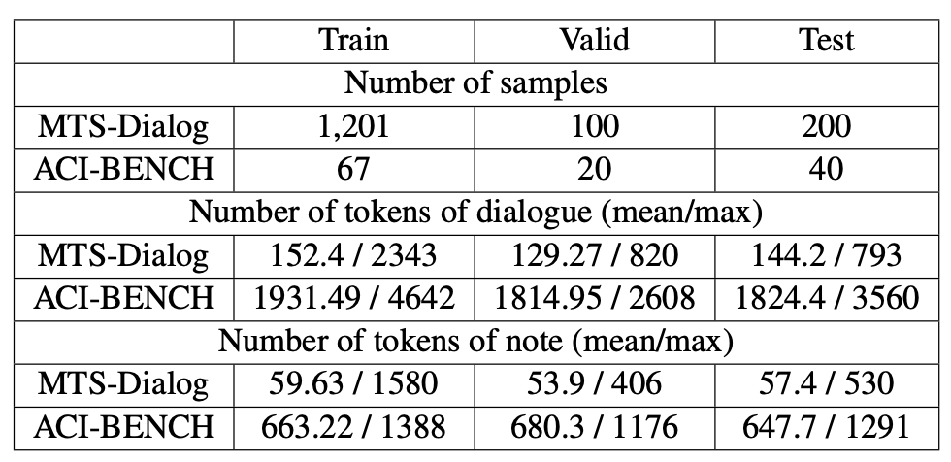
Statistic of MTS-Dialog and ACI-BENCH dataset

Slide 15
Mapping between original note categories and SOAP
Dataset | Original section | # of samples
Subjective
MTS-Dialog | GENHX, FAM/SOCHX, PASTMEDICALHX, CC, PASTSURGICAL, ALLERGY, ROS, MEDICATIONS, IMMUNIZATIONS, GYNHX, PROCEDURES, OTHER_HISTORY, | 175
ACI-BENCH | Subjective: CHIEF COMPLAINT, HISTORY OF PRESENT ILLNESS, and REVIEW OF SYSTEMS. | 40
Objective
MTS-Dialog | EXAM, IMAGING, LABS | 7
ACI-BENCH | Objective exam and objective result: RESULTS, PHYSICAL EXAMINATION, and VITALS REVIEWED. | 40
Assessment and plan
MTS-Dialog | ASSESSMENT, DIAGNOSIS, DISPOSITION, PLAN, EDCOURSE | 18
ACI-BENCH | Assessment and plan: ASSESSMENT AND PLAN | 40
Is SOAP written in a similar way?

Slide 16

Introduction of LIWC
Linguistic Inquiry and Word Count
A text analysis software that provides insights into the emotional, cognitive, and structural components of written or spoken language.
LIWC analyzes text based on a predefined set of linguistic categories and calculates the percentage of words in a given text to uncover patterns and meanings in the text.
Input text
LIWC features
“Past medical history is unremarkable.”
[ 0, 0, 0 , 0.166, …, ]
I
we
you
health
https://www.liwc.app/
Notes:
Related to HW2

Slide 17
LIWC features related to healthcare
LIWC feature | Examples
pronoun | I, you, that, it
number | one, two, first, once
posemo (positive emotion) | good, love, happy, hope
negemo (negative emotion) | bad, hate, hurt, tired
anx (anxiety) | worry, fear, afraid, nervous
anger | hate, mad, angry, frustr*
sad | sad, disappoint*, cry
hear | heard, listen, sound
feel | touch, hold, felt
bio | eat, blood, pain
body | ache, heart, cough
health | medic*, patients, health
ingest (food) | food*, drink*, eat, dinner*
risk | secur*, protect*, pain, risk*
time | when, now, then, day
Hypothesis:
LIWC features should be similar across different dataset SOAP categories.

Slide 18
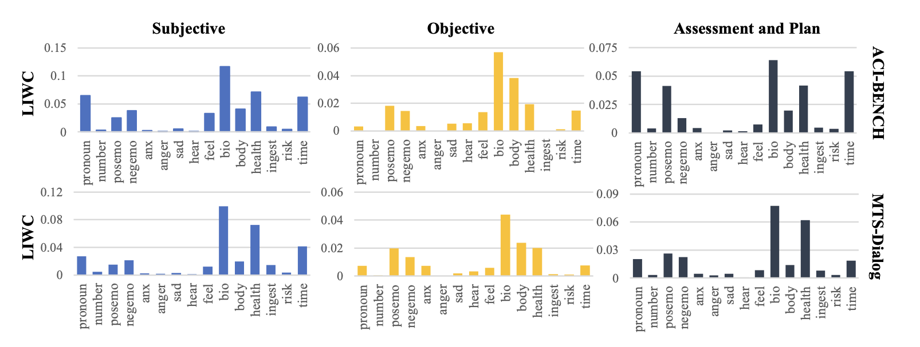
Notes:
Higher LIWC score indicate that the word in that category is more important in the conversation.

Slide 19
Correlation: 0.93
Correlation: 0.95
Correlation: 0.77

Slide 20
Subjective (subjective information from the patient)
is similar to
Assessment and plan (subjective information from the doctor)

Slide 21
LIWC features have characteristics that resonate with SOAP notes in real-world scenarios

Slide 22
Case study – performance on out-of-domain data
Model: Fine-tuned LED on ACH-BENCH dataset (longer conversation).
How the model perform across datasets?
Test data: very short conversation (from MTS-Dialog dataset)
Have you had your flu or Pneumonia vaccination this year?
I got my flu shot this year, but I did not get the one for Pneumonia.
Reference: Immunizations were up to date for influenza, negative for Pneumovax.
Notes:
LED is train

Slide 23
Case study - Results
Have you had your flu or Pneumonia vaccination this year?
I got my flu shot this year, but I did not get the one for Pneumonia.
Reference: Immunizations were up to date for influenza, negative for Pneumovax.
Model | Section | Generated note
LED | S | (CHIEF COMPLAINT) Pneumonia. (MEDICAL HISTORY) Patient reports history of pneumonia in the past. (SOCIAL HISTORY) patient reports that she has a family history of pneumonia. (MEDICATIONS) Patient reports she received a flu shot this year. (REVIEW OF SYSTEMS) Constitutional: Reports pneumonia. Respiratory: Denies pneumonia. Gastrointestinal: Reports abdominal pain. Genitourinary: Reportsuria. Musculoskeletal: Reports right lower extremity pain.
 | O | (PHYSICAL EXAM) Itegumentary. Examination: Normal gait. Examination of Abdomen: No enlarged lymph nodes. Palpation: Normal perfusion. Auscultation of Lungs: No evidence of lymphadenopathy. Cardiovascular Examination; normal perfusion, bilaterally. - Musculosity: Normal pulmonary function. gastrointestinal: Normal vaginal bleeding.
 | AP | 1. Pneumonias. - Medical Reasoning: Based on the patient's examination and radiographic findings, we believe this is a case of Pneumona. - Patient Education and Counseling: We discussed the diagnosis and treatment options with the patient. We also discussed the importance of maintaining a high index of suspicion when treating patients with suspected pneumonia. - Additional Testing: We recommended that all patients be referred to a thoracic/GI/Lymphatic surgeon for further evaluation and possible treatment. - medical Treatment: Initiate antiviral treatment. Patient Agreements: The patient understands and agrees with the recommended medical treatment plan. (INSTRUCTIONS) The patient will follow-up as needed.

Slide 24
Case study – Results (Cont.)
Have you had your flu or Pneumonia vaccination this year? I got my flu shot this year, but I did not get the one for Pneumonia.
Model | Section | Generated note
gpt3.5 | S | N/A
 | O | The patient has received a flu vaccination this year, but they have not received a pneumonia vaccination
 | AP | The patient has not received a pneumonia vaccination. Recommend the patient to get their pneumonia vaccination.
gpt4 | S | The patient reported having received their annual flu vaccination, but they have not been vaccinated for pneumonia this year.
 | O | N/A
 | AP | The patient is up to date with their flu vaccination but lacks their pneumonia shot for the current year. The plan is likely to facilitate the pneumonia vaccination for the patient.

Slide 25
Evaluation metrics
ROUGE-N (e.g., ROUGE-1, ROUGE-2): measures the number of matching n-grams between the model-generated text and a human-produced reference.
BLEU: Bilingual Evaluation Understudy score
N-Gram Overlap: The n-gram overlap counts how many unigrams, bigrams, trigrams, and four-grams (i=1,...,4) match their n-gram counterpart in the reference translations. This term acts as a precision metric.
Brevity Penalty: The brevity penalty penalizes generated translations that are too short compared to the closest reference length with an exponential decay.
BERTscore: based on contextual embeddings from pre-trained models
Notes:
ROUGE-1 refers to the overlap of unigrams (each word) between the system and reference summaries.
ROUGE-2 refers to the overlap of bigrams between the system and reference summaries.

Slide 26
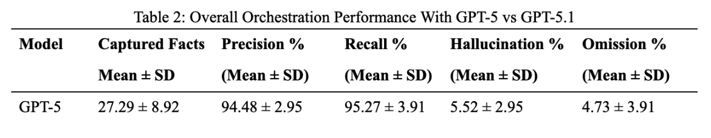
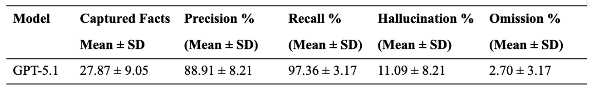
Evaluation metrics – Cont.
Decompose statement into multiple atomic facts
For example, “Blood pressure 140/90, down from 150/95 last week” was decomposed into
(1) current BP 140/90, (2) prior BP 150/95, and (3) a temporal comparison indicating a decrease.
→ Calculate the precision (hallucination), recall (Omission)
(Data: 15 real-world home healthcare visits with 428 expert-annotated atomic facts.)

Slide 27
Summary
GPT-generated SOAP notes are mostly correct.
GPT’s SOAP notes tend to include more details than real clinician notes.
The real-world situation is more complex.
- Clinicians may intentionally omit some information.
- Clinicians may emphasize specific aspects.
→ No clear conclusion on what constitutes the ideal clinical note.
Next
Use Spoken Dialogue Systems for Real-world Diagnostic Support

Slide 28


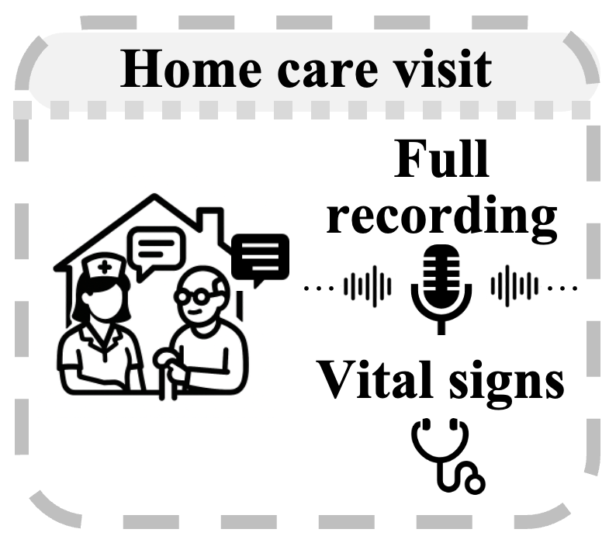

Hearing Health in Home Healthcare: Leveraging LLMs for Illness Scoring and ALMs for Vocal Biomarker Extraction
Columbia CS + EE + Nursing school
VNS health
Data collection
Patient visited the hospital
Patient enrollment & demographic / clinical data collection
(
)
…
60 days
Goal:
Automatic assessment of patient’s health condition

Slide 29
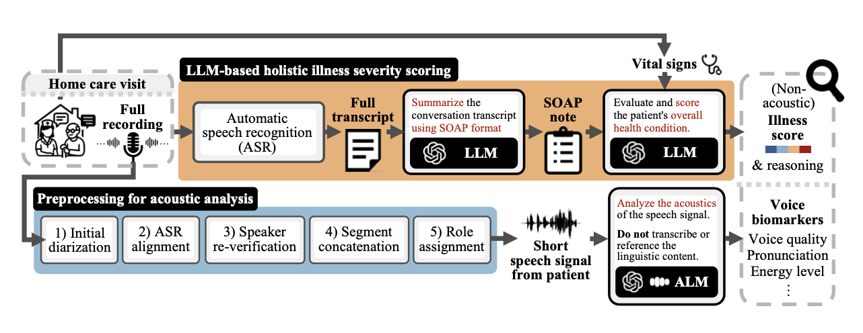
Semantic: Assessing health through conversation content (What people say reveals health condition)
Acoustic: Assessing health through voice characteristics (How people speak reflects health changes)
(30s)
- 160 home care visits
- 6 to 70 mins (avg 30 mins)
- 77 patients (23 male, 54 female, age: 20-99) & 9 clinicians

Slide 30
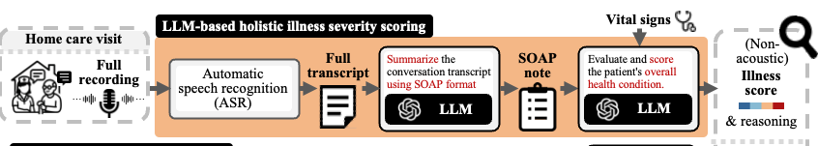
LLM-based holistic illness severity scoring
Illness score (1-5)
Score 1: good overall health
Score 5: critical condition, hospital referral recommended
How to evaluate LLM’s illness score?
Can LLM interpret the information in the SOAP note and vital information correctly?
Compare No ED/HOSP and ED/HOSP groups

Slide 31
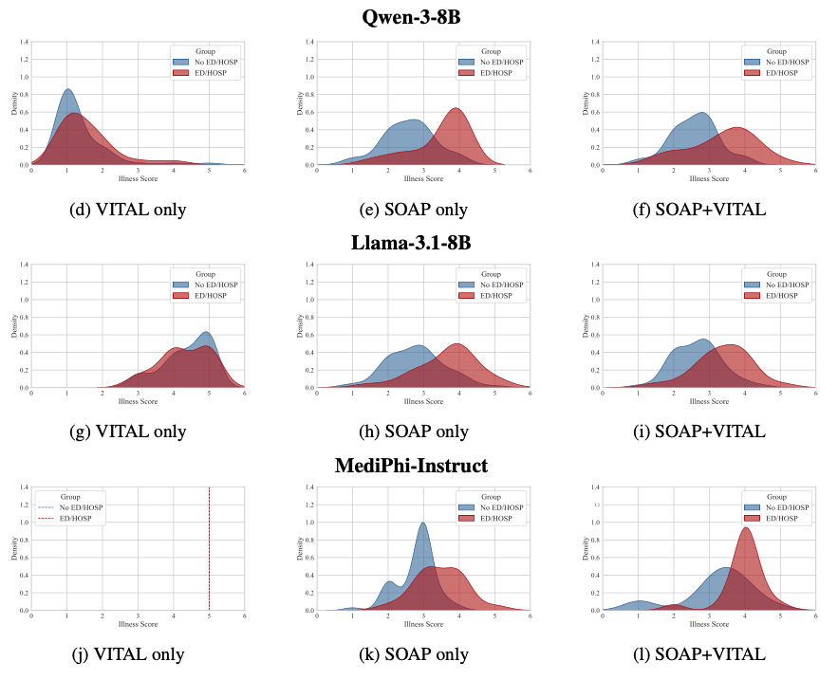
Results
No ED/HOSP group
ED/HOSP group
Notes:
How to read the figure. Axis mean?
Interpret the results

Slide 32
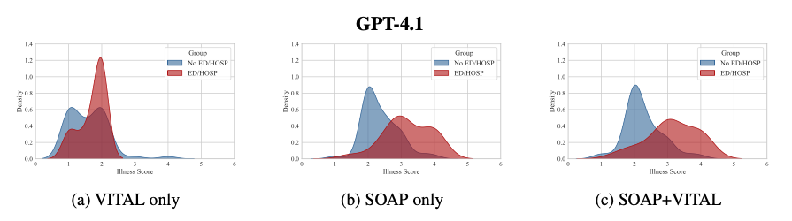
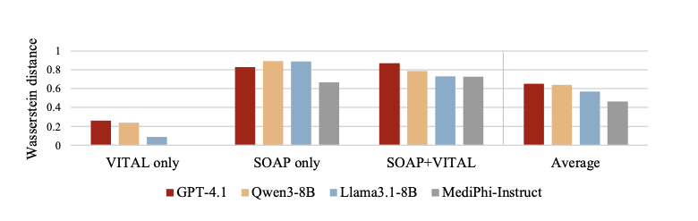
Results (Cont.)
Notes:
the difference between two distribution (higher-> more separated -> better
Gpt never give a score of five.

Slide 33
Examples of LLM’s rationale for illness scores
1 (Good health): The patient demonstrates excellent recovery after the procedure, with normal vital signs, good functional mobility, independence with daily activities and exercise, and no current pain or acute issues. …
2: Patient is making good post-operative progress with stable vital). Incision is healing well with no signs of infection, pain is mild and well controlled, and patient is able to perform activities of daily living with minimal assistance. Only mild issues such as minor discomfort and adhesive residue are present. …
3: The patient is stable…. However, there is persistent right-sided paralysis with significant ongoing mobility limitations, elevated blood glucose consistently above target indicating suboptimal diabetes control, and safety concerns regarding stairs. The condition is chronic and requires ongoing management but does not meet criteria for hospital referral at this time.
4 (Poor health): Patient is elderly, recently hospitalized, and requires ongoing oxygen therapy for chronic respiratory issues with worsening dyspnea. The patient is unable to stand or transfer independently and needs significant physical assistance and equipment for mobility. ….
Notes:
(GPT’s result)

Slide 34
Summary – health assessment from textual information
Assessing health through conversation content
(What people say reveals health condition)
Evaluate commercial and open-source LLMs for illness score estimation
Demonstrate correlation of illness score with real clinical outcomes
→ SOAP notes are substantially more informative than vital signs
Next
Assessing health through voice characteristics (acoustic information)
(How people speak reflects health changes)

Slide 35

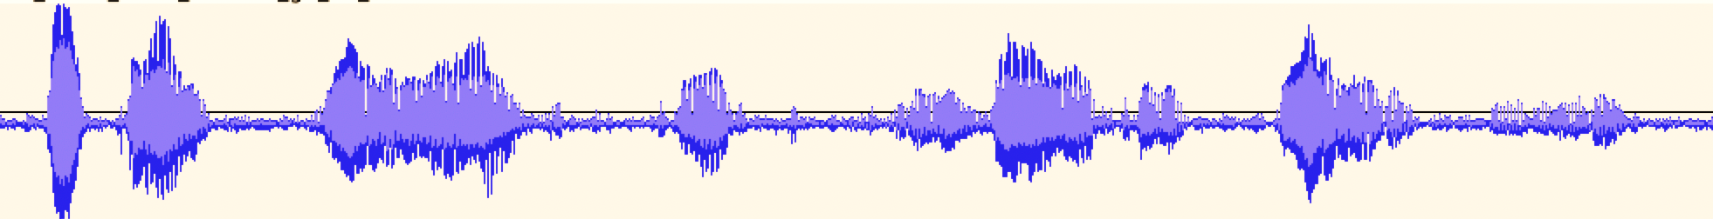





Audio processing - From who said what to who they are
??
1) Speech diarization (SD)
+ automatic speech recognition (ASR)
How are you?
Well…I am…
ok
Have you seen my keys?
2) Identity detection
= clinician
= patient
= family member

Slide 36
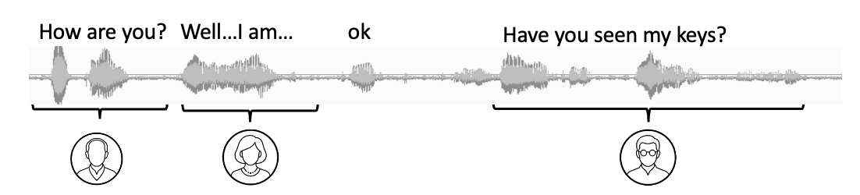
SD+ASR+LLM preprocessing pipeline
Speech diarization (SD) + automatic speech recognition (ASR)
Align the transcript with pseudo-speaker labels with timestamp
LLM
Context-aware speaker label correction
O text
X speaker label
⚠
Number of speakers may be unknown!
Identity detection
“You are given a conversation with speaker labels. Your task is to assign an identity to each speaker. If different original speaker labels refer to the same person, merge them by assigning the same identity, but only do this if you are very sure.”

Slide 37
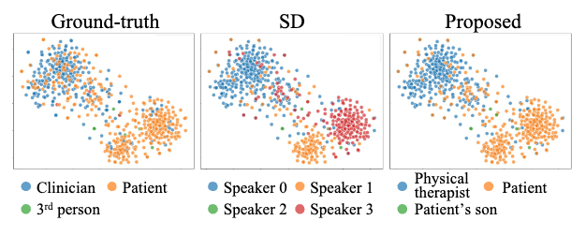
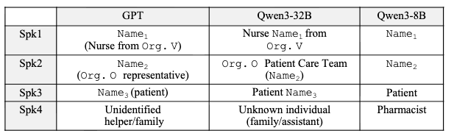
Speech diarization with identity detection
Notes:
Qwen -> need specific design prompt 8B-> challenging for case such as meeting ----------------------------------- STEP 1 — EVIDENCE (plain text) ----------------------------------- For each speaker, list 2–4 short quotes or behavioral observations that justify your reasoning. ----------------------------------- STEP 2 — ROLE INFERENCE (use the highest tier supported by evidence) ----------------------------------- TIER 1 — Structural Role (requires: 2+ independent strong evidence pieces) Based purely on conversational function, not domain. TIER 2 — Behavioral Role (requires: 1 strong OR 2 weak evidence pieces) Weak evidence = question frequency, turn length, who defers to whom, whether they initiate vs. react ----------------------------------- STEP 3 — RESOLVE DUPLICATE ROLES ----------------------------------- Review your output from Step 2. If two or more DISTINCT speakers share the exact same role label: A. Are they truly the same person mis-labeled by diarization? - If YES: assign them the same role (this is intentional, they will be merged downstream). - If NO: you MUST differentiate them. B. To differentiate, go back to the transcript and find distinguishing behavioral signals: - Who speaks more? → add "Primary" vs "Secondary" - Do they have different focuses or sub-topics? → reflect that in the label - Do they have different levels of authority or involvement? → reflect that - Can you extract a name for one but not the other? → use the name for that speaker C. If no distinguishing signal exists at all, append their speaker label to break the tie: - "Team Member (Speaker 0)" - "Team Member (Speaker 2)" The goal is: identical role labels should ONLY appear when you are confident the speakers are the same person. ----------------------------------- STEP 4 — FINAL OUTPUT -----------------------------------

Slide 38
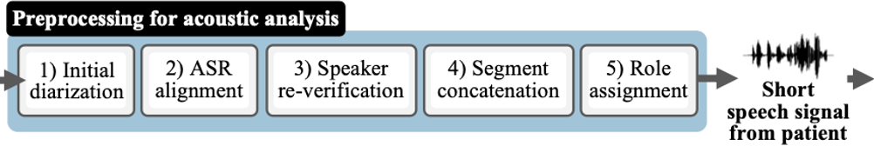
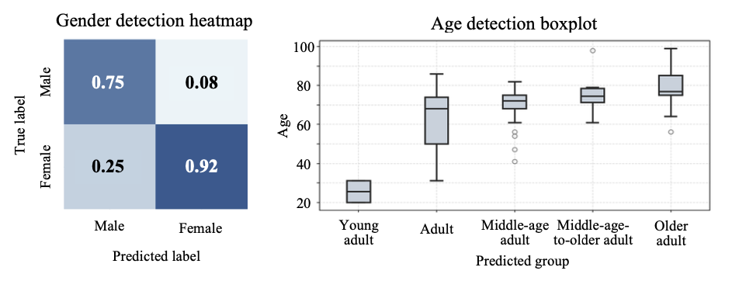
ALM in recognizing people’s voice.
GPT 4.0

Slide 39
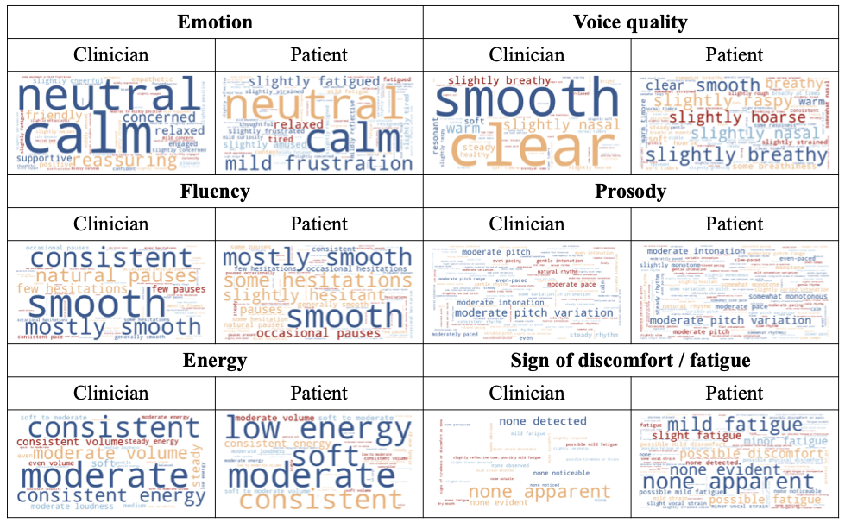
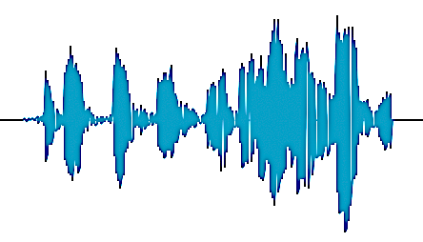


ALM analysis of patient voices across health conditions
Extracted speech signal
Analyze the acoustics of the speech signal.
Do not transcribe or reference the linguistic content.
ALM
Voice biomarkers

Slide 40
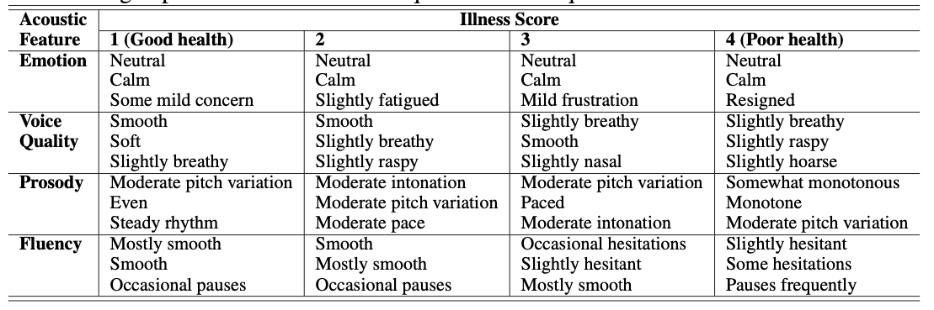
ALM analysis of patient voices across health conditions

Slide 41
Limitation / challenge / research direction
- Environment (e.g., background noise)
→ Affect diarization, transcription, voice assessment
- Limitation of current ALMs
e.g., ALM’s bias toward semantic cues
- Personalization
→ Each individual has a different baseline state

