Slide 1
Decoding Human Emotions: From Psychological Theories to Multimodal NLP Models
Sara (Ziwei) Gong
Oct 21, 2025
Notes:
Hello everyone, my talk today is Decoding Human Emotions: From Psychological Theories to Multimodal NLP Models. My name is Ziwei Gong, and I am a Ph.D. candidate at Columbia, working with Julia. My research focuses on speech and natural language processing, with an emphasis on multimodal emotion recognition, and AI+mental health.

Slide 2
Outline
Emotion detection
  Emotion classifications theories
Multimodal Emotion detection
  Sota
  Fusion methods
Emotion elicitation/generation
Low-resources setting for emotion detection
  New dataset
  Methods
Notes:
This talk is structured as follows. First, I will provide an overview of emotion detection and classification theories, covering foundational psychological frameworks. Next, we will explore multimodal emotion detection. We will also discuss emotion elicitation and generation in NLP models. Following that, I will introduce challenges in low-resource settings for emotion detection and the development of new datasets and methods for addressing these challenges.

Slide 3
A Mapping on Current Classifying Categories of Emotions Used in Multimodal Models for Emotion Recognition
EACL 2024
Ziwei Gong, Muyin Yao, Xinyi Hu, Xiaoning Zhu, Julia Hirschberg
Department of Computer Science
Columbia University
Paper link: https://aclanthology.org/2024.law-1.3/
Notes:
We’ll start with overview of emotion classification theories from psychology and how they’re (and should be) applied in ML

Slide 4
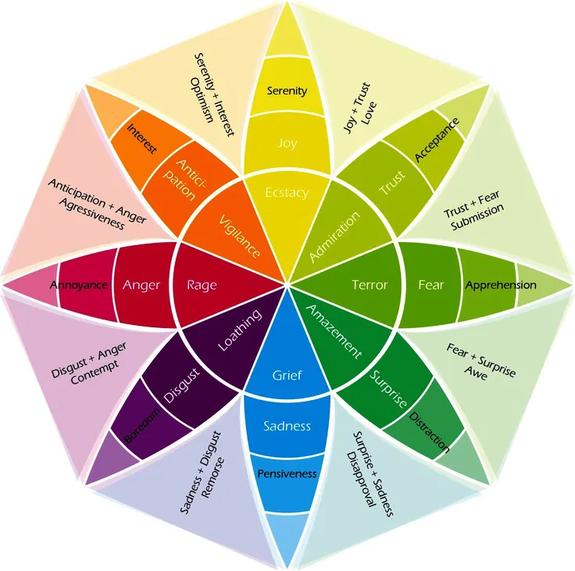
Emotion classification theory:
Plutchik’s wheel of emotions
8 Primary Emotions:
  Joy, sadness, trust, disgust, anticipation, surprise, anger, fear
24 + 8 Fine-grained emotions
  Intensity and Combinations
Theory based on evolution and biological classification
Dimensional Theory
Notes:
Introduce Plutchik’s wheel of emotions, which is often used when people intent to use a more fine-grained emotion categories, and is development based on evolutionary theory and the needs and function of emotions, focusing on why one has one emotion.
Emotion classification is a crucial step in NLP applications that involve affective computing. One widely accepted framework is Plutchik’s Wheel of Emotions, which defines eight primary emotions: (listed here). These primary emotions can be combined to form complex emotional states, leading to 24+8 fine-grained emotions. Additionally, emotions in this framework have varying intensities, making it a dimensional model that allows for a gradient representation of affective states. Plutchik’s model is often used in computational emotion recognition due to its structured approach to modeling emotional intensity and relationships between emotions.

Slide 5
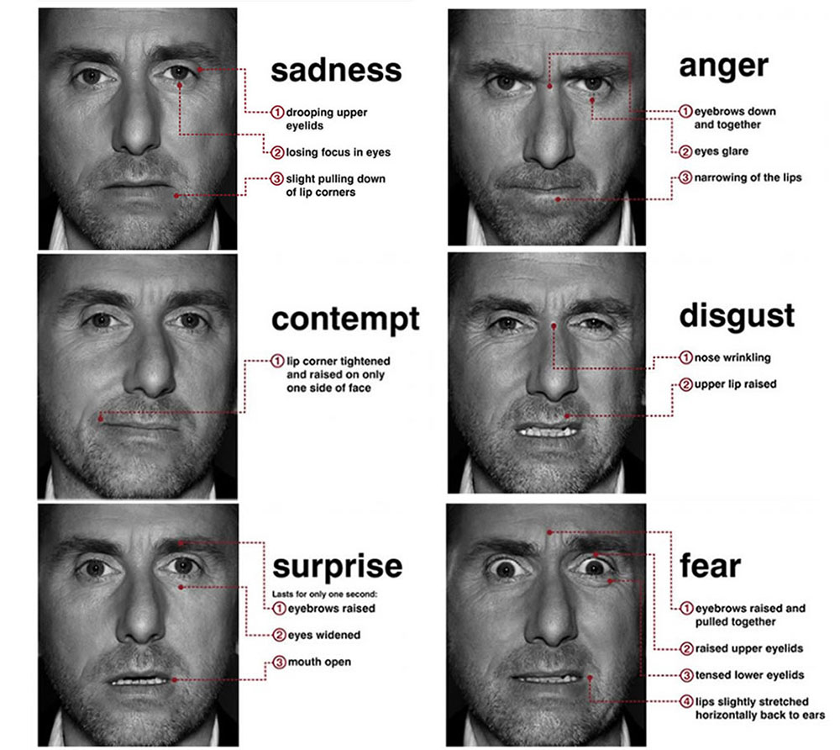
Emotion classification theory:
Ekman’s basic emotions
Proposed 6 basic emotions
  Fear,
  Anger,
  Joy,
  Sadness,
  Disgust, and
  Surprise
Based on universal facial expressions
An earlier version of the theory
Notes:
Introduce Ekman’s 6 basic emotions. -> this is developed based on universal understanding of facial expressions, which make it more like a cv approach.
Another foundational theory in emotion classification is Ekman’s Basic Emotions, which proposes that there are six universal emotions: fear, anger, joy, sadness, disgust, and surprise. This theory is based on facial expressions and has been widely used in computer vision and multimodal emotion recognition. Unlike Plutchik’s model, which incorporates intensity and emotion combinations, Ekman’s theory focuses on discrete emotional states that are assumed to be universal across cultures.

Slide 6
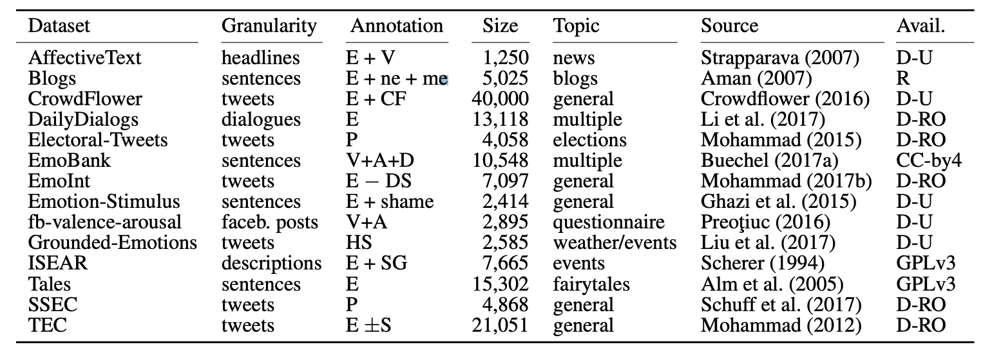
Current Studies
E: Ekman’s
V: Valence
P: Plutchik’s
A: arousal
D: dominance
Table from Bostan and Klinger (2018)’s An analysis of annotated corpora for emotion classification in text.
Notes:
One challenge in emotion recognition research is that different datasets use different emotion taxonomies, making it difficult to train models across multiple datasets. To address this, we worked on mapping emotion categories between datasets based on their valence-arousal properties
Table 1: Selection of resources for emotions analysis. Ann. refers to the following annotation schemata: [E] Ekman: anger, disgust, fear, joy, sadness, surprise, [P] Plutchik: anger, disgust, fear, joy, sadness, surprise, trust, anticipation, [CF] enthusiasm, fun, hate, neutral, love, boredom, relief, empty, [DS] disgust, surprise, [JS] happy, sad, [V] valence, [A] arousal, [D] dominance, [SG] shame, guilt, [±S] positive surprise, negative surprise, [ne] no emotion [me] mixed emotion and Availability refers to the following [D-RO] Available to download, research only, [D-U] Available to download, unknown licensing, [R] Available upon request, [GPLv3] GNU Public License version 3, [CC-by 4] Creative Commons Attribution version 4.0’
Table taken from Bostan and Klinger (2018). A fine summarization of current datasets – which often adapt their own category based on the need of task.

Slide 7
Mapping
Plutchik’s 14 Emotion
Joy
Fear
Disgust
Anger
Sadness
Surprise
Trust
Anticipation
Serenity
Interest
Annoyance
Boredom
Distraction
Neutral
Plutchik’s 8 Primary
Joy
Fear
Disgust
Anger
Sadness
Surprise
Trust
Anticipation
Ekman’s 6
Joy
Fear
Disgust
Anger
Sadness
Surprise
5 Emotions
Happiness
Sadness
Fear
Anger
Neutral
Sentiment
Positive
Negative
Neutral
Notes:
Our mapping!

Slide 8
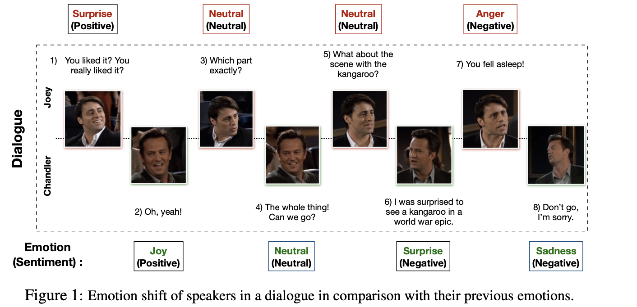
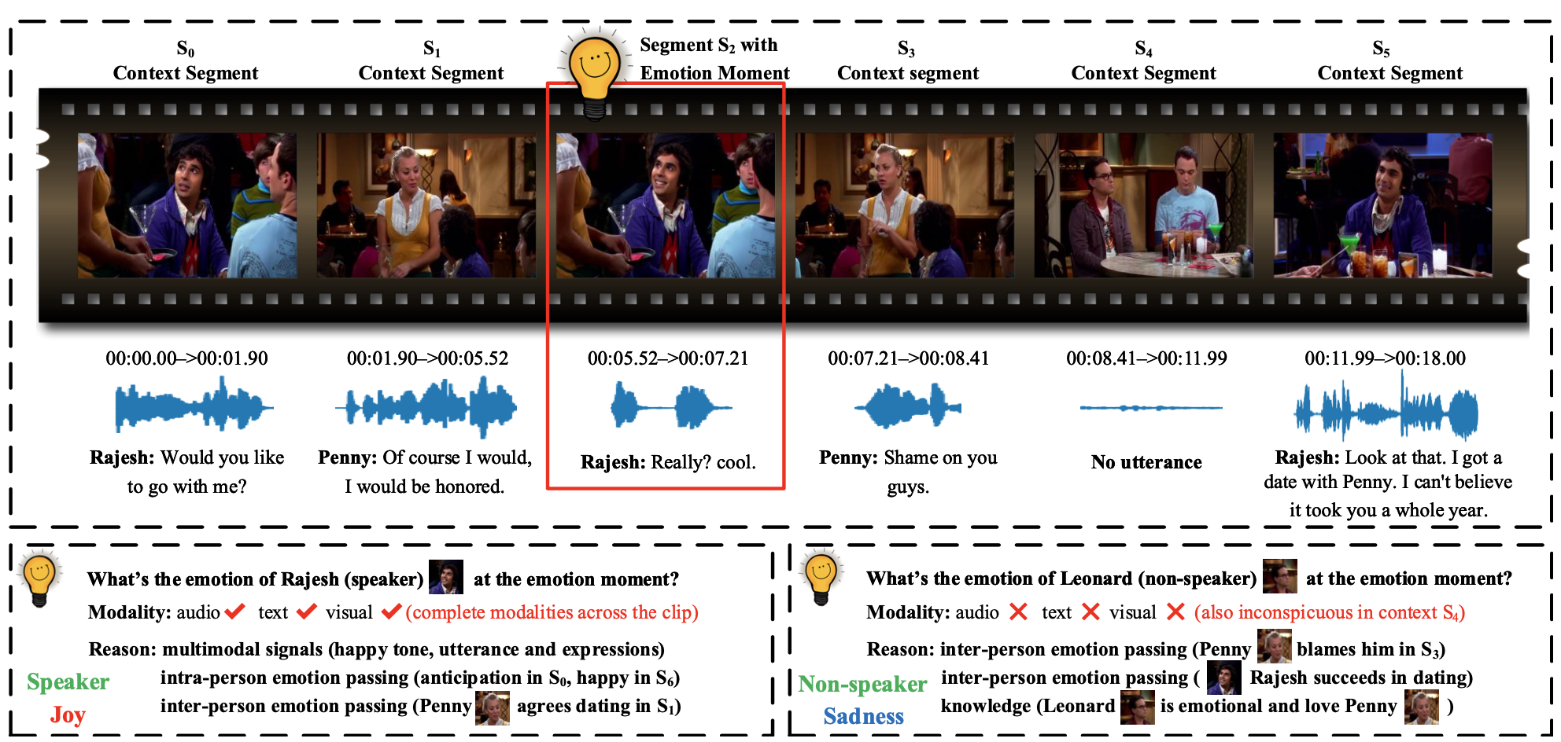
Datasets
Multimodal Conversational Emotion detection dataset (English)
MEmoR:
Plutchik’s wheel of emotions
MELD:
Ekman’s 6 basic emotions
Notes:
For example, in the Multimodal Conversational Emotion Detection Dataset, emotions are labeled using Plutchik’s model, while in MELD, emotions are based on Ekman’s six basic emotions.
Introduce two dataset that we focus on in our study.
In this slide is the MEmoR dataset, which uses 8 and 14 emotions
MELD dataset that uses the Ekman’s 6 emotions: anger, disgust, fear, joy, neutral, sadness, and surprise

Slide 9
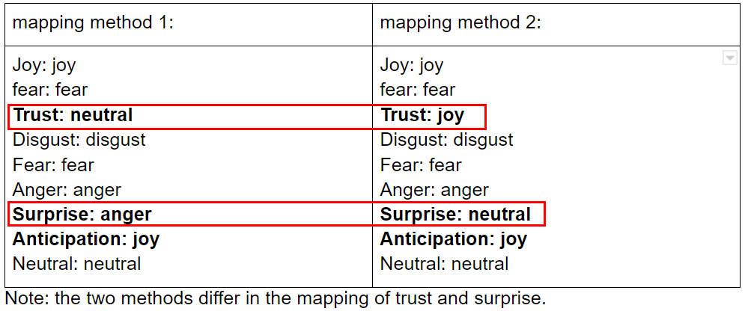
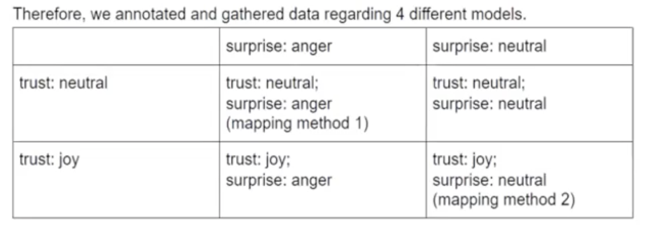
Example:
Mapping on Dataset: 8 to 5
How We Choose the Mapping Method:
  based on valence and arousal of different emotions
How we decides between mapping choices:
  Choose mapping 1
  A re-annotation of mapped emotions
    Annotator 1 -- 0.96
    Annotator 2 -- 0.917
    the inner annotator agreement as 0.318
Conclusion:
  it is possible to map the 8 emotion categories onto 5 emotion categories with relative accuracy
Notes:
The process and relevant numbers. A sample on how we decide between a dilemma.
Data Analysis after mapping
agreement rate (both agreed with 'yes' or 'no') is $\geq 70 \%$ agreement rate (decreased by $10 \%$ from task1)
disagreement rate (one marked "yes" and other marked "no") is : $12 \%$ (is similar across two tasks)
Cohen's Kappa value is $\underline{0.313}$ which falls under the fair range
Conclusion: it is possible to map the 8 emotion categories onto 5 emotion categories with relative accuracy

Slide 10
Mapping on Dataset: 8 to 5
How we decide between mapping choices:
  A re-annotation of mapped emotions
    Annotator 1 -- 0.96
    Annotator 2 -- 0.917
    the inner annotator agreement as 0.318 (Cohen’s K, moderate agreement)
Conclusion:
  it is possible to map the emotion categories with relative accuracy
Notes:
To create a unified framework, we mapped the 8 Plutchik emotions onto 5 categories. This mapping was validated through a re-annotation study, achieving high inter-annotator agreement of 0.96 and 0.917 for two annotators, with a moderate Cohen’s Kappa score of 0.318. This suggests that it is possible to unify different emotion taxonomies with relative accuracy, enabling more flexible and scalable emotion recognition models.”
The process and relevant numbers. A sample on how we decide between a dilemma.
Data Analysis after mapping
agreement rate (both agreed with 'yes' or 'no') is $\geq 70 \%$ agreement rate (decreased by $10 \%$ from task1)
disagreement rate (one marked "yes" and other marked "no") is : $12 \%$ (is similar across two tasks)
Cohen's Kappa value is $\underline{0.313}$ which falls under the fair range
Conclusion: it is possible to map the 8 emotion categories onto 5 emotion categories with relative accuracy

Slide 11
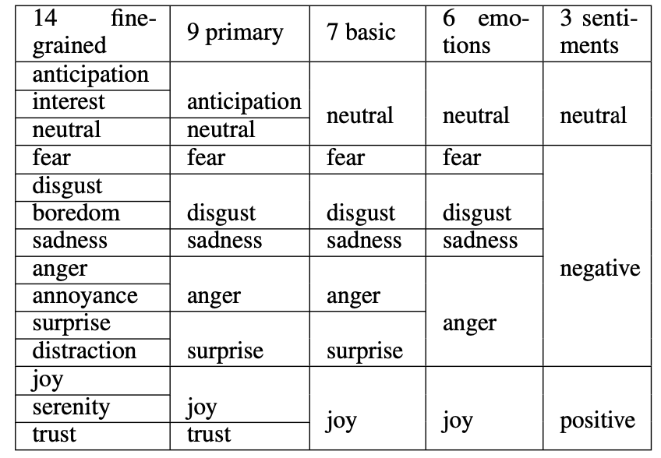
Mapping Method of Classifying Categories
Table 1: Mapping results. This table demonstrates how 14 fine-grained emotions, listed on the leftmost column, are mapped onto 9 primary emotions, Ekman’s basic emotions, 6 emotions, and the 3 sentiments.

Slide 12
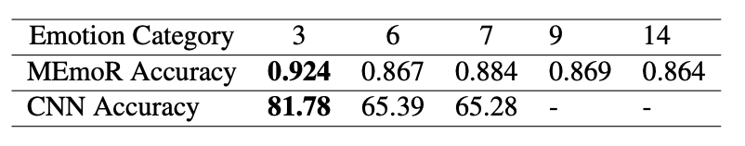
Results of experiments on CNN (vision)
and MEmoR (multimodal) model
Table 2. Experimental results from the MEmoR model and the CNN model. This table shows the overall accuracy of the models trained and tested on datasets reconstructed based on each 3 classification method. The highest achieved is bolded. The MEmoR model uses visual, audio, textual features. In the CNN model, only visual information is used.
Takeaway: models generally perform better when there are fewer emotion categories, meaning that more fine-grained emotions are more difficult for models to differentiate,
Notes:
To test the effectiveness of our mapped emotion categories, we trained two different models:
1. A CNN model using only visual data
2. The MEmoR multimodal model, which integrates visual, audio, and textual features
Our results show that models generally perform better when the number of emotion categories is reduced. This is because fine-grained emotions introduce greater ambiguity, making classification more difficult
From the results of the experiments, we found that models generally perform better when there are fewer emotion categories, meaning that more fine-grained emotions are harder for models to differentiate, regardless of which modality, or which combination of modality is used. This finding validates that our mapping is accuracte, as it is among the general understanding in the machine learning community that using less classification categories, when correctly applied, would leads to higher accuracy since the complexity of the task is reduced.
A possible reason is that classifying emotion into 7 categories is derived from Ekman’s 6 basic emotion theory (Ekman’s 6 + 1 neutral), which is based on facial expression.

Slide 13
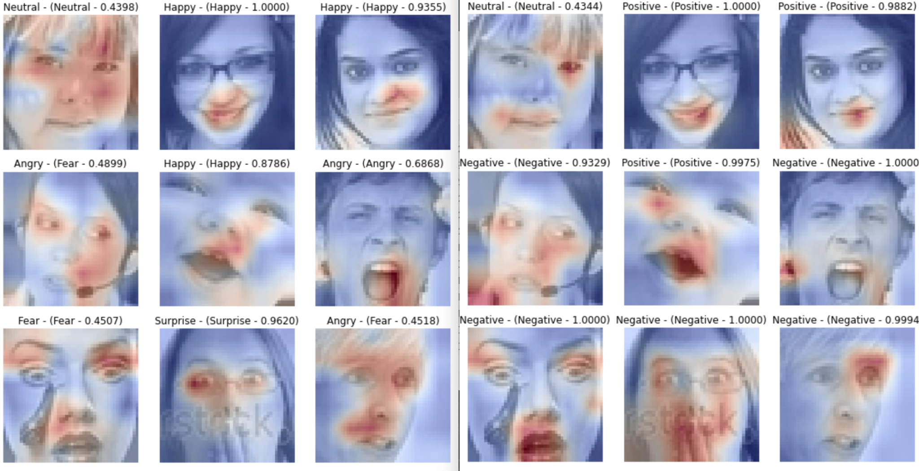
Results: Heat Map on CNN (vision) model
Heat map on model trained on 7 emotions
Heat map on model trained on 3 emotions
Figure 2. Comparison between prediction heat map on 9 random pictures, between a CNN model trained on a dataset categorized into 7 categories (left) versus a CNN model trained on the same dataset categorized into 3 categories (right). Red indicates high attention to the area.
Takeaway:We observe that the attention of the model trained with more fine-grained emotions is more spread out through the face, with some stress around the eye and mouth area.
Notes:
Additionally, our heatmap analysis shows that models trained on more fine-grained emotions spread their attention more diffusely across the face, while models trained on coarser emotion categories focus more precisely on key facial regions like the eyes and mouth. This suggests that coarser categories may lead to more interpretable feature extraction in deep learning models.
Figure 2. Comparison between prediction heat map on 9 random pictures, between a CNN model trained on a dataset categorized into 7 categories (left) versus a CNN model trained on the same dataset categorized into 3 categories (right). Red indicates high attention to the area.
The images are randomly selected from the FER2013 dataset, with the MIT License. So itt is okay to include the facial images in publication.
From the heatmap of CNN models (Figure 2), we observed that the attention of the model trained with more fine-grained emotions is more spread out through the face, with some stress around the eye and mouth area. In comparison, the attention of the model trained on three sentiments is more focused on specific areas and created red dots on the heat map. The difference between more overall attention and scattered attention could be caused by the fact that there are more subtle cues to distinguish fine-grained on the face, requiring the model to learn to prediction based on more information from different areas, compare to sentiments that are simpler and distinguishable through some key area like the mouth (smiling or not, for example).

Slide 14
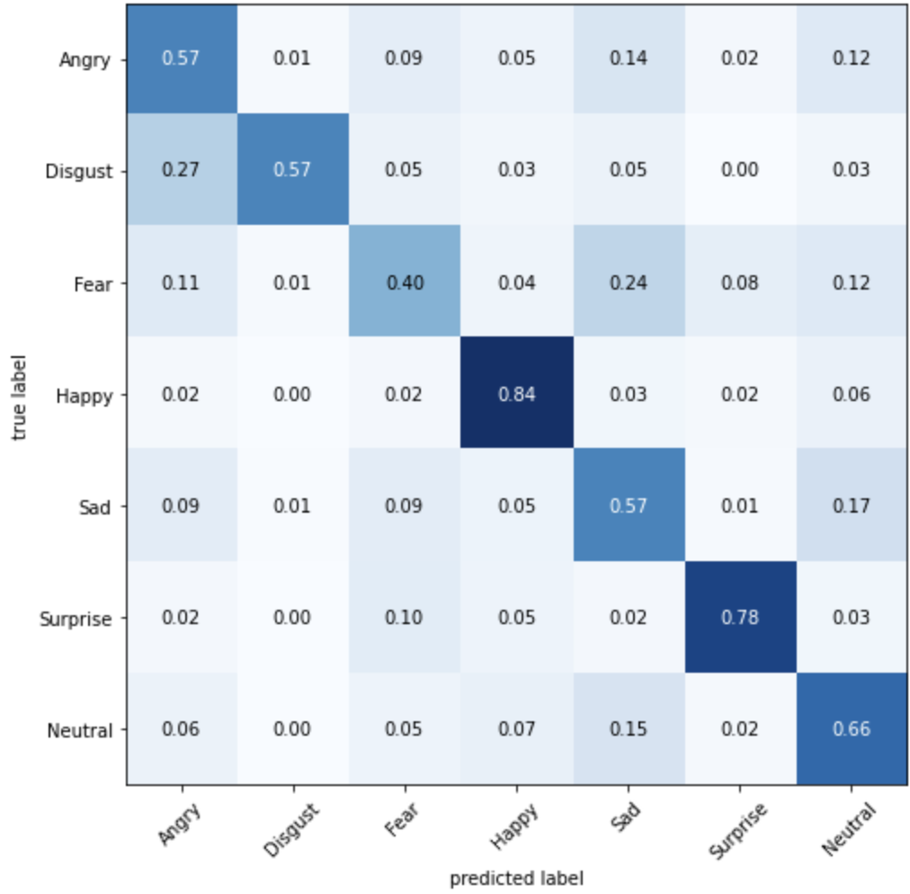
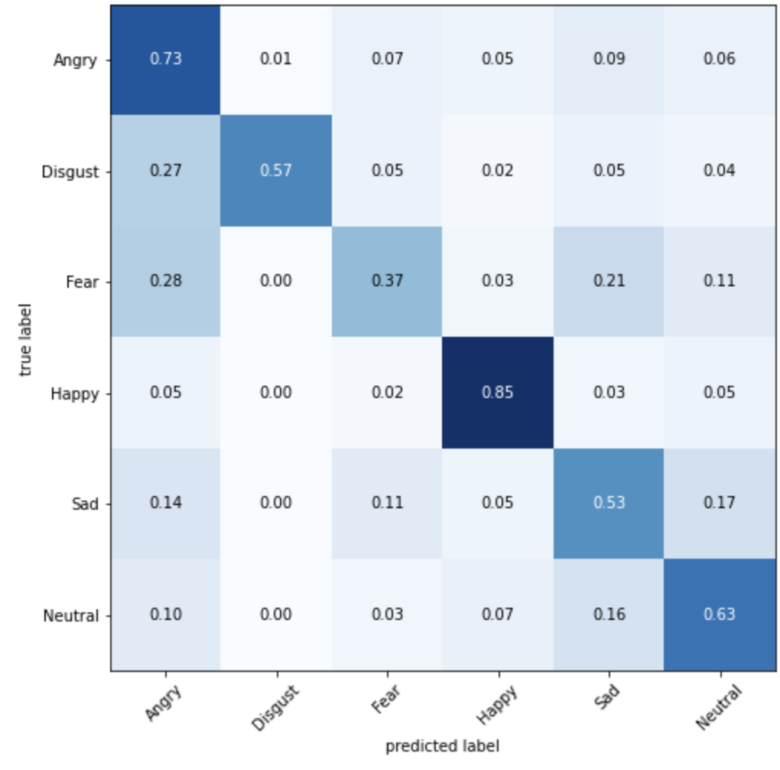
Results: Confusion matrices (CNN)
Confusion matrices on model trained on 7 emotions
Confusion matrices on model trained on 3 emotions
Takeaway: improvement was mainly on the adjusted category
Notes:
Figure 3. Confusion matrices generated by three CNN models trained on a dataset, all learning from the same set of pictures but labels are categorized into 7 categories (left) and 6 categories (right ). Columns represent the predicted label and rows represent the true label.
We reduced the number of example confusion matrix for a more clear presentation while preserving information revealed by the confusion matrix as discussed in 4.2

Slide 15
Conclusion
We propose the first complete mapping that connects different emotion categories for multimodal emotion recognition studies
Using our mapping allows researchers to obtain larger and more flexible datasets for training and to analyze models
Observation: Models generally perform better when there are fewer emotion categories, meaning that more fine-grained emotions are more difficult for models to differentiate.
Observation: We observe that the attention of the model trained with more fine-grained emotions is more spread out through the face, compared to only focusing around the eye and mouth area.
Notes:
In summary, our work presents the first complete mapping of emotion taxonomies for multimodal emotion recognition. This mapping enables researchers to:
1. Unify multiple emotion datasets, creating larger and more flexible training corpora.
2. Improve model generalization, as evidenced by better performance in models trained on fewer categories.
3. Enhance interpretability, with coarser emotion labels leading to more focused model attention.

Slide 16
Multimodal Multi-loss Fusion Network
for Sentiment Analysis
NAACL 2024
Zehui Wu∗, Ziwei Gong∗, Jaywon Koo, Julia Hirschberg
Department of Computer Science
Columbia University
Paper link: https://aclanthology.org/2024.naacl-long.197/
Notes:
Multimodal Multi-loss Fusion Network for Sentiment Analysis.

Slide 17
Outline
Motivation
Model Structure Overview
Datasets
Experiments
  Text/Audio Features Comparison
  Model structure performance
  Multi-loss training
  Context Modeling
Comparison with SOTA
Notes:
Here is the outline: I will start with our motivation, and give an overview of the model structure, and then the datasets we used in our experiments.
Next, I will talk about the experiments we performed, in which we gain lots of useful insights. First, the feature selection process for both text and audio. Then the model structure performance results. At last, I will introduce the two techniques, multi-loss training and context modeling, that we used to improve our model.
At the very end, I will compare our performance with the recent works on these datasets, and show that we achieved SOTA performance.

Slide 18
Motivation
Task: Multimodal sentiment analysis
Goal: An optimized feature selection and fusion approach for enhancing sentiment detection in neural networks
Achievements:
Investigates the optimal selection and fusion of feature encoders across multiple modalities
Examine the impact of multi-loss training within the multi-modality fusion network, identifying surprisingly important findings relating to subnet performance.
We have also found that integrating context significantly enhances model performance.
Our best model achieves state-of-the-art performance for three sentiment datasets.
Notes:
Let me first mention our motivation.
Task: Multimodal sentiment analysis
Sentiment analysis is one of the classification tasks that can really take advantage of signals other than text. The same sentence can be expressed very differently in emotion by using different pitch and intensity.
Goal: An optimized feature selection and fusion approach for enhancing sentiment detection in neural networks, so that the model can pick up signals other text

Slide 19
y_{f}
Model structure
Fully-connected layer
f_{f}
Concatenation
Feature Network (red portion)
Pre-trained model for each modality
Text: RoBerta
Audio: pre-trained ASR model
Fusion Network (yellow portion)
For each modality:
One Cross-attention encoder
One Self-attention encoder
Three fully connected layers
f_{t} ^{N}
f_{a}^{N}
Pointwise feed-forward network
Self-attention encoder
Self-attention encoder
Fusion network
Cross-attention encoder
Cross-attention encoder
q_{t}
k_{a}
v_{a}
v_{t}
k_{t}
q_{a}
f_{t}
f_{a}
y_{t}
Text feature network
Audio feature network
y_{a}
Fully-connected layer
Fully-connected layer
Text
Audio
Notes:
Let’s begin with the Model structure overview, and I will talk about the motivations in the next few slides.
On the right, we have a graph of the whole model structure. It is splitted into two main portions: feature network and fusion network.
For the feature network, we use pre-trained models for each modality. We use RoBERTa for the text feature network, and we use different pre-trained ASR models based on languages.
For the fusion network, which is the yellow portion, for each modality, we have one cross-attention encoder, one self-attention encoder and three fully connected layers.
The cross-attention encoder mixes the modalities by projecting features from one modality into the space of another modality. And then the self-attention encoder and the fully connected layers serve to refine these representations.
At last, we concatenate the final representation from each modality.

Slide 20
Sentiment Datasets
CMU-MOSI, CMU-MOSEI (English):
Modality: audio, text, and video
Size: 2199/23453 annotated video segments
videos collected from YouTube
CH-SIMS (Mandarin)
Modality: audio, text, and video
Size: 2281 annotated video segments
TV shows and movies
multiple labels for the same utterance based on different modalities
Notes:
We used three sentiment datasets of two languages in our experiments.
The first two datasets, CMU-MOSI and CMU-MOSEI, are English datasets with three modalities: audio, text and video.They collected videos from YouTube.
The last dataset is Mandarin, also with all three modalities. It is collected from TV shows and movies. The one unique feature of this dataset is that they have multiple annotations for the same utterance based on different modalities, so they have one annotation for text, one for audio, one for video, and one for the combined modality.
These datasets provide a broad and multicultural perspective on sentiment detection, allowing for a thorough evaluation of our model.

Slide 21
Text features: Using fine-tuned RoBerta
CMU-MOSI (English):
CH-SIMS (Mandarin):
 | RoBerta(EN)
Class-2 ACC | 0.8455
 | Translation + RoBerta(EN) | RoBerta(CH)
Class-2 ACC | 0.7806 | 0.7921
(Class-2 ACC: positive vs negative valence accuracy)
Takeaway:
Model performs well on both datasets.
Directly using a Chinese pre-trained model is better than using a translated Chinese to English model.
Notes:
For the text feature, we use a fine-tuned RoBERTa.
We can see that it achieves decent performance for both datasets.
For CMU-MOSI, we can get 84 percent accuracy by only using text.
For the CH-SIMS dataset, we have two approaches: the first is using translation and then applying an English RoBERTa; the second is directly using a chinese RoBERTa.
The second approach is better in our case.

Slide 22
Audio features: 3 Different Features
CMU-MOSI (English):
CH-SIMS (Mandarin):
Feature name | Class-2 ACC
openSMILE | 0.4606
Mel Spectrogram | 0.4519
Fine-tuned Data2vec(EN) | 0.7099
We use three types of audio features:
openSMILE: low level descriptors extracted from raw audio signals
Mel Spectrogram
Large Pre-trained speech models
Feature name | Class-2 ACC
openSMILE | 0.6696
Mel Spectrogram | 0.6805
Fine-tuned HuBert(CH) | 0.7465
Takeaway:
Pre-trained models work the best for both datasets
Notes:
We experimented with 3 different audio features.
OpenSMILE features are low level descriptors extracted from raw audio signals.
Mel Spectrogram is the image representation of the audio.
We also experimented with extracting features from large pre-trained ASR models.
On the left, we can see results from both the English and Mandarin datasets. Pre-trained models work the significantly better for both datasets

Slide 23
y_{f}
Model structure
Fully-connected layer
f_{f}
Concatenation
f_{t} ^{N}
f_{a}^{N}
Two variations:
Concatenation
Add transformer fusion network before concatenation
Pointwise feed-forward network
Self-attention encoder
Self-attention encoder
Fusion network
Cross-attention encoder
Cross-attention encoder
q_{t}
k_{a}
v_{a}
v_{t}
k_{t}
q_{a}
f_{t}
f_{a}
y_{t}
Text feature network
Audio feature network
y_{a}
Fully-connected layer
Fully-connected layer
Text
Audio
Notes:
Our motivation is that we want to find an effective approach to construct models with multiple modalities. We have seen in other papers that cross-attention can be an effective fusion approach.
So we want to see if that’s case for combining pre-trained models from different modalities.
We have two model variations.
Concatenation is without the fusion network, the yellow portion.
The second variation is the model with fusion network before concatenation.

Slide 24
Model Structure Performance Comparison
MOSI | Has0_acc_2 | Has0_F1 | Non0_acc_2 | Non0_F1 | acc_5 | acc_7 | MAE | Corr
text-only | 84.79 | 84.72 | 87.29 | 87.29 | 56.41 | 48.68 | 64.96 | 83.61
concat | 85.77 | 85.74 | 87.6 | 87.62 | 56.51 | 48.79 | 64.27 | 84.06
fusion | 85.91 | 85.85 | 88.16 | 88.15 | 56.08 | 48.25 | 64.29 | 83.8
MOSEI | Has0_acc_2 | Has0_F1 | Non0_acc_2 | Non0_F1 | acc_5 | acc_7 | MAE | Corr
text-only | 84.81 | 84.95 | 86.34 | 86.19 | 54.99 | 52.7 | 53.31 | 78.6
concat | 84.77 | 84.9 | 86.82 | 86.65 | 55.99 | 53.94 | 51.63 | 79.81
fusion | 85.61 | 85.67 | 87.01 | 86.81 | 56.85 | 53.69 | 52.19 | 79.94
CH-SIMS | ACC_2 | ACC_3 | ACC_5 | F1 | MAE | CORR
text-only | 79.21 | 65.06 | 42.02 | 79.14 | 42.65 | 59.4
concat | 81.91 | 70.68 | 47.12 | 82.1 | 34.96 | 72.37
fusion | 82.93 | 69.37 | 49.38 | 82.9 | 33.2 | 73.26
Takeaway:
Adding audio feature is always better
Transformer fusion works slightly better than concatenation overall.
Notes:
Here we have three tables for each of the dataset. The top two tables are for the English dataset, and bottom table is for the mandarin dataset.
For the evaluation metrics, we use accuracies of different levels, mean absolute error and correlation.
The first row corresponds to only fine-tuning RoBERTa models with the text inputs.
The second row, concatenation, corresponds to the model without fusion network.
And the last row corresponds to the whole model with fusion network.
The first observation we can have is adding audio feature always boosts performance.
And we can also observe that incorporating fusion network works better than just concatenation overall.

Slide 25
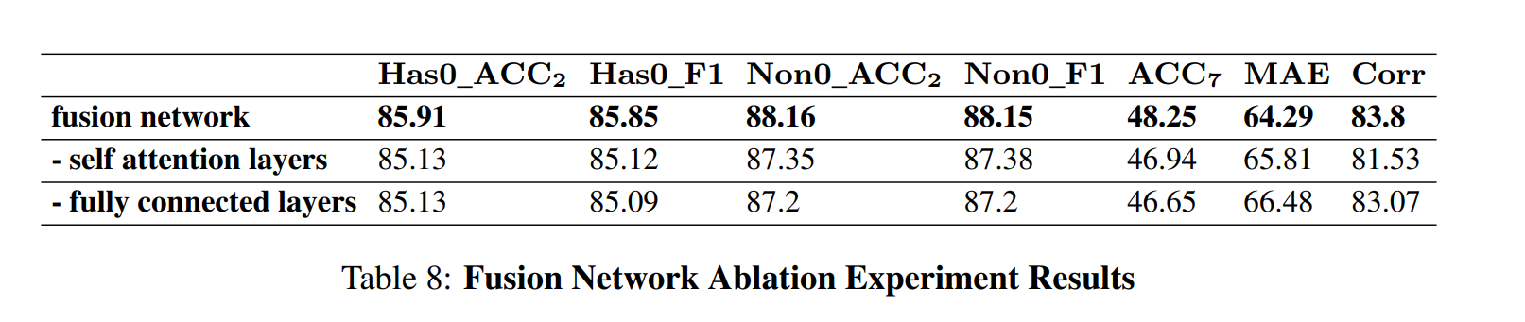
Fusion Network Ablation
Takeaway:
Self-attention layers and fully connected layers are important in the Fusion Network
Notes:
Here is an ablation experiment of the fusion network.
After we took out the self-attention layers, the performance of fusion network dropped for all metrics.
And after we further took out the fully connected layers, the performance dropped again.
In conclusion, Self-attention layers and fully connected layers are important components in the Fusion Network, and they serve to refine the representations from different modalities.

Slide 26
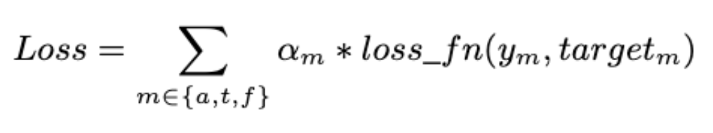
Multi-loss Training
Single loss: loss from the fusion network
vs.
Three losses: loss from the fusion network
and two subnetworks
y_{m}
y_{t}
Fully-connected layer
y_{a}
f_{f}
(weighted sum of each loss)
Fusion Network
Fully-connected layer
Fully-connected layer
Note:
The Mandarin dataset (CH-sims) offers distinct labels for different modalities, so each loss can have different targets.
The other two English datasets (CMU-MOSI, CMU-MOSEI) have only one label, so each loss has to use the same target.
f_{t}
f_{a}
Text Model
Audio Model
r_{t}
r_{a}
Text
Audio
Notes:
In our training, we use a multi-loss objective to improve our performance. Here, we want to compare the performance between using a single loss and multiple losses.
The single loss is the loss from the fusion network, and in that case, the model only has one output.
The three losses are the loss from the fusion network and the two losses from the two sub-networks. The multi-loss model has three outputs, and that’s why we can have three losses. The final loss is the weighted sum of each loss.
There are two things to note here:
First, The Mandarin dataset (CH-sims) offers distinct labels for different modalities, so each loss can have different targets.
However, The other two English datasets (CMU-MOSI, CMU-MOSEI) have only one label, so each loss has to use the same target. We duplicate the same annotation to each loss.

Slide 27
Multi-loss Training Results
MOSEI | Has0_acc_2 | Has0_F1 | Non0_acc_2 | Non0_F1 | acc_5 | acc_7 | MAE | Corr
single-loss | 85.22 | 85.39 | 87.02 | 86.91 | 55.95 | 53.85 | 51.96 | 79.68
multi-loss | 84.77 | 84.9 | 86.82 | 86.65 | 55.99 | 53.94 | 51.63 | 79.81
Takeaway:
If we use the same target for the different losses, it does not improve the model performance.
CH-SIMS | ACC_2 | ACC_3 | ACC_5 | F1 | MAE | CORR
Single-loss | 78.34 | 67.18 | 46.83 | 78.59 | 39.09 | 62.69
multi-loss | 81.91 | 70.68 | 47.12 | 82.1 | 34.96 | 72.37
Takeaway:
But If we have different labels for each modality, we can have a significant improvement in all metrics
Notes:
Here are the results comparing single-loss and multi-loss model, for the English and Mandarin dataset respectively.
On the top, we have the results for the English dataset. This is the dataset with only one label per utterance.
We can observe that, If we use the same target for the different losses, it does not improve the model performance.
On the other hand, for the mandarin dataset which we have distinct labels for each loss, we have a very significant improvement in all metrics by using multi-loss training.

Slide 28
Multi-loss Training for text subnets
Is there a difference in the text subnetwork performance
between using only text signal and using both signals?
The gradient from audio signals can backpropagate to the text model from the fusion network
y_{t}
y_{m}
Fully-connected layer
y_{t}
Fully-connected layer
y_{a}
f_{f}
f_{t}
Fusion Network
Fully-connected layer
Fully-connected layer
vs
Text Model
f_{t}
f_{a}
Text Model
Audio Model
r_{t}
Text
r_{t}
r_{a}
Text
Audio
Notes:
Then we want to ask this question: Is there a difference in the text subnetwork performance between using only text signal and using both signals?
On the left, we have the model using only text signals in training, which is the same as only fine-tuning the RoBERTa model.
On the right, we use the whole model in training and use multiple losses, even though we only want to use the output from the text model in inference.
Here, the gradient from audio signals can backpropagate to the text model from the fusion network

Slide 29
Multi-loss Training Text-Subnet Results
MOSI | Has0_acc_2 | Has0_F1 | Non0_acc_2 | Non0_F1 | acc_5 | acc_7 | MAE | Corr
text-loss | 84.79 | 84.72 | 87.29 | 87.29 | 56.41 | 48.68 | 64.96 | 83.61
multi-loss | 85.62 | 85.56 | 87.91 | 87.9 | 55.01 | 47.42 | 64.76 | 83.79
MOSEI | Has0_acc_2 | Has0_F1 | Non0_acc_2 | Non0_F1 | acc_5 | acc_7 | MAE | Corr
text-loss | 84.81 | 84.95 | 86.34 | 86.19 | 54.99 | 52.97 | 53.31 | 78.6
multi-loss | 84.77 | 84.9 | 86.82 | 86.65 | 55.99 | 53.94 | 51.63 | 79.81
Takeaway:
Using multi-loss training can have a small positive impact on most metrics for the text subnet, even when we use the same target.
CH-SIMS | ACC_2 | ACC_3 | ACC_5 | F1 | MAE | CORR
text-loss | 79.21 | 65.06 | 42.02 | 79.14 | 42.65 | 59.4
multi-loss | 83.15 | 72.14 | 48.21 | 83.74 | 28.58 | 78.72
Takeaway:
If we have labels for other modalities, it can produce a significant improvement.
However, such effect is not seen for the audio subnet.
Notes:
Here we have the multi-loss training results from all three datasets.
Again, the top two tables are the results from the English datasets. For them, we use the same label in multi-loss training for each utterance.
Despite the labels for other modalities are not available, using audio signals and multi-loss training have a small positive impact on most metrics for the text subnet.
If we have labels for other modalities, like in the case of the mandarin dataset, it can produce a significant improvement.
However, such effect is not seen for the audio subnet. The intuition is that the text signal is way stronger than the audio signal, so the training will prioritize the text portion.

Slide 30
Benefit Of Using Multi-loss Training
The multi-output model can also work with a single modality
(no need for extra models)
When having distinct labels for different modalities, we can significantly improve the overall performance
We can also help improve the performance of individual subnetworks by using signals from other modalities
Notes:
In conclusion for the mult-loss training, the benefits of using Multi-loss Training are three-fold.
First, The multi-output model can also work with a single modality (so there is no need for extra text or audio models)
Secondly, When having distinct labels for different modalities, we can significantly improve the overall performance
Last but not least, we can also help improve the performance of individual subnetworks by using signals from other modalities, even though we might only want to use the text inputs. We can extract out text portion after training.

Slide 31
Context Modeling
Integration of contextual data (previous utterances) into existing model frameworks
Comparing two context modeling methods:
the concatenation of context (previous utterances) and the current utterance as a singular input stream to the model
independent processing of context (previous utterances) and the current utterance, followed by a subsequent fusion of their respective representational outputs
Feature representation
Feature representation
Feature representation
Transformer-based Model
Transformer-based Model
Transformer-based Model
context
SEP
current
context
current
1. concatenation
2. Separation
Notes:
At last, we experiment with context modeling, which is the Integration of contextual data (previous utterances) into existing model frameworks, since past literatures point out that context is beneficial for emotion modeling.
We are comparing two modeling approaches:
the concatenation of context (previous utterances) and the current utterance as a singular input stream to the model
independent processing of context (previous utterances) and the current utterance, followed by a subsequent fusion of their respective representational outputs

Slide 32
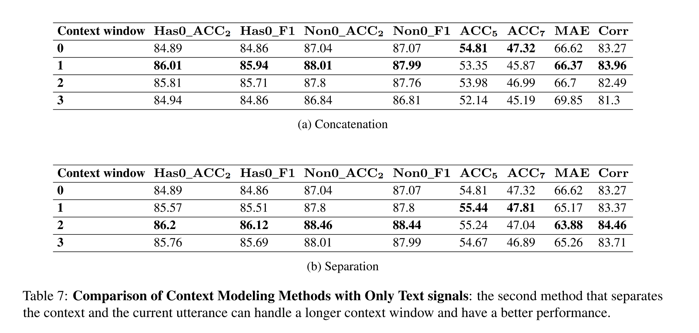
Context Modeling: Concatenation vs. Separation
(on CMU-MOSI text data)
Context window:
the number of preceding utterances considered as contextual input
Takeaways:
Incorporating context improves performance
The Separation method can handle a longer context length, and has a better performance
Notes:
Here we have the results comparing these two methods. The top table is the results for concatenation and the bottom table is the results for the separation method.
Context window means the number of preceding utterances considered as contextual input. 0 means no context is used, 1 means we used 1 utterance as context.
There are two observations.
First, Incorporating context improves performance for both methods.
Second, The Separation method can handle a longer context length, because it reaches the best on the context window of 2 instead of 1, and has a better performance on all metrics.

Slide 33
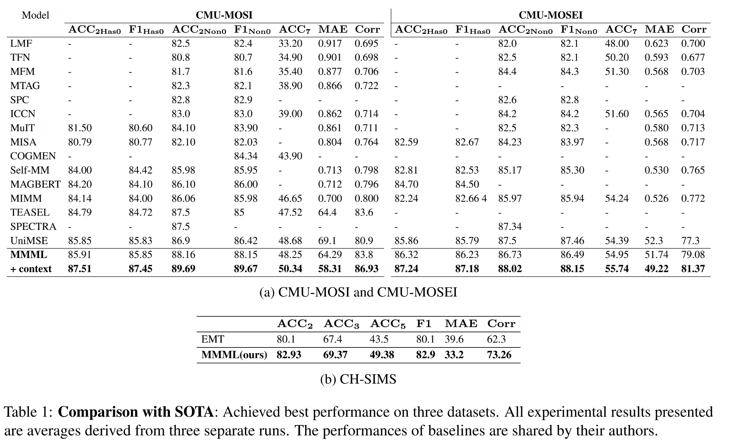
Comparison with SOTA
Notes:
Here is the table comparing our work with the other recent works on these datasets. We achieved SOTA performance with or without context.
The model with context significantly improves the performance and exceed the others by a large margin.

Slide 34
Summarization
The use of pre-trained models for raw audio yielded superior results
Combining audio and text signals consistently outperformed using text signals alone, with the transformer fusion network showing promise in enhancing cross-modality modeling.
Multi-loss training proved beneficial for overall performance and subnet performance, particularly when using unique labels for each modality.
Our contextual model markedly outperformed our best non-contextual model across all evaluative metrics
We have achieved state-of-the-art results on three sentiment detection datasets
Notes:
In summary, there are five achievements or findings in our paper.
The use of pre-trained models for raw audio yielded superior results
Combining audio and text signals consistently outperformed using text signals alone, with the transformer fusion network showing promise in enhancing cross-modality modeling.
Multi-loss training proved beneficial for overall performance and subnet performance, particularly when using unique labels for each modality.
Our contextual model markedly outperformed our best non-contextual model across all evaluative metrics
We have achieved state-of-the-art results on three sentiment detection datasets
(21 minutes)

Slide 35
Beyond Silent Letters: Amplifying LLMs in Emotion Recognition with Vocal Nuances
NAACL 2025
Zehui Wu, Ziwei Gong, Lin Ai, Pengyuan Shi, Kaan Donbekci, Julia Hirschberg
Paper Link: https://arxiv.org/abs/2407.21315
Notes:
So after introducing methods in multimodal emotion detection under transformer model, we look into how to include speech effectively to LLM

Slide 36


Approach: SpeechCueLLM
SpeechCueLLM
Instruction
Now you are an expert of sentiment and emotional analysis. The following conversation involves several speakers.
SpeechCueLLM integrates descriptions of speech characteristics in natural language into the prompt for LLMs.
By translating audio signals into natural language descriptions, SpeechCueLLM enables LLMs to perform more accurate and nuanced multimodal emotion recognition.
Context
Speaker_0: "Um- I think I have some friends."
Speaker_1: "That would be perfect." (high pitch with medium variation)
Speaker_0: "There's actually, a friend of mine is um- moving out of her place and her place is amazing." (low pitch with low variation)
Speaker_1: "Really?" (medium pitch with medium variation)
Speaker_0: "yeah"
Speech Descriptions
Target speech characteristics:
low volume with low variation,
very low pitch with very low variation,
very low speaking rate.
Question
Please select the emotional label of < Speaker_0: "yeah"> from <happy, sad, neutral, angry, excited, frustrated> based on both the context and audio features. Respond with one label only:
Output
Output
"Excited"
"Neutral"
Notes:
Let’s start with a quick overview of SpeechCueLLM and why understanding speech signals is so important in emotion recognition.
First, when we listen to speech, certain cues—like tone, pitch, and rhythm—provide valuable emotional context that text alone often misses. This insight is the foundation of SpeechCueLLM, our framework designed to help LLMs interpret emotions more effectively by integrating these speech characteristics.
How does it work? SpeechCueLLM translates audio signals into natural language descriptions, which are then fed into the prompt for LLMs. By doing so, it bridges the gap between raw audio features and LLM processing, enabling more accurate and nuanced multimodal emotion recognition.
This approach not only brings out richer emotional insights but also helps align LLM performance closer to human understanding in spoken contexts.

Slide 37
Related Work: LLMs for Emotion Recognition
In our work, we build upon the InstructERC framework (Lei et al., 2024), which reformulates emotion recognition as a generative task using LLMs.
Recent extensions have incorporated additional contextual information into the prompt:
BiosERC (Xue et al., 2024): biographical data
CKERC (Fu, 2024): commonsense knowledge
DialogueLLM (Zhang et al., 2024b): visual descriptions
Our approach distinguishes itself by focusing on integrating speech characteristics into the templates as natural language descriptions, bridging the gap between audio and text modalities in LLM-based emotion recognition systems.
Notes:
Some existing work uses language models for emotion recognition, building on prior research. These methods often extend beyond text to incorporate additional biographical data, common sense knowledge, visual descriptions, and audio cues. Many of these approaches involve extra parameters and sometimes additional training steps to align audio with text.

Slide 38
Related Work: Speech Incorporation in LLMs
Recent works have explored integrating speech features into LLM-based systems for various downstream tasks. Some examples include:
SECap (Xu et al., 2023) uses LLaMA as a text decoder to generate speech emotion captions, relying on an additional audio encoder and bridging network.
Similarly, (Zhang et al., 2024a) incorporates acoustic landmark tokens for depression detection and requires extra parameters and pre-training.
SpeechCueLLM differs from these approaches by processing audio-derived information without requiring architectural modifications. This method is highly compatible with existing LLM infrastructures, facilitating easy implementation and integration into current systems.
We select some of these approaches as baselines for our method.
Notes:
Our approach, however, differs as it integrates information without requiring architectural modifications.

Slide 39
Methodology: Speech Features
Five intuitive speech features:
  Volume: average intensity, intensity variation
  Pitch: average pitch, pitch variation
  Speed: articulation rate
We can extract these features easily
Human and LLM can understand them easily
Each feature is standardized by gender or speaker
Notes:
Our methods selectively process speech features, such as volume, intensity, pitch variation, articulation rate, and speaker clarity. We chose these features because they’re quickly extractable, easily interpretable, and intuitively understood by humans.
Question: why these features?
- I have tested a few other features and did not find them to be particularly useful, but I do need to add a more extensive feature selection experiment for the rebuttal, since having informative audio features is the foundation of our approach.

Slide 40
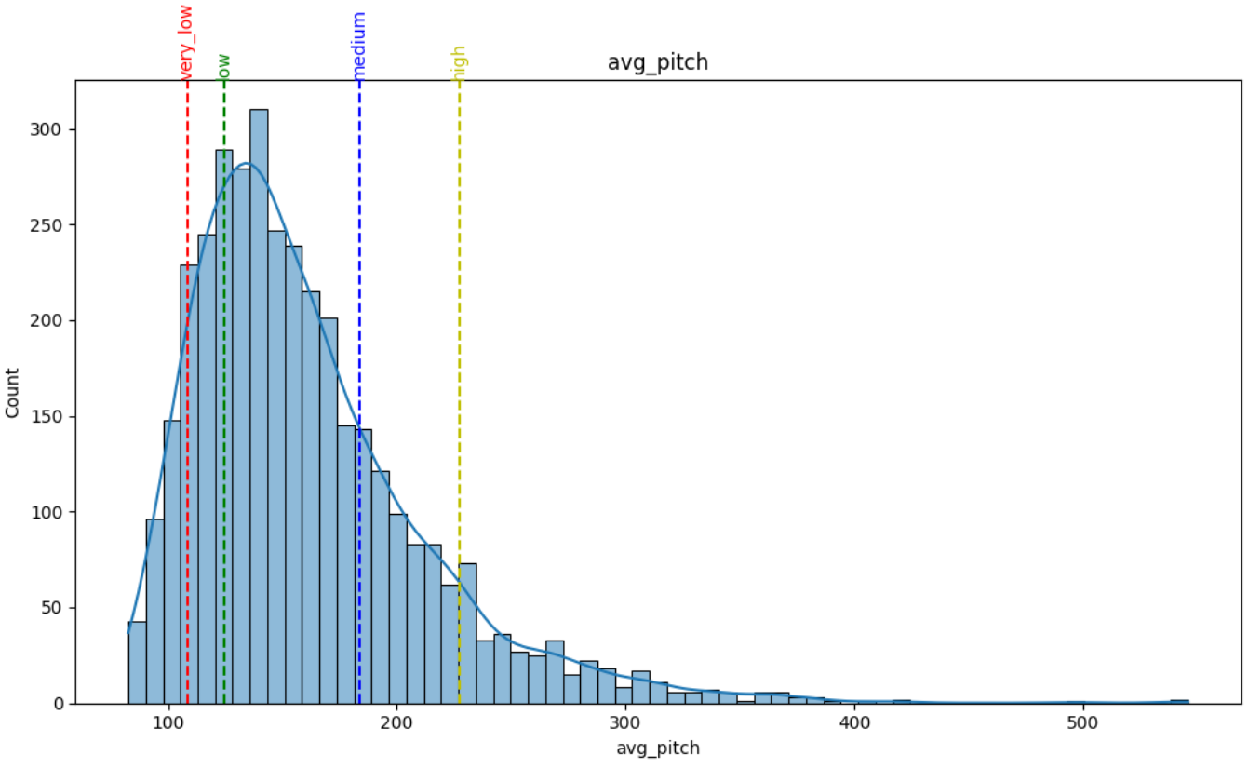
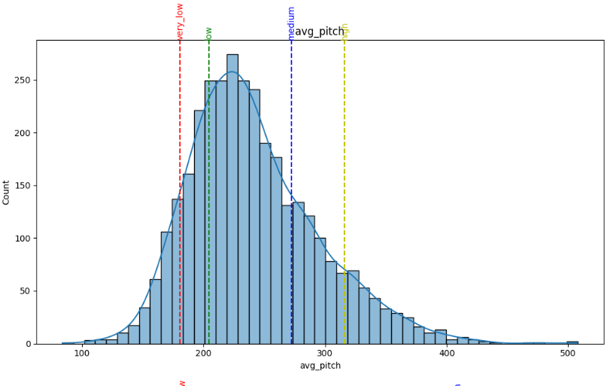
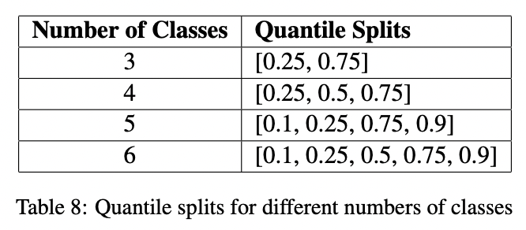
Methodology: Audio Feature Processing
Male
Female
Processing Step:
Speaker-Specific Threshold Calculation : Depending on the desired granularity, the feature space is divided into 3, 4, 5, or 6 classes, with thresholds determined by appropriate quantiles.
Categorization: Based on the calculated thresholds, each numerical feature is categorized. For example, in a 5-class system, a feature value may be classified as "very low," "low," "medium," "high," or "very high."
Feature-Specific Descriptions: For each key audio feature, we generate descriptive phrases corresponding to their categorical values. For instance, "high volume with moderate variation" or "low pitch with high variation" offers a more accessible and interpretable description of the audio features.
Notes:
Methodology: Audio Feature Processing
Processing Step:
Speaker-Specific Threshold Calculation : Depending on the desired granularity, the feature space is divided into 3, 4, 5, or 6 classes, with thresholds determined by appropriate quantiles.
Categorization: Based on the calculated thresholds, each numerical feature is categorized. For example, in a 5-class system, a feature value may be classified as "very low," "low," "medium," "high," or "very high."
Feature-Specific Descriptions: For each key audio feature, we generate descriptive phrases corresponding to their categorical values. For instance, "high volume with moderate variation" or "low pitch with high variation" offers a more accessible and interpretable description of the audio features.

Slide 41
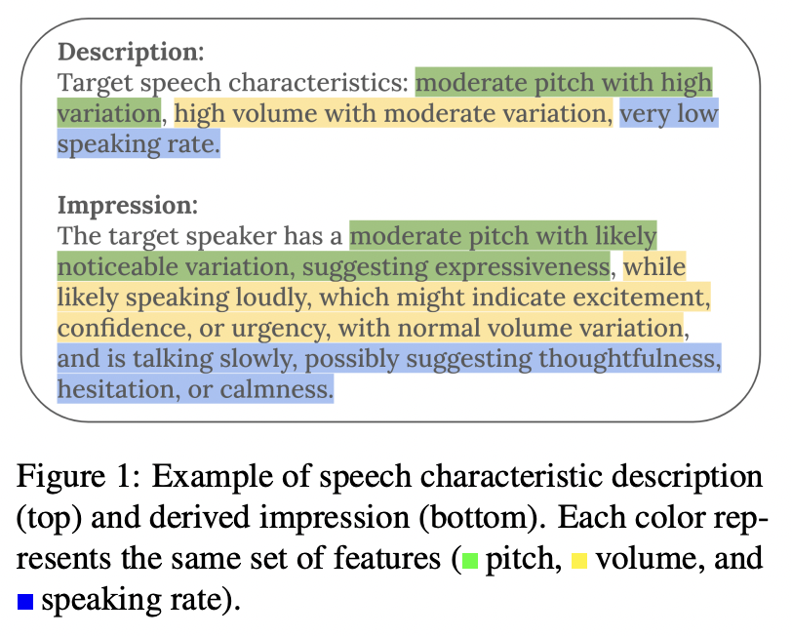
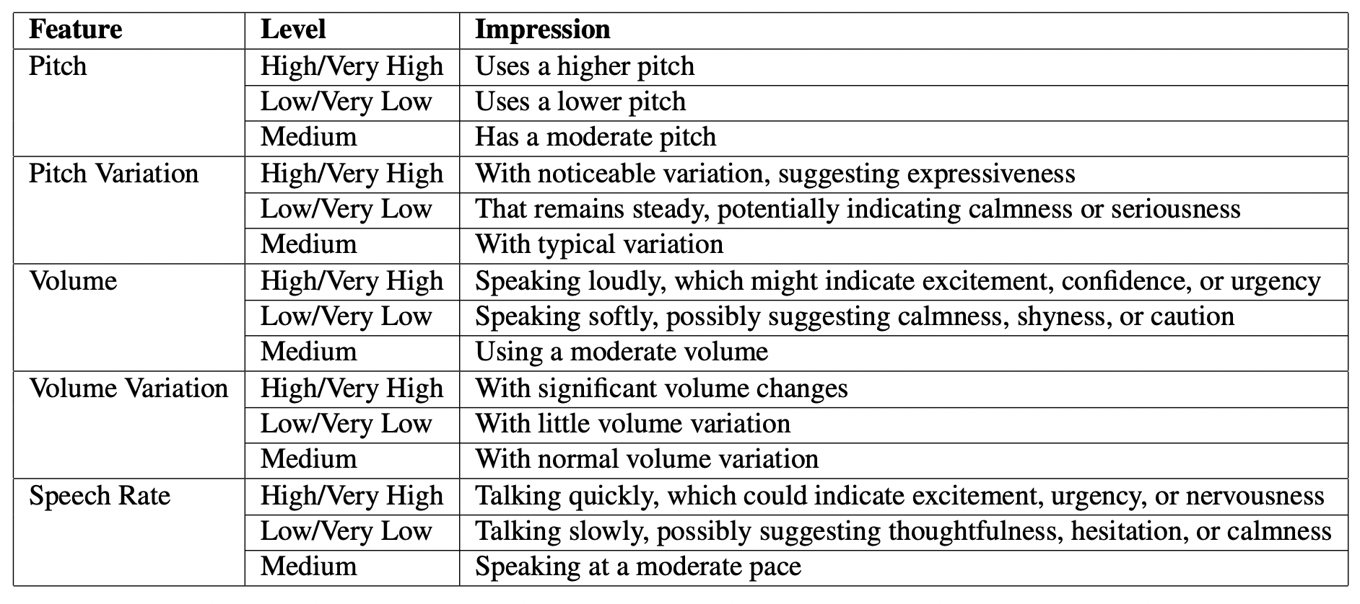
Methodology: Audio Impression
To make the audio features more accessible and meaningful for both human interpretation and LLM processing, we generate hard-coded natural language impressions based on the categorized features. The feature-impression mapping is manually curated based on established correlation between prosodic features and emotional states in the literature.
To account for the inherent uncertainty in interpreting speech patterns, we incorporate hedge words (e.g., "likely," "may") depending on the level of the category. This nuanced approach prevents overconfident interpretations, particularly in borderline cases.
Notes:
To make audio features more accessible and interpretable for both humans and LLMs, we generate hard-coded natural language impressions based on categorized features. This feature-impression mapping is manually curated, following established correlations between prosodic features and emotional states found in the literature.
To handle the inherent uncertainty in interpreting speech patterns, we incorporate hedge words—such as ‘likely’ and ‘may’—depending on the feature’s level within each category. This nuanced approach helps prevent overconfident interpretations, especially in borderline cases.
Question: why this feature-impression mapping?
The biggest challenge of creating this mapping is each low-level feature can be corresponding to various distinct emotion states. For example, high pitch, can be linked to both excitement and anxiety. We try to make the impression as simple as possible to avoid confusing the LLM. That’s also one reason why we add the hedge words into the impression. This is of course far from a perfect mapping and we can benefit from some experiments to tune this mapping.

Slide 42
Experiment settings
Emotion Datasets:
IEMOCAP:12 hours of audiovisual data from 10 actors
MELD: It contains 13,708 utterances from 1,433 dialogues in the TV show Friends
SpeechCueLLM Training Settings:
Use the LLaMA-2-base model as our LLM
Apply the LoRA (Low-Rank Adaptation) fine-tuning method
Notes:
Experiment settings
Emotion Datasets:
IEMOCAP:12 hours of audiovisual data from 10 actors
MELD: It contains 13,708 utterances from 1,433 dialogues in the TV show Friends
SpeechCueLLM Training Settings:
Use the LLaMA-2-base model as our LLM
Apply the LoRA (Low-Rank Adaptation) fine-tuning method

Slide 43
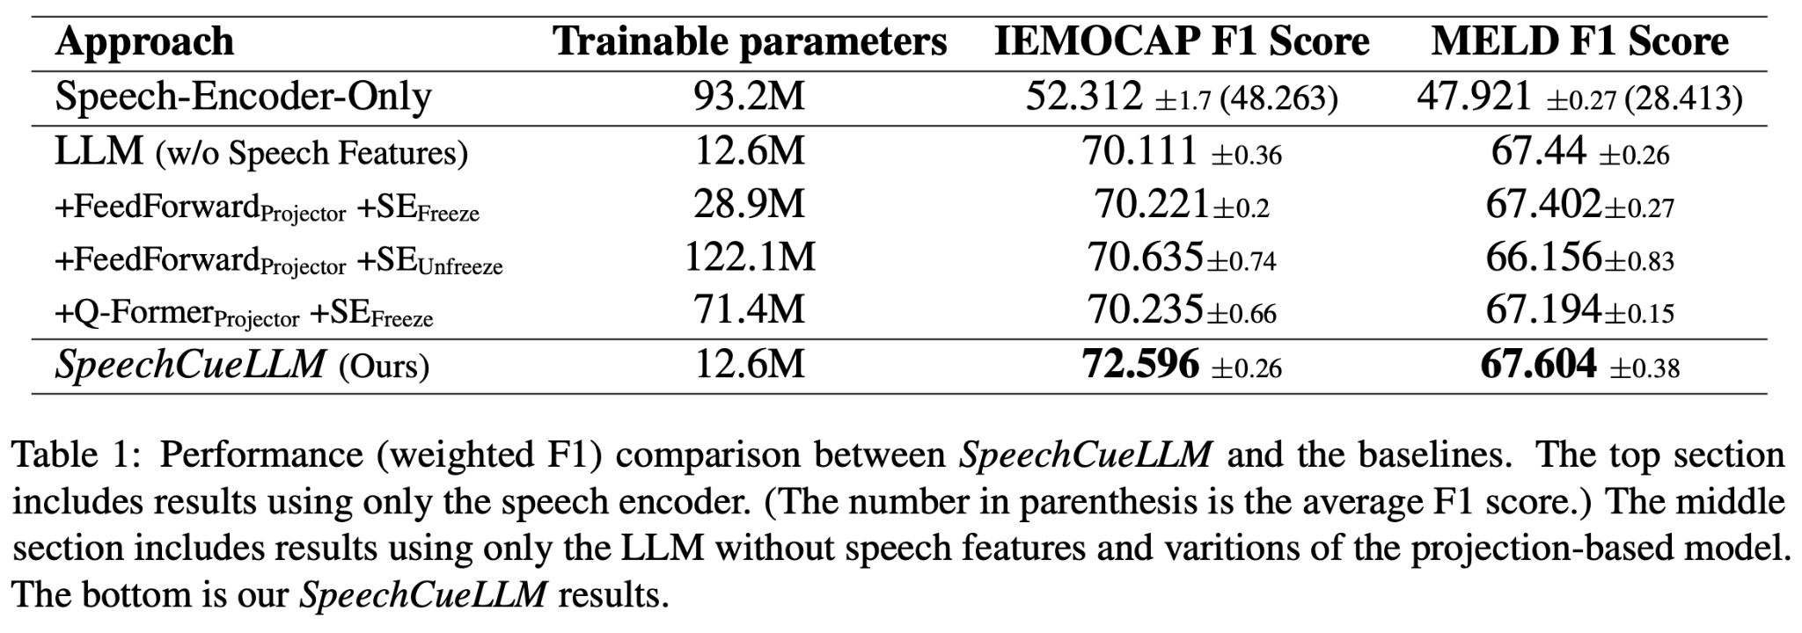


Experiments: Comparison with the Baselines
Emotion Output
LLM
…
A1 A2 … An T1 T2 … Tn
Projector
Embedding
Downsampler
Tokenizer
Audio Encoder
SpeechCueLLM outperforms baselines that embed audio features using speech encoders, achieving state-of-the-art (SOTA) performance.
Notes:
To address the risk of overconfidence in two-dimensional comparisons with the baseline, let’s start by looking at the left figure. This figure represents the baseline model, which is a projection-based model.
In this model, audio is first encoded using an audio encoder. Then, a projector is used to map this audio information into LLM embedding tokens. This enables the LLM to utilize speech information in the same way as it would text tokens. This projection-based approach is commonly used when integrating speech data into LLMs.
Now, let’s examine the table. In the first row, we see results for the ‘speech encoder only’ condition, where only the speech encoder is trained.
With this approach, we achieved around 50% F1 score for IEMOCAP, with the macro F1 score indicated in parentheses. For MELD, the F1 score is notably lower. This might be due to two factors: firstly, many audio samples contain laughter, which affects the accuracy of speech features.
In the second row, we have results from the language model (LM) without any speech features, so it’s based on text alone.
Then, for the baseline variations:
• The first variation uses a feed-forward projector with the speech encoder frozen during training.
• The second variation also uses a feed-forward projector, but we train the speech encoder.
• The third variation applies a more complex Q-former structure as the projector, while keeping the speech encoder frozen.
The last row shows our method, with results for both cases. With the baseline model, incorporating speech features led to slight improvements in IEMOCAP but not in MELD. However, our method shows significant improvements, especially for IEMOCAP. This may be because projection-based models introduce a discrepancy in distribution between audio and text, which complicates training due to the need for alignment. Our method sidesteps this issue by leveraging the inherent strengths of IML in processing natural language.

Slide 44
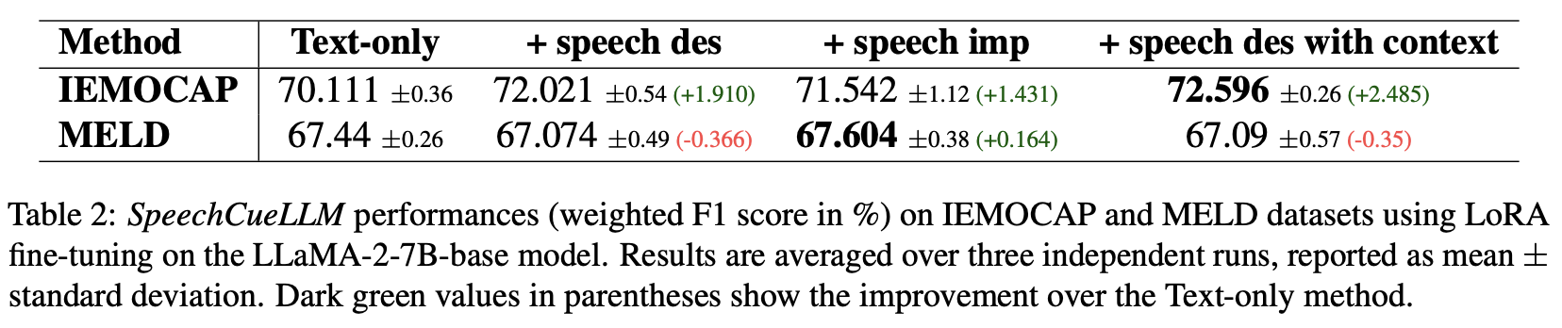
Experiments: How Effective Are Various Speech Features?
For IEMOCAP, we observe a significant improvement of nearly 2 percentage points when adding speech descriptions to the text input (from 70.111% to 72.021%). By further enriching the input with additional speech features for context, the model improves to 72.596%
Using the speech impressions are not consistently better than using speech descriptions. Though it is more interpretative, it may introduce noise or inaccuracies that the model struggles to utilize effectively.
The lower audio quality in MELD limits the effectiveness of speech feature integration
Notes:
We also evaluate the effectiveness of various speech features. We tests:
1. A text-only model,
2. A model adding speech descriptions,
3. A model incorporating impressions.
And also 4 with context information
As you can see in the table:
On IEMOCAP, adding speech descriptions boosts accuracy by nearly 2 points, from 70.1% to 72.0%, and goes up slightly more with added speech features (72.6%). However, using speech impressions isn’t always better—while more interpretative, they can introduce noise. In MELD, the lower audio quality limits gains from speech integration.

Slide 45
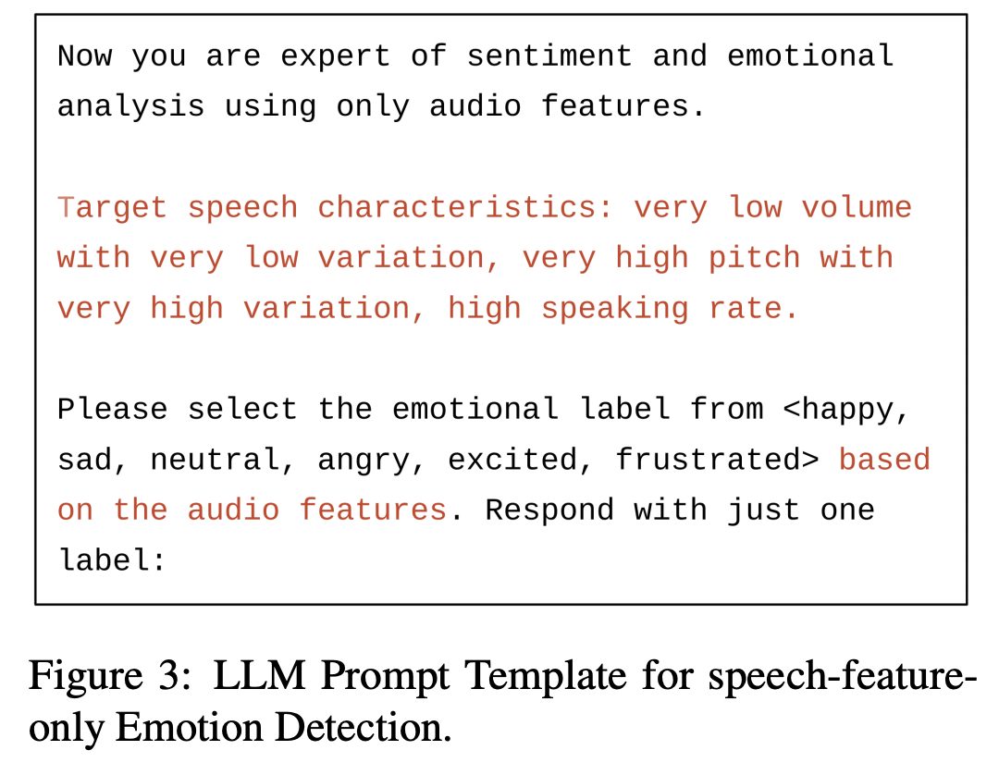
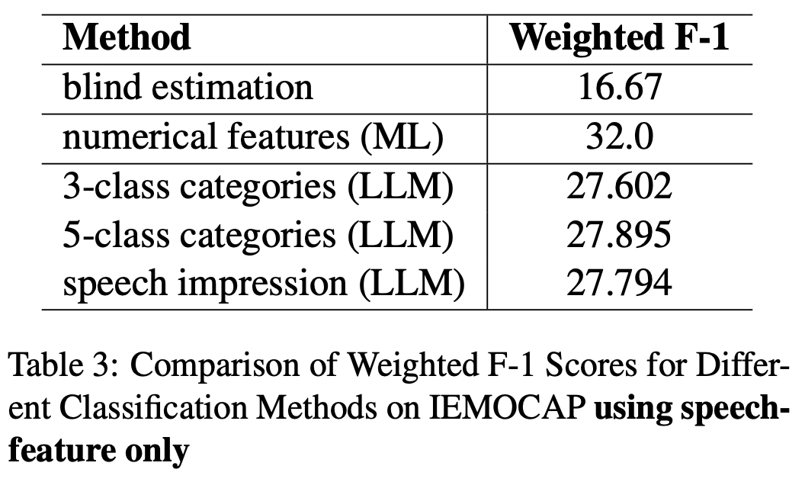
Experiments: Can LLMs Leverage Speech Features Alone?
The results in right table demonstrate the potential of LLMs in leveraging these features for emotion classification, significantly outperforming the blind estimation baseline of 16.67%
Notes:
To further validate the effectiveness of simple speech features, we conduct experiments using only speech features in the prompt, as shown in the left figure.
The results in right table demonstrate the potential of LLMs in leveraging these features for emotion classification, significantly outperforming the blind estimation baseline of 16.67%

Slide 46
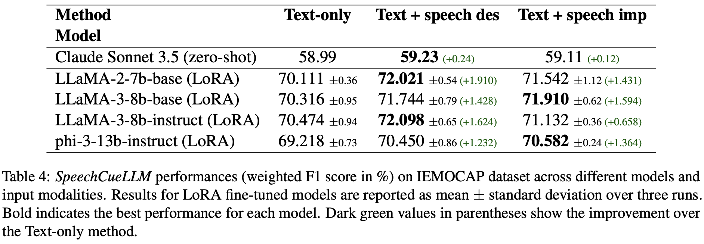
Experiments: How Do LLMs Differ in Performance?
Our results show consistent performance improvements across all models when either speech descriptions or impressions are integrated
Having stronger performance on public benchmarks does not necessarily lead to better performance in this task
The substantial performance gap between the zero-shot Claude model and the fine-tuned models highlights the importance of task-specific fine-tuning for emotion recognition
Notes:
We run experiments on both closed sourced model like claude and open sourced ones like different version of LLaMA and phi3:instruct from microsoft.
Integrating speech descriptions or impressions consistently improves performance across models. Interestingly, stronger benchmark models don’t always perform better here. The large gap between zero-shot Claude and fine-tuned models underscores the importance of task-specific tuning for emotion recognition.
Long version: Our experiments reveal that integrating either speech descriptions or impressions leads to consistent performance improvements across all models. However, it’s interesting to note that models with stronger performance on public benchmarks don’t necessarily perform better on this specific emotion recognition task.
One notable finding is the substantial performance gap between the zero-shot Claude model and the fine-tuned models. This highlights the critical role of task-specific fine-tuning when it comes to emotion recognition.

Slide 47
Conclusion
Our main contributions are as follows:
We introduce SpeechCueLLM, a method that enables multimodal analysis by integrating speech characteristics into text prompts, facilitating emotion recognition without architectural changes to the LLMs. SpeechCueLLM outperforms traditional approaches that incorporate speech encoders for embedding audio features into LLMs.
We present key findings on the effectiveness and limitations of this method, showing that incorporating speech descriptions enhances emotion recognition accuracy across multiple LLMs while offering insights into the role of audio quality and the advantages of prompt-based techniques.
Notes:
In Conclusion, Our main contributions are as follows:
We introduce SpeechCueLLM, a multimodal method that integrates speech cues into text prompts for emotion recognition—without modifying LLM architectures. SpeechCueLLM surpasses traditional speech-encoder approaches, showing that prompt-based integration improves emotion recognition accuracy and reveals how audio quality influences model performance.

Slide 48
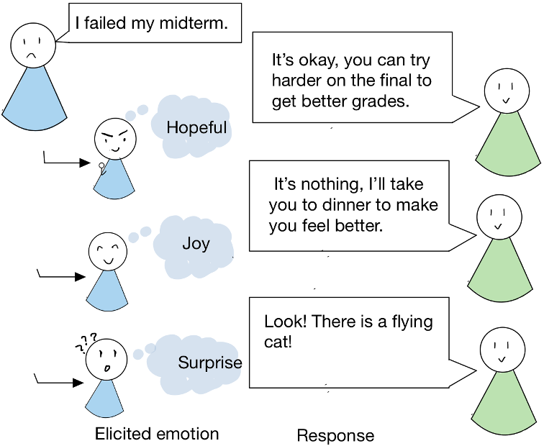
SICon, ACL2023
Eliciting Rich Positive Emotions
in Dialogue Generation
Ziwei (Sara) Gong, Qingkai Min
Yue Zhang
Paper link: https://aclanthology.org/2023.sicon-1.1/
Notes:
So after talking about Multimodal Emotion detection, I think it would be interesting to study how emotion works in generation, especially emotion elicitation.
This work is about how to elicit rich positive emotions in dialog generation, which can greatly enhance the effectiveness of a dialog system.
In our daily communications, there are usually several ways to respond to someone's statements in order to elicit a desired emotion.
For example, in the graph: for someone who was feeling bad from failing a midterm, there are multiple ways to cheer this person up: to make the person feel hopeful and to encourage the person, you could say that one can work harder and will better next time.
Alternatively, you can change the topic and make the person feel joy by taking them out for a nice dinner.
Or, just to purely distract the person, say there’s a flying cat so the person would be surprised and forget about the midterm (for at least a couple of turns of the conversation)
This is an important ability in our daily conversation so that you can guide the conversation in different directions

Slide 49
Related Work
Emotion in Generation
Emotion Elicitation
  statistical response generator (Hasegawa et al., 2013)
  Hierarchical Recurrent Encoder Decoder model (Serban et al.,2016) extended with a separate layer of emotion modules (Lubis et al., 2018)
  encoder-decoder adversarial model with two discriminators to increase emotion-awareness or empathetic dialogue generation (Li et al., 2020)
Style Transfer
  control text over multiple styles in generation while preserving the original content
  Using Variational Autoencoder (VAE) and wake-sleep learning procedure (Fu et al., 2018;Tikhonov et al., 2019; Fei et al., 2020)
Conditional Variational Autoencoder
  CVAE is an extension of VAE, which has been used for dialogue generation (Chen et al., 2019) by introducing a latent variable to capture discourse-level variations (Zhao et al., 2017).
Notes:
SKIP THIS SLIDE
So what are some of the related working generating emotions?
1:24:32
So let's just start with so we already covered part of the emotion generation by Brenda she covered like the
1:24:38
generate the sentences with different emotions speech similarity in generation of emotion sentences in tabs aside,
1:24:45
it's like generate a sentence say I love this restaurant compared to this is a horrible place to go.
1:24:55
So it's in terms of the sentiment where the emotion of the sentence.
1:25:03
So besides of generating something that's directly containing emotion, there is also a line of work, emotion, elicitation.
1:25:08
When it comes to generating emotionally engaging dialogues, there have been several approaches based on "emotion elicitation" that aim to incorporate affective dimensions in the generation process. One such approach is the "statistical response generator" proposed by Hasegawa et al. (2013), which models the distribution of appropriate responses based on the context and generates a response that maximizes the likelihood of eliciting the desired emotion.
Another approach is the "hierarchical recurrent encoder-decoder model" (Serban et al., 2016) that extends the basic sequence-to-sequence model for dialogue generation by adding a separate layer of emotion modules (Lubis et al., 2018) to capture emotional states and integrate them into the response generation process.
A recent advancement in emotion-aware dialogue generation is the "encoder-decoder adversarial model" proposed by Li et al. (2020). This model uses two discriminators to increase emotion-awareness or empathetic dialogue generation by learning to generate responses that not only match the input context but also align with the target emotion.
Another aspect of dialogue generation that has received significant attention is "style transfer" which allows controlling the text over multiple styles while preserving the original content. To achieve this, researchers have explored the use of "Variational Autoencoder" (VAE) and "wake-sleep learning procedure" (Fu et al., 2018; Tikhonov et al., 2019; Fei et al., 2020) that can learn a continuous latent representation of the input text and generate diverse outputs that match different styles.
Finally, "Conditional Variational Autoencoder" (CVAE) is an extension of VAE that has been used for dialogue generation (Chen et al., 2019) by introducing a latent variable to capture discourse-level variations (Zhao et al., 2017). By conditioning the generation on different values of the latent variable, the model can generate responses that reflect different emotional states or stylistic variations.
Regenerate response
Different from above work, we are the first to model the elicitation of rich positive emotions using one neural network

Slide 50
Motivations
Key factors to a conversation (in human communication theory):
  intentionality (intention of speakers) and effectiveness (effects of conversations)
  both exhibited by emotions.
Current work on emotion elicitation focuses on positive sentiment.
However, positive sentiment can include more fine-grained emotions such as “Hopeful”, “Joy” and “Surprise”, which can further serve to deepen the model’s understanding of effect, if not intention.
Small-scale human-annotated datasets, which limit the capacity of eliciting various emotions.
Notes:
One may wonder why we are specifically focusing on emotion elicitation. Well, the key to successful communication, according to human communication theory, lies in the intentionality and effectiveness of the conversation. In other words, it's not just about successfully conveying a message, but also successfully eliciting a desired emotional response in the listener.
This is similar to the goal of successful business communication where it's not just about expressing oneself, but also about getting the other person to agree.
Existing work focuses on generating utterances with targeted emotions to express, yet few studies have explored how one’s emotion is affected by utterances, or the intentionality of the generated sentences. Hence the task of emotion elicitation, which considers generating of the responses that elicit a pre-specified emotion in the other party.
Therefore, our work focuses on developing a method to capture these fine-grained emotions in a single neural network model, with the aim of deepening the model's understanding of the text and generating more diverse sentences.

Slide 51
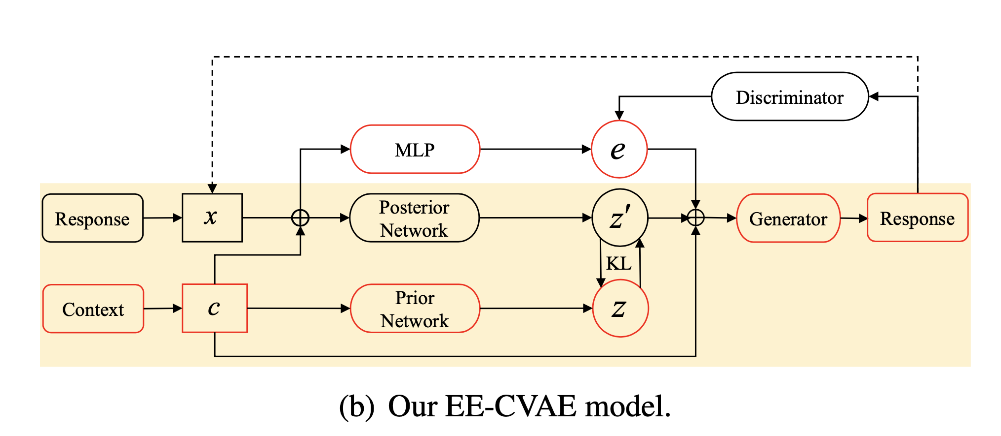
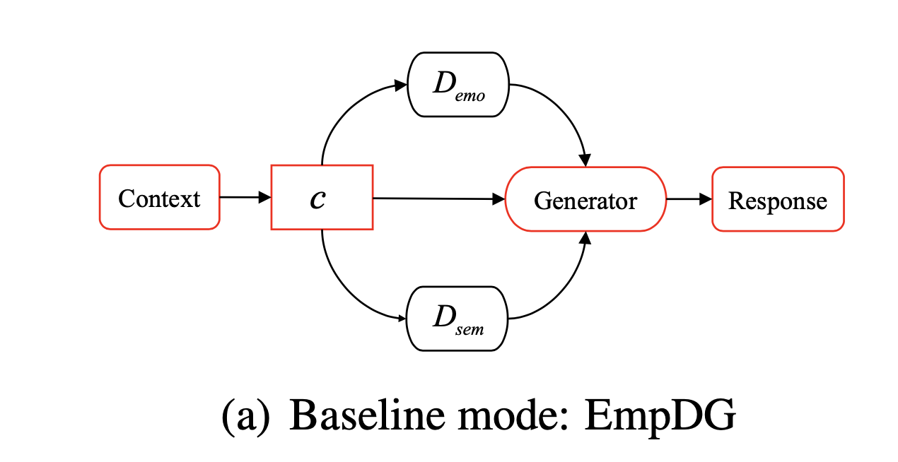
Model Comparison
Single emotion category
Multiple emotion categories
The latent variable e is used to control the generation of the response
The latent variable z is separated from e to fully capture the elicited emotions
Notes:
For model design, we have choose use a baseline model, one the left, and our proposed model is on the right.
Baseline model EmpDG is a sequence-to-sequence model that enhances the elicitation of a single positive emotion through empathy.
we have revised slightly for it to generate towards a single emotion category.
And we have also proposed a model, which is EE-CVAE, a conditional variation of or encoder model that can control over the emotion generation on multiple emotion categories.

Slide 52
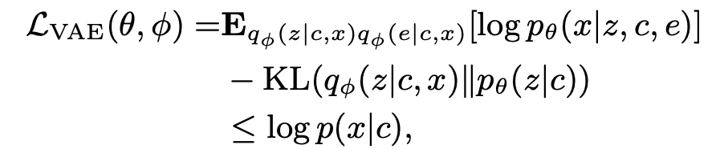

Model Detail
CVAE for Dialogue Generation (yellow background)
Adding Emotion Elicitation Function
augment CVAE with a latent variable e, which is used to control the generation of a response together with the unstructured variable z.
a discriminator D is used to force the generator to produce coherent emotions
Similarly, the variational encoder is reused to separate unrelated attributes from e by forcing them to be fully captured by z. It can be considered as another discriminator E :
Combining, we have
Training illustration of our model. Red components are used for testing. CVAE in yellow background. Dashed arrow denotes a discriminator.
Notes:
[model structure of CVAE ] To model elicited emotion, we augment CVAE with a latent variable e, which is used to control the generation of a response together with the unstructured variable z. The latent variable e is used to control the generation of the response. The latent variable z is separated from e to fully capture the elicited emotions.
more details:
It can be seen as an extension of CVAE (yellow part) with a latent variable and two discriminators to elicit emotions
1:31:05
As you can see in the graph here,
1:31:11
the part of the model in the yellow background are the CVAE model
the generative process of a dialogue-based CVAE
two steps:
1. Sample a latent vector z from prior network pθ(z|c), where c is the dialogue context.
2. Generate a response x through a generator pθ(x|z, c), given dialogue context c and latent vector z, where θ denotes the parameters of a generative network.
To model elicited emotion, we augment CVAE with a latent variable e, which is used to control the generation of a response together with the unstructured variable z.
discriminator D is used to enforce the generator to produce coherent emotions:
similarly, the variational encoder is reused to separate unrelated attributes from e by enforcing them to be fully captured by z
Therefore, in this model we were able to control and learn the emotion representations from the latent
1:31:31
variable and also put the feedback into the generation of the responses: sentences with certain target emotion to elicit.

Slide 53
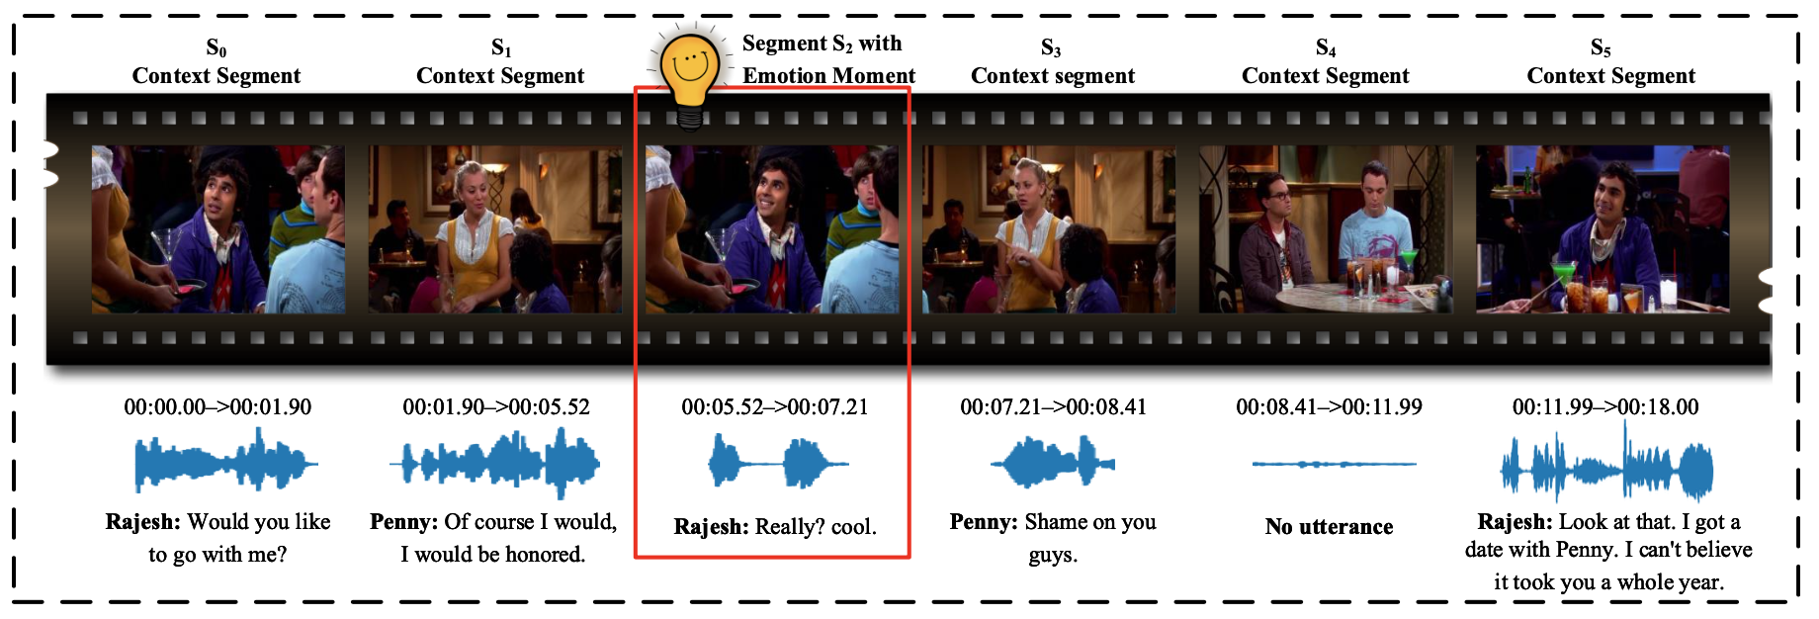
Dataset
Reconstructed the multi-modal MEmoR dataset to fit our emotion elicitation task and conducted human evaluation to validate the usability in a single modality. (annotator agreement of 80% accuracy (Cohen’s d = 0.491) )
The reconstructed corpus has 22,732 utterances
  Split the data in training (18,943), dev (1,894), and test (1,894).
Pretrain: we use more than 200k utterances from the Friends and Open Subtitles datasets
Notes:
Dataset: As we all know, many emotion data sets lack a target emotion, which makes it difficult for us to analyze and understand them. We have reconstructed the multi-modal MEmoR dataset to fit our emotion elicitation, and validate the usability of a single modality (text).
We also collected additional conversations from the Friends TV show and the open subtitle dataset for pre-training of both the baseline model and our own CVAE model, which helped us to achieve better results in generation.

Slide 54
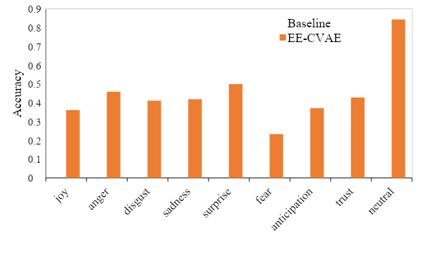
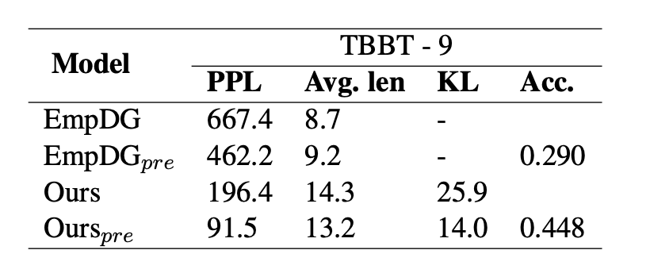
Results
The quality of the response has been improved, from the comparison of PPL and Avg.len
The accuracy of the emotion in generated response has significantly improved during manual evaluation
Pretraining is effective in improving the quality of generation in both models
The Effect of Modeling Negative Emotions: Using all emotions in pretraining and finetuning produces the best performance in eliciting positive emotions.
Table 1: Results of models generation in comparison.
Comparison of accuracy across 9 emotions.
Notes:
The results are shown in table on the left. The bar chart on the right hand side shows a more fine-grained result of emotion accuracy Not only the quality of the repones has been improved, but more importantly, the accuracy of the emotion in generated responses has been significantly improved during manual evaluation。
From table, we observe that pretraining is effective in improving the quality of generation in both models
The results are shown in Table 1. The
320 perplexity of our method is lower than that of the
321 EmpDG baseline, which shows that our model can
322 generate more fluent responses. This can be be-
323 cause of the two-channel model structure by Em-
324 pDG, where implicit emotions can interfere with
325 generation by introducing noise. In contrast, the
326 use of CVAE can be also more effective in isolating
327 the influence of emotion signals.
328 The output length of our model is 13.2 on aver-
age, 43% longer than that of the baseline. We find
330 that the baseline model tends to give more short
331 and generic outputs such as “really’ and “what”,
332 as can be seen in Table 2. The maximum output
length are similar, 31 (baseline) and 39 (ours) re-
333 spectively. This again shows the effectiveness of
334 the LVAE and LAttr,z loss design in our model as
335 compared to Lsem of the baseline.
e-training of the generation module is added.
338 Compared with EmpDG, the rate of PPL reduction
339 is significantly larger for our model. This shows
340 that our CVAE structure can make better use of
341 wake-sleep learning. In addition, pre-training re-
342 duces the KL of our model. This shows that more
343 data allows the model to better separate the emotion
344 signal e and the semantic context z.
And in the bar.
1:37:52
Bar chart on the right. This shows a more fine grained result of emotion accuracy.
1:37:59
Figure 3 shows a more fine-grained result of 378
emotion accuracy. Our model outperforms the base-
line on all emotion types except for anticipation. 379
This is likely because many cases in the category 380
involve more generic utterances such as “what”. 381
For neutral, our method gives the largest advantage, 382
which is likely because it gives fluent, meaningful 383
responses most of the time, as shown in Table 2.

Slide 55
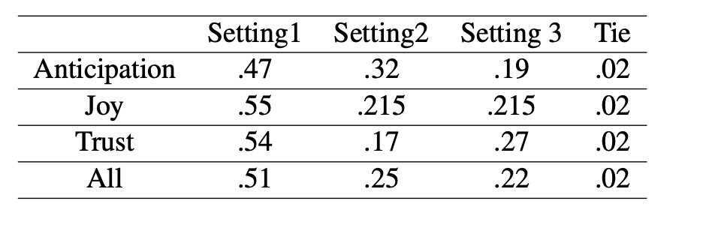
The Effect of Modeling Negative Emotions
Results comparing three settings with the percentage of times one model is considered the best when eliciting different positive emotions.
Setting 1: modeling all emotions in pretraining and fine-tuning.
Setting 2: modeling all emotions in pretraining, fine-tuning with only positive emotions.
Setting 3: modeling only positive emotions in pretraining and fine-tuning.
Using all emotions in pretraining and finetuning produces the best performance in eliciting positive emotions.
Notes:
We have also conducted The Effect of Modeling Negative Emotions:, With this comparison, we found that if you include negative emotion utterances in pre-training or in training stages, they will improve their generation towards elicit positive emotions.
And we also did ablation patients ablation study to test whether it is important
1:42:47
or whether it is helpful to include negative emotions in our training.
1:42:55
Because there have been many work focusing on generating positive emotions and only focusing on positive emotion and compost core business.
1:43:01
However, with this comparison, we found that
if you include negative emotion utterances in other training or in fine-tuning stages, another way they will improve their generation towords elicit positive emotions.
1:43:27
This means using all emotion in pre-training and fine-tuning produce the best performance in eliciting positive emotion.
1:43:30
It has shown that introducing the model to more diverse emotions actually helps the model to
1:43:39
better identify the differences between emotions,
1:43:45
especially between telling the difference between positive and negative emotions.

Slide 56
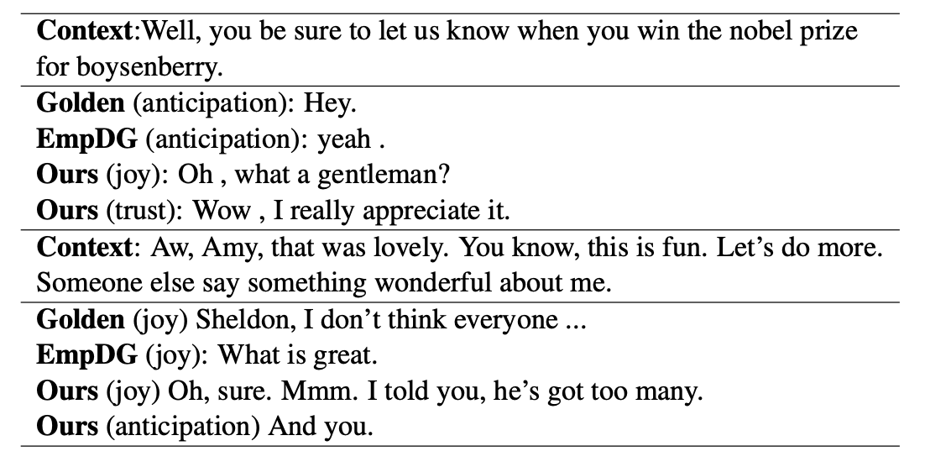
Sample generations
Notes:
And here are some simple generations we could go over together.
1:39:01
[GO OVER IT]
1:42:06
So the generation when we cherry-picked it and that’s pretty nice, but I have to admit,
1:42:14
Not all of the generation are as fluent or as successful as this was.
1:42:20
And there. And if we go back and look at the results, the accuracy,
1:42:26
Even our model that performed the best with a pre-train, it only reached less than half of the accuracy.
1:42:31
It is pretty good for a model but still far away from human performance on the same task.

Slide 57
Conclusions and Future Directions
Using all emotions in pretraining and finetuning produces the best performance in eliciting positive emotions.
Results show the advantage of using a latent variable for modeling rich emotions, compared to hard-coding one emotion in a multi-encoder model.
The effectiveness of our model in pretraining.
Future directions:
LLMs?
Affective computing for HCI?
Notes:
Conclusions:
Using all emotions in pretraining and finetuning produces the best performance in eliciting positive emotions.
Results show the advantage of using a latent variable for modeling rich emotions, compared to hard-coding one emotion in a multi-encoder model.
The effectiveness of our model in pretraining.
For future work, LLM? HCI? Recent work?.
(8 mins)

Slide 58
Akan Cinematic Emotions (ACE): A Multimodal Multi-party Dataset for Emotion Recognition in Movie Dialogues
ACL Findings, 2025
David Sasu, Zehui Wu, Ziwei Gong, Run Chen, Pengyuan Shi, Lin Ai,
Julia Hirschberg, Natalie Schluter
Paper Link: https://arxiv.org/abs/2502.10973
Dataset Link: https://anonymous.4open.science/r/Akan-Cinematic-Emotion-A328
Notes:
Emotion Recognition in Conversation, or ERC, plays a crucial role in developing technologies such as chatbots, and we just showed advancement on emotion recognition and generation. However, most ERC datasets focus on high-resource languages like English and Chinese, creating a substantial gap for low-resource languages, especially those in Africa
Therefore, we introduce the Akan Cinematic Emotions dataset, or ACE, a groundbreaking multimodal dataset developed for emotion recognition in movie dialogues, specifically focusing on the Akan language

Slide 59
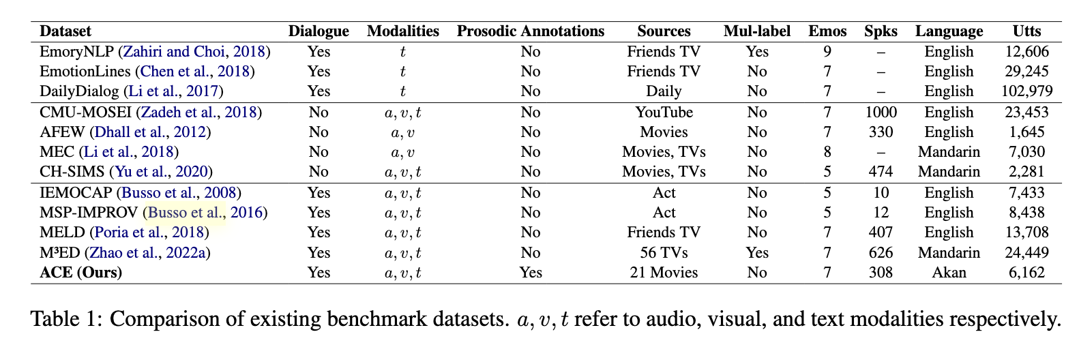
A Comprehensive Multimodal Dataset for Akan: ACE
ACE includes 385 emotion-labeled dialogues and 6,162 utterances from 21 Akan movies.
Features audio, visual, and textual modalities with word-level prosodic prominence annotations.
Ensures gender balance with contributions from 308 speakers (155 male, 153 female).
Notes:
The ACE dataset comprises 385 emotion-labeled dialogues and 6,162 utterances extracted from 21 Akan-language movies. This multimodal dataset encompasses audio, visual, and textual data, along with word-level prosodic prominence annotations, making it the first prosodically annotated dataset for an African language. Notably, ACE maintains gender balance, featuring contributions from 308 speakers, split almost equally between males and females

Slide 60
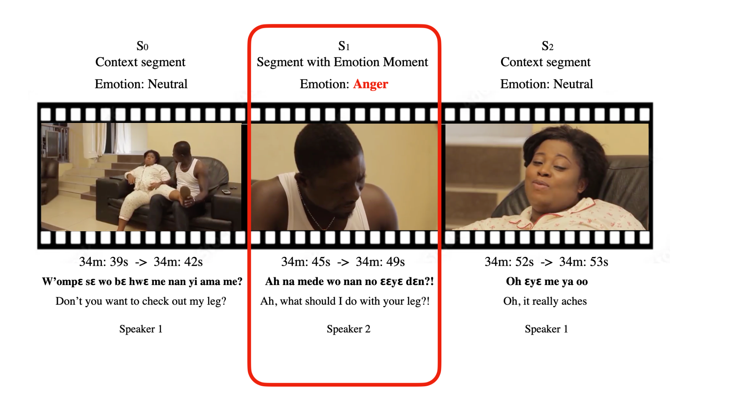
Detailed and Culturally Relevant Annotations
• Emotion labels cover seven categories:
Neutral, Sadness, Anger, Fear, Surprise, Disgust, and Happy.
• Annotations conducted by native Akan speakers, ensuring cultural relevance.
• Prosodic prominence annotations highlight the importance of tone in conveying emotions in Akan
Notes:
The dataset’s annotations encompass seven emotion categories: Neutral, Sadness, Anger, Fear, Surprise, Disgust, and Happy. Native Akan speakers carried out the annotation process, ensuring cultural and linguistic relevance. Additionally, the inclusion of prosodic prominence annotations underscores the significance of tone in expressing emotions within the Akan language

Slide 61
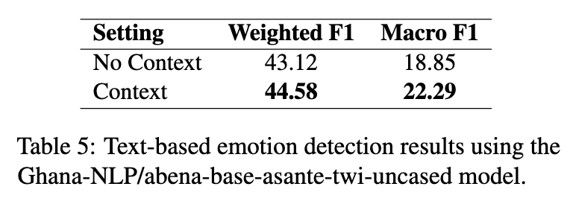
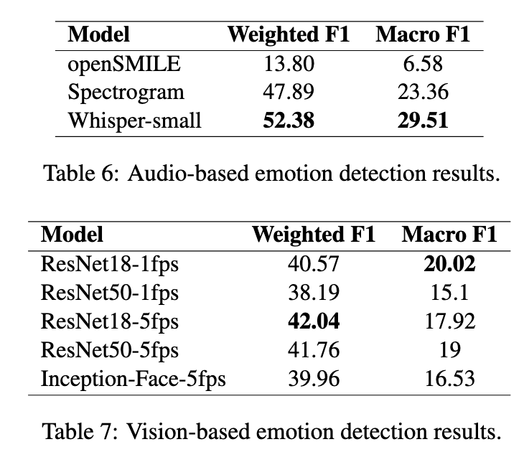
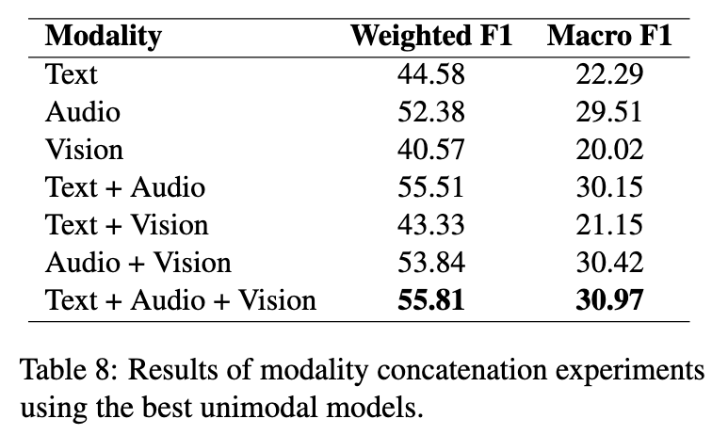
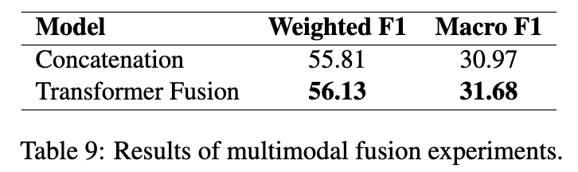
Establishing Baselines with State-of-the-Art Methods
Baseline experiments utilized state-of-the-art emotion recognition methods.
• Multimodal approaches integrating text, audio, and visual data achieved the best performance.
• Results validate the dataset’s quality and utility for future research.
Notes:
To validate the ACE dataset, baseline experiments employed state-of-the-art emotion recognition methods. The most effective performance emerged from multimodal approaches that integrated text, audio, and visual data. These findings confirm the dataset’s quality and its potential as a valuable resource for future research in emotion recognition.

Slide 62
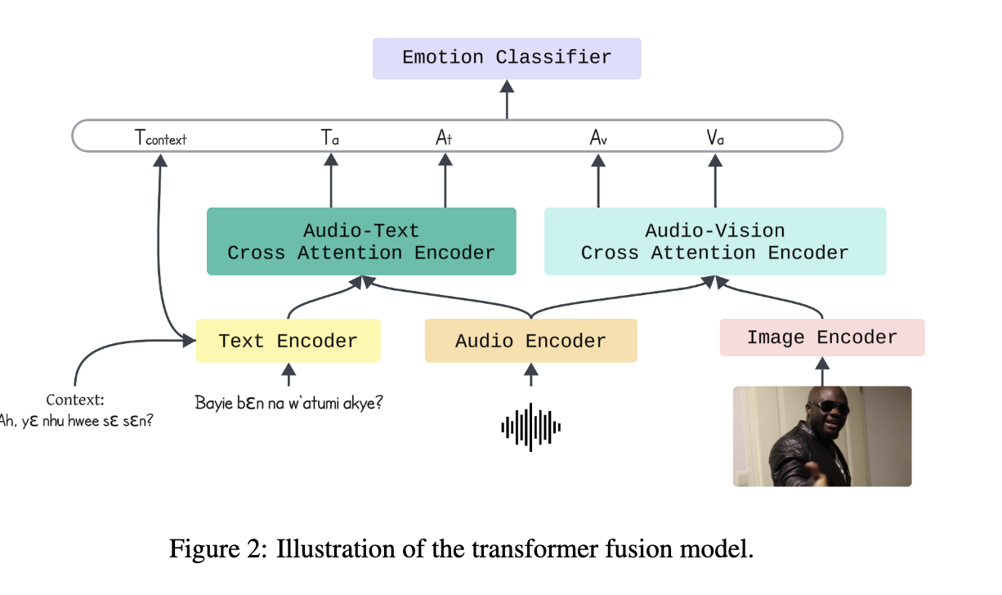

Slide 63
Paving the Way for Inclusive NLP Research
ACE fills a critical gap by providing a multimodal ERC dataset for an African language.
Facilitates cross-cultural and linguistic studies in emotion recognition.
Future work includes expanding to other African languages and enhancing multimodal recognition techniques.
Notes:
In conclusion, the ACE dataset addresses a significant gap by offering a multimodal ERC dataset tailored to an African language. It opens avenues for cross-cultural and linguistic studies in emotion recognition. Future endeavors aim to extend this work to other African languages and to refine multimodal recognition techniques, thereby contributing to more inclusive and diverse nlp research.

Slide 64
Learning More with Less: Self-Supervised Approaches for
Low-Resource Speech Emotion Recognition
Interspeech 2025
Ziwei Gong, Pengyuan Shi, Kaan Donbekci, Lin Ai, Run Chen, David Sasu, Zehui Wu, Julia Hirschberg
Under Review [Interspeech 2025]
Notes:
Then, for this challenge in low-resources language and low-resources setting, our research investigates self-supervised learning to mitigate these issues.
In this work, ‘Learning More with Less: Self-Supervised Approaches for Low-Resource Speech Emotion Recognition.’ We look into how we leverage self-supervised learning techniques, specifically Contrastive Learning (CL) and Bootstrap Your Own Latent (BYOL), to improve Speech Emotion Recognition (SER) for low-resource languages.

Slide 65
Introduction: Problem Statement & Motivation
Speech Emotion Recognition (SER) is critical for human-computer interaction, affective computing, and mental health applications.
Current deep learning-based SER models perform well for high-resource languages (HRLs) but struggle with low-resource languages (LRLs).
Data scarcity in LRLs leads to poor generalization and performance disparities.
Transfer learning offers a promising solution.
Notes:
Skip!!!
Our research investigates self-supervised learning to mitigate these issues.
●Speech Emotion Recognition (SER) is crucial for human-computer interaction, affective computing, and many downstream applications. Deep learning has significantly improved SER in high-resource languages (HRLs), but low-resource languages (LRLs) suffer due to data scarcity. Our research investigates self-supervised learning to mitigate these issues.

Slide 66
Challenges in Low-Resource SER
• Dependence on labeled data: Supervised learning approaches require large labeled datasets, which are unavailable for most LRLs.
• Generalization challenges: Models fine-tuned on HRLs often fail to generalize effectively to different LRLs due to linguistic differences.
• Unsupervised learning challenges: Self-supervised learning methods like contrastive learning and BYOL remain underexplored for SER.
• Practical deployment concerns: Biases in SER models could lead to fairness issues, especially in sensitive applications like mental health.
Key hypothesis: Self-supervised learning can bridge the gap between HRLs and LRLs in emotion recognition
Notes:
Shorter: There are several key challenges in developing SER models for low-resource languages.
1. Dependence on labeled data: Most supervised approaches require large amounts of labeled data, which are scarce in low-resource languages.
2. Generalization challenges: Models trained on high-resource languages tend to perform poorly on low-resource languages due to linguistic differences.
3. Unsupervised learning remains underexplored: Self-supervised techniques like Contrastive Learning and BYOL could help, but their effectiveness in SER is not well understood.
4. Practical deployment concerns
We hypothesize that self-supervised learning can bridge the gap between high-resource and low-resource languages in emotion recognition.

Slide 67
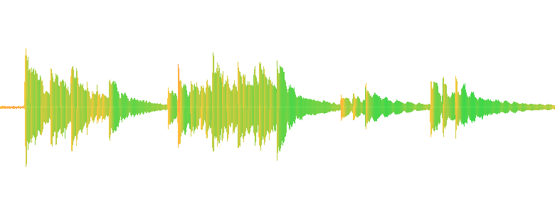
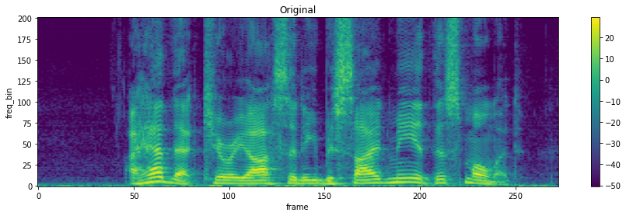



Proposed Methodology 1: Contrastive Learning (CL)
Stage 1: Contrastive Adaptation
Whisper Encoder
Speaker Classifier
Whisper Encoder
Pool
Classifier
Augmentation
Contrastive Loss
➕
Speaker Loss
Raw Wav
Supervised Emotion Loss
LRL
Whisper Encoder
Pool
HRL
Stage 2: Emotion Fine-Tuning
Contrastive Learning
We propose using Contrastive Learning (CL) and Bootstrap Your Own Latent (BYOL) to improve SER in LRLs.
CL differentiates similar and dissimilar samples using self-supervised similarity measures.
Notes:
We first introduce Contrastive Learning, or CL, as one of our self-supervised learning methods.
CL works by differentiating between similar and dissimilar samples using self-supervised similarity measures.
We employ a two-stage framework:
1. Speaker-Contrastive Adaptation: We use speaker identity as a pre-training signal, as previous research has shown that speaker information is strongly correlated with emotion.
2. Emotion Fine-Tuning: We fine-tune the model on emotion-labeled data from high-resource languages, transferring the learned representations to low-resource languages.
This method encourages the model to learn language-agnostic features for emotion recognition

Slide 68
Proposed Methodology 2: Bootstrap Your Own Latent (BYOL) (BYOL)
BYOL
Online Model
LRL+HRL
Whisper Encoder
Supervised Emotion Loss
(On HRL Only)
Augmentation
BYOL Loss
➕
Classifier
Pool
Raw Wav
Whisper Encoder
Target Model
BYOL learns representations without negative samples, promoting consistency and feature invariance.
Both methods reduce reliance on labeled data and aim to enhance cross-lingual generalization.
Notes:
Bootstrap Your Own Latent, or BYOL, is another self-supervised learning approach that we explore.
Unlike Contrastive Learning, BYOL does not rely on negative samples.
Instead, it maintains two network branches:
1. An online model and a target model.
2. The online model learns by aligning its outputs with the target model, which is updated in a momentum fashion.
This encourages the model to learn consistent and robust feature representations.
We integrate BYOL with a supervised objective on high-resource language data to improve SER performance across multiple languages

Slide 69
Stage 1: Contrastive Adaptation
Whisper Encoder
Speaker Classifier
Whisper Encoder
Pool
Classifier
Augmentation
Contrastive Loss
➕
Speaker Loss
Raw Wav
Supervised Emotion Loss
LRL
Whisper Encoder
Pool
HRL
Stage 2: Emotion Fine-Tuning
Contrastive Learning
BYOL
Online Model
LRL+HRL
Whisper Encoder
Supervised Emotion Loss
(On HRL Only)
Augmentation
BYOL Loss
➕
Classifier
Pool
Raw Wav
Whisper Encoder
Target Model

Slide 70
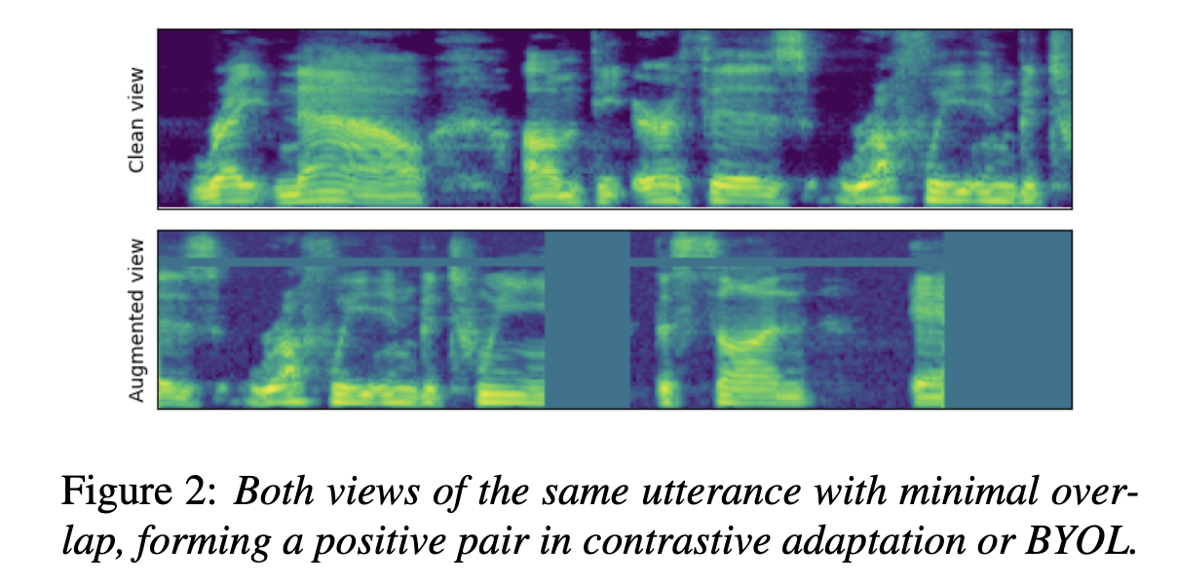
Datasets & Augmentation
• Datasets Used:
- High-resource: MSP-Podcast, IEMOCAP (English).
- Low-resource: EMO-DB (German), URDU (Urdu), SUBESCO (Bangla).
• Feature Extraction: Mel-spectrograms
• Data Augmentation Techniques:
- CL: Gaussian noise injection, polarity inversion, gain manipulation.
- BYOL: Speed perturbation, spectral stretch, SpecAugment, time-frequency masking.
• Why Augmentation Matters?
- Helps models learn robust and invariant features.
- Prevents overfitting to high-resource training data.
- Increases diversity in training samples, improving cross-lingual adaptation.
Notes:
To train and evaluate our models, we use multiple datasets.
• For high-resource languages, we use MSP-Podcast and IEMOCAP, which contain rich labeled emotional speech data in English.
• For low-resource languages, we use EMO-DB for German, URDU for Urdu, and SUBESCO for Bangla.
We extract mel-spectrogram features and apply various data augmentation techniques:
• For Contrastive Learning: Gaussian noise injection, polarity inversion, and gain manipulation.
• For BYOL: Speed perturbation, spectral stretching, SpecAugment, and time-frequency masking.
Data augmentation is critical for ensuring that models learn robust and invariant emotion representations, helping them generalize better to new and unseen languages.

Slide 71
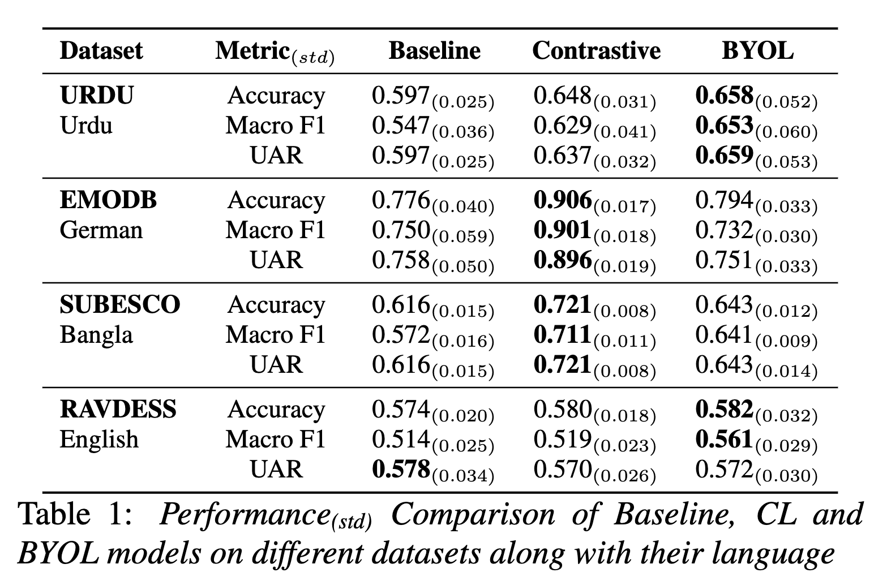
Experiments Results
Our results show that:
CL significantly improves emotion classification in German (90% zero-shot accuracy on EmoDB).
BYOL is more effective for Urdu and Bangla, demonstrating robustness to dataset biases.
Zero-shot performance remains stable, showing that self-supervised learning enhances generalization.
Takeaway: Self-supervised methods can reduce dependency on HRL data while improving performance on LRLs.
Model Architectures:
- Whisper encoder for feature extraction.
- Fine-tuning with contrastive learning and BYOL.
- Classification head with fully connected layers.
Training Details:
- Experiments repeated five times to ensure stability.
Notes:
Our experimental results show significant improvements in F1-score for low-resource languages:
• Urdu: +10.6%
• German: +15.2%
• Bangla: +13.9%
Contrastive Learning performed exceptionally well on German, achieving 90% zero-shot accuracy on the EMO-DB dataset.
On the other hand, BYOL was more effective for Urdu and Bangla, demonstrating better robustness to dataset biases.
These results confirm that self-supervised learning can enhance SER performance in low-resource settings

Slide 72
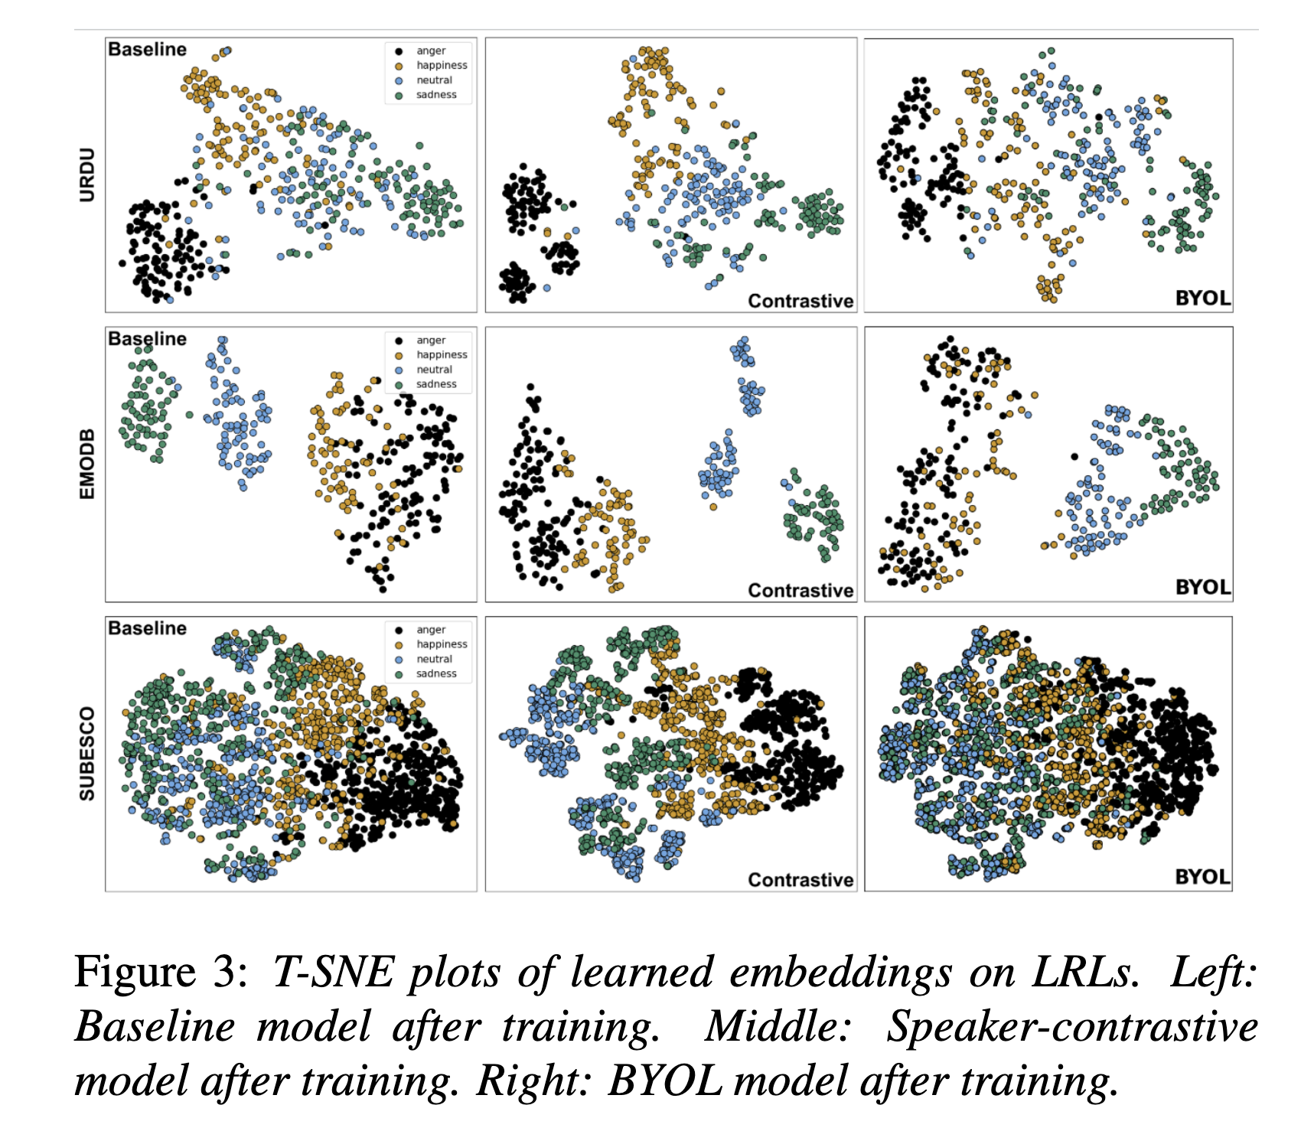
Results & Discussion: Model Interpretability Insights
• Embedding Visualization (t-SNE Analysis)
- CL showed more structured emotion clusters but struggled with linguistic transfer.
- BYOL provided smoother feature spaces, allowing better adaptation to unseen data.
• Confusion Matrix Insights
- CL reduced errors in anger-happiness misclassifications.
- BYOL improved differentiation of neutral and sad emotions.
• Post-hoc Analysis (SHAP & LIME)
- CL heavily relied on pitch features
- BYOL showed a more balanced reliance on spectral and temporal cues, aiding robustness.
Notes:
Model interpretability is critical for understanding and improving SER.
We use t-SNE visualizations to analyze learned embeddings:
• CL improves emotion clustering but remains sensitive to linguistic differences.
• Confusion matrices reveal that CL reduces misclassification between anger and happiness, while BYOL improves differentiation of neutral and sad emotions.
• Post-hoc Analysis: CL relies heavily on pitch features, while BYOL has a more balanced reliance on spectral and temporal cues, leading to improved robustness.
●Model interpretability is critical for SER.
●- **t-SNE Visualizations**: Showed improved emotion clustering after CL and BYOL training.
●- **Confusion Matrices**: CL reduced anger-happiness misclassifications, while BYOL improved differentiation of neutral and sad emotions.
●- **SHAP/LIME Analysis**: CL relied heavily on pitch features, potentially explaining gender bias. BYOL had a more balanced reliance on spectral and temporal cues, improving robustness.

Slide 73
Results & Discussion: Model Bias & Fairness
• Gender Bias in Urdu SER
- CL models showed a 10% performance drop for female speakers in Urdu.
- BYOL exhibited more balanced performance, reducing the bias observed in CL.
- Possible cause: Male-dominated training data in Urdu Common Voice dataset.
- Future Work: Rebalancing datasets to ensure fairness across gender groups.
• Linguistic Biases
- German outperformed other LRLs, likely due to its proximity to English.
- Cross-lingual emotion mapping remains a challenge, as some emotions are expressed differently across cultures.
Notes:
Model fairness is an important issue in SER.
• Gender Bias in Urdu SER: CL models showed a 10% performance drop for female speakers in Urdu.
• BYOL exhibited more balanced performance, reducing the bias observed in CL.
• Linguistic Biases: German outperformed other low-resource languages, likely due to its similarity to English.

Slide 74
Conclusion & Future Work
Self-supervised learning (CL & BYOL) improves SER performance in low-resource settings.
Contrastive Learning (CL) excels in structuring feature spaces, but struggles with gender imbalance.
BYOL is more robust to speaker and dataset variability, making it better suited for diverse LRLs.
Zero-shot performance remains challenging, with German benefiting more than Urdu/Bangla due to linguistic similarities.
Model interpretability is essential for identifying biases, as seen in gender imbalances in Urdu
Future research should focus on hybrid models, combining strengths of CL, BYOL, and domain adaptation techniques.
Notes:
●In conclusion, our proposed self-supervised learning methods significantly improves SER in low-resource settings. Our main contributions are:
●1. Demonstrating F1-score improvements for multiple LRLs.
●2. Providing insights into self-supervised model behavior and interpretability.
●3. Highlighting challenges such as gender bias and linguistic transfer limitations.
●Future directions include extending this work to additional languages and refining training strategies to improve fairness and robustness.
(maybe)
●Key takeaways from our study:
●- CL enhances clustering but is sensitive to linguistic differences.
●- BYOL provides smoother feature spaces and better cross-lingual adaptation.
●- Zero-shot SER performance improves but remains challenging, especially for linguistically distant LRLs.
●- Model interpretability is crucial for identifying biases and improving fairness in SER systems.
●Future research will focus on hybrid models combining CL, BYOL, and domain adaptation techniques.

Slide 75
Results & Discussion: Overall Performance
• Contrastive Learning vs. BYOL
- CL showed better structure in learned embeddings but struggled with gender bias.
- BYOL was more robust to dataset shifts but exhibited greater variance in performance.
- CL relied on high-quality negative samples, making it sensitive to dataset selection.
- BYOL’s reliance on consistency learning helped avoid overfitting to HRL characteristics.
• Zero-Shot Performance Analysis
- CL performed well in HRL-to-LRL adaptation but overfit when speaker distribution was unbalanced.
- BYOL was better at capturing emotion dynamics in LRLs but sometimes struggled with fine-grained emotion classes.
Notes:
Comparing Contrastive Learning & BYOL
“Now, let’s compare the performance of Contrastive Learning and BYOL.
• Contrastive Learning structured the learned embeddings more effectively but suffered from gender bias.
• BYOL was more robust to dataset shifts but exhibited higher performance variance.
• CL relies on high-quality negative samples, making it sensitive to dataset selection.
• In terms of zero-shot performance, CL adapts well from high-resource to low-resource languages, but struggles when the speaker distribution is unbalanced.
• BYOL, however, captures emotion dynamics better in low-resource languages but struggles with fine-grained emotion distinctions.

Slide 76
Conclusion & Future directions
• Our study shows that emotion recognition models achieve relatively good performance.
• However, challenges persist, especially in low-resource settings, where limited labeled data affects generalization and robustness.
• An exciting new direction is emotion elicitation in agentive workflows, allowing AI systems to actively shape and respond to user emotions.
• Integrating context-aware multimodal learning and LLM-driven emotion-aware AI will be crucial for more adaptive, human-centered AI systems.
Notes:
In summary, our study shows that emotion recognition models perform relatively well, but challenges remain, especially in low-resource settings, where limited labeled data affects generalization.
Looking ahead, a key direction is emotion elicitation in agentive workflows, where AI systems don’t just recognize emotions but actively shape and respond to them. This could enhance conversational AI, mental health support, and personalized experiences.
To advance affective computing, we must integrate context-aware multimodal learning—leveraging text, speech, and visual cues—and combine LLMs with emotion-aware AI to capture long-term emotional context. By doing so, we move toward more adaptive, emotionally intelligent AI systems that engage with users in a meaningful way

Slide 77
Thank you :). Any questions or comments?
Notes:
(42 mins)
Thank you for listening! Collaboration ideas welcomed too :)
Btw - one of the slides is created by gpt fully - guess which?

