Slide 1
Personalization in English-Teaching Chatbots
Siyan Li

Slide 2
Overview
Two research projects on Chatbots for English Learning:
Empathetic Chatbots to Address Learner Frustration [1-2]
Proficiency-Adaptive Chatbots to Accommodate Learner English Levels (Ongoing work)
[1] Siyan, L., Shao, T., Yu, Z., & Hirschberg, J. (2024). Using Adaptive Empathetic Responses for Teaching English. BEA Workshop, NAACL 2024.
[2] Siyan, L., Shao, T., Yu, Z., & Hirschberg, J. (2024). EDEN: Empathetic Dialogues for English Learning. Findings of EMNLP 2024.

Slide 3
Empathetic Chatbots

Slide 4
Motivation
Frustration due to foreign language anxiety is common in English learning (or second-language learning in general)
  Could make learners give up
Wu et al. (2023) : perceived teacher affective support (correlates with empathy) positively correlates with student L2 grit (passion and perseverance in second language learning process) [1]
This is done with English teachers and Mandarin native speaker learners.
[1] Wu, W., Wang, Y., & Huang, R. (2023). Teachers matter: exploring the impact of perceived teacher affective support and teacher enjoyment on L2 learner grit and burnout. System, 117, 103096.

Slide 5
Does a Sufficiently Empathetic English-Teaching Chatbot increase Student L2 Grit?
Notes:
So a natural question would be, …

Slide 6
Chatbot System Overview
Notes:
So, we design the following system.

Slide 7
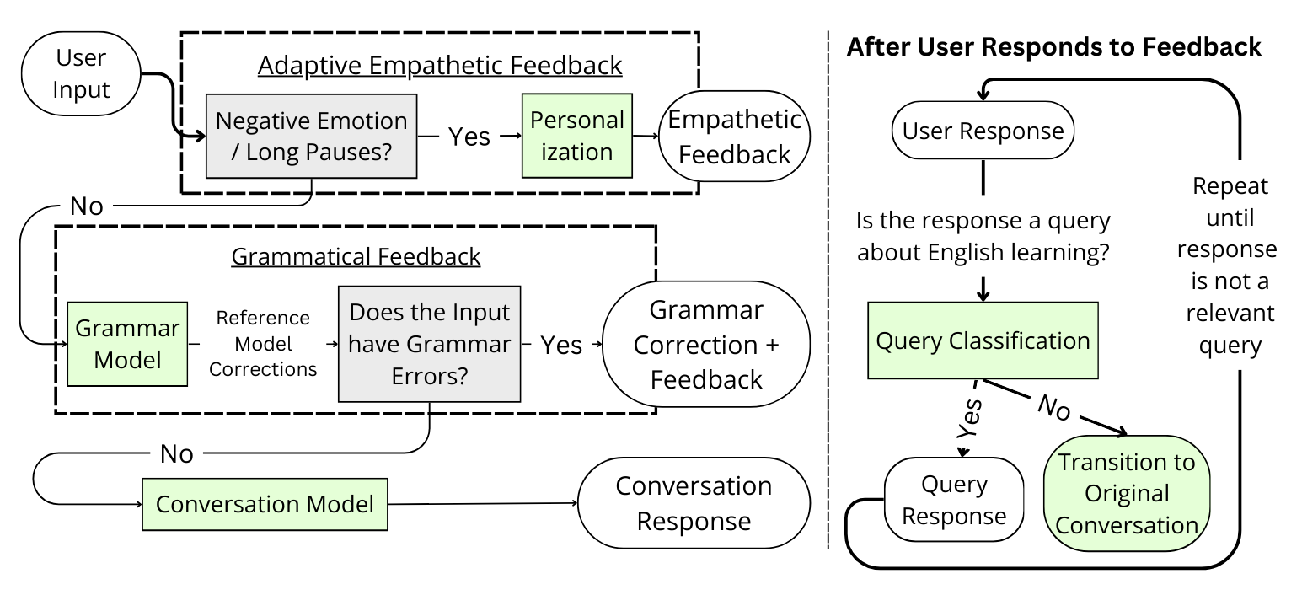
System Design
A chatbot for users to practice English conversations with, capable of grammar and empathetic feedback. We improve upon Siyan et al. [1]; improvements highlighted in Green.
[1] Siyan, L., Shao, T., Yu, Z., & Hirschberg, J. (2024). Using Adaptive Empathetic Responses for Teaching English. BEA Workshop, NAACL 2024.

Slide 8
Implementation
Notes:
So, we design the following system.

Slide 9
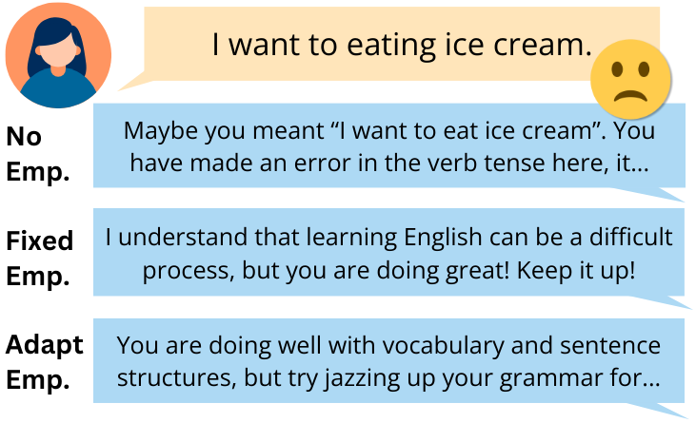
Empathetic Feedback Mechanisms

Slide 10
Negative Affect & Pause Detection
Perceived negative emotions
  Use existing wav2vec speech emotion recognition model [1]
Pauses, since pauses are related to foreign language anxiety
  Use Silero-VAD (voice activity detection) for pause duration [2]
  Use the average pause length as a metric
If we detect either, then trigger Empathetic Feedback
[1] https://huggingface.co/ehcalabres/wav2vec2-lg-xlsr-en-speech-emotion-recognition
[2] https://github.com/snakers4/silero-vad

Slide 11
Adaptive Empathetic Feedback
Based on past user utterances to provide targeted, specific feedback
Employ a “criticism sandwich” structure
E.g. “You’re doing well with the topic, but work on your grammar to sound smoother. For instance, say "I know what the recipe should taste like" instead of "I know the recipe taste like." Keep practicing to get even better! Does that sound alright to you?”

Slide 12
Grammatical Feedback
Synthesized grammar corrections for real Mandarin native speaker utterances using GPT-4
Fine-tuned Llama-2-chat-7B to provide grammar corrections
Use a template-based approach, coupled with POS tagging, to create the grammar feedback

Slide 13
Conversation
Current dialogue models tend to assume that both speakers in a dialogue are native English speakers
Used ChatGPT to synthesize conversations where one party is an ESL speaker
Fine-tuned Llama-2-Chat-7B to conduct conversations with ESL speakers on a variety of topics
  E.g. TV shows, movies, books, etc
Spoken chatbot; TTS using Amazon Polly, ASR using Whisper

Slide 14
User Study

Slide 15
Population
Recruited through social media and personal connections
31 Native Mandarin speakers
Self-reported English proficiency at least intermediate
Filled out questionnaire for perceived affective support from chatbot and L2 grit

Slide 16
PAS and Different Empathetic Feedback Mechanisms
 | Encourages me when struggling | Listens to me | Cares about my opinion | Appreciates and praises me when doing well | PAS
None | 3.53 | 4.12 | 4.00 | 3.47 | 3.78
Fixed | 3.83 | 2.83 | 3.00 | 3.67 | 3.33
Adaptive | 4.38 | 4.00 | 3.88 | 4.38 | 4.16

Slide 17
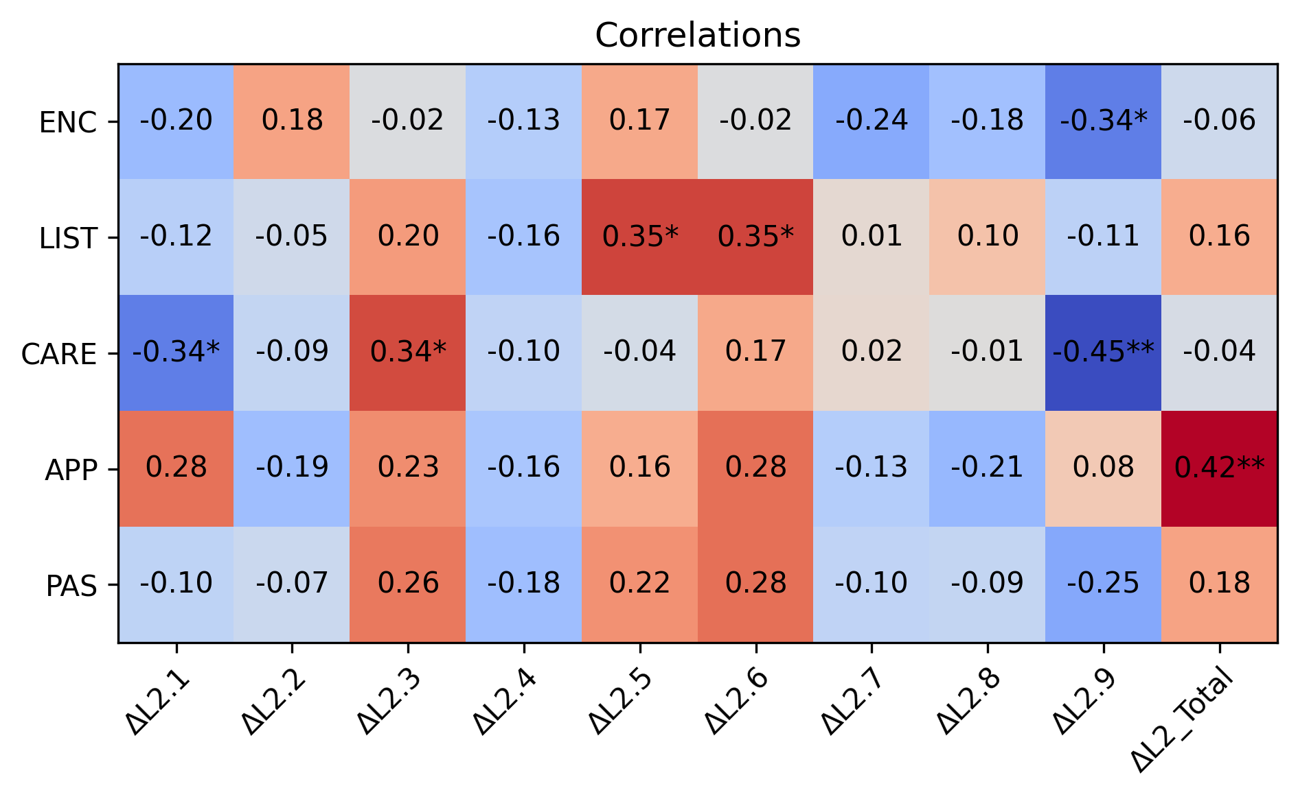
Correlation between PAS and Change in L2 Grit

Slide 18
Takeaways
The adaptive empathetic feedback approach is the most effective at increasing perceived affective support.
Some aspects of perceived affective support correlate with increasing student L2 grit post-interactions.
We can attempt to expand sample size, but this can be difficult for many reasons in the United States.
Users appreciate how supportive the empathetic chatbot is; they are sometimes pleasantly surprised when they receive encouragement.

Slide 19
Proficiency-Adaptive Chatbot
Slides Text Credit: Zack Rackauckas

Slide 20
Motivation
English learners have different proficiency levels
Using vocabulary that are significantly out of their proficiency level can be frustrating and discouraging
LLMs like ChatGPT often assume that the users are native English speakers
  And therefore produce prolonged responses with complex vocabulary

Slide 21
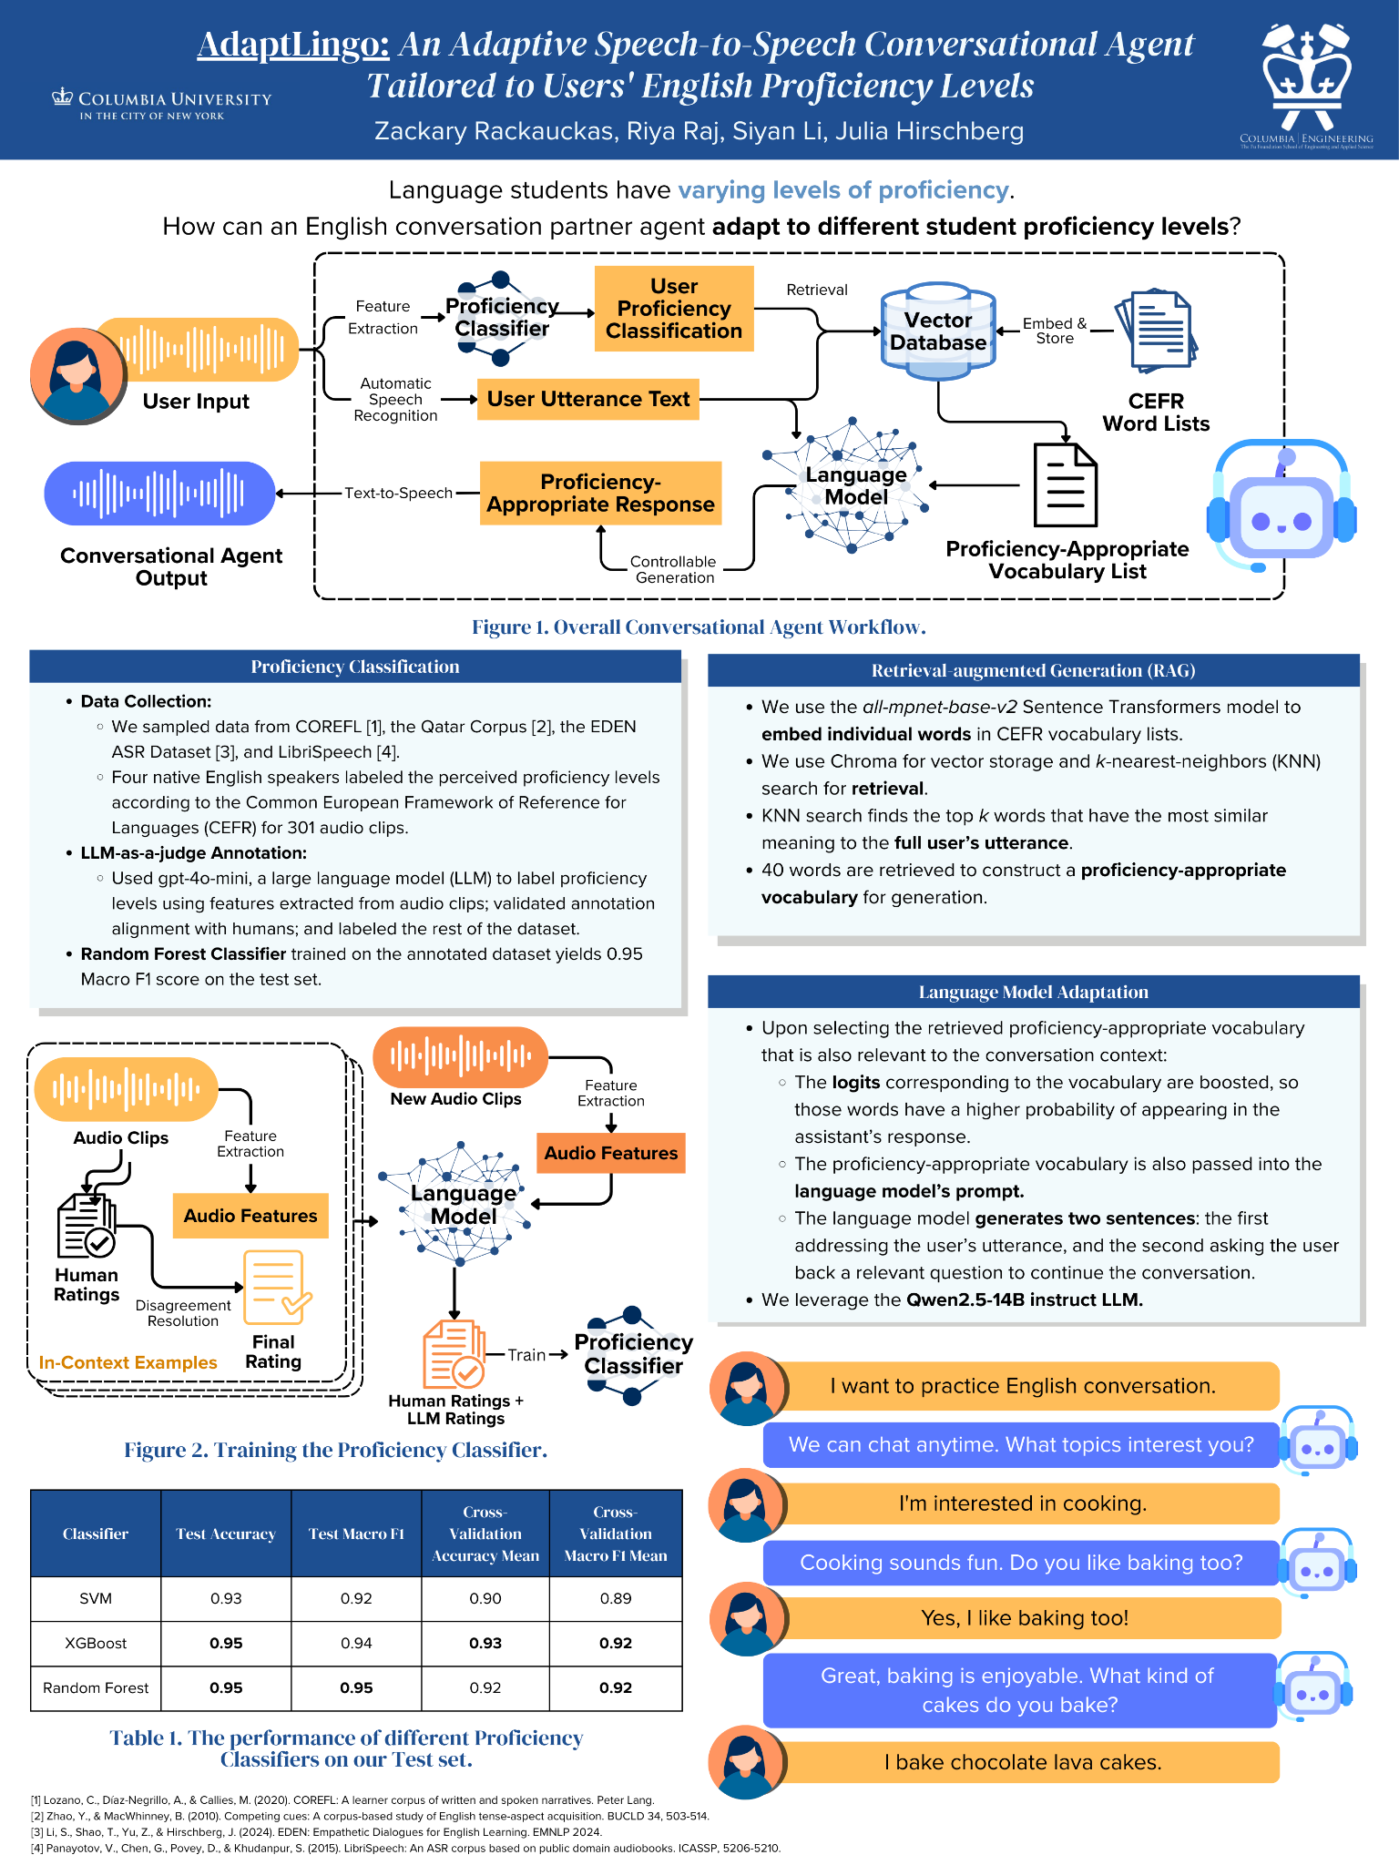
Chatbot System Structure
Common European Framework of Reference for Languages (CEFR): Measure for English language proficiency. Levels range from A1 through C2.

Slide 22
Proficiency Classifier
Data Collection:
  We sampled data from COREFL [1], the Qatar Corpus [2], the EDEN ASR Dataset [3], and LibriSpeech [4].
  Four native English speakers labeled the perceived proficiency levels according to CEFR.
LLM-as-a-judge Annotation:
  Used gpt-4o-mini, a large language model (LLM) to label proficiency levels using features extracted from audio clips; validated annotation alignment with humans; and labeled the rest of the dataset.
Random Forest Classifier trained on the annotated dataset yields 0.95 Macro F1 score on the test set.

Slide 23
Proficiency-Based Output Adaptation
Upon selecting the retrieved proficiency-appropriate vocabulary that is also relevant to the conversation context:
  The logits corresponding to the vocabulary are boosted, so those words have a higher probability of appearing in the assistant’s response.
  The proficiency-appropriate vocabulary is also passed into the language model’s prompt.
  The language model generates two sentences: the first addressing the user’s utterance, and the second asking the user back a relevant question to continue the conversation.
We leverage the Qwen 2.5-14B instruct LLM.

Slide 24
Thank You!
Contact: siyan.li@columbia.edu

