Slide 1

Audio-Language Models
William Ho

Slide 2
Overview
Yu-Wen mentioned challenges with Audio-Language Models
We will dive into some of those!
However, to understand these challenges, we first need to understand Audio-Language Models themselves
We will learn how to build an Audio-Language Model

Slide 3
Motivation
Large Language Models have seen unprecedented development in the past few years
Built using the “Transformer” architecture, which was originally proposed for text sequence-to-sequence processing
People have extended them to many modalities
Images
Audio

Slide 4
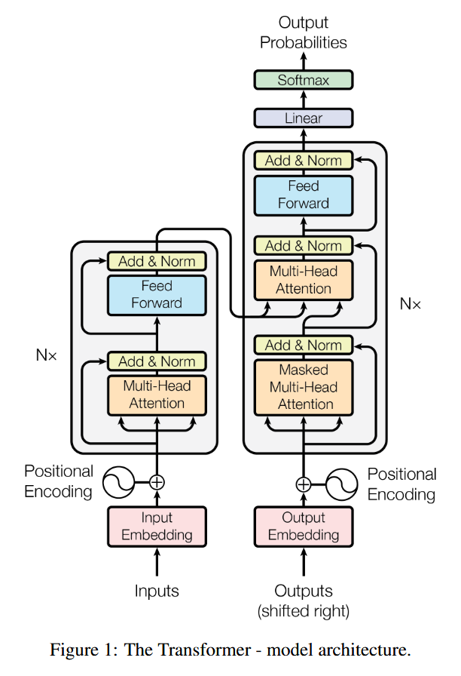
Large Language Models Architecture Overview

Slide 5
Large Language Models Architecture Overview
Decoder
Encoder
The original transformer is an encoder-decoder model for sequence processing

Slide 6
Large Language Models Architecture Overview
Decoder
Encoder
“Generative” auto-regressive LLMs are built using only the transformer decoder
“Masked self-attention” prevents the model from “cheating” by seeing the future
This is your “GPT” style models
Input

Slide 7
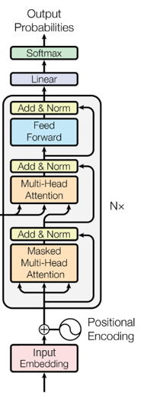
Large Language Models Architecture Overview
Decoder
LLMs are pretrained on a vast text corpora
- Rich semantic understanding out of the box
Strong reasoning and instruct-following
- Can respond to user queries
Strong transfer learning
- Can effectively be fine-tuned to new domains and accept modalities

Slide 8
Large Language Models Architecture Overview
We will abstract the Large Language Model
Decoder
Output
(usually text)
LLM
…

Slide 9

Large Language Models Architecture Overview
Output
(usually text)
The transformer architecture is generic and can process any sequence you can think of
Key idea: if you can turn it into a (sequence of) vector(s), you can feed it into the LLM!
LLM
…
$x_{i}∈ℝ^{d}, i=1,…, n$

Slide 10
Large Language Models Architecture Overview
Output
(usually text)
The transformer architecture is generic and can process any sequence you can think of
Key idea: if you can turn it into a (sequence of) vector(s), you can feed it into the LLM!
Examples:
Text → Subwords → Embedding lookup
Images → Image patches → Linear Projection
Audio → We will discuss this!
LLM
…
$x_{i}∈ℝ^{d}, i=1,…, n$

Slide 11
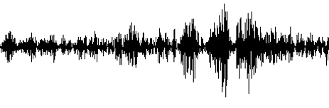
Large Language Models For Audio?
Goal: We want to process audio using an LLM
We need to turn an audio waveform into a sequence of vectors
How?
Output
(usually text)
LLM
?
…
$x_{i}∈ℝ^{d}, i=1,…, n$

Slide 12
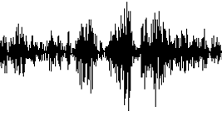

Large Language Models For Audio? Approach 1: Cascading System
Output
(usually text)
Naïve method:
Transcribe audio into text
Feed text into LLM
LLM
ASR Model
Text Transcript:
“I am feeling good”
…
$x_{i}∈ℝ^{d}, i=1,…, n$

Slide 13
Large Language Models For Audio? Approach 1: Cascading System
Output
(usually text)
Naïve method:
Transcribe audio into text
Feed text into LLM
Problem - No access to actual Audio!
We only capture what was said, but not how it was said.
LLM
ASR Model
Text Transcript:
“I am feeling good”
…
$x_{i}∈ℝ^{d}, i=1,…, n$

Slide 14
Large Language Models For Audio? Approach 1: Cascading System
Output
(usually text)
Naïve method:
Transcribe audio into text
Feed text into LLM
Problem - No access to actual Audio!
We only capture what was said, but not how it was said.
Text preserves semantic content, but discards prosodic, paralinguistic, and speaker-specific information.
LLM
ASR Model
Text Transcript:
“I am feeling good”
…
$x_{i}∈ℝ^{d}, i=1,…, n$

Slide 15
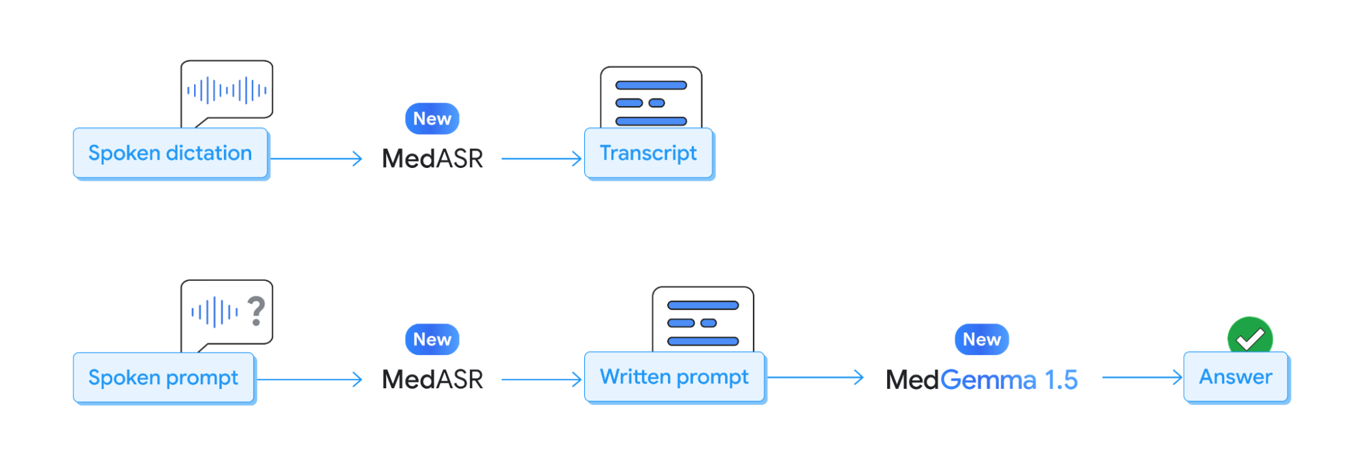
Large Language Models For Audio? Approach 1: Cascading System
Google Health AI team’s current pipeline

Slide 16

Large Language Models For Audio? Approach 2: Raw Audio Input
Output
(usually text)
Feed waveform directly into LLM
Set $x_{i}$ as frame $i$
LLM
…
$x_{i}∈ℝ^{d}, i=1,…, n$

Slide 17
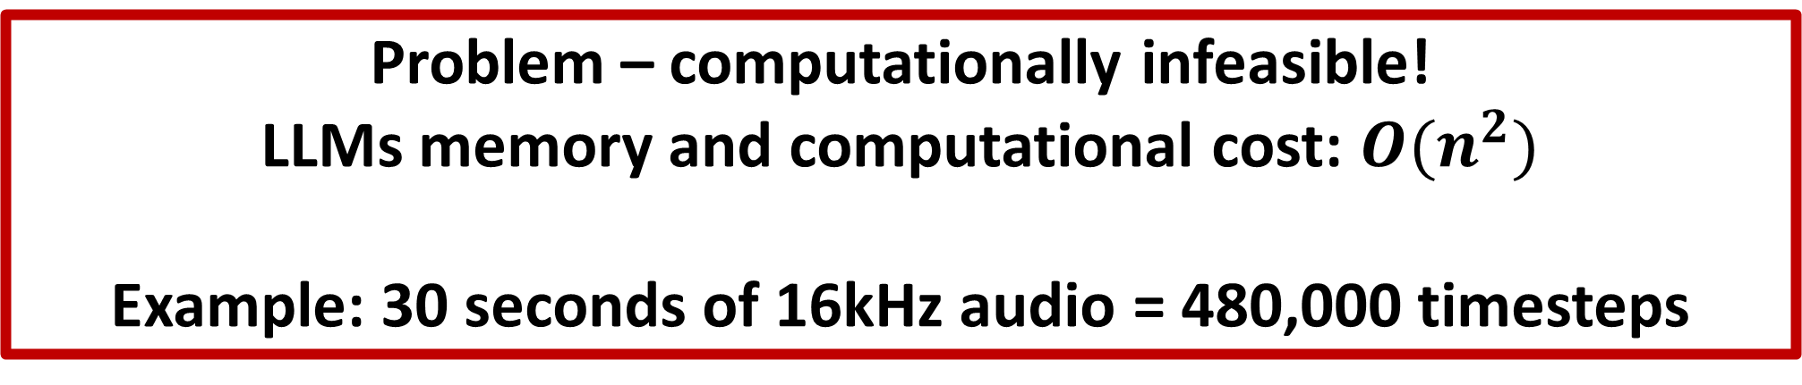
Large Language Models For Audio? Approach 2: Raw Audio Input
Output
(usually text)
Feed waveform directly into LLM
Set $x_{i}$ as frame $i$
Problem – computationally infeasible!
LLMs memory and computational cost: $O(n^{2})$
Example: 30 seconds of 16kHz audio = 480,000 timesteps
LLM
…
$x_{i}∈ℝ^{d}, i=1,…, n$

Slide 18
Large Language Models For Audio? Approach 2: Raw Audio Input
Examples: No one does this in practice…

Slide 19
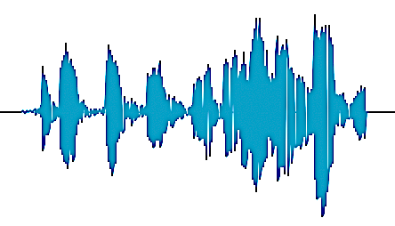
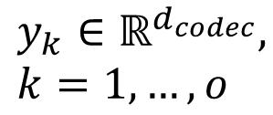
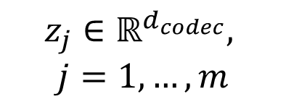

Large Language Models For Audio? Approach 3: Discrete Audio Tokens
Audio!
Decoder
Introduced last week!
Instead of continuous waveforms, lets work with discrete audio tokens!
Output tokens
…
$y_{k}∈ℝ^{d_{codec}}, k=1,…, o$
LLM
Latent Vectors
Quantization
+ Emb. lookup
Encoder
…
…
$$z_{j}∈ℝ^{d_{codec}},$$
$$j=1,…,m$$
$x_{i}∈ℝ^{d}, i=1,…, n$

Slide 20
Large Language Models For Audio? Approach 3: Discrete Audio Tokens
Audio!
Decoder
Flow (slightly simplified):
Waveforms are encoded into continuous vectors
Output tokens
…
$y_{k}∈ℝ^{d_{codec}}, k=1,…, o$
LLM
Latent Vectors
Quantization
+ Emb. lookup
Encoder
…
…
$$z_{j}∈ℝ^{d_{codec}},$$
$$j=1,…,m$$
$x_{i}∈ℝ^{d}, i=1,…, n$

Slide 21
Large Language Models For Audio? Approach 3: Discrete Audio Tokens
Audio!
Decoder
Flow (slightly simplified):
Waveforms are encoded into continuous vectors
The vectors are quantized and matched to their nearest codebook entry, and only the index is kept
The tokens are used to look up input embeddings for LLM
Output tokens
…
$y_{k}∈ℝ^{d_{codec}}, k=1,…, o$
LLM
Latent Vectors
Quantization
+ Emb. lookup
Encoder
…
…
$$z_{j}∈ℝ^{d_{codec}},$$
$$j=1,…,m$$
$x_{i}∈ℝ^{d}, i=1,…, n$

Slide 22
Large Language Models For Audio? Approach 3: Discrete Audio Tokens
Audio!
Decoder
Flow (slightly simplified):
Waveforms are encoded into continuous vectors
The vectors are quantized and matched to their nearest codebook entry, and only the index is kept
The tokens are used to look up input embeddings for LLM
LLM processes input embeddings as before
Output tokens
…
$y_{k}∈ℝ^{d_{codec}}, k=1,…, o$
LLM
Latent Vectors
Quantization
+ Emb. lookup
Encoder
…
…
$$z_{j}∈ℝ^{d_{codec}},$$
$$j=1,…,m$$
$x_{i}∈ℝ^{d}, i=1,…, n$

Slide 23
Large Language Models For Audio? Approach 3: Discrete Audio Tokens
Audio!
Decoder
Flow (slightly simplified):
Waveforms are encoded into continuous vectors
The vectors are quantized and matched to their nearest codebook entry, and only the index is kept
The tokens are used to look up input embeddings for LLM
LLM processes input embeddings as before
Output tokens are mapped back to vectors using the same codebook from step 2
The vectors are decoded back to audio
Output tokens
…
$y_{k}∈ℝ^{d_{codec}}, k=1,…, o$
LLM
Latent Vectors
Quantization
+ Emb. lookup
Encoder
…
…
$$z_{j}∈ℝ^{d_{codec}},$$
$$j=1,…,m$$
$x_{i}∈ℝ^{d}, i=1,…, n$

Slide 24
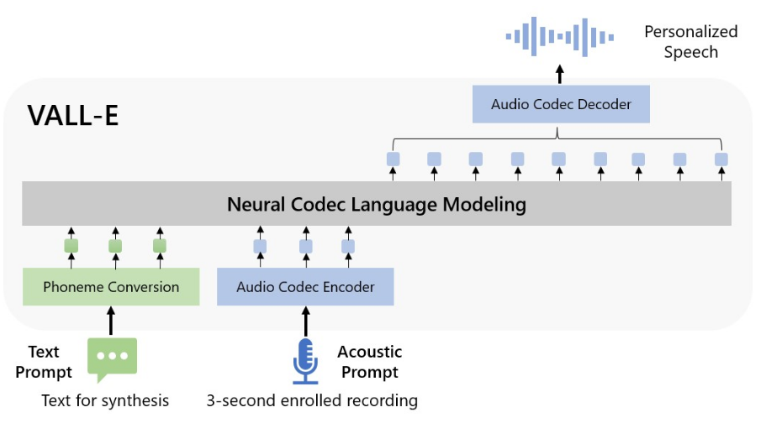
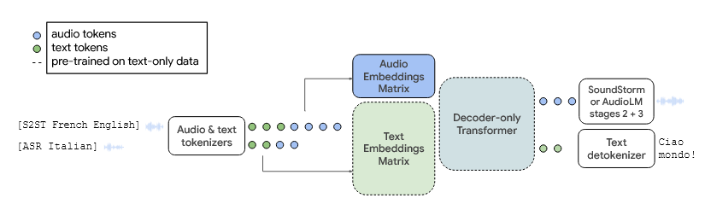
Large Language Models For Audio? Approach 3: Discrete Audio Tokens
This family of models can generate audio!
VALL-E
AudioPaLM

Slide 25
Large Language Models For Audio? Approach 3: Discrete Audio Tokens
This family of models can generate audio!
VALL-E
AudioPaLM
Problem – Audio Quality!
Audio tokenization is a lossy compression method, so the resulting audio quality has a ceiling

Slide 26
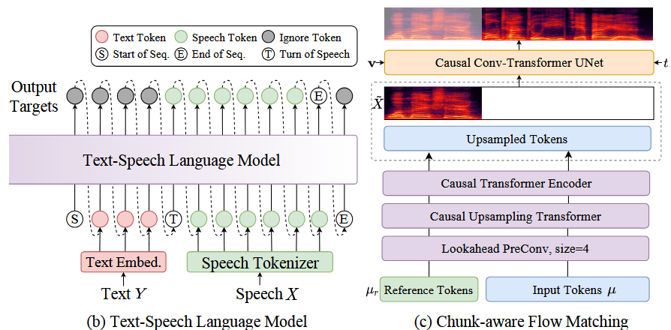
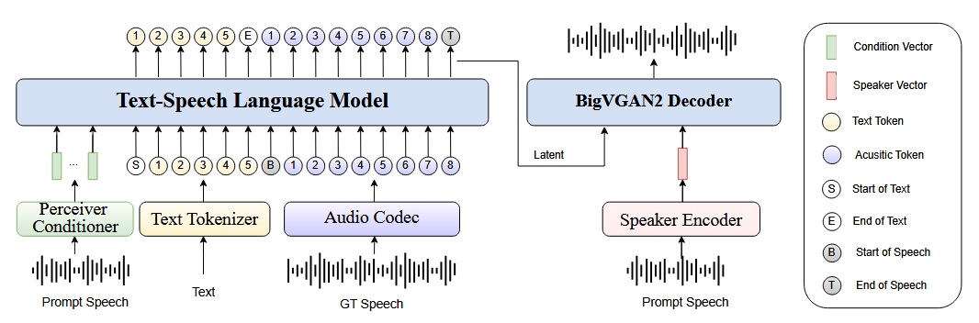
Large Language Models For Audio? Approach 3: Discrete Audio Tokens
Recent models use vocoders to generate audio
Vocoder
IndexTTS (1)
CosyVoice 2
Method 1: Directly convert LLM output latent vector into a waveform using a vocoder.
(Less popular method)
Method 2: Convert LLM outputs to a spectrogram and apply vocoder to generate waveform.
(More popular. IndexTTS2 also uses this method)

Slide 27
Large Language Models For Audio? Approach 3: Discrete Audio Tokens
This family of models is typically used for speech / audio generation
Audio tokens typically capture lots of acoustic information
However, requires a high sampling rate, leading to many input tokens to LLM
Audio tokens are trained for audio reconstruction – they do not necessarily capture semantic information for reasoning
Furthermore, a lot of the information captured might not be relevant for reasoning about the audio itself

Slide 28
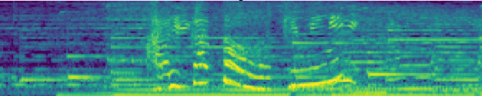
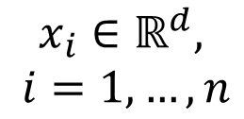
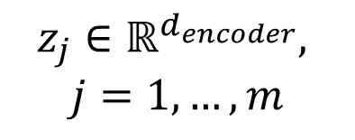
Large Language Models For Audio? Approach 4: Continuous Audio Representations
Output
(usually text)
Instead of quantizing to a fixed set of audio tokens, we directly input continuous audio embeddings
The LLM processes both text embeddings and audio embeddings simultaneously
Enables LLM to reason about the audio
LLM
…
Modality Projector
$$x_{i}∈ℝ^{d},$$ $i=1,…, n$
Audio Embeddings
Audio Encoder
…
$$z_{j}∈ℝ^{d_{encoder}},$$
$$j=1,…,m$$

Slide 29
Large Language Models For Audio? Approach 4: Continuous Audio Representations
Output
(usually text)
Flow (slightly simplified):
Waveform converted into log-mel spectrogram
LLM
…
Modality Projector
$$x_{i}∈ℝ^{d},$$ $i=1,…, n$
Audio Embeddings
Audio Encoder
…
$$z_{j}∈ℝ^{d_{encoder}},$$
$$j=1,…,m$$

Slide 30
Large Language Models For Audio? Approach 4: Continuous Audio Representations
Output
(usually text)
Flow (slightly simplified):
Waveform converted into log-mel spectrogram
The spectrogram is processed by an audio encoder (usually OpenAI Whisper encoder) into audio embeddings
LLM
…
Modality Projector
$$x_{i}∈ℝ^{d},$$ $i=1,…, n$
Audio Embeddings
Audio Encoder
…
$$z_{j}∈ℝ^{d_{encoder}},$$
$$j=1,…,m$$

Slide 31

Large Language Models For Audio? Approach 4: Continuous Audio Representations
Output
(usually text)
Flow (slightly simplified):
Waveform converted into log-mel spectrogram
The spectrogram is processed by an audio encoder (usually OpenAI Whisper encoder) into audio embeddings
Embeddings are projected to the LLM’s text embedding space via a multi-modal projector (linear layer or small MLP) $ℝ^{d_{encoder}}→ℝ^{d}$ ($usually d_{encoder}$ smaller than $d$)
LLM
…
Modality Projector
$$x_{i}∈ℝ^{d},$$ $i=1,…, n$
Audio Embeddings
Audio Encoder
…
$$z_{j}∈ℝ^{d_{encoder}},$$
$$j=1,…,m$$

Slide 32

Large Language Models For Audio? Approach 4: Continuous Audio Representations
Output
(usually text)
Flow (slightly simplified):
Waveform converted into log-mel spectrogram
The spectrogram is processed by an audio encoder (usually OpenAI Whisper encoder) into audio embeddings
Embeddings are projected to the LLM’s text embedding space via a multi-modal projector (linear layer or small MLP) $ℝ^{d_{encoder}}→ℝ^{d}$ ($usually d_{encoder}$ smaller than $d$)
LLM processes audio embeddings AND text embeddings as before
LLM
…
Modality Projector
$$x_{i}∈ℝ^{d},$$ $i=1,…, n$
Audio Embeddings
Audio Encoder
…
$$z_{j}∈ℝ^{d_{encoder}},$$
$$j=1,…,m$$

Slide 33


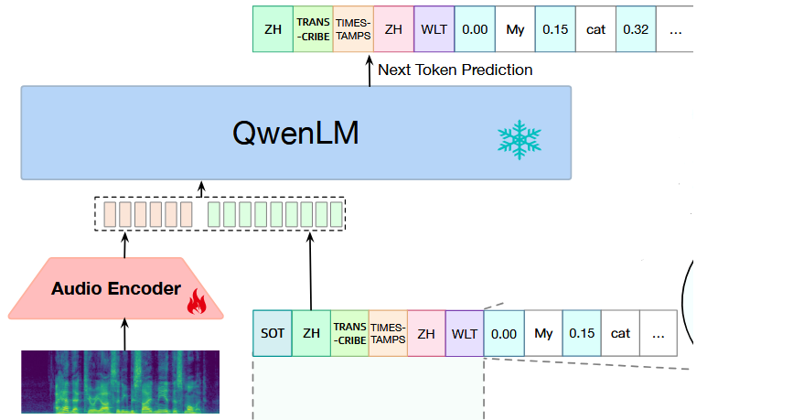
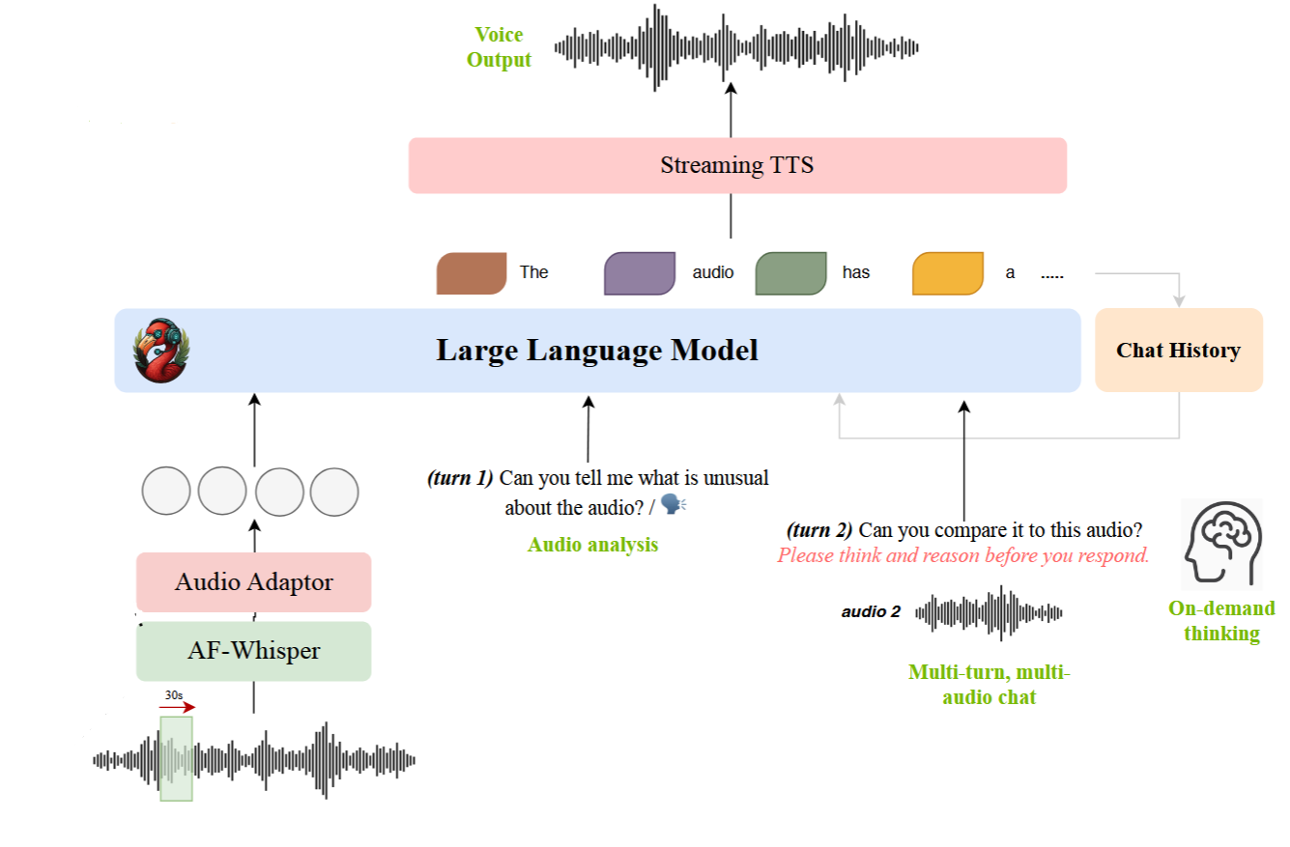
Large Language Models For Audio? Approach 4: Continuous Audio Representations
You can chat with these models like a normal LLM, but with speech (and text)!
Qwen-Audio
Audio-Flamingo 3

Slide 34
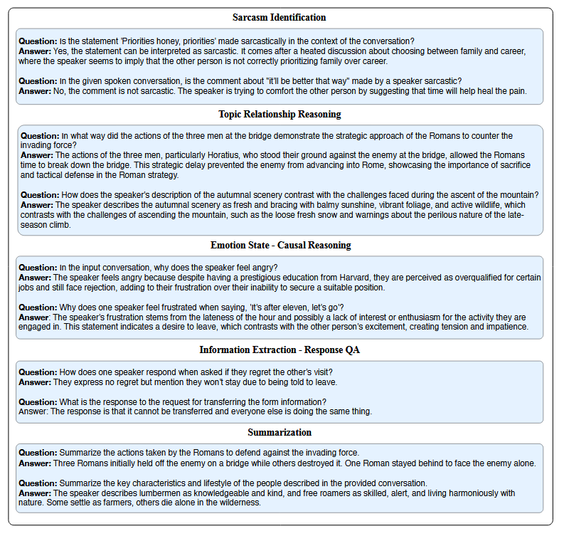
Large Language Models For Audio? Approach 4: Continuous Audio Representations
Trained through instruction-finetuning on a large dataset of diverse audio/speech tasks
(Audio + Text input → Text output)
Should learn general audio/speech reasoning

Slide 35
Large Language Models For Audio? Approach 4: Continuous Audio Representations
Output
(usually text)
The audio encoder is typically a OpenAI Whisper encoder pretrained on ASR (transcribe audio)
The audio embeddings encode strong semantic information
Furthermore, the LLM is a pretrained text-only LLM, which is finetuned together with the new components to process audio + text information simultaneously
LLM
…
Modality Projector
$$x_{i}∈ℝ^{d},$$ $i=1,…, n$
Audio Embeddings
Audio Encoder
…
$$z_{j}∈ℝ^{d_{encoder}},$$
$$j=1,…,m$$

Slide 36
Large Language Models For Audio? Approach 4: Continuous Audio Representations
Output
(usually text)
The audio encoder is typically a OpenAI Whisper encoder pretrained on ASR (transcribe audio)
The audio embeddings encode strong semantic information
Furthermore, the LLM is a pretrained text-only LLM, which is finetuned together with the new components to process audio + text information simultaneously
LLM
…
Modality Projector
$$x_{i}∈ℝ^{d},$$ $i=1,…, n$
Audio Embeddings
Audio Encoder
…
$$z_{j}∈ℝ^{d_{encoder}},$$
$$j=1,…,m$$

Slide 37
Large Language Models For Audio? Approach 4: Continuous Audio Representations
Output
(usually text)
The audio encoder is typically a OpenAI Whisper encoder pretrained on ASR (transcribe audio)
The audio embeddings encode strong semantic information
Furthermore, the LLM is a pretrained text-only LLM, which is finetuned together with the new components to process audio + text information simultaneously
LLM
Do these models actually capture relevant acoustic speech cues?
…
Modality Projector
$$x_{i}∈ℝ^{d},$$ $i=1,…, n$
Audio Embeddings
Audio Encoder
…
$$z_{j}∈ℝ^{d_{encoder}},$$
$$j=1,…,m$$

Slide 38





When Vocal Tone and Literal Meaning Diverge: An Acoustic–Semantic Incongruity Study for Large Audio–Language Models
They canceled the entire project after we worked all weekend
I appreciate that
Wow, you’re a genius
I am fine

Slide 39
Large Audio-Language Models
Output
(usually text)
From here, we will refer to Large Audio-Language Models (LALMs) as those described in Approach 4
LLM
…
Modality Projector
$$x_{i}∈ℝ^{d},$$ $i=1,…, n$
Audio Embeddings
Audio Encoder
…
$$z_{j}∈ℝ^{d_{encoder}},$$
$$j=1,…,m$$

Slide 40
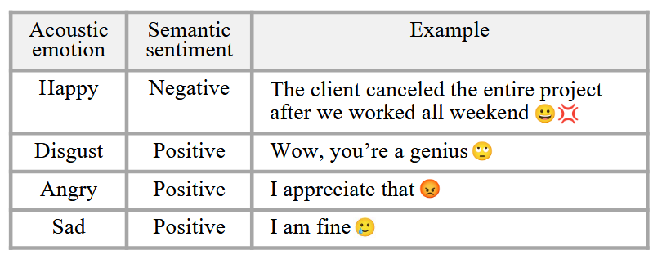
Do Audio-Language Models Actually Listen?
In many real-world cases, vocal tone and literal word meaning conflict
Humans are good at identifying these situations, but are LALMs?
We investigate whether LALMs genuinely listen to vocal cues, or simply rely on the words being spoken

Slide 41
How do we evaluate ALMs?
We need data!
Limited open-source dataset
Few datasets have both acoustic & semantic labels
Incongruous examples are especially scarce
Subjective acoustic emotion ≠ Objective semantic sentiment
Example: “he had a car accident.”
Acoustic emotion: neutral (factual), sad (sympathetic), or even happy (malicious)
Semantic sentiment: negative

Slide 42
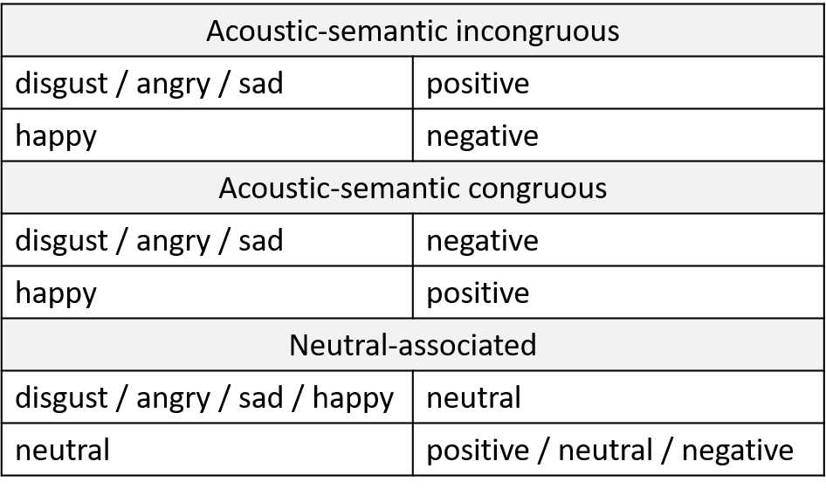
CREMA-ASIS
We build a synthetic speech dataset with incongruent acoustic emotions (how it’s said) and semantic sentiment (what is said)
Leverage SOTA TTS model with emotion control
Data synthesis
Source: GoEmotion
Target sentence
(e.g., positive sentence)
Source: CREMA-D
Audio
reference
(e.g., sad voice &
neutral-content)
Index
TTS2
Acoustic sad,
Semantic positive

Slide 43
CREMA-ASIS
We build a synthetic speech dataset with incongruent acoustic emotions (how it’s said) and semantic sentiment (what is said)
Leverage SOTA TTS model with emotion control
Data synthesis
Source: GoEmotion
Target sentence
(e.g., positive sentence)
Source: CREMA-D
Audio
reference
(e.g., sad voice &
neutral-content)
Index
TTS2
Acoustic sad,
Semantic positive

Slide 44
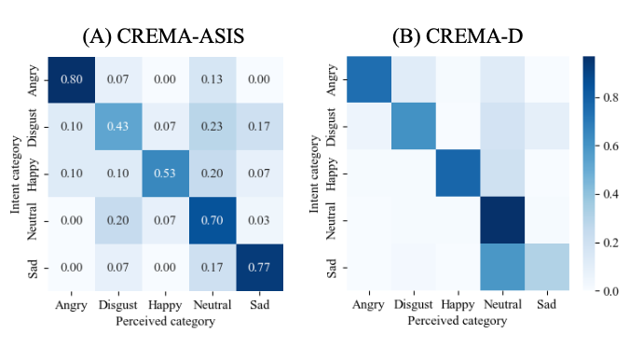
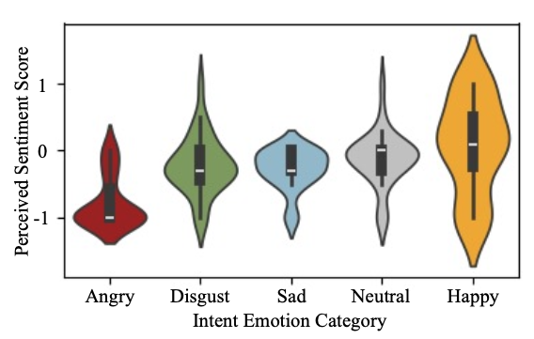
CREMA-ASIS Validation
WER≈0.1
Word error rate
(WER)
Target sentence
Audio
reference
Index
TTS2
Synthesized
speech signal
Recognized
sentence
ASR
Subjective listening

Slide 45



CREMA-ASIS Examples
Angry tone
Positive semantics
Sad tone
Positive semantics
Disgusted tone
Positive semantics
Happy tone
Negative semantics

Slide 46
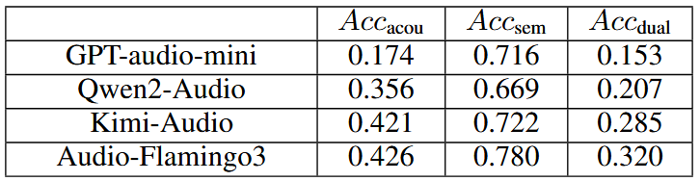



ALM performance on CREMA-ASIS
ALM for multitask recognition
ALM
Bad at acoustics, but good at semantics
Acoustic emotion?
Semantic sentiment?

Slide 47
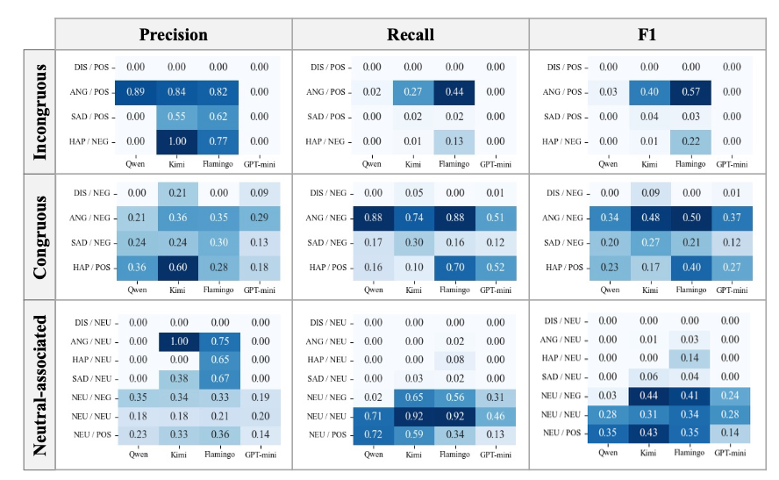
ALM performance on CREMA-ASIS
ALM for multitask recognition
ALM
Acoustic emotion?
Semantic sentiment?

Slide 48
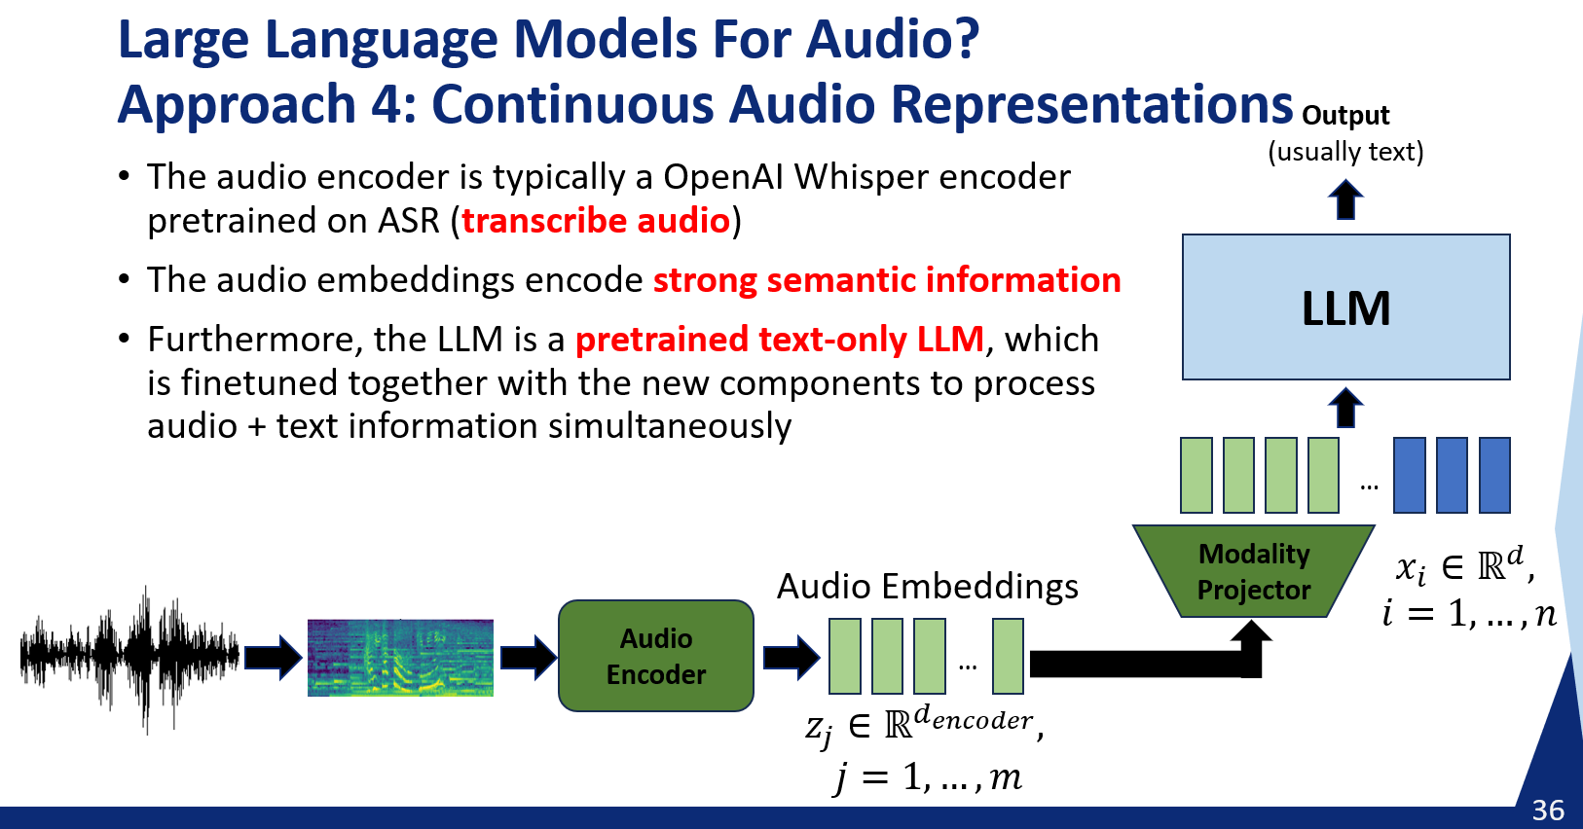
Let’s Recall What We Discussed Before
We studied ALMs that use continuous audio representations
Is this weakness due to audio representations with strong semantic information?

Slide 49
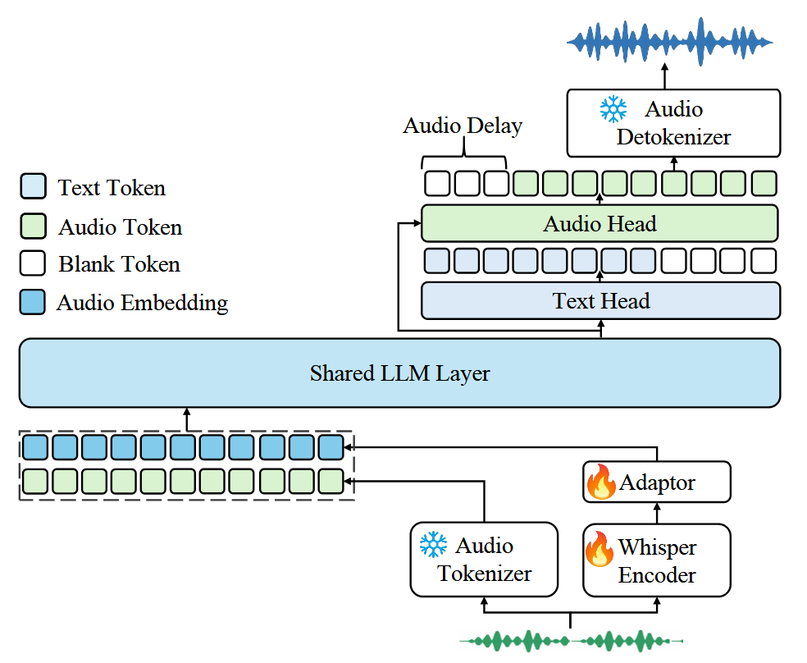

Let’s Recall What We Discussed Before
Is this weakness due to audio representations with strong semantic information?
Kimi-Audio combines continuous representations and (semantic) audio tokens
The problem still persists
Research question: do acoustic audio tokens help?
Kimi-Audio

Slide 50
So ALMs Are Not Very Good at Capturing Acoustic Cues…
What now?

Slide 51
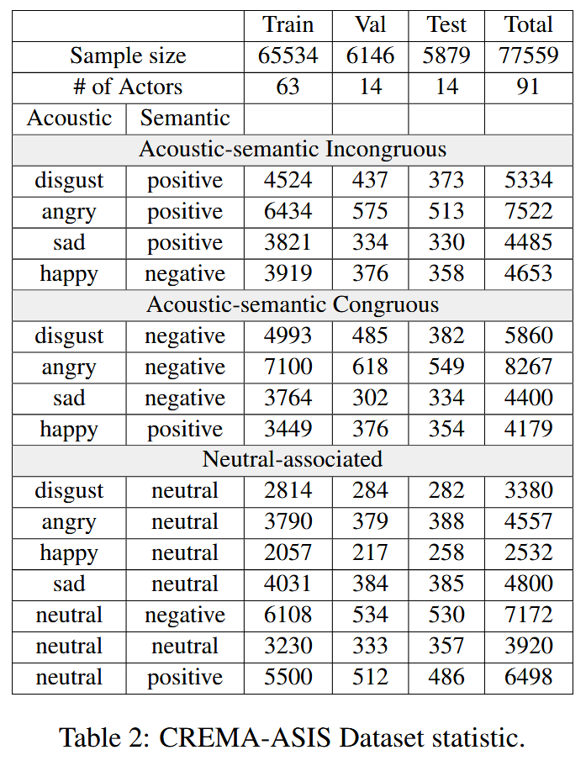
So ALMs Are Not Very Good at Capturing Acoustic Cues…
What now?
Synthetic data allows us to scale!
Can we use this to train the models to better capture acoustic cues?

Slide 52
Supervised Fine-Tuning (SFT)
You are an expert in annotation. Analyze the given audio and identify both its **acoustic** emotion and **semantic** sentiment.
Definitions:
- *Acoustic emotion*: the emotion conveyed by voice, regardless of word meaning or spoken content.
- *Semantic sentiment*: the sentiment expressed by the literal meaning of the words, regardless of how they are spoken.
Respond strictly in the following JSON format (no explanations, no extra text): { "acoustic_emotion": "<emotion inferred solely from acoustic cues: happy | sad | angry | fear | disgust | surprise | neutral | calm >",
"semantic_sentiment": "<sentiment inferred solely from semantic cues: positive | negative | neutral >"}
{
“acousitc_emotion:” “sad”,
“semantic_sentiment”: “positive”
}
ALM

Slide 53
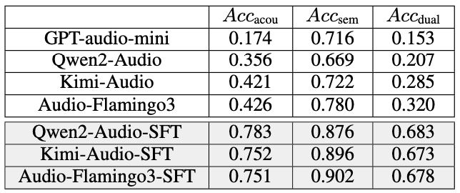
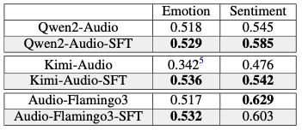
Results of SFT with Synthetic Data
Evaluation on synthetic test set (multi-task) (CREMA-ASIS)
Evaluation on joint recognition setting (MELD dataset)
Multi-task
Join recognition
Acoustic emotion?
Emotion?
ALM
ALM
Semantic sentiment?
Sentiment?
ALM

Slide 54
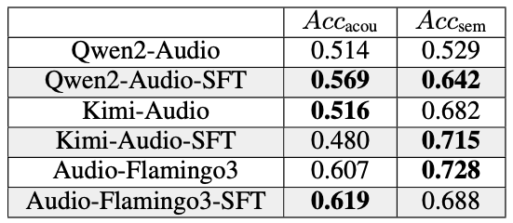
Results of SFT with Synthetic Data
Evaluation on out-of-domain data
(LISTEN dataset - real speech)
Multi-task
Acoustic emotion?
ALM
Semantic sentiment?

Slide 55

What is Happening Inside the ALM?
How does the ALMs process acoustic vs. semantic information?
How does SFT affect them?
We probe the hidden representations of the models across layers
(Embedding of ALM’s n’th layer)
(Embedding of ALM’s n’th layer)
(same embedding)
Linear
(independent classifiers)
Linear
Acoustic emotion
Semantic sentiment
CREMA-ASIS Label

Slide 56
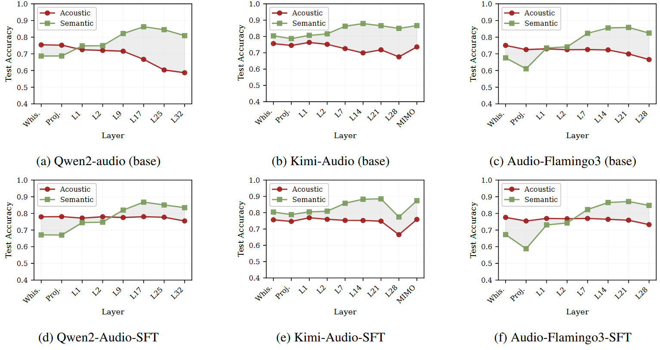
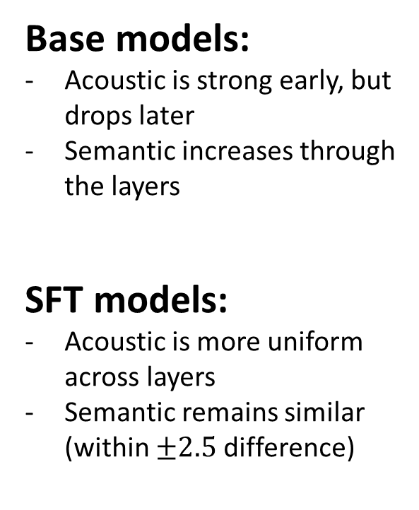
Layer-wise Linear Probing of ALMs
Base models:
Acoustic is strong early, but drops later
Semantic increases through the layers
SFT models:
Acoustic is more uniform across layers
Semantic remains similar (within $±2.5$ difference)

Slide 57
What Have We Learned?
We can adapt LLMs to process audio and speech
Two prominent directions:
Discrete Audio Tokens
Continuous Representations
Continuous representation ALMs don’t seem to actually “listen to how you talk”, but implicitly “read what you say”
SFT on synthetic data mitigates this bias

