Slide 1
Tools for Speech Analysis
Julia Hirschberg & Debasmita Bhattacharya
CS 6706
Thanks to Jean-Philippe Goldman, Fadi Biadsy, and many more...

Slide 2
Assignment Clarification
We will not ask you for writing assignments on weeks when a Homework is due – just check the Assignments link in Courseworks2
  Reminder: For Assignments, for each assigned paper or chapter, please provide 100-200 words for each positive and for each negative; this gives us a better chance to assess the quality of your responses.
  For some Assignments (not all), you will also be asked to provide “3 insightful and potentially challenging questions each about one of the readings (paper or chapter).”
Notes:
As usual, we are going to start with a brief housekeeping note. This week’s announcement is a clarification: [read slide]
[Make sure to have the mac fold /Documents/CS6998-23/Slides/mywavefiles up on mac]

Slide 3
Today
We’ll go through some exercises recording and analyzing files through the Praat software
  First, make sure you have the latest version of Praat, 6.4.39 from 07/13/2025, installed on your laptop
  If you have not been able to record yourself before this class, please do so now: put on your headphones and adjust the microphone so that it is slightly to one side of your mouth
  Also download these files as a backup from our course Files -> Wav files
    mama-jh.wav will be your first wavfile today
Notes:
[read slide]

Slide 4
A Speech Analysis Tool: Praat
Developed by Paul Boersma and David Weenink at the Institute of Phonetic Sciences, University of Amsterdam
General purpose speech tool
  Used for editing, segmentation and labeling, prosodic manipulation and analysis, and more (as you’ve seen in the readings and video tutorials for today)
  Large user community, Praat-Users-List
  Today we will go through some basics together
Notes:
While everyone is getting set up, I’m going to share a brief introduction to the software that we’ll spend the class using.
As you will have seen in your readings for today, Praat is a general purpose speech tool that was developed by two scientists at the Institute of Phonetic Sciences, whose first aim was to give students and scientists of Phonetics a handy tool for manipulating speech data and for creating stimuli for perception experiments. It can be used to help with many aspects of speech analysis, and we’ll spend the class today walking through some of the basics together.

Slide 5
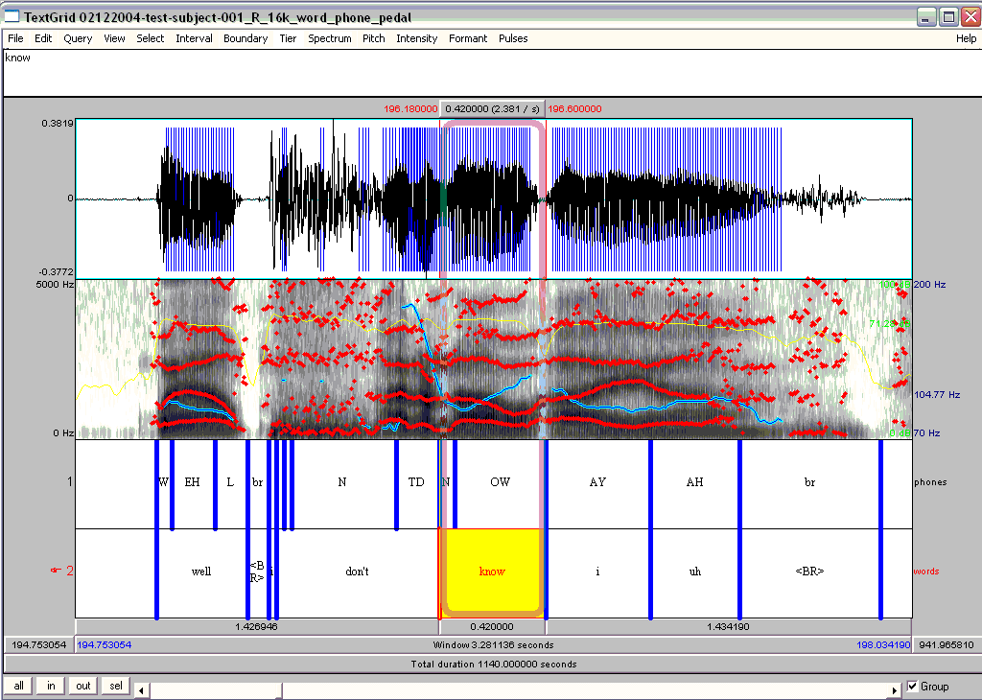
Notes:
This is what one form of a well-annotated speech file looks like in Praat, with wav file, spectrogram, and phones and words. Now we’re going to find out how to produce one of these.

Slide 6
Revisiting Assignment for Today
“Record your own voice in a quiet room preferably using a head-mounted microphone. Recordings to produce and save where X is your name:
  “My mama lives in Memphis.” Save as “mama”-X
  Now record the same sentence as a whisper. Save as “whisper”-X
  And now record the same sentence in a creaky voice. Save as “creaky”-X
  Now record the same sentence as a yes-no question with pitch starting low and rising at the end “My mama lives in Memphis?” Save as “ynq”-X
  And now record “Where does my mama live?” as a wh-question with pitch starting high and gradually becoming low to the end. Save as “whq”-X
  Record “My mam lives in Memphis” again in 3 ways: as angry speech, as sad speech, and as happy speech. Save each as “angry”-X, “sad”-X, and “happy”-X”
Did anyone use Praat to do the recordings? If so, you don’t need to record again, and can just upload your recordings in Praat
If you did not, let’s all learn how to do that and record the first file “mama”-X again in Praat – but those who have a better (quieter) version already should use that for the rest of the class
Notes:
This is the assignment that you should have done for today: how many of you were able to do this? How many could not?
Did anyone use Praat to make their recordings? If so, you don’t need to do this next part again, and you can just upload your recordings to Praat now. If you didn’t use Praat to make your recordings, we’re all going to step through how to do that now and record the first file again in Praat BUT don’t replace the version you recorded at home! This exercise is just to show you how to make a recording in Praat and you should use your home-recorded versions of the files for the rest of class.

Slide 7
How do we Record and Manage Files?
Open Praat on your laptop
  You’ll see 2 windows, an Objects window (left) and a Picture window (right)
  Today we’ll focus on the first
Notes:
So everyone should do this recording but don’t lose your better version of “mama-X”
[read slide]
[Show both in next slide: objects and picture windows then recording window]
The Picture window basically lets you save results in a more legible way

Slide 8
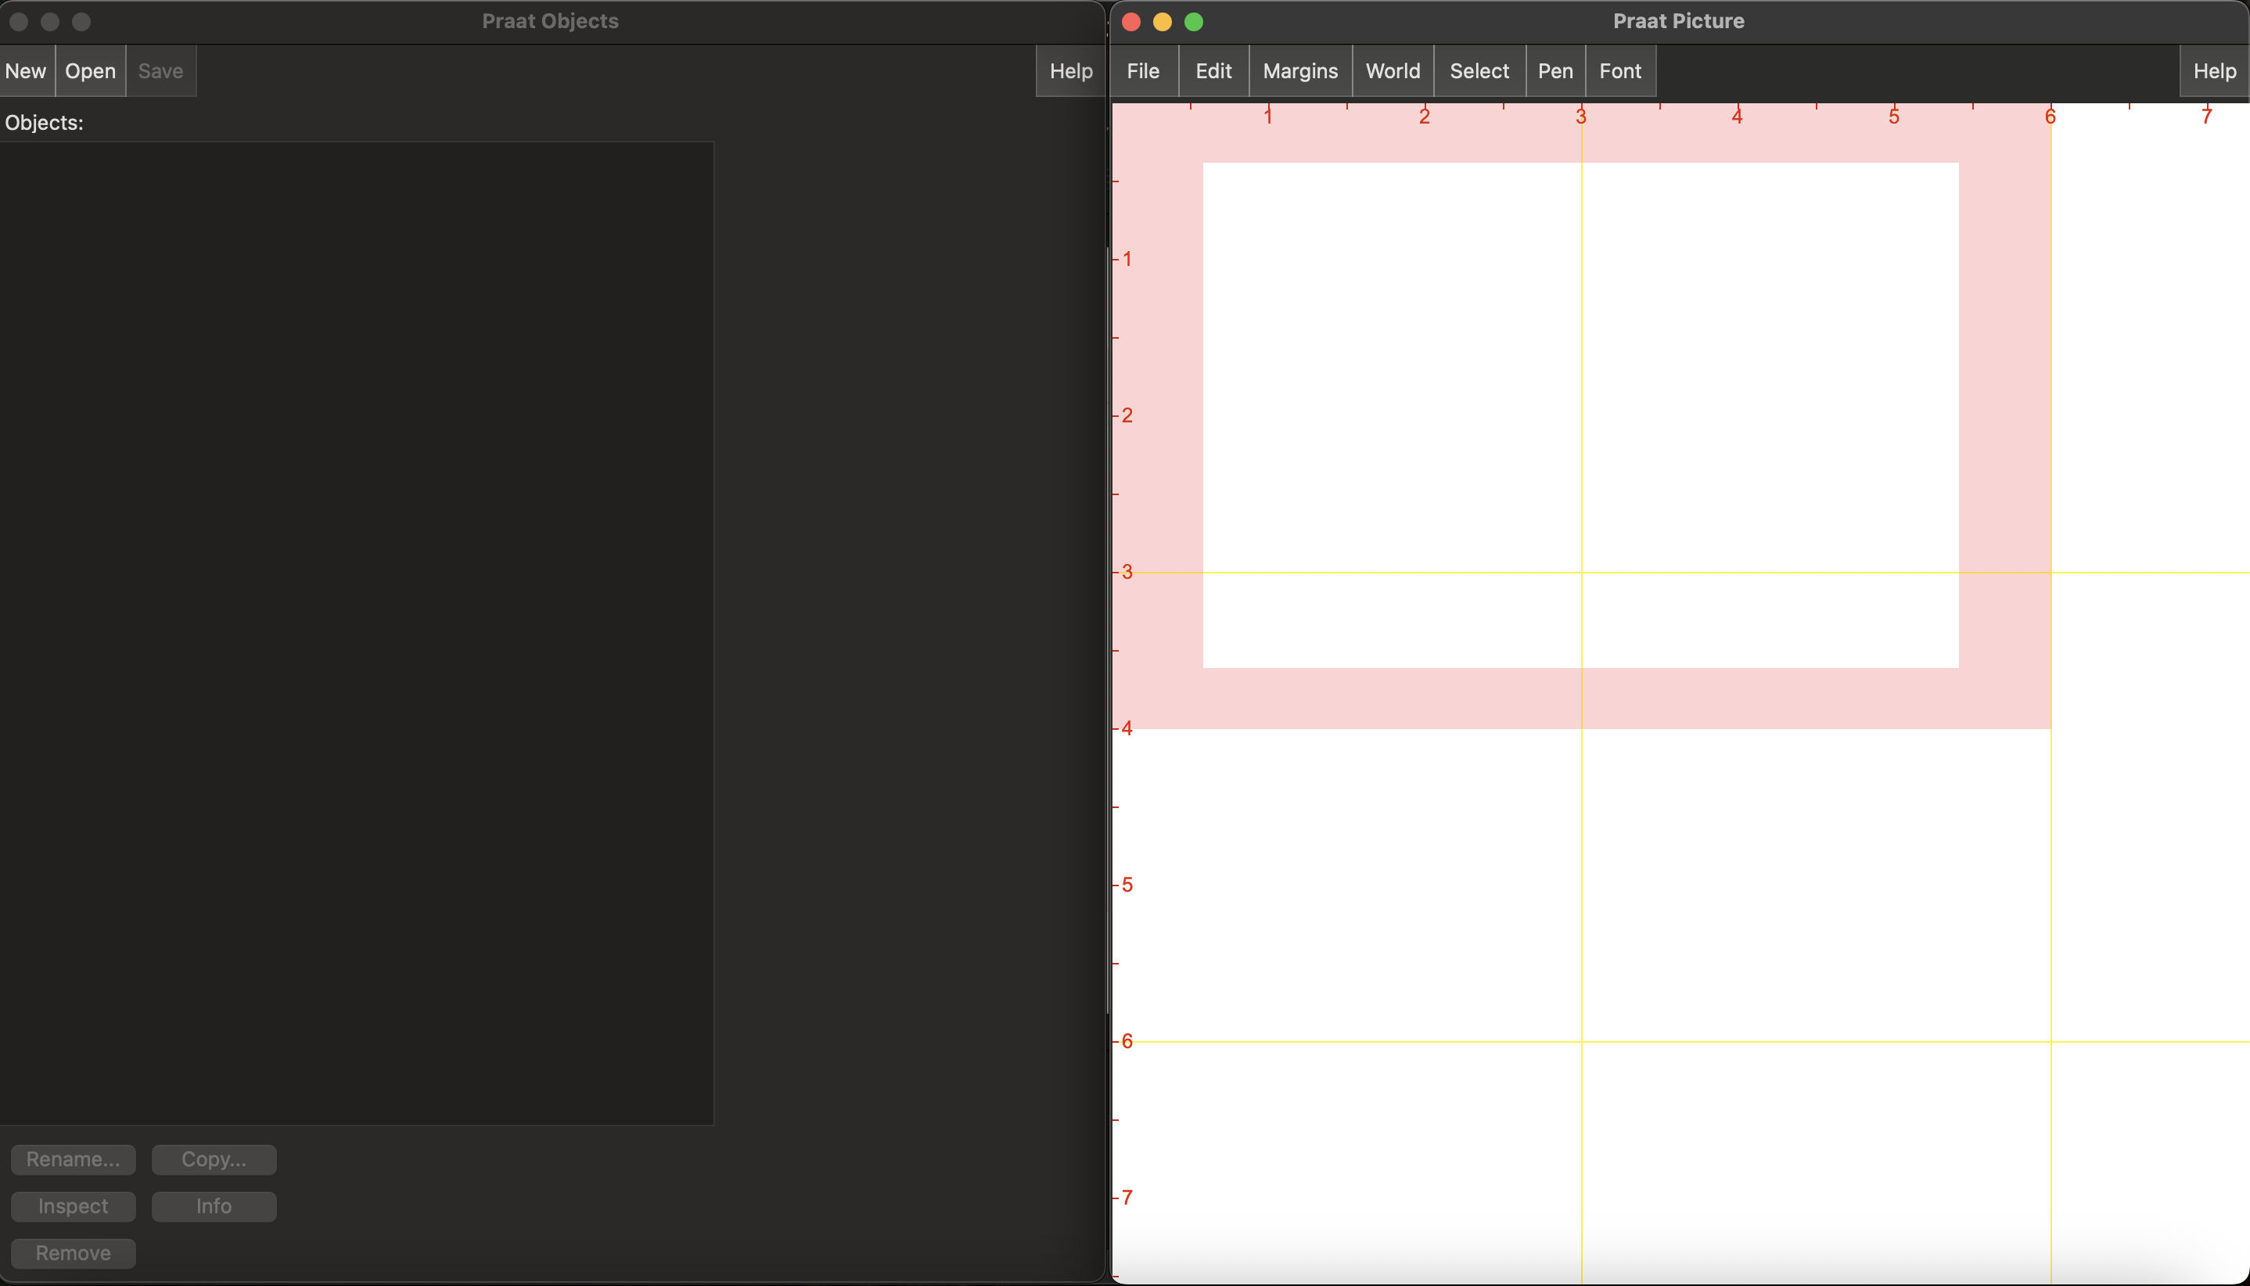
Notes:
Here is what you should see when you open Praat.
To record your voice in Praat:
Select “New” in the Objects window on the left… [go to next slide]

Slide 9

How do we Record and Manage Files?
How to Record files and save them
  Select the New tab at top left of the Objects window:
    Record mono sound: “My mama lives in Memphis” as a statement, stop recording, play it to see if you like it, name it (bottom left) as “mama-<your name>” and Save-to-list-&-close
  If you have already recorded yourself using Praat, in Praat Objects select your file from your laptop using Open -> Read from file (or select the downloaded file mama-jh.wav from Courseworks → Files)
Notes:
… and follow the rest of the instructions up on this slide. You’re going to record a mono sound in Praat using these steps. If you’ve already recorded yourself in Praat, you can load your file into the window using Open and Read from file. I’m going to switch slides now to show you what you should see if you are recording in Praat.

Slide 10
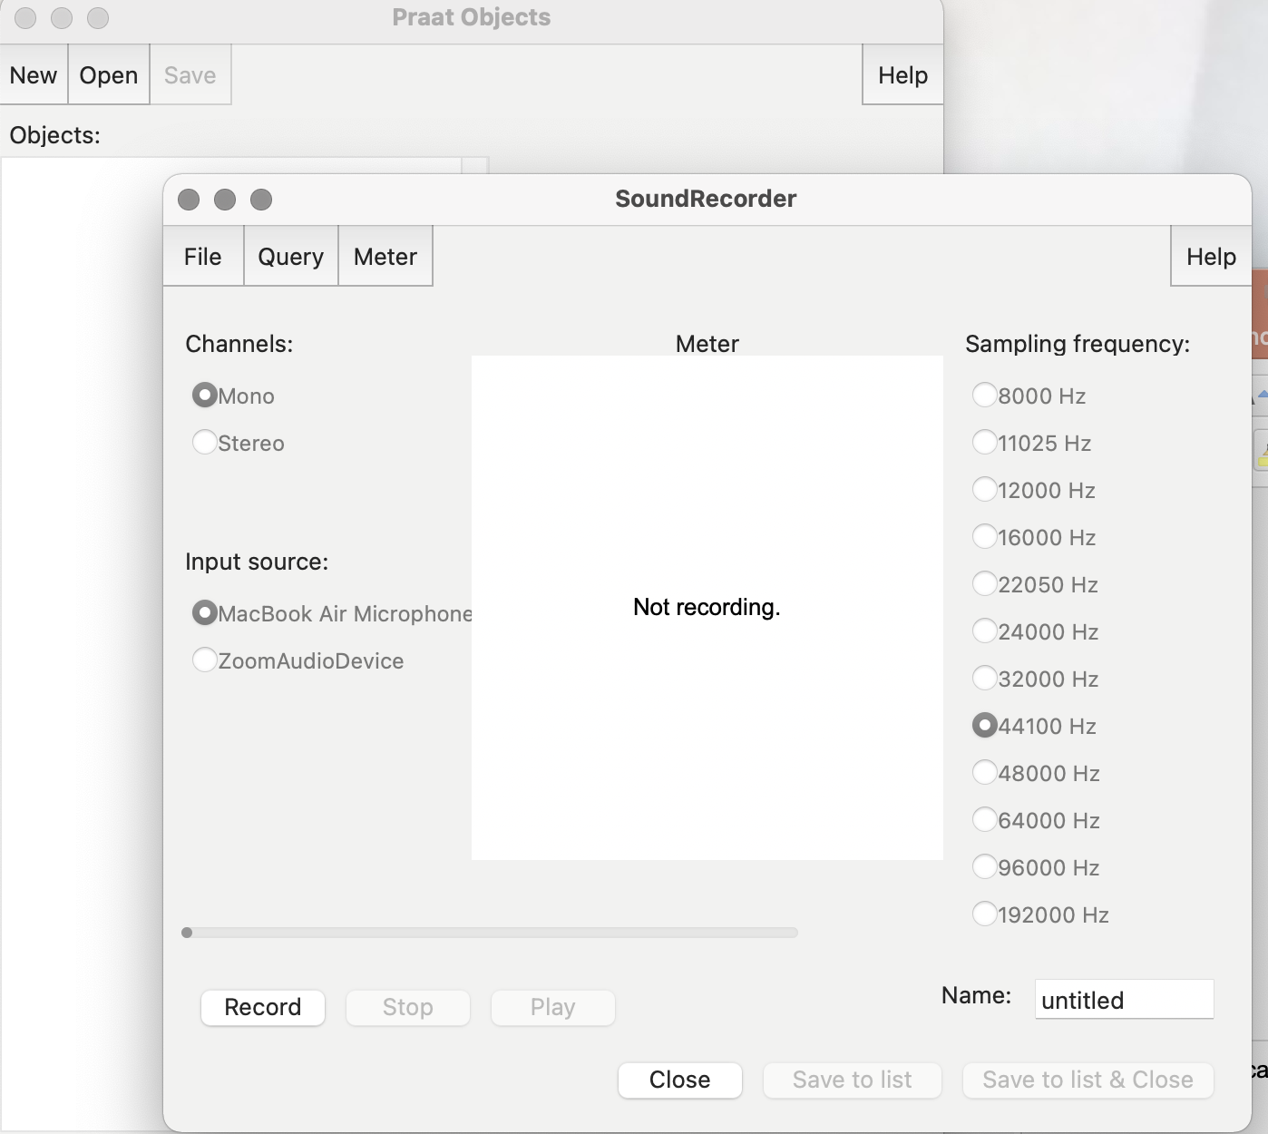
Notes:
If you need to record: This window will pop up. Use Mono as your channel, and whatever Mic you have as the input source and 44100 Hz sampling frequency. Select Record on the bottom left and hit Stop when you’re finished. Name your file on the left of the SoundRecorder Then select Save to list and close.

Slide 11
How do we Record and Manage Files?
  Now select the file in the Objects window, click Save at the top left, choose Save as WAV file and place it where you can find it on your machine
  Now select the file in Praat and click Remove from the bottom of the Objects window
Notes:
So, if you just finished recording a file in Praat, select it in the Objects window and save it. I’ll show you what the save window looks like on the next slide, but after saving, you can remove the file from the Objects window.

Slide 12
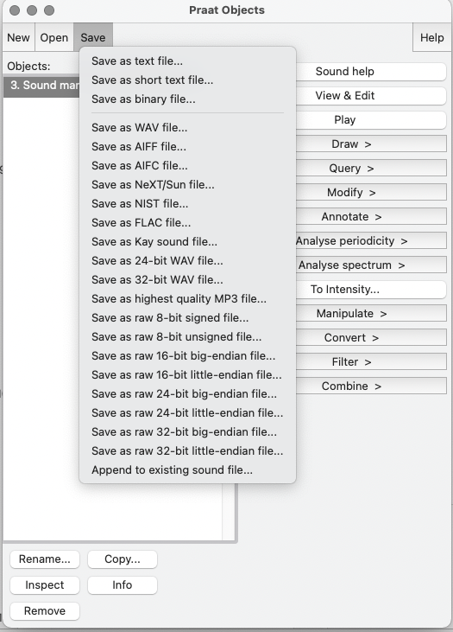
Notes:
So here is what it should look like when you go to save the newly recorded file.

Slide 13
How do we Record and Manage Files?
Now we’ll see how to open files from disk
  Note: For those who have recorded a ”mama” file earlier in a quiet place open this file as below and not the one you just recorded
  Select Open from the Objects window, choose “Read from file”, find your (best) “mama” file and open in Praat
  Select this file in the Objects window to see many options on the right of the Objects window
  Select View and Edit
Notes:
Now we’re going to see how to open a file from disk. Remember, use the recording you made at home, not the one you just did. So, to open a pre-existing file, select open from the objects window, and then read from file. You can click on this file in the Objects window to see many options covering what you can do with the file: from here select view and edit.

Slide 14
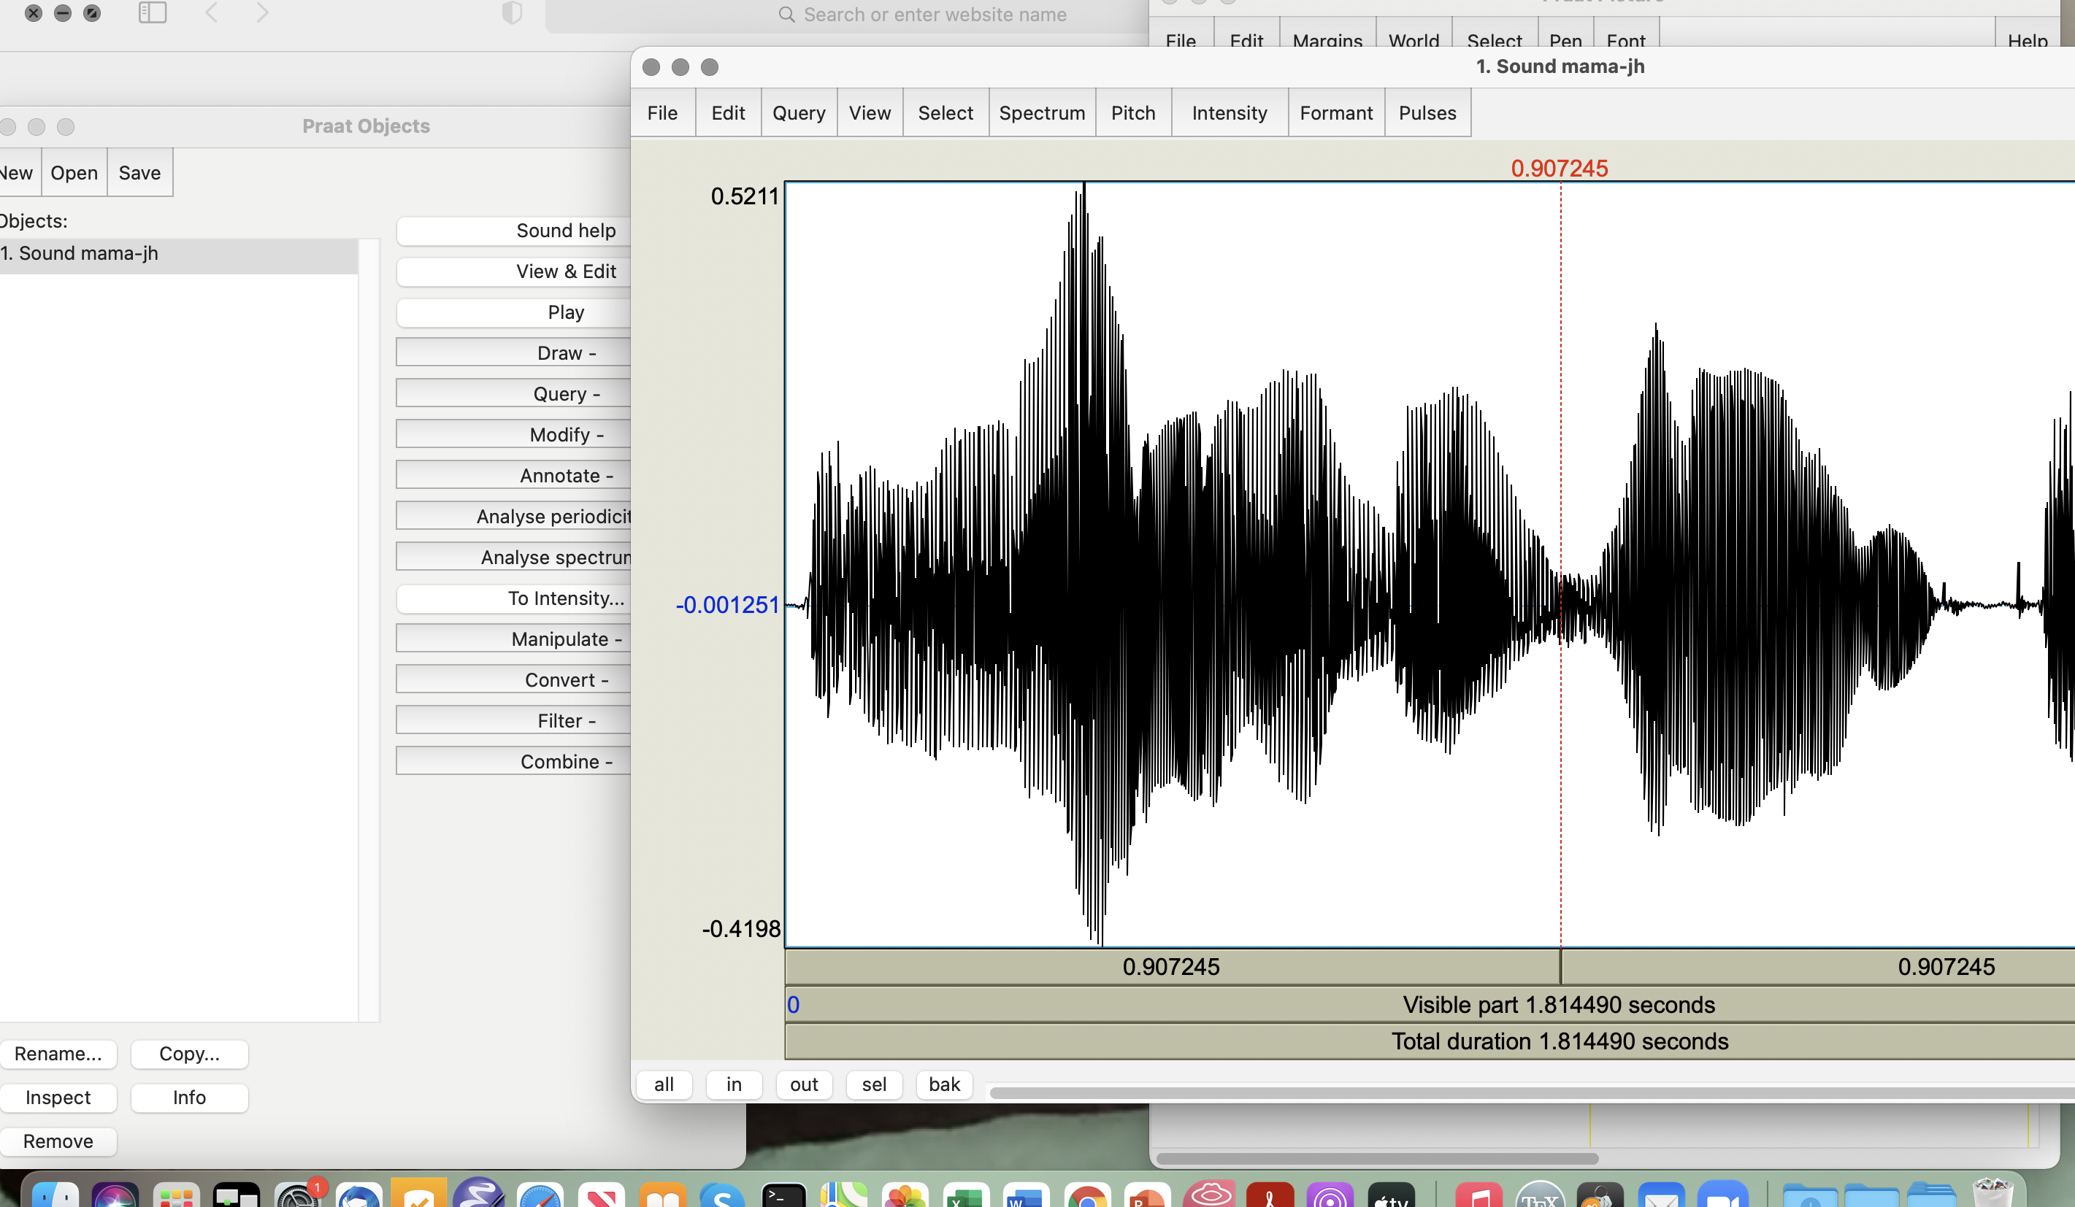
Notes:
Once you click on view and edit, Here’s probably what you will see: just the waveform of the selected file.

Slide 15
Display Options from Objects File
In the window you see with the waveform, highlight only the speech portion of the file (not silence or noise) and click “sel” on the bottom left to select that portion
From the menus at the top of your sound file we’ll now find some Praat viewing choices
  At the bottom of the display, Row 1: the selected portion; Row 2: all the visible file; Row 3: the total duration of the file
  You can select a portion and hit sel at the bottom left to zoom in to it; use in and out to make visible longer or shorter, all to see the whole file and bak to go to previous view
Notes:
[read slide]

Slide 16
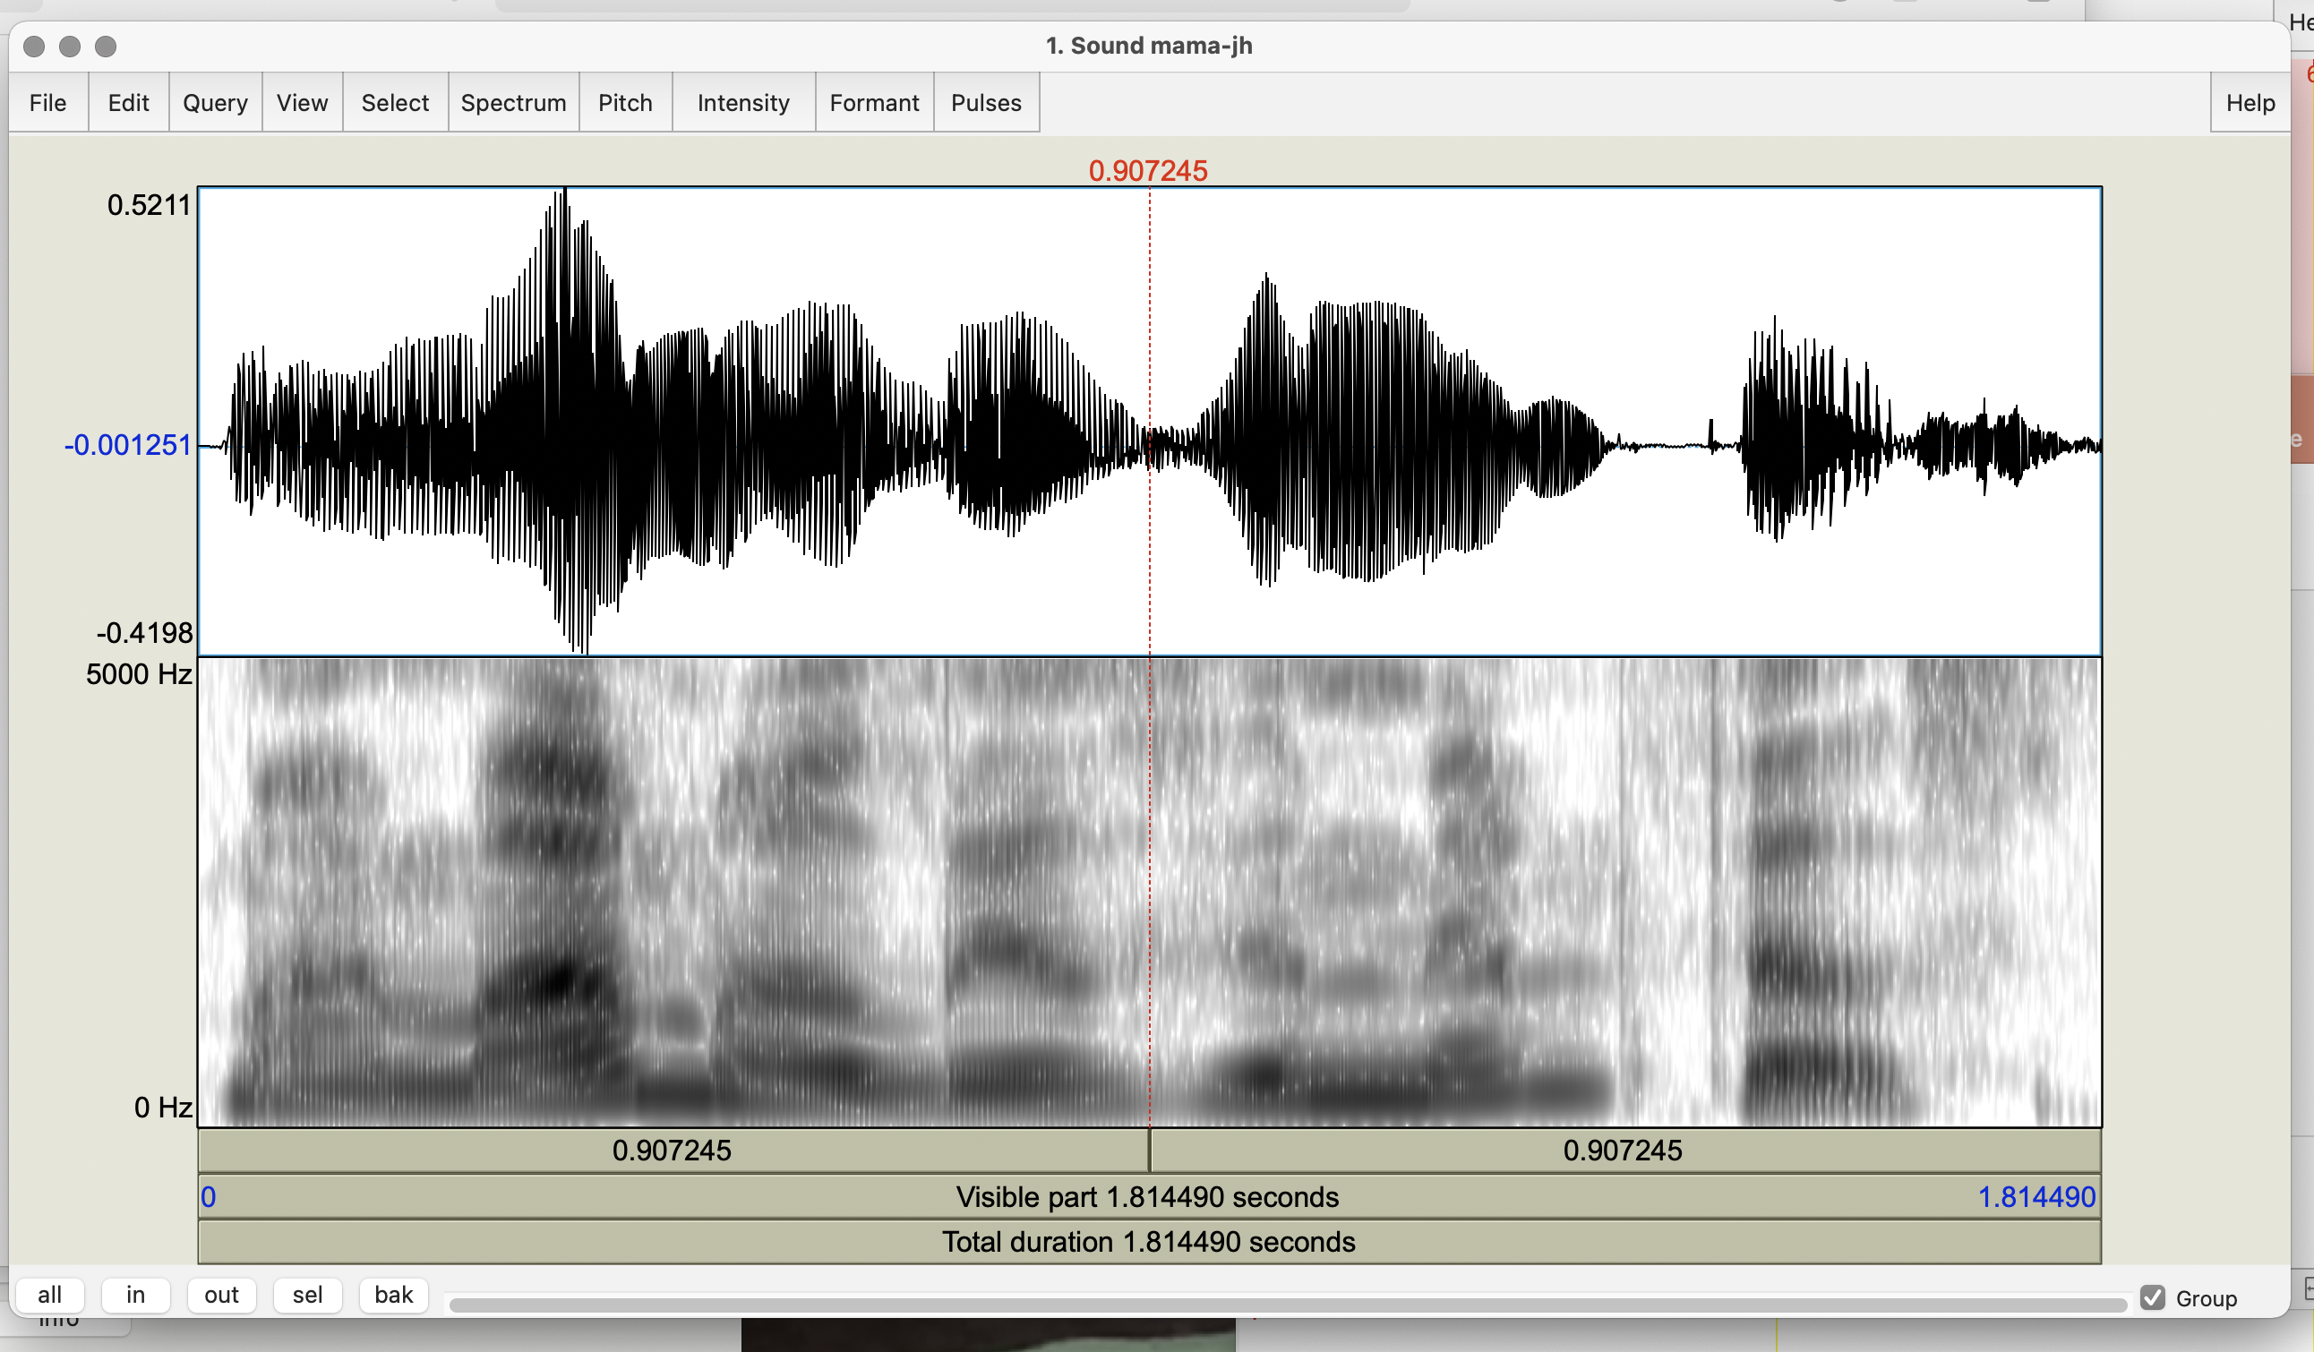
Notes:
You should be seeing something like this now: This is the wav form and these are the harmonics of the pitch

Slide 17
Display Options from Objects File
  Spectrum:
    If you do not already see your spectrogram select Spectrogram → Show spectrogram
    Select a point in your sound file and choose Spectrogram → View spectral slice (bottom) to see the frequencies in Hz (x axis) and the sound pressure in dB (y axis)
    Try to play some words one by one by selecting the correct portion of the spectrogram for each word and play by clicking on the top row at the bottom
Notes:
[read slide]
[show spectral slice on next slide]

Slide 18
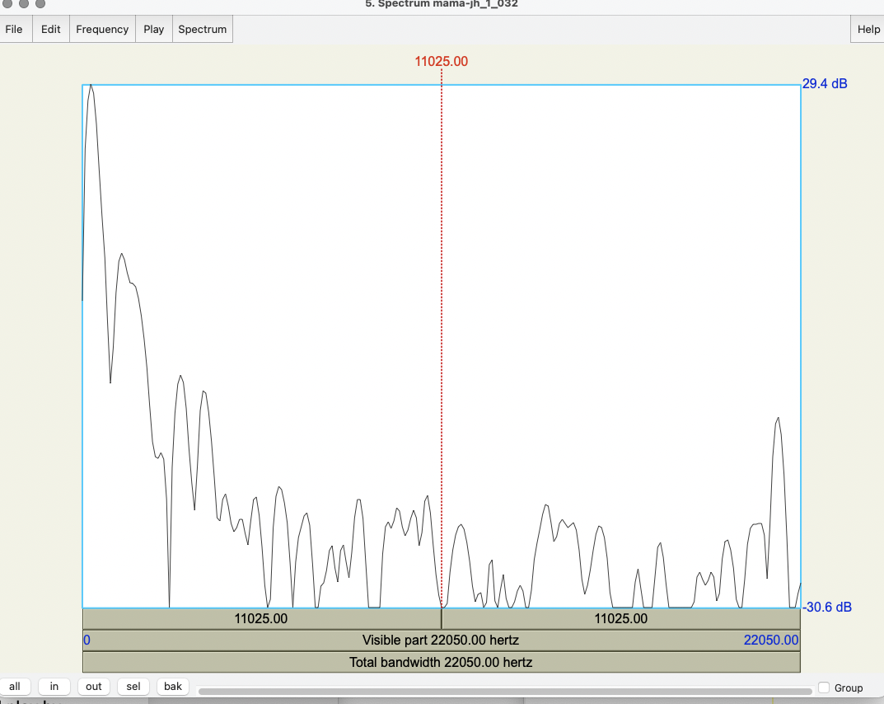
Notes:
This is what a spectral slice looks like

Slide 19
Display Options from Objects File
  Pitch
    Pitch → Show pitch
    Find your mean, min, and max, pitch with Pitch → Get pitch, → Get minimum pitch, → Get maximum pitch
    Can you describe the pitch contour you see?
Notes:
[read slide]
[Show pitch file after Pitch]

Slide 20
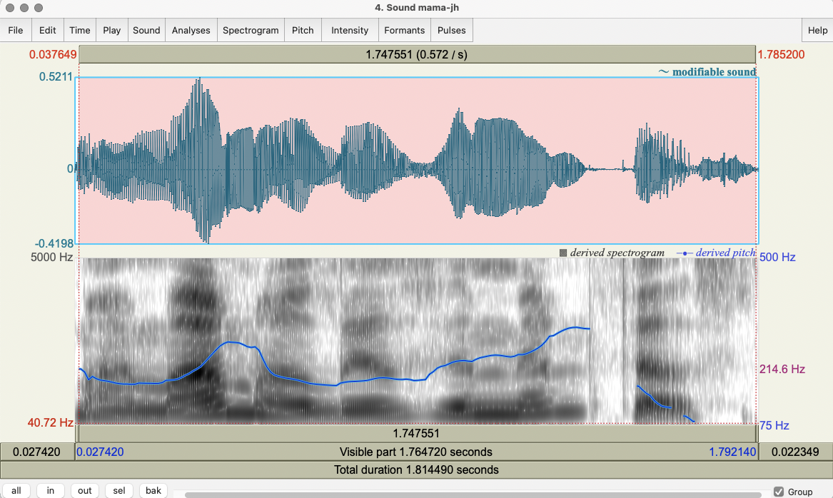
Notes:
Here we see the pitch contour in blue

Slide 21
Display Options from Objects File
  Intensity:
    Intensity → Show intensity
    Intensity → Get intensity, Get minimum intensity, Get maximum intensity
    Check Intensity → Intensity settings for times
Notes:
[read slide]

Slide 22
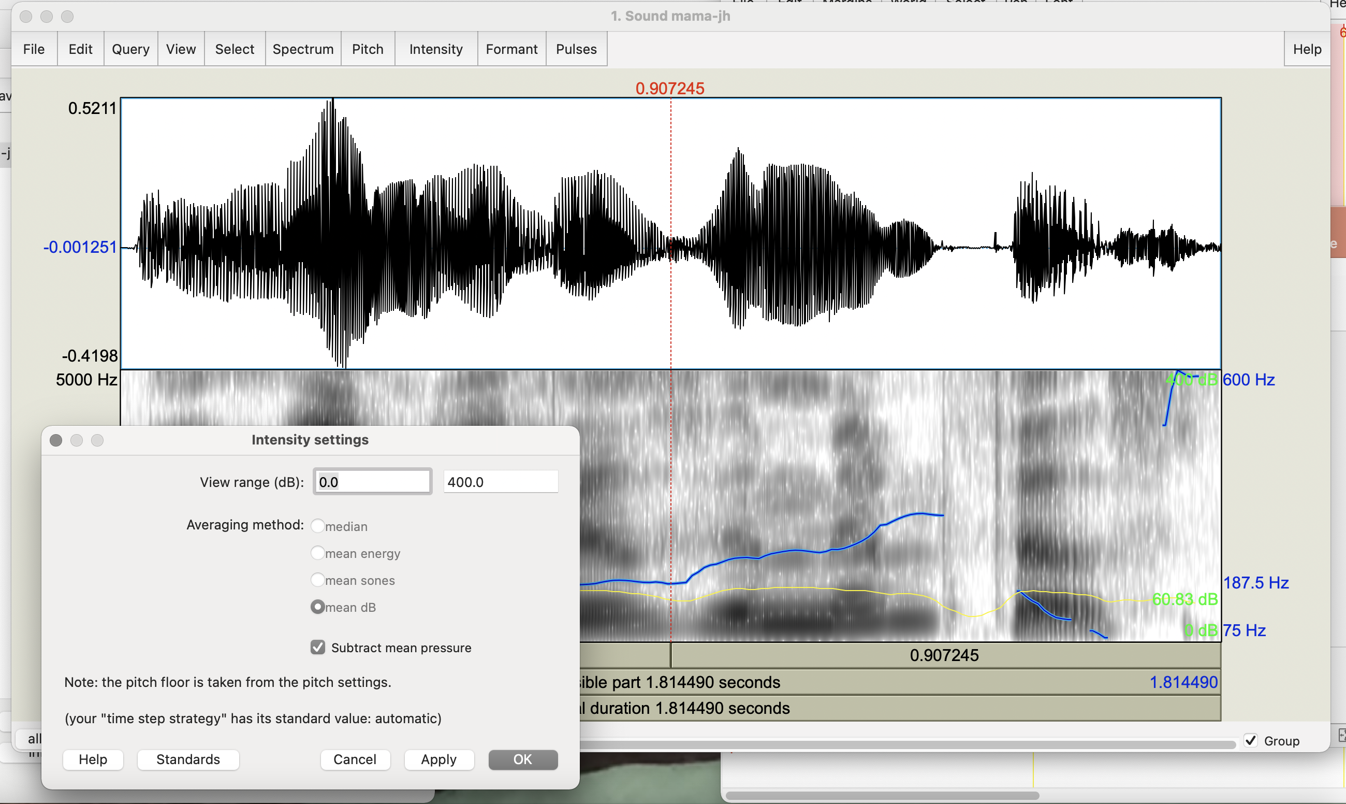
Notes:
0.0-400.0 is the usual setting for intensity

Slide 23
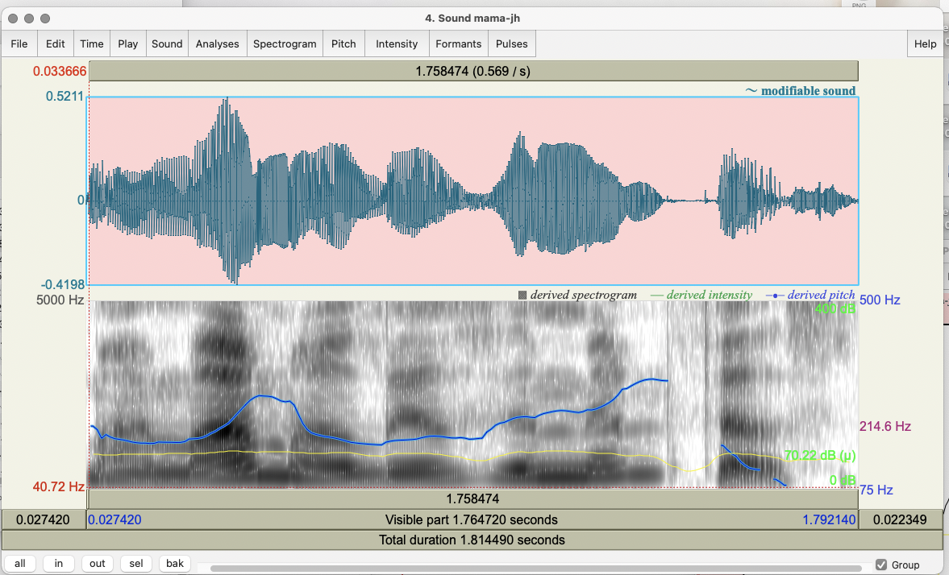
Notes:
Now we see both pitch (blue) and intensity (yellow) contours

Slide 24
Display Options from Objects File
  Pulses represent the vocal fold vibrations over time:
    Pulses → Show pulses
    Select a segment in your speech file
    Pulses → Voice report – this gives you an overall summary (not always precise) of the pitch, pulses, voiced/unvoiced frames, jitter, shimmer, and HNR using many types of analysis
Notes:
[read slide]
Pulses will show up on your waveform as shaded regions.

Slide 25
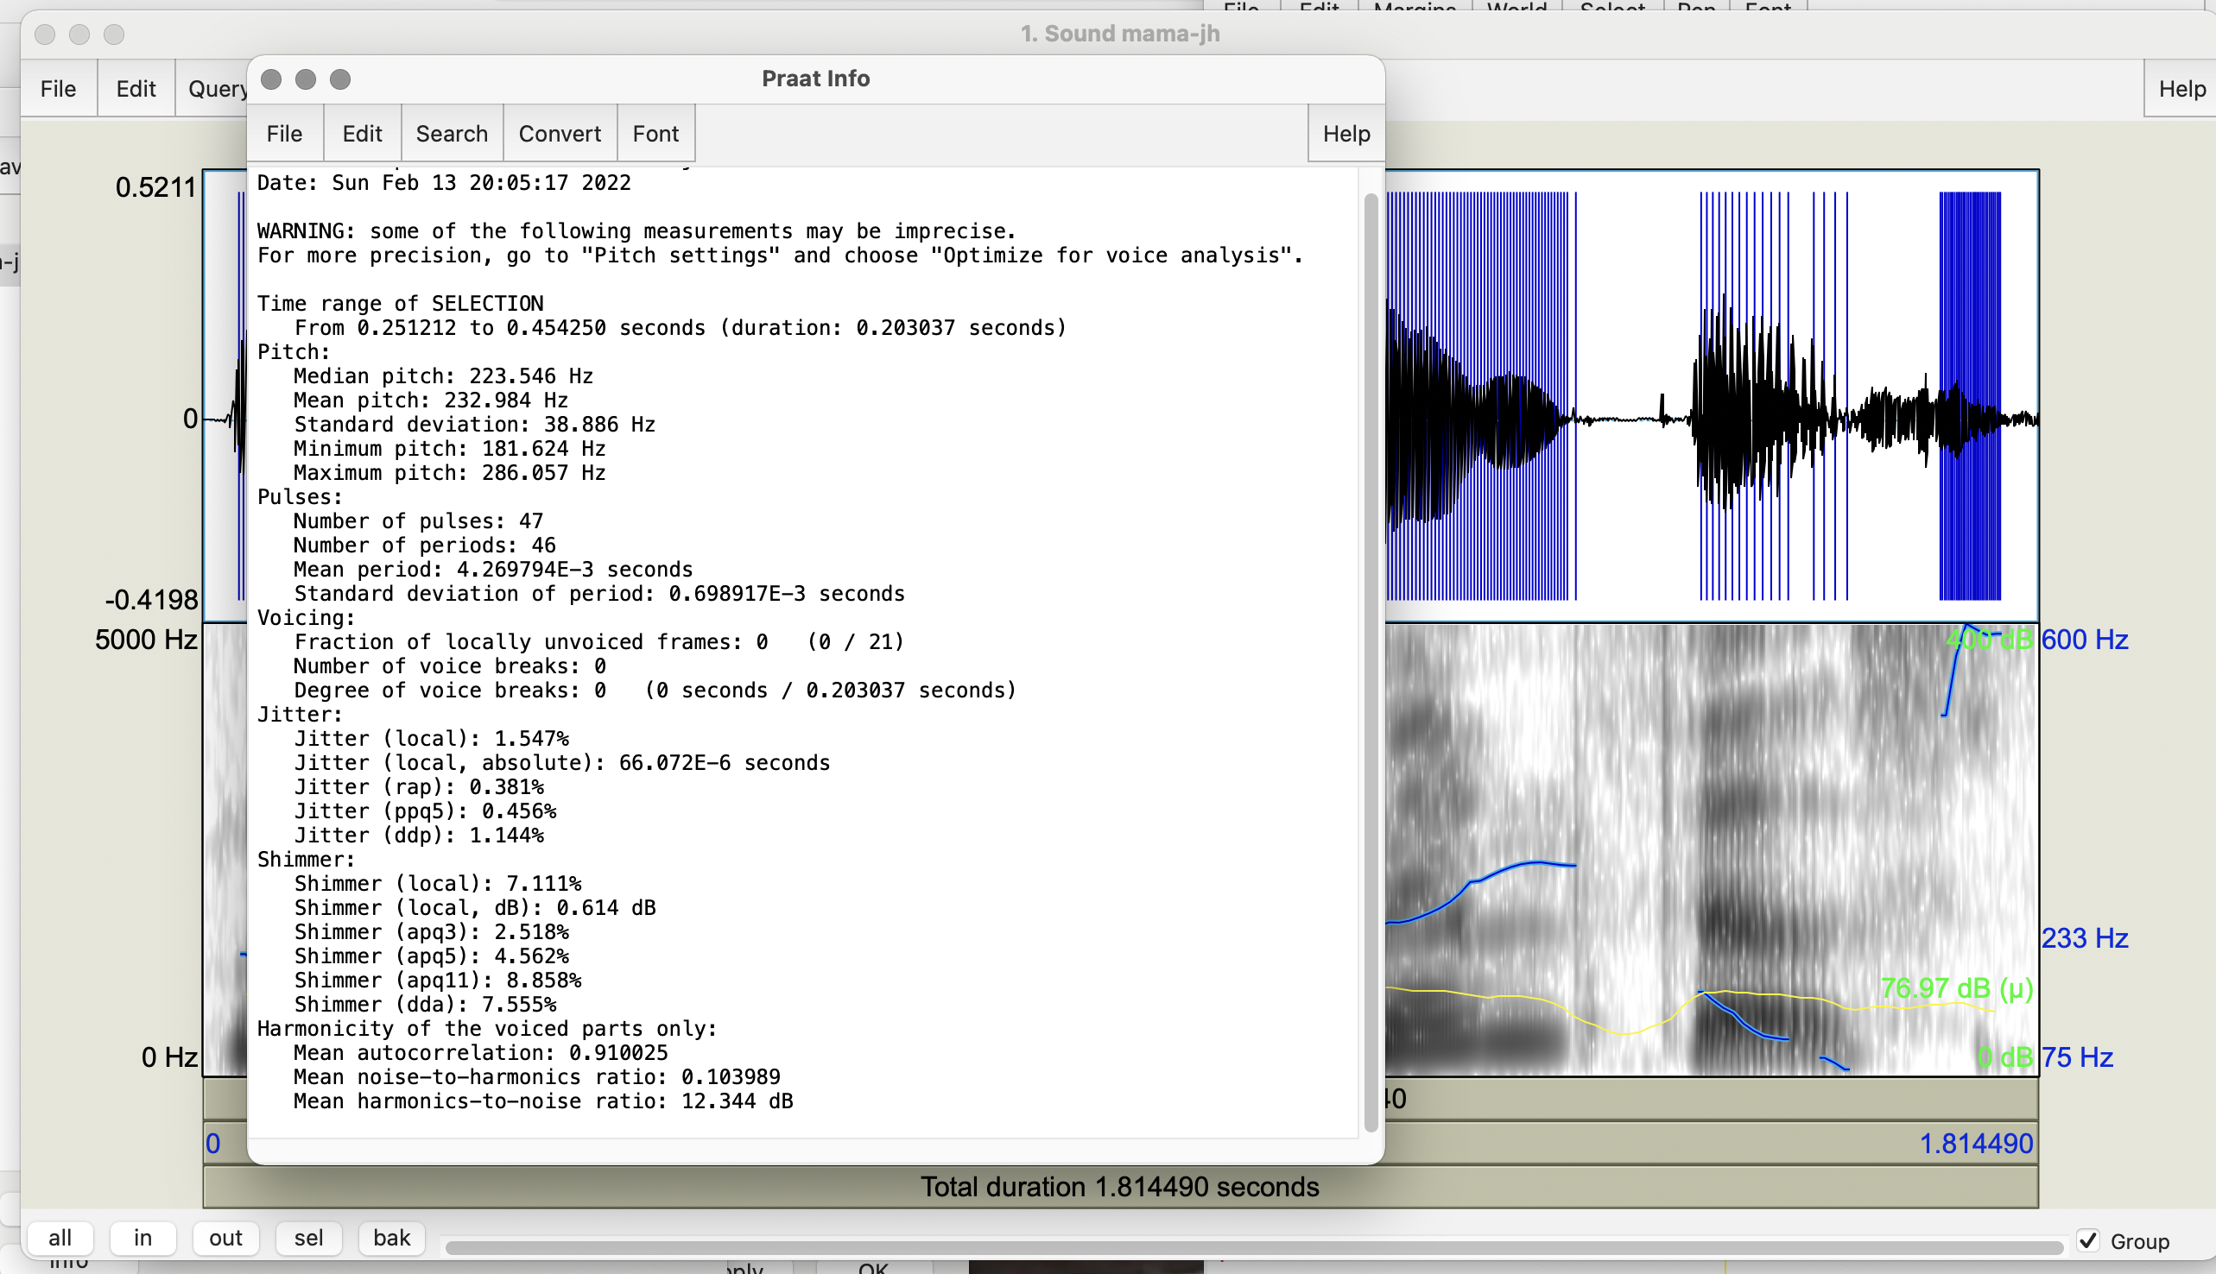
Notes:
And here is what the voice report should look like.

Slide 26
Display Options from Objects File
  Formant:
    Formant → Formant settings: Number of formants = 4.0 or 5.0; Dynamic range = 50.0
    Formant → Show formants
    Do the formant values match those you expect for vowels [aj] as in my, [ɑ] as in mama, [ɪ] as in lives, [ɛ] as in memphis?
Notes:
Now we’re going to look at formants and check if the ones in your speech match the ones you’d expect.
[read slide]

Slide 27
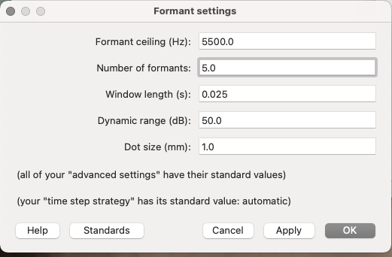
Notes:
Here is the first part with the formant settings. Now select Show Formants from the Formants tab

Slide 28
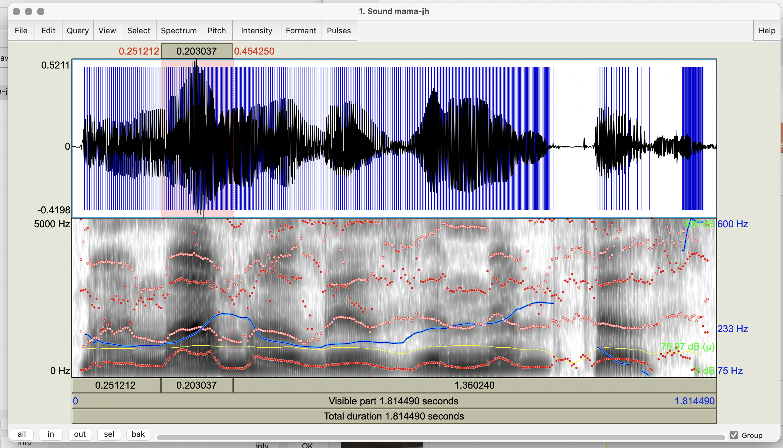
Notes:
Formants F1-5 shown – different colors (red 1, 3, 5; yellow 2, 4)

Slide 29
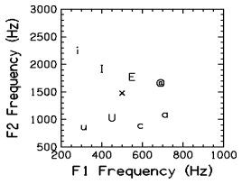
[i] - as in heed
[I] - as in hid
[E] - as in head
[@] - as in had
[a] - as in ha
[c] - as in hawed
[U] - as in hood
[u] - as in who'd
[x] - as in hud
Notes:
Do the formant values in your file match those you expect for vowels [aj] as in my, [ɑ] as in mama, [ɪ] as in lives, [ɛ] as in memphis?

Slide 30
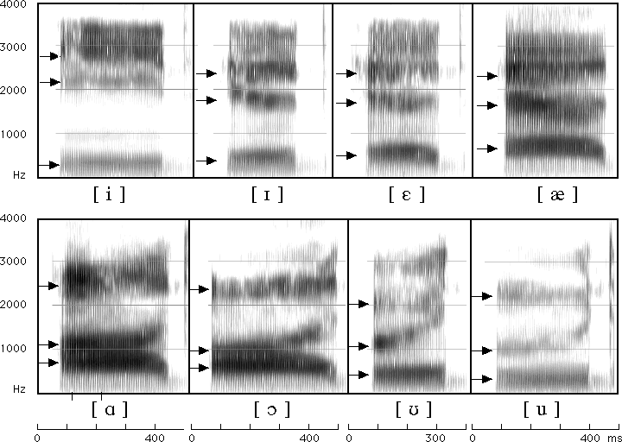
Match your Vowels in the Spectrogram to Formants for English Vowels
09/23/2025
Notes:
My (a i/5 to 1) mama (a/5) lives in (I/2) Memphis (e/3 and i/2). How close are your vowels to these?

Slide 31
How to Set Other Praat Parameters
Select the speech segment from Sound mama
For pitch extraction:
  Open Pitch menu on Sound mama
  Select Show pitch and then Pitch settings
  Set Pitch → Pitch settings to min 75 max 500 (standard) for now but experiment with your own voice: try to find your highest and lowest pitch
Notes:
Let’s now try setting some other parameters. [read slide]
My high is 600

Slide 32
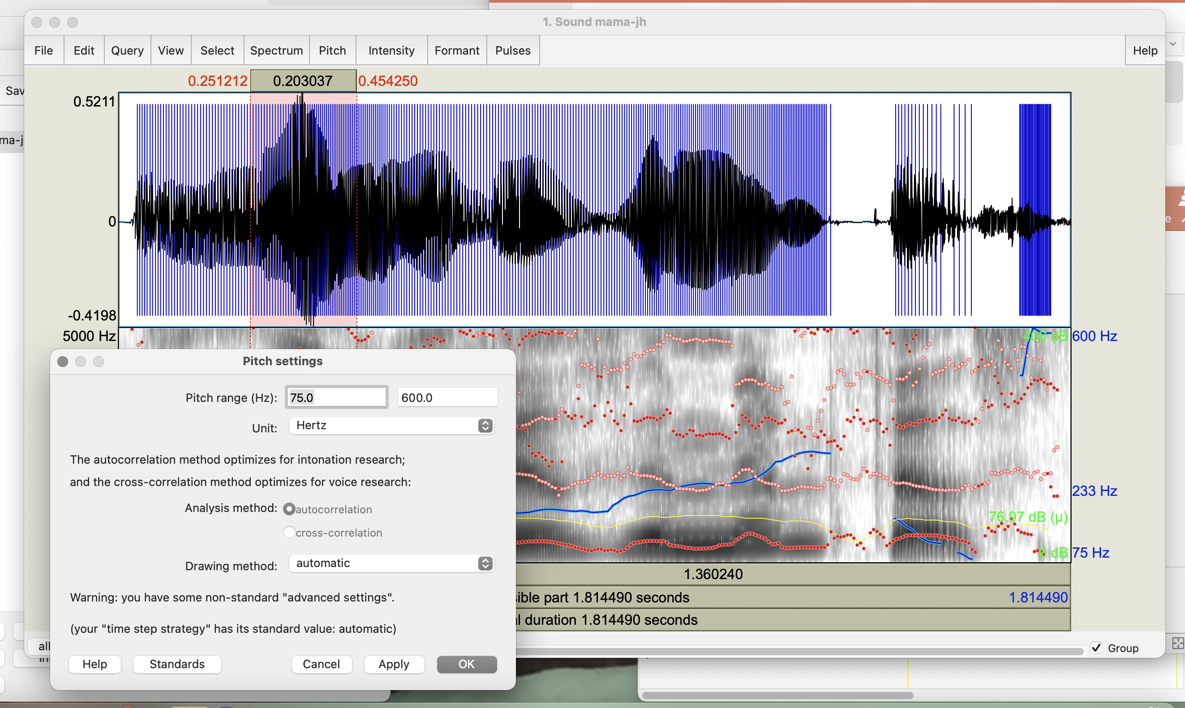
Notes:
[Go to next slide and do jitter settings]

Slide 33
How to Set Other Praat Parameters
For jitter (local only):
  In Objects window select Sound mama
  On right select Analyze periodicity
  Select To PointProcess periodic, cc
  Again set pitch max (500) and min (75) and click “OK”
  In Objects window Select newly created PointProcess mama
  Choose Query → Get jitter (local) and set parameters in seconds: Shortest period = 0.0001; Longest period = 0.02, max period factor = 1.3 and click “OK”
Notes:
[read slide]

Slide 34
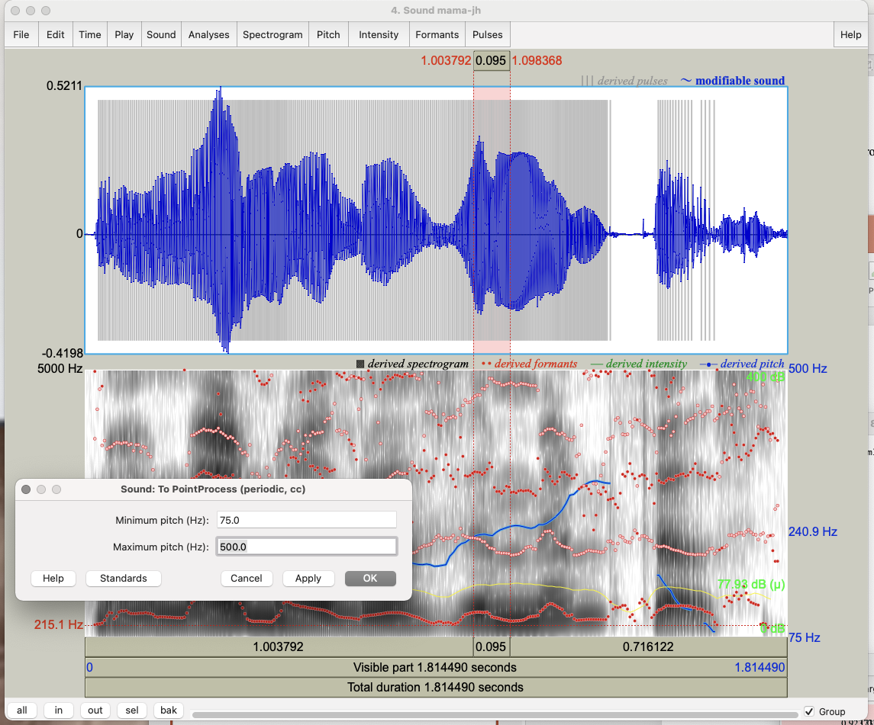

Slide 35
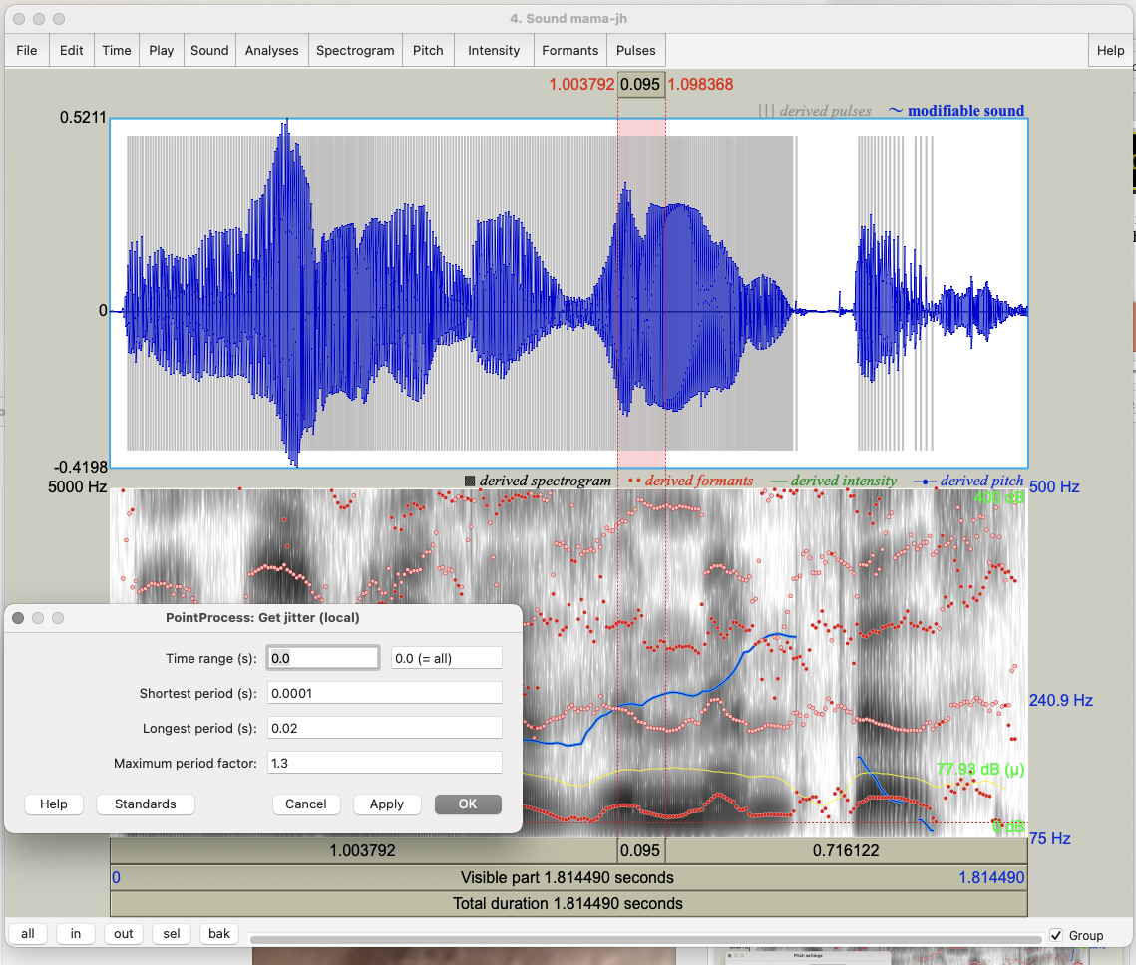

Slide 36
How to Set Other Praat Parameters
For shimmer (local only):
  Select both Sound and PointProcess files from Objects
  Choose Query → Get shimmer (local) and set period floor to 0.0001s, period ceiling to 0.02s, max period factor to 1.3, and max amplitude factor to 1.6 and click “OK”

Slide 37
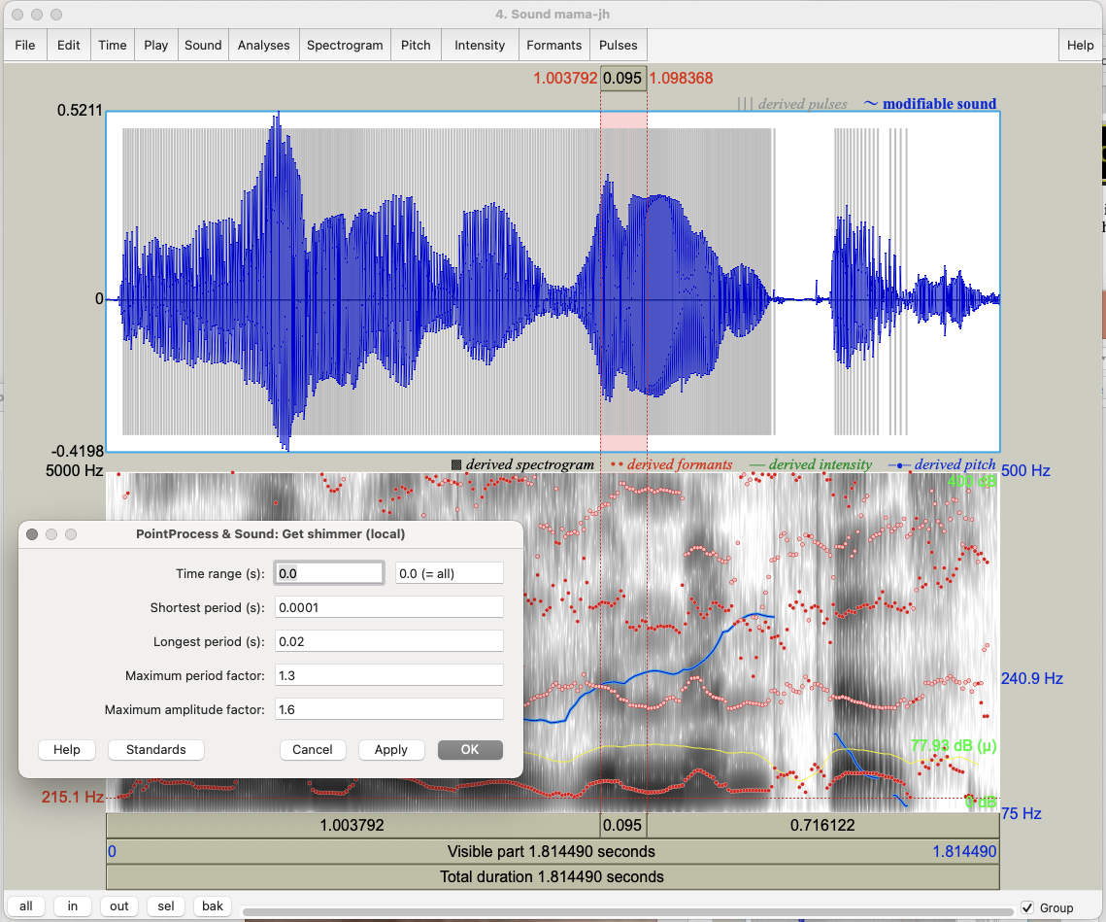

Slide 38
How to Set Other Praat Parameters
For HNR:
  In Objects window select Sound mama
  On right select Analyze periodicity
  Select To harmonicity (cc) and set time step to 0.01, min pitch to 75Hz, silence threshold to 0.1, and periods per window to 1.0

Slide 39
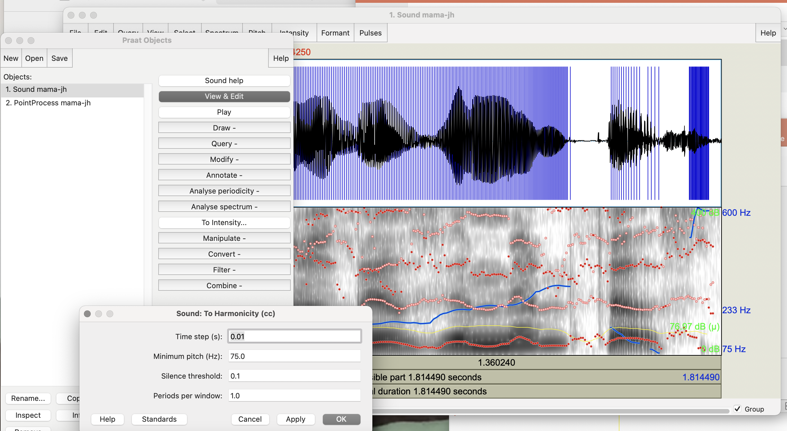
Notes:
On right select Analyze periodicity
Select To harmonicity (cc)
Go to next slide

Slide 40
How to Set Other Praat Parameters
For speaking rate: Divide #words or #syllables by utterance duration (or use a Praat script or parselmouth script)
To identify silences:
  Select Sound mama in Objects window
  Select Annotate → To TextGrid (silences); click OK
  Select both Sound mama and TextGrid file created (using command (⌘))
  Choose View and Edit on the right
Notes:
[read slide]
We’ll look more closely at identifying silences now

Slide 41
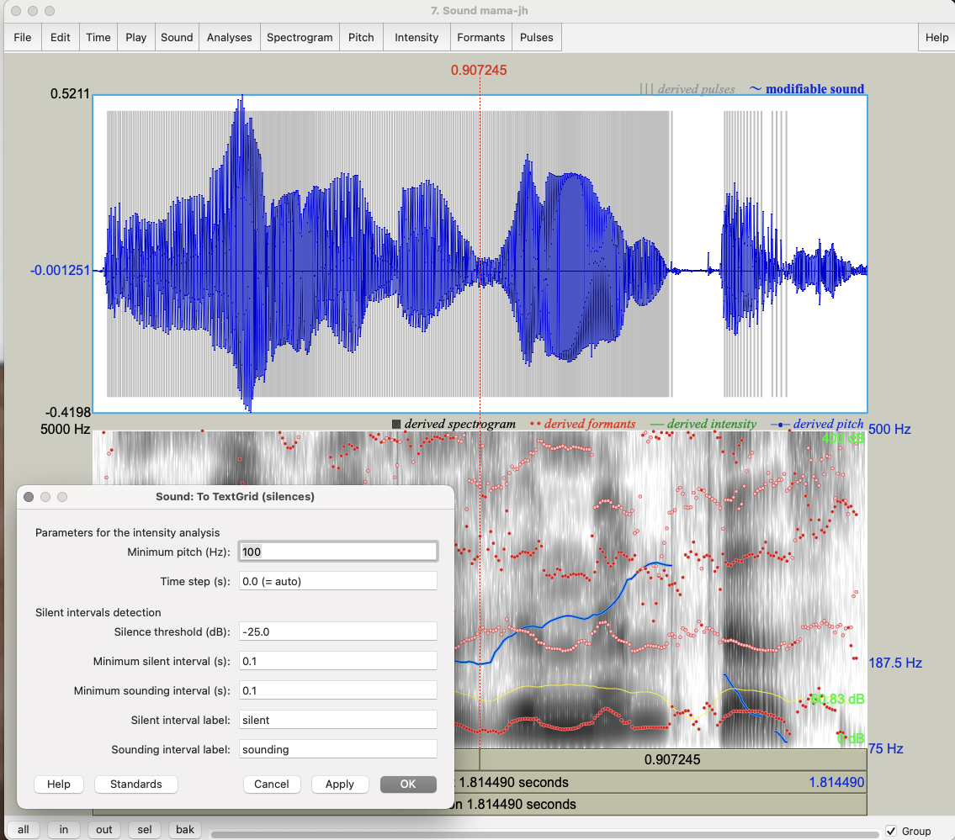

Slide 42
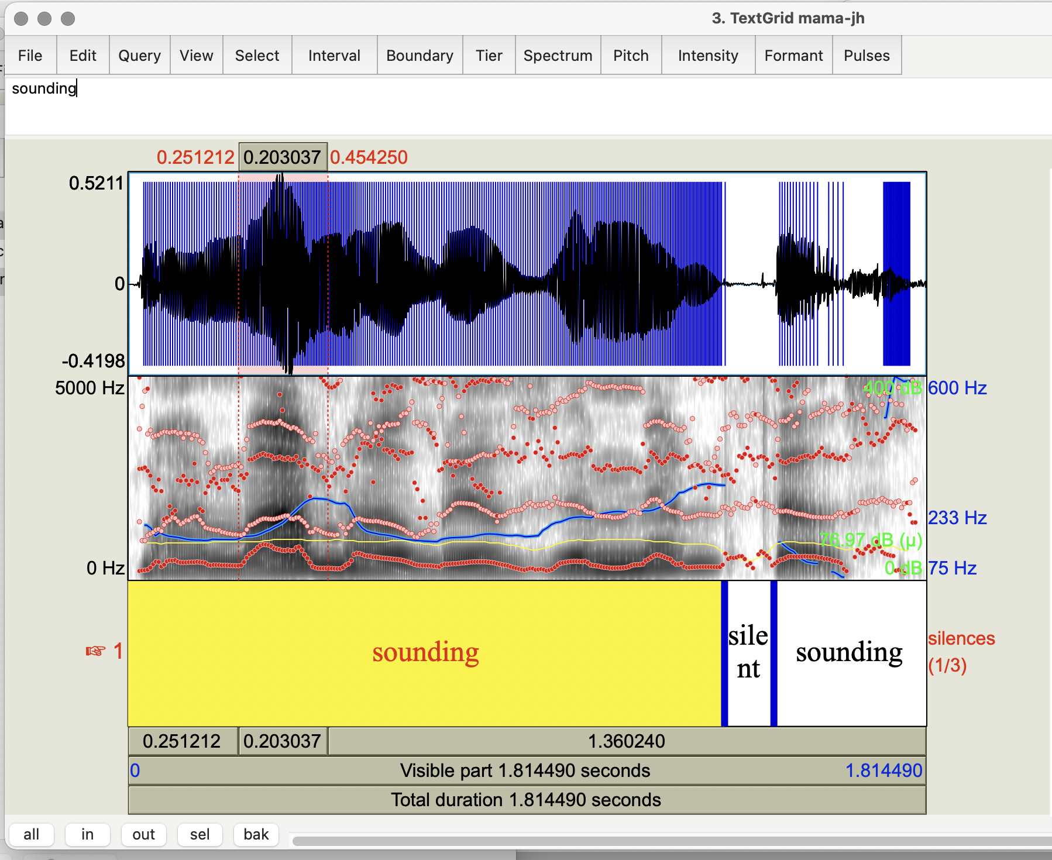
Notes:
This is what it should look like

Slide 43
Task 1: Pitch and Intensity
Open your mama file in Praat; select View & Edit on right
  Select the most prominent word (using “sel” at the bottom) and find a single cycle in the waveform using “in” on the bottom left
  Select the cycle -- what is the frequency (1/cycle length) identified at the top of the spectrogram?
Select the entire contour again using “all” at the bottom left and selecting only the waveform
  Select Pitch → Show Pitch and Intensity → Show intensity
  What is the minimum pitch? Maximum? Mean? Minimum intensity? Maximum? Mean?
Notes:
Now we’ve had an overview of a sample of the various things you can do in Praat, we’re going to transition into some exercises for the rest of class.
Here are the instructions for the first exercise you’re going to do. I’m briefly going to switch slides to show you an example of the cycle selection step, but I’ll come back to the instructions right after that.

Slide 44
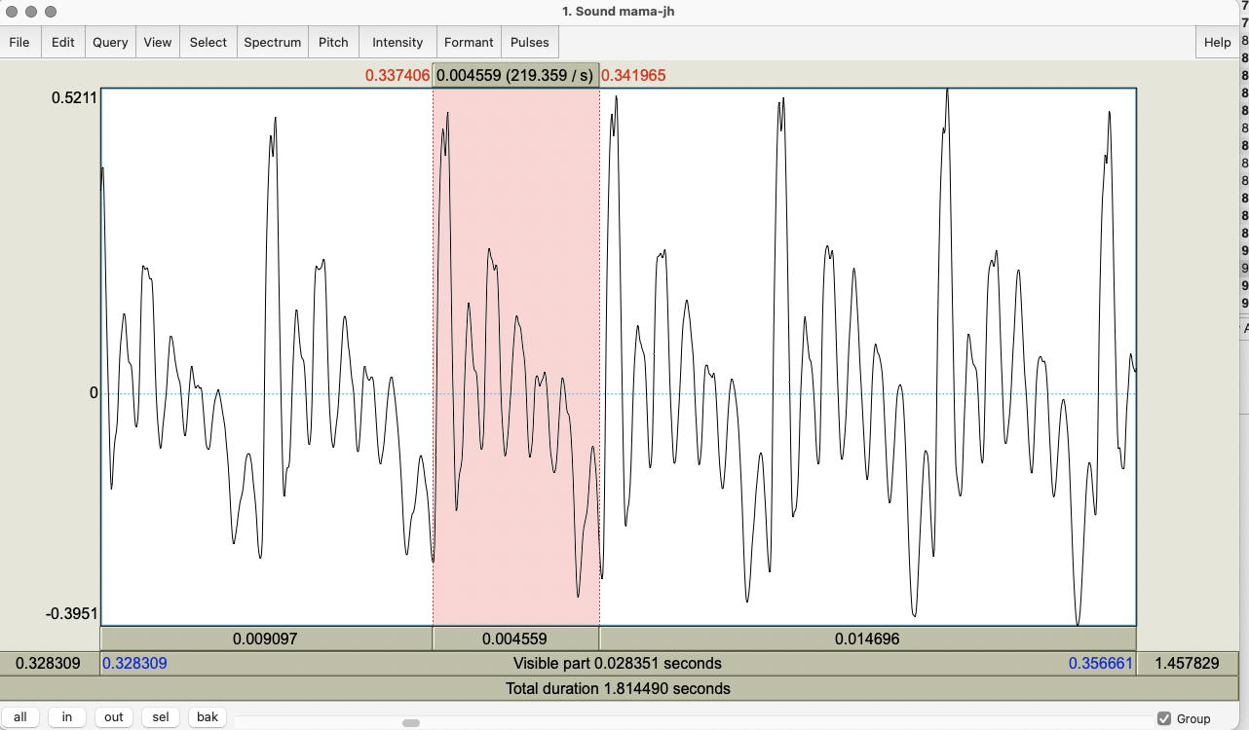
Notes:
Here is an example of a cycle selected from the first syllable of Mama

Slide 45
Task 1: Pitch and Intensity
Open your mama file in Praat; select View & Edit on right
  Select the most prominent word (using “sel” at the bottom) and find a single cycle in the waveform using “in” on the bottom left
  Select the cycle -- what is the frequency (1/cycle length) identified at the top of the spectrogram?
Select the entire contour again using “all” at the bottom left and selecting only the waveform
  Select Pitch → Show Pitch and Intensity → Show intensity
  What is the minimum pitch? Maximum? Mean? Minimum intensity? Maximum? Mean?
Notes:
Here are the instructions again, let me know if anyone needs a reminder of what display to expect when showing pitch and intensity, or when we are all ready to move on to the next exercise.
One note I have for showing pitch and intensity: You can remove Spectrograph → Show spectrogram if you want to see pitch and intensity more clearly
[Show pitch and intensity in following 2 slides]

Slide 46
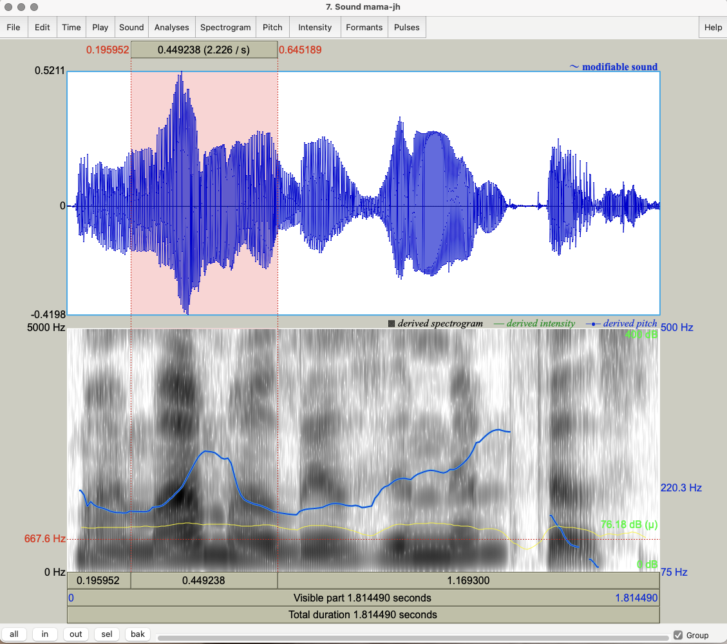

Slide 47
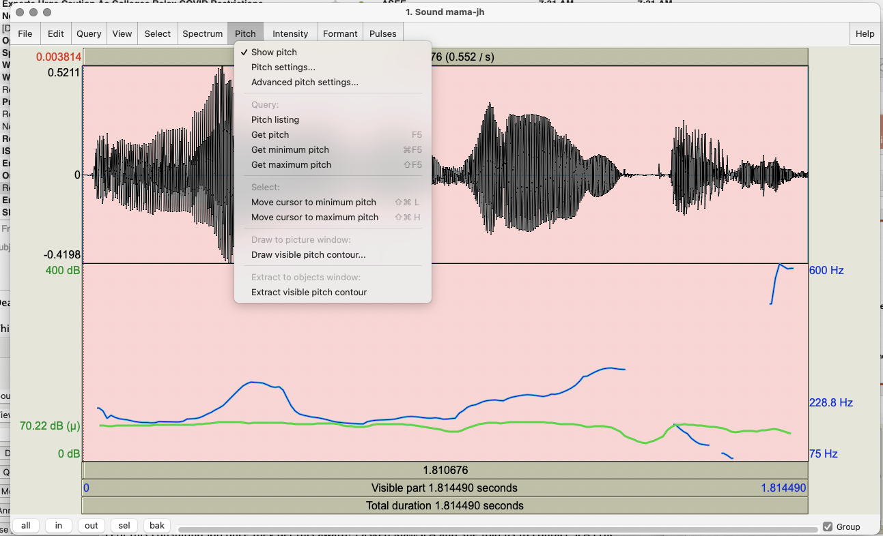

Slide 48


Task 2: Voice Quality
Record “My mama lives in Memphis”
  in a whisper
  in a creaky voice
Add to Praat Objects and View & Edit each
  Study the pitch contours in normal vs. whisper vs. creaky. What do you notice?
  Now select Pulses → Show pulses and select the whole waveform
  Analyze jitter, shimmer and HNR of your 3 files using Pulses → Voice report
Notes:
The next exercise is going to get you to compare your normal, whisper, and creaky voices by looking at the differences in jitter, shimmer, and HNR for each.
I’m again going to briefly switch slides to show you the expected spectrogram display for the whispered voice with pulses shown, but I’ll come back to the instructions right after.
[Show next 2 slides for whisper
All slide changes must be by selecting next slide on bottom bar]

Slide 49
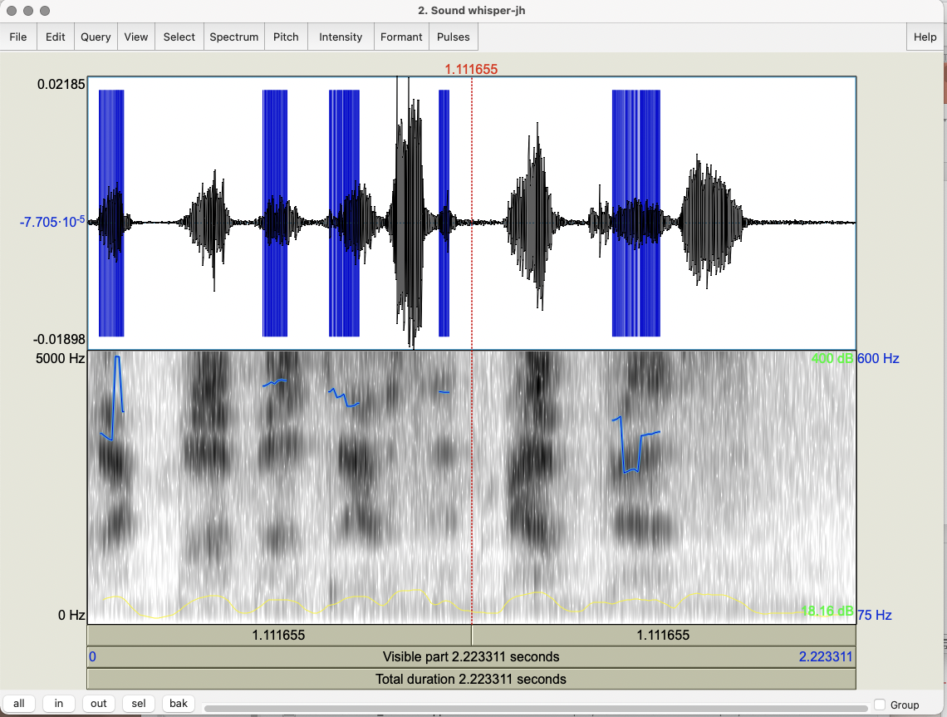
Notes:
Showing spectrogram for whisper

Slide 50
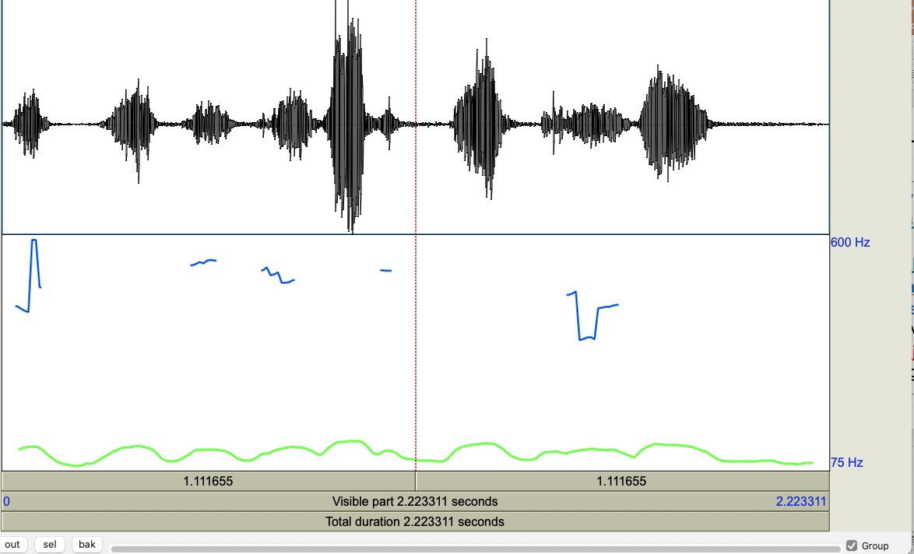
Notes:
Only pitch and intensity for whisper

Slide 51
Task 2: Voice Quality
Record “My mama lives in Memphis”
  in a whisper
  in a creaky voice
Add to Praat Objects and View & Edit each
  Study the pitch contours in normal vs. whisper vs. creaky. What do you notice?
  Now select Pulses → Show pulses and select the whole waveform
  Analyze jitter, shimmer and HNR of your 3 files using Pulses → Voice report
Notes:
Here are the instructions again. Let me know if anyone would like to see the expected displays for creaky voice. [Show next 2 slides for creaky; voice reports are after]

Slide 52
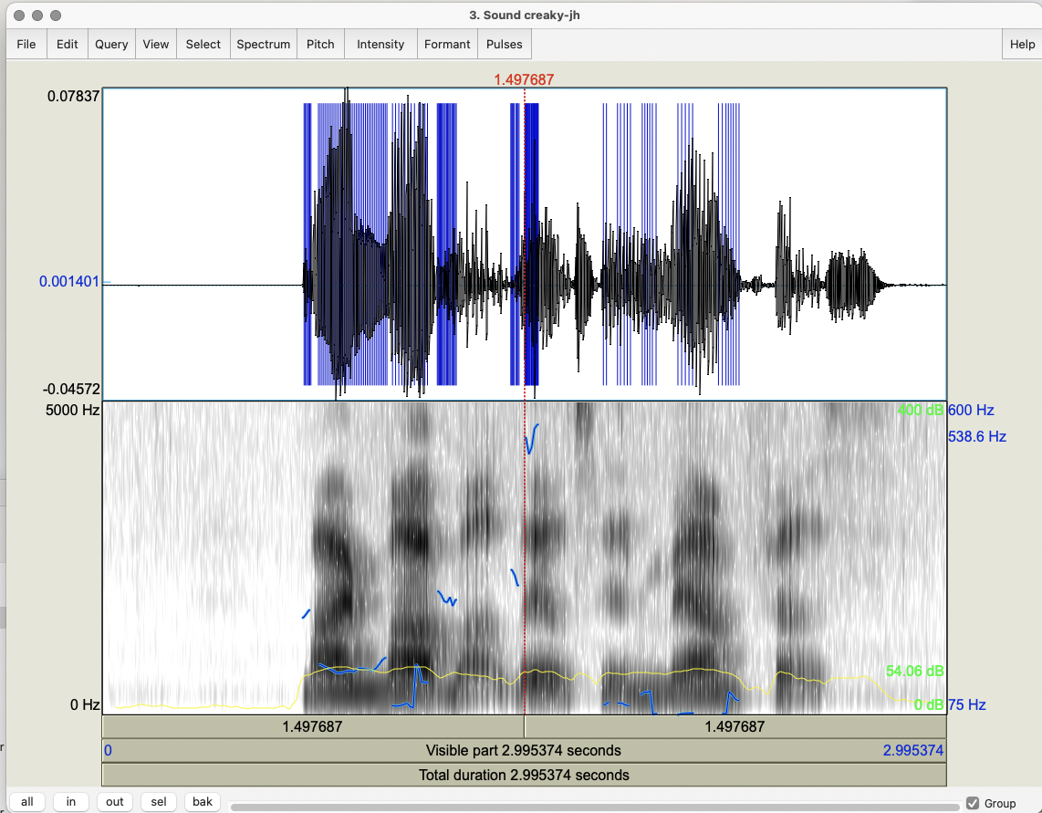
Notes:
With spectrogram for creaky

Slide 53
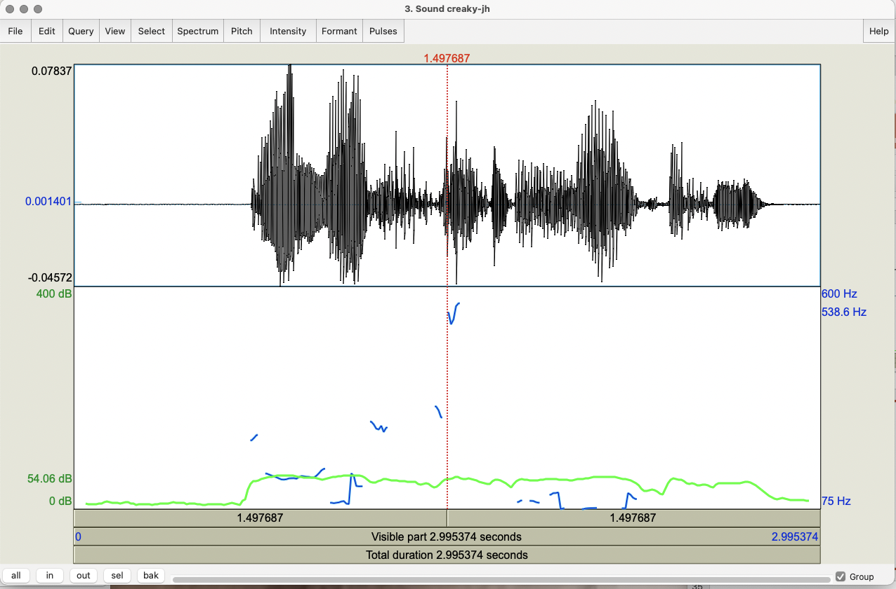
Notes:
Without spectrogram for Creaky voice

Slide 54
Task 2: Voice Quality
Record “My mama lives in Memphis”
  in a whisper
  in a creaky voice
Add to Praat Objects and View & Edit each
  Study the pitch contours in normal vs. whisper vs. creaky. What do you notice?
  Now select Pulses → Show pulses and select the whole waveform
  Analyze jitter, shimmer and HNR of your 3 files using Pulses → Voice report
Notes:
Here are the instructions again. I also have example voice reports for comparisons in the next few slides, so let me know if anyone would like to see them, before we move on to the next exercise.

Slide 55
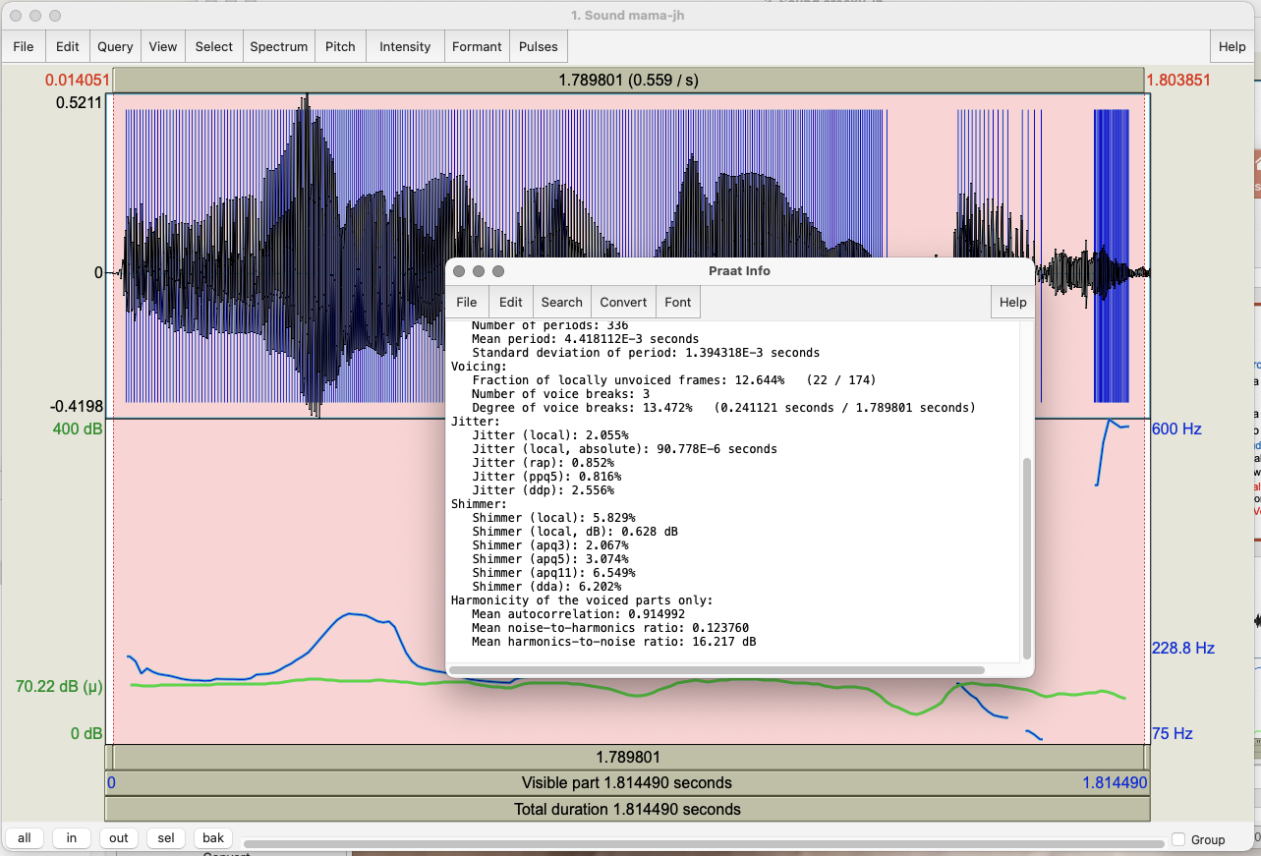
Notes:
Normal voice:
Compare to Whisper and then compare to Creaky: next 2 sides for each

Slide 56
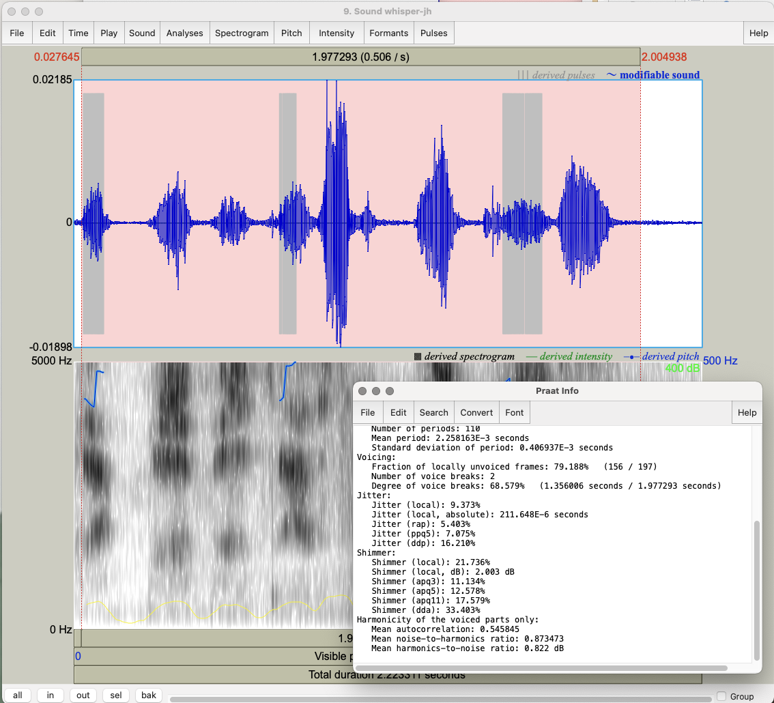
Notes:
Voice report for whisper: less voicing, less jitter, more shimmer, lower harmonicity (HNR)

Slide 57
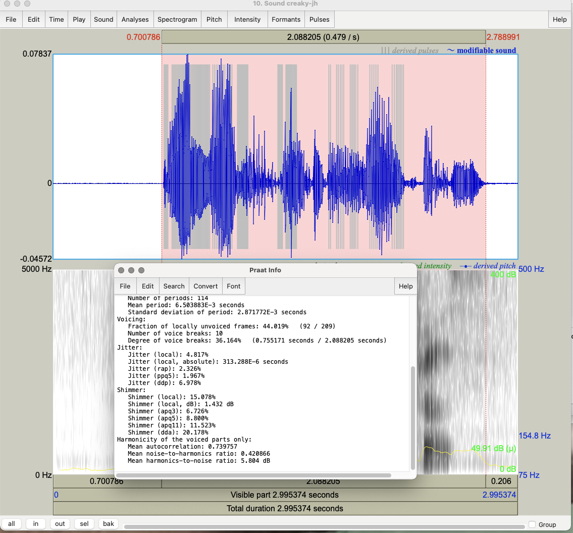
Notes:
Voice report for creaky: less voicing, more jitter, more shimmer, lower HNR ratio
On to slide 56

Slide 58
Task 3: Contours
Record “My mama lives in Memphis” as a yes-no question
  Compare to your Mama statement
  What are the similarities in F0? Differences?
Now record a wh-question: “Where does my mama live?”
Which of the other 2 contours is most similar?
Notes:
Here is the third exercise for today. You are going to compare a statement to a yes/no question and to a wh-question. I’ll leave these instructions up for a bit, but let me know when we are ready to see an example of the F0 contour for the yes/no question.

Slide 59
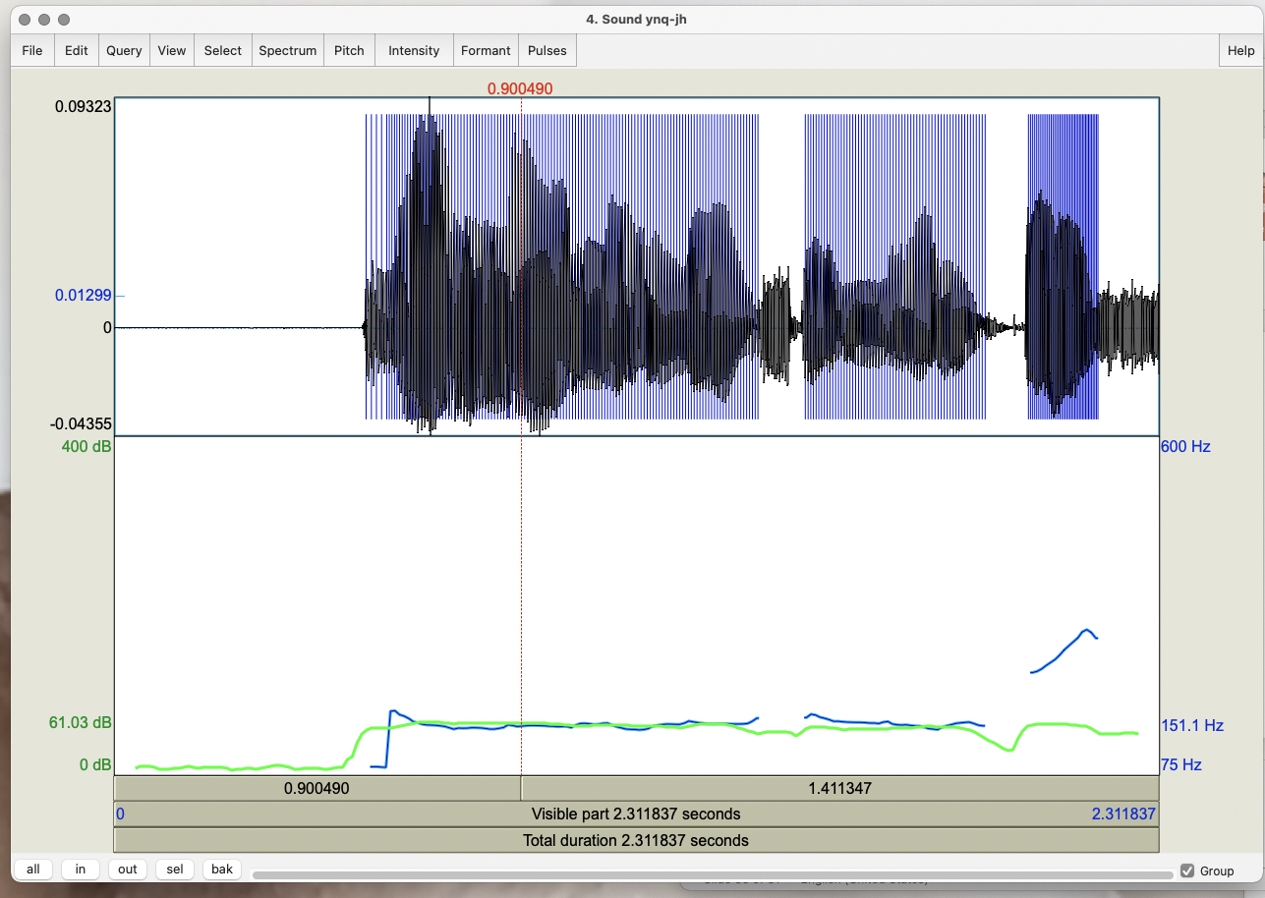
Notes:
Ynq contour goes up at the end
On to slide 58

Slide 60
Task 3: Contours
Record “My mama lives in Memphis” as a yes-no question
  Compare to your Mama statement
  What are the similarities in F0? Differences?
Now record a wh-question: “Where does my mama live?”
Which of the other 2 contours is most similar?
Notes:
Here are the instructions again. As before, let me know when we are ready to see an example expected F0 contour for a wh-question. [Show next slides for wh-q’s ]

Slide 61
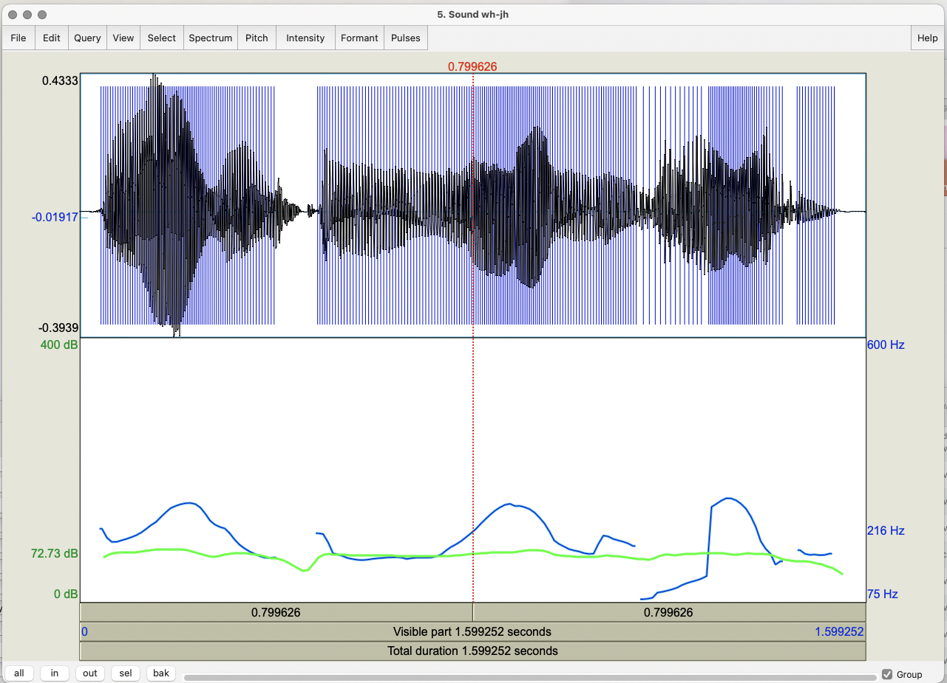
Notes:
Version 1 of whq

Slide 62
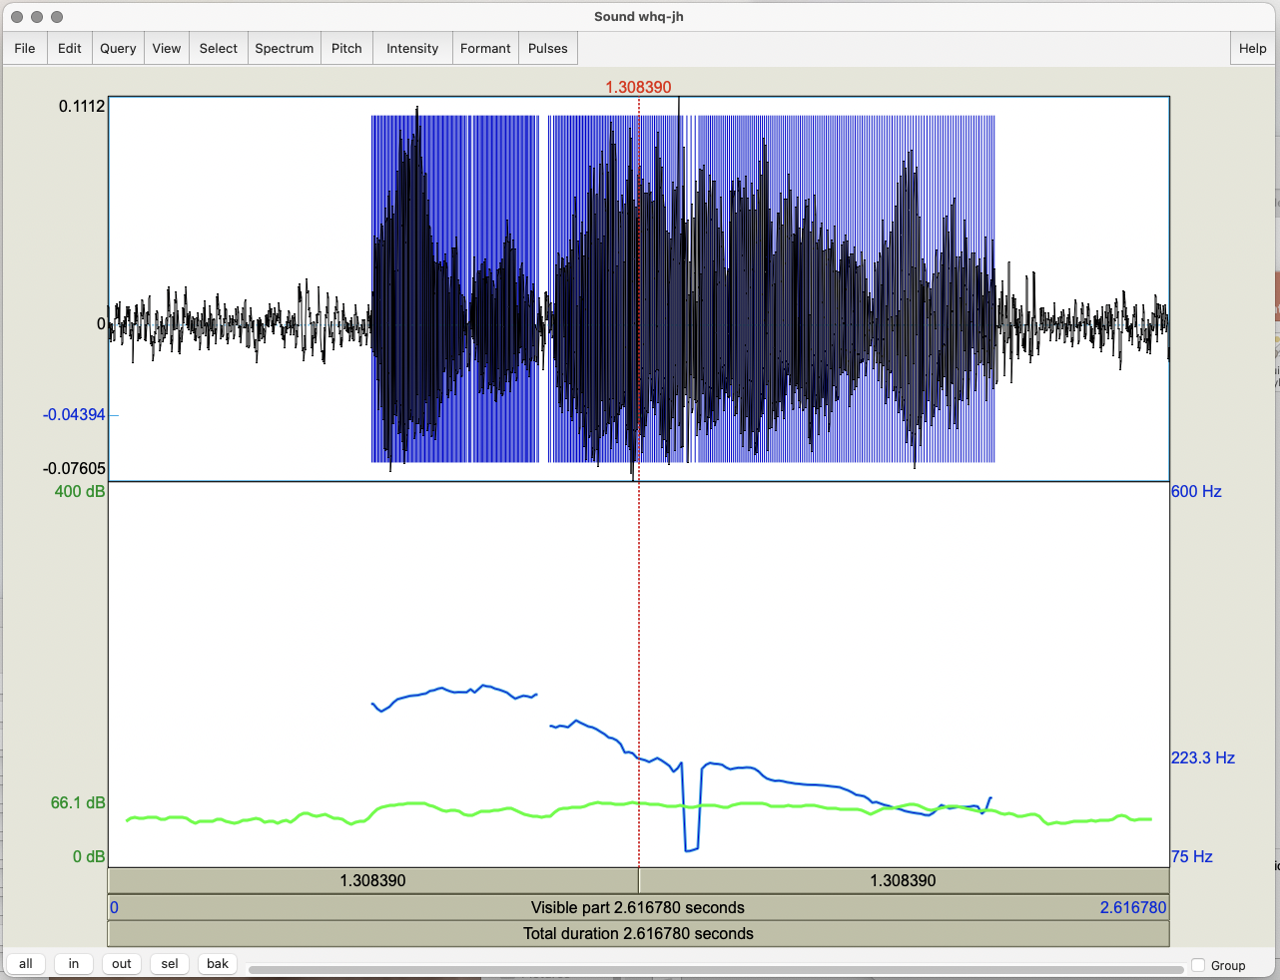
Notes:
Wh version 2 --
What difference do you see? What’s the difference in interpretation?
On to slide 61

Slide 63
Task 4: Emotional Speech
Record “My mama lives in Memphis” again
  As angry speech
  As sad speech
  As happy speech
For each token, do you see any differences in:
  Mean pitch? Maximum?
  Mean intensity? Maximum?
  Voice quality?
  Duration?
  F0 contour?
Notes:
For this exercise, you are going to specifically work on emotional speech. Add these three files to Praat and select view and edit, and then compare various speech features across the emotions. I’ll leave this slide up for the entire exercise, so let me know when we are ready for the next exercise.

Slide 64
Task 5: Changing the Pitch Contour
Take the initial statement version of your mama file and modify it to produce a question with a rising intonational contour
  Go to Manipulate → To manipulation – in the menu that pops up click OK
  In the Objects window select Manipulation <filename>
  Go to View & Edit
  In the Manipulation window:
    Go to Pitch → Stylize pitch (2st)
  Modify pitch by dragging points up and down
    Turn your statement into a question by lowering earlier pitch and raising final pitch
Notes:
This next exercise is a little bit different from the ones we’ve seen so far. For this one, you’re going to learn how to change the pitch contour of a speech segment. The instructions are a little bit longer, so let me know when you are next for me to switch slides to the next part of the step-by-step walkthrough for this.

Slide 65
    Play the result
    To save go to File → Publish resynthesis
    Compare it on Praat Objects to the yes-no question version you recorded
  Now modify the duration in the bottom section:
    Place cursor at a point in the duration manipulation band where you want to change the duration up or down
    Go to Dur → Add duration point at cursor several times
    Drag points up (slower) and down (faster) to change rate in different utterance parts
    Play the result
Notes:
Here are the rest of the instructions for this exercise. I can show an example of the expected display for this if anyone is interested, or I can stay on this slide with the instructions.
File --> Publish resynthesis is at the top left of the window you see
Dur → Add duration point at cursor is at the top of the window in the middle
To to next slide

Slide 66
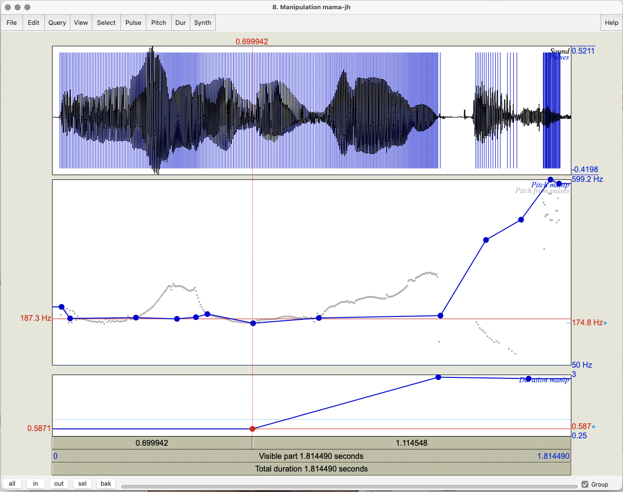

Slide 67
Task 6: Modifying Emotion
Take your happy version of mama
  Go to Manipulate → To manipulation and click OK
  Go to View & Edit with Manipulation object
  Go to Pitch → Stylize pitch (2st)
  Modify Pitch by dragging points up and down
  Modify Dur by dragging points up and down
  Turn your happy speech into sad speech; play the result
  To save: File → Publish resynthesis to get a new sound file “Sound from ManipulationEditor
Notes:
Now that we’ve tried modifying pitch and duration, we’re going to apply that to modifying emotion in speech. Give this a try and let me know when we are ready to see the example on the next slide.
[Show next slide]

Slide 68
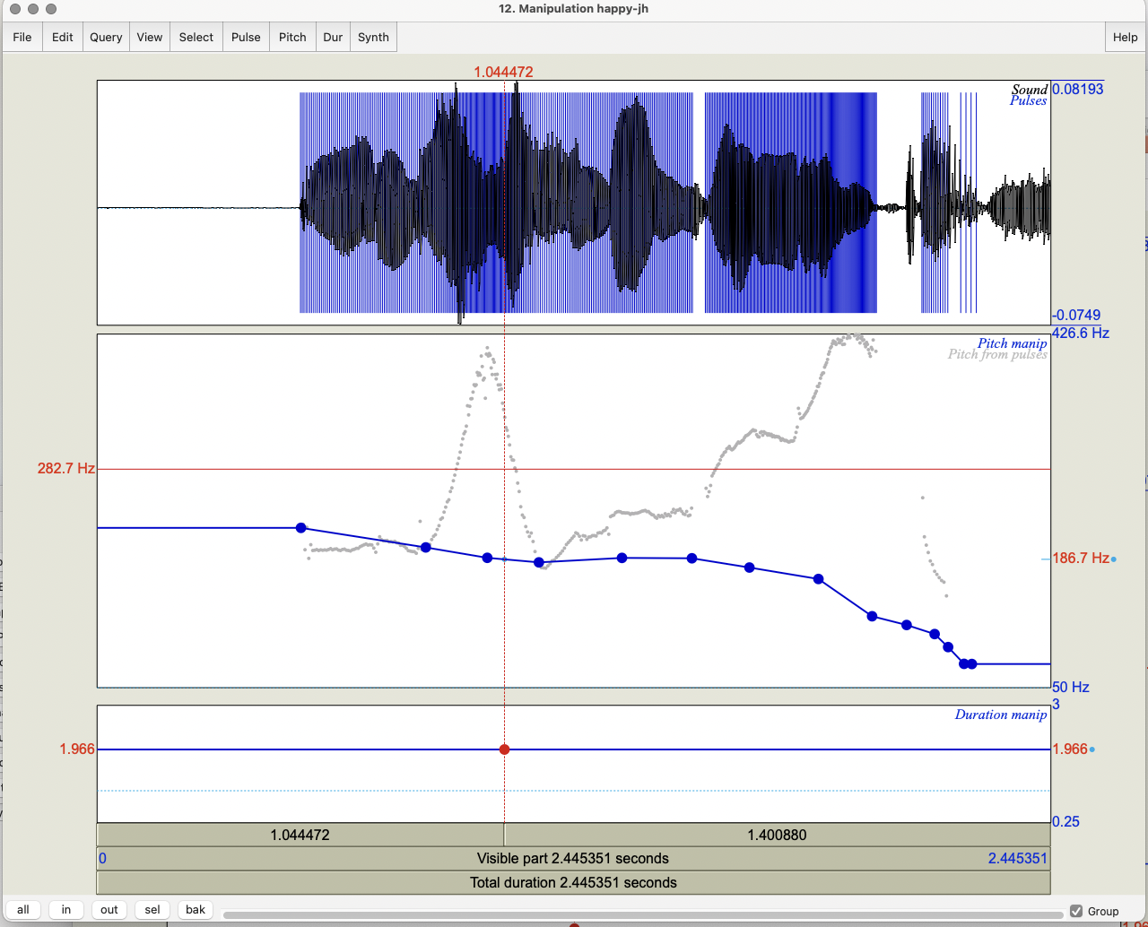
Notes:
How we changed the f0 of the happy file

Slide 69
Task 7: Pitch Contour Cloning
Record a sad version of mama and read both the happy.wav and sad.wav versions into Praat
  Create a manipulation object for happy.wav
  Select Extract pitch tier on right
  Create a manipulation object for sad.wav
  Select the pitch tier of happy.wav and the manipulation object for sad.wav and click Replace pitch tier
  Select the manipulation object for sad.wav and click Get resynthesis…
  View & Edit the new version of sad.wav
Notes:
Another exercise you can try is pitch contour cloning. Once you follow these instructions, you want to compare your original sad wavefile to the new sad wavefile, and also compare the new sad wavefile to the original happy wavefile.
Note that to create a manipulation object, you need to use Manipulate → To manipulation and click OK

Slide 70
  Compare the original sad.wav file and the new sad.wav
  Compare the new sad.wav and the original happy.wav
Notes:
Original sad to new modified sad
Original happy to new sad2happy version

Slide 71
Task 8: Clipping
Record a short phrase in a very loud voice, to produce clipping, and see what the waveform looks like
How do you identify clipping?
  Input signal amplitude is greater than the range that can be represented in
Avoid it?
    Increase the resolution (sampling rate)
    Decrease the amplitude

Slide 72
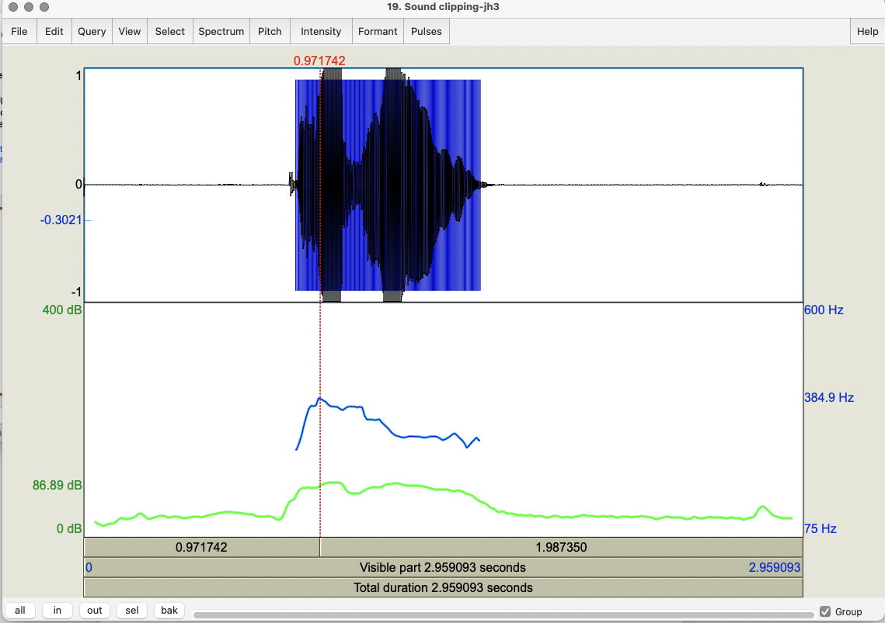

Slide 73
Task 9: Formant Analysis
Extract F1 and F2 values for the vowels in your mama file
Formant -> Show formants
  For each, select the vowel in the wavefile
    Formant → Get first formant
    Formant → Get second formant
  You can submit yours results here if you wish:
https://goo.gl/forms/ZIOvmXOP5ubIq1rS2

Slide 74
Task 8: Annotation using Textgrids
Select mama file in Objects window
  Select View & Edit
  Select Spectrogram → Show spectrogram
  On Praat Objects: Annotate → To Textgrid
    In the box that pops up you can see a request for names of Textgrid tiers and whether these are point tiers (where you label points on the spectrogram) or interval tiers (where you label intervals)
  Select Sound mama and Textgrid mama and select View & Edit
Notes:
This is the second-to-last exercise in today’s class. You’re going to see how textgrids work and practice annotating one. This exercise also has slightly longer instructions, so I will switch the slide in just a moment to show you the difference between point and interval tiers and how to work with them.

Slide 75
Task 8: Annotation using Textgrids
    Point vs. interval tiers
    Tier → Add a point tier and name it PartofSpeech in the box that appears on the left
      Add a point by 1) selecting a point in the waveform or spectrogram, 2) clicking on the circle that appears at the top of the PartofSpeech tier, and 3) insert the POS at this point
    Tier → Add an interval tier and name it WordsinTier
      Add an interval by 1) selecting a point at the beginning of the word in the waveform or spectrogram, 2) clicking on the circle that appears at the top of the WordsinTier, 3) selecting a point at the end of the word, and 4) insert the word in the interval created
Notes:
Here are the instructions for working with the point tier and the interval tier. Let me know when we are ready to see an example of an annotated textgrid on the next slide.

Slide 76
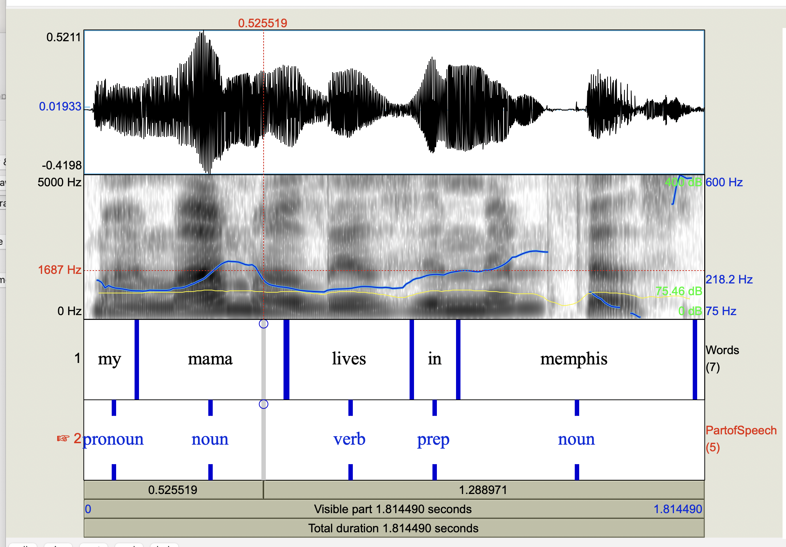

Slide 77
Task 11: Masking
Select original mama file each time
Select Convert → Change gender; OK
Select Filter →filter (pass) Hann band; OK
  Retains only a specified range through
  Find a pass band that masks the words but retains the intonation
  Find a pass band that masks the intonation but retains the words
Modify → Reverse
Notes:
Filter: keeping lower bands keeps intonation; higher bands (e.g. 500-1000) keep words
Modify Formant Shift Ratio (lower is male; 1.0 is no change; higher is female); New Pitch Median can also be reset to a lower or higher value for male vs. female
To change female to male try things like 0.8 or 0.9 for formant shift and 65 for pitch median…

Slide 78
Task 9: Scripting
From what you’ve just done in Praat:
  Go to Praat (top left of screen) → New Praatscript → Edit → Paste history
  Select File → Save (or Save as) the script, which you’ll see is everything you’ve done today if you’ve kept Praat open – on your laptop
  To use again, select Praat -> Open Praat Script
  When the script opens, choose Run or Run selection on the top left of the file (you can run all or part of the script)
You can also write scripts or modify existing scripts yourself using these resources
Notes:
To wrap up for today, I want to mention scripting, which is what allows you to accumulate multiple Praat functions into a single command. You can do this either by using your Praat history, or by writing a script from scratch. I’ll leave these instructions up for a bit too, but let me know if you want to see an example script on the next slide.

Slide 79
Sample Praat Script
# This script will create a new text-grid for a wav file
form Make a text-grid for a .wav file
comment Source Directory?
sentence Directory C:\Documents and Settings\julila\My Documents\
comment File name?
sentence Filename
comment Tier Name?
sentence Tier
endform
Read from file... 'directory$‘ ‘filename$'
stem$ = left$(filename$,length(filename$)-4)
select Sound 'stem$'
To TextGrid... 'tier$' 'tier$‘ # tier names, which tiers are point tiers
Write to text file... 'directory$'\'stem$'.TextGrid
Remove

Slide 80
Praat Resources
Online Praat help, FAQ, manual
  Links from http://www.praat.org
  UCLA resources
  Parselmouth vs. Praat Scripting
There are more Tasks you can look at in today’s slides…
Notes:
There are lots of resources available online to help you get more familiar with Praat. If you’d like more hands on practice, you can take a look at some of the hidden slides in this presentation for additional exercises that we didn’t have time for today.
[For a quick check, you can use Praat → New Praat Script --> Edit → Paste history]

Slide 81
Next Class
Readings:
  ToBI Conventions
  AuToBI
  Prosody and Meaning
  *Guidelines for ToBI Labeling
Post 5 on these is due next Monday (09/29/25) at 11:59 pm
HW 1 assigned: due before class 10/07/25 at 4:10 pm
Questions?
Notes:
Next time, we’ll be talking about prosody, so make sure to do the readings and post your weekly post.

