Slide 1
Acoustics of Speech
Julia Hirschberg & Debasmita Bhattacharya
CS 6706

Slide 2
Assignments
If you were unable to do the Week 2 assignment last week for any reason, please do the Week 2 (late for students signing up late) post ASAP -- how many of you does this apply to?
Please remember to provide 100 words each for positive and also for each negative for each assigned chapter/subchapter or paper
If you have any questions about an Assignment or a Homework or anything else involving this course, please first look at the threads on Ed Discussion.
  If you don’t see an answer to your question then do create a new post on Ed Discussion and we’ll respond promptly
Notes:
We’ll start with a couple of housekeeping notes as usual.

Slide 3
Reminder: Sample Assignment from an earlier course for Jurafsky & Martin on Dialogue
Positive aspects:
I found this chapter interesting and enjoyed learning about the various
approaches of building dialogues systems: rule based, corpus-based, sequence to sequence Chatbot and more. One of the things I appreciated the author including were ethical issues concerned with building dialog systems. They were very important issues raised such as the tendency for agents to have female names, biases in the training data and even more fascinating how users can corrupt an agents’ knowledge as in the case of Microsoft Tau making reinforcement learning a double edge-sword. In other words, while reinforcement learning can help chat-bots better personalize to a user it can also be trained to reflect discriminative opinions of the user.

Slide 4
Negative aspects:
One of the things that I felt was incomplete was in understanding turn-taking. How can the system know when the user is done speaking? Are there prosodic cues such as the F0 contour that can help the system to avoid overlapping speech with the user, causing the agent to miss out on important information? On the note of prosody, in most conversations the emotional state and the intent of a speaker can inform the type of response that is desired. How can a system deal with a situation when a user is sarcastic of frustrated in a conversation? How can it detect this and how should it respond?
Challenge Question: Are there cues besides F0 contour that can help the system avoid overlapping speech with the user, which might cause the agent to miss out on important information?
Please do present your assignments in this form for each reading assigned, although the Challenge Question is assigned only for some.
Notes:
Any questions?

Slide 5
Today and Next Class
How do we define cues to segments and intonation?
  Fundamental frequency (pitch)
  Amplitude/energy (loudness/intensity)
  Spectral features (formant frequencies)
  Timing (pausing, speaking rate)
  Voice Quality (jitter, shimmer, HNR)
How do we extract them?
  Praat (or parselmouth)
  openSMILE
  libROSA…
Notes:
We’ll start with an overview of the upcoming content we’ll cover on the acoustics of speech. This will include learning how to define cues to segments and intonation like fundamental frequency and amplitude, and learning how to extract these from speech. Our class today will focus on the first aspect, and next class we’ll get some hands on experience with the second aspect.
[Formant frequencies correspond to resonances in the vocal tract]

Slide 6
Today
Motivating goals
Sound production
Capturing speech for analysis
Feature extraction
Spectrograms
Notes:
Here is a roadmap of what we will specifically focus on today. As you can see, we have quite a few topics to cover, and we will probably need the full two hours of class time today, so I’ll go ahead and get started with the motivating goals for today’s lecture.

Slide 7

Goal 1: Distinguishing One Phoneme from Another, Automatically
ASR: Did the caller say ‘I want to fly to Newark’ or ‘I want to fly to New York’?
Forensic Linguistics: Did the accused say ‘Kill him’ or ‘Bill him’?
What evidence is there in the speech signal?
  How accurately and reliably can we extract it?
  Let’s look at the waveform and spectrogram
Notes:
When it comes to performing speech analysis, we have a couple of main goals. One of these is to be able to distinguish one phoneme from another automatically, as we discussed briefly last week. This is particularly useful for automatic speech recognition and forensic linguistics, especially in more ambiguous cases like these examples. [play sounds]
To achieve this goal of distinguishing between phonemes, we need to look to the speech signal for accurate and reliable evidence.
[ATIS corpus for ASR: dialogue system for travel arrangements: record something not so clear about N*]

Slide 8
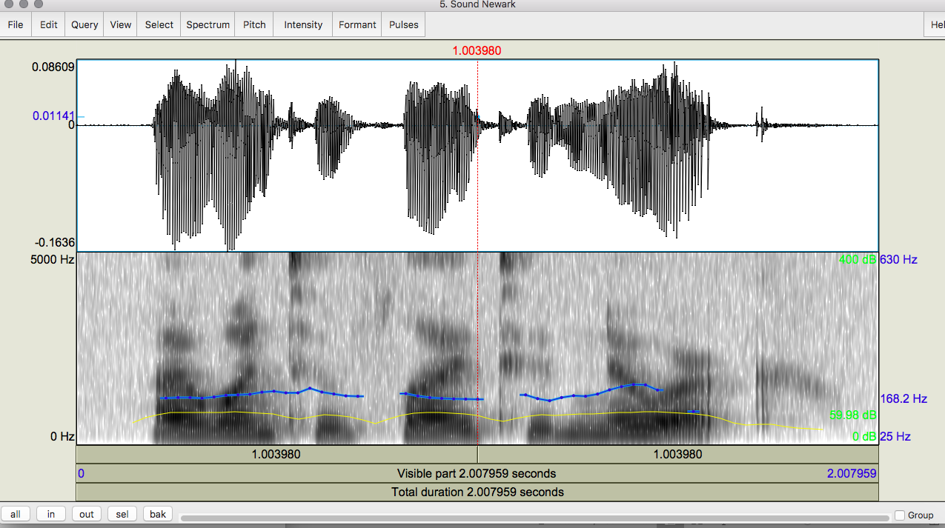
Notes:
[play sound] I want to fly to Newark: waveform at the top and spectrogram at the bottom. The spectrogram also has information here on pitch (blue) and intensity (yellow)

Slide 9
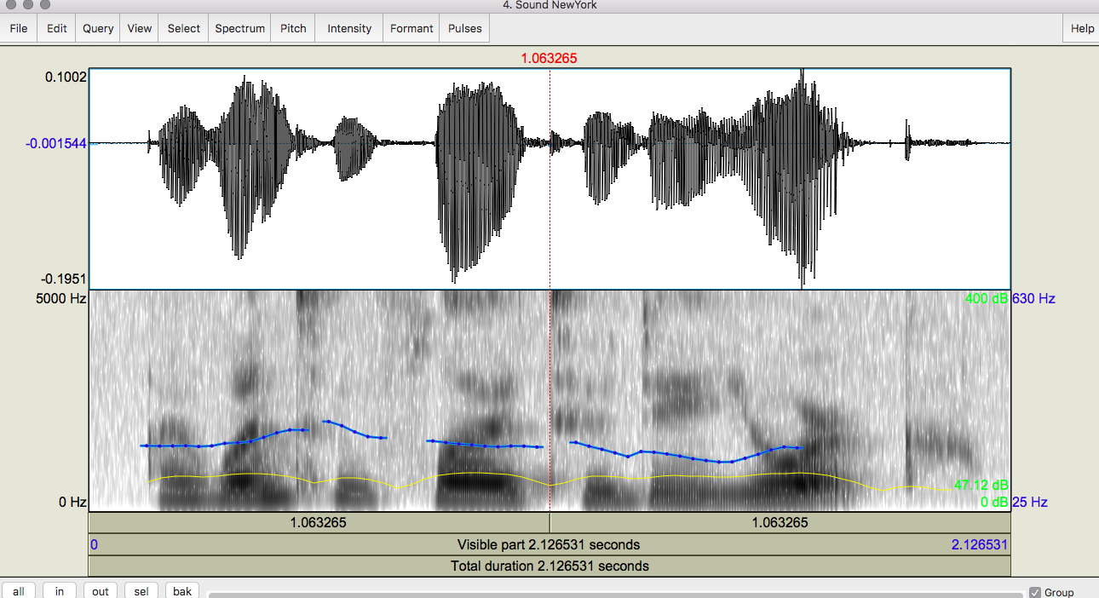
Notes:
[play sound] I want to fly to New York

Slide 10
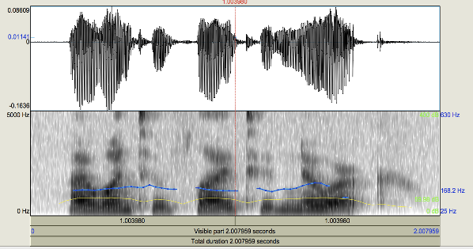
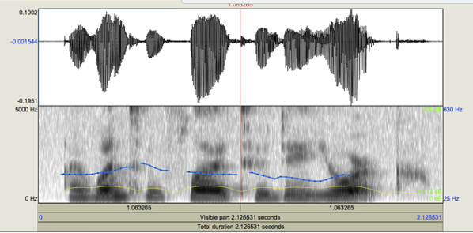
Notes:
Let’s compare the 2: where do you see the differences? I want to fly to Newark/New York.

Slide 11
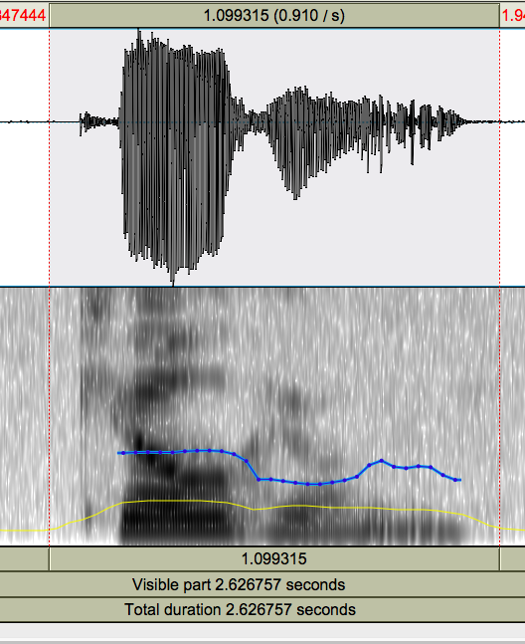
Notes:
Here’s another wav form and spectrogram. Kill – voiceless stop with VOT (voice onset time) from the beginning of “k” → you can tell this from how intensity begins on the spectrogram before pitch does.
[VOT: a phonetic measurement that quantifies the time lag between the release of a stop consonant and the start of voicing (vocal cord vibration) in the following vowel]

Slide 12
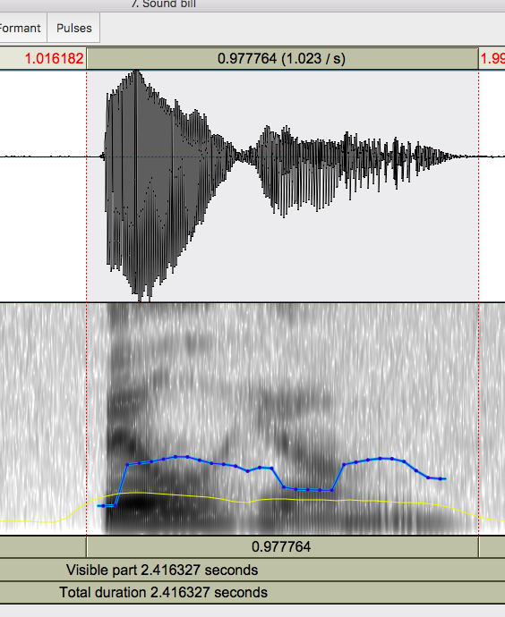
Notes:
This is in contrast with Bill him – voiced consonant, no VOT (voice onset time)

Slide 13
Goal 2: Understanding Speaker Intention Through Determining How Things Are Said
Intonation
  Forensic Linguistics: ‘Kill him!’ or ‘Kill him?’
  TTS: ‘Are you leaving tomorrow./?’
  What information do we need to extract from or generate in the speech signal?
  What tools do we have to do this?
Notes:
A second main goal that builds directly on the first is to be able to understand speaker intention in speech by determining how things are said, which is often critical to the goal. To illustrate this, we have some more examples to listen to. [play sounds]
What are the differences? For kill: “I’m telling you what to do” “I’m asking if you want to do it” “I’m surprised that you want to kill this particular person”
For leaving: ”I’m pretty sure you are leaving tomorrow” “I don’t know if you’re leaving tomorrow”
To be able to achieve this second goal, we need to think about what specific information we can extract or generate in the speech signal and the tools that can enable us to do so.

Slide 14
Sound Production
Pressure fluctuations in the air can be caused by a musical instrument, a car horn, a voice…
  Sound waves propagate through the air like marbles thrown in a lake: slow, stone-in-lake ripples
  This causes our eardrums (tympanum) to vibrate
  Our auditory system translates these into neural impulses
  Our brain then interprets these as sounds
  We can plot these sounds as changes in air pressure over time
Notes:
To achieve both of the goals I introduced, we have to understand sound production. We already know that sounds can be produced by various sources. Regardless of the specific source, the production of a sound involves air pressure fluctuations known as sound waves, which propagate through the air. If you took a physics class in high school, you would have probably come across this concept then. Sound waves cause vibrations in our eardrums, which our auditory system then translates into neural impulses that the brain can interpret as sound.
For our purposes, we can plot sounds as changes in air pressure over time.

Slide 15
Sound Production
From a speech-centric point of view, sound not produced by the human voice is noise
  Ratio of speech-generated sounds to other simultaneous sounds: Signal-to-Noise Ratio (SNR)
  Harmonics to Noise Ratio (HNR) measures the ratio between periodic and aperiodic speech components (speech waveforms that show repeating patterns over time vs. those that do not) in distorted or unnatural speech
    For example, when people with dysarthria, apraxia, aphasia, autism, stuttering try to speak but have trouble speaking clearly
  What do we do to measure speech?
Notes:
Note that in the speech world, sound that isn’t produced by the human voice is treated as its own separate category called noise, and we measure the ratio of speech sounds to noise sounds though a metric called signal to noise ratio. For example, when people are speaking while music is playing or cars are running by or a tea kettle is brewing or any other sort of non-speech noise is in the background of a phone call, we examine the SNR. SNR: compares signal power to background noise, and is expressed in decibels –here, a ratio higher than 1:1 indicates more signal than noise, which in turn indicates a stronger speech signal that can be analyzed more accurately.
We also measure another aspect of speech known as the harmonics to noise ratio or HNR: compares ratio between periodic and non-periodic speech, and is important in measuring pathologic voices. We’ll circle back to talking about HNR in more detail towards the end of today’s class. For now, we’ll start with looking more generally at how we can measure speech.

Slide 16
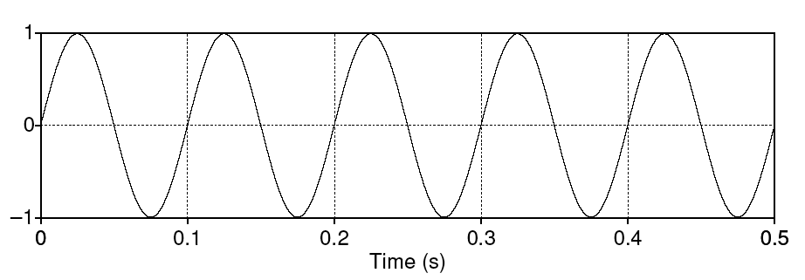
Simple Periodic Speech Waves
Characterized by their frequency (x-axis) and amplitude (y-axis)
Frequency (F) – # of cycles per second
Amplitude – maximum value in y-axis
Period (T) – time it takes for one cycle to complete
Notes:
We’ll start by looking at a simple periodic speech wave, from which we can measure frequency, amplitude, and period.
Frequency = 5 cycles /.5 sec = 10 Hz
Amplitude = 1
Period (T) = .1 sec

Slide 17
One Period
Characterized by their frequency (x-axis) and amplitude (y-axis)
Frequency (F) – # of cycles per second
Amplitude – maximum value in y-axis
Period (T) – time it takes for one cycle to complete
Notes:
Just to reiterate:
The x axis provides the length of a period and the number of periods in time
The y axis provides the amplitude of the sound
These soundwave measurements correspond to how high pitched our voice is (in terms of frequency) and how loud it is (in terms of amplitude). We’ll come back to these correspondences towards the middle of today’s class.

Slide 18
Speech is Composed of Complex Periodic Waves
Cyclic but composed of multiple sine waves
  Fundamental frequency (F₀): rate at which largest sine wave pattern repeats (unit: Hertz or Hz)
  Harmonics: waves with a frequency that is a positive integer multiple of the frequency of the F₀, which is typically called the first harmonic
Any complex waveform can be analyzed into its component sine waves with their frequencies, amplitudes, and phases using the Fourier Transform
  Fourier analysis allows us to evaluate amplitude, phases, and frequencies of data
Notes:
The previous example speech soundwave was very simple – in reality, speech is composed of multiple periodic waves. So when we measure the frequency of a segment of speech, we are usually most interested in the fundamental frequency, or the rate at which the largest sine wave pattern repeats. The fundamental frequency is also known as the first harmonic of the speech wave, with higher harmonics being waves that have a frequency that is a positive integer multiple of the frequency of the first harmonic.
As you may have seen in certain engineering or possibly calculus classes, we can analyze a complex waveform and break it down into the various harmonics using the Fourier Transform or Fourier analysis.

Slide 19
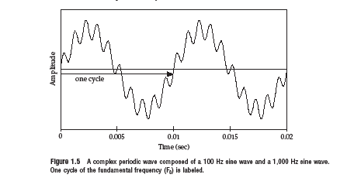
2 Sine Waves Combining to Form 1 Complex Periodic Wave
Notes:
Here’s an example of a very simple complex periodic wave form. We can see the F0 or first harmonic by tracing over one repetition of the form with fewest repetitions and the second harmonic by tracing over a repetition of the one with more repetitions

Slide 20
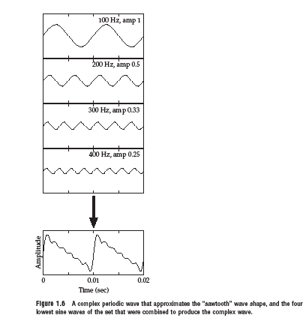
4 Sine Waves→ 1 Complex Periodic Wave
Notes:
Here’s an example of a more “normal” or typical complex periodic wave showing each of the sine waves separately and together. Note from their y axes that each one has a different amplitude, from the top (highest, 1) to the bottom (.25)

Slide 21
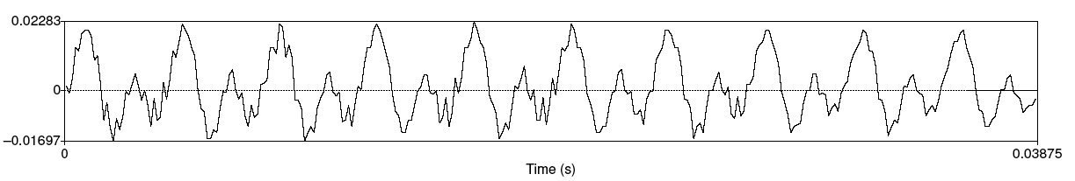
Speech Sound Waves: /iy/
X-axis: time
Y-axis: air pressure above (+ Compression), at (0 Normal air pressure), and below (- Rarefaction / decompression) normal air pressure
Combined sound waves of different frequencies
Notes:
Here you can see that it’s easiest to identify the F0 (first harmonic) but you can also see that there are other sine waves which continue throughout.

Slide 22
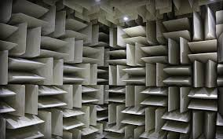
How do we Capture Speech for Analysis?
Recording conditions: Quiet office, head-mounted mic, sound booth, or anechoic chamber
Notes:
In order to perform speech analysis as we just saw, we need to first capture or record the speech. Ideal recording conditions involve [read slide].

Slide 23
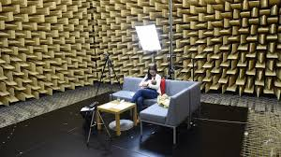
Notes:
When Professor Hirschberg was at Bell Labs, they had one larger than this but typically used smaller ones to record speech that they needed to train their TTS systems.

Slide 24
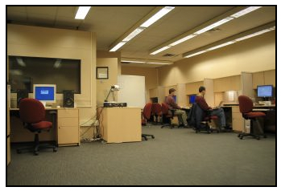
A Smaller Sound Booth in our Speech Lab
Notes:
8” x 8.51 and 8.4’ high
This is one they used at Bell Labs which Prof Hirschberg was given when she came to Columbia and they created her Speech Lab, in CEPSR 7LW3 now.

Slide 25
What do we need to capture speech well?
Good recording conditions (quiet space, close-talking microphone): please remember this when recording your own voice!
Microphones convert sounds into electrical current: oscillations of air pressure become oscillations of voltage in an electric circuit
  Analog devices (e.g. tape recorders) store these as a continuous signal
  Digital devices (e.g. computers, Digital Audio Tape (DAT) systems) first convert continuous signals into discrete signals (digitizing)
    Now … cell phones and head-mounted microphones… as well
Notes:
So, what else do we need to capture speech well? We already mentioned good recording conditions, one aspect of which is a good microphone. A microphone converts sounds into electrical current, which is then stored either as a continuous signal or as a discrete signal, depending on the type of microphone. If you use an analog device, you’ll store sounds as a continuous signal; if you use a digital device, you’ll store sounds as discrete signals instead.
A fun fact about Digital Audio Tape systems: DAT systems were developed by Sony in 1980s. There was much pushback in the U.S. by the Recording Industry Association of America (RIAA) because of their ability to copy LPs, CDs, and pre-recorded cassettes. Sony released its last DAT in 1995 and continued to produce these until 2005.

Slide 26
Speech Sampling
Sampling rate: how often do we need to sample?
  At least 2 samples per cycle to capture periodicity of a waveform component at a given frequency – why?
    Need to identify positive and negative wave components
    So, a 100 Hz waveform needs 200 samples per sec
  Nyquist frequency:
    Highest-frequency component that can be captured for a given sampling rate (half the sampling rate) so that the signal can be reconstructed – e.g. an 8K Hz sampling rate (the rate that most phones use) captures frequencies only up to 4K Hz
Notes:
Another important aspect of capturing speech well is the sampling rate of the recording. [read slide]
[We need the positive and negative wav components – the up and the down – most phones do not record all your voice correctly because of their 8K sampling rate.]
In other words, a signal can be perfectly reconstructed from its samples if the sampling rate is at least twice the highest frequency component present in the original signal
The Nyquist frequency is half the sampling rate used when digitally representing an analog signal. It's a crucial concept in signal processing, ensuring that a signal can be accurately reconstructed from its sampled values. If a signal is sampled at or above the Nyquist frequency, it can be perfectly reconstructed, but sampling below this frequency leads to aliasing, where high-frequency components are incorrectly interpreted as lower frequencies.

Slide 27
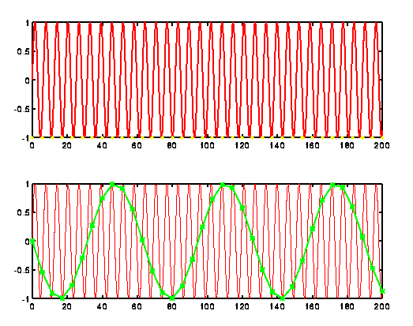
Ideal Sampling
Notes:
Take the speech signal shown at the top and sample the min and max of the sound wave over a longer segment to get a reasonable estimation of the signal.
F = 32 cycles / 1 sec

Slide 28
Sampling/Storage Tradeoff
Human hearing: ~20K Hz top frequency
  Do we really need to store 40K samples per second of speech?
Telephone speech: 300-4K Hz (8K sampling)
  But some speech sounds (e.g. fricatives, stops) have energy above 4K…so these may be hard to hear
44K Hz (CD quality audio) vs.16-22K Hz (usually good enough to study pitch, amplitude, duration, …)
Notes:
Related to sampling, storage is also an important aspect of capturing speech well, and involves a tradeoff with sampling. For example, [read slide]
[Golden Ears: Steve crandall: It was at Oberlin College, The Cleveland Orchestra (we learned a lot from the concertmaster) and Telarc Records in Cleveland. TCO and Telarc had certified Tone Masters. What we learned was hearing is much better if you’re under 30 and you can train students in a few hours to be as good as a tone master. We used students from the music conservatory and tried some from other departments. The best two or three (out of the dozen we trained for the tests) weren’t in music:) One was an art major — I can’t remember the others. A very strange finding was asking people to list music genres. Most people can do six to eight. Music students up to 20 with a few outliers. Niki Fallen was the statistical sport with over 150… that’s where I first learned about Calgary (Canada) Sugar Pop. The mind wobbles.]

Slide 29
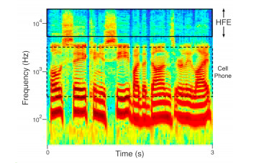
What your Phone is not Telling You
High frequency samples
Notes:
If you’ve ever noticed how or wondered why people sound different on your cell phone than in person, this will be an interesting link for you to follow after class. We just mentioned how a cell phone doesn’t transmit all of the sounds that the human voice creates. Specifically, cell phones don’t transmit very low-frequency sounds (below about 300 Hz) or high-frequency sounds (above about 3,400 Hz). The voice can and typically does make sounds at very high frequencies in the “treble” audio range (from about 6,000 Hz up to 20,000 Hz) in the form of vocal overtones and noise from consonants. Your cell phone cuts all of this out, however, leaving it up to your brain to “fill in” if you need it. If you want to know what you’re missing out on, you can follow the link and listen to only the high frequencies and report back on what you hear, either at the start of next class or on Ed Discussion before then.
[Listen to only the high frequencies and report what you hear. We can do this using conventional signal processing methods: cut out everything below 6,000 Hz thereby only transmitting sounds above 6,000 Hz to the ear of the listener. When we do this, some listeners only hear chirps and whistles, but most normal-hearing listeners report hearing voices in the high frequencies. Strangely, some voices are very easy to hear out in the high frequencies, while others are quite difficult. The reason for this difference is not yet clear. You might experience this phenomenon if you listen to the following clips of high frequencies from several different voices. You’ll need a good set of high-fidelity headphones or speakers to ensure you’re getting the high frequencies. The closes to intelligible is the last one in the list. Cell phones now trying to include high frequency transmission…]

Slide 30
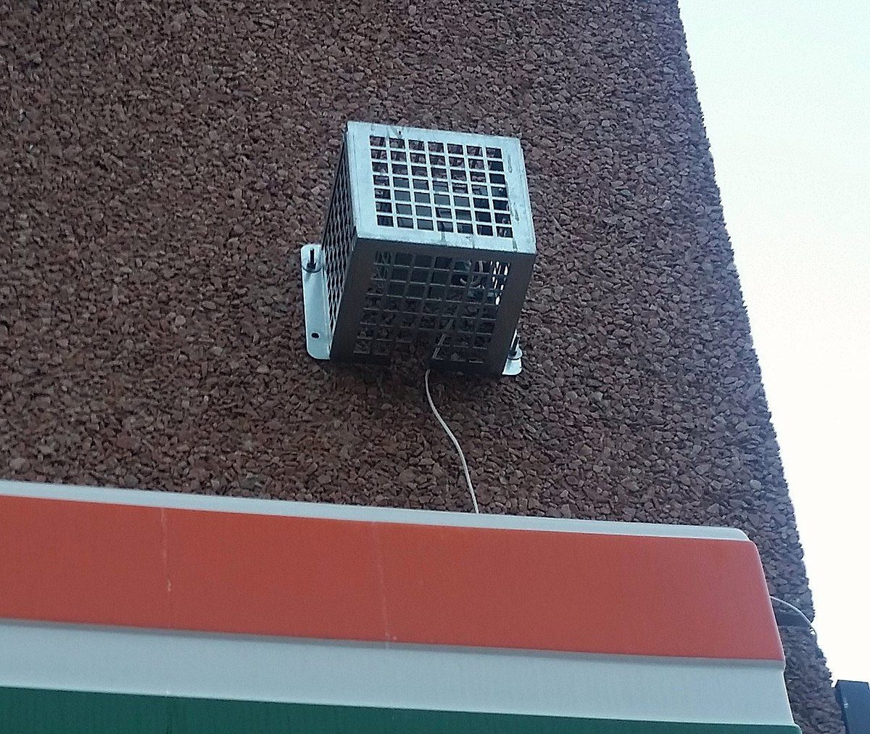
The Mosquito Alarm
Listen (at your own risk)
Teen Buzz ringtone
Notes:
Another setting where high frequency sounds are key is in anti-loitering devices. As we age, we lose our ability to hear high frequency sounds, but if you are a homeowner dealing with young people like teenagers loitering around your property and generally being a nuisance, this device emits sound frequencies that can only be heard by young people. These are very unpleasant to hear and effectively make it difficult to remain close to the source of the sound, solving the loitering problem.
Play from Listen (title goes to Mosquito company)
[The newest version of the device, launched late in 2008, has two frequency settings, one of approximately 17.4 kHz^{[4]} that can generally be heard only by young people, and another at 8 kHz that can be heard by most people. The maximum potential output sound pressure level is stated by the manufacturer to be 108 dB decibels (dB), and the manufacturer's product specification furthermore states that the sound can typically be heard by people below 25 years of age.^{[1]} The ability to hear high frequencies deteriorates in most humans with age (a condition known as presbycusis), typically observable by the age of 18.^{[5]}]
Can you hear this?
Teen Buzz ringtone: The sound was made into a mobile phone ringtone, which could not be heard by teachers if the phone rang during a class.^{[14]} Mobile phone speakers are capable of producing frequencies above 20 kHz.^{[15]} This ringtone became informally known as "Teen Buzz"^{[16]} or "the Mosquito ringtone" and has since been sold commercially.

Slide 31
Sampling Errors
Aliasing:
  Different signals can become indistinguishable (aliases) from one another when they are sampled
  E.g. signals with frequency higher than the Nyquist frequency
  Solutions for analysis:
    Increase the sampling rate
    Filter out frequencies above half the sampling rate (anti-aliasing filter)
Notes:
We’ve covered a few different aspects of sampling so far, and we’re now going to briefly talk about sampling errors.
One error is known as aliasing, which causes different signals to become indistinguishable (or aliases of one another) when sampled. It also often refers to the distortion or artifact that results when a signal reconstructed from samples is different from the original continuous signal.
In other words, aliasing is the effect of new frequencies appearing in the sampled signal after reconstruction, that were not present in the original signal. It is caused by too low a sample rate for sampling a particular signal or too high frequencies present in the signal for a particular sample rate. Some solutions for this are to increase the sampling rate, or if this isn’t possible, to filter out frequencies above the Nyquist frequency when attempting reconstruction.

Slide 32
Quantization Issues: Representing the Signal in Digital Form
How do we measure the amplitude (sound pressure) of speech?
  Choose sampling points: what resolution should you choose?
  Integer representation: 8, 12 or 16 bits per sample
Noise due to less useful quantization steps can be avoided by higher resolution -- but requires more storage
  How many different amplitude levels do we need to distinguish?
  Choice depends on data and application (44K 16bit stereo requires ~10Mb storage): music vs. speech
Notes:
Other issues that come up when recording speech are related to representing the signal in digital form. One relevant question in this area involves how we measure the amplitude of speech. Choosing a higher sampling resolution helps avoid capturing noise to a greater extent, but this requires more storage, again pointing to the sampling/storage tradeoff. How we ultimately make a decision on the tradeoff often depends on the specific use case of the data.

Slide 33
Quantization Issues: Representing the Signal in Digital Form
  But clipping occurs when the input volume (i.e. the amplitude of a signal) is greater than the range that can be represented
  Watch for this when you are recording…
  Most recorders (including Praat) will give you a signal when you are above the sound range
  Solutions
    Increase the resolution (sampling rate)
    Decrease the amplitude of the recording
    Important to check the right amplitude before you start recording
Notes:
Another issue to be mindful of in sampling amplitude is clipping, which occurs when the input amplitude is greater than the range that can be represented. We can listen to an example of this to get an intuitive sense of what happens with clipping.
[read slide]
Recording devices will usually show you if clipping is likely

Slide 34
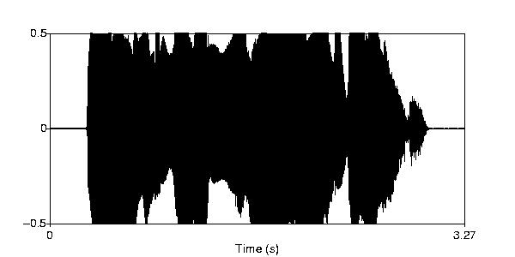

An Example of Clipping
Notes:
And here is a visual representation along with another example of clipping.

Slide 35
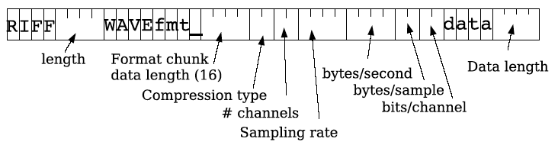
Speech File Formats: WAV and Many More
Many formats, trade-offs in compression, quality
SoX (Sound eXchange) can be used to convert speech formats from one to another:
  .WAV, AIFF, HTK, MP2/MP3/MP4, MPEG, SPHERE, Ogg Vorbis, u-law, .VOX, .VOC, RIFF
Notes:
To close out our discussion of how we can capture speech well, we have to mention speech file formats. There are many, which involve tradeoffs in terms of compression and quality. The one you’ll see and use the most in this class is the .wav file format.
[Resource Interchange File Format: RIFF file: M$ wave file format with header and data.]

Slide 36
Frequency
How fast are the vocal folds vibrating?
  Vocal folds vibrate for voiced sounds, causing regular peaks in amplitude
As discussed earlier: F₀ – is the fundamental frequency of the periodic waveform
  Lowest frequency of the waveform
Pitch track – plot of F₀ over time
Notes:
Now, we’re going to circle back to frequency and amplitude and build on how they represent perceptual pitch and loudness, starting with frequency.
You’ll recall from our last class that when vocal folds vibrate, they produce voiced sounds, and the rate of vibration is the frequency or pitch of the sound produced. The faster the vibration, the higher the pitch. If we want to measure this vibration via fundamental frequency of the waveform, as is typical, we can use a pitch track, which is a plot of F0 over time.

Slide 37
Estimating Pitch
Frequency = cycles per second
  Simple approach to calculating cycles: count the zero crossings in a time range -- changes in signal from pos2neg and neg2pos -- and divide by 2
Notes:
Here is an example of a pitch track that we would use to estimate pitch or F0, with a reminder on the slide of how to visually calculate frequency.
[Or just count pos2neg or neg2pos]

Slide 38
F₀ Measure: Autocorrelation Process
Idea: Identify the period between successive cycles of the wave
  F₀ = 1/period length
Where does one cycle end and another begin?
  Find the similarity between one piece of the signal and the next -- a shifted version of itself
  The period is the chunk of the segment that matches best with the next chunk
  Systems were developed to do just this, e.g. Praat
Notes:
In slightly more detail, we can use a process known as autocorrelation to estimate pitch from a pitch track. To illustrate how this works, I’ll go back to the previous slide in a moment.
[read slide, then Return to previous slide to show how to do]

Slide 39
F₀ Measure: Autocorrelation Process
  Parameters considered
    Window size (chunk size)
    Step size (how quickly the next chunk appears)
    Frequency range
Notes:
[read slide]

Slide 40
Common Problems in Pitch Tracking
Microprosody effects of consonants (e.g. /v/, /m/) on following vowels’ F₀
Creaky voice → no pitch track
System errors to watch for in reading pitch tracks:
  Halving: shortest lag calculated is too long → estimated cycle too long, too few cycles per sec (under-estimate pitch)
  Doubling: shortest lag too short and second half of cycle similar to first → cycle too short, too many cycles per sec (over-estimate pitch)
Notes:
Like almost all of the other methods we’ve discussed in class so far, there are some issues that can crop up when doing pitch tracking. The first one is the issue of microprosody effects, and we have a good video to explain this. [Play the link for microprosody]
Other issues include the absence of a pitch track for certain kinds of voices, like creaky voice, as well as system errors like halving and doubling which lead to incorrect estimations of pitch.

Slide 41
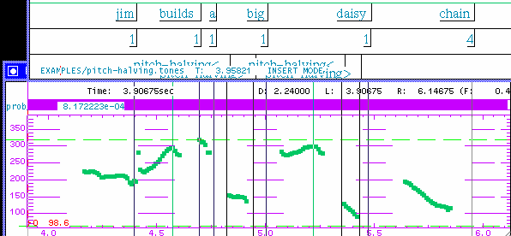

Pitch Halving
Pitch is halved
Notes:
The two artefacts pointed out on this slide are incongruous with the remaining parts of the pitch track. In this case of pitch halving, if you double the pitch, you’ll see if is a better match for the preceding pitch.

Slide 42
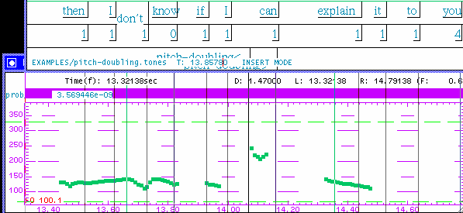
Pitch Doubling
Pitch is doubled
Notes:
Whereas in the case of pitch doubling, if you halve the pitch, you’ll see a better match. When you see and listen to pitch in the pitch track (e.g. in Praat) which seems not to be coordinated with the previous and following pitch, check by looking at half that pitch (does that coordinate better) or twice that pitch

Slide 43
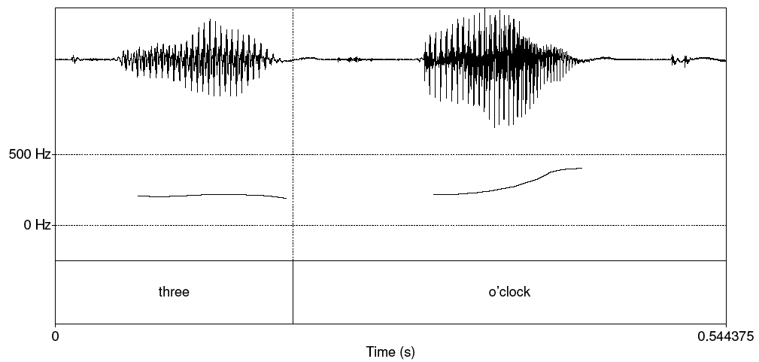
Better Pitch Track
Notes:
[Smooth]

Slide 44
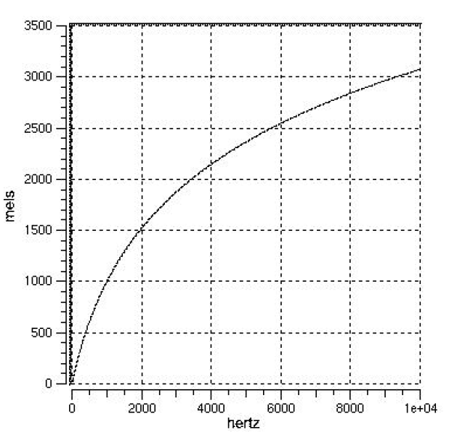
Pitch vs. F₀
Pitch is the perceptual correlate of F₀
  Human hearing is not equally sensitive to all frequency bands;
    Most accurate between 100Hz and 1000Hz
    Less sensitive at higher frequencies, roughly > 1000 Hz
Notes:
As we’ve alluded to already, pitch is the perceptual correlate of fundamental frequency. But we can’t hear all the possible frequency bands that could be produced and are instead only sensitive to those between 100Hz and 1000Hz.

Slide 45
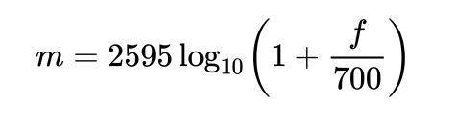
Pitch vs. F₀
Mel scale
  Mel: A perceptual scale of pitches judged by listeners to be equal in distance from one another: above 500 Hz though, increasingly large intervals are judged to produce equal pitch increments
  Psycho-acoustic model of pitch
  Can convert F₀ Hz into Mel scale to understand typical listener identification of pitch using this equation:
Notes:
The mel scale is named after the word “melody” and is a perceptual scale of pitches judged by listeners to be equal in distance from one another. One interesting thing that happens is that above 500 Hz, increasingly large intervals are perceived to produce equal pitch increments, so bigger differences in frequency sound like they produce the same differences in pitch. You can convert frequencies in Hz to the mel scale using this equation on the slide. The reference point between this scale and normal frequency measurement is defined by assigning a perceptual pitch of 1000 mels to a 1000 Hz tone, 40 db above the listener's threshold.
[Natural log to the base e (~2.718281828459)]

Slide 46
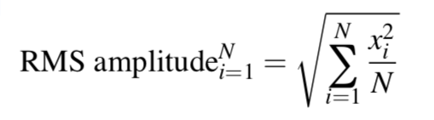
Amplitude
Measuring amplitude over a speech segment
  Root Mean Squared (RMS): Square each peak value of speech units x on the y axis over a speech segment and take the average
Notes:
That finishes our discussion of frequency and pitch, so now we can move on to amplitude and loudness or intensity.
The first thing we’ll note here is that amplitude is measured using the root mean squared value over a segment of speech., which is calculated using the equation presented on the slide.

Slide 47
Intensity
Human-perceived loudness is measured in decibels (dB) on a logarithmic scale comparing 2 sounds to one another
Difference in sound level (dB): 10 log₁₀ (P₂/P₁)
Notes:
Just as pitch is the perceptual correlate of frequency, intensity or loudness is the perceptual correlate of amplitude, and this is measured in decibels
For instance, suppose we have two loudspeakers, the first playing a sound with power P₁, and another playing a louder version of the same sound with power P₂, but everything else (how far away, frequency) kept the same.
Using the decibel unit, the difference in sound level, between the two is defined to be
10 log (P₂/P₁) dB where the log is to base 10.
If the second produces twice as much power than the first, the difference in dB is10 log (P₂/P₁) = 10 log 2 = 3 dB (to a good approximation).

Slide 48
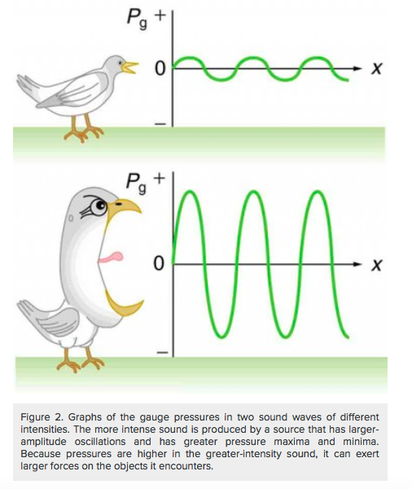
Notes:
Recall that we previously talked about amplitude in terms of air pressure, which is measured in Pascale units.T he larger the pressure max and min, the more intense the sound

Slide 49
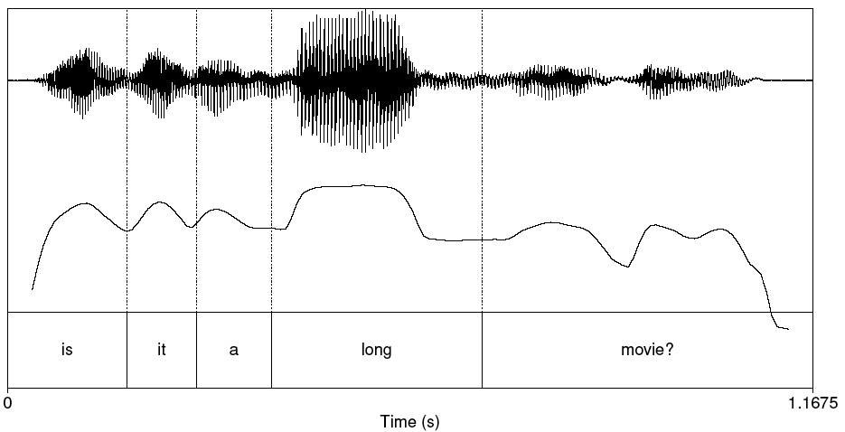
Plot of Intensity
Notes:
Here we have an example plot of intensity. The speaker emphasizes the word long, which gives it more sound pressure or amplitude

Slide 50
How Loud are Common Sounds – How Much Pressure is Generated?
Event Pressure (Pa) Db
Absolute Silence 20 0
Whisper 200 20
Quiet office 2K 40
Conversation 20K 60
Bus 200K 80
Subway 2M 100
Thunder 20M 120
*DAMAGE* 200M 140
Best decibel meters
Notes:
You might be interested in how loud common sounds are – here is a common list spanning silence all the way to the point at which you can damage your ears.
Pa = Pascal pressure metric
Db = Decibel
You can measure dbs on your phone: Decibel X et al

Slide 51
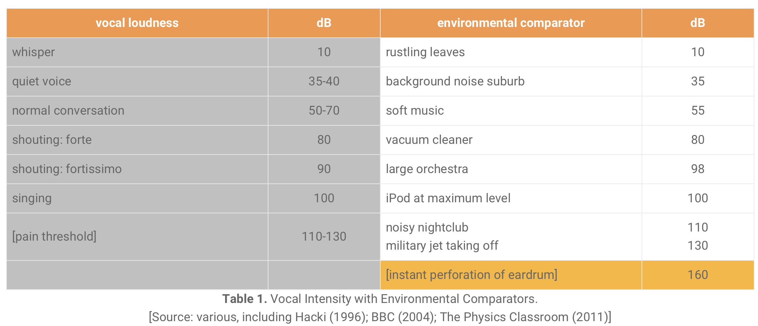
Notes:
And an alternate version of the previous list.

Slide 52
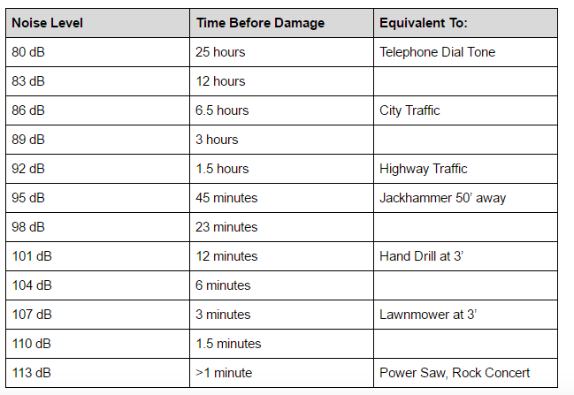
Notes:
And a slightly different version of the previous lists that tells you how long you can withstand certain sustained decibel levels of sound before damage to the ear drum occurs. So if you are frequently going to places on the louder end of the spectrum like concerts or even the NYC subway, I would recommend getting a good pair of concert earplugs that dampen noise while still letting you hear music – I personally use the Loops brand and they’re great because once a person’s hearing is damaged there is no way to restore it.

Slide 53
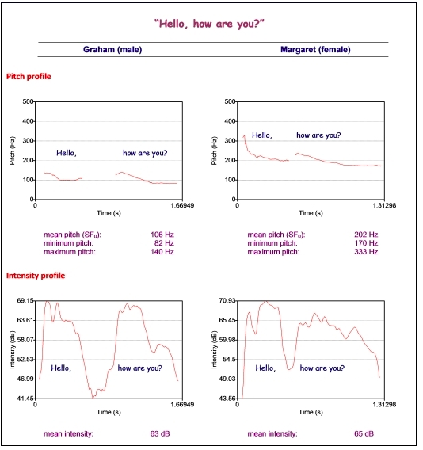

Slide 54
Voice quality
Jitter
Shimmer
Harmonics to Noise Ratio (HNR)
Notes:
So far, we’ve talked about the basic aspects of soundwaves. We’ll now get to more complex measures that we can derive from a soundwave that correspond to our perception of voice quality. These are known as jitter, shimmer, and HNR, and we’ll go over each one in detail now.

Slide 55
Voice quality
Jitter
  Random cycle-to-cycle variability in F₀
  Pitch perturbation/irregularity
Shimmer
  Random cycle-to-cycle variability in amplitude
  Amplitude perturbation/irregularity
Notes:
Jitter and shimmer are closely related, where jitter measures variation in pitch in speech, while shimmer measures variation in intensity.

Slide 56
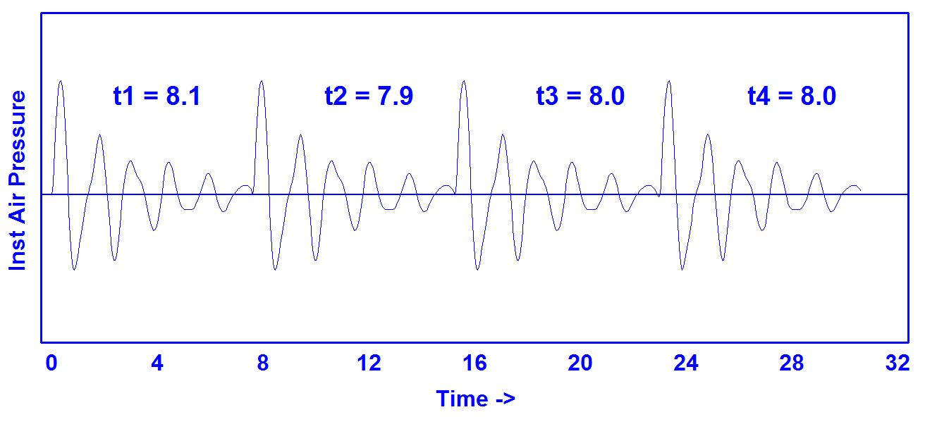
Jitter (Pitch Irregularity)
https://homepages.wmich.edu/~hillenbr/501.html
Notes:
Pitch irregularity

Slide 57
Synthetic Continuum Varying in Jitter (Pitch)
0.0% 2.0%
0.2% 2.5%
0.4% 3.0%
0.6% 4.0%
0.8% 5.0%
1.0% 6.0%
1.5%
https://homepages.wmich.edu/~hillenbr/501.html

Slide 58
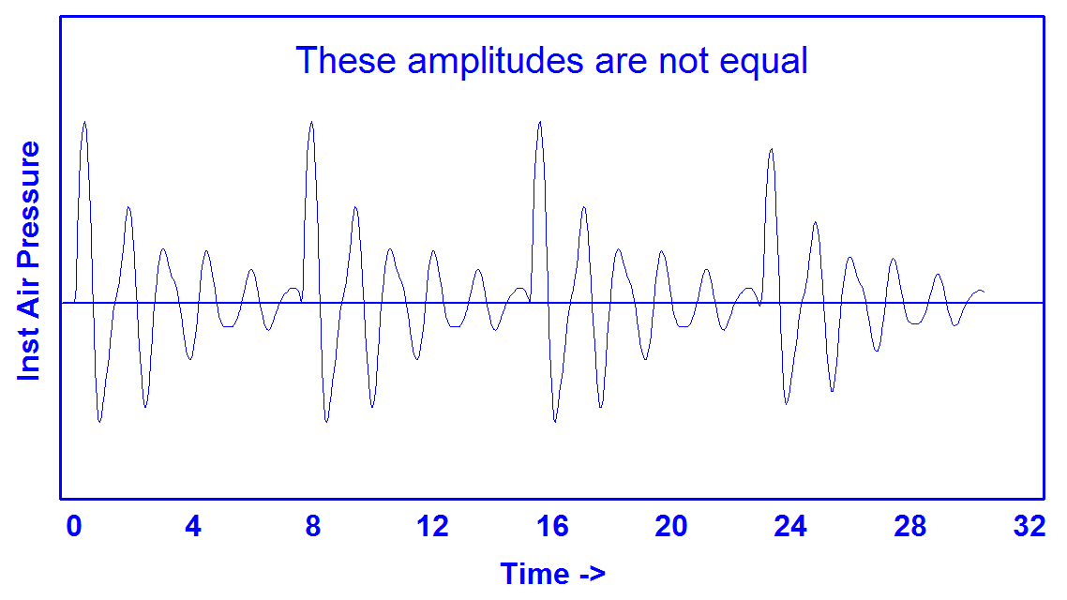
Shimmer (Amplitude Irregularity)
https://homepages.wmich.edu/~hillenbr/501.html
Notes:
Amplitude irregularity

Slide 59
Synthetic Continuum Varying in Shimmer (Amplitude)
0.00 dB 1.60 dB
0.20 dB 1.80 dB
0.40 dB 2.00 dB
0.60 dB 2.25 dB
0.80 dB 2.50 dB
1.00 dB 2.75 dB
1.20 dB 3.00 dB
1.40 dB
https://homepages.wmich.edu/~hillenbr/501.html

Slide 60
HNR
Harmonics to Noise Ratio
  Ratio between periodic and aperiodic components of a voiced speech segment
Periodic: vocal fold vibration
Non-periodic: glottal noise
Lower HNR -> more noise in signal, perceived as hoarseness, breathiness, roughness
Pathologic voice disorders
  Vocal fatigue, muscle tension, dysphonia (nerve causes vocal cords to spasm), diplophonia, (voice perceived as having 2 concurrent pitches), ventricular phonation (false vocal folds squeeze true folds), laryngitis (vocal cord swelling), vocal cord paralysis
Notes:
The final aspect of voice quality that we have to discuss today is harmonics to noise ratio, which is the ratio between the periodic or speech-related components of a speech segment relative to the aperiodic or noise-related components of a speech segment. We want a high HNR as this indicates little noise and clear speech, whereas a low ratio indicating more noise can indicate hoarseness, breathiness, and roughness of the voice, which can in turn point to certain voice disorders.
[Harmonics: good; Noise: not]

Slide 61
Speaking Rate (Jason Kottke)
Different languages are spoken at varying speeds but thanks to correlated differences in data-density, the same amount of information is conveyed within a given time period.
“For all of the other languages, the researchers discovered, the more data-dense the average syllable is, the fewer of those syllables had to be spoken per second — and the slower the speech thus was. English, with a high information density of .91, is spoken at an average rate of 6.19 syllables per second. Mandarin, which topped the density list at .94, was the spoken slowpoke at 5.18 syllables per second. Spanish, with a low-density .63, rips along at a syllable-per-second velocity of 7.82. The true speed demon of the group, however, was Japanese, which edges past Spanish at 7.84, thanks to its low density of .49. Despite those differences, at the end of, say, a minute of speech, all of the languages would have conveyed more or less identical amounts of information.”
Notes:
Apart from voice quality, we also want to be able to measure the speaking rate of a speech segment, usually in terms of syllables uttered per second, but sometimes in terms of words uttered per second. Speaking rate is linked to the information density of a given language, where greater information density correlates with slower speaking rate. Why do you think that might be the case?
https://kottke.org/11/09/the-speed-and-density-of-language

Slide 62
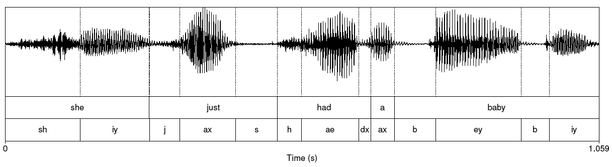
Reading Waveforms
Notes:
That brings us to the last topic on the agenda today, which is reading representations of speech segments. How can we look at something like this and associate specifics parts of the waveform with what we hear?

Slide 63
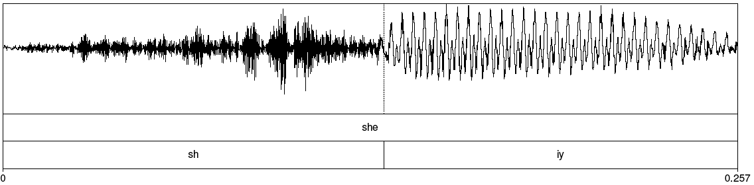
Fricative vs. Vowel
Notes:
For example, we want to be able to see a difference in appearance of waveforms like this, and tell that the denser section corresponds to a fricative consonant Sh, whereas the sparser section corresponds to a vowel iy in the word “She”

Slide 64
Spectrum
Representation of the different frequency components of a waveform: amount of power (dB) as a function of frequency (Hz)
  Computed by a Fourier Transform
    FTs can take a complex waveform and decompose it into its constituent frequencies
    Here are some useful tools for computing spectra and spectrograms using LibROSA
  Linear Predictive Coding (LPC) spectrum – smoothed version
    Here are more python tools for LPC
Notes:
In addition to waveforms, we also want to be able to read the spectrum of a speech segment ,or the spectrogram. This is what represents the different frequency components in a given waveform, and is computed using a Fourier Transformer or with Linear Predictive Coding. You can follow the links on the slide to get more information about specific tools that allow you to apply both of those techniques.
[Change loudness, the amplitude gets bigger
Change the pich, the frequency of all components increases]

Slide 65
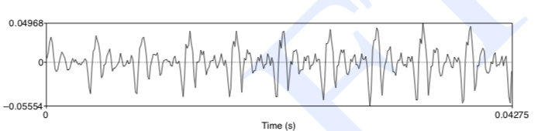
Part of [ae] Waveform from “had”
Complex wave repeated 10 times (~234 Hz)
Smaller waves repeated 4 times per large (~936 Hz)
Two tiny waves on the peak of 936 Hz waves (~1872 Hz)

Slide 66
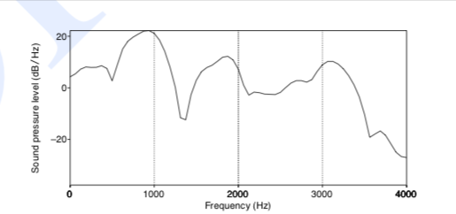
Spectrum “Slice”
Represents frequency components: Sound pressure at different frequencies
  Computed by the Fourier Transform
  Peaks at 930 Hz, 1860 Hz, and 3020 Hz
Notes:
Here is a slice of a spectrum representing sound pressure at different frequencies.
[ae] from had in “She had a baby.”

Slide 67
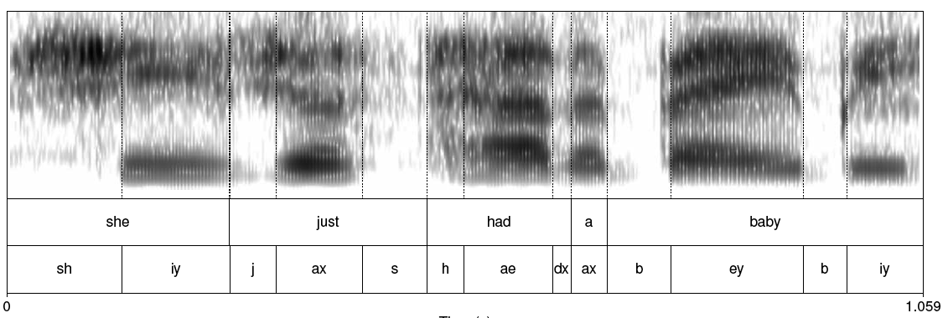
Spectrogram: Many Spectra “Slices”
Notes:
When we have multiple such slices we get a spectrogram.
Spectrogram shows frequencies over time with intensity identifying amplitude – what you can see in Praat.
For vowels in particular you can see spectral formants (the darker shaded parts) which relate to the different positions of the articulators we discussed last week.
Note that iy is a high front vowel, ax is a middle vowel, ae is low front, and ey is mid and front
Iy for she and baby look fairly similar although different lengths because of pitch accent

Slide 68
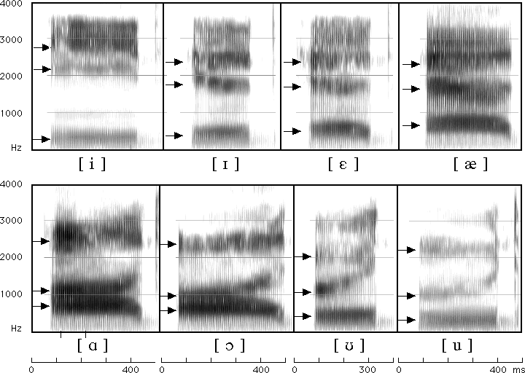
Formants for English Vowels
Notes:
Specifically for vowels, different patterns of formants on a spectrogram can be used to identify different vowels in speech.
i ee
I ih
e eh
ae ae
a ah
c ao
u oo (wood)
u oo (tulip)

Slide 69
Source-filter Model
Why do different vowels have different spectral signatures?
  Source = glottis
  Filter = vocal tract
When we produce vowels, we change the shape of the vocal tract cavity by placing articulators in particular positions

Slide 70
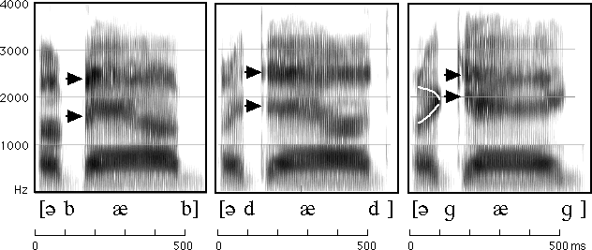
Reading Spectrograms: Changes in Vowels Based on Different Consonant Contexts
Notes:
But! The details of the formants associated with a particular vowel can vary depending on the consonant context in which that vowel is produced.
uhbab, uhdad, uhgag…”uh” before “b”, “d”, “g”

Slide 71
Other Useful Features for Analysis: MFCCs
Sounds that we generate are filtered by the shape of the vocal tract (tongue, teeth etc.)
If we can determine the shape, we can identify the phoneme being produced
Mel Frequency Cepstral Coefficients are widely used features in speech recognition to approximate these shapes
Can be calculated using this python library
Notes:
Finally, one last feature used in speech analysis that I’m going to mention today is Mel Frequency Cepstral Coefficients, which are used to approximate the shape of the vocal tract that is then associated with specific kinds of phoneme production. Luckily, there are python libraries and other tools that allow you to measure this.

Slide 72
MFCC Calculation
Frame the signal into short frames
Take the Fourier transform of the signal
Apply mel filterbank to power spectra, sum up energy in each filter
Take the log of all filterbank energies
Take the Discrete Cosine Transform (DCT) of the log filterbank energies
Keep DCT coefficients 2-13
Or… use this python library ☺

Slide 73
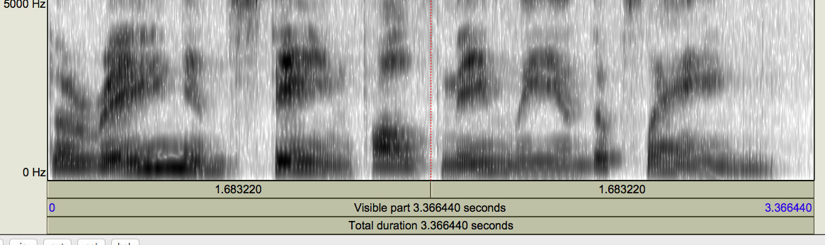
Mystery Spectrogram
Notes:
See if you can figure this out on your own after class without listening to the speech wav file ☺
Then you can listen and see how well you did!

Slide 74
Next Class
Download the latest version of Praat from the link on the course syllabus page
View all the Praat video tutorials also linked from the syllabus
Record yourself in a quiet room saying the utterances requested here (link also provided in the syllabus)
Bring a laptop and headphones with a close-talking mic to class
Any questions?

