Slide 1
Multimodal Humor Detection
Zixiaofan Yang, Lin Ai, Julia Hirschberg
COMS 6706

Slide 2
Why Study Humor?
To understand human interaction
To detect when people are being humorous rather than serious to evaluate the content of what they say
To learn the characteristics of humorous speech to be able to synthesize it (e.g. for robots, chatbots, games, advertisements)
Because it’s interesting…

Slide 3
How Do We Define Humor?
Producer + Perceiver
Positive emotional reactions (laughter)
Highly individualistic & cultural specific
Lack of multimedia data annotated with humor

Slide 4
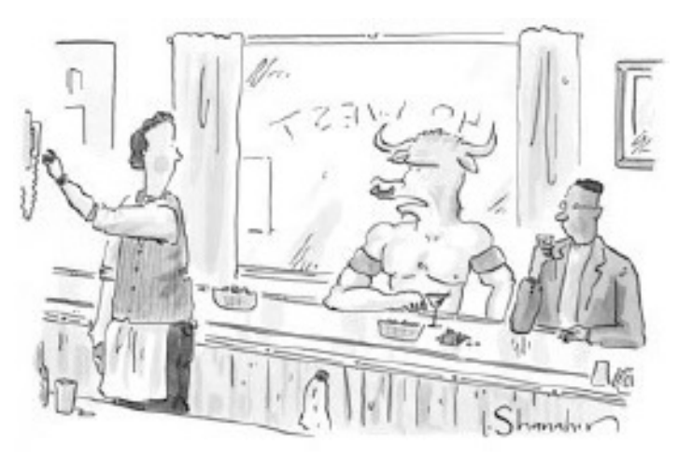
Humor Detection in Text
16k one-liners (Mihalcea and Strapparava, 2005)
Humor-Specific Stylistic Features: alliteration/rhyme, antonymy, adult slang
“A clean desk is a sign of a cluttered desk drawer”
One-liners + 1k news article from “The Onion” (Mihalcea and Pulman, 2007)
Human-centeredness and negative polarity
“Take my advice; I don’t use it anyway”
The New Yorker Cartoon Caption Contest (Radev et al, 2015)
Negative sentiment, human-centeredness
“If that ’s theseus , I ’m not here.”
Notes:
Alliteration: same sound of letter at the beginning of 2 close words
Antonymy: word with an opposite meaning
Theseus: a divine hero in Greek mytholody

Slide 5
Humor Detection in Text
Extract humor anchor in one-liners (Yang et al., 2015)
The subset of candidates that provides the maximum decrement of humor scores: “The one who invented the door knocker got a No-bell prize.”
1k tweets (Zhang and Liu, 2014)
Phonetic + morpho-syntactic + lexico-semantic + pragmatic + affective features: “I generally avoid temptation unless I can't resist it. - Mae West #quote #humor”
TED talk transcripts (Chen and Lee, 2017)
Sentences containing or immediately followed by markup ‘(Laughter)’:
“If you’re a dog and you spend your whole life doing nothing other than easy and fun things, you’re a huge success! (Laughter) ”
Notes:
Yang et al 2015: the anchors are the least humorous part of the one-liner

Slide 6
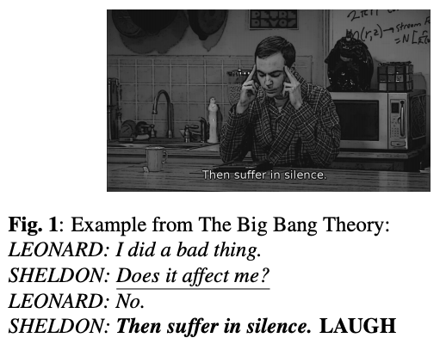
Multimodal Humor Detection
TV sitcoms
Use canned laughter to label humor
FRIENDS (Purandare and Litman, 2006)
The Big Bang Theory (Bertero and Fung, 2016)
Seinfeld (Bertero and Fung, 2016)
No study has shown that canned laughter actually represents the audience’s actual perception of humor.

Slide 7
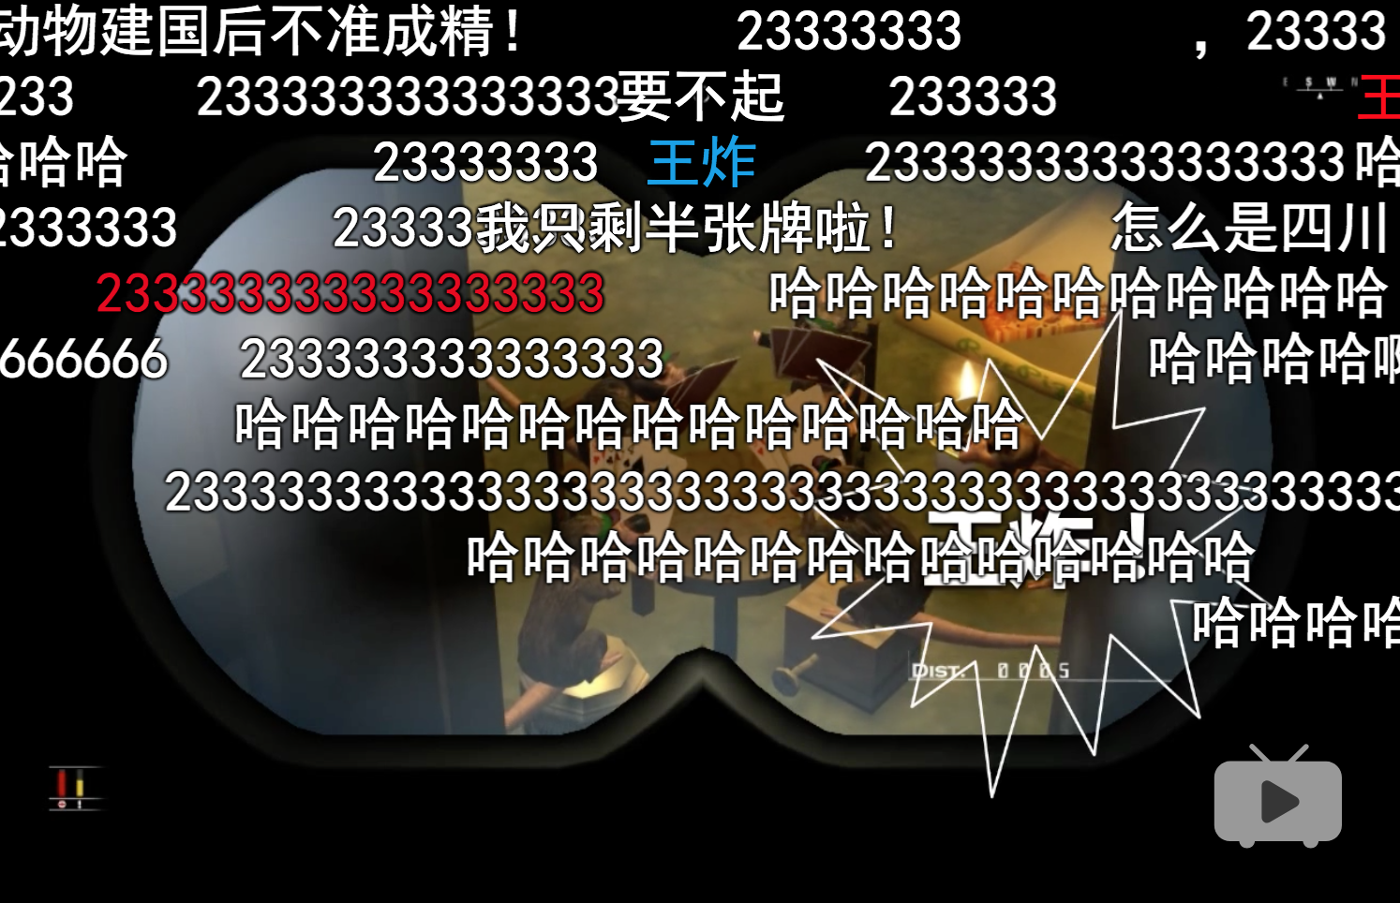
Danmu/bullet curtain – Time-aligned Comments
https://www.bilibili.com/video/BV1nJ411h7ax?share_source=copy_web
https://www.nicovideo.jp/
Notes:
People watching a video can make comments while watching and see everyone else’s comments as well. All are saved.

Slide 8
Hypothesis
Audiences tend to respond to humor in videos with laughing
A high volume of laughing comments at a given time
HUMOR!
Laughing indicators
‘233’ (internet meme)
‘哈哈’ & ‘hh’ (onomatopoeia of laughter)
Notes:
Onomatopoeia: the formation of a word from a sound associated with what is named

Slide 9
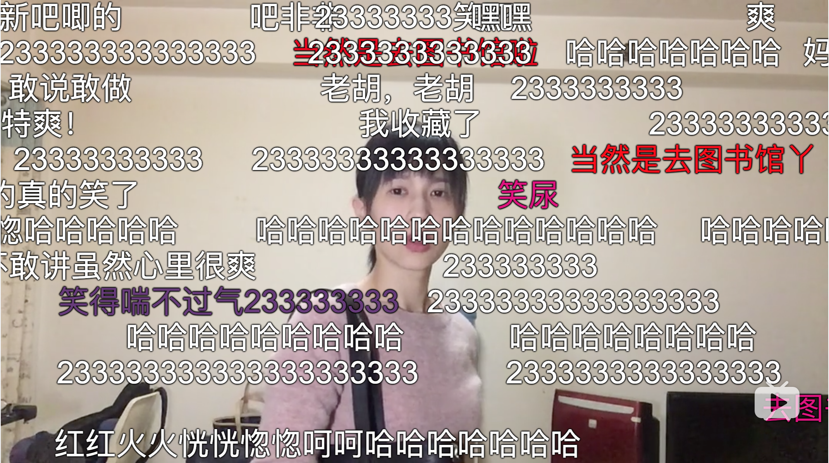
Data Collection
‘Papi酱’
A Chinese influencer
Famous for discussing trending topics in a humorous way
7 million subscribers, 660 million views on Bilibili.com

Slide 10
Data Collection
We use early videos created by ‘Papi酱’
Filtered out videos containing dialects and advertisements
100 videos, 93,593 time-aligned comments
5,064 comments with ‘233’
7,255 comments with ‘哈哈’
730 with ‘hh’
Segmentation
One-second unit level
Inter-pausal unit (IPU) level: 3 seconds on average

Slide 11
Constructing Unsupervised Labels
Users typically comment
Response Time = reaction time + typing time
Smooth the number of laughing comments by response time distribution
Set threshold to distinguish humor from non-humor segments
One-second unit level
6,508 humorous segments; 17,847 non-humorous segments
Inter-pausal unit (IPU) level
2,531 humorous segments; 5,394 non-humorous segments

Slide 12
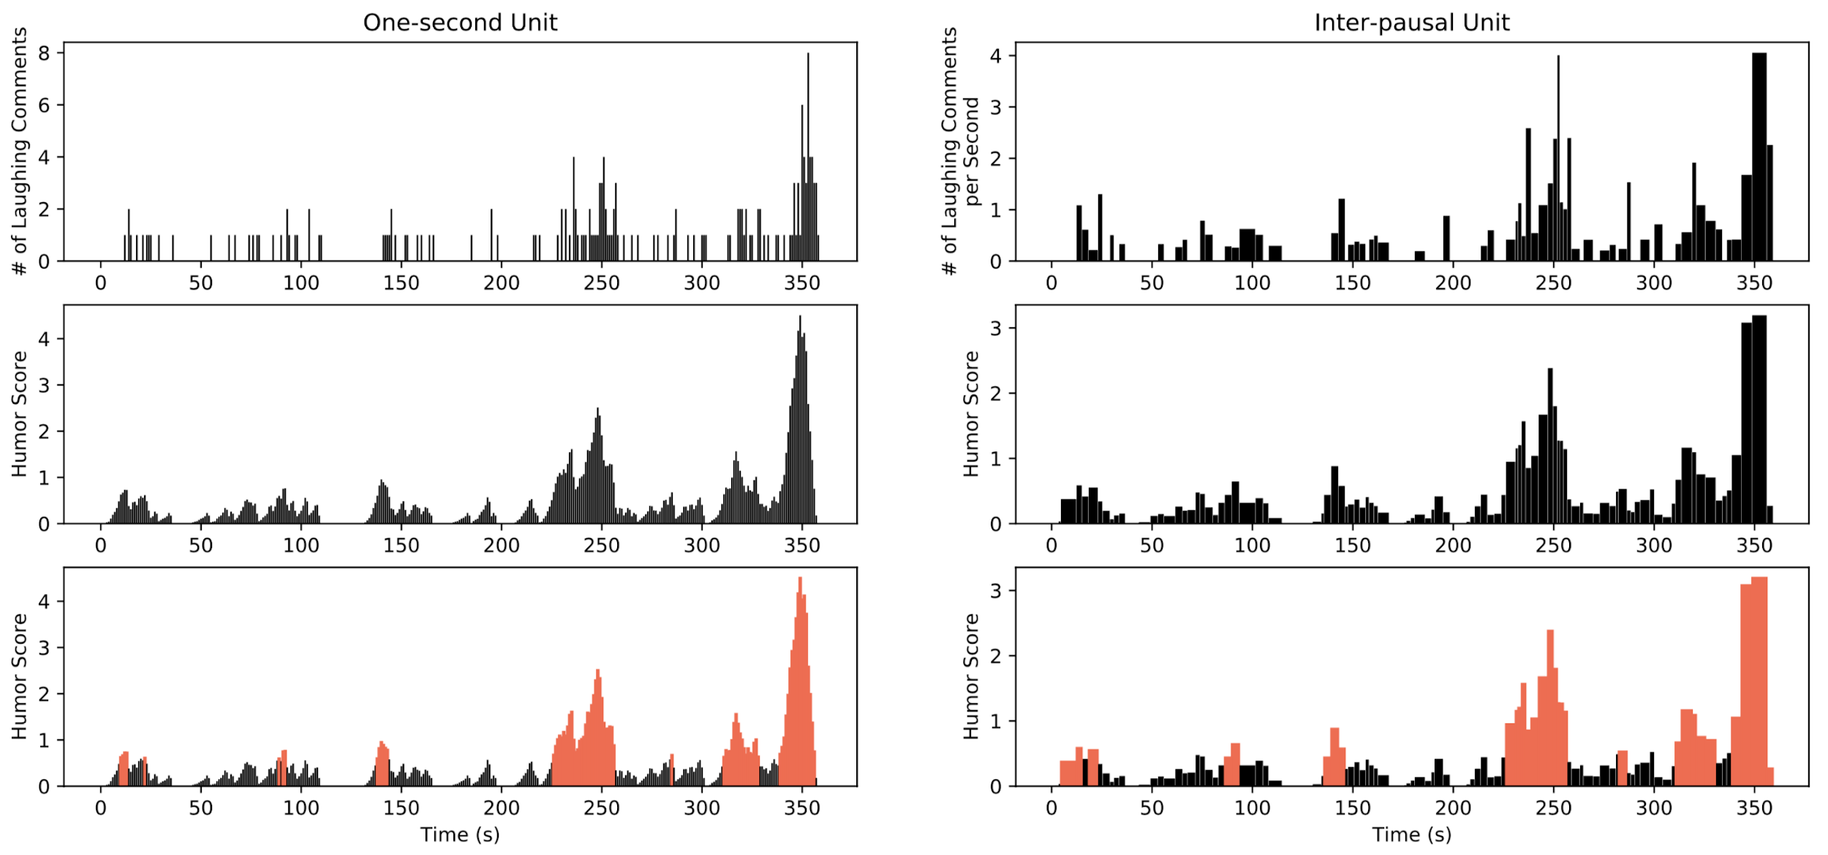
Constructing Unsupervised Labels
Before smoothing
After smoothing
After labeling
Notes:
Blue: non-laughter; Red: laughter

Slide 13
Verification: Human Annotation
We need a manually annotated test set to verify our unsupervised labeling method
Three human annotators
Label each second with humor/non-humor
Measure degree of agreement:
Average Cohen’s Kappa: 0.65
Fleiss’ Kappa: 0.65
Gold labels on test set: majority vote
Unsupervised labels’ accuracy
One-second units: 0.78
Inter-pausal units: 0.76

Slide 14
Features — Acoustic-Prosodic
Tools: Praat, openSMILE, Google ASR API
Features:
Min, max, mean, range, std of pitch
Min, max, mean, range, std of intensity
Pitch existence: whether extractable pitch values exists in the segment
384 features from openSMILE
More features, more functions
Speaking Rate: Number of characters per second (from ASR transcript)

Slide 15
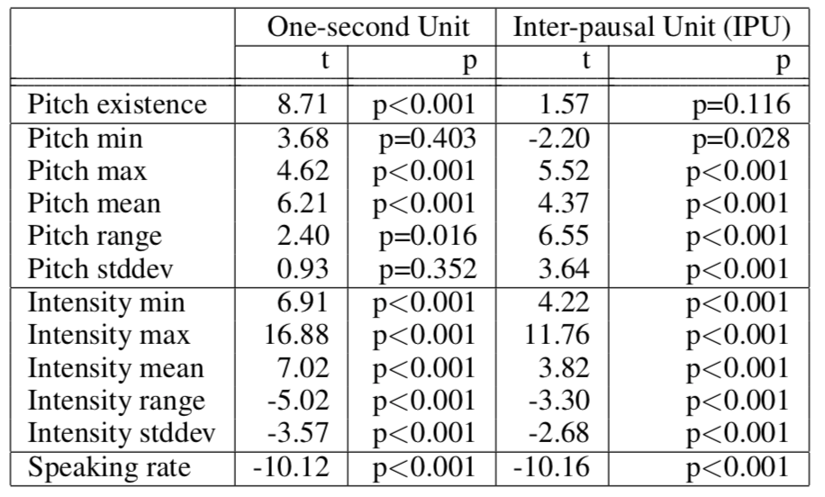
Analysis - Speech Features
The simple existence of pitch is positively correlated with humor
Exclude segments with no pitch values in the analysis of other speech features
Notes:
T-tests of importance of difference speech features

Slide 16
Analysis - Speech Features
Humorous speech has
Higher pitch value
Larger change in pitch
Higher intensity value
Smaller change in intensity
Slower speaking rate
Humor techniques
Exaggeration and bombast
Notes:
To appreciate our next slides: Shakespeare 1599-1601 play: The ghost of the King of Denmark tells his son Hamlet to avenge his murder by killing the new king, Hamlet's uncle. Hamlet feigns madness, contemplates life and death, and seeks revenge. His uncle, fearing for his life, also devises plots to kill Hamlet. The play ends with a duel, during which the King, Queen, Hamlet's opponent and Hamlet himself are all killed.

Slide 17
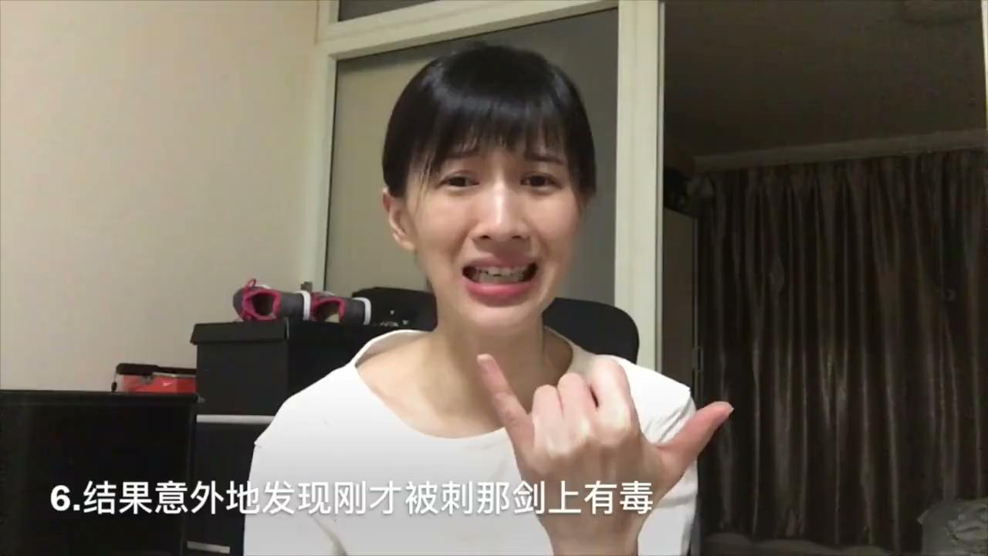
Analysis - Speech Features
(Hamlet) In the end, surprisingly and also not surprisingly — everyone died!
Notes:
use slide show and click picture, then click on back slide and go to Use presenter view at bottom

Slide 18
Features — Transcript-based
Tools: Google ASR API, Jieba (Chinese word segmenter), LIWC
Audio preprocessing:
‘Papi酱’ speeds her videos, so we slowed them down to 0.75 times the original speed for ASR
Normalized intensity and pitch
Transcript preprocessing:
Word segmentation using ‘Jieba’
LIWC (CLIWC): 91 word categories:
e.g. function words, affect words, social words, etc.
Notes:
Jieba: Chinese for “stutter” – python-based Chinese word segmentation module

Slide 19
Analysis - Lexical Features
One-second unit level
Positively correlated with humor:
Strategy: Anxiety, risk, netspeak, i
Content: Power, drive, religion
Negatively correlated with humor:
Strategy: Cognitive process, insight
Content: Sexual, female, biological process
IPU level
Positively correlated with humor:
Strategy: i
Content: religion
Negatively correlated with humor:
Strategy: Cognitive process, cause, interrogatives, auxverb, they
Content: Female, biological process, body
Notes:
Some are similar

Slide 20
Analysis - Lexical Features
Humorous one-liners vs. non-humorous short sentence (Mihalcea and Pulman, 2007)
Negative polarity, Human-centeredness
Negative polarity
Negation: not significant
Negative emotion: ‘anxiety’ significant on one-second unit level
Human-centeredness
‘i’ (first person pronouns): significant on both one-second unit and IPU level
Other personal pronouns: not significant
Notes:
Comparing our findings with others

Slide 21
Features — Visual
Frame similarity:
Assumption: difference between frames may capture visual patterns such as change of scenes and large body movements
Extracted 1 frame in each 10ms and compute similarity with neighboring extracted frames
Measure: structural similarity index (SSIM): higher SSIM means more similar
Features: min, max, mean, range, std

Slide 22
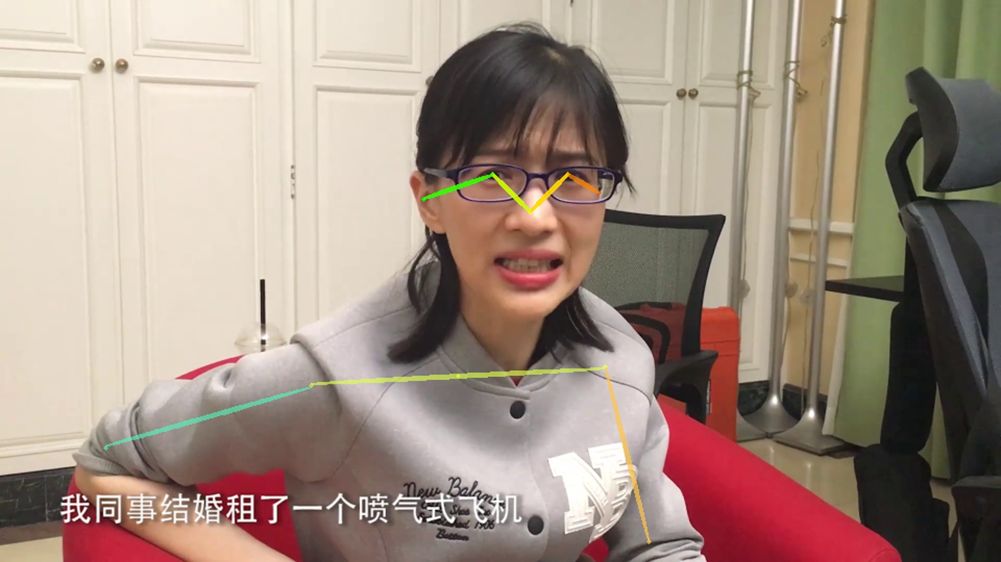
Features — Visual
Body poses
Extraction: AlphaPose
Identify 17 keypoints of body junctions with confidence scores
Use binary features to indicate the appearance of hips and legs
Features: mean, std, mean of frame-level differences, std of differences

Slide 23
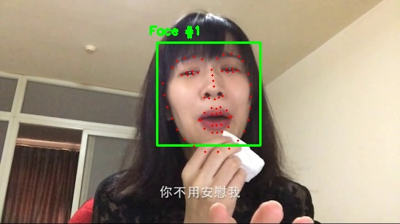
Features — Visual
Facial landmarks:
Extraction: dlib library
68 coordinates of facial landmarks
Preprocessing: rescaled, computed relative position, exclude keypoints for jawline
Features: mean, std, mean of frame-level differences, std of differences

Slide 24
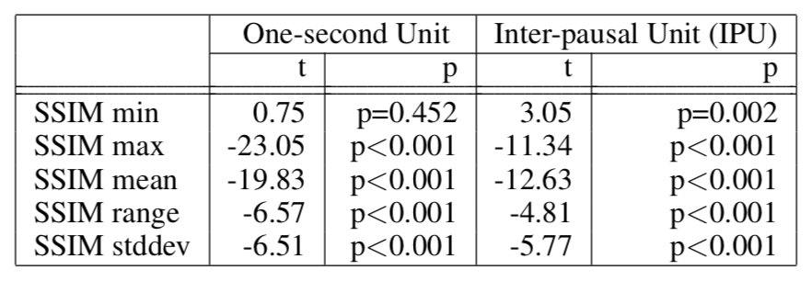
Analysis - Visual Features
SSIM - frame similarity
Humor segments
Are unlikely to be motionless
But also have fewer complete scene changes

Slide 25
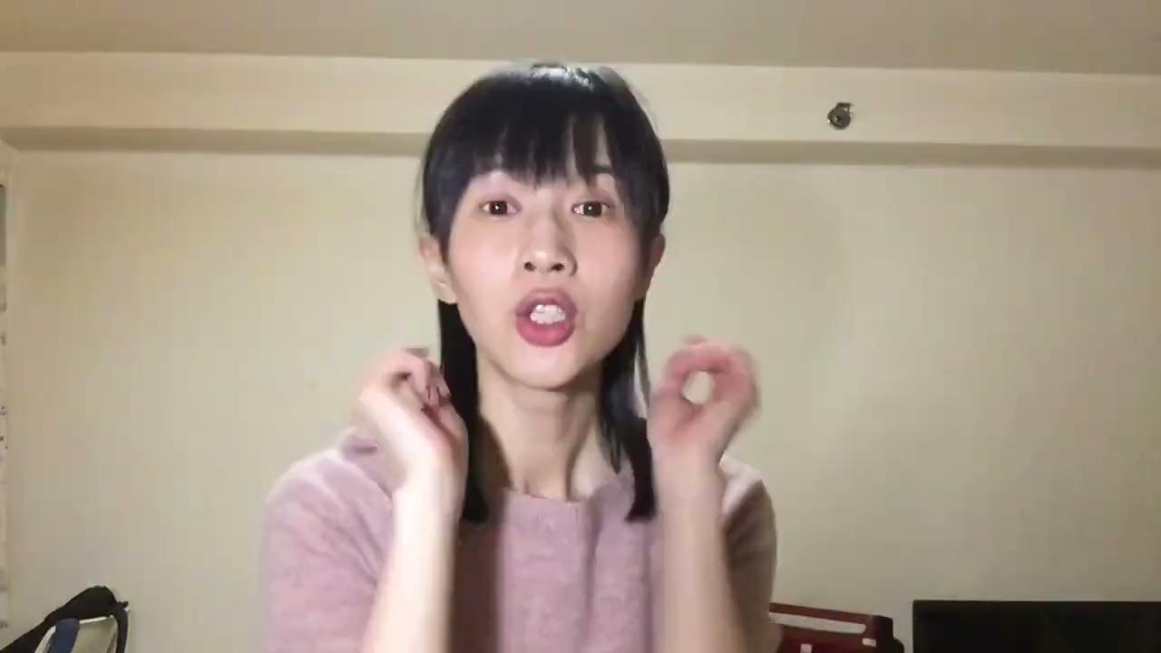
Analysis - Visual Features
Good news for those who are single! In 2016 — you will still be a single dog.
Notes:
use slide show and click picture, then click back slide and go to Use presenter view at bottom

Slide 26
Analysis - Visual Features
Body poses:
One-second unit: keypoints above hips are significant
IPU unit: keypoints above shoulder are significant
The movements of keypoints are correlated with humor, but the movement directions are not significant
Facial landmarks:
Most significant keypoints: brows, nose (head-turning information)

Slide 27
Classification Experiments
70 videos (unsupervised labels) in training set, 30 videos (human labels) in test set
Feature dimensions:
396 speech features (11 from Praat, 384 from openSMILE, speaking rate)
91 text features (CLIWC)
522 visual features (5 from frame similarity, 408 from facial landmarks, 109 from body pose)
Model: random forest classifier with 1000 estimators

Slide 28
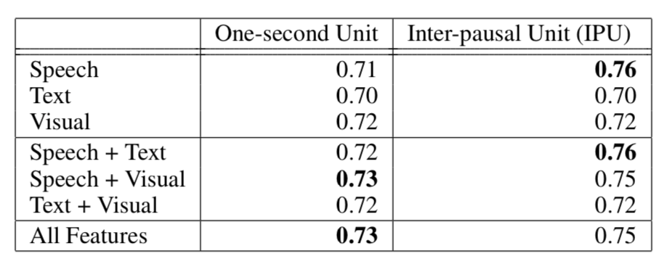
Classification Experiments
IPU segmentation outperforms one-second unit segmentation.
Speech features are the most useful.
Notes:
Done in 2018 so not yet using Deep Learning

Slide 29
Future Directions
Collect more videos from different types of humorous video creators
Current videos mainly include humor techniques like exaggeration and bombast
Explore larger variety of characteristics in humor
Apply to different types of emotions and reactions
Examine other platforms and create automatic labeling of video segments
Use videos collected from other sources such as YouTube live chats
Notes:
What we actually did was to collect humorous comments from FaceBook/Meta

Slide 30
Thanks233!

Slide 31
Next Week
Deception and Trust
Detection of Positive vs. Negative Intent in Social Media
Radicalization and De-Radicalization in Online Videos for Left- and Right-Leaning Groups

