Slide 1
Building an ASR using HTK
CS4706
Fadi Biadsy

Slide 2
Outline
Speech Recognition
Feature Extraction
HMM
  3 basic problems
HTK
  Steps to Build a speech recognizer

Slide 3
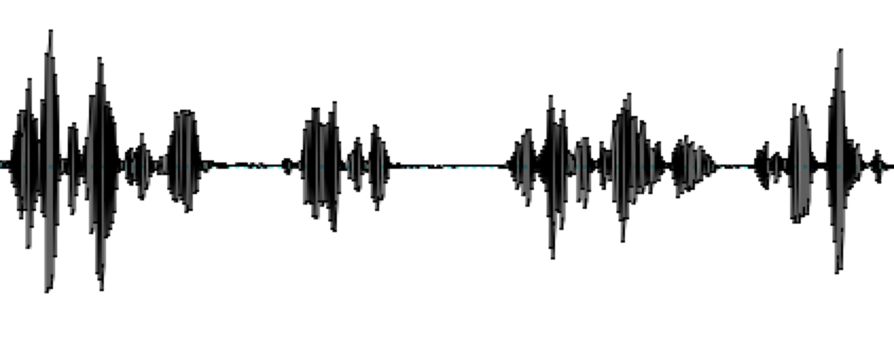
Speech Recognition
Speech Signal to Linguistic Units
ASR
There’s something happening when Americans…

Slide 4
It’s hard to recognize speech
Contextual effects
  Speech sounds vary with context
    E.g., “How do you do?”
Within-speaker variability
  Speaking Style
    Pitch, intensity, speaking rate
  Voice Quality
Between-speaker variability
  Accents, Dialects, native vs. non-native
Environment variability
  Background noise
  Microphone

Slide 5
Feature Extraction
Wave form?
Spectrogram?
We need a stable representation for different examples of the same speech sound

Slide 6
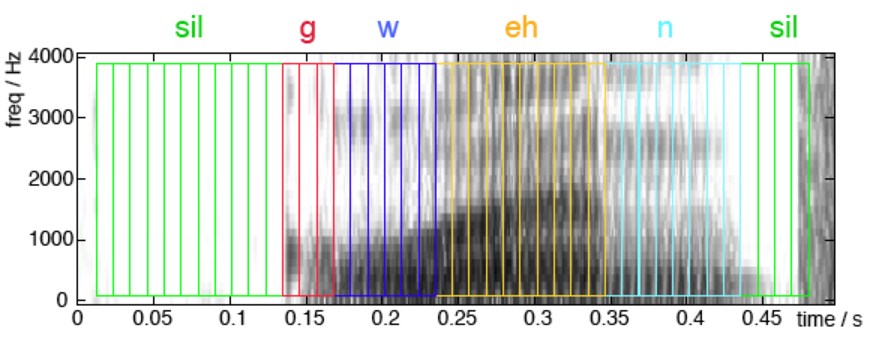
Feature Extraction
Extract features from short frames (frame period 10ms, 25ms frame size) – a sequence of features

Slide 7
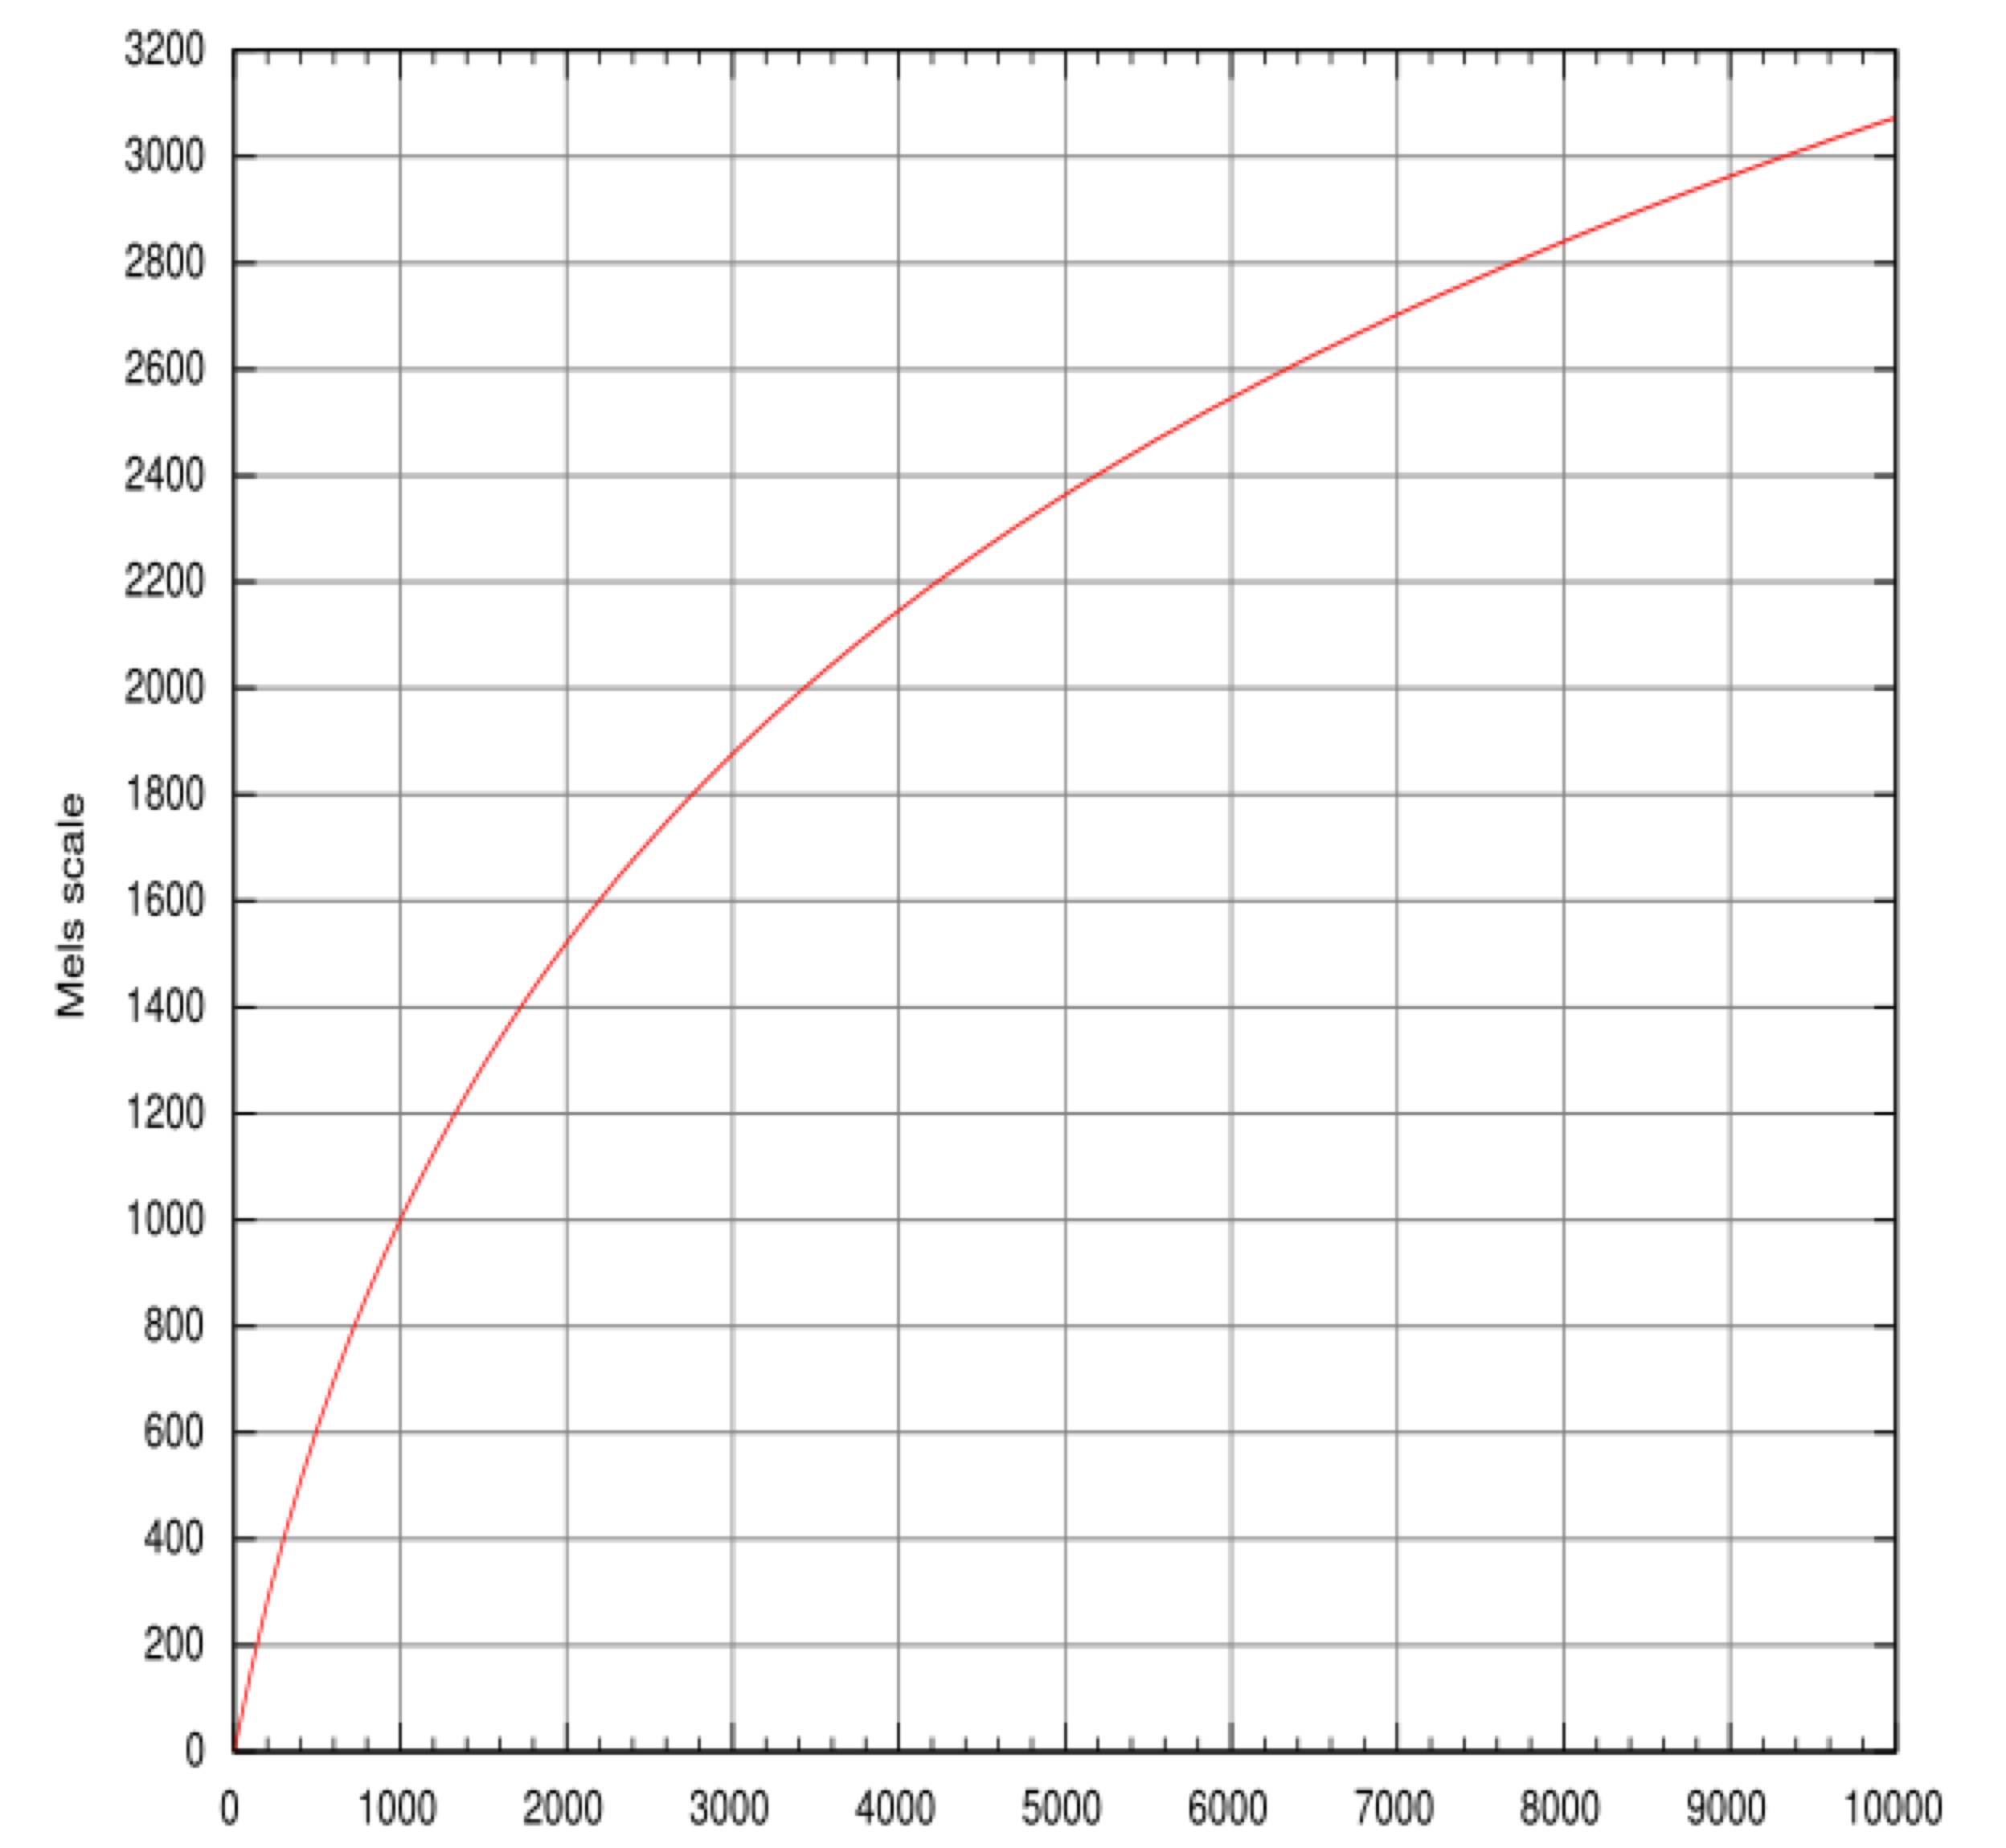
Feature Extraction - MFCC
Mel Scale
  approximate the unequal sensitivity of human hearing at different frequencies

Slide 8

Feature Extraction - MFCC
MFCC (Mel frequency cepstral coefficient)
  Widely used in speech recognition
  Take the Fourier transform of the signal
  Map the log amplitudes of the spectrum to the mel scale
  Discrete cosine transform of the mel log-amplitudes
  The MFCCs are the amplitudes of the resulting spectrum

Slide 9
Feature Extraction - MFCC
Extract a feature vector from each frame
    12 MFCCs (Mel frequency cepstral coefficient) + 1 normalized energy = 13 features
    Delta MFCC = 13
    Delta-Delta MCC = 13
  Total: 39 features
  Inverted MFCCs:
39 Feature vector

Slide 10
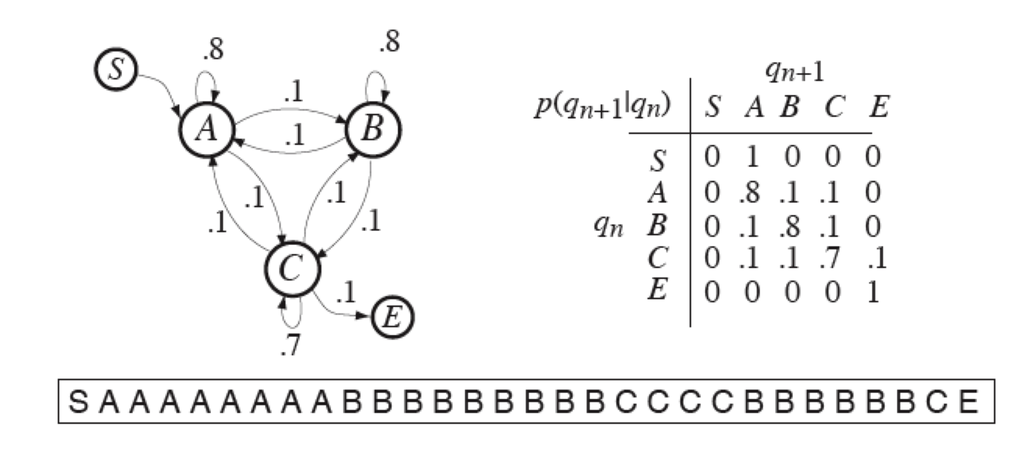
Markov Chain
Weighted Finite State Acceptor: Future is independent of the past given the present

Slide 11
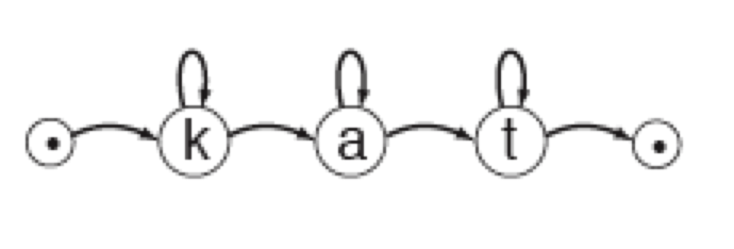
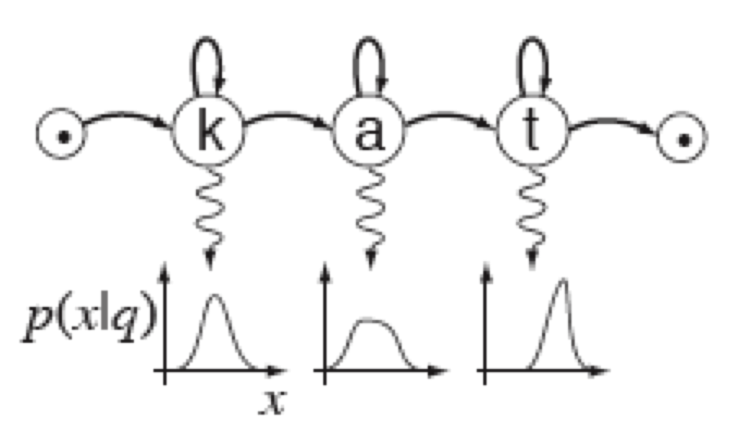
Hidden Markov Model (HMM)
HMM is a Markov chain + emission probability function for each state.
Markov Chain
HMM M=(A, B, Pi)
A = Transition Matrix
B = Observation Distributions
Pi = Initial state probabilities

Slide 12
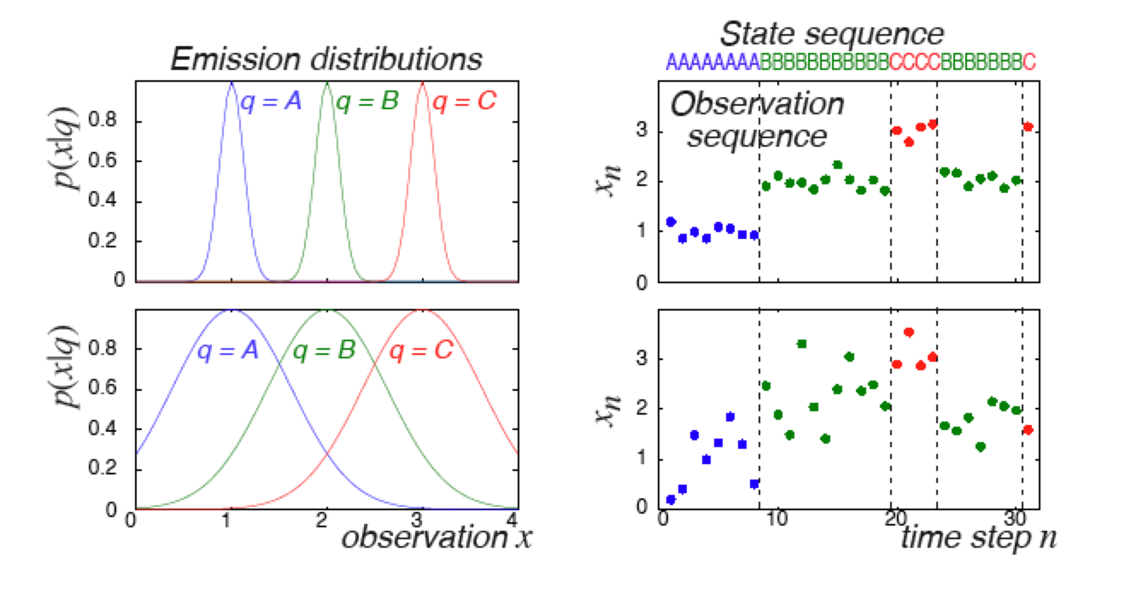
HMM Example
/d/
/aa/
/n/
/aa/

Slide 13
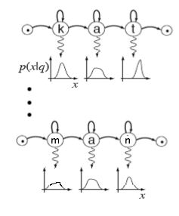

HMM – 3 basic problems (1) – Evaluation
1. Given the observation sequence O and a model M, how do we efficiently compute:
P(O | M) = the probability of the observation sequence, given the model?
argmax _{i} (P(O | Θ_{i})

Slide 14
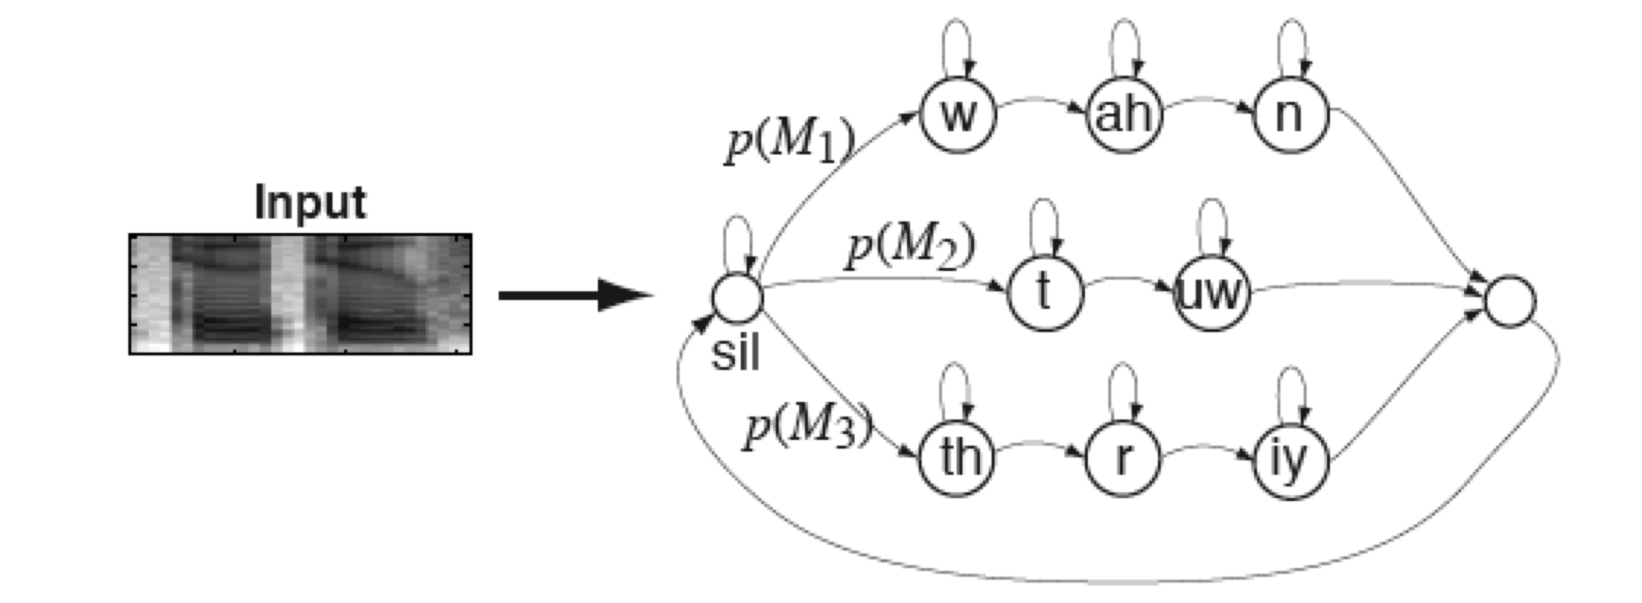
HMM – 3 basic problems (2) - Decoding
2. Given the observation sequence O and the model M, how do we choose a corresponding state sequence Q = q1 q2 . . . qt which best “explains” the observation O?
Q* = argmax _{Q} (P(O | Q, M)) = argmax_{Q}(P(Q|O,M)P(Q|M))

Slide 15
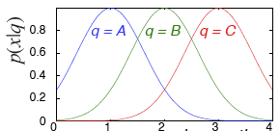
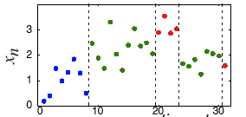
Viterbi algorithm
Is an efficient algorithm for Decoding O(TN^2)
/d/
/aa/
/n/
/aa/
Start
End
/uw/
/d/ /aa/ /n/ /aa/ => dana

Slide 16
HMM – 3 basic problems (3) – Training
How do we adjust the model parameters M= (A, B, Pi) to maximize P(O | M)?
/d/
/aa/
/n/
/aa/
dana => /d/ /aa/ /n/ /aa/
1) Transition Matrix: A
2) Emission probability distribution:
Estimate

Slide 17
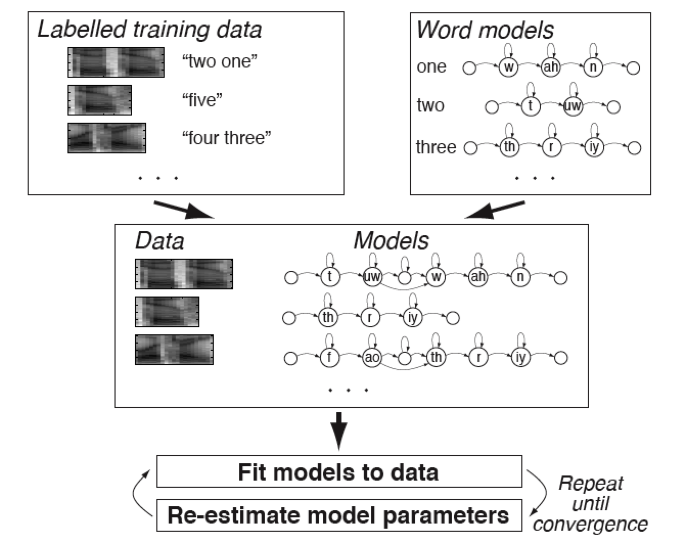
HMM – 3 basic problems (3) – Training

Slide 18
HTK
HTK is a toolkit for building Hidden Markov Models (HMMs)
HTK is primarily designed for building HMM-based speech processing tools (e.g., extracting MFCC features)

Slide 19
Steps for building ASR voice-operated interface for phone dialing
Examples:
  Dial three three two six five four
  Phone Woodland
  Call Steve Young
Grammar:
  $digit = ONE | TWO | THREE | FOUR | FIVE | SIX | SEVEN | EIGHT | NINE | OH | ZERO;
  $name = [ JOOP ] JANSEN | [ JULIAN ] ODELL | [ DAVE ] OLLASON | [ PHIL ] WOODLAND | [ STEVE ] YOUNG;
  ( SENT-START ( DIAL <$digit> | (PHONE|CALL) $name) SENT-END )

Slide 20
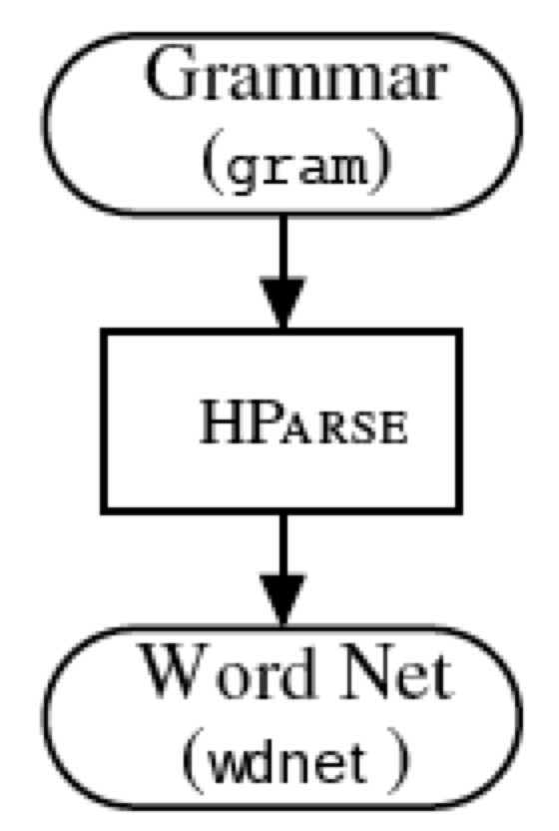
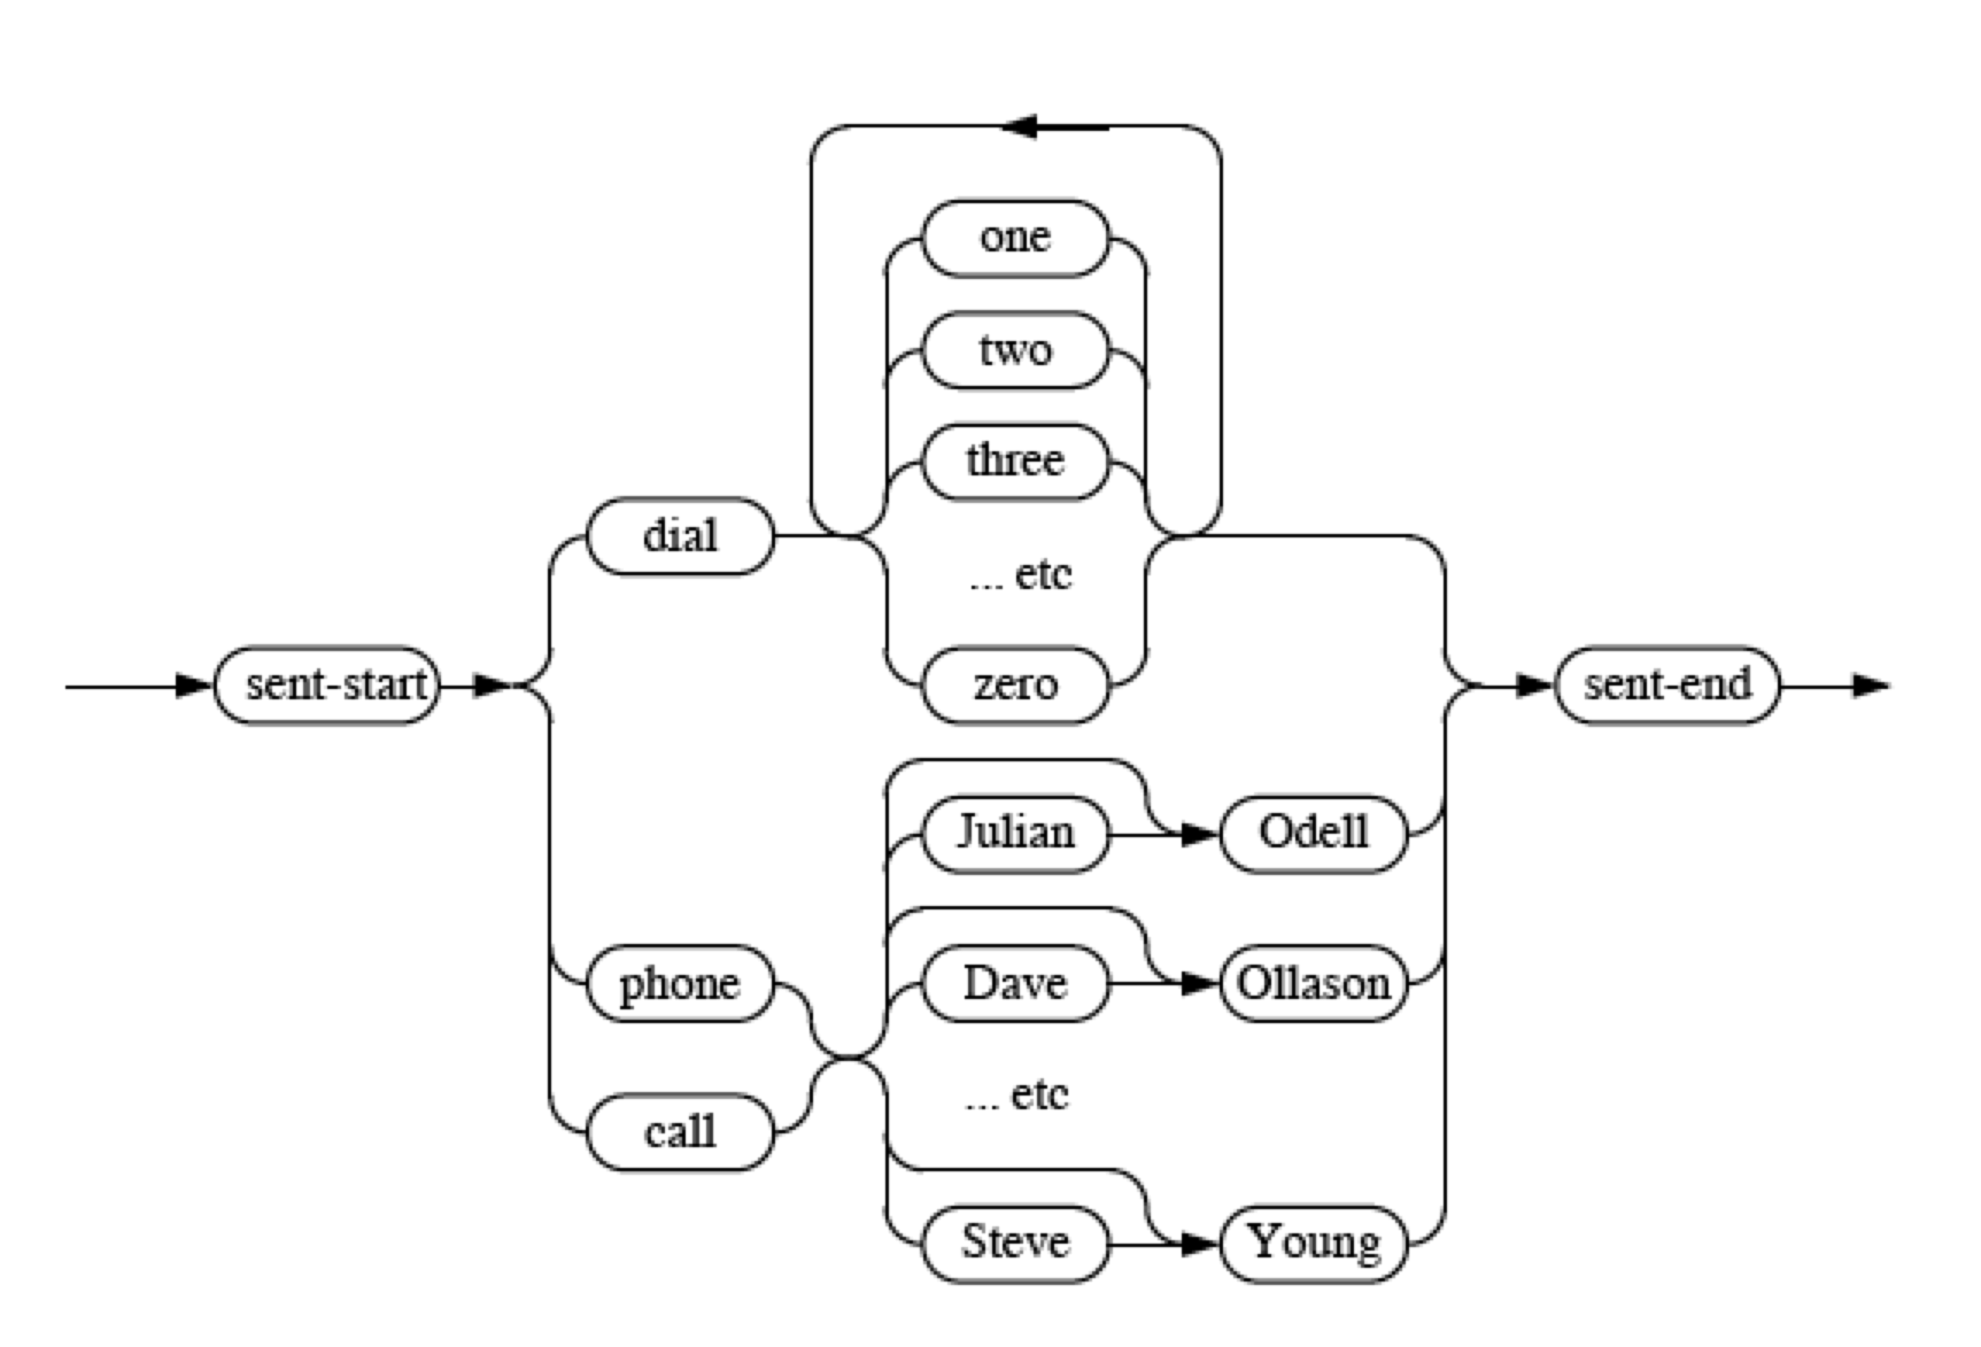

Slide 21
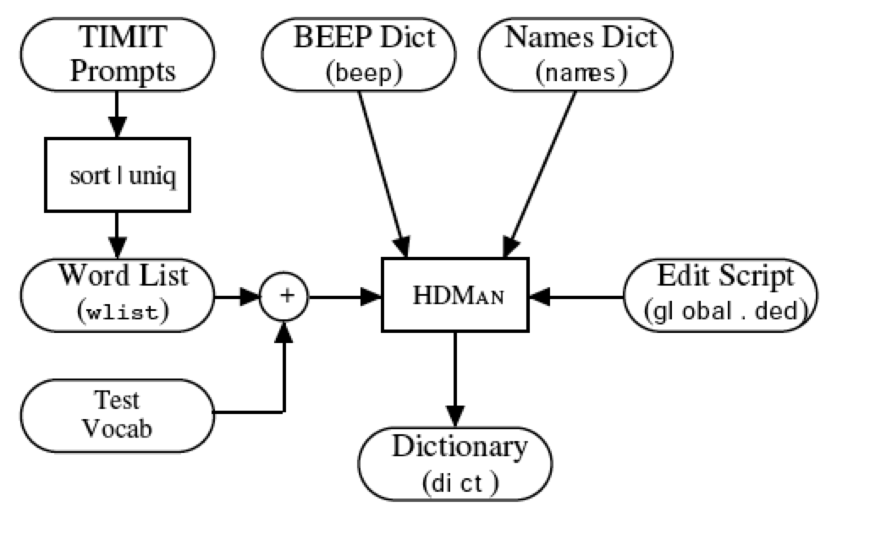
S0001 ONE VALIDATED ACTS OF SCHOOL DISTRICTS
S0002 TWO OTHER CASES ALSO WERE UNDER ADVISEMENT
S0003 BOTH FIGURES WOULD GO HIGHER IN LATER YEARS
S0004 THIS IS NOT A PROGRAM OF SOCIALIZED MEDICINE
etc
A ah sp
A ax sp
A ey sp
CALL k ao l sp
DIAL d ay ax l sp
EIGHT ey t sp
PHONE f ow n sp
…

Slide 22
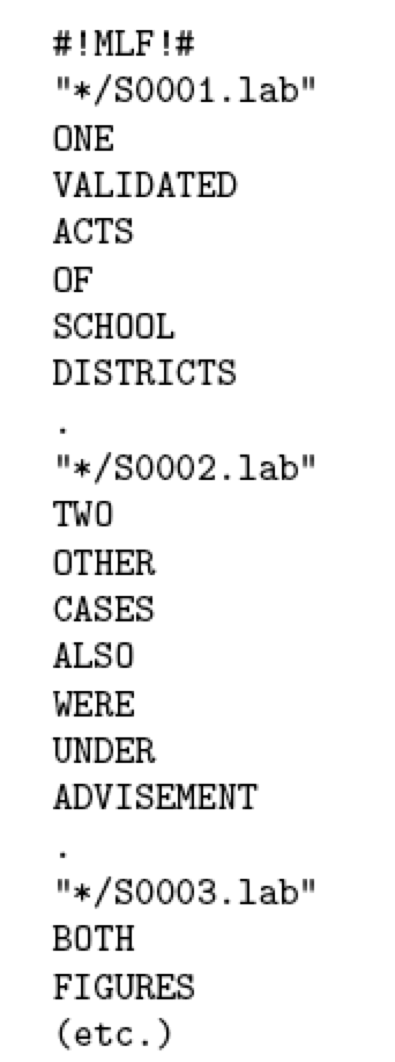
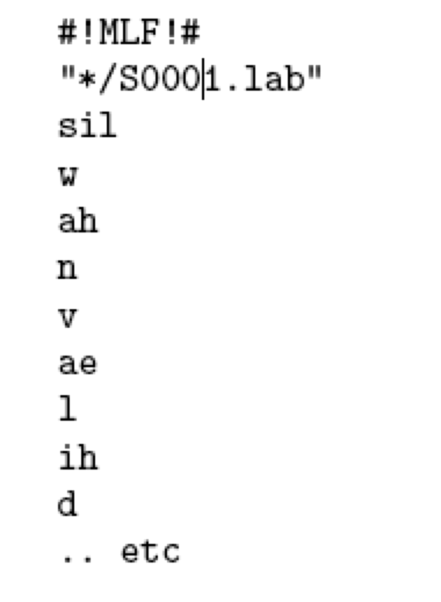
HTK scripting language is used to generate Phonetic transcription for all training data

Slide 23
Extracting MFCC
For each wave file, extract MFCC features.

Slide 24

Creating Monophone HMMs
Create Monophone HMM Topology
5 states: 3 emitting states
Flat Start: Mean and Variance are initialized as the global mean and variance of all the data
S1
S2
S3
S4
S5

Slide 25
Training
For each training pair of files (mfc+lab):
1. concatenate the corresponding
monophone HMMS:
2. Use the Beam-Welch Algorithm to
train the HMMS given the MFC
features.
ONE VALIDATED ACTS OF SCHOOL DISTRICTS
/w/
/ah/
/n/
S1
S2
S3
S4
S5
S1
S2
S3
S4
S5
S1
S2
S3
S4
S5

Slide 26
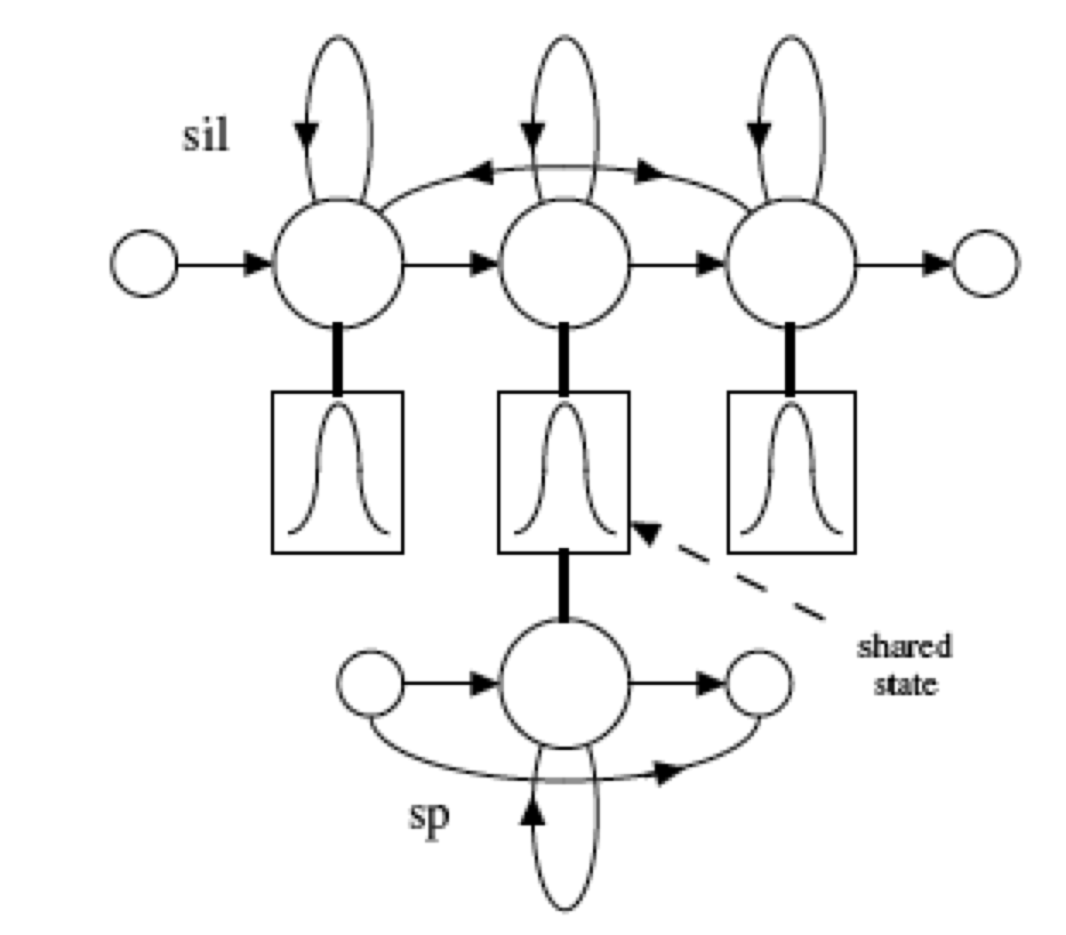
Training
So far, we have all monophones models trained
Train the sp model

Slide 27
Forced alignment
The dictionary contains multiple pronunciations for some words.
Realignment the training data
Run Viterbi to get the best pronunciation that matches the acoustics
/d/
/ey/
/t/
/ax/
/ae/
/dx/

Slide 28
Retrain
After getting the best pronunciation
  => Train again using Baum-Welch algorithm using the “correct” pronunciation.

Slide 29
Creating Triphone models
Context dependent HMMs
Make Tri-phones from monophones
  Generate a list of all the triphones for which there is at least one example in the training data
  jh-oy+s
  oy-s
  ax+z
  f-iy+t
  iy-t
  s+l
  s-l+ow

Slide 30
Creating Tied-Triphone models
  Data insufficiency => Tie states
/t/
/aa/
/b/
S1
S2
S3
S4
S5
S1
S2
S3
S4
S5
S1
S2
S3
S4
S5
/aa/
/b/
/l/
S1
S2
S3
S4
S5
S1
S2
S3
S4
S5
S1
S2
S3
S4
S5

Slide 31
Tie Triphone
Data Driven Clustering: Using similarity metric
Clustering using Decision Tree. All states in the same leafe will be tied
L = Class-Stop ?
t+ih t+ae
t+iy t+ae
ao-r+ax r
t+oh t+ae
ao-r+iy
t+uh t+ae
t+uw t+ae
sh-n+t
sh-n+z sh-n+t
ch-ih+l
ay-oh+l
ay-oh+r ay-oh+l
n
y
R = Nasal ?
L = Nasal ?
n
y
n
y
R = Glide?
n
y

Slide 32
After Tying
Train the Acoustic models again using Baum-Welch algorithm

Slide 33
Decoding
Using the grammar network for the phones
  Generate the triphone HMM grammar network WNET
  Given a new Speech file, extract the mfcc features
  Run Viterbi on the WNET given the mfcc features to get the best word sequence.

Slide 34
Summary
MFCC Features
HMM 3 basic problems
HTK

Slide 35
Thanks!

Slide 36
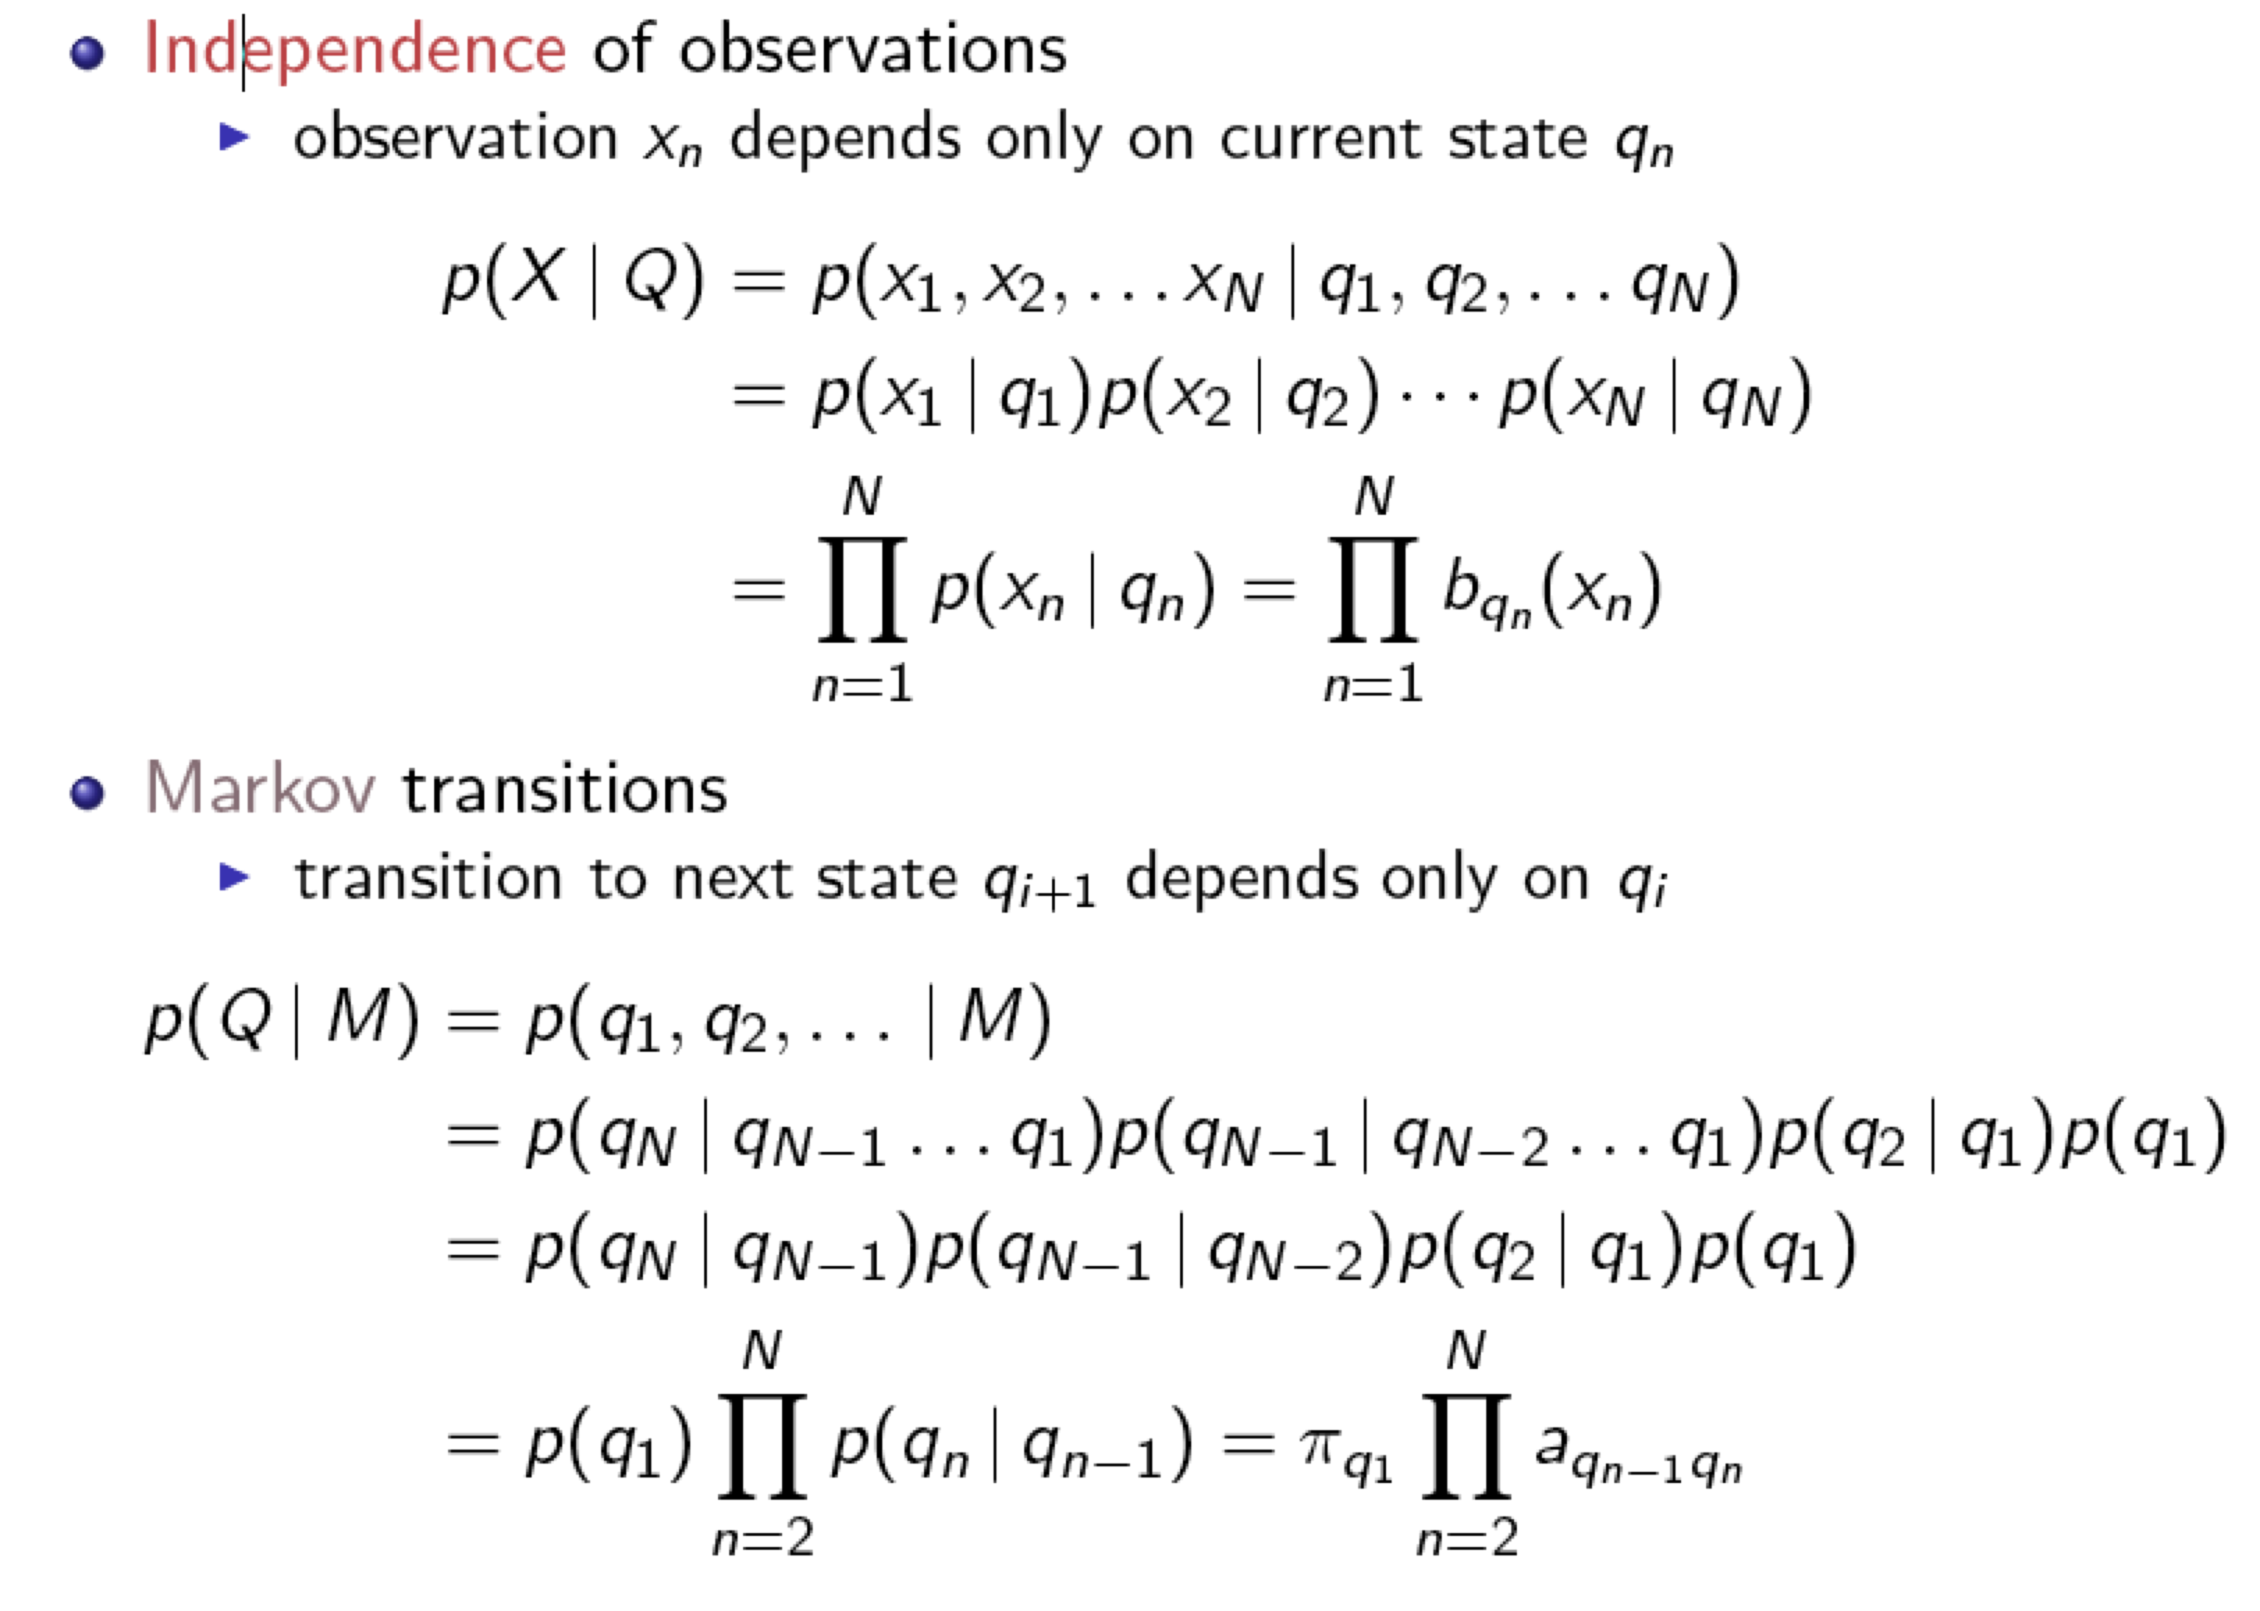
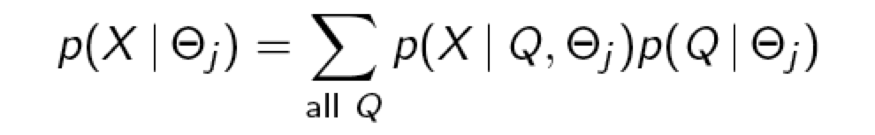
HMM - Problem 1

