Slide 1
Word Relations and Word Sense Disambiguation
Julia Hirschberg
CS 4705
Slides adapted from Kathy McKeown, Dan Jurafsky, Jim Martin and Chris Manning

Slide 2
Three Perspectives on Meaning
Lexical Semantics
The meanings of individual words
Formal Semantics (or Compositional Semantics or Sentential Semantics)
How those meanings combine to make meanings for individual sentences or utterances
Discourse or Pragmatics
How those meanings combine with each other and with other facts about various kinds of context to make meanings for a text or discourse
Dialog or Conversation is often lumped together with Discourse

Slide 3
Today
Introduction to Lexical Semantics
Homonymy, Polysemy, Synonymy
Review: Online resources: WordNet
Computational Lexical Semantics
Word Sense Disambiguation
Supervised
Semi-supervised
Word Similarity
Thesaurus-based
Distributional

Slide 4
Word Definitions
What’s a word?
Definitions so far: Types, tokens, stems, roots, inflected forms, etc...
Lexeme: An entry in a lexicon consisting of a pairing of a form with a single meaning representation
Lexicon: A collection of lexemes

Slide 5
Possible Word Relations
Homonymy
Polysemy
Synonymy
Antonymy
Hypernomy
Hyponomy
Meronomy

Slide 6
Homonymy
Lexemes share a form
Phonological, orthographic or both
But have unrelated, distinct meanings
Clear examples
Bat (wooden stick-like thing) vs. bat (flying scary mammal thing)
Bank (financial institution) versus bank (riverside)
Can be homophones, homographs:
Homophones:
Write/right, piece/peace, to/too/two
Homographs:
Desert/desert
Bass/bass

Slide 7
Issues for NLP Applications
Text-to-Speech
Same orthographic form but different phonological form
bass vs. bass
Information retrieval
Different meanings same orthographic form
QUERY: bat care
Machine Translation
Speech recognition

Slide 8
Polysemy
The bank is constructed from red brick I withdrew the money from the bank
Are these the same sense? Different?
Or consider the following WSJ example
While some banks furnish sperm only to married women, others are less restrictive
Which sense of bank is this?
Is it distinct from the river bank sense?
The savings bank sense?

Slide 9
Polysemy
A single lexeme with multiple related meanings (bank the building, bank the financial institution)
Most non-rare words have multiple meanings
Number of meanings related to word frequency
Verbs tend more to polysemy
Distinguishing polysemy from homonymy isn’t always easy (or necessary)

Slide 10
Metaphor vs. Metonymy
Specific types of polysemy
Metaphor: two different meaning domains are related
.Citibank claimed it was misrepresented.
Corporation as person
Metonymy: use of one aspect of a concept to refer to other aspects of entity or to entity itself
The Citibank is on the corner of Main and State.
Building stands for organization

Slide 11
How Do We Identify Words with Multiple Senses?
ATIS examples
Which flights serve breakfast?
Does America West serve Philadelphia?
The “zeugma” test: conjoin two potentially similar/dissimilar senses
?Does United serve breakfast and San Jose?
Does United serve breakfast and lunch?

Slide 12
Synonymy
Word that have the same meaning in some or all contexts.
filbert / hazelnut
couch / sofa
big / large
automobile / car
vomit / throw up
Water / H₂0
Two lexemes are synonyms if they can be successfully substituted for each other in all situations
If so they have the same propositional meaning

Slide 13
Few Examples of Perfect Synonymy
Even if many aspects of meaning are identical
Still may not preserve the acceptability based on notions of politeness, slang, register, genre, etc.
E.g, water and H₂0, coffee and java

Slide 14
Terminology
Lemmas and wordforms
A lexeme is an abstract pairing of meaning and form
A lemma or citation form is the grammatical form that is used to represent a lexeme.
Carpet is the lemma for carpets
Dormir is the lemma for duermes
Specific surface forms carpets, sung, duermes are called wordforms
The lemma bank has two senses:
Instead, a bank can hold the investments in a custodial account in the client’s name.
But as agriculture burgeons on the east bank, the river will shrink even more.
A sense is a discrete representation of one aspect of the meaning of a word

Slide 15
Synonymy Relates Senses not Words
Consider big and large
Are they synonyms?
How big is that plane?
Would I be flying on a large or a small plane?
How about:
Miss Nelson, for instance, became a kind of big sister to Benjamin.
?Miss Nelson, for instance, became a kind of large sister to Benjamin.
Why?
big has a sense that means being older, or grown up
large lacks this sense

Slide 16
Antonyms
Senses that are opposites with respect to one feature of their meaning
Otherwise, they are very similar
dark / light
short / long
hot / cold
up / down
in / out
More formally: antonyms can
Define a binary opposition or an attribute at opposite ends of a scale (long/short, fast/slow)
Be reversives: rise/fall, up/down

Slide 17
Hyponyms
A sense is a hyponym of another if the first sense is more specific, denoting a subclass of the other
car is a hyponym of vehicle
dog is a hyponym of animal
mango is a hyponym of fruit
Conversely
vehicle is a hypernym/superordinate of car
animal is a hypernym of dog
fruit is a hypernym of mango
superordinate | vehicle | fruit | furniture | mammal
hyponym | car | mango | chair | dog

Slide 18
Hypernymy Defined
Extensional
The class denoted by the superordinate
Extensionally includes class denoted by the hyponym
Entailment
A sense A is a hyponym of sense B if being an A entails being a B
Hyponymy is usually transitive
(A hypo B and B hypo C entails A hypo C)

Slide 19
WordNet
Category | Unique Forms
Noun | 117,097
Verb | 11,488
Adjective | 22,141
Adverb | 4,601
A hierarchically organized lexical database
On-line thesaurus + aspects of a dictionary
Versions for other languages are under development

Slide 20
Where to Find WordNet
http://wordnetweb.princeton.edu/perl/webwn

Slide 21
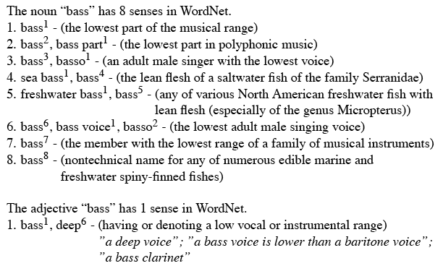
WordNet Entries

Slide 22
WordNet Noun Relations

Slide 23
WordNet Verb Relations

Slide 24
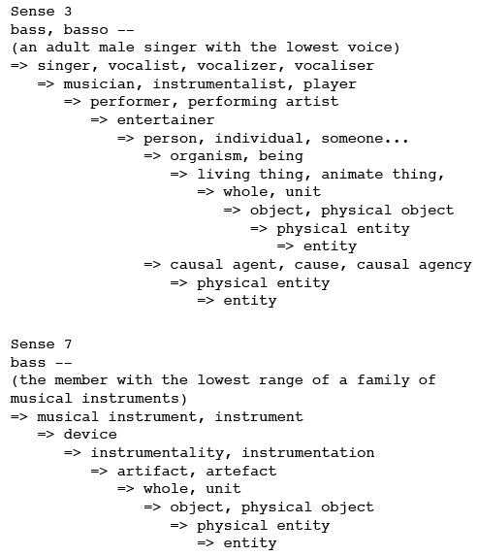
WordNet Hierarchies

Slide 25
How is ‘Sense’ Defined in WordNet?
The set of near-synonyms for a WordNet sense is called a synset (synonym set); their version of a sense or a concept
Example: chump as a noun to mean ‘a person who is gullible and easy to take advantage of’
Each of these senses share this same gloss
For WordNet, the meaning of this sense of chump is this list.

Slide 26
Word Sense Disambiguation
Given
A word in context,
A fixed inventory of potential word senses
Decide which sense of the word this is
English-to-Spanish MT
Inventory is set of Spanish translations
Speech Synthesis
Inventory is homographs with different pronunciations like bass and bow
Automatic indexing of medical articles
MeSH (Medical Subject Headings) thesaurus entries

Slide 27
Two Variants of WSD
Lexical Sample task
Small pre-selected set of target words
And inventory of senses for each word
All-words task
Every word in an entire text
A lexicon with senses for each word
~Like part-of-speech tagging
Except each lemma has its own tagset

Slide 28
Approaches
Supervised
Semi-supervised
Unsupervised
Dictionary-based techniques
Selectional Association
Lightly supervised
Bootstrapping
Preferred Selectional Association

Slide 29
Supervised Machine Learning Approaches
Supervised machine learning approach:
Training corpus of depends on task
Train a classifier that can tag words in new text
Just as we saw for part-of-speech tagging, statistical ML
What do we need?
Tag set (“sense inventory”)
Training corpus
Set of features extracted from the training corpus
A classifier

Slide 30
Bass in WordNet
The noun bass has 8 senses in WordNet
bass - (the lowest part of the musical range)
bass, bass part - (the lowest part in polyphonic music)
bass, basso - (an adult male singer with the lowest voice)
sea bass, bass - (flesh of lean-fleshed saltwater fish of the family Serranidae)
freshwater bass, bass - (any of various North American lean-fleshed freshwater fishes especially of the genus Micropterus)
bass, bass voice, basso - (the lowest adult male singing voice)
bass - (the member with the lowest range of a family of musical instruments)
bass -(nontechnical name for any of numerous edible marine and freshwater spiny-finned fishes)

Slide 31
Sense Tags for Bass

Slide 32
What kind of Corpora?
Lexical sample task:
Line-hard-serve corpus - 4000 examples of each
Interest corpus - 2369 sense-tagged examples
All words:
Semantic concordance: a corpus in which each open-class word is labeled with a sense from a specific dictionary/thesaurus.
SemCor: 234,000 words from Brown Corpus, manually tagged with WordNet senses
SENSEVAL-3 competition corpora - 2081 tagged word tokens
Notes:
Line of people, chalk line; hard as difficult or solid

Slide 33
What Kind of Features?
Weaver (1955) “If one examines the words in a book, one at a time as through an opaque mask with a hole in it one word wide, then it is obviously impossible to determine, one at a time, the meaning of the words. […] But if one lengthens the slit in the opaque mask, until one can see not only the central word in question but also say N words on either side, then if N is large enough one can unambiguously decide the meaning of the central word. […] The practical question is : `What minimum value of N will, at least in a tolerable fraction of cases, lead to the correct choice of meaning for the central word?’”

Slide 34
dishes
washing dishes.
simple dishes including
convenient dishes to
of dishes and
bass
free bass with
pound bass of
and bass player
his bass while

Slide 35
“In our house, everybody has a career and none of them includes washing dishes,” he says.
In her tiny kitchen at home, Ms. Chen works efficiently, stir-frying several simple dishes, including braised pig’s ears and chcken livers with green peppers.
Post quick and convenient dishes to fix when your in a hurry.
Japanese cuisine offers a great variety of dishes and regional specialties

Slide 36
We need more good teachers – right now, there are only a half a dozen who can play the free bass with ease.
Though still a far cry from the lake’s record 52-pound bass of a decade ago, “you could fillet these fish again, and that made people very, very happy.” Mr. Paulson says.
An electric guitar and bass player stand off to one side, not really part of the scene, just as a sort of nod to gringo expectations again.
Lowe caught his bass while fishing with pro Bill Lee of Killeen, Texas, who is currently in 144th place with two bass weighing 2-09.

Slide 37
Feature Vectors
A simple representation for each observation (each instance of a target word)
Vectors of sets of feature/value pairs
I.e. files of comma-separated values
These vectors should represent the window of words around the target How big should that window be?

Slide 38
What sort of Features?
Collocational features and bag-of-words features
Collocational
Features about words at specific positions near target word
Often limited to just word identity and POS
Bag-of-words
Features about words that occur anywhere in the window (regardless of position)
Typically limited to frequency counts
Notes:
Start here.

Slide 39
Example
Example text (WSJ)
An electric guitar and bass player stand off to one side not really part of the scene, just as a sort of nod to gringo expectations perhaps
Assume a window of +/- 2 from the target

Slide 40
Collocations
Position-specific information about the words in the window
guitar and bass player stand
[guitar, NN, and, CC, player, NN, stand, VB]
Word_{n-2,} POS_{n-2,} word_{n-1,} POS_{n-1,} Word_{n+1} POS_{n+1}…
In other words, a vector consisting of
[position n word, position n part-of-speech…]

Slide 41
Bag of Words
Information about what words occur within the window
First derive a set of terms to place in the vector
Then note how often each of those terms occurs in a given window

Slide 42
Co-Occurrence Example
Assume we’ve settled on a possible vocabulary of 12 words that includes guitar and player but not and and stand, and you see
“…guitar and bass player stand…”
[0,0,0,1,0,0,0,0,0,1,0,0]
Counts of words pre-identified as e.g.,
[fish, fishing, viol, guitar, double, cello…]

Slide 43
Classifiers
Once we cast the WSD problem as a classification problem, many techniques possible
Naïve Bayes (the easiest thing to try first)
Decision lists
Decision trees
Neural nets
Support vector machines
Nearest neighbor methods…

Slide 44
Classifiers
Choice of technique, in part, depends on the set of features that have been used
Some techniques work better/worse with features with numerical values
Some techniques work better/worse with features that have large numbers of possible values
For example, the feature the word to the left has a fairly large number of possible values

Slide 45
Naïve Bayes
ŝ = p(s|V), or
Where s is one of the senses S possible for a word w and V the input vector of feature values for w
Assume features independent, so probability of V is the product of probabilities of each feature, given s, so
p(V) same for any ŝ
Then

Slide 46
How do we estimate p(s) and p(v_{j}|s)?
p(s_{i}) is max. likelihood estimate from a sense-tagged corpus (count(s_{i},w_{j})/count(w_{j})) – how likely is bank to mean ‘financial institution’ over all instances of bank?
P(v_{j}|s) is max. likelihood of each feature given a candidate sense (count(v_{j},s)/count(s)) – how likely is the previous word to be ‘river’ when the sense of bank is ‘financial institution’
Calculate for each possible sense and take the highest scoring sense as the most likely choice

Slide 47
Naïve Bayes Evaluation
On a corpus of examples of uses of the word line, naïve Bayes achieved about 73% correct
Is this good?

Slide 48
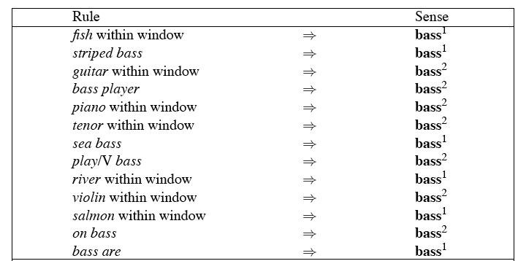
Decision Lists
Can be treated as a case statement….

Slide 49
Learning Decision Lists
Restrict lists to rules that test a single feature
Evaluate each possible test and rank them based on how well they work
Order the top-N tests as the decision list

Slide 50
Yarowsky’s Metric
On a binary (homonymy) distinction used the following metric to rank the tests
This gives about 95% on this test…

Slide 51
WSD Evaluations and Baselines
In vivo (intrinsic) versus in vitro (extrinsic) evaluation
In vitro evaluation most common now
Exact match accuracy
% of words tagged identically with manual sense tags
Usually evaluate using held-out data from same labeled corpus
Problems?
Why do we do it anyhow?
Baselines: most frequent sense, Lesk algorithm

Slide 52
Most Frequent Sense
Wordnet senses are ordered in frequency order
So “most frequent sense” in WordNet = “take the first sense”
Sense frequencies come from SemCor

Slide 53
Ceiling
Human inter-annotator agreement
Compare annotations of two humans
On same data
Given same tagging guidelines
Human agreements on all-words corpora with WordNet style senses
75%-80%

Slide 54
Unsupervised Methods: Dictionary/Thesaurus Methods
The Lesk Algorithm
Selectional Restrictions

Slide 55
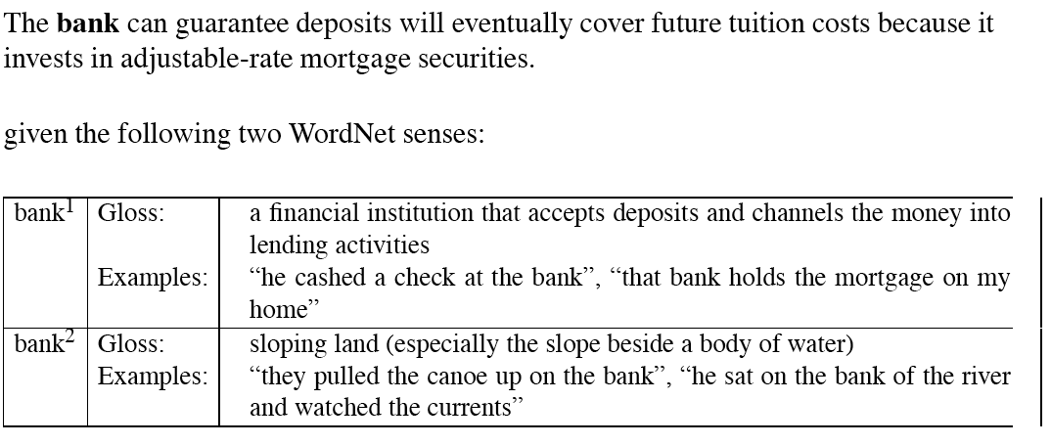
Simplified Lesk
Match dictionary entry of sense that best matches context

Slide 56
Original Lesk: pine cone
Compare entries for each context word for overlap

Slide 57
Corpus Lesk
Add corpus examples to glosses and examples
The best performing variant

Slide 58
Disambiguation via Selectional Restrictions
“Verbs are known by the company they keep”
Different verbs select for different thematic roles
wash the dishes (takes washable-thing as patient)
serve delicious dishes (takes food-type as patient)
Method: another semantic attachment in grammar
Semantic attachment rules are applied as sentences are syntactically parsed, e.g.
VP --> V NP
V→ serve <theme> {theme:food-type}
Selectional restriction violation: no parse

Slide 59
But this means we must:
Write selectional restrictions for each sense of each predicate – or use FrameNet
Serve alone has 15 verb senses
Obtain hierarchical type information about each argument (using WordNet)
How many hypernyms does dish have?
How many words are hyponyms of dish?
But also:
Sometimes selectional restrictions don’t restrict enough (Which dishes do you like?)
Sometimes they restrict too much (Eat dirt, worm! I’ll eat my hat!)
Can we take a statistical approach?

Slide 60
Semi-Supervised Bootstrapping
What if you don’t have enough data to train a system…
Bootstrap
Pick a word that you as an analyst think will co-occur with your target word in particular sense
Grep through your corpus for your target word and the hypothesized word
Assume that the target tag is the right one

Slide 61
Bootstrapping
For bass
Assume play occurs with the music sense and fish occurs with the fish sense

Slide 62
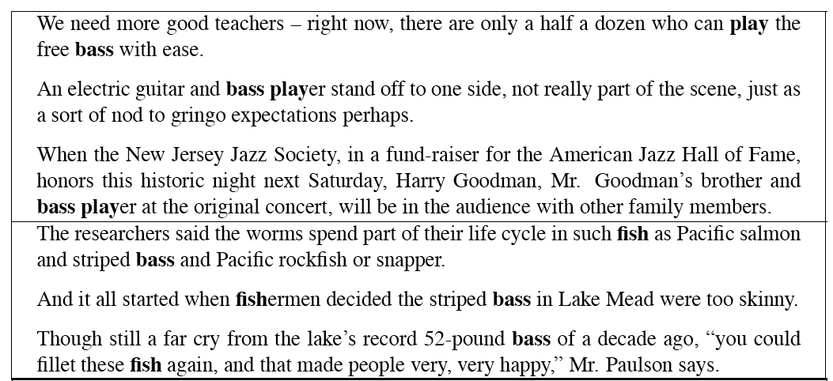
Sentences Extracts for bass and player

Slide 63
Where do the seeds come from?
Hand labeling
“One sense per discourse”:
The sense of a word is highly consistent within a document - Yarowsky (1995)
True for topic-dependent words
Not so true for other POS like adjectives and verbs, e.g. make, take
Krovetz (1998) “More than one sense per discourse” not true at all once you move to fine-grained senses
One sense per collocation:
A word recurring in collocation with the same word will almost surely have the same sense

Slide 64
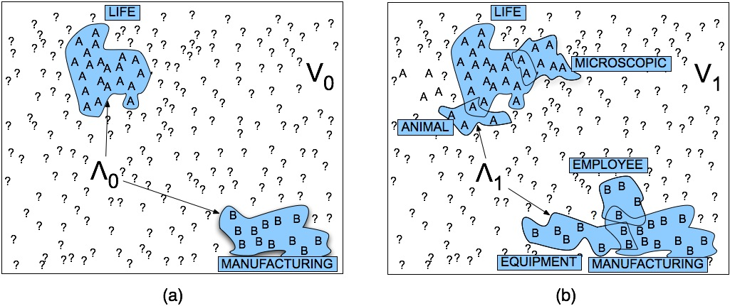
Stages in Yarowsky Bootstrapping Algorithm

Slide 65
Issues
Given these general ML approaches, how many classifiers do I need to perform WSD robustly
One for each ambiguous word in the language
How do you decide what set of tags/labels/senses to use for a given word?
Depends on the application

Slide 66
WordNet ‘bass’
Tagging with this set of senses is an impossibly hard task that’s probably overkill for any realistic application
bass, bass part - (the lowest part in polyphonic music)
bass, basso - (an adult male singer with the lowest voice)
sea bass, bass - (flesh of lean-fleshed saltwater fish of the family Serranidae)
freshwater bass, bass - (any of various North American lean-fleshed freshwater fishes especially of the genus Micropterus)
bass, bass voice, basso - (the lowest adult male singing voice)
bass - (the member with the lowest range of a family of musical instruments)
bass -(nontechnical name for any of numerous edible marine and
bass - (the lowest part of the musical range)
freshwater spiny-finned fishes)

Slide 67
History of Senseval
SLIDE FROM CHRIS MANNING
ACL-SIGLEX workshop (1997)
Yarowsky and Resnik paper
SENSEVAL-I (1998)
Lexical Sample for English, French, and Italian
SENSEVAL-II (Toulouse, 2001)
Lexical Sample and All Words
Organization: Kilkgarriff (Brighton)
SENSEVAL-III (2004)
SENSEVAL-IV -> SEMEVAL (2007)

Slide 68
WSD Performance
Varies widely depending on how difficult the disambiguation task is
Accuracies of over 90% are commonly reported on some of the classic, often fairly easy, WSD tasks (pike, star, interest)
Senseval brought careful evaluation of difficult WSD (many senses, different POS)
Senseval 1: more fine grained senses, wider range of types:
Overall: about 75% accuracy
Nouns: about 80% accuracy
Verbs: about 70% accuracy

Slide 69
Summary
Lexical Semantics
Homonymy, Polysemy, Synonymy
Thematic roles
Computational resource for lexical semantics
WordNet
Task
Word sense disambiguation

