Slide 1
Basic Parsing with Context-Free Grammars
CS 4705
Julia Hirschberg
Some slides adapted from Kathy McKeown and Dan Jurafsky

Slide 2
Syntactic Parsing
Declarative formalisms like CFGs, FSAs define the legal strings of a language -- but only tell you whether a given string is legal in a particular language
Parsing algorithms specify how to recognize the strings of a language and assign one (or more) syntactic analyses to each string

Slide 3
“The old dog the footsteps of the young.”
S → NP VP | VP → V
S → Aux NP VP | VP -> V PP
S -> VP | PP -> Prep NP
NP → Det Nom | N → old | dog | footsteps | young
NP →PropN | V → dog | eat | sleep | bark | meow
Nom -> Adj N | Aux → does | can
Nom → N | Prep →from | to | on | of
Nom → N Nom | PropN → Fido | Felix
Nom → Nom PP | Det → that | this | a | the
VP → V NP | Adj -> old | happy| young

Slide 4
How do we create this parse tree?
S
NP
VP
V
NP
DET
NOM
NOM
DET
N
The
old
dog
the
N
PP
of the young
footsteps

Slide 5
Parsing is a form of Search
We search FSAs by
  Finding the correct path through the automaton
  Search space defined by structure of FSA
We search CFGs by
  Finding the correct parse tree among all possible parse trees
  Search space defined by the grammar
Constraints provided by the input sentence and the automaton or grammar

Slide 6
Top Down Parsing
Builds from the root S node to the leaves
Expectation-based
Common top-down search strategy
  Top-down, left-to-right, with backtracking
  Try first rule s.t. LHS is S
  Next expand all constituents on RHS
  Iterate until all leaves are POS
  Backtrack when candidate POS does not match POS of current word in input string

Slide 7
“The old dog the footsteps of the young.”
S → NP VP | VP → V
S → Aux NP VP | VP -> V PP
S -> VP | PP -> Prep NP
NP → Det Nom | N → old | dog | footsteps | young
NP →PropN | V → dog | eat | sleep | bark | meow
Nom -> Adj N | Aux → does | can
Nom → N | Prep →from | to | on | of
Nom → N Nom | PropN → Fido | Felix
Nom → Nom PP | Det → that | this | a | the
VP → V NP | Adj -> old | happy| young
Notes:
7

Slide 8
Expanding the Rules
The old dog the footsteps of the young.
    Where does backtracking happen?
    What are the computational disadvantages?
    What are the advantages?
    What could we do to improve the process?

Slide 9
Bottom Up Parsing
Parser begins with words of input and builds up trees, applying grammar rules whose RHS matches
  Det N V Det N Prep Det N
  The old dog the footsteps of the young.
  Det Adj N Det N Prep Det N
  The old dog the footsteps of the young.
  Parse continues until an S root node reached or no further node expansion possible

Slide 10
“The old dog the footsteps of the young.”
S → NP VP | VP → V
S → Aux NP VP | VP -> V PP
S -> VP | PP -> Prep NP
NP → Det Nom | N → old | dog | footsteps | young
NP →PropN | V → dog | eat | sleep | bark | meow
Nom -> Adj N | Aux → does | can
Nom → N | Prep →from | to | on | of
Nom → N Nom | PropN → Fido | Felix
Nom → Nom PP | Det → that | this | a | the
VP → V NP | Adj -> old | happy| young
Notes:
10

Slide 11
Bottom Up Parsing
When does disambiguation occur?
What are the computational advantages and disadvantages?
What could we do to make this process more efficient?

Slide 12
Issues to Address
Ambiguity:
  POS
  Attachment
    PP:…
    Coordination: old dogs and cats
  Overgenerating useless hypotheses
  Regenerating good hypotheses

Slide 13
Dynamic Programming
Fill in tables with solutions to subproblems
For parsing:
  Store possible subtrees for each substring as they are discovered in the input
  Ambiguous strings are given multiple entries
  Table look-up to come up with final parse(s)
Many parsers take advantage of this approach

Slide 14
Review: Minimal Edit Distance
Simple example of DP: find the minimal ‘distance’ between 2 strings
  Minimal number of operations (insert, delete, substitute) needed to transform one string into another
  Levenstein distances (subst=1 or 2)
  Key idea: minimal path between substrings is on the minimal path between the beginning and end of the 2 strings

Slide 15
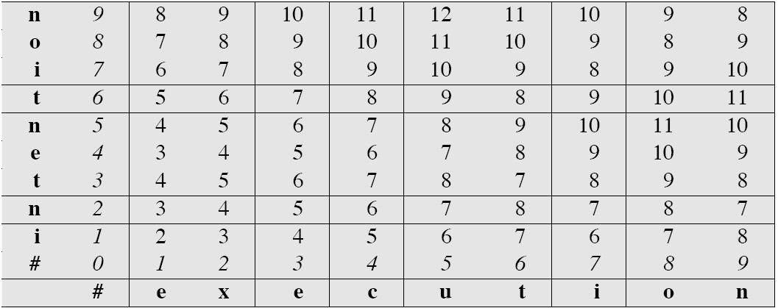
Example of MED Calculation
Notes:
Add ins, del, or subst penalty to each neighboring cell and take min, for each [i,j]

Slide 16
DP for Parsing
Table cells represented state of parse of input up to this point
Can be calculated from neighboring state(s)
Only need to parse each substring once for each possible analysis into constituents

Slide 17
Parsers Using DP
CKY Parsing Algorithm
  Bottom-up
  Grammar must be in Chomsky Normal Form
  The parse tree might not be consistent with linguistic theory
Earley Parsing Algorithm
  Top-down
  Expectations about constituents are confirmed by input
  A POS tag for a word that is not predicted is never added
Chart Parser

Slide 18
Cocke-Kasami-Younger Algorithm
Convert grammar to Chomsky Normal Form
  Every CFG has a weakly equivalent CNF grammar
  A→ B C (non-terminals)
  A → w (terminal)
  Basic ideas:
    Keep rules conforming to CNF
    Introduce dummy non-terminals for rules that mix terminal and non-terminals (e.g. A→ Bw becomes A→ BB’; B’→ w)
    Rewrite RHS of unit productions with RHS of all non-unit productions they lead to (e.g. A→ B; B→ w becomes A→ w)
    For RHS longer than 2 non-terminals, replace leftmost pairs of non-terminals with a new non-terminal and add a new production rule (e.g. A→ BCD becomes A→ ZD; Z→ BC)
    For ε-productions, find all occurences of LHS in 2-variable RHSs and create new rule without the LHS (e.g. C→ AB;A→ ε becomes C→B)
Notes:
These rules may not look so linguistically intuitive

Slide 19
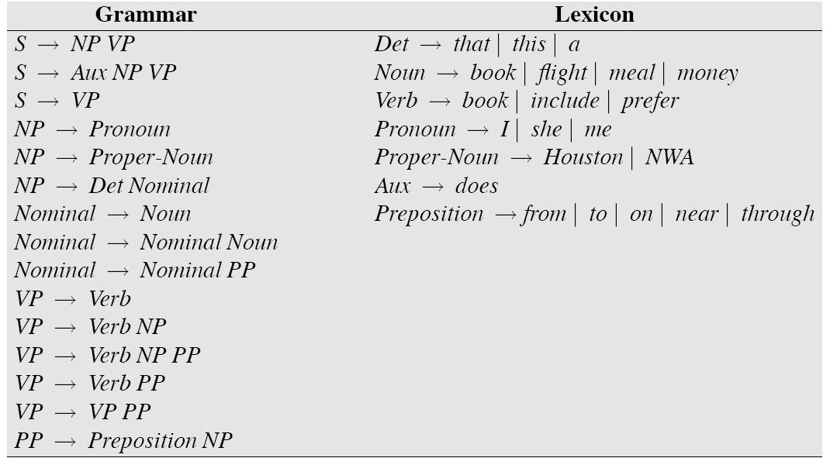
A CFG

Slide 20
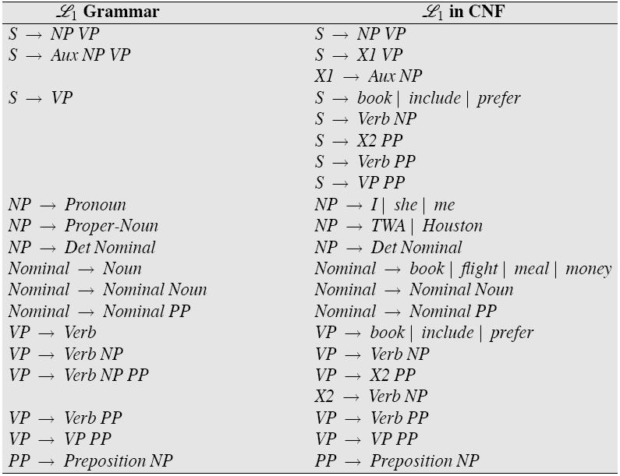
Figure 13.8

Slide 21
CYK in Action
Each non-terminal above POS level has 2 daughters
  Encode entire parse tree in N+1 x N+1 table
  Each cell [i,j] contains all non-terminals that span positions [i-j] betw input words
  Cell [0,N] represents all input
  For each [i,j] s.t. i<k<j, [i,k] is to left and [k,j] is below in table
  Diagonal contains POS of each input word
  Fill in table from diagonal on up

Slide 22
  For any cell [i,j], cells (constituents) contributing to [i.j] are to left and below, already filled in

Slide 23
Figure 13.8

Slide 24
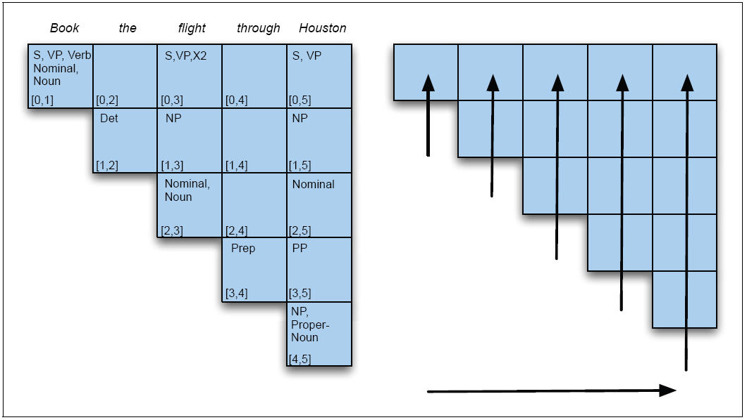
CYK Parse Table
X2

Slide 25
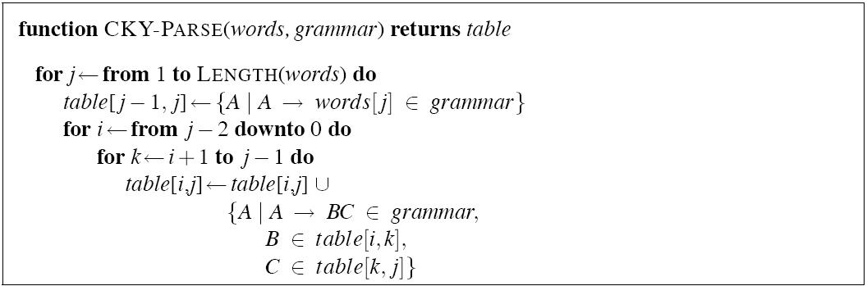
CYK Algorithm

Slide 26
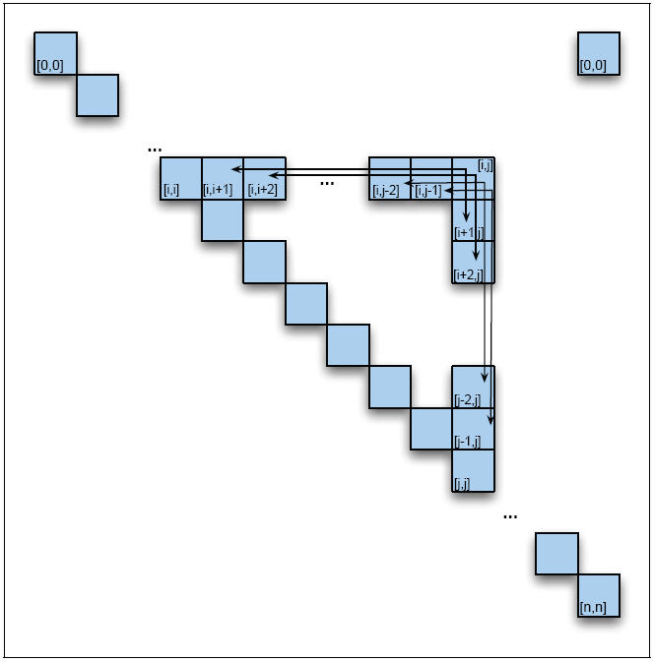
Filling in [0,N]: Adding X2
[0,n]
Notes:
At every split i<k<j, can the row and column cells be combined via a rule in the grammar.
How do we know to add X2

Slide 27
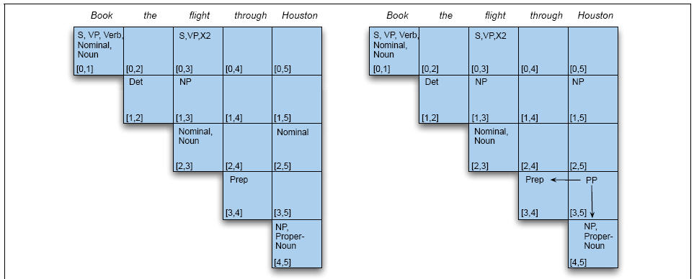
Filling the Final Column (1)

Slide 28
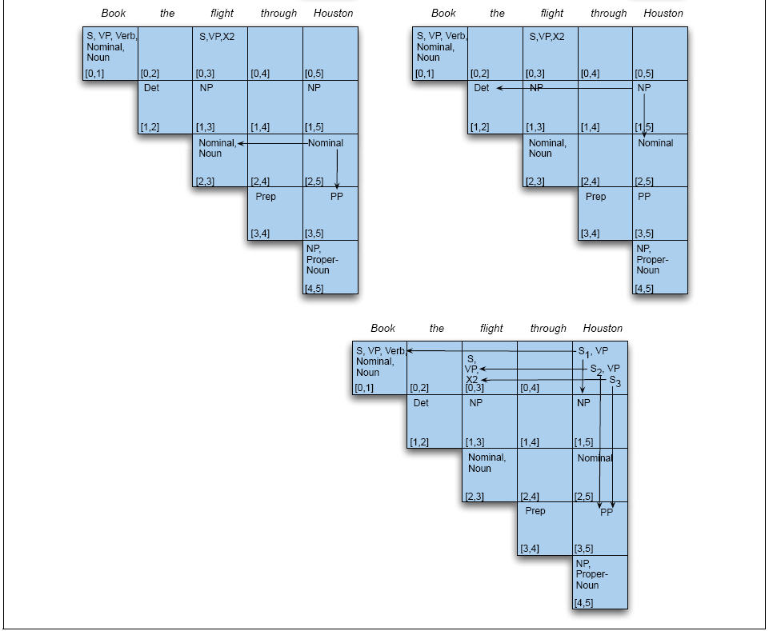
Filling the Final Column (2)
X2

Slide 29
Earley Algorithm
Top-down parsing algorithm using DP
Allows arbitrary CFGs: closer to linguistics
Fills a chart of length N+1 in a single sweep over input of N words
  Chart entries represent state of parse at each word position
    Completed constituents and their locations
    In-progress constituents
    Predicted constituents

Slide 30
Parser States
The table-entries are called states and are represented with dotted-rules
  S -> · VP A VP is predicted
  NP -> Det · Nominal An NP is in progress
  VP -> V NP · A VP has been found

Slide 31
CFG for Fragment of English
S → NP VP | VP → V
S → Aux NP VP | PP -> Prep NP
S → VP | N → book | flight | meal | money
NP → Det Nom | V → book | include | prefer
NP →PropN | Aux → does
Nom → N Nom | Prep →from | to | on
Nom → N | PropN → Houston | TWA
Nom → Nom PP | Det → that | this | a | the
VP → V NP

Slide 32
Some Parse States for Book that flight
S8
S9
S8
S10
S9
S11
S8
S12
S13
Notes:
32

Slide 33
Filling in the Chart
March through chart left-to-right.
At each step, apply 1 of 3 operators
  Predictor
    Create new states representing top-down expectations
  Scanner
    Match word predictions (rule with POS following dot) to words in input
  Completer
    When a state is complete, see what rules were looking for that complete constituent

Slide 34
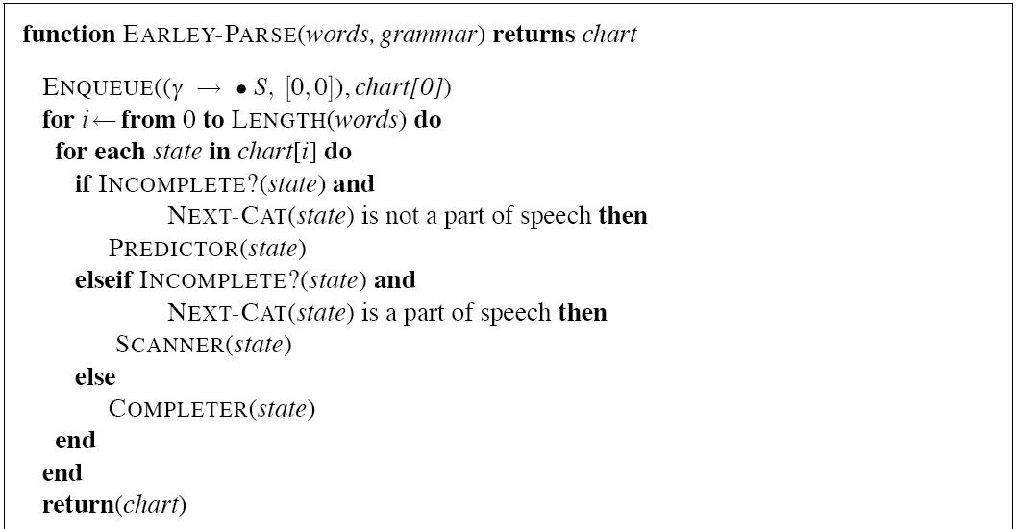
Top Level Earley

Slide 35
Predictor
Given a state
  With a non-terminal to right of dot (not a part-of-speech category)
  Create a new state for each expansion of the non-terminal
  Put predicted states in same chart cell as generating state, beginning and ending where generating state ends
  So predictor looking at
    S -> . VP [0,0]
  results in
    VP -> . Verb [0,0]
    VP -> . Verb NP [0,0]

Slide 36
Scanner
Given a state
  With a non-terminal to right of dot that is a POS category
  If next word in input matches this POS
  Create a new state with dot moved past the non-terminal
E.g., scanner looking at VP -> . Verb NP [0,0]
  If next word can be a verb, add new state:
    VP -> Verb . NP [0,1]
  Add this state to chart entry following current one
  NB: Earley uses top-down input to disambiguate POS --only POS predicted by some state can be added to chart

Slide 37
Completer
Given a state
  Whose dot has reached right end of rule
  Parser has discovered a constituent over some span of input
  Find and advance all previous states that are ‘looking for’ this category
  Copy state, move dot, insert in current chart entry
E.g., if processing:
  NP -> Det Nominal . [1,3] and if state expecting an NP like VP -> Verb. NP [0,1] in chart
Add
  VP -> Verb NP . [0,3] to same cell of chart

Slide 38
Reaching a Final State
Find an S state in chart that spans input from 0 to N+1 and is complete
Declare victory:
  S –> α · [0,N+1]

Slide 39
Converting from Recognizer to Parser
Augment the “Completer” to include pointer to each previous (now completed) state
Read off all the backpointers from every complete S

Slide 40
Gist of Earley Parsing
  Predict all the states you can as soon as you can
  Read a word
    Extend states based on matches
    Add new predictions
    Go to 2
  Look at N+1 to see if you have a winner

Slide 41
Example
Book that flight
Goal: Find a completed S from 0 to 3
Chart[0] shows Predictor operations
Chart[1] S12 shows Scanner
Chart[3] shows Completer stage

Slide 42
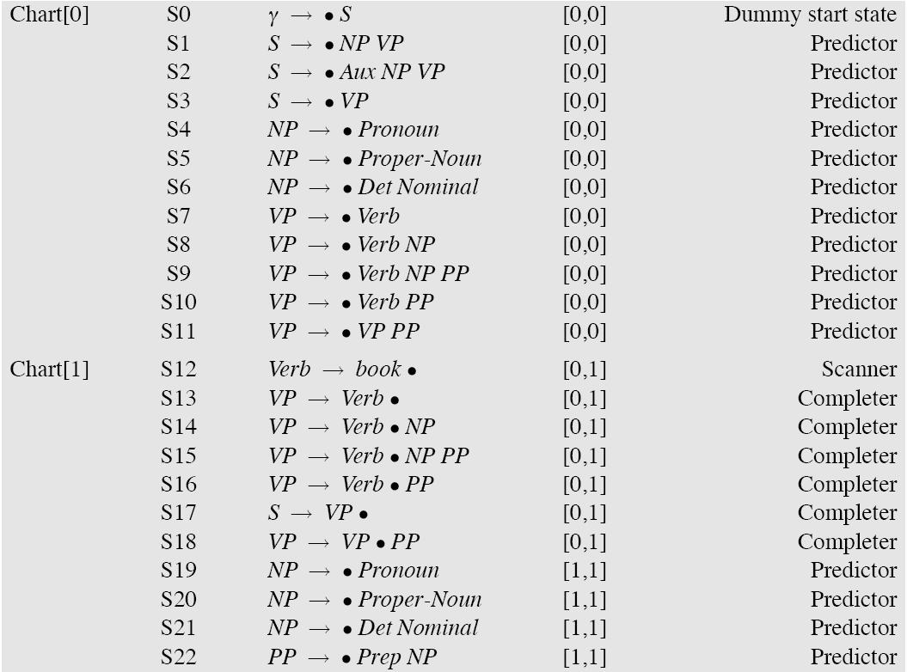
Figure 13.14

Slide 43
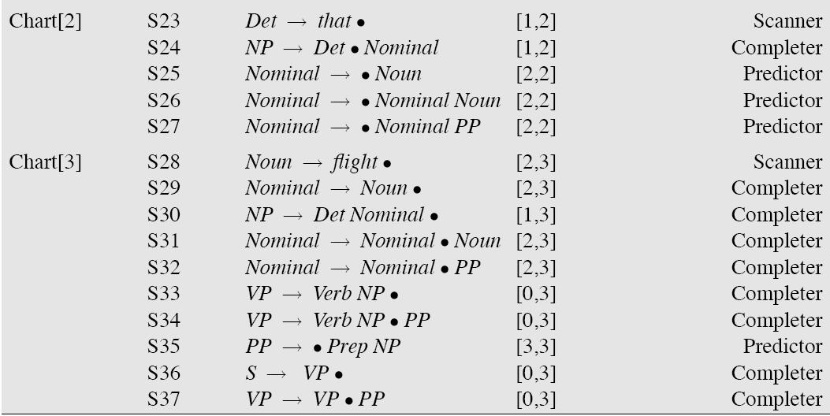
Figure 13.14 continued

Slide 44
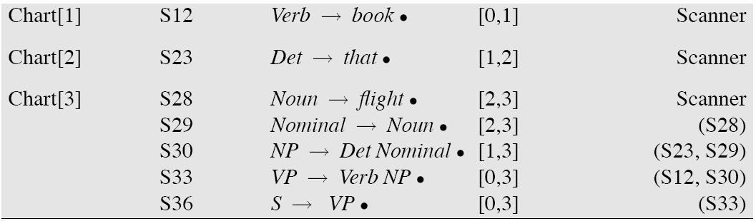
Final Parse States

Slide 45
Chart Parsing
CKY and Earley are deterministic, given an input: all actions are taken is predetermined order
Chart Parsing allows for flexibility of events via separate policy that determines order of an agenda of states
  Policy determines order in which states are created and predictions made
  Fundamental rule: if chart includes 2 contiguous states s.t. one provides a constituent the other needs, a new state spanning the two states is created with the new information

Slide 46
Summing Up
Parsing as search: what search strategies to use?
  Top down
  Bottom up
  How to combine?
How to parse as little as possible
  Dynamic Programming
  Different policies for ordering states to be processed
  Next: Shallow Parsing and Review

