Slide 1
Information Extraction
CS 4705
Julia Hirschberg

Slide 2
Information Extraction (IE) -- Task
Idea: ‘extract’ or tag particular types of information from arbitrary text or transcribed speech

Slide 3
Named Entity Tagger
Identify types and boundaries of named entity
For example:
Alexander Mackenzie , (January 28, 1822 - April 17, 1892), a building contractor and writer, was the second Prime Minister of Canada from ….
<PERSON>Alexander Mackenzie</PERSON> , (<TIMEX >January 28, 1822 <TIMEX> - <TIMEX>April 17, 1892</TIMEX>), a building contractor and writer, was the second Prime Minister of <GPE>Canada</GPE> from ….

Slide 4
IE for Template Filling Relation Detection
Vehicle Type | # accidents | # casualties | Weather
SUV | 1200 | 190 | Rainy
Trucks | 200 | 20 | Sunny
Given a set of documents and a domain of interest, fill a table of required fields.
For example:
Number of car accidents per vehicle type and number of casualty in the accidents.

Slide 5
IE for Question Answering
Q: When was Gandhi born?
A: October 2, 1869
Q: Where was Bill Clinton educated?
A: Georgetown University in Washington, D.C.
Q: What was the education of Yassir Arafat?
A: Civil Engineering
Q: What is the religion of Noam Chomsky?
A: Jewish

Slide 6
Approaches
Statistical Sequence Labeling
Supervised
Semi-Supervised and Bootstrapping

Slide 7
Approach for NER
<PERSON>Alexander Mackenzie</PERSON> , (<TIMEX >January 28, 1822 <TIMEX> - <TIMEX>April 17, 1892</TIMEX>), a building contractor and writer, was the second Prime Minister of <GPE>Canada</GPE> from ….
Statistical sequence-labeling techniques approach can be used – similar to POS tagging.
Word-by-word sequence labeling
Example of Features:
POS tags
Syntactic constituents
Shape features
Presence in a named entity list

Slide 8
Supervised Approach
Given a corpus of annotated relations between entities, train two classifiers:
A binary classifier:
Given a span of text and two entities
Decide if there is a relationship between these two entities.
A classifier is trained to determine the types of relations exist between the entities
Features:
Types of two named entities
Bag-of-words
…
Problems?

Slide 9
Pattern Matching for Relation Detection
Patterns:
“[CAR_TYPE] went out of control on [TIMEX], causing the death of [NUM] people”
“[PERSON] was born in [GPE]”
“[PERSON] was graduated from [FAC]”
“[PERSON] was killed by <X>”
Matching
Exact matching
Pros and Cons?
Flexible matching (e.g., [X] was .* killed .* by [Y])
Pros and Cons?

Slide 10
Pattern Matching
How can we come up with these patterns?
Manually?
Task and domain specific -- tedious, time consuming, and not scalable

Slide 11
Semi-Supervised Approach AutoSlog-TS (Riloff, 1996)
MUC-4 task: extract information about terrorist events in Latin America.
Two corpora:
Domain-dependent corpus that contains relevant information
A set of irrelevant documents
Algorithm:
Using some heuristic rules, all patterns are extracted from both corpora. For example:
Rule: <Subj> passive-verb
<Subj> was murdered
<Subj> was called
The output patterns are then ranked by frequency of their occurrences in corpus1 / corpus2.
Filter out the patterns by hand

Slide 12
Bootstrapping
Seed Patterns
Tuple Search
Pattern Extraction
Tuple Set
Pattern Set
Tuple Extraction
Pattern Search
Seed Tuples

Slide 13
TASK 12: (DARPA – GALE year 2) PRODUCE A BIOGRAPHY OF [PERSON].
Name(s), aliases:
*Date of Birth or Current Age:
*Date of Death:
*Place of Birth:
*Place of Death:
Cause of Death:
Religion (Affiliations):
Known locations and dates:
Last known address:
Previous domiciles:
Ethnic or tribal affiliations:
Immediate family members
Native Language spoken:
Secondary Languages spoken:
Physical Characteristics
Passport number and country of issue:
Professional positions:
Education
Party or other organization affiliations:
Publications (titles and dates):
13
Notes:
13

Slide 14
Biography – Two Approaches
14
To obtain high precision, we handle each slot independently using bootstrapping to learn IE patterns.
To improve recall, we utilize a biographical-sentence classifier.
Notes:
14

Slide 15
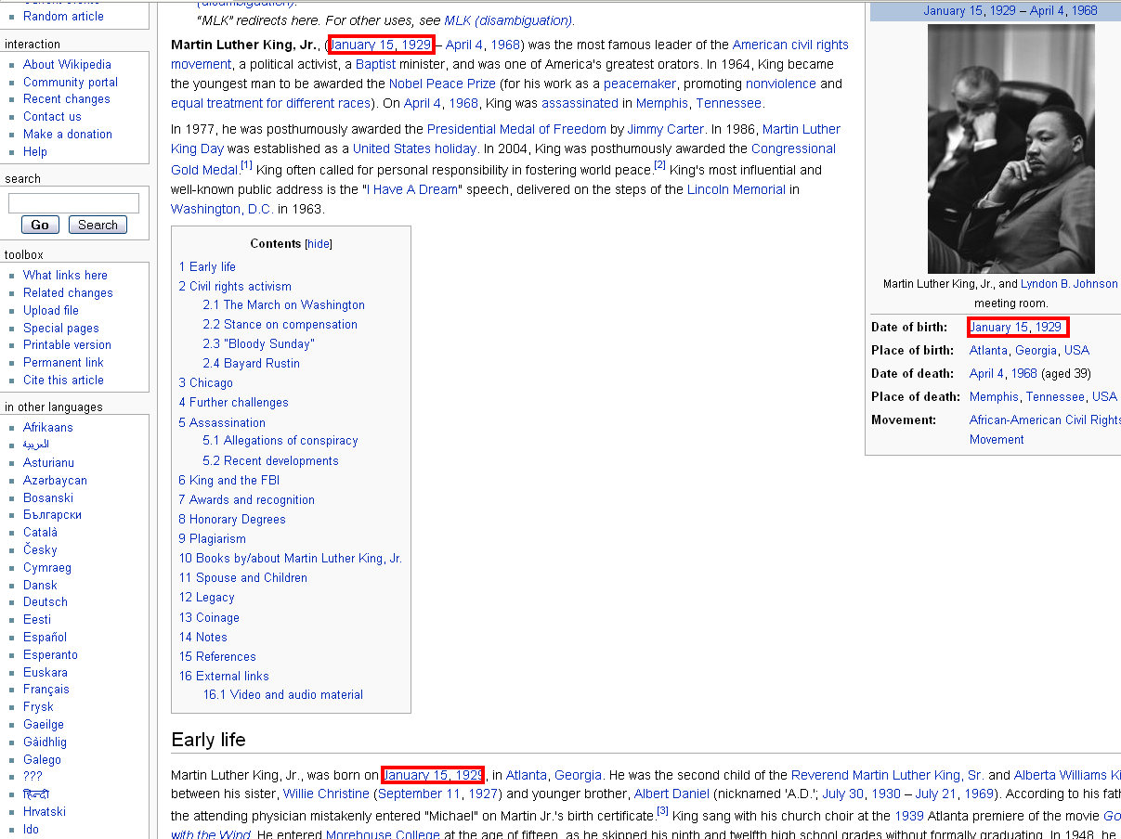
Biography patterns from Wikipedia
15
Notes:
15

Slide 16
Biography patterns from Wikipedia
Martin Luther King, Jr., (January 15, 1929 – April 4, 1968) was the most …
Martin Luther King, Jr., was born on January 15, 1929, in Atlanta, Georgia.
16
Notes:
16

Slide 17
Run NER on these sentences
17
<Person> Martin Luther King, Jr. </Person>, (<Date>January 15, 1929</Date> – <Date> April 4, 1968</Date>) was the most…
<Person> Martin Luther King, Jr. </Person>, was born on <Date> January 15, 1929 </Date>, in <GPE> Atlanta, Georgia </GPE>.
Take the token sequence that includes the tags of interest + some context (2 tokens before and 2 tokens after)
Notes:
17

Slide 18
Convert to Patterns:
18
<Target_Person> (<Target_Date> – <Date>) was the
<Target_Person> , was born on <Target_Date>, in
Remove more specific patterns – if there is a pattern that contains another pattern, take the smallest > k tokens.
➔ <Target_Person> , was born on <Target_Date>
➔ <Target_Person> (<Target_Date> – <Date>)
Finally, verify the patterns manually to remove irrelevant patterns.
Notes:
18

Slide 19
Sample Patterns
19
502 distinct place-of-birth patterns:
600 <Target_Person> was born in <Target_GPE>
169 <Target_Person> ( born <Date> in <Target_GPE> )
44 Born in <Target_GPE> , <Target_Person>
10 <Target_Person> was a native <Target_GPE>
10 <Target_Person> 's hometown of <Target_GPE>
1 <Target_Person> was baptized in <Target_GPE>
291 distinct date-of-death patterns:
770 <Target_Person> ( <Date> - <Target_Date> )
92 <Target_Person> died on <Target_Date>
19 <Target_Person> <Date> - <Target_Date>
16 <Target_Person> died in <GPE> on <Target_Date>
3 < Target_Person> passed away on < Target_Date >
1 < Target_Person> committed suicide on <Target_Date>
Notes:
19

Slide 20
Biography as an IE task
20
This approach is good for the consistently annotated fields in Wikipedia: place of birth, date of birth, place of death, date of death
Not all fields of interests are annotated, a different approach is needed to cover the rest of the slots
Notes:
20

Slide 21
Bouncing between Wikipedia and Google
21
Use one seed tuple only:
<Target Person> and <Target field>
Google: “Arafat” “civil engineering”, we get:
Notes:
21

Slide 22
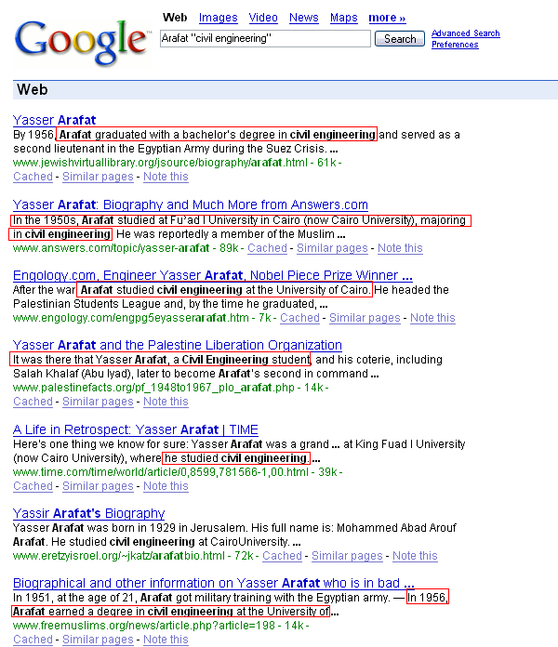
22
Notes:
22

Slide 23
Bouncing between Wikipedia and Google
23
Use one seed tuple only:
<my person> and <target field>
Google: “Arafat” “civil engineering”, we get:
Arafat graduated with a bachelor’s degree in civil engineering
Arafat studied civil engineering
Arafat, a civil engineering student
…
Using these snippets, corresponding patterns are created, then filtered
Notes:
23

Slide 24
Bouncing between Wikipedia and Google
24
Use one seed tuple only:
<my person> and <target field>
Google: “Arafat” “civil engineering”, we get:
Arafat graduated with a bachelor’s degree in civil engineering
Arafat studied civil engineering
Arafat, a civil engineering student
…
Using these snippets, corresponding patterns are created, then filtered out manually
Due to time limitation the automatic filter was not completed.
To get more seed tuples, go to Wikipedia biography pages only and search for:
“graduated with a bachelor’s degree in”
We get:
Notes:
24

Slide 25
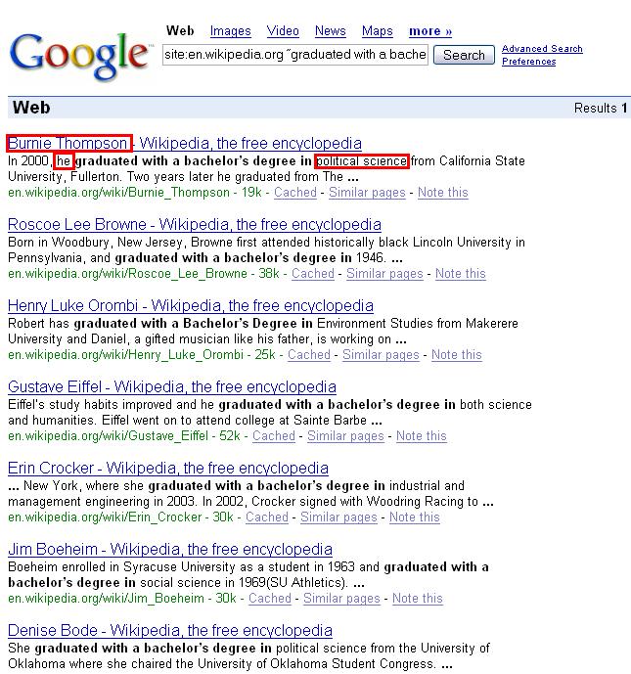
25
Notes:
25

Slide 26
Bouncing between Wikipedia and Google
26
New seed tuples:
“Burnie Thompson” “political science“
“Henrey Luke” “Environment Studies”
“Erin Crocker” “industrial and management engineering”
“Denise Bode” “political science”
…
Go back to Google and repeat the process to get more seed patterns!
Notes:
26

Slide 27
Bouncing between Wikipedia and Google
27
This approach works well for a few fields such as: education, publication, immediate family members, and party or other organization affiliations
Does not provide good patterns for some of the fields, such as: Religion, Ethnic or tribal affiliations, and Previous domiciles) – lots of noise
Why is `bouncing’ better than using only one corpus?
What if none of the patterns match? -- Back-off strategy…
Notes:
27

Slide 28
Biographical-Sentence Classifier (Biadsy, et al., 2008)
28
Train a binary classifier to identify biographical sentences
Manually annotating a large corpus of biographical and non-biographical information (e.g., Zhou et al., 2004) is labor intensive
Our approach: collect biographical and non-biographical corpora automatically
Notes:
28
We need to retain biographical sentences only. So we will train a binary classifier.
So we need to find the training data.
Instead of manually annotating a large corpus, we will construct these two sets of biographical and non-biographical sentences automatically using wikipedia and another corpus

Slide 29
Training Data: A Biographical Corpus from Wikipedia
29
Utilize Wikipedia biographies
Extract 17K biographies from xml version of Wikipedia
Apply simple text processing techniques to clean up the text
Notes:
29

Slide 30
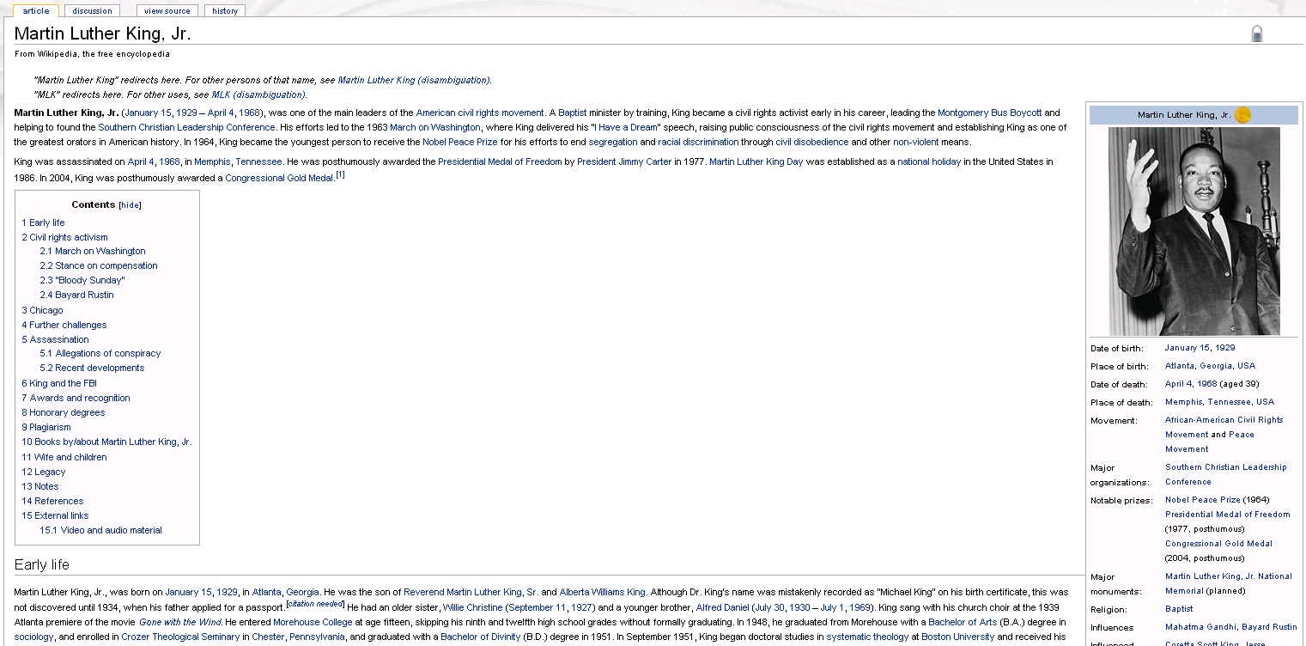
Constructing the Biographical Corpus
30
Identify the subject of each biography
Run NYU’s ACE system to tag NEs and do coreference resolution (Grishman et al., 2005)
Notes:
30
For each page we identify the subject of the biography from the title and then run NYU’s ACE system to tag NE and do coreference resolution

Slide 31
Constructing the Biographical Corpus
In September 1951, King began his doctoral studies In theology at
Boston University.
In [TIMEX] , [PER_ Individual] began [TARGET_HIS] doctoral studies
In theology at [ORG_Educational] .
31
Replace each NE by its tag type and subtype
Notes:
31
Let’s generalize our sentences so we will replace each NE by its type and subtype.

Slide 32
Constructing the Biographical Corpus
In September 1951, King began his doctoral studies In theology at
Boston University.
In [TIMEX] , [TARGET_PER] began [TARGET_HIS] doctoral studies
In theology at [ORG_Educational] .
32
Replace each NE by its tag type and subtype
Non-pronominal referring expression that is coreferential with the target person is replaced by [TARGET_PER]
Notes:
32
We replace non-pronominal referring expression that refers to target person by TARGET_PER

Slide 33
Constructing the Biographical Corpus
In September 1951, King began his doctoral studies In theology at
Boston University.
In [TIMEX] , [TARGET_PER] began [TARGET_HIS] doctoral studies
In theology at [ORG_Educational] .
33
Replace each NE by its tag type and subtype
Non-pronominal referring expression that is coreferential with the target person is replaced by [TARGET_PER]
Every pronoun P that refers to the target person is replaced by [TARGET_P], where P is the pronoun replaced
Notes:
33

Slide 34
Constructing the Biographical Corpus
In September 1951, King began his doctoral studies In theology at
Boston University.
In [TIMEX] , [TARGET_PER] began [TARGET_HIS] doctoral studies
In theology at [ORG_Educational] .
34
Replace each NE by its tag type and subtype
Non-pronominal referring expressions that are coreferential with the target person are replaced by [TARGET_PER]
Every pronoun P that refers to the target person is replaced by [TARGET_P], where P is the pronoun replaced
Sentences containing no reference to the target person are removed
Notes:
34

Slide 35
Constructing the Non-Biographical Corpus
35
English newswire articles in TDT4 used to represent non-biographical sentences
Run NYU’s ACE system on each article
Select a PERSON NE mention at random from all NEs in article to represent the target person
Exclude sentences with no reference to this target
Replace referring expressions and NEs as in biography corpus
Notes:
35
So far we have the positive class: a set of biographical class-based lexical sentences.
We will construct our negative class: the non-biographical sentences from a general corpus, in our case: TDT4 newswire corpus. R

Slide 36
Biographical-Sentence Classifier
36
Train a classifier on the biographical and non-biographical corpora
Biographical corpus:
30,002 sentences from Wikipedia
2,108 sentences held out for testing
Non-Biographical corpus:
23,424 sentences from TDT4
2,108 sentences held out for testing
Notes:
36

Slide 37
Biographical-Sentence Classifier
37
Features:
Frequency of [class /lexical]1-2-3 grams, e.g.:
[TARGET_PER] was born
[TARGET_HER] husband was
[TARGET_PER] said
Frequency of 1-2 grams of POS
Chi-squared (presence of ngram in biographical corpus vs. non-biographical) for feature selection
Notes:
37

Slide 38
Classification Results
Classifier | Accuracy | F-Meassure
SVM | 87.6% | 0.87
M. Naïve Bayes (MNB) | 84.1% | 0.84
C4.5 | 81.8% | 0.82
38
Experimented with three types of classifiers:
Note: Classifiers provide a confidence score for each classified sample
Notes:
38
MNB Multinomial Naïve Bayes

Slide 39
Summary
39
Information extraction typically done via pattern-matching approaches
Important
Clever choice of corpora
Automatic techniques for generating and evaluating patterns
Importance of good text processing tools: POS and NE taggers, chunkers, anaphora resolution algorithms
Notes:
39

