Slide 1
Face detection using Random projections
Sunil Khanal

Slide 2






Random Projections
Randomly project high dimensional data into low dimension
Given , project it to using projection matrix :
Can use to generate each element of the projection matrix
Use the projection matrix to reduce data to 100-1000 dimensions
Use the output for classification

Slide 3





The theory
Robustness ( ) of a concept class:
Let be random projections of . Given a threshold , and target dimension k
Projecting from a 50,000 dimension space to 1000 dimension preserves pairwise distances to with % probability

Slide 4




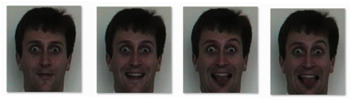
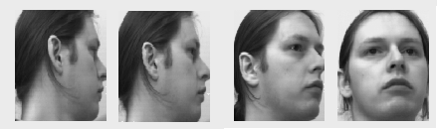
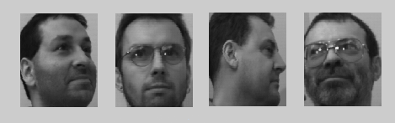




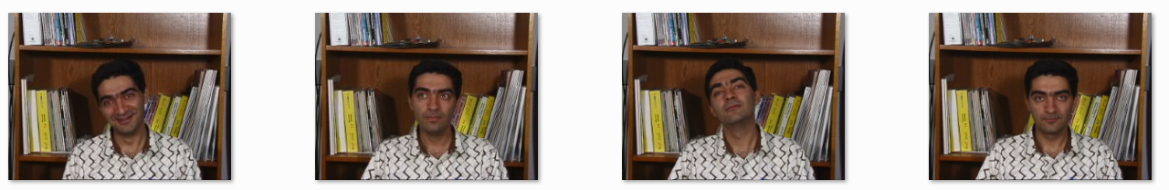
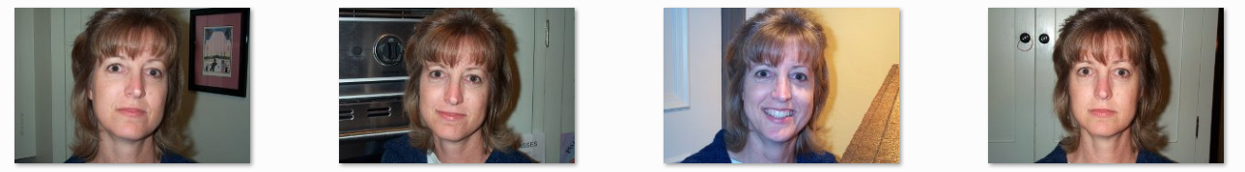
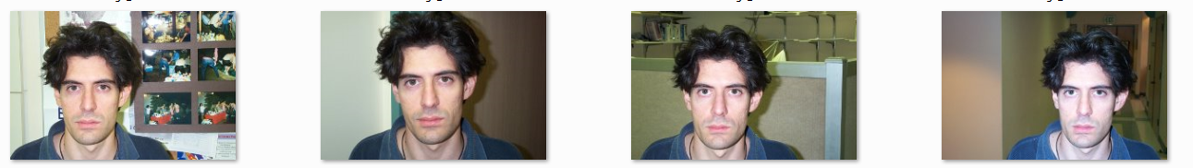
Datasets tested
Essex Faces (Expression variations, 360 images)
Sheffield Faces (Pose variation, 575 images)
Georgia Tech Faces (Similar lighting condition and background, 750 images)
Caltech Faces (Varying lighting condition and background, 436 images)

Slide 5

Results
- SVM classification with polynomial kernel (degree 3)
90% training, 10% testing
Sheffield (20 persons)
Georgia Tech (50 persons)
Caltech (26 persons)
Essex (18 persons)

Slide 6
Planned Work
Interpreting the projection
Explore different probability distributions for calculating the projection matrix
Explore probabilistic kernel methods (esp. Gaussian product kernel) on the projected data
RP seemingly works well for faces, but sensitive to background changes
Comparison against PCA/feature based approaches

