Slide 1
TCP-over-UDP
Cheng-Han Lee (cl2804)

Slide 2
Outline
ToU APIs
Using of ToU: Sample code
Simulation
Environmental Setup
Test Results
Architecture
ToU Modules
Processtou Thread/ Timer thread (fired pkt & dup ACKs rexmit)
Congestion FSM(TCP Reno)/ Processtou FSM/ Delayed ACK FSM
Logging mechanisms
Closure (close func.) and Connection control
Demo (Vmware)

Slide 3
ToU APIs
Server Mode
Initialize ToU
Client Mode
touSocket()
Initialize ToU
Just like C/C++ Socket
Sample Codes
Client
Server
touBind()
touSocket()
touListen()
touBind()
touAccept()
touConnect()
run()
run()
touRecv()
touSend()
touClose()
touClose()

Slide 4
#include "tou.h"
#include <sys/socket.h>
#include <netdb.h>
using namespace std;
/*
… main …
*/
touMain tm;
/* fill in the socket struct with server's info */
memset(&socket_svr, NULL, sizeof(socket_svr));
assign_addr(&socket_svr, AF_INET, SVR_IP, SVR_PORT);
/* fill in client socket info */
memset(&socket_cli, NULL,sizeof(socket_cli));
socket_cli.sin_family = AF_INET;
socket_cli.sin_addr.s_addr = INADDR_ANY;
socket_cli.sin_port = htons(CLI_PORT);
/* grab client socket */
sockd = tm.touSocket(AF_INET,SOCK_TOU,0);
/* bind the socket wiht port number */
tm.touBind(sockd,(struct sockaddr*) &socket_cli,sizeof(socket_cli));
/* connect to port on server */
tm.touConnect(sockd,(struct sockaddr_in*)&socket_svr,sizeof(socket_svr));
/*
... read data to send_data with size of read_sz */
/* send a message to the server PORT */
while(true){
FD_ZERO(&socks);
FD_SET(sockd, &socks);
tim.tv_sec = TIMEOUTVAL;
tim.tv_usec = 0;
if(!indata.eof() && tm.getCirSndBuf() > MORE_BUF)) {
indata.read(send_data, MORE_BUF);
readsize = indata.gcount();
sendsize = tm.touSend(sockd,send_data, readsize ,0);
total_sendsize += sendsize;
}
selectval = select(sockd+1, &socks, NULL, NULL, &tim);
if (selectval){
tm.run(sockd);
}else {
break;
}
if (totalsendsize < readsize) {
sendsize = tm.touSend(sockd,send_data, readsize ,0);
total_sendsize += sendsize;
}
}// while(true) cout << "Exit!" << endl; tm.touClose(sockd);
Client Side

Slide 5
#include "tou.h"
#include <sys/socket.h>
#include <netdb.h>
using namespace std;
/*
… main …
*/
touMain tm;
/* Set socket structures */
memset(&socket_svr, 0, sizeof(socket_svr));
socket_svr.sin_family = AF_INET;
socket_svr.sin_addr.s_addr = INADDR_ANY;
socket_svr.sin_port = htons(SVR_PORT);
memset(&socket_cli, 0, sizeof(socket_cli));
sockd = tm.touSocket(AF_INET,SOCK_TOU,0);
tm.touBind(sockd,(struct sockaddr*) &socket_svr,sizeof(socket_svr));
tm.touListen(sockd,1);
socklen_t sinlen = sizeof(socket_cli);
tm.run(sockd);
tm.touAccept(sockd,(struct sockaddr_in*)&socket_cli,&sinlen);
while(true){
FD_ZERO(&socks);
FD_SET(sockd, &socks);
tim.tv_sec = TIMEOUTVAL;
if (select(sockd+1, &socks, NULL, NULL, &tim)){
tm.run(sockd);
//RECV: touRecv data
memset(recv_data, 0, sizeof(recv_data));
tm.touRecv(sockd,recv_data,MAXSNDBUF,0);
}else{
break;
}
}// while(true)
cout << "Exit!" << endl;
tm.touClose(sockd);
Server Side

Slide 6
Outline
ToU APIs
Using of ToU: Sample code
Simulation
Environmental Setup
Test Results
Architecture
ToU Modules
Processtou Thread/ Timer thread (fired pkt & dup ACKs rexmit)
Congestion FSM(TCP Reno)/ Processtou FSM/ Delayed ACK FSM
Logging mechanisms
Closure (close func.) and Connection control
Demo (Vmware)

Slide 7
Environmental Setup
Using physical machines rather than vmware to make sure the simulations are close to real cases.
Hardware setting of client, server, and router
ASUS m5200a
D-Link DI-604
Sony NW120J
OS: Ubuntu 9.04 2.6.28-19
CPU: Intel Pentium-M 740
MEM:768MB
OS: Ubuntu 9.04 2.6.28-19
CPU: Intel Core2 T6500 MEM:4096MB

Slide 8
Environmental Setup
Turn the kernel to TCP Reno.
Configure the kernel recv/send buffers.
echo "reno" > /proc/sys/net/ipv4/tcp_congestion_control
echo "3" > /proc/sys/net/ipv4/tcp_reordering
echo "0" > /proc/sys/net/ipv4/tcp_abc
echo "0" > /proc/sys/net/ipv4/tcp_dsack
echo "0" > /proc/sys/net/ipv4/tcp_sack
echo "0" > /proc/sys/net/ipv4/tcp_fack
echo "0" > /proc/sys/net/ipv4/tcp_timestamps
echo "1" > /proc/sys/net/ipv4/tcp_window_scaling
echo "1" > /proc/sys/net/ipv4/tcp_no_metrics_save
echo "0" > /proc/sys/net/ipv4/tcp_slow_start_after_idle
echo "5000" > /proc/sys/net/core/netdev_max_backlog
echo "72800" > /proc/sys/net/core/optmem_max
# Socket buffer's size
echo "72800" > /proc/sys/net/core/rmem_default
echo "4194304" > /proc/sys/net/core/rmem_max
echo "72800" > /proc/sys/net/core/wmem_default
echo "4194304" > /proc/sys/net/core/wmem_max
#Number of pages allowed for queuing.
echo "65000 80000 94000" > /proc/sys/net/ipv4/tcp_mem
echo "65000 80000 94000" > /proc/sys/net/ipv4/udp_mem
#TCP buffer limits
echo "4096 72800 4194304" > /proc/sys/net/ipv4/tcp_rmem
echo "4096 72800 4194304" > /proc/sys/net/ipv4/tcp_wmem
#Minimal size buffers used by UDP sockets.
echo "8192" > /proc/sys/net/ipv4/udp_rmem_min
echo "8192" > /proc/sys/net/ipv4/udp_wmem_min

Slide 9
Environmental Setup
Turn off TSO/GSO.
#! /bin/bash
ethtool –K ethX tso off
ethtool –K ethX gso off
ethtool –k ethX
Connection monitor for TCP.
#! /bin/bash
modprobe tcp_probe port=$1
chmod 666 /prob/net/tcpprobe
cat /proc/net/tcpprobe > /tmp/tcpprobe.out & TCPPROB=$!
Commands for emulating WAN.
# Delay 50ms
tc qdisc add dev eth0 root netem delay 50ms
tc qdisc change dev eth0 root netem delay 100ms 10ms
# Loss rate set to 0.1%
tc qdisc change dev eth0 root netem loss 0.1%
ToU: tou –s \ tou IP test_file -c TCP: ttcp -r -v -p Port > /dev/null \ ttcp –t –v –l 1456 -p Port IP < test_file

Slide 10
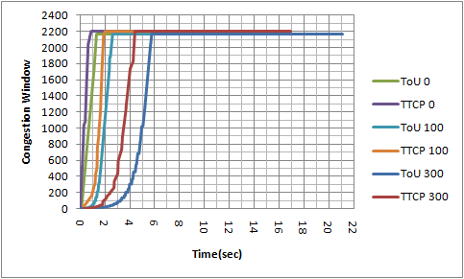
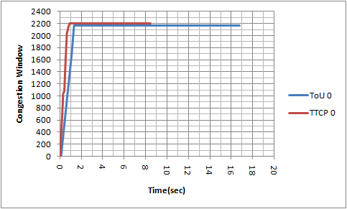
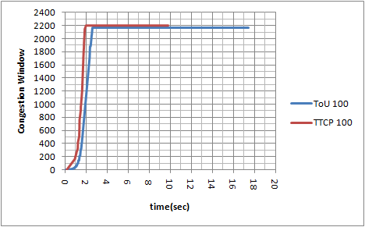
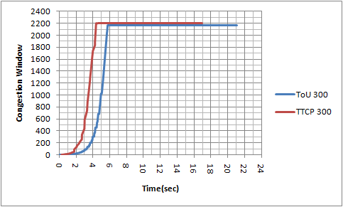
Test Results
Sending 100MB, loss rate 0%, delay 0ms 100ms 300ms
16.47 real seconds , 6261.39 KB/sec
8.47 real seconds , 11895.53 KB/sec
17.46 real seconds , 5906.35KB/sec
9.70 real seconds , 10386.96 KB/sec
21.07 real seconds , 4894.40 KB/sec
16.62 real seconds , 6058.87 KB/sec

Slide 11
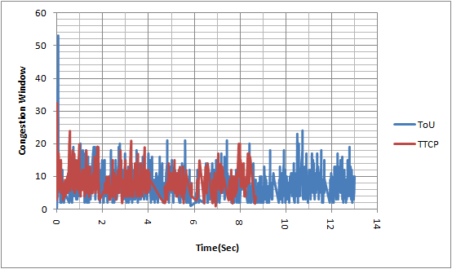
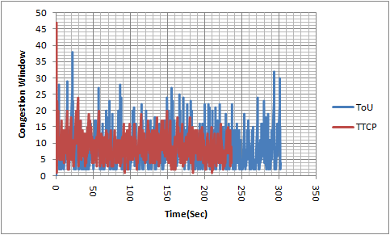
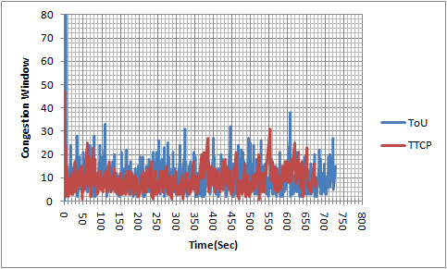
Test Results
Sending 30MB, loss rate 1%, delay 0ms 100ms 300ms
12.99 real seconds , 2421.65 KB/sec
8.69 real seconds , 3533.34 KB/sec
Avg. cwnd: tou(7.99077)/ ttcp(8.934413)
Avg. cwnd: tou(9.539957)/ ttcp(9.615262)
Avg. cwnd: tou(9.79832714)/ ttcp(11.6885906)
0ms
302.22 real seconds , 104.087 KB/sec
239.15 real seconds , 128.46 KB/sec
728.58 real seconds , 43.176 KB/sec
674.59 real seconds , 45.54 KB/sec
100ms
300ms

Slide 12
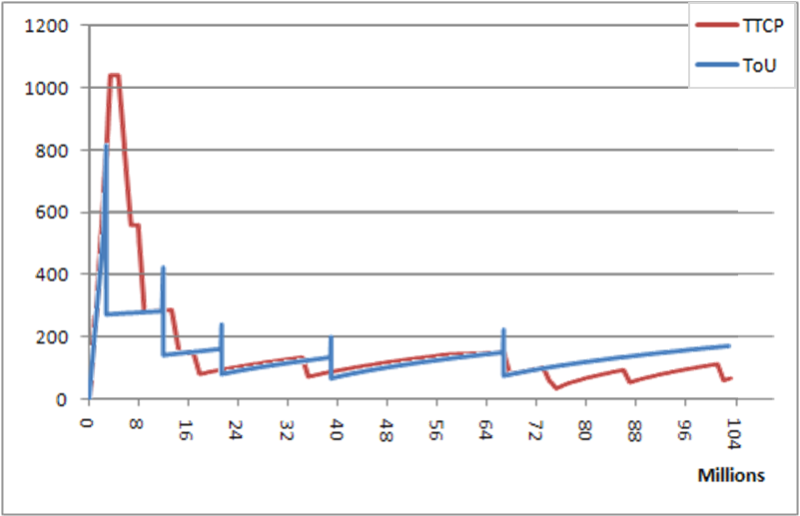
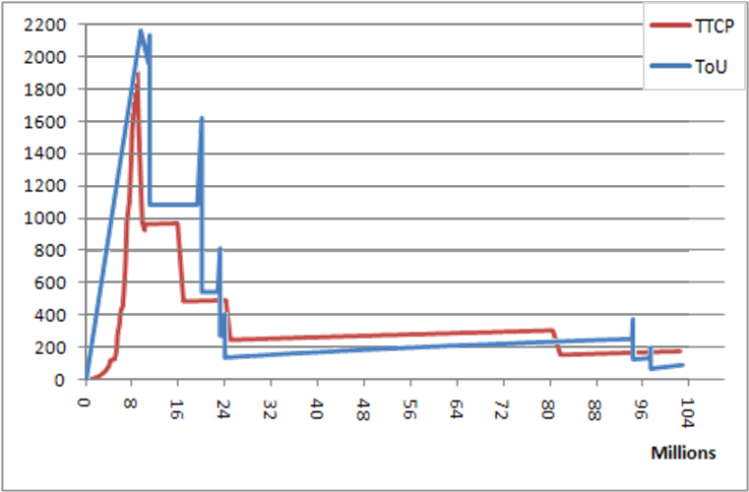
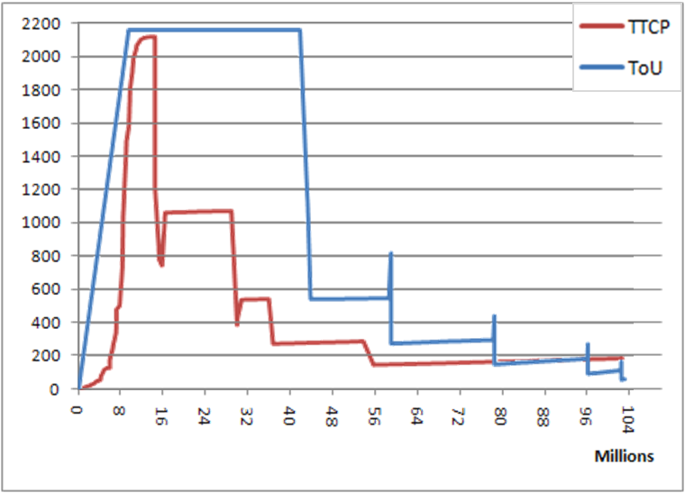
Test Results
Sending 100MB, loss rate 0.01%, delay 0ms 100ms 300ms
16.61 real seconds , 6205.39 KB/sec
8.98 real seconds , 11216.41 KB/sec
100MB is about 103124992 bytes. A pkt is about 1460 bytes. There’re about 70000 transmits in total. Since the loss rate is 0.01%, there’re about 7 losses.
0ms
38.08 real seconds , 2707.78 KB/sec
23.75 real seconds , 4239.86 KB/sec
71.02 real seconds , 1451.85 KB/sec
61.39 real seconds , 1640.38 KB/sec
100ms
300ms

Slide 13
Test Results: Summary
Delay Loss Rate |  | 0ms | 100ms | 300ms
0%(100mb) | ToU | 16.47 real seconds 6261.39 KB/sec | 17.46 real seconds 5906.35KB/sec | 21.07 real seconds 4894.40 KB/sec
 | TCP | 8.47 real seconds 11895.53 KB/sec | 9.70 real seconds 10386.96 KB/sec | 16.62 real seconds 6058.87 KB/sec
1%(30mb) | ToU | 12.99 real seconds 2421.65 KB/sec | 302.22 real seconds 104.087 KB/sec | 728.58 real seconds 43.176 KB/sec
 | TCP | 8.69 real seconds 3533.34 KB/sec | 239.15 real seconds 128.46 KB/sec | 674.59 real seconds 45.54 KB/sec
0.01%(100mb) | ToU | 16.61 real seconds 6205.39 KB/sec | 38.08 real seconds 2707.78 KB/sec | 71.02 real seconds 1451.85 KB/sec
 | TCP | 8.98 real seconds 11216.41 KB/sec | 23.75 real seconds 4239.86 KB/sec | 61.39 real seconds 1640.38 KB/sec

Slide 14
Outline
ToU APIs
Using of ToU: Sample code
Simulation
Environmental Setup
Test Results
Architecture
ToU Modules
Processtou Thread/ Timer thread (fired pkt & dup ACKs rexmit)
Congestion FSM(TCP Reno)/ Processtou FSM/ Delayed ACK FSM
Logging mechanisms
Closure (close func.) and Connection control
Demo (Vmware)

Slide 15
ToU Modules
Threading model
Timer thread/ Main thread
Adopt TCP Reno as congestion control algorithm
Slow Start/ Congestion Avoidance/ Fast Retransmit
Fast Recovery
Karn & Partridge Algorithm
Round-Trip Time Estimates for calculating Retransmission Timeout

Slide 16
ToU Programs
wc: 6064 lines 18641 words 155678 total
-rwxrw-rw- 1 w4180 w4180 6356 2011-03-27 23:21 circ_buf.cpp
-rwxrw-rw- 1 w4180 w4180 2000 2011-03-03 16:28 circ_buf.h
-rwxrw-rw- 1 w4180 w4180 16709 2011-02-04 13:39 processtou.cpp
-rwxrw-rw- 1 w4180 w4180 3139 2011-03-31 20:16 processtou.h
-rwxrw-rw- 1 w4180 w4180 17573 2011-03-31 15:56 timer.cpp
-rwxrw-rw- 1 w4180 w4180 8099 2011-03-31 12:34 timer.h
-rwxrw-rw- 1 w4180 w4180 4833 2011-03-20 23:29 timer_mng.cpp
-rwxrw-rw- 1 w4180 w4180 4263 2011-03-28 09:06 timer_node.cpp
-rwxrw-rw- 1 w4180 w4180 1377 2011-03-10 22:29 timestamp.cpp
-rwxrw-rw- 1 w4180 w4180 240 2011-03-03 18:07 timestamp.h
-rwxrw-rw- 1 w4180 w4180 284 2010-05-16 15:04 tou_boost.h
-rwxrw-rw- 1 w4180 w4180 2535 2011-03-28 11:27 tou_comm.h
-rwxrw-rw- 1 w4180 w4180 2152 2011-03-28 09:01 tou_congestion.h
-rwxrw-rw- 1 w4180 w4180 1515 2011-03-26 23:23 tou_control_block.h
-rwxrw-rw- 1 w4180 w4180 6810 2011-03-27 23:08 tou_sock_table.cpp
-rwxrw-rw- 1 w4180 w4180 4614 2011-03-27 22:43 tou_sock_table.h
-rwxrw-rw- 1 w4180 w4180 3983 2011-03-26 23:19 tou_ss_ca.cpp
-rwxrw-rw- 1 w4180 w4180 13915 2011-03-26 11:05 tou.cpp
-rwxrw-rw- 1 w4180 w4180 2445 2011-03-16 08:37 tou.h
-rwxrw-rw- 1 w4180 w4180 4900 2010-05-04 23:09 tou_header.cpp
-rwxrw-rw- 1 w4180 w4180 2231 2011-03-20 14:24 tou_header.h
-rwxrw-rw- 1 w4180 w4180 4415 2011-03-24 09:10 tou_logger.cpp
-rwxrw-rw- 1 w4180 w4180 2285 2011-03-12 20:54 tou_logger.h
Circular Buffer
ToU Process Thread
Timer Thread
Congestion FSM/ Structs
ToU APIs
ToU Packets/ Structs
ToU Logger

Slide 17
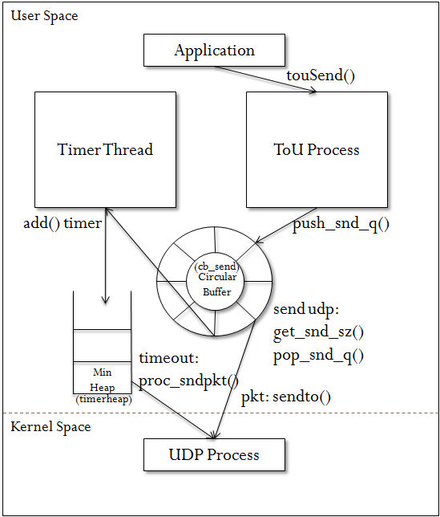
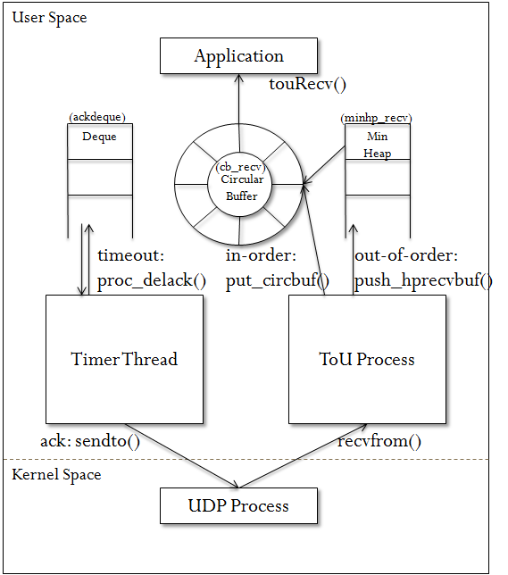
ToU Transmission Models
Transmit
Receive

Slide 18
ToU Process Thread
head
head
tail
Circular Buffer
2097152 (2M)
.
.
.
Timer Heap
snd_una
snd_nxt
Sequence number
Window Size
window

Slide 19
Timer Thread
100ms
node_t
cmp current time
.
.
.
Timer Heap

Slide 20
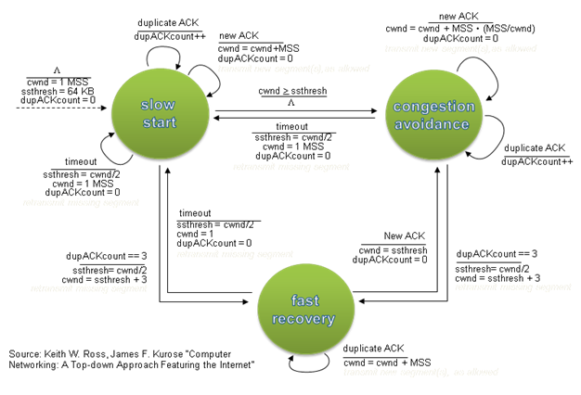
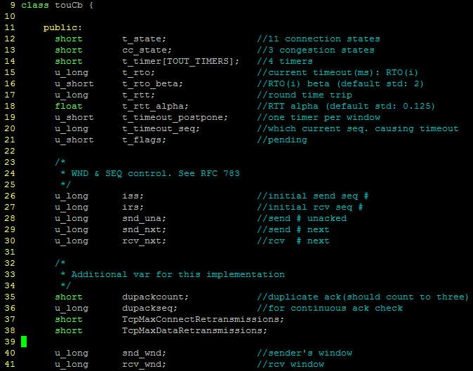
ToU Control Block

Slide 21
Congestion FSM(TCP Reno)

Slide 22
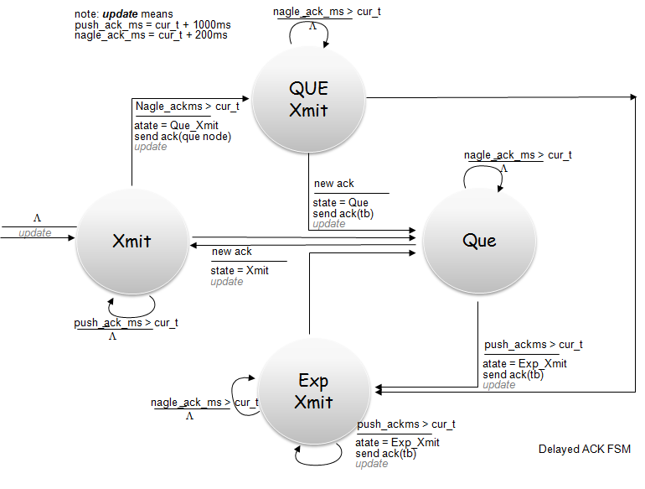
Processtou FSM/ Delayed ACK FSM

Slide 23
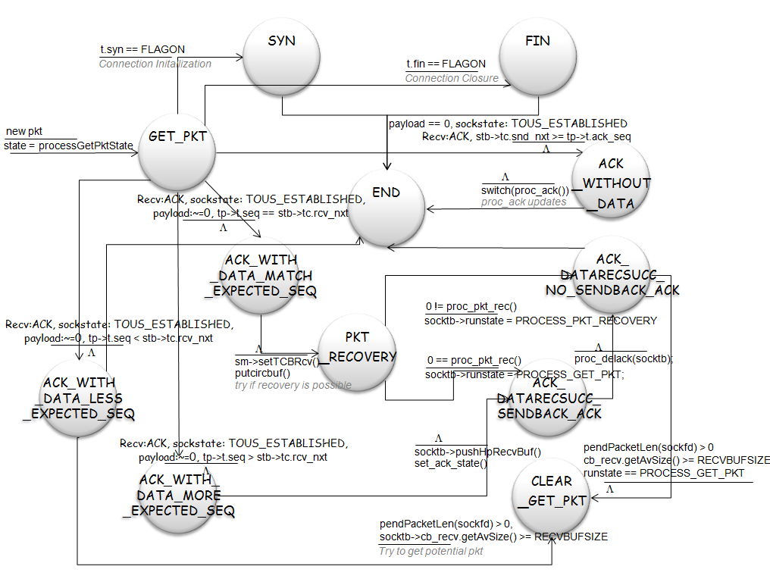

Slide 24
Demo
30mb file with 1% packet loss & 100ms delay
Log file
Congestion window, sequence number.
Socket tables.
Packet Send/Recv. Logs.
Timer Logs.

Slide 25
Thank You!

Slide 26
User Space
Application
touSend()
Timer Thread
ToU Process
RTT/RTO:
add() timer
push_snd_q()
(cb_send)
Circular Buffer
send udp:
get_snd_sz() pop_snd_q()
timeout: proc_sndpkt()
Min
Heap
(timerheap)
pkt: sendto()
Kernel Space
UDP Process

Slide 27
User Space
Application
touRecv()
(ackdeque)
(minhp_recv)
Deque
Min
Heap
(cb_recv)
Circular Buffer
timeout: proc_delack()
in-order:
put_circbuf()
out-of-order: push_hprecvbuf()
Timer Thread
ToU Process
ack: sendto()
recvfrom()
Kernel Space
UDP Process

Slide 28
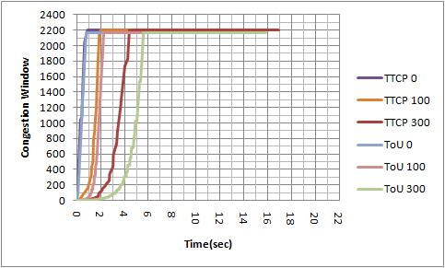
Figure 19. cwnd(packets) vs. sequence number

Slide 29
Test Results: Summary
Delay Loss Rate |  | 0ms | 100ms | 300ms
0%(100mb) | ToU | 9463.98 KB/ sec | 8104.67 KB/sec | 6422.19 KB/sec
 | TCP | 11895.53 KB/sec | 10386.96 KB/sec | 6058.87 KB/sec
Delay | 0ms | 100ms | 300ms
Average cwnd size (ToU/TCP) | 7.99077/8.934413 | 9.539957/ 9.615262 | 9.798327/ 11.68859

