Slide 1
SECE Location Tracking
Goal:
Track what room in a building objects are in
Pass information to SECE
Implementation:
“Tags” are placed on items to be tracked
“Beacons” are placed in locations that should track tags

Slide 2
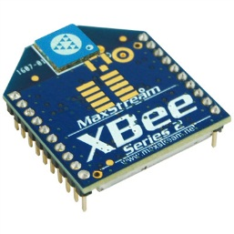
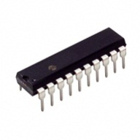
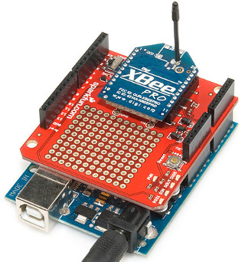
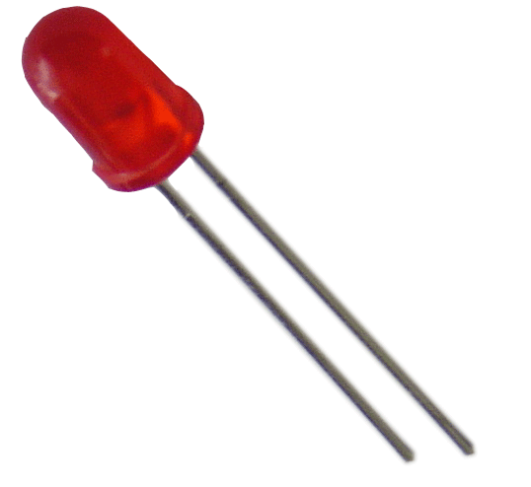
Beacons
Beacons periodically transmit wirelessly
Telling the location that a beacon is present
Transmission is low powered – penetration of other locations is minimized
Indicate connection status
Location #1
Location #2
PIC Beacon
+
Arduino Beacon

Slide 3
Beacon Types
PIC
Low power usage: can run on battery for extended periods of time
Hard to communicate with TCP/IP
Arduino
Heavier power usage
Easier to communicate with TCP/IP using existing libraries
+

Slide 4
Tags
Tags receive messages from beacons (1)
Capture signal strength of message
Determines which beacon is closest based on signal strength (2)
Transmit closest beacon ID to SECE when it changes (3)
Highest Signal Strength
Tag
(2)
Closest Beacon ID
+
(3)
Lower Signal Strength
(1)
(1)
Lower Signal Strength
(1)
Lower Signal Strength

Slide 5
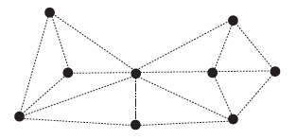
Technical Details
Wireless uses mesh network – no central node is needed
Beacons and tags sleep at the same time to conserve power
Syncing of sleep time is achieved through wireless protocol
Beacons broadcast messages through network but do not relay messages from other beacons
Tags send messages directly to Arduino beacon – messages are relayed through other beacons
Signal strength delivered to PIC from XBee via pulse width modulation

Slide 6
Power Consumption (No Sleep)
Part Name | Average Current Draw (mA)
XBee DigiMesh Module | 50
Processor | 0.007500033
Variables | Value
Sleep Period (s) | 1
Awake Time (s) | 1
XBee Max Amps Awake (mA) | 50
XBee Max Amps Sleep (mA) | 0.05
Battery mAh | 225
Processor Max Amps Awake (mA) | 0.00015
Processor Max Amps Sleep (mA) | 0.00000065
Current Adjustment | 1.1
XBee Data Rate (kbps) | 250
TX/RX Data Bytes (bytes) | 200
Calculations
Awake Times Per Hour | 3600
Percent Awake | 1
Percent Sleep | 0
XBee Average Current Draw (mA) | 50
Processor Average Current Draw (mA) | 0.007500033
Required Awake Time | 0.0064
Results
Battery Life (h) | 4.090295544
Battery Life (d) | 0.170428981

Slide 7
Power Consumption (Sleep)
Part Name | Average Current Draw (mA)
XBee DigiMesh Module | 50
Processor | 0.007500033
Variables | Value
Sleep Period (s) | 5
Awake Time (s) | 1
XBee Max Amps Awake (mA) | 50
XBee Max Amps Sleep (mA) | 0.05
Battery mAh | 225
Processor Max Amps Awake (mA) | 0.00015
Processor Max Amps Sleep (mA) | 0.00000065
Current Adjustment | 1.1
XBee Data Rate (kbps) | 250
TX/RX Data Bytes (bytes) | 200
Calculations
Awake Times Per Hour | 720
Percent Awake | 0.2
Percent Sleep | 0.8
XBee Average Current Draw (mA) | 10.04
Processor Average Current Draw (mA) | 0.0075000325
Required Awake Time | 0.0064
Results
Battery Life (h) | 20.3578456216795
Battery Life (d) | 0.84824356756998

Slide 8
Future Work
Improve signal strength readings
Can use average signal strength readings over a period of time
Report beacon battery status
Tag “panic” button
Tag out of range detection
Prevent lost messages

