Slide 1
SECE Geoloc v2.0
Advised By:
Prof. Henning Schulzrinne
Jan Janak
Riddhi N. Mehta
UNI : rnm2119
MS Computer Science
Columbia University

Slide 2
Introduction
- The goal of this work is to create a web-based User Interface (UI) that could be used to determine precise location for Smart Objects, as well as to build a database with geospatial boundaries for real-world objects. Specifically the UI should be easy and intuitive enough so that it can be used directly by users of the SECE system, without having to acquire specific knowledge about geospatial systems first.
- The UI consists of the following components:
        Dashboard
        Floor Plan Editor
        Polygon Editor
        group Editor
        Smart Object Locator

Slide 3
Dashboard
- Dashboard is the first component of the Geolocation UI that the user sees
- The main navigation entity is the tree of all the objects. The tree always has the root.
- The right hand part of the Dashboard shows a Google Maps view with polygon overlays and Smart Objects markers.

Slide 4
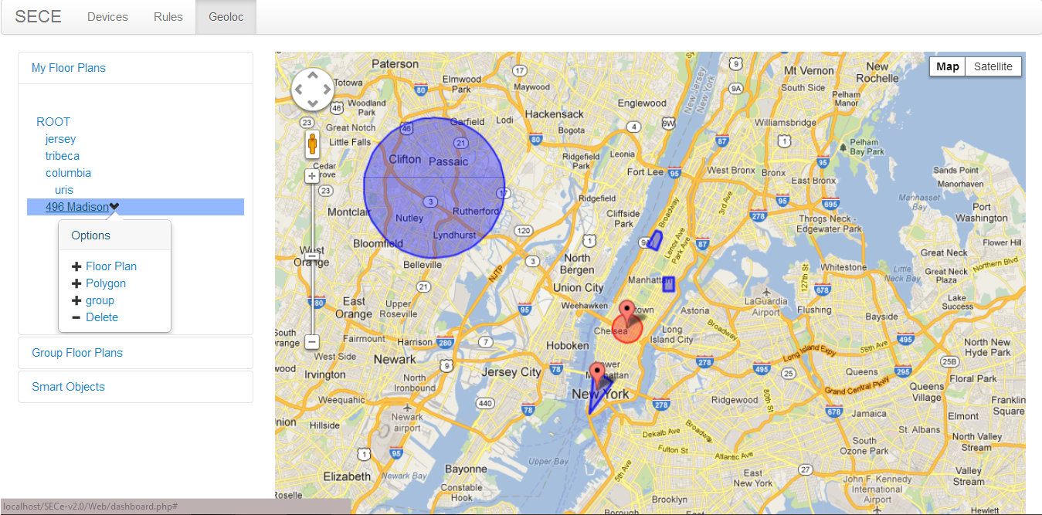

Slide 5
Groups
- Root
- Add new group
- Add name and other optional information regarding the group

Slide 6
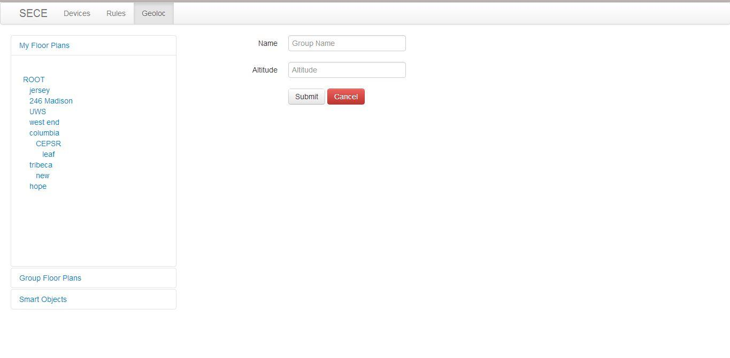

Slide 7
Polygons
- floorplan polygons
- Google maps polygons
- Name, altitude information regarding the polygon

Slide 8
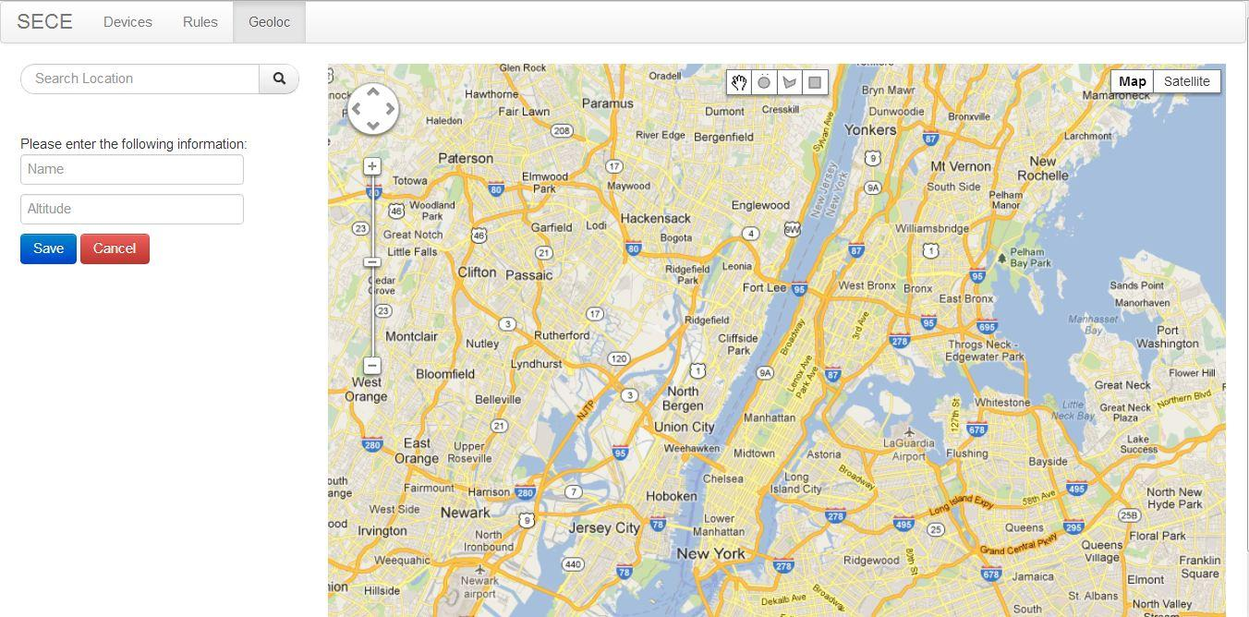
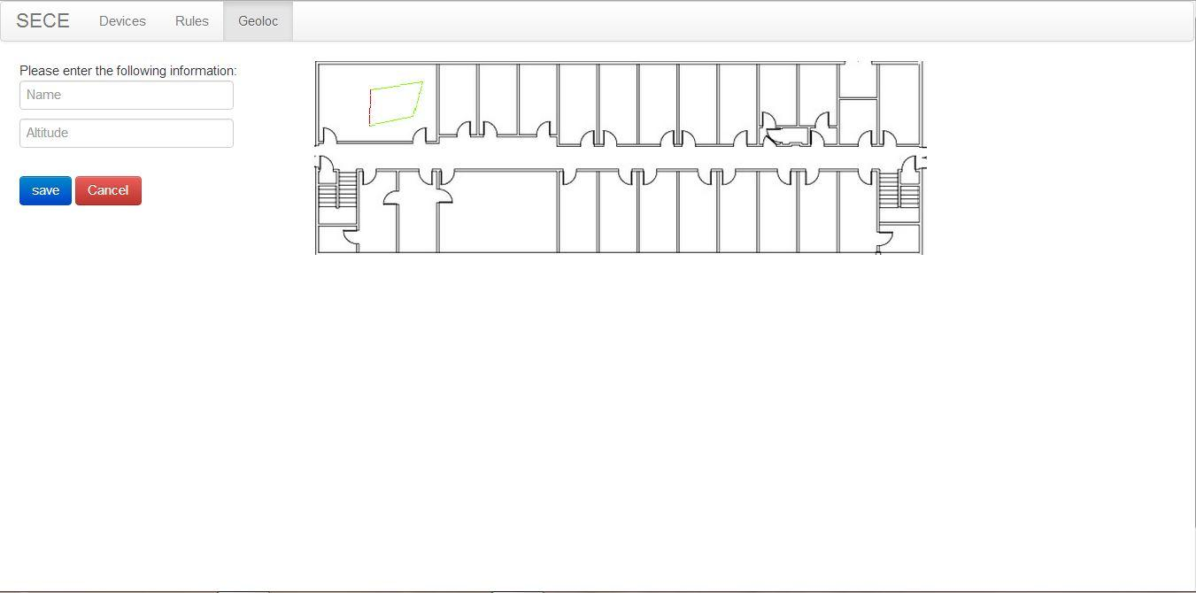

Slide 9
Floorplans
- Overlaytiler
- Cross-site Scripting & php proxy
- Adding new floorplan
- Edit floorplan

Slide 10
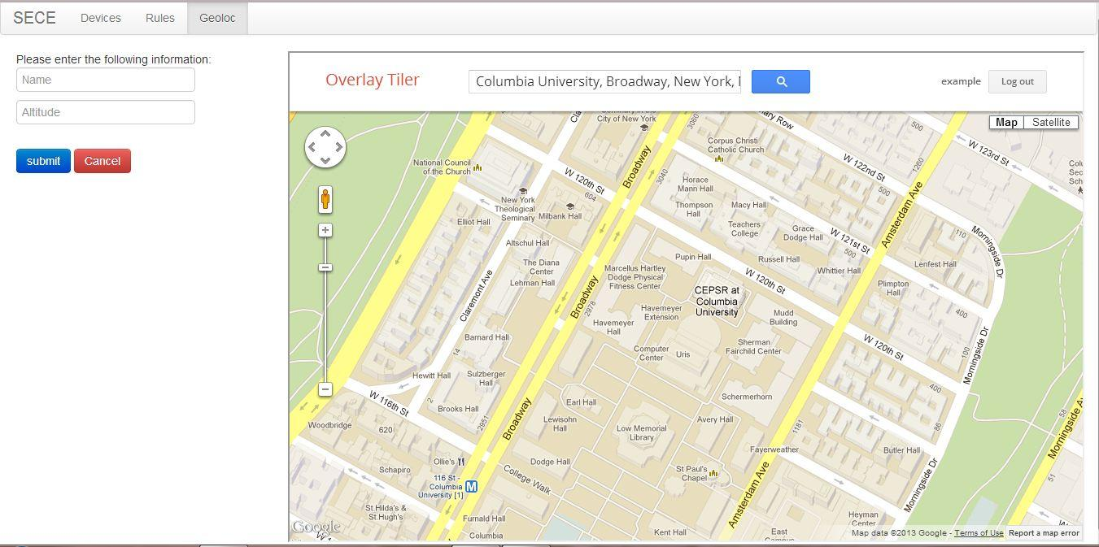

Slide 11
SmartObjects
- Get existing smartobject information from external database along with the name of the source
- Edit smartobject location on both google maps and floorplans they are in
- Timestamp and accuracy

Slide 12
Demo
http://irtlaptop8.cs.columbia.edu

Slide 13
Future Work
Due to difficulties faced in order to couple the Geoloc UI application with the overlay tiler application which was used to generate tiles of the floor plans to be overlaid on top of google maps, there are a few features which are not yet implemented in the system.
The file upload in the add floorplan feature occurs through drag and drop and not through the form on the left.
Cannot adjust the location of a smartObject on a floor plan.
Cannot view the polygons added to the floor plan on th google maps view.

Slide 14
Future Work
Can we get access to the database that Google maps already maintains?
Can we also get access to polygons created by Google, and not just by users?
Can we obtain the polygon for Old Town Square in Prague?
Consistency Checks:
Do we need to ensure that the logical ordering of items in the tree is synchronized with their geo-based ordering?
Is this something the user would expect?
Maybe we could implement a button that would make it possible to rearrange the tree so that the user can see either the logical ordering or the geo-based ordering of the tree
The initial prototype will be without any consistency checks
We may need to do A/B testing on a small group of users to see if this is required at all
For some of the features in the UI A/B testing with a small group of users may be needed

Slide 15
References
A Noob's Guide to Creating Google Maps Tiles from a Plain Old Image | Bryce Thomas
Overlays - Google Maps JavaScript API v3 — Google Developers
Map Types - Google Maps JavaScript API v3 — Google Developers
MySQL :: MySQL 5.0 Reference Manual :: 12.16.5.4 Functions for Testing Spatial Relations Between Geometric Objects
MySQL. Create polygon geometries
http - The Go Programming Language
How to use MySQL Spatial Extensions: Using Circular Area Selection
Creating a Store Locator with PHP, MySQL & Google Maps - Google Maps API — Google Developers
Writing Web Applications - The Go Programming Language
gis - See if lat / long falls within a polygon using mysql - Stack Overflow
Draw Cycle Overlay on google map - Stack Overflow
MySQL :: MySQL 5.0 Reference Manual :: 12.16.4.4 Populating Spatial Columns
PHP - unpacking Multipolygons from MySQL (Page 1) — Programming and Web Development — Forum
Draggable | jQuery UI
mysql - Traverse array as tree in php - Stack Overflow
http://irtlaptop8.cs.columbia.edu:8000
https://github.com/zsalzbank/SECE-Location-API
https://github.com/zsalzbank/SECE-Device-Manager
http://dev.mysql.com/doc/refman/5.1/en/functions-for-testing-spatial-relations-between-geometric-objects.html#relations-on-geometry-mbr
http://benalman.com/projects/php-simple-proxy/
https://github.com/riddhinm5/SECE
http://brittonkerin.com/image_region_selector/irs_demo.html

