Slide 1
SECE-Android client
CS project-coms e6901
Professor: H. Schulzrinne
Name : Jiawen Sun
UNI : js3990
Tutor : Jan Janak

Slide 2
Android application -SECE_Android-Client
Main Function-Background Service
Listen to the android phone state, includes call state(IDLE, RINGING, OFFHOOK), sensor state(SHAKE, STILL) and environmental state(Lighting condition so far);
Communicate state update information(design the relevant information to XML and JSON format) with SECE server using both SIP (PUBLISH request) and HTTP (POST) protocol

Slide 3
Registration -SECE Android Client
When the application is first installed in the phone, Users will need to register in order to use the service properly.
Press register button
Redirect to the website for registration
Get the authorization code and start using the service

Slide 4
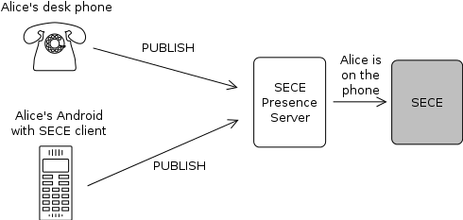
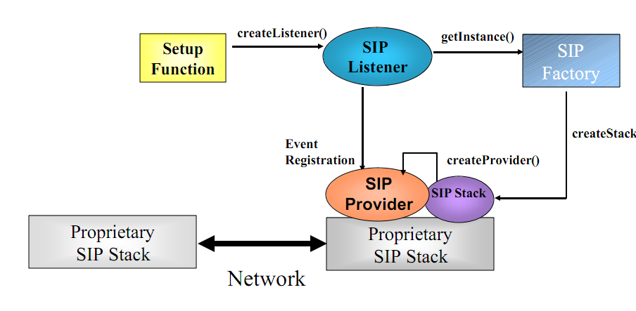
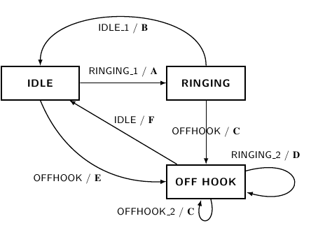
Phone Calling State -SECE Android Client
Implement the phone state machine to listen to the calling state changes. (TelePhonyManager API)
Initialize SIP protocol method with the registration code (BASE64 format)
(Jain-sip API provides SIP methods)
Send phone state (XML) changes to SECE Server within PUBLISH Request
Difficulties: outgoing number, XML status file format.

Slide 5
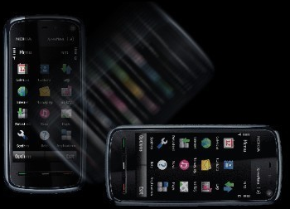
Sensor State -SECE Android Client
Use the Sensor ACCELEROMETER inside the Android phone to compute for identification of the shaking motion of the phone; (calculate moving speed)
SensorManager API and also SensorEventListerner to listen the the valuse change of the sensor;
Implement a simple two state state machine to check the status from shaking to still or still to shaking;
Add the authorization code to the header and send the states by HTTP POST method.

Slide 6
Lighting Condition -SECE Android Client
Ambient Light Sensor;
Also use SensorManager API listen to the lighting value changes and send the lighting condition information to SECE server via HTTP POST in JSON format;
Change the lighting value to percentage;
Json format:
{"m":[{ "n": "ambient_light", "u":%, "v":23.5 }]}

Slide 7
Summary
Background Service;
Registration
Listen to state change
Communicate with SECE server
SIP protocol (Jain-sip API)
HTTP protocol (HTTP API)
Android API (TelePhonyManger, SensorManager, WifiManager etc.)
Exchange data format(XML format, Json format)

