Slide 1
Music Share on Android platform
Project Presentation

Slide 2
Outline
1.Application features
2.Application interfaces
3.Technology and API
4.Improvement over iShare
5.Challenges
6.Future work

Slide 3
Application features
Stay connected
Log in to your facebook account to join music sharing group, publish your IP or post on your wall!
Manage Music and Friend
Manage the list of your current songs and friends, and play your favorite song instantly!
Share Music
Share music between users by either push, pull or two-way share based on your music interest!

Slide 4
Different ways to share music
Interest Based
Share music between users based on each other’s music interest
Push
Music
Push specific songs to another user
Pull
Music
Pull relevant music from available peers based on the provided keyword

Slide 5
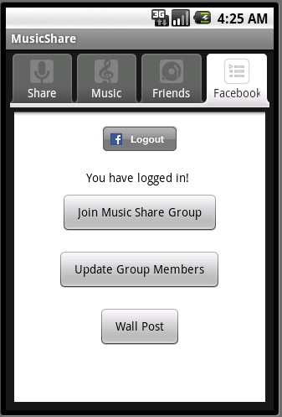
Application Interface - Facebook
Login Page
Main Page

Slide 6
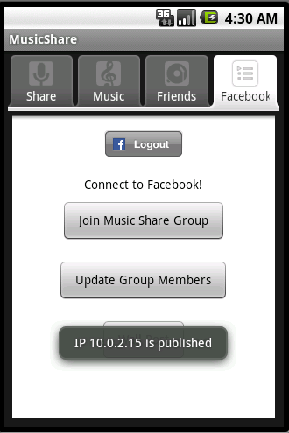
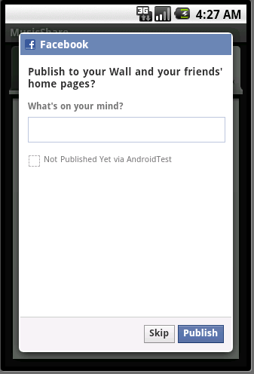
Application Interface - Facebook
Join Group and Publish IP
Wall Post

Slide 7
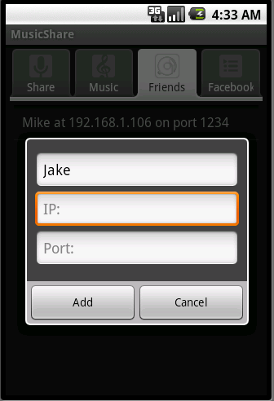
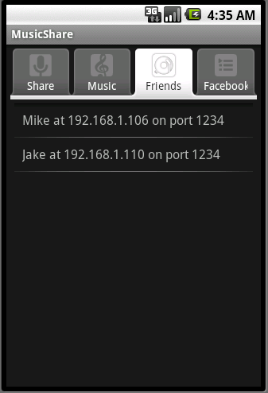
Application Interface - Friends
Add new friend
Friends list

Slide 8
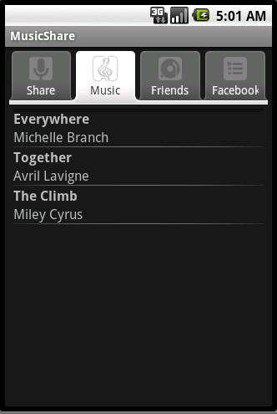
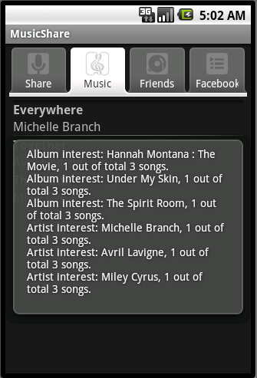
Application Interface - Music
Music List
Music Interest

Slide 9
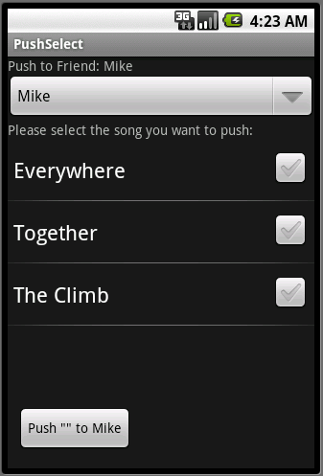
Application Interface - Share
Share tab
Push Music

Slide 10
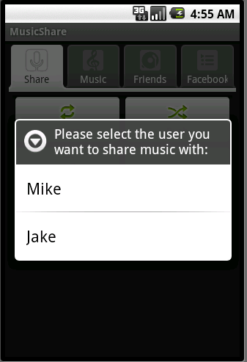
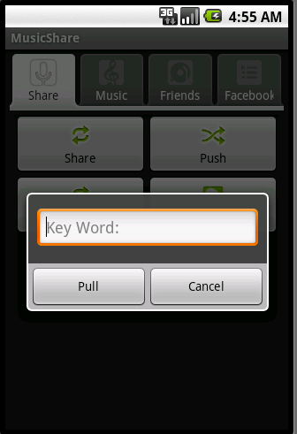
Application Interface - Share
Share Music
Pull Music

Slide 11
Key Technology - Facebook
1.Facebook use OAuth 2.o for authentication and authorization
2.Graph API and OLD REST API is used to interact with facebook
3.use “events.rsvp” method to join the music share group

Slide 12
Key Technology - Facebook
1. use “/EVENT_ID/attending” to get current available peers
2. use “users.setStatus” and “status.get” method to publish and retrieve IP

Slide 13
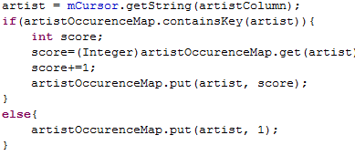
Key Technology - Music
1. Use managed cursor to query for all music in the external drive
2.Put the title and artist of each song in list view
3.Decide the interest of user based on the artist, album and genre info of the current music in the library

Slide 14
Key Technology - Push
1. Always get the duplicate songs before sending out
2.Inform user the final result in the dialog
3.Use handler to update push progress in the UI thread

Slide 15
Key Technology - Pull
1. Send pull request to all available user in the friends list iteratively
2.The user who receive such request will prepare all the songs that’s relevant, and send them back

Slide 16
Key Technology - Share
1. Both users will first exchange interest profile
2.Then the user who initialize the sharing will first send songs the other party is interested in
3.The other user will wait for this process to finish, and then do the same thing

Slide 17
Improvement over iShare
1.Two additional ways to share music
Push and Pull
2.Advanced music interest definition
Include Artist and Album other than Genre
3.Facebook module
Have a lot of potentials other than publish IP
4.Music List
Allow user to browse through music library

Slide 18
Future Work
Challenges: JmDNS
1.More Sophisticated interest definition
2.Facebook utilities expansion
3.Independent Activity for music play
4.Mode selection to give user choice to reject music

Slide 19
Thank you!

