Slide 1
Audio-Video
Conferencing
Submitted By:
Aayush Beri
Di Wen

Slide 2
Introduction
Library : Java Media Framework (JMF)
Protocol and System Design
Code Snippet
Simulation

Slide 3
Library : Java Media Framework (JMF)
Java Media Framework (JMF) is a java library that enables audio and video (time based media) to be added to Java Applications and Applets
Criticism : Cannot play MPEG-2, MPEG-4,Windows Media and other popular media types
Solution : Fobs4JMF library integrated with JMF

Slide 4
Protocol and System Design
Protocol used : Real-time Transport Protocol(RTP)
  It defines a standardized packet format for delivering audio and video
  Developed in 1996 by IETF
  Two ports need to specified for
    RTP : Always an event port; Carries media streams
    RTCP : Next higher odd number; Monitor quality of service

Slide 5
Protocol and System Design
System Design
  P2P : Peer to Peer Architecture
    Unicast & Multicast : Audio and Video
    RTP & JMF Send
    RTP & JMF Receive

Slide 6
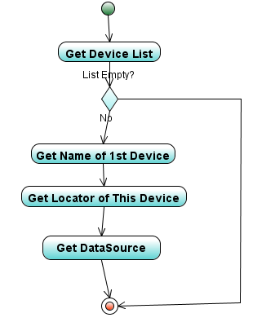
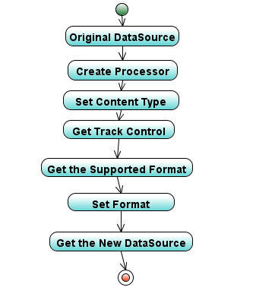
Capture Audio/Video Signals Process Audio/Video Signals

Slide 7
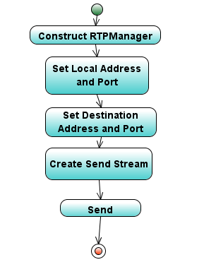
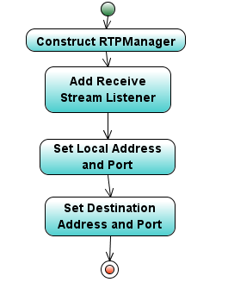
Send Audio/Video Signals Receive Audio/Video Signals
(STEP 1: Set Receive Stream Listener)

Slide 8
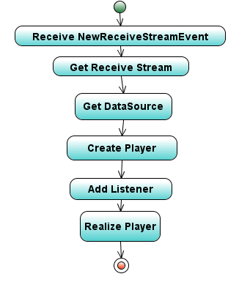
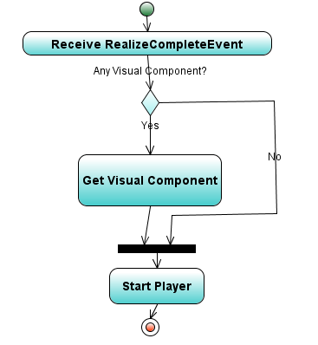
Receive Audio/Video Signals
(STEP 2: Receive Stream) (STEP 3: Start Player)

Slide 9
Lessons Learned & Future Plan
Application only runs in LAN (NAT Restrictions)
No text chat & admin control (Team Management Issues)
JMF is so NOT up-to-date (Format Issues)
Difficulties faced by VoIP Applications
Future Plan: Include :
  Stun servers and SIP (NAT)
  Text chat & Floor Control

