Slide 1
Do You See What I See (DYSWIS)
Aditya Muthyala (am3551)
School of Engineering and Applied Science
Columbia University, Fall 2011

Slide 2
Requirements
Wireless Network Diagnosis
Monitoring data and matching patterns
Peer Probing to conclude on the root cause of the issue

Slide 3
Challenges
Needed a rich and well maintained API to monitor the wireless metrics
Microsoft Native Wifi API was a solution
API supported only C/C++
JNI bridging used to exchange data to and from native code

Slide 4
Design
Monitor the wireless interface metrics
Transmitted frame counts
Bytes exchanged
Signal quality
Error counts
Exchange data with peers
Diagnosis Engine

Slide 5
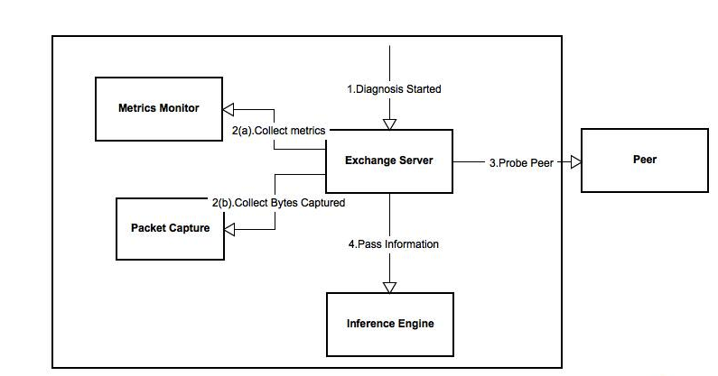
System Architecture

Slide 6
System Requirements
Native Wifi Api (Windows)
Windows 7/XP(SP3)

Slide 7
Implementation
Metrics Monitor
Collected from Native Wifi API by Microsoft
10 minute average stored at a time
Written in C++
Packet Capture
Used to monitor the number of bytes exchanged
Written in Java

Slide 8
Simulation and Testing

Slide 9
Challenges
Simulating real world scenarios is difficult
Tried to use network simulators
Some did not provide the metrics we require
Others concentrated on simulating mobility
No proper representation of results

Slide 10
Simulation Environment and metrics
Environment
Network nodes (laptops)
Network router
Metrics
Signal quality
Error counts/transmitted counts
Bytes exchanged

Slide 11
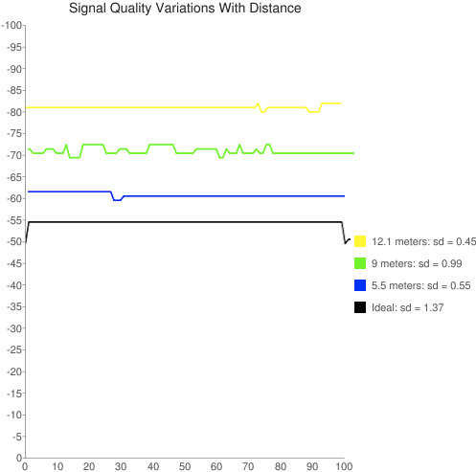
Simulation results
Signal Strength
Time Interval

Slide 12
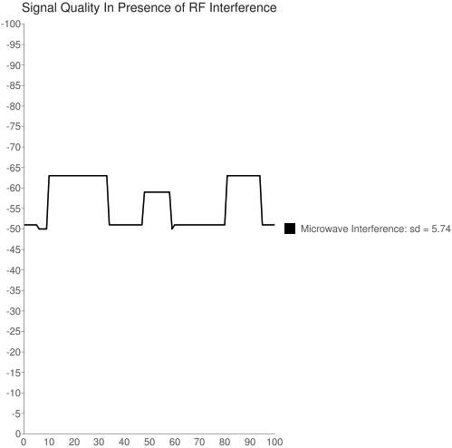
Signal Strength
Time Interval

Slide 13
Observations
Signal Quality remains constant for static environment
Signal quality variations are too high in case of RF interference
FCS grows linearly with time. No plausible conclusion reached
No threshold on bytes transferred

Slide 14
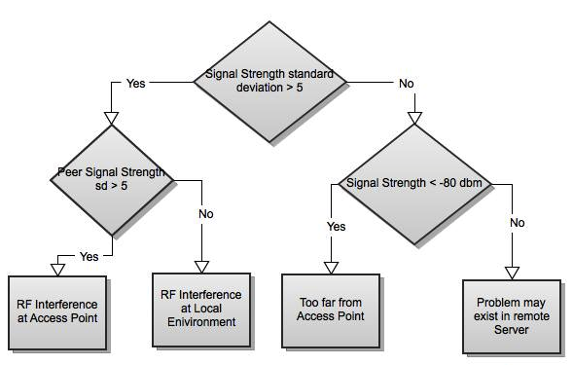
Algorithm

Slide 15
Future Work
Packet Capture from non participating nodes
Monitor Received Packet counts and FCS errors to diagnose Packet drops
Signal quality variations due to various RF interferences

