Slide 1
Networking as Civil Infrastructure: The Role of Policy and Economics
Henning Schulzrinne
(Columbia University)
50 Jahre KIT-Fakultät für Informatik
October 20, 2022

Slide 2
A retro-perspective into the future
Networking is really four fields
Networking is civil (infrastructure) engineering
We’re no longer “new” – adult hood (and middle age+) is painful
Standards make networking different – but the valley of death looms
The internet is no longer the great equalizer
Responsible AI → responsible networking
Networking is no longer the (PhD) student attractor
Internet literacy (not just skills) is our next challenge

Slide 3
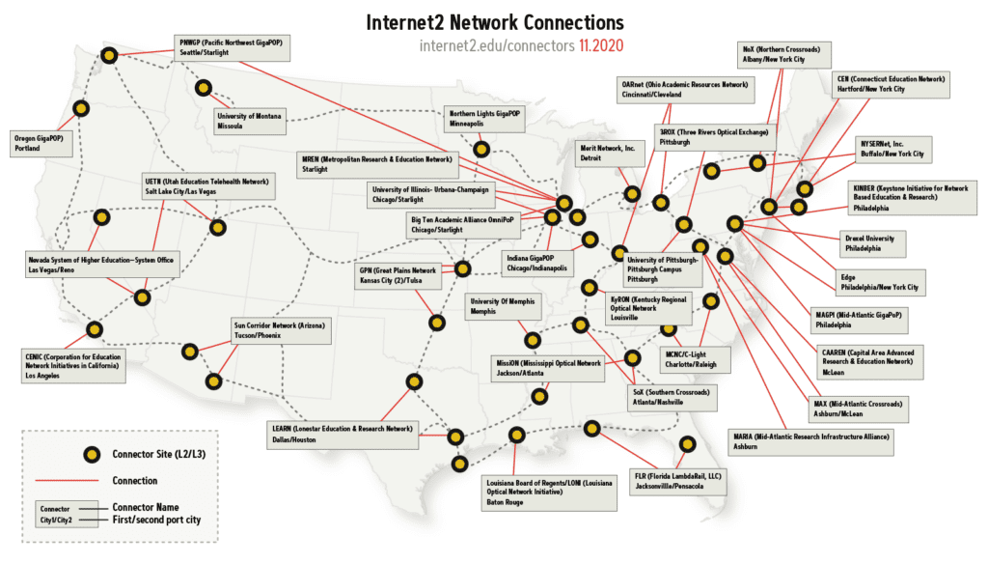
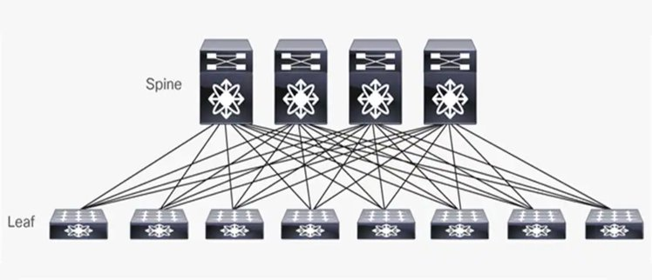
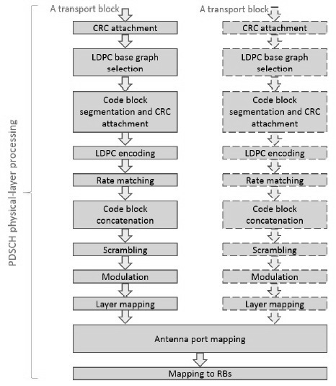
Networking has become (at least) four areas
PHY
sensing
Notes:
https://www.sdxcentral.com/networking/sdn/definitions/enterprise-data-center-networking/
https://wballiance.com/wp-content/uploads/2019/10/WBA-Wi-Fi-Sensing-paper.pdf

Slide 4
Networks as core civil infrastructure

Slide 5
Civil infrastructure systems involves the design, analysis and management of infrastructure that supports human activities, such as electric power, oil and gas, water and wastewater, communications, transportation and the buildings that make up urban and rural communities. These networks deliver essential services, provide shelter and support social interactions and economic development. They are society’s lifelines.
Notes:
https://ce.udel.edu/research/research-overview/transportation-engineering-and-civil-infrastructure-systems/

Slide 6
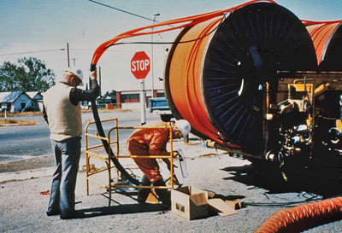
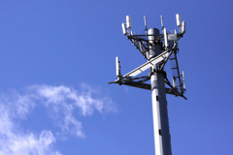
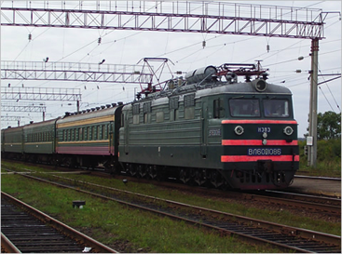
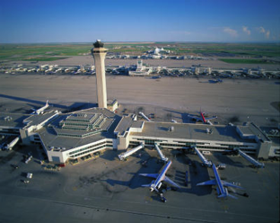
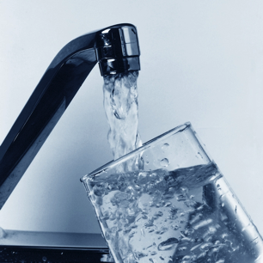
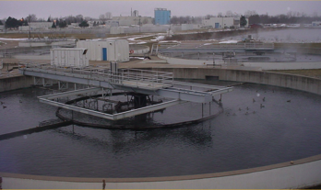
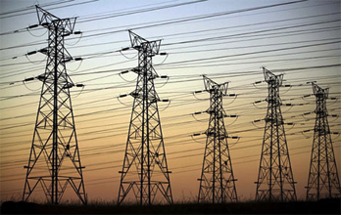
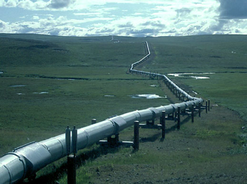
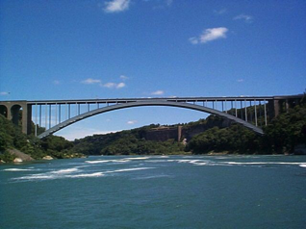
The great civil infrastructures
internet communications
Constructed over generations
Not replacement, but continual refurbishment
Interdependent components with well-defined interfaces
High initial cost, but operating cost dominates
transportation
water
energy

Slide 7
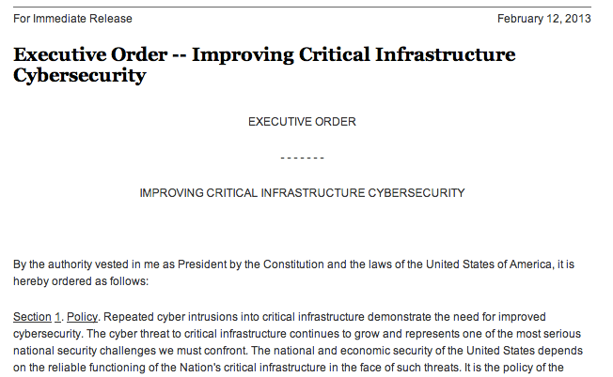
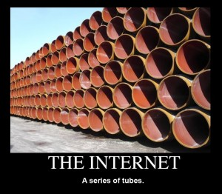
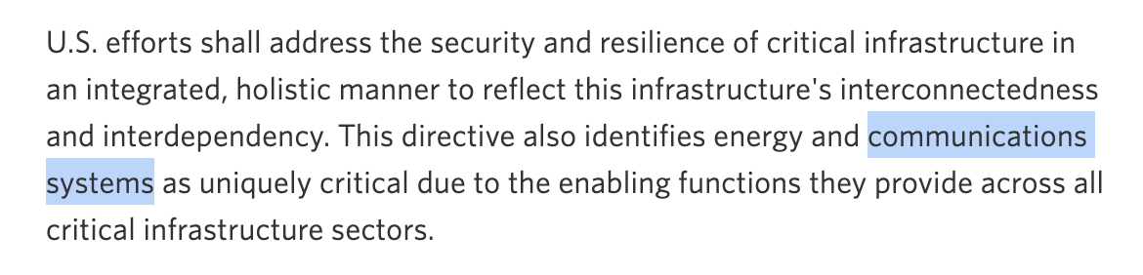
The Internet as core civil infrastructure
Ted Stevens (R-AK, 2006)
Notes:
https://obamawhitehouse.archives.gov/the-press-office/2013/02/12/presidential-policy-directive-critical-infrastructure-security-and-resil

Slide 8
Interdependencies with other lifelines
outside plant
Trans
recovery coordination
control
Water
CO & data centers
flooding
shared
RoW
Internet
shared
poles
towers & antennas
fuel
parts
Power
Pipelines

Slide 9
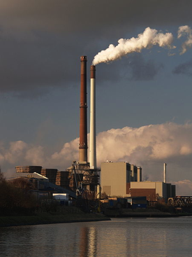
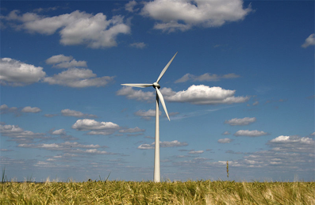
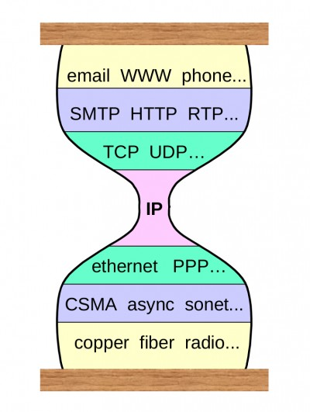
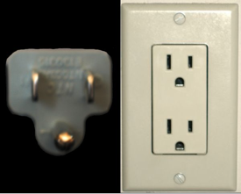

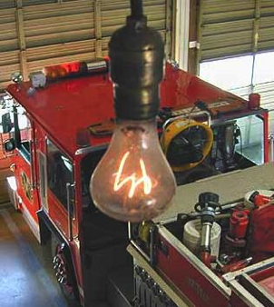

Interfaces: Energy
110/220V
NEMA 1-15R
~1915 (2 prong)
1901
http://www.centennialbulb.org/cam.htm
Notes:
http://www.iec.ch/worldplugs/history.htm
https://rustbeltanthro.wordpress.com/2015/04/02/mapping-electrical-sockets-and-plugs-a-history-of-colonialism-war-and-non-globalization/
https://www.oilshell.org/blog/2022/02/diagrams.html
http://www.mosaicshades.com/antique2005/sockets/

Slide 10
Civil engineers care a lot about reliability & costs

Slide 11
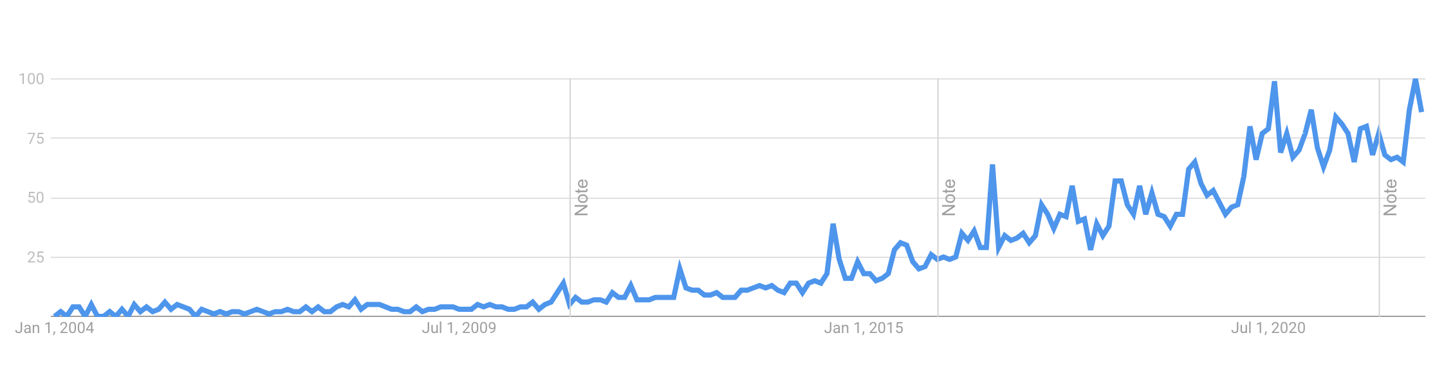
”Internet outage” trends
Notes:
https://trends.google.com/trends/explore?date=all&geo=US&q=internet%20outage

Slide 12
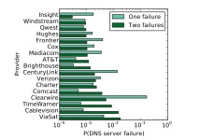
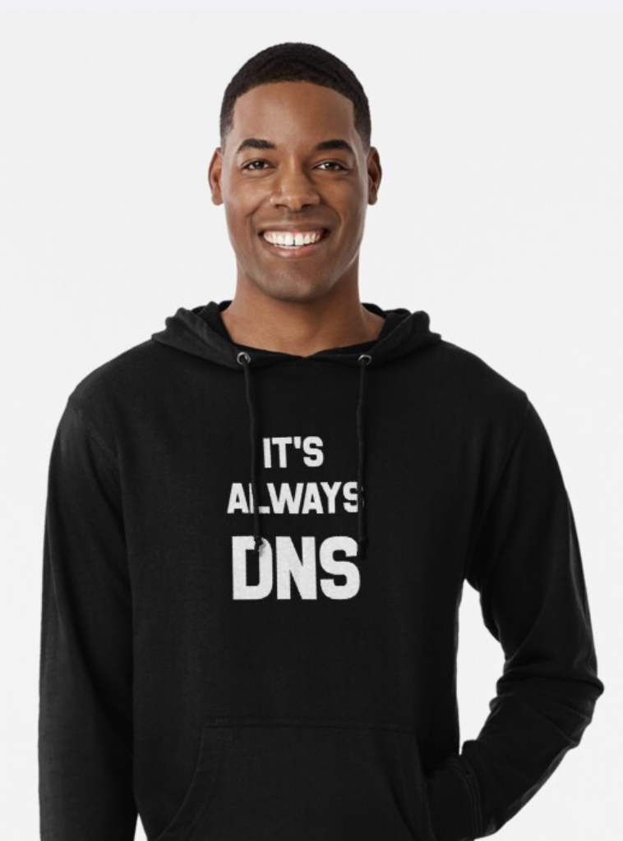
Still working on those 5 nines – and we need to keep trying!
Bischof, 2018
Notes:
https://dx.doi.org/10.2139/ssrn.3121942

Slide 13
Security ∈ Reliability
Many security problems manifest themselves as reliability problems
→ system does not perform to specification
including confidentiality and (data) integrity
e.g., ransomware impacts are largely business disruption impacts

Slide 14
Like civil engineers, we rely on standards or: implementors (mostly) don’t read papers, they read standards or: impact ≠ citation counts

Slide 15
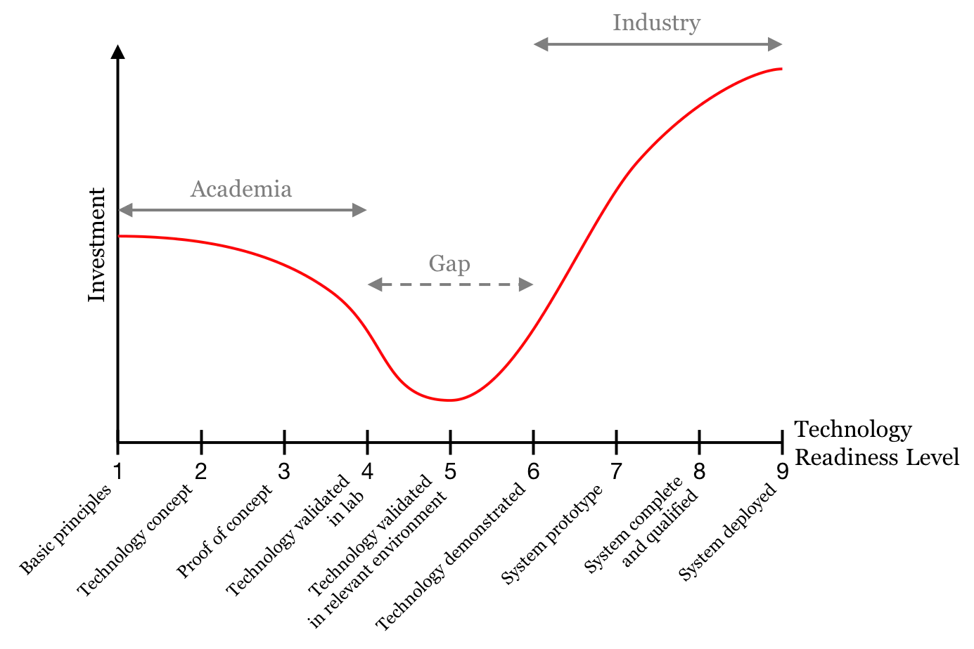
Standards bridge the valley of death
standards
”rough consensus and running code”
PwC
Notes:
https://www.pwc.no/en/bridging-the-technological-valley-of-death.html

Slide 16
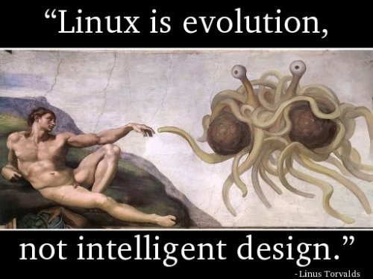
Nobody beyond conference TPCs cares about the Internet because of its simplicity and mathematical elegance
(and if you do, you may want to participate in recent standards meetings…)
The internet

Slide 17
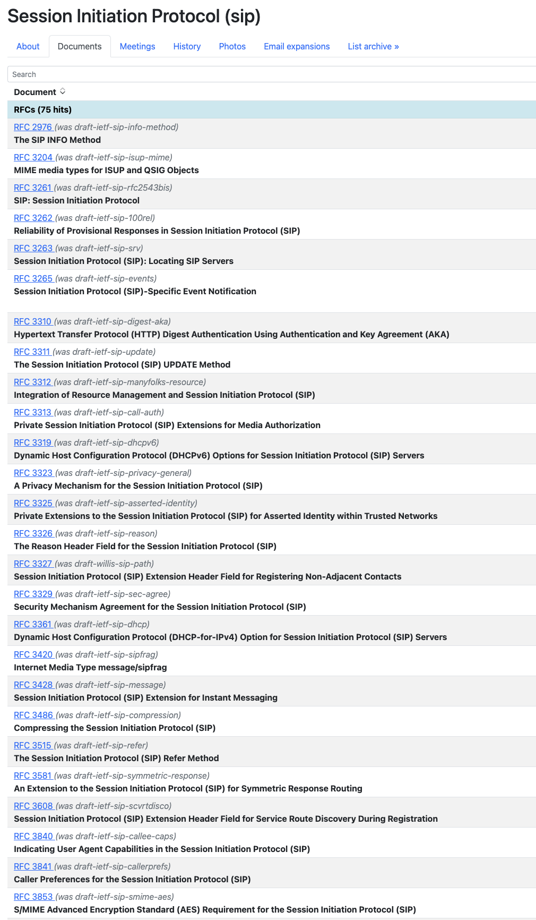
Standards are eco-systems, not one document
What students see:
What implementors see:
“SMTP, defined in RFC 5321, is at the heart of … mail.” (Kurose/Ross)

Slide 18
We are no longer the young crowd

Slide 19
Evolution of networking
Can you do video over the Internet?
At decent quality?
My job depends on Zoom!
How much does it cost?
On my phone?
1990s
2000s
2010s
2022

Slide 20

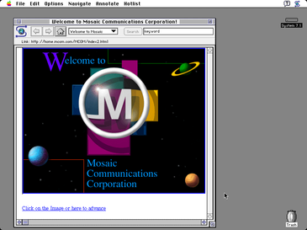
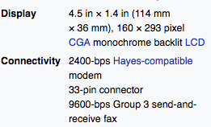
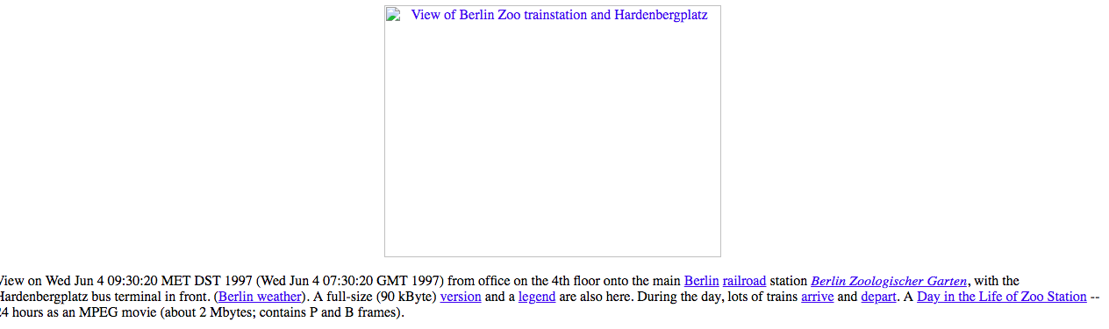
~30 years ago
August 1993
IBM Simon (announced 11/1993)
Mosaic 1.0: November 1993
Euro-ISDN: 1994
DSL patent: 1990
DOCSIS started 1995
DSL in Germany: 7/1999
GMD webcam (1997)

Slide 21
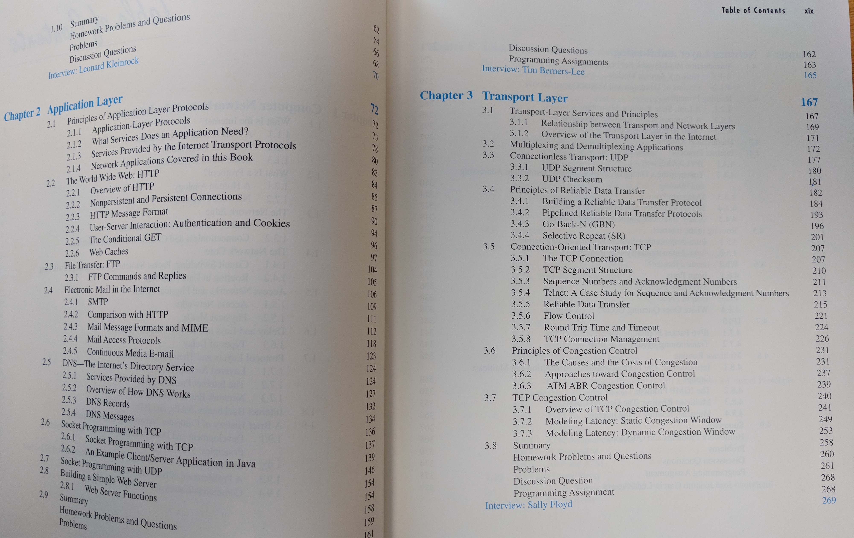
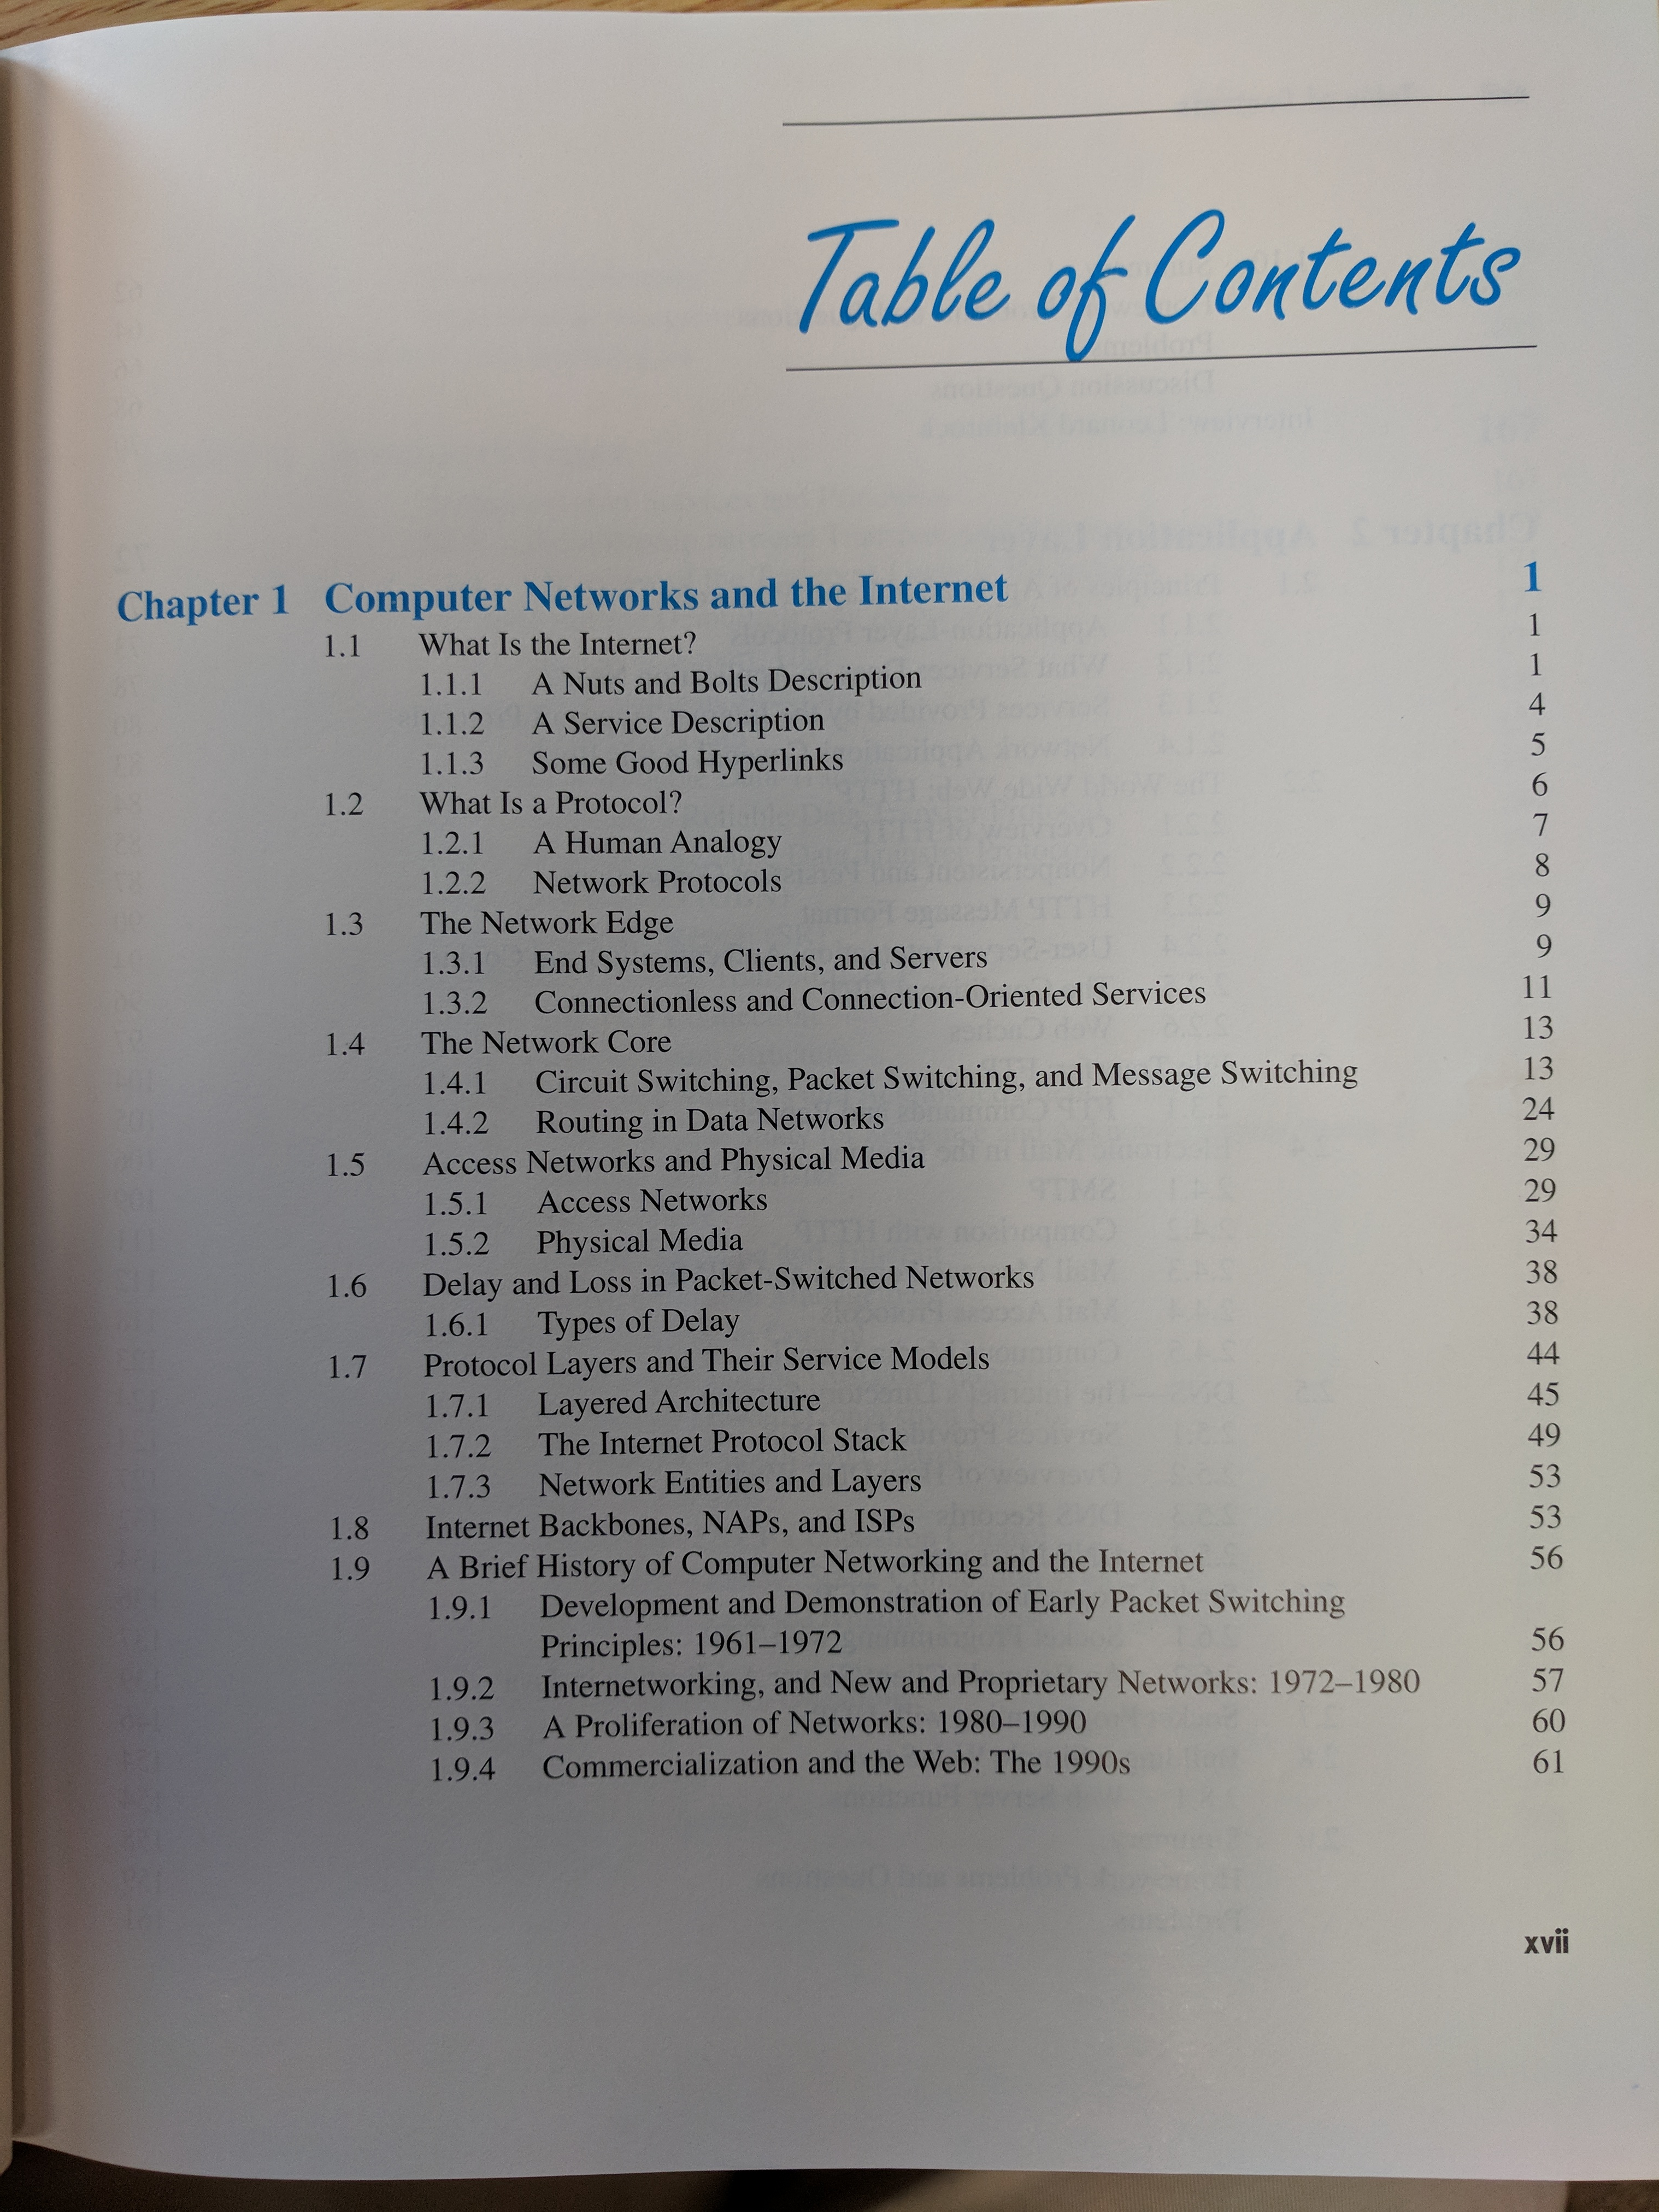
Kurose/Ross, 2000

Slide 22
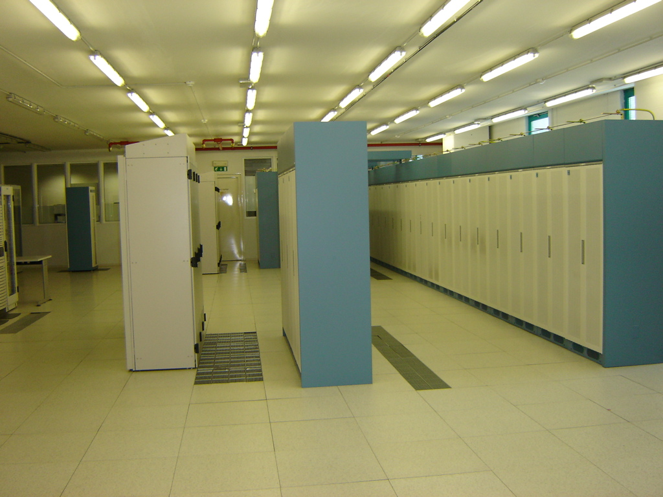
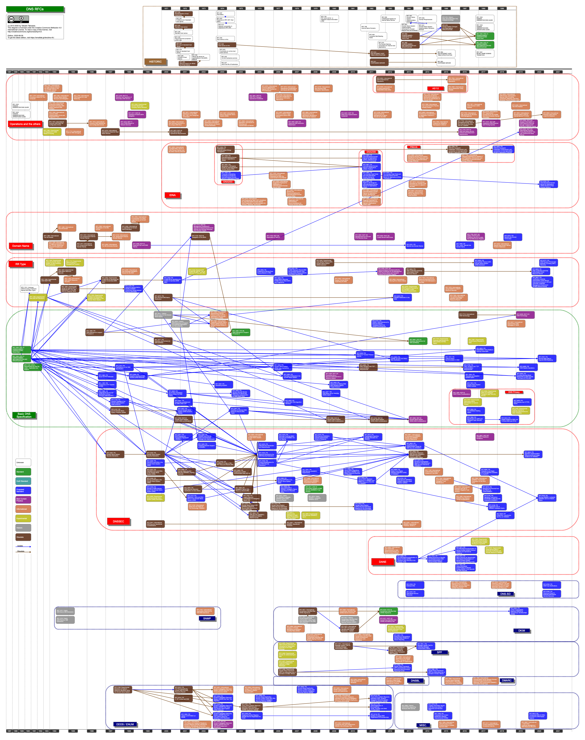
We’ve met complexity, and it is us
“In fact, the code complexity of an IP router now rivals that of a 5ESS telephony switch [app. 5-10 million lines of code].” (Ramjee, 2016)
RFC 1034: 54 pages (1987)
Quagga: 226,048 CLOC
Notes:
https://www.microsoft.com/en-us/research/wp-content/uploads/2016/11/comsware.pdf

Slide 23
The internet has scaled – to hyper-scalers

Slide 24
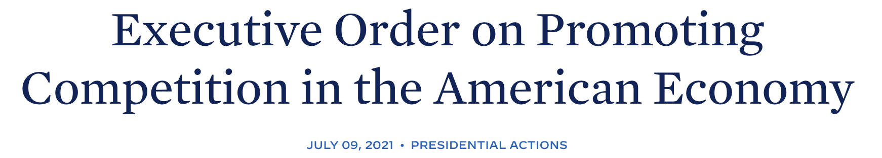
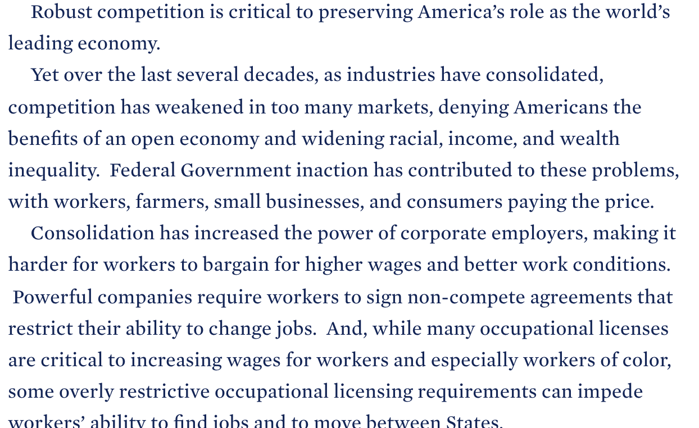
Centralization is not just an internet concern
https://www.whitehouse.gov/briefing-room/presidential-actions/2021/07/09/executive-order-on-promoting-competition-in-the-american-economy/

Slide 25
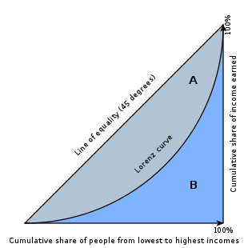
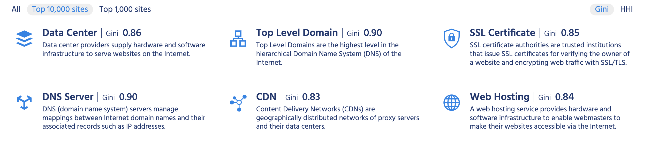
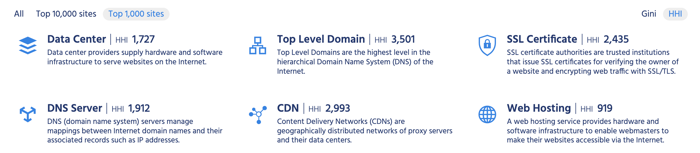
Increasing concentration
Highly concentrated: HHI > 1800
Σ market share²
https://pulse.internetsociety.org/concentration

Slide 26
Classical consequences of market concentration
Consequence | Non-networking example | Networking example
Cost to consumers | Airline pricing | Platform charge for ads, app store Privacy “cost”
Lack of innovation | (US) railroads | Social media
Lack of resiliency | Container shipping | DNS (Dyn), CDNs (Fastly), Facebook outage
Monopsony | Lower wages for nurses | Lower prices for news content?
”Quality of service” | Beer? | Social media
Notes:
https://www.nytimes.com/2020/09/02/business/inflation-worse-pandemic-coronavirus.html

Slide 27
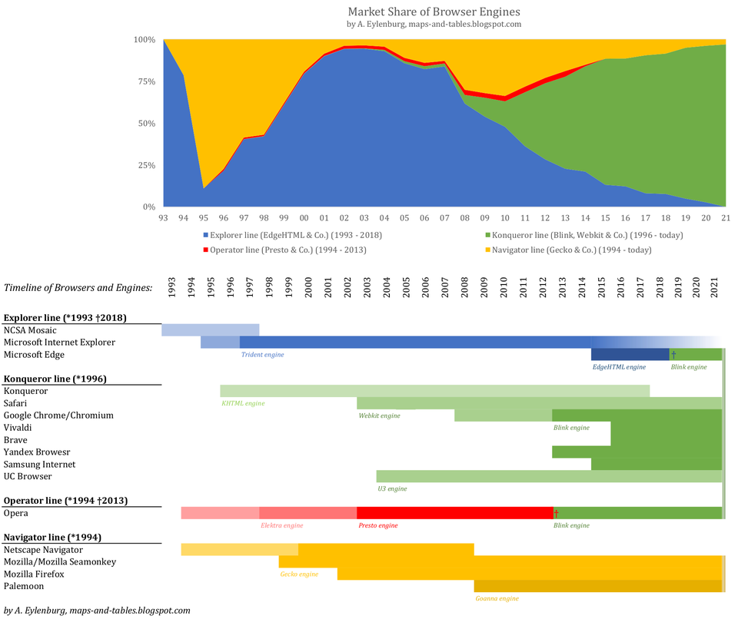
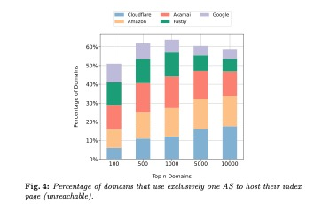
Web (browsers): lack of software diversity
Wang, et al: “A First Look at the Consolidation of DNS and Web Hosting Providers”, Oct. 2021

Slide 28
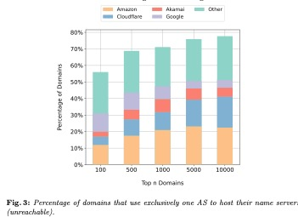
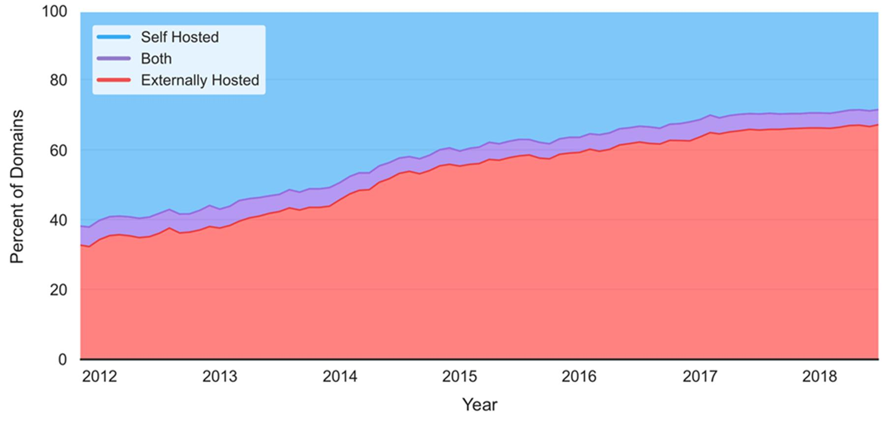
DNS: lack of operational diversity
Wang, et al: “A First Look at the Consolidation of DNS and Web Hosting Providers”, Oct. 2021
https://www.lawfareblog.com/internet-entropy
Bates, et al: “Evidence of Decreasing Internet Entropy: The Lack of Redundancy in DNS Resolution by Major Websites and Services”, Journal of Quantitative Description: Digital Media 1(2021)

Slide 29
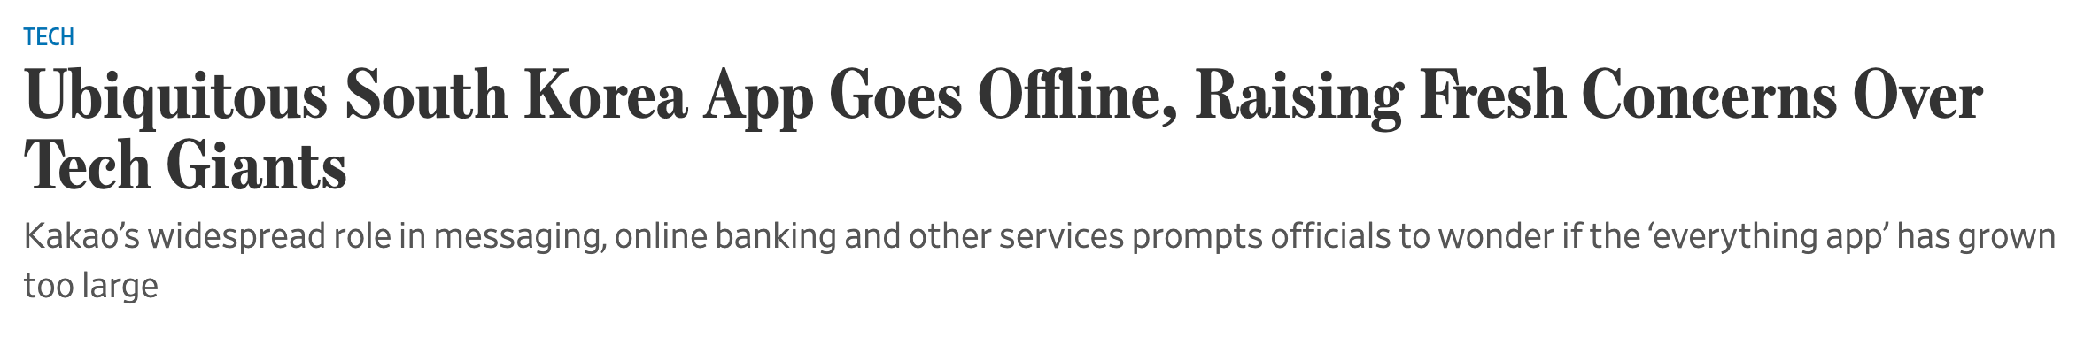
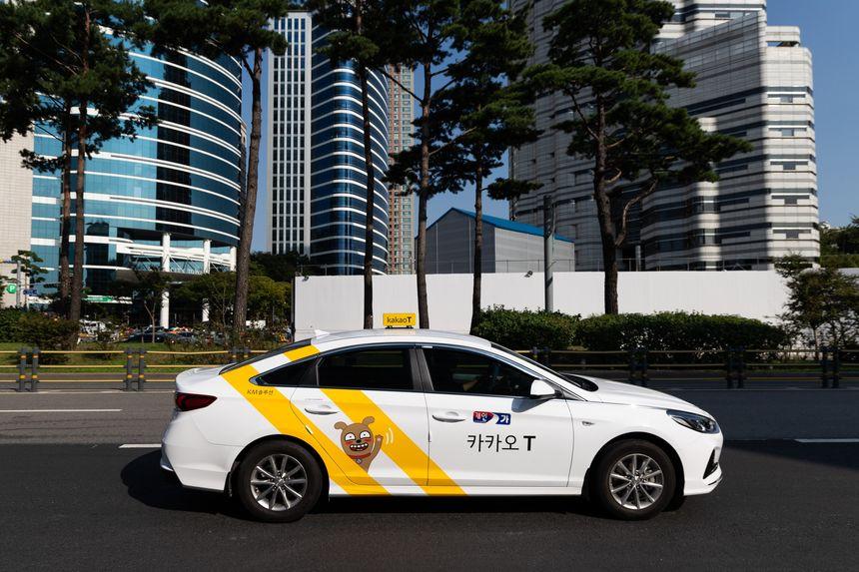
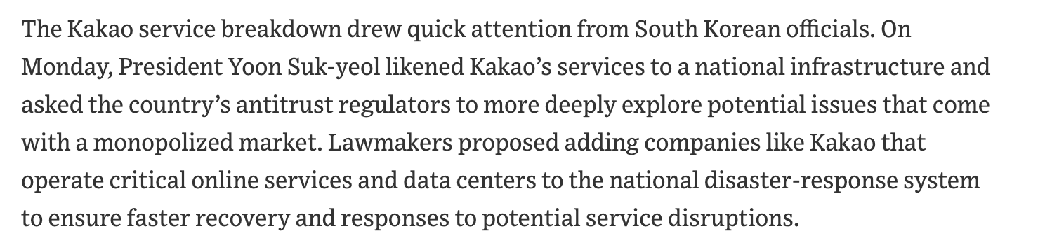
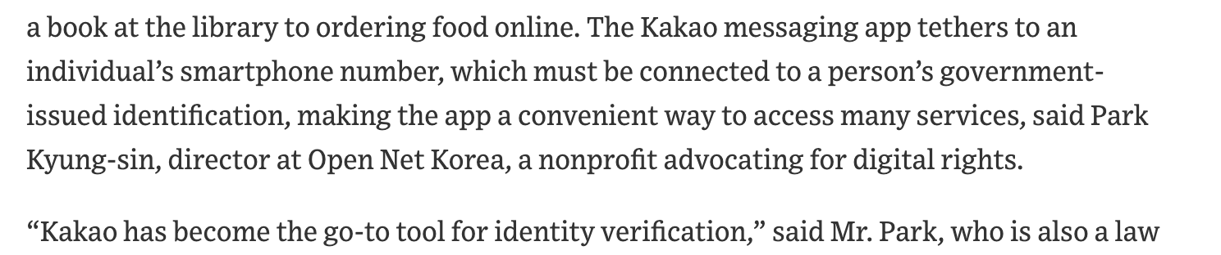
A web app is now “national infrastructure”
Oct. 17, 2022 (WSJ)
Notes:
https://www.wsj.com/articles/ubiquitous-south-korea-app-goes-offline-raising-fresh-concerns-over-tech-giants-11666009504

Slide 30
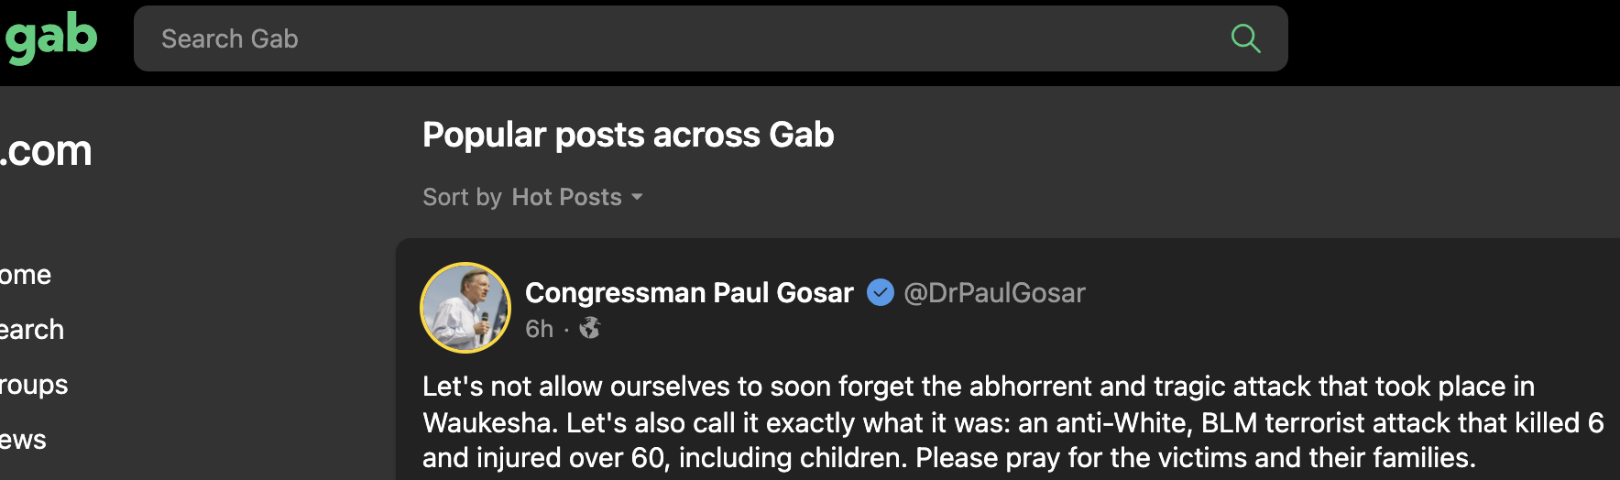

Competition does not guarantee good results
A fully competitive service provision may discourage investment in R&D
Many bad actors are small
  Robocalls are not generated by AT&T and Comcast
  Spam is not generated by Google (directly) or Facebook
  Most of the fencing of stolen goods is done by independent sellers
  Some of the competitive social networks are hardly beacons of objectivity

Slide 31
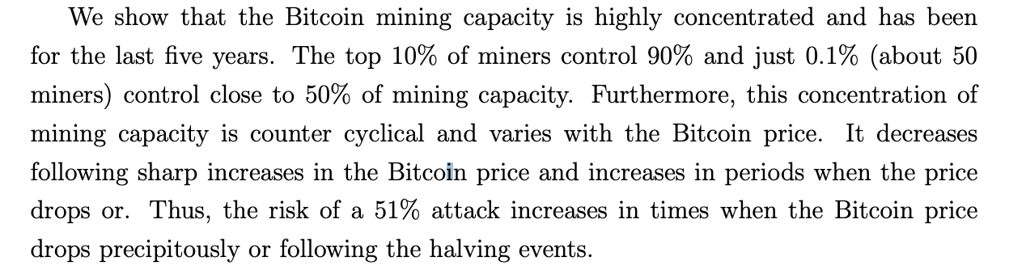
But Bitcoin (or blockchain) is different!
Blockchain Analysis of the Bitcoin Market
Igor Makarov and Antoinette Schoar
NBER Working Paper No. 29396
October 2021
Notes:
https://www.nber.org/system/files/working_papers/w29396/w29396.pdf

Slide 32
Relying on technology to achieve decentralization is likely a distraction or diversion
See Web3

Slide 33
Why do we believe in technology solutions?
No hard choices, just good engineering and perfect outcomes!
Solve once & done!
Clever, mysterious algorithms!
  Chord, Paxos, Ethereum
We can keep the lawyers out!
We don’t have to deal with messy human systems!
Technology is necessary, but usually the easier part

Slide 34

Governance matters
Large (internet) entities are often “affected with the public interest”
Tools: regulation (common carrier, safety, …) & governance
  learn from telecom regulation experience
Governance examples:
  Facebook Oversight Board
  Rural electric cooperatives (members)
  Europe corporate governance (employee board representatives)
  B corporations (shareholders)

Slide 35
With impact comes responsibility

Slide 36
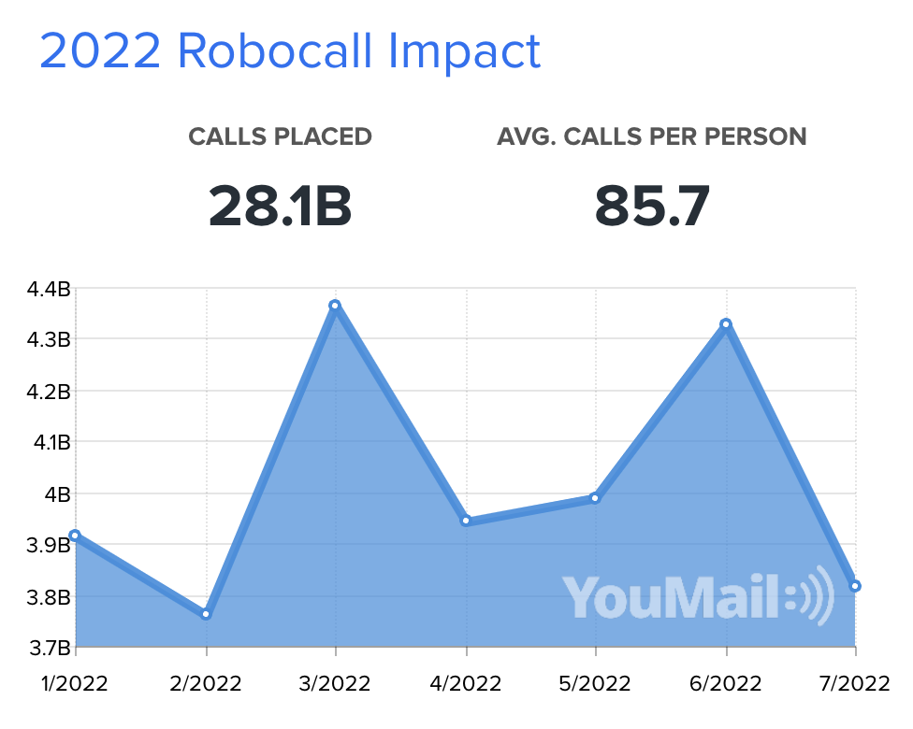
“100% of robocalls use the protocol I worked on”
Technology
Law & regulation
Operations
Law enforcement
STIR/SHAKEN
TRACED Act
Robocall Mitigation DB
Traceback
Traceback
State AGs
KYC
Mandate caller auth.
Analytics
too cheap to meter
the death of
distance
unregulated
(not PSTN)
open-source
software
programmable
low barriers
to entry
incremental, not done yet!
Notes:
https://robocallindex.com/history/time

Slide 37



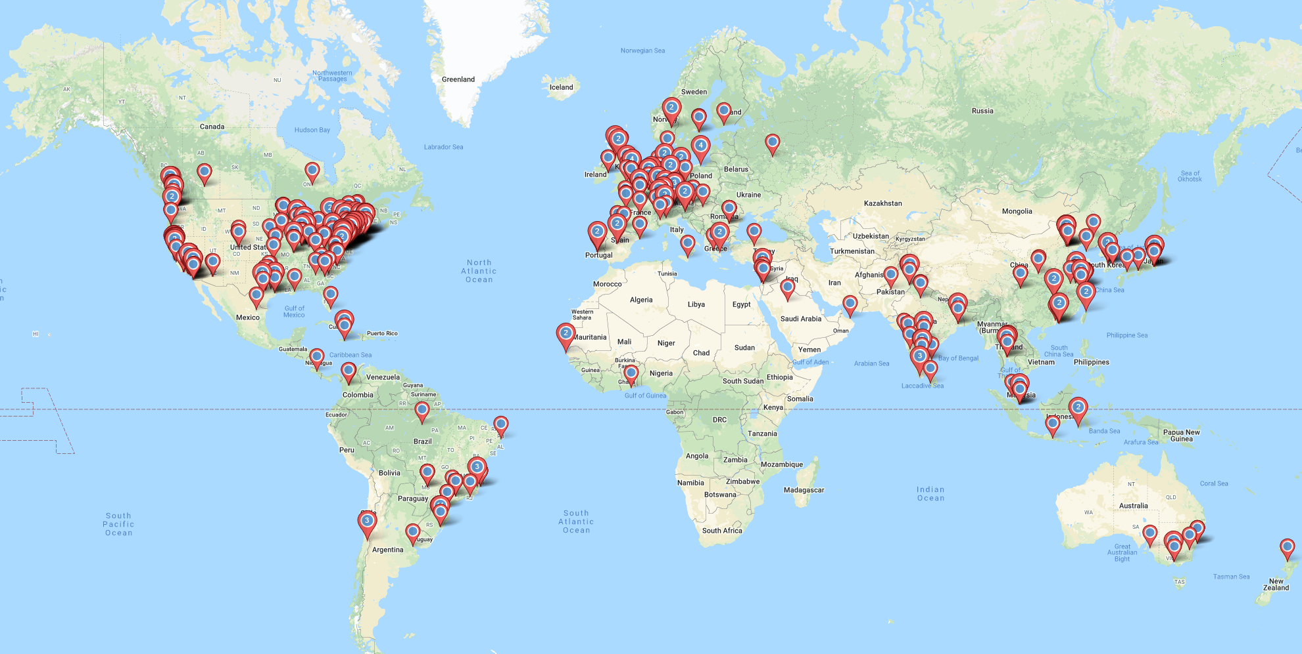

The good, the bad & the ugly – we can’t just take credit for the first
Bad
but improvable
The good
Wicked problems
unwanted communications
DDOS
CIA violations
➔ bad actors are the “other”
lack of reliability
lack of usability
We’ve met the problem – and they sponsor our conferences and hire our students!
deindustrialization
death of Main Street
Notes:
https://www.tandfonline.com/doi/pdf/10.1080/26883597.2020.1801331

Slide 38



What if you build a technology and nobody (except VCs) want it?
If Sidewalk’s Quayside failure taught us anything, it’s that these technologies need to respond better to human needs.
Sure, the tech industry has made life more productive over the past two decades, but has it made it better?
Notes:
https://www.technologyreview.com/2022/06/29/1054005/toronto-kill-the-smart-city/
https://arstechnica.com/cars/2022/08/v2x-is-finally-dead-as-court-refuses-to-stop-fccs-5-9-ghz-reallocation/
https://www.youtube.com/watch?v=QEJ9HrZq7Ro

Slide 39

“We’re just designing concrete structures”
Notes:
https://www.history.com/news/interstate-highway-system-infrastructure-construction-segregation

Slide 40
But we’re just building tools!
"Once the rockets are up,
who cares where they come down?
That's not my department,"
says Wernher von Braun. (Tom Lehrer)
The but-for test is a test commonly used in both tort law and criminal law to determine actual causation. The test asks, "but for the existence of X, would Y have occurred?” (Cornell LII)
The internet is not just the telephone network with packets
any (digital) content
ubiquity in time & space
amplification: one-to-many & any-to-one
generality
programmability & automation
international
Notes:
https://www.law.cornell.edu/wex/but-for_test

Slide 41

Individualized ethics falls short
ACM Code of Ethics: “Computing professionals should consider whether the results of their efforts will respect diversity, will be used in socially responsible ways, will meet social needs, and will be broadly accessible. They are encouraged to actively contribute to society by engaging in pro bono or volunteer work that benefits the public good.”
Unbiased ML for content recommendation does not protect democracy.
Encryption does not mean privacy.
Accessible systems may not mean inclusion.
Test your ML system for bias.
Use encryption in your protocols.
Make systems accessible.
“nerd harder”

Slide 42
Civil Engineering Ethics (ASCE) – [Society]
“first and foremost, protect the health, safety, and welfare of the public;
enhance the quality of life for humanity;
express professional opinions truthfully and only when founded on adequate knowledge and honest conviction;
endeavor to be of service in civic affairs;
acknowledge the diverse historical, social, and cultural needs of the community, and incorporate these considerations in their work;
consider the capabilities, limitations, and implications of current and emerging technologies when part of their work; and
report misconduct to the appropriate authorities where necessary to protect the health, safety, and welfare of the public.”

Slide 43

Responsible AI → responsible networking
Robust ✅
Ethical ✅
Abuse-resistant?
Responsive to public policy?
Google
Responsible AI ensures that AI and machine learning (ML) models are Robust, Explainable, Ethical and Efficient. (FICO)

Slide 44
The next generation network(ers)

Slide 45
Networking: now dominated by ML
CRA Taulbee Surveys of
PhD-granting CS & CE departments in US & Canada
Do we know why?
“petroleum engineering”
“boooring”
“no jobs”
< 2008 combines OS & networking
https://cra.org/resources/taulbee-survey/
Notes:
https://cra.org/resources/taulbee-survey/

Slide 46
The faculty pipeline is drying up
171 departments
4 tenure-track faculty hires

Slide 47
2022 Columbia University CS MS student tracks
N=1146

Slide 48
Infrastructure is not a hot subject
Today’s Power Engineering Shortage – An Alarming Problem With a Powerful Upside (2008)
“77% of energy companies find it difficult to hire qualified employees.”
“There has been a decline in power engineering programs at universities over the past two decades; the current estimate is less than 30 programs in the United States and about 75 programs worldwide.” (2008)
Notes:
https://cdn.selinc.com/assets/Literature/Publications/Technical%20Papers/6303_TodaysEngineeringShortage_JP_20071026_Web.pdf?v=20151202-215825
https://today.rowan.edu/news/2021/10/rowan-developing-new-power-engineering-program.html
https://www.energy.gov/sites/prod/files/oeprod/DocumentsandMedia/Workforce_Trends_Report_090706_FINAL.pdf

Slide 49
Few(er) students may want to do networking research
All* students need to understand networks
Current: how does congestion control work?
  few students take the quad: OS, networks, distributed systems, security
Future: how can I build scalable, reliable and secure services?
  Do all CS students need to know how BGP and TCP Reno work?
Current: digital & computer literacy
  “the ability to use information and communication technologies to find, evaluate, create, and communicate information, requiring both cognitive and technical skills.” (ALA)
Future: internet literacy
  How does the internet function? Who governs that function? Who can change it?
  How does digital advertising work?
  What is privacy? Is it the same as encryption?
  What are platforms? What is common carriage? What is Section 230?

Slide 50



Slide 51
The CS systems disciplines are changing
Talked about networks, but applies (mostly) to OS and SE
Critical infrastructure, with emphasis on reliability (incl. security)
Performance matters, but often cheaper than reliability
Requires mindset of a civil engineer, not a novelty seeker
Knowledge decay rate is also less
Systems approach to ethics, not component
Need better interaction with governments

