Slide 1
Scaling networks up and down: new network architectures for 6G
This material is based upon work supported by the National Science Foundation under Grant No. 1932418. Any opinions, findings, and conclusions or recommendations expressed in this material are those of the author(s) and do not necessarily reflect the views of the National Science Foundation.
Henning Schulzrinne
Columbia University

Slide 2



Classical ecological niches
pairing
profiles
mesh
low energy
smartphones
international roaming
voice
IoT WAN
laptops
Wi-Fi offload
voice
mobility
international roaming
speed
authentication
peripherals
lowest-end
devices

Slide 3
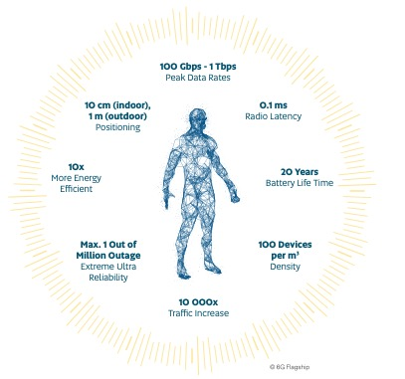
Classical requirements pyramid
mostly PHY requirements!
Notes:
http://jultika.oulu.fi/Record/isbn978-952-62-2354-4

Slide 4
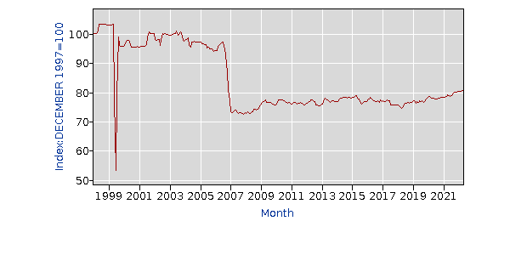
The most important metric is missing!
average: 500 GB/month
➔ $0.12/GB
BLS data (Internet services and electronic information providers)
Notes:
https://data.bls.gov/timeseries/CUUR0000SEEE03
https://openvault.com/ovbi-2-tb-usage-growth-surging-as-subscriber-speeds-increase/

Slide 5
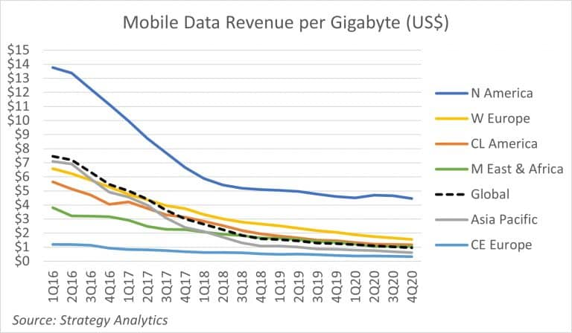


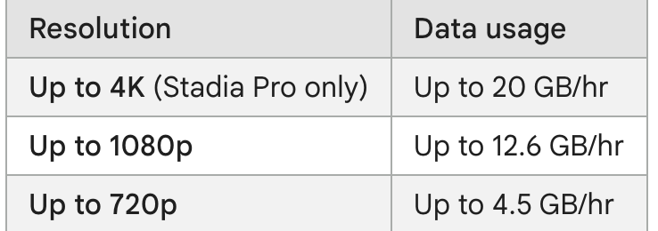
Without cost (and price) decrease, no advanced applications
➔ The key performance metric is $/GB (and maybe $/km² coverage)
Notes:
https://support.google.com/stadia/answer/9607891?hl=en
https://www.telecompetitor.com/report-mobile-revenue-per-gigabyte-is-under-1/

Slide 6
Generational surprises
Generation | Expectation | Surprise | Cost per GB
0G (landline) | voice | fax & modem
1G | corporate limousine | eavesdropping
2G | better voice quality (“digital!”) | SMS | $1000
3G | WAP | web | $100
4G | IMS | YouTube, WhatsApp, notifications | $10
5G | IoT (low latency) | FWA | $1?
underestimated cost and fixed-equivalence as drivers
are the even generations the successful ones?

Slide 7
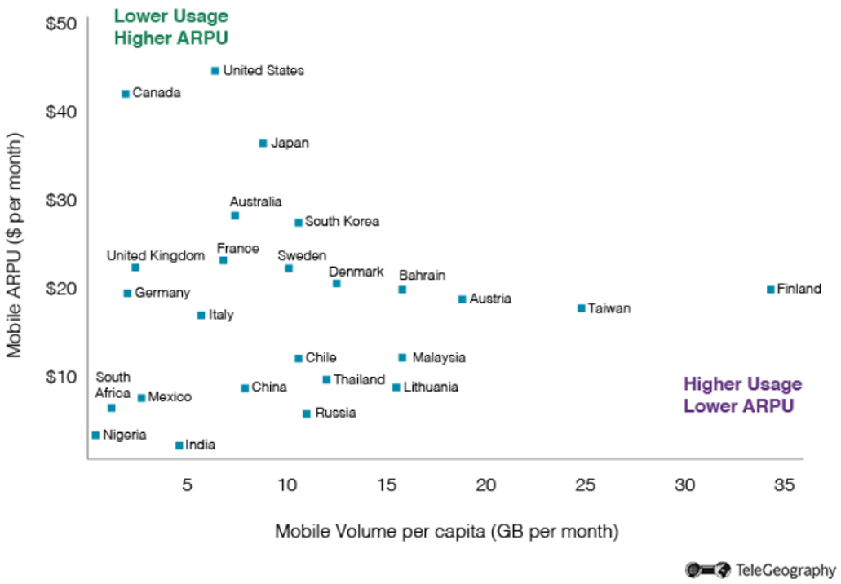
Network cost and price are highly variable
avg. about 5.1 GB/month
T-Mobile: 10 GB tethering
March 2020
Notes:
https://451research.com/blog/1662-featured-data-1

Slide 8
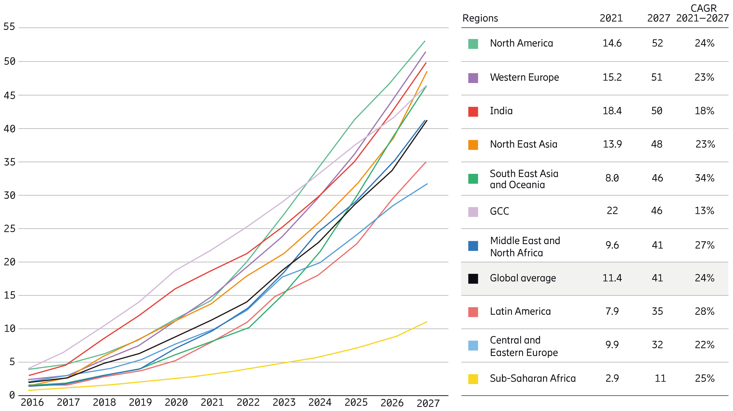
Mobile data usage
Ericsson Mobility Report Nov. 2021
US ARPU (2022) = $35
➔ $2.40/GB
~20 times more expensive per GB than home (“Wi-Fi”)
Notes:
https://www.ericsson.com/en/reports-and-papers/mobility-report/dataforecasts/mobile-traffic-forecast

Slide 9

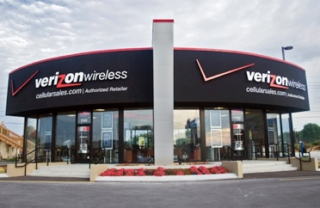
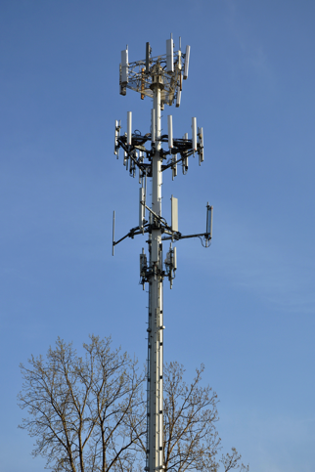
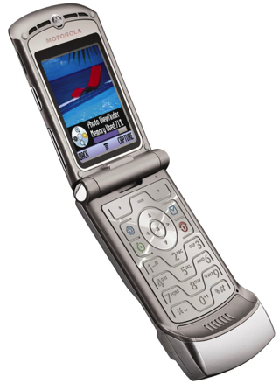
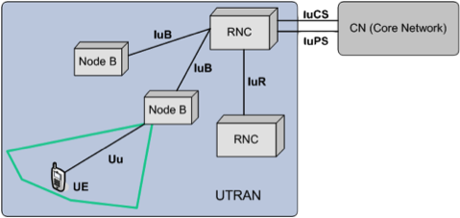
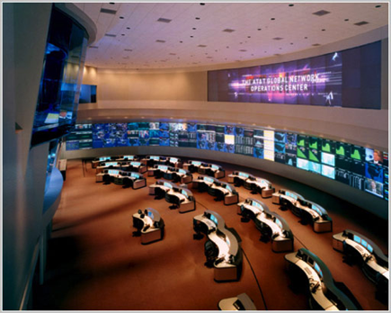
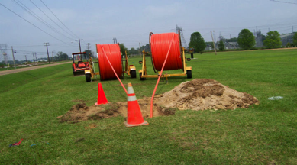
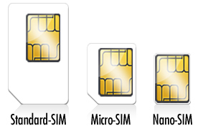
Networks 1G through 4Gish
national carrier
one subscriber,
one phone,
one provider

Slide 10




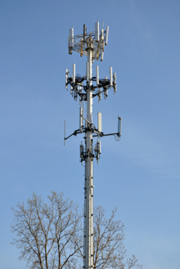
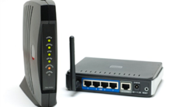
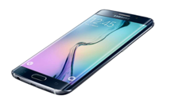

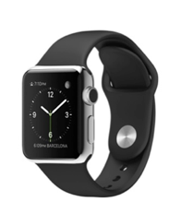
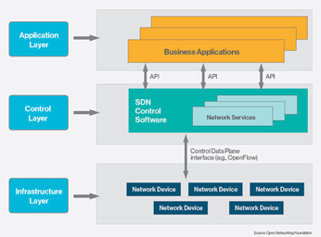


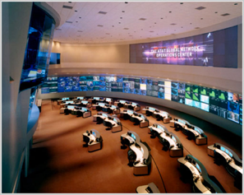


What exactly is a carrier?
Spectrum DB
Spectrum DB
40k towers each (US)
Level3
Cogent
LTE-U
802.11n
LTE

Slide 11
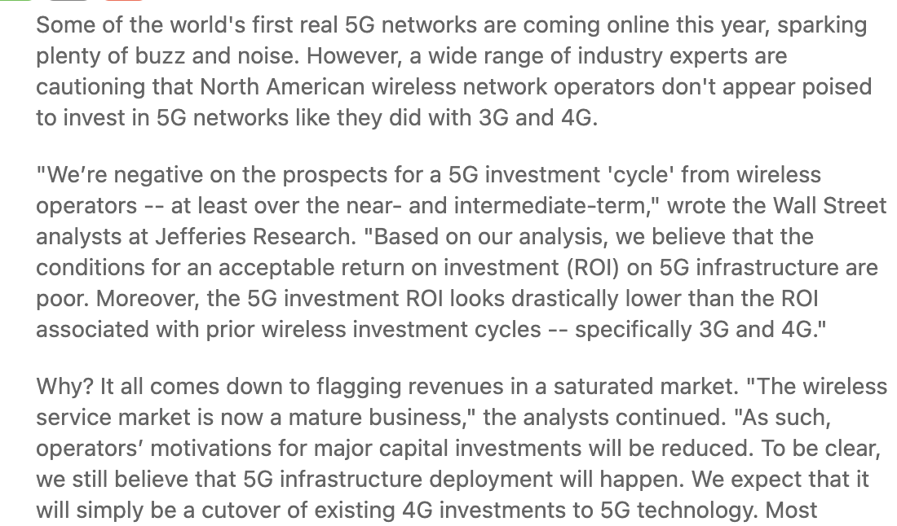
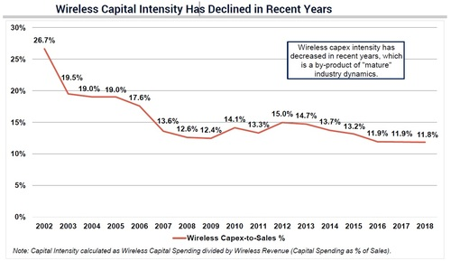
Investment incentives for 5G are modest – are they going to be better for 6G?
Notes:
https://www.lightreading.com/mobile/5g/a-big-5g-investment-cycle-dont-hold-your-breath/d/d-id/751698

Slide 12
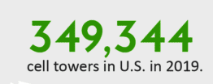
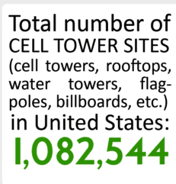
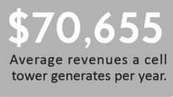
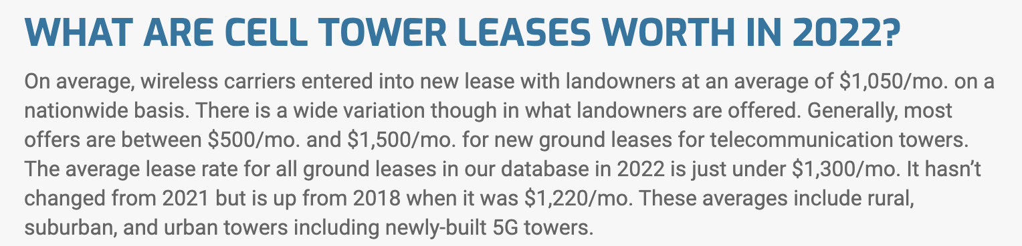
Cell towers as cost driver (or revenue source)
cellular revenue per cell site:
$190B US total → $175k
* Cost does not include radio equipment and backhaul!
https://www.celltowerleaseexperts.com/cell-tower-lease-news/cell-tower-industry-facts-figures-2016

Slide 13
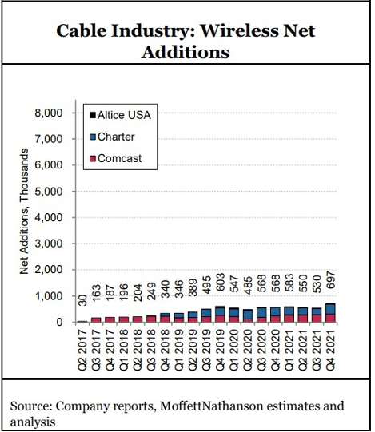
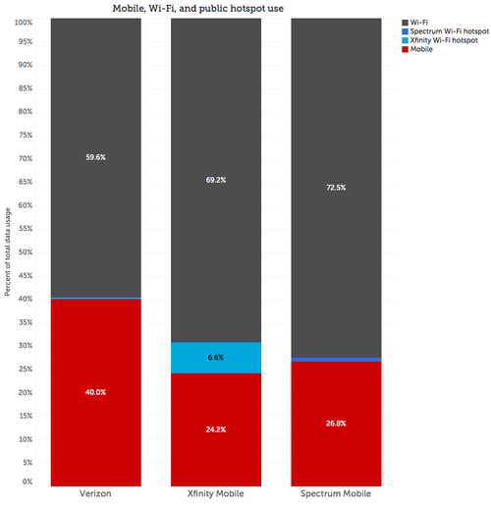
New operator models – cable (HFC) industry
All major US cable operators are offering cellular service
hybrid model:
MVNO + Wi-Fi + CBRS
Comcast | 4M
Charter | 3.56 M
Altice | 186k
LightReading, 3/22
LightReading, 7/19
Notes:
https://www.lightreading.com/cable/cable-wi-fi/an-inside-look-at-cables-mvno-business-model/d/d-id/752938
https://www.lightreading.com/cable-tech/us-cable-holds-steady-with-29-of-mobile-adds-in-q4/d/d-id/776127

Slide 14
FTTH as the new backhaul
https://www.fiberbroadband.org/
Notes:
https://www.fiberbroadband.org/d/do/4335

Slide 15
FTTH now dominates fiber deployment
https://www.fiberbroadband.org/
Notes:
https://www.fiberbroadband.org/d/do/4335

Slide 16
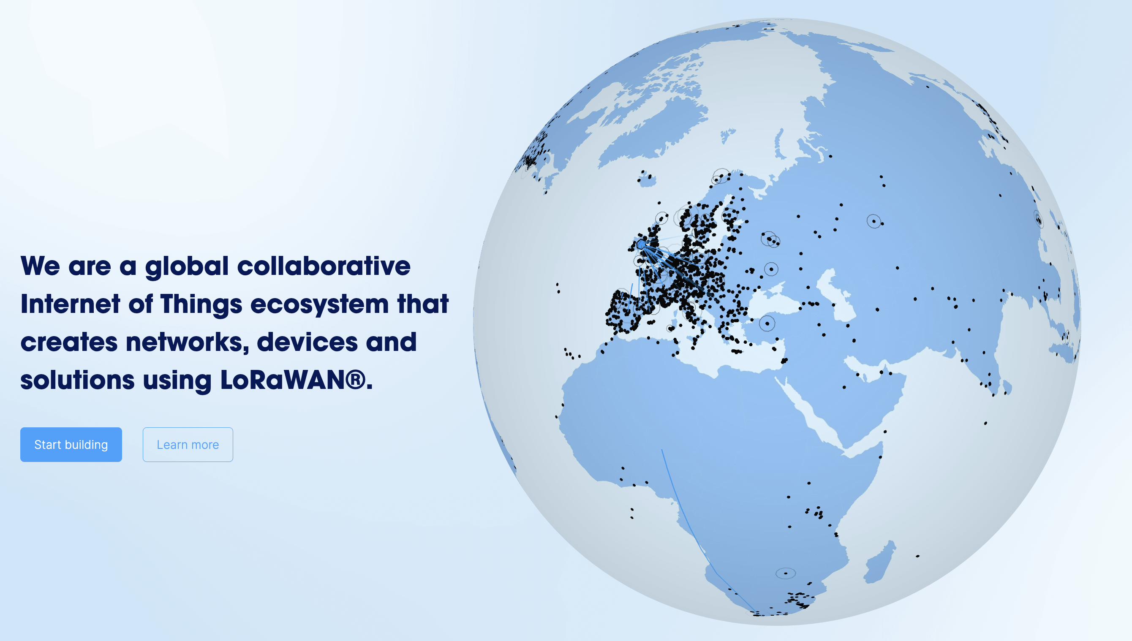
The Things Network
Notes:
https://ttnmapper.org/heatmap/

Slide 17
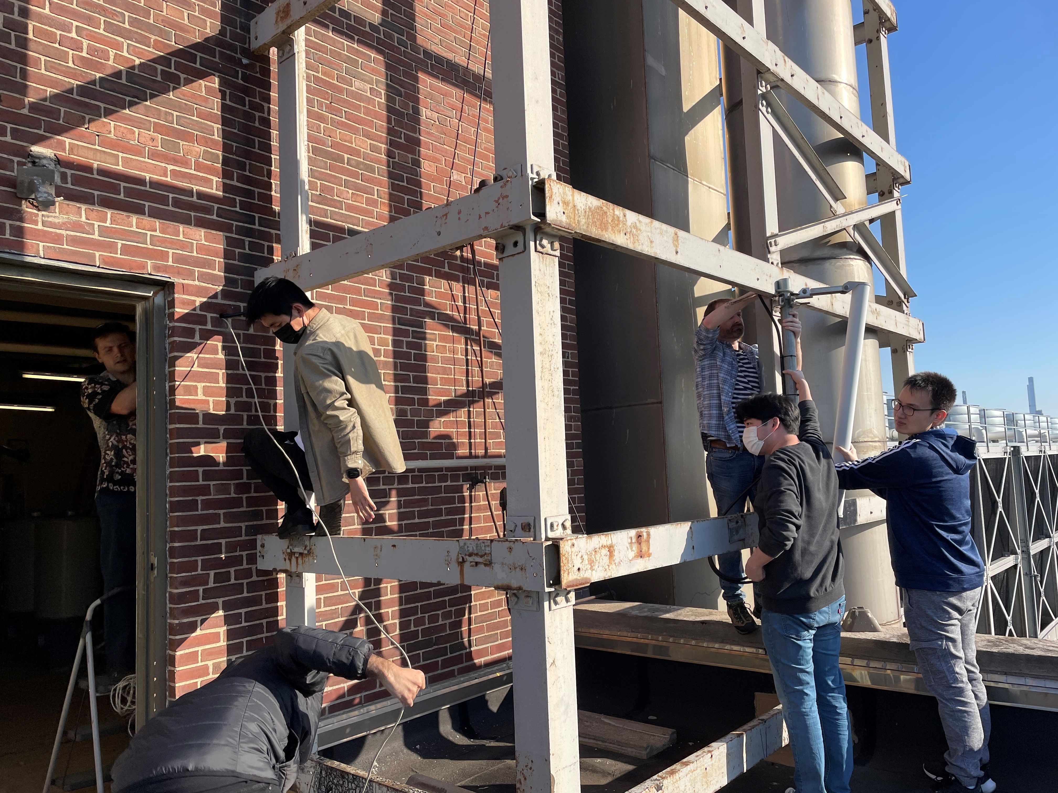
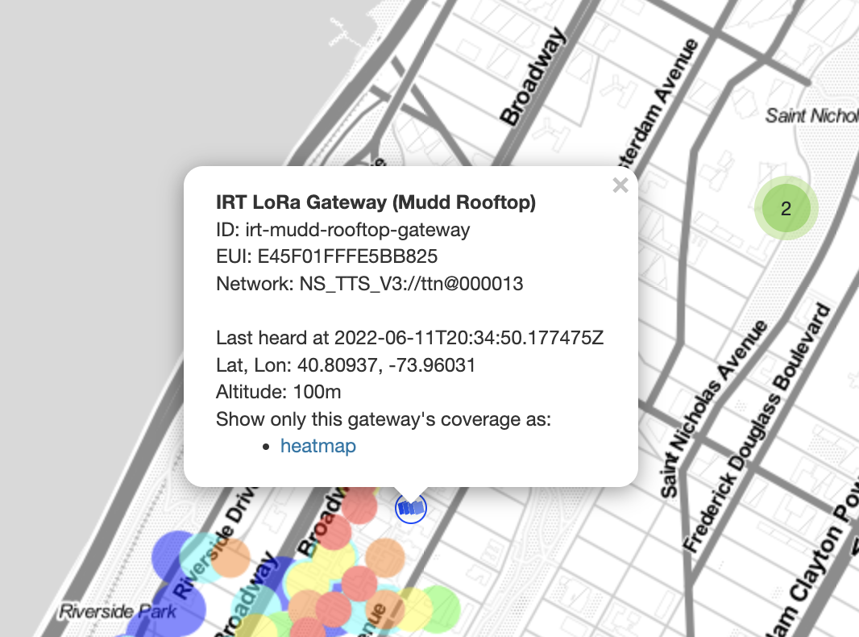
The Things Network
April 2022 (Columbia U.)

Slide 18
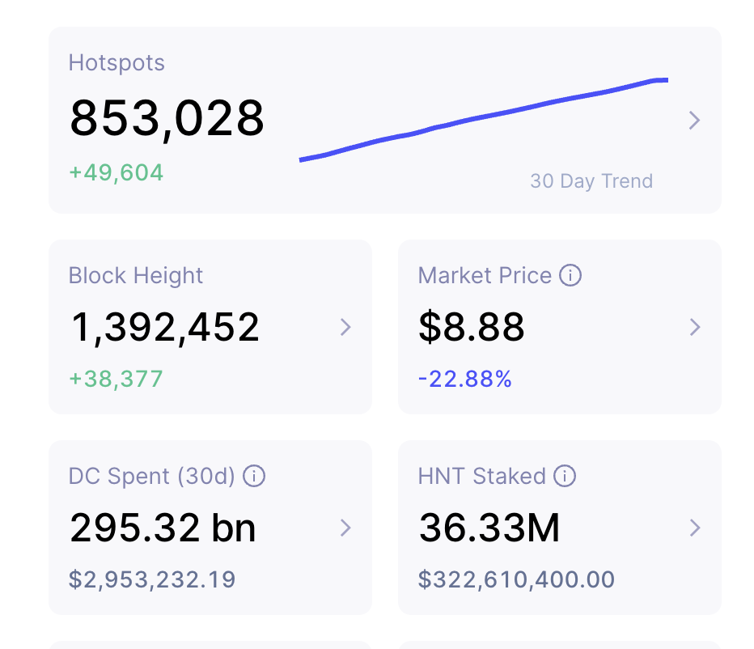
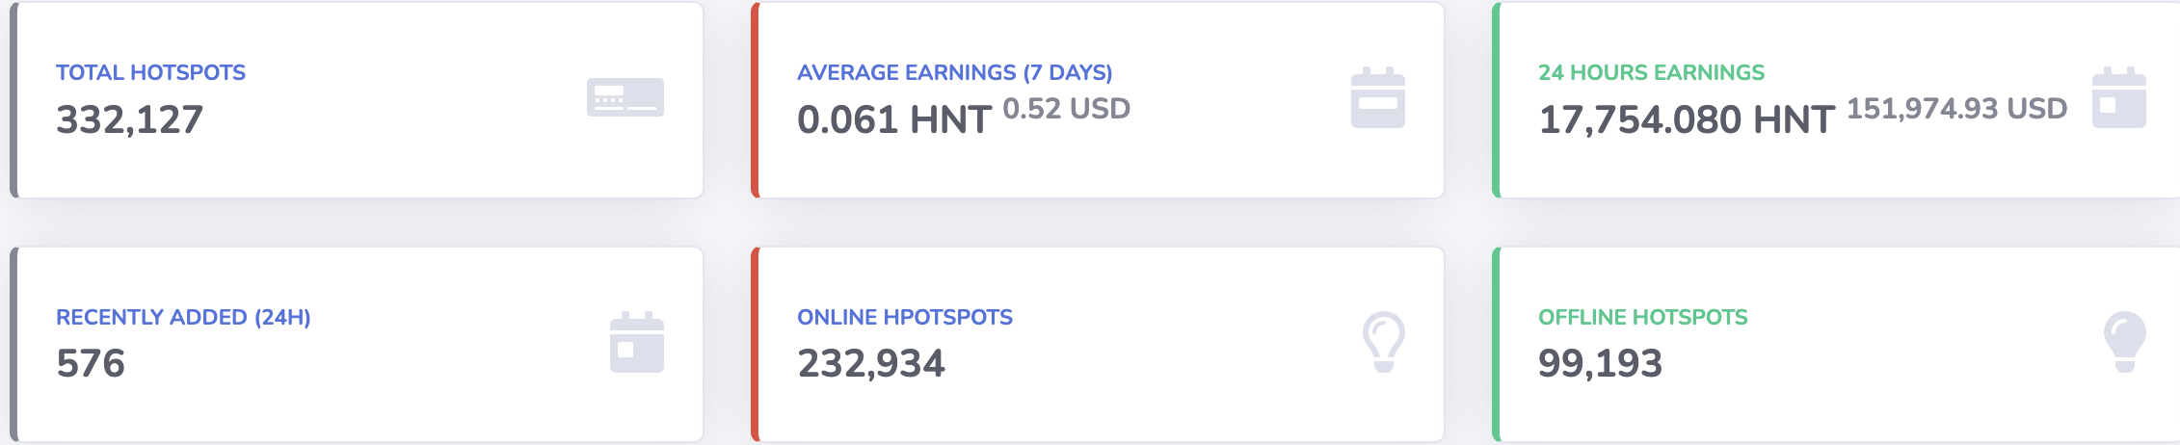
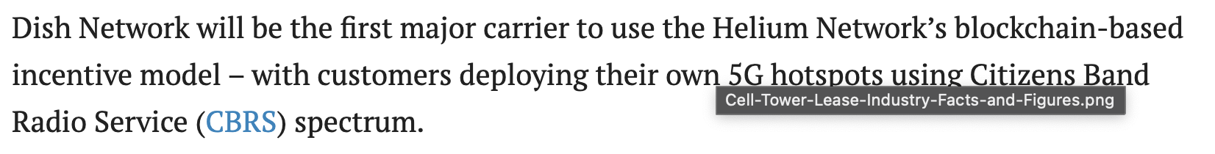
Helium LoRa model for IoT
Helium: 0.001c per 24-byte message (→ $416/GB)
$3.46 per month and hotspot
5W of energy → $0.37 electricity
Notes:
https://www.steelintheair.com/cell-tower-lease-rates/
https://www.celltowerleaseexperts.com/cell-tower-lease-news/cell-tower-industry-facts-figures-2016
https://www.fiercewireless.com/operators/dish-partners-helium-hotspot-model-featuring-cbrs-blockchain

Slide 19
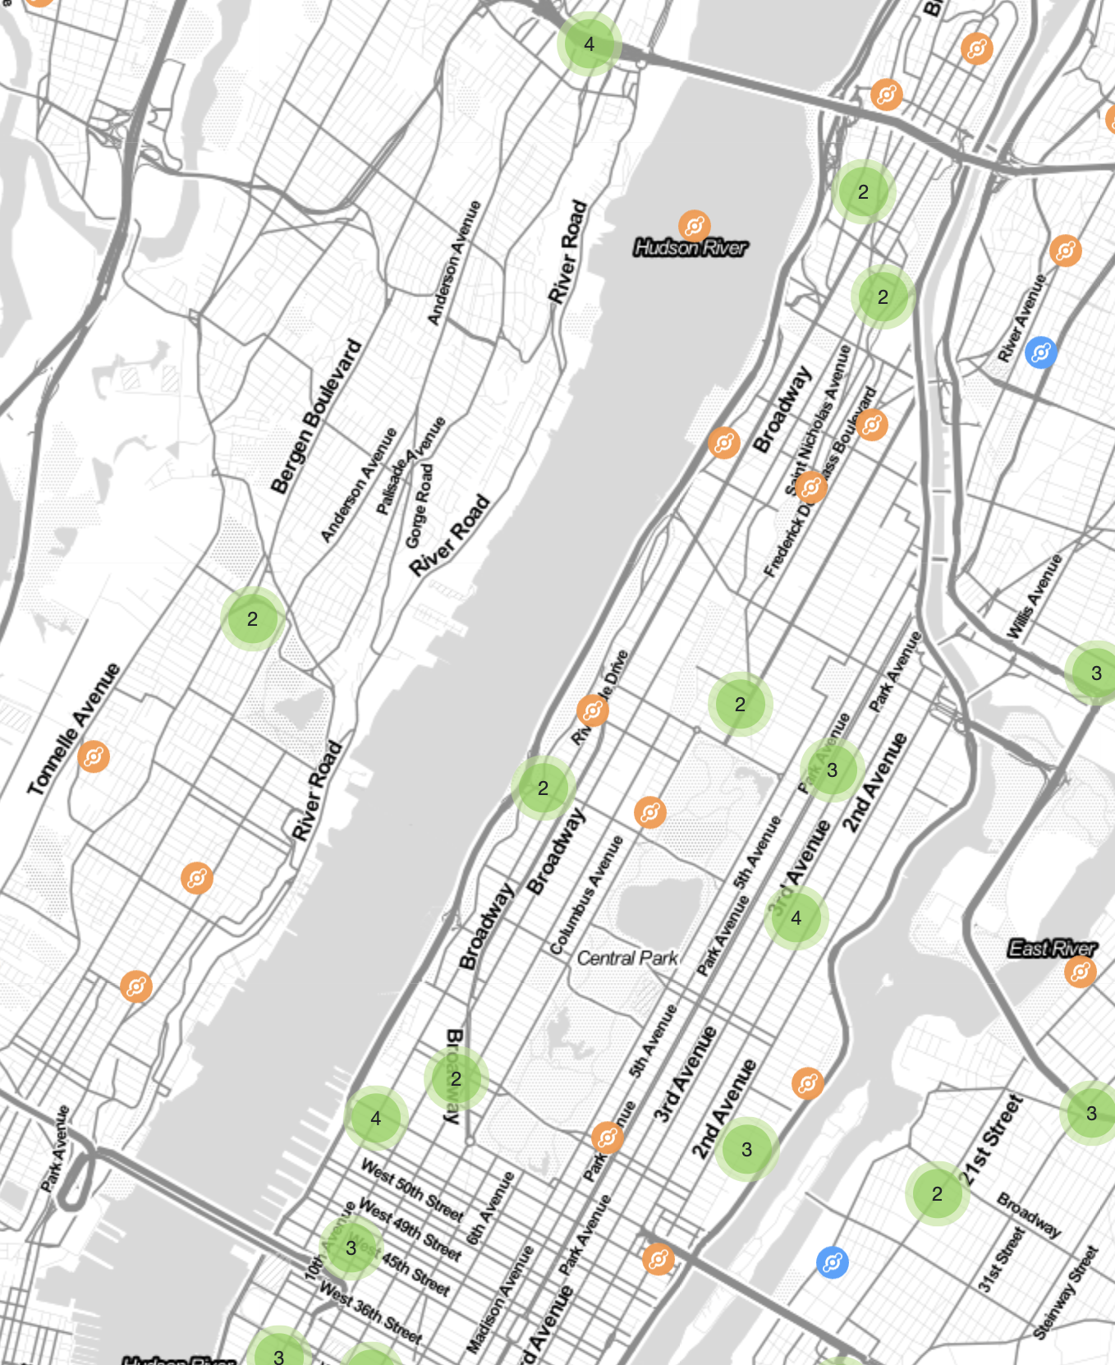
Helium in Manhattan

Slide 20
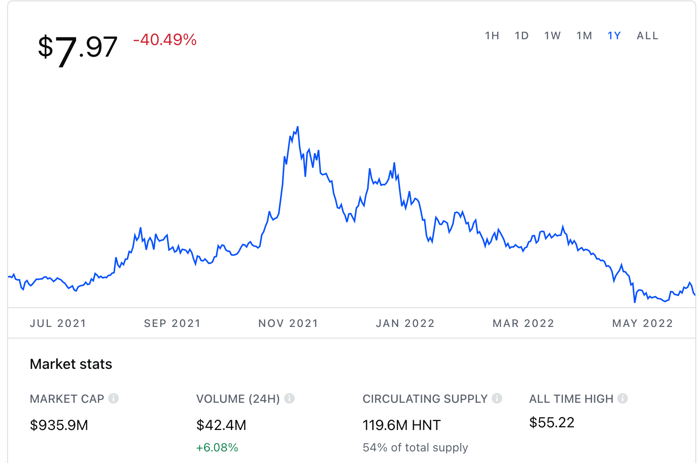
But blockchain models are volatile
https://www.coinbase.com/price/helium

Slide 21
LTE EPC
Notes:
https://www.slideshare.net/aliirfan04/lte-and-epc-specifications

Slide 22
5G & 4G EPC
Ericsson, Oct. 2020
Notes:
Ericsson: Your guide to building a cloud native 5G Core

Slide 23
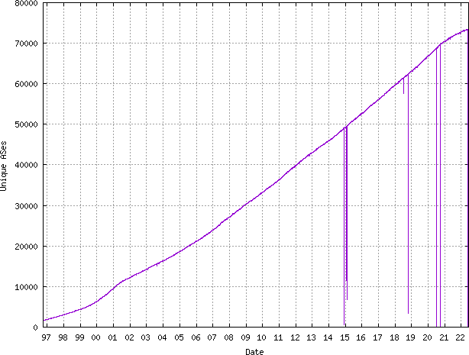
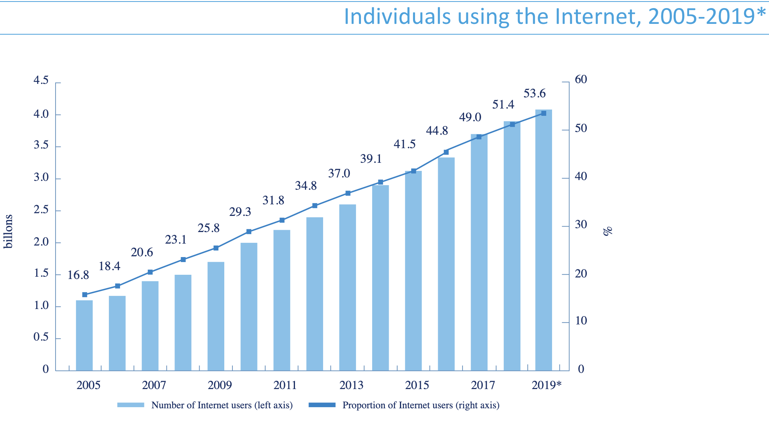
Users per ASN roughly constant
roughly unchanged at 60k users per AS
(slight decrease in users / routing table entry)
https://www.cidr-report.org/
https://itu.foleon.com/itu/measuring-digital-development/internet-us

Slide 24
Home networks are now small enterprise networks
Largely self-managed:
routing (mesh)
device management
device & user authentication
Notes:
https://www.telecompetitor.com/report-connected-devices-have-more-than-doubled-since-2019/

Slide 25
Scaling down is harder than scaling up
no PhD (or carrier training) needed!
firewall
DNS
edge computing
large enterprise
management
mesh backhaul
identity management and trust still deficient

Slide 26
Network value is (much) more than PHY
Property | Requirements? | Example
Universality | Can I operate my system (almost) anywhere in the world? | Adaptive frequency use by region (device knows location)
Incremental system cost | How much does it cost to add the functionality to the system? | < $5 for IoT devices
Data cost | Can I build “free” data systems, even if restricted? Can I leverage cheap landline BW? | < $0.10/GB for in-home use
Network architecture | Can I build my own network? | peer-to-peer → mesh → access point → cellular → long-range
User management | Can I design my own user management? | database + credential device-based model coupled to other systems (e.g., combined with other services)
System management | Can the system largely manage itself? | Frequencies & power, but also users and traffic restrictions

Slide 27
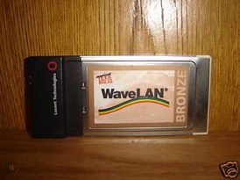
Parallel timelines
realistic top speeds
< 0.1 Mb/s
0.1-1.5 Mb/s
5-50 Mb/s
150-200 Mb/s
1G
2G
3G
4G
5G
1980
1985
1990
1995
2000
2005
2010
2015
2020
2.4 GHz
ISM
802.11g
~20 Mb/s
802.11ax
~1 Gb/s
802.11a
~20 Mb/s
802.11n
~100 Mb/s
802.11ac
~200 Mb/s
802.11
~2 Mb/s
802.11b
~6 Mb/s
approximate standardization
or first deployment
Notes:
https://www.tomsguide.com/us/best-mobile-network,review-2942.html
https://kenstechtips.com/index.php/download-speeds-2g-3g-and-4g-actual-meaning

Slide 28
Wi-Fi & 5G technology likely similar
Revisiting Wireless Internet Connectivity: 5G vs Wi-Fi 6
Notes:
Revisiting Wireless Internet Connectivity: 5G vs Wi-Fi 6
https://arxiv.org/abs/2010.11601

Slide 29
What made Wi-Fi successful?
Scalable complexity – 802.11b/g/n to 802.11ax
Architectural flexibility
  peer-to-peer, access point, mesh, long haul Pt2MP & Pt2Pt
  re-use cheap local wired network and shared (managed & firewalled) access
Multiple authentication models
  from open access to federated 802.1x RADIUS
Minimal viable network functionality
  Ethernet frames + IP
  local multicast
International usability
  universal “bootstrap” band (2.4 GHz)
  locally-discoverable spectrum availability

Slide 30
Wi-Fi (and BT & LoRa) ”won” by integration
$6.95
ESP8266
Arduino MKR1000
$36
Arduino Uno WiFi R2
$45
Wi-Fi + computer
Wi‑Fi 802.11b/g/n
$7.84
Adafruit Feather M0 with RFM95 LoRa Radio - 900MHz – RadioFruit $35

Slide 31

Currently, 3G/4G is ~10-15x expensive – why?
Cellular LTE Transceiver Module 700MHz, 850MHz, 1.7GHz, 1.9GHz
$104
Bluetooth, Cellular 4G LTE CAT-M1 (AT&T/Verizon) Transceiver Module
$69
Cellular 3G (AT&T) Transceiver Module 850MHz, 900MHz, 1.8GHz, 1.9GHz, 2.1GHz
$69
AT&T: >72¢ /MB
Notes:
https://www.multitech.com/brands/multiconnect-dragonfly-nano
Digi XBee3 Cellular

Slide 32
What’s bad about having both Wi-Fi and (nG) cellular?
System hardware complexity (e.g., for IoT devices)
No seamless roaming
Maintain multiple user identities
Difficult to do consistent traffic restriction
  cellular bypasses corporate firewall
Inconsistent network behavior
  e.g., IPv6 support
More limited competition

Slide 33
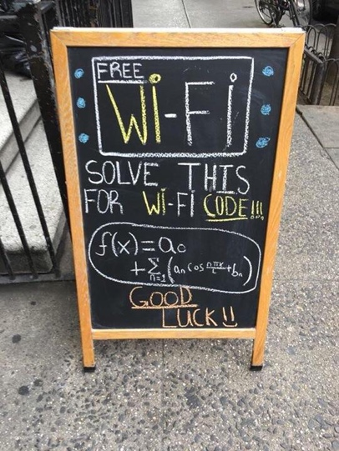

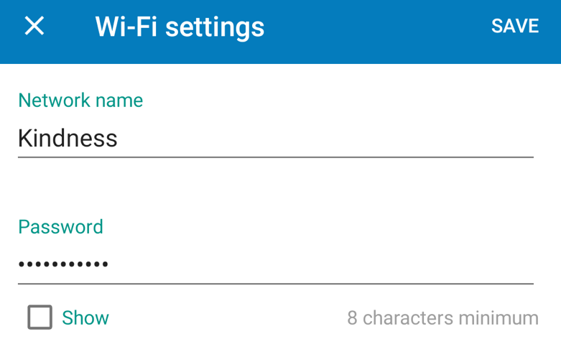

Current authentication models
picket fence security
802.1x
international roaming
hard to scale
to IoT
federated (RADIUS, DIAMETER)
WPA2-Personal

Slide 34
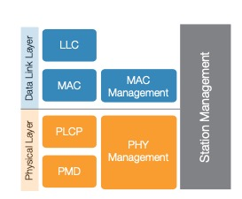
Stacks always focus on data – complexity is in control

Slide 35
Requirements for simple networks
Separate link layer from network architecture
  Why can’t 5G (or 6G) NR operate on a home router, without a carrier?
  Assume flexible spectrum access (geo database)
Every interface must be testable and self-testing
Interface neutrality = every control needs to be accessible to network consumer, not just operator (bounded by slice or authorization)
Clean interfaces particularly at layer 2 and 3
No configuration files, ever
No hard-coded addresses (e.g., gateways), ever

Slide 36
What’s needed for down-scalable networks?
Better frequency coordination for CBRS GAA (and similar systems)
  e.g., allow time-domain (slot?) coordination
Support simple self-contained EPC that can run on AP
  or OpenRAN with many untrusted participants → zero-trust networks
Simplified roaming and settlement mechanisms
  GSMA unlikely to scale
May need new mobility models, but most new applications are likely nomadic and (somewhat) disruption-tolerant, not mobile and voice-like

Slide 37
Protocols matter, but programmability matters more
Nobody wants to program raw protocols
Most significant network application creation advances:
  1983: socket API → abstract data stream or datagram
  1998: Java network API → mostly names, HTTP, threads
  1998: PHP → network input as script variables
  2005: Ruby on Rails → simplify common patterns
Many fine protocols and frameworks failed the programmer hate test
  e.g., JAIN for VoIP, SOAP for RPC
Most IoT programmers and factory automation specialists will not be computer scientists (and won’t have a telecom background)
Nobody learns ONAP in their CS BS

Slide 38
What has changed in network technology since 3G?
Cheap & universal GNS (GPS, Beidou, Galileo, …)
  ➔ accurate time and position for every device ➔ mobility and discovery
Multiple simultaneous connections
  ➔ simplify hand-off and spectrum discovery
Low-cost Certificate Authorities (e.g., letsencrypt.org)
  ➔ simplify authentication
Trusted execution environments on all but lowest-end devices
  ➔ simplify authentication and device integrity

Slide 39
What has changed?
FTTH provides access networks
  BEAD project will add $42.5B (mostly) fiber connections
Most new applications are nomadic, not mobile
  i.e., no need for voice-like continuity of connectivity
Multiple transparent access modalities common
  Wi-Fi to cellular vertical “hand-off” mostly transparent to users

Slide 40




Two evolutionary paths for 6G
mostly not a PHY problem
like 4G & 5G, just more
highest mobility
lowest bandwidth cost

Slide 41
Conclusion
The key performance metric is $/GB (and maybe $/km² coverage)
The key challenge is incentivizing investment
6G needs an architecture re-think, not (only) better PHY
Cleaner separation between media/complexity-dependent layers, common data transport and control planes
Design scalable, IP-based control plane for everything from peer-to-peer mode to managed national cellular network
Cleanly separate access from backbone
  since likely continue to be both locally (enterprise) and third-party managed
Opportunity to bridge the Wi-Fi - cellular chasm

