Slide 1
Accelerating Digital Inclusion – Making the Internet Available and Affordable to Everyone
Henning Schulzrinne
Columbia University

Slide 2
Overview
Availability, affordability and relevance
What makes deploying fixed broadband necessary & expensive?
Technology may help – if it can dig trenches & automate operations
Affordability may become a larger problem than availability
Government is likely to play a major role
Mostly focus on United States, but basic problems similar elsewhere

Slide 3
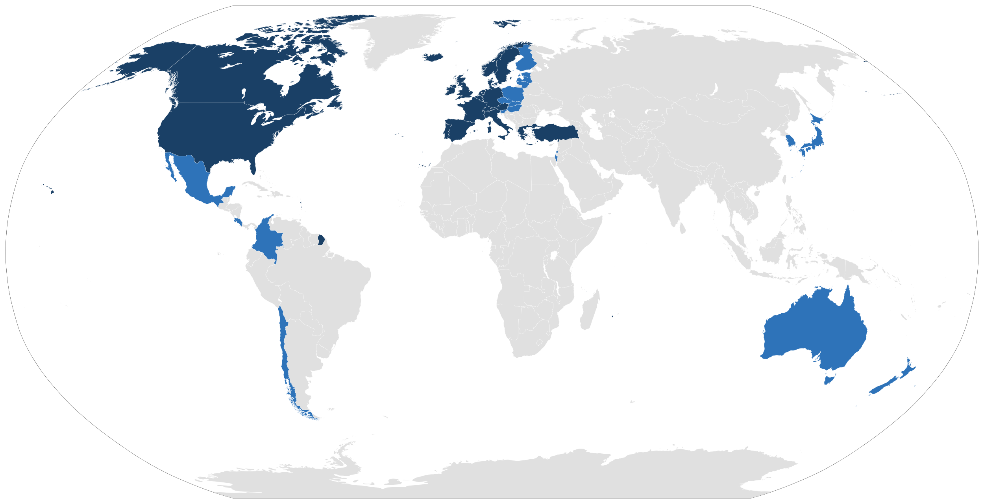
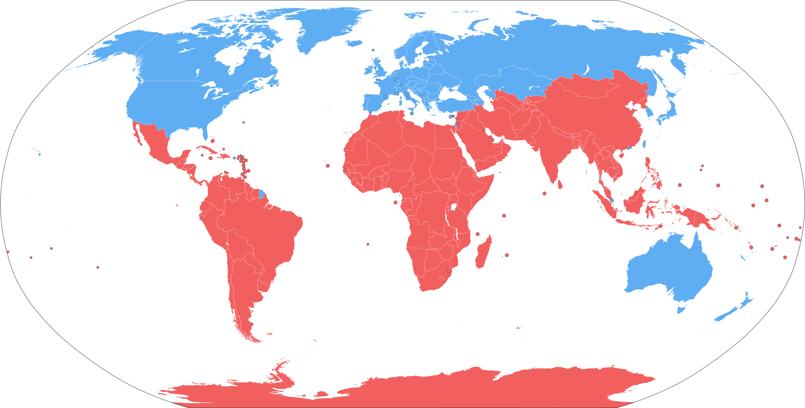
OECD/high-income vs. lower-income issues
wired (or fixed) broadband widely available
transition from copper to fiber (and FWA)
least-connected 10%
affordability for low-income households
adoption – digital literacy
applications (“Factory 4.0”, telehealth, distance learning)
wired broadband uncommon: mobile first
transition from 2G to 4G
middle mile, transoceanic fiber
IXPs to avoid tromboning through US
broad-based affordability
applications like banking, health, jobs

Slide 4
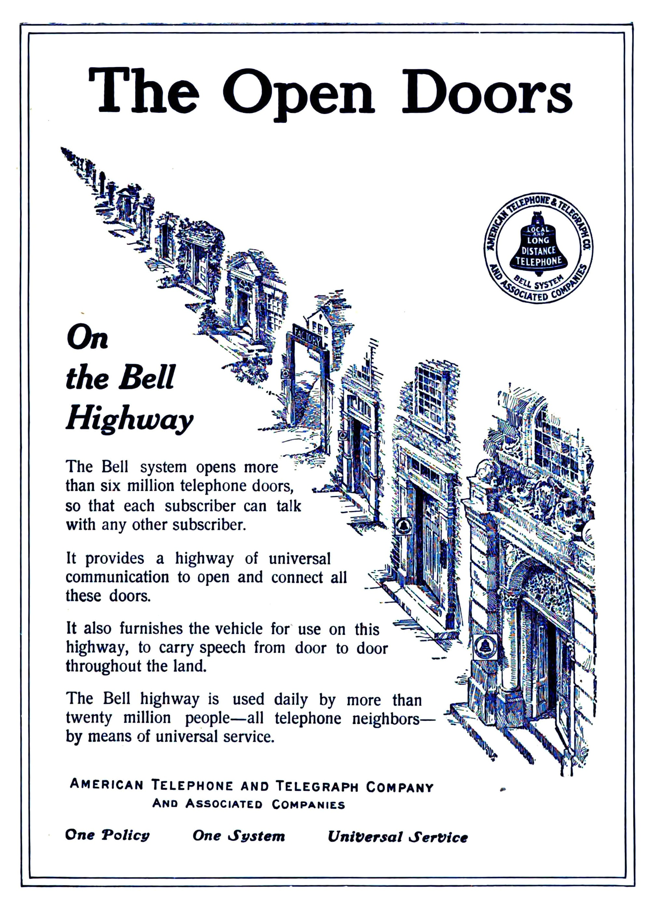
Universal Service is more than a century old
cross-subsidies: long-distance → local (& rural) service
universal service obligation (utility) in service territory
example: inter-carrier compensation (ICC)
monopoly phone company → 1996 TA
local competition → ”cream skimming” →
explicit universal service fund

Slide 5
How bad is the problem?

Slide 6
Global Internet users
Notes:
Internet Trends 2019 (Mary Meeker)

Slide 7
Global internet growth – 2009–2018
Notes:
Internet Trends 2019 (Mary Meeker)

Slide 8
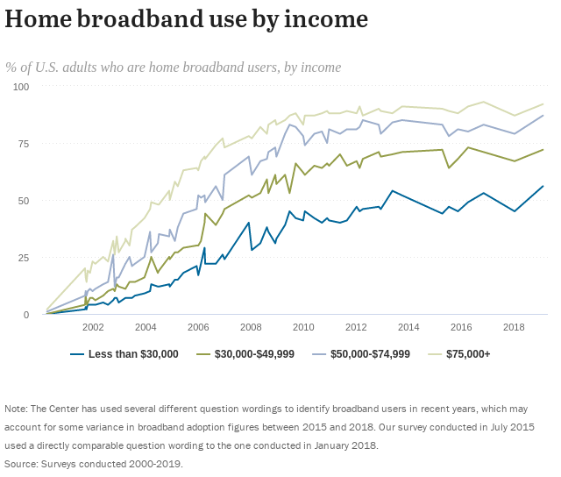
US: Income plays a major role
Pew Research
Notes:
https://www.pewresearch.org/internet/fact-sheet/internet-broadband/

Slide 9
Rural broadband US
Notes:
https://fivethirtyeight.com/features/the-worst-internet-in-america/

Slide 10
By race, too

Slide 11
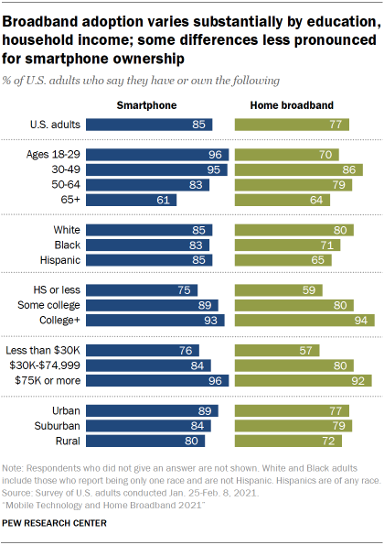
15% of U.S. adults are smartphone-only
Smartphones = mostly consumption devices
+ TikTok!
Hard to do homework on a smartphone
Hard to do telework
Notes:
https://www.pewresearch.org/internet/2021/06/03/mobile-technology-and-home-broadband-2021/

Slide 12
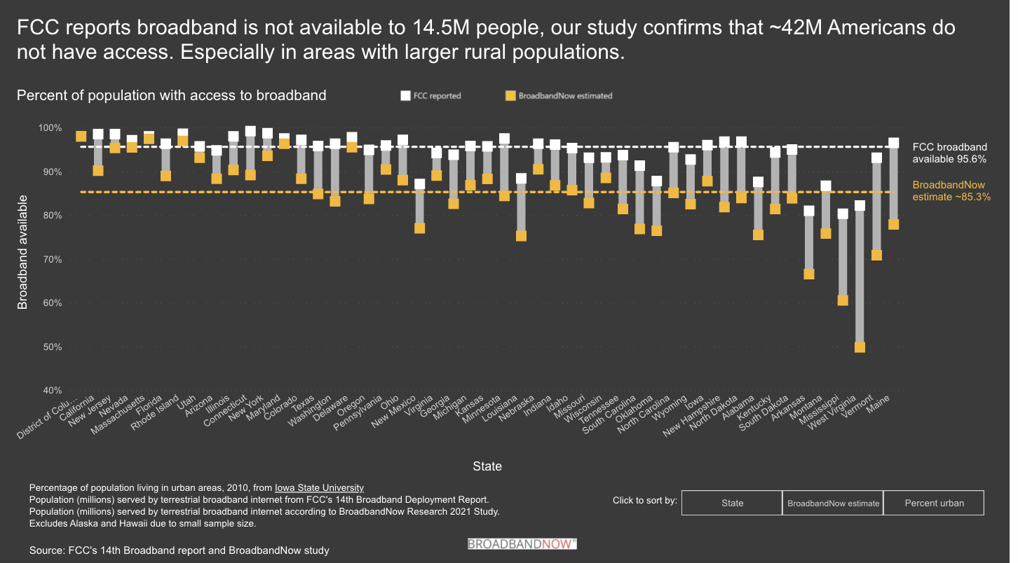
Broadband access by speed & geography
2017
15% of US population
Notes:
https://broadbandnow.com/research/fcc-broadband-overreporting-by-state
https://www.brookings.edu/research/signs-of-digital-distress-mapping-broadband-availability/

Slide 13
What are the causes?

Slide 14
Lower population density, easier broadband
32.45/km²
2.91/km²
3.49/km²
to be covered requires
Deloitte, 2017

Slide 15
Availability, affordability and relevance are coupled
Availability
Relevance
Affordability
carriers don’t build or improve in low-income areas (“digital redlining”)
not available – don’t know what
you don’t have
if not relevant, low on spending priority
if can’t afford, easier to claim “don’t want it”

Slide 16
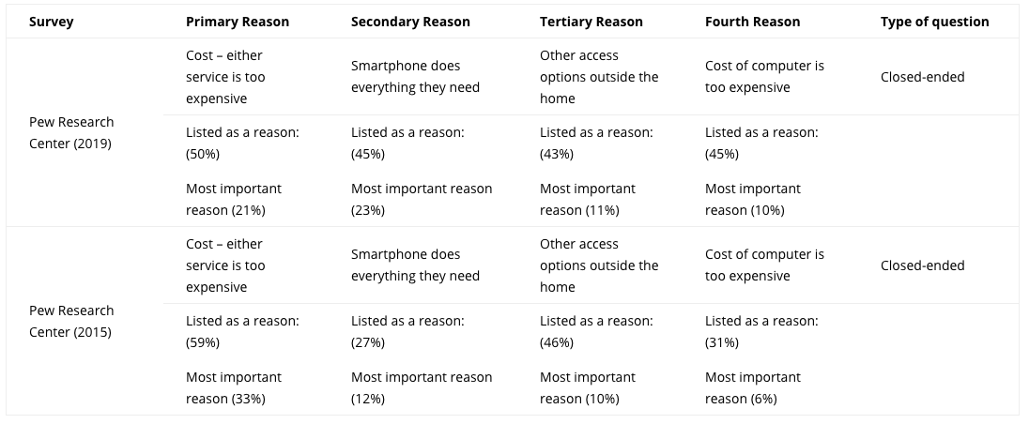
Reason for non-adoption
https://www.digitalinclusion.org/measuring-the-gap/

Slide 17
It all depends on your (network) roots

Slide 18
Accidental broadband
94.2% of US
households have
phone service
G.992.2
ADSL
DSL patents
1988-1991
1993
1999
62.1 million US
households have
cable TV
“peak CATV”:
82% of HH
16 million
US subscribers
DOCSIS 3.1
(10G/1G)
DOCSIS 1.0
(40M/1M)
1980
1995
1997
2008
2016
➔ DSL and cable infrastructure near-universally or widely available well before use as Internet access
Notes:
1997_Mar_Trends.pdf
https://www.calcable.org/learn/history-of-cable/

Slide 19
Broadband technology 2021
OECD (June 2021)
Notes:
https://ipcarrier.blogspot.com/2021/07/
https://www.oecd.org/sti/broadband/1.2.OECD-FixedMobileBB-2021-06.xls

Slide 20
FTTH internationally (OECD)
Notes:
http://www.oecd.org/internet/broadband/broadband-statistics-update.htm
https://www.oecd.org/sti/broadband/broadband-statistics/

Slide 21
Improving availability

Slide 22
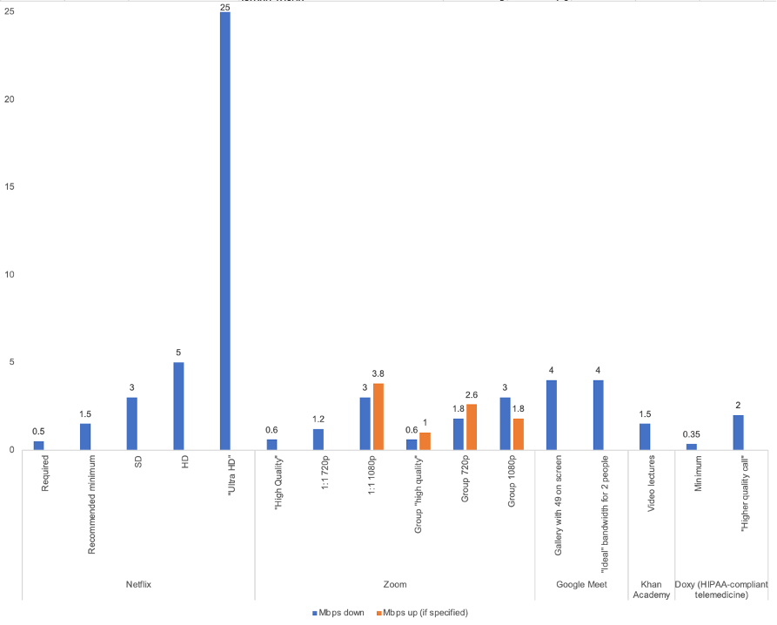
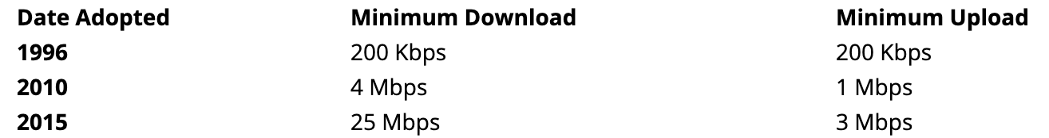
How much speed do we need?
industry: most applications don’t need lots of bandwidth
advocates: but we want future-proof networks!
Technology Policy Institute, 3/21
Notes:
https://techpolicyinstitute.org/2021/03/29/youve-been-served/
https://broadbandnow.com/report/fcc-broadband-definition/

Slide 23
For non-fiber networks, problem is likely capacity, not speed
Notes:
https://www.xfinity.com/support/articles/data-usage-average-network-usage

Slide 24
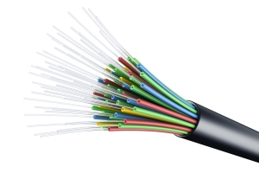
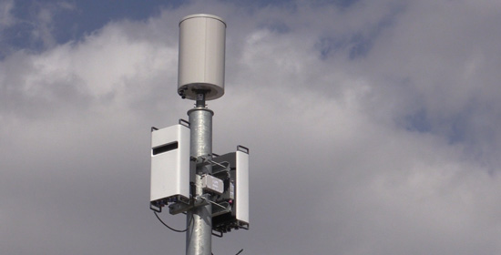
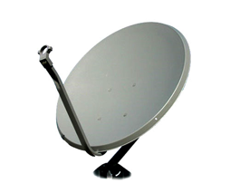
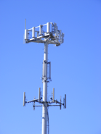
Metrics: not Gb/s or b/s/Hz, but $/GB and $/year
$/month
in-building cells
switch to small cells
2nd GEO satellite
GB/subscriber or GB/square mile

Slide 25
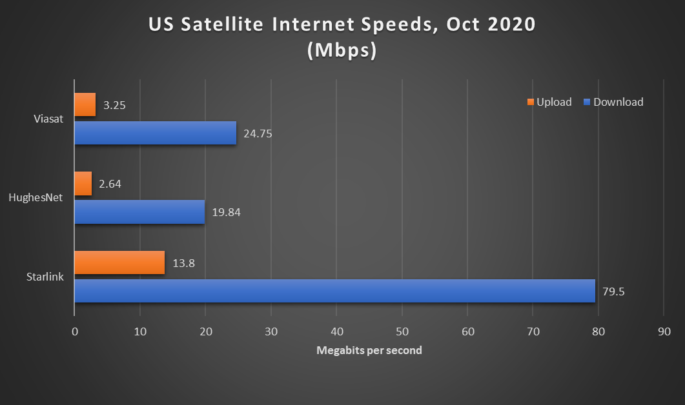
Density determines network choices
REC
cable
satellite
DSL (common)
FTTH
WISP
HH/road mile
1454
1
7
10
20
50
100
1000
Alaska roadmiles
Notes:
Manhattan: 508 road miles - http://venus.fcny.org/cmgp/streets/pages/2001PDF/Report/DFMN.pdf ; Wikipedia: 738,644 households in Manhattan
Alaska: 15,178 miles; 741,894 population
https://www.pcmag.com/news/tested-spacexs-starlink-satellite-internet-service-is-fast-but-itll-cost

Slide 26
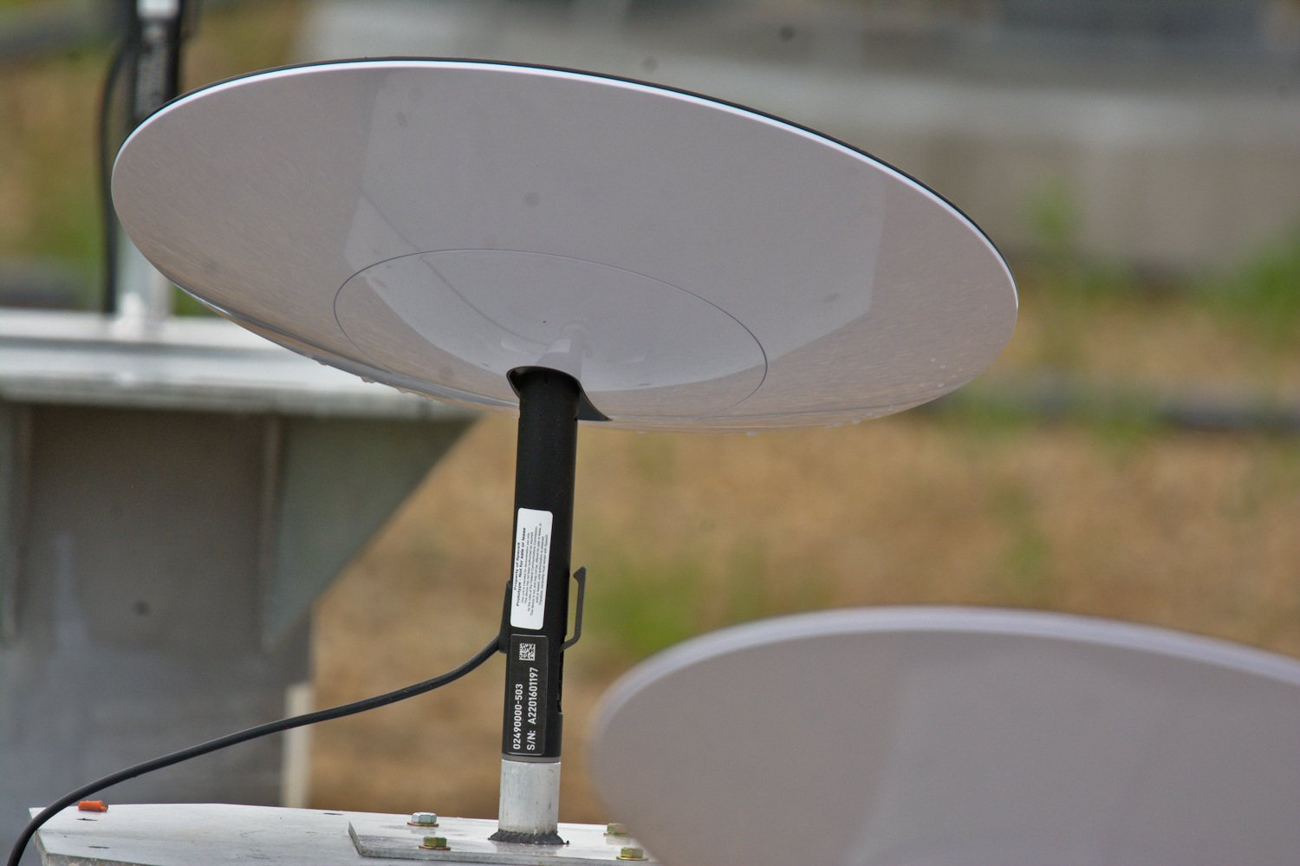
Challenges for rural broadband
Who is going to build out?
  some incumbent local exchange carriers (ILECs) are not interested
  municipalities may be prohibited by state laws
    or hurdle is extremely high
  rural electric cooperatives – serve 14M homes in US (out of ~110M)
    average, 5.8 electric meters per mile
Upgrade copper or new infrastructure?
  fiber closer to the home (“FTTN”) OR
  fiber to the home (FTTH) or fixed wireless (FWA) or LEO
Who is going to pay for broadband?
  subsidize once, for N years, or forever?
Are non-landline approaches scalable?
  TV white spaces, HAPS
  satellite – NGS like OneWeb (600 satellites) or StarLink
    currently, about 500k residential satellite subscribers
      ”better than nothing”
      lacking capacity, high delay, low reliability, expensive
    LEOs change the picture
      but same concerns + spectrum + horizon visibility
50-150 Mb/s, 40 ms RTT
$99/month
$499 antenna
Notes:
https://www.tesmanian.com/blogs/tesmanian-blog/ufo-starlink-terminal

Slide 27

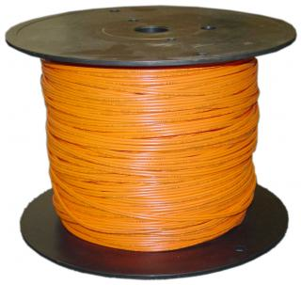
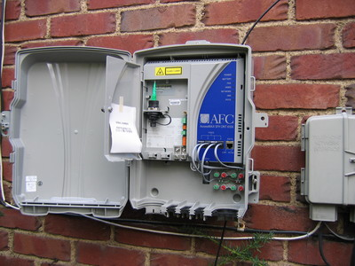
Network economics, (over)simplified
70%
30%
traditional: 12-15 staff/10k customers
Iliad, FR: 3-4 staff/10k
Notes:
opex ratios: Deloitte

Slide 28
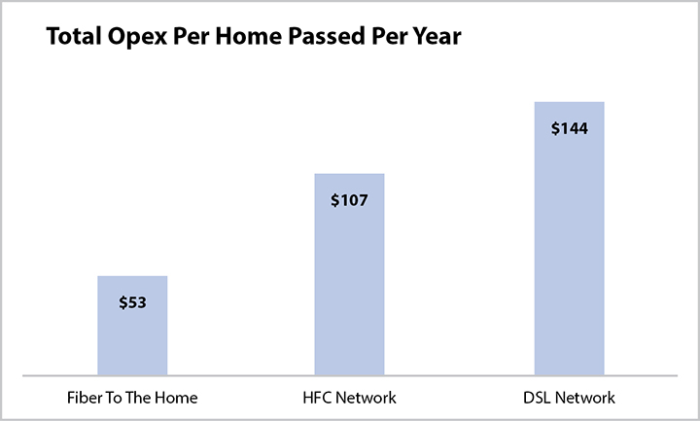
Fiber observations
Fiber middle-mile cost: $50-70k/mile
Fiber per home passed: $1,250 (bottom 90%)
Fiber is cheap: 144 strands = $10k/mile, 48 strands = $4.7k/mile
Common characteristics:
  avoid active elements in network → power, maintenance → PON
  recently: avoid anything except fiber (including splitters)
    cf. wireless last mile approach
  fiber home run, even if PON (Google Fiber, Stockholm)
Fiber cost higher for buried, but cheaper if conduit or aerial
Notes:
https://www.bbcmag.com/broadband-applications/to-reduce-network-operating-expenses-choose-ftth
https://www.telecompetitor.com/report-for-an-extra-70-billion-ftth-could-be-available-to-90-of-u-s-homes-by-2029/

Slide 29
How do we pay for this?

Slide 30
Universal Service Fund (USF)
Contributions from telecom providers
(assessment of ~25-30% on their interstate end-user revenues)
wireline telco
wireless telco
Universal Service Fund
lifeline
($854M)
e-rate
(schools & libraries) ($2.1B)
disbursement of funds to eligible entities
reduce costs for rural telcos
reduce costs for low-income consumers
cable
high-cost
($5.1B)
rural health care
($298M)
reduce costs for schools & libraries
reduces costs for rural health providers
Allison Baker, 2017; modified 2021

Slide 31
We’ve tried this for a while: Connect America Fund (CAF) and off-spring
Connect America Fund
RDOF
Fixed Services
Mobile Services
Legacy Competitive ETCs
Price Cap Area
Rate-of-Return Areas
Mobility Fund Phase I
CAF Phase I
CAF - ACAM
Frozen High Cost Support
Alaska Plan (Mobile)
CAF Phase II
CAF-BLS (ICLS)
Mobility Fund Phase II
CAF ICC (PC)
HCLS (SNA, SVS)
5.0B for 2019
4.7B for 2021
Rural Broadband Experiments
Alaska Plan (RoR)
CAF Phase II (Auction)
Key
CAF ICC (RoR)
CAF Programs
Remote Areas Fund (Auction)
Future Programs
Legacy Programs
Notes:
https://docs.fcc.gov/public/attachments/DOC-362272A1.pdf
https://opendata.usac.org/High-Cost/High-Cost-Funding-Disbursement-Search/cegz-dzzi
https://www.fcc.gov/general/federal-state-joint-board-monitoring-reports

Slide 32
Your (mobile) phone bill at work
911 fee
USF
funds the FCC

Slide 33
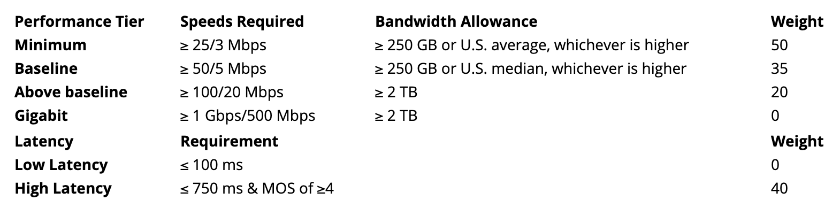
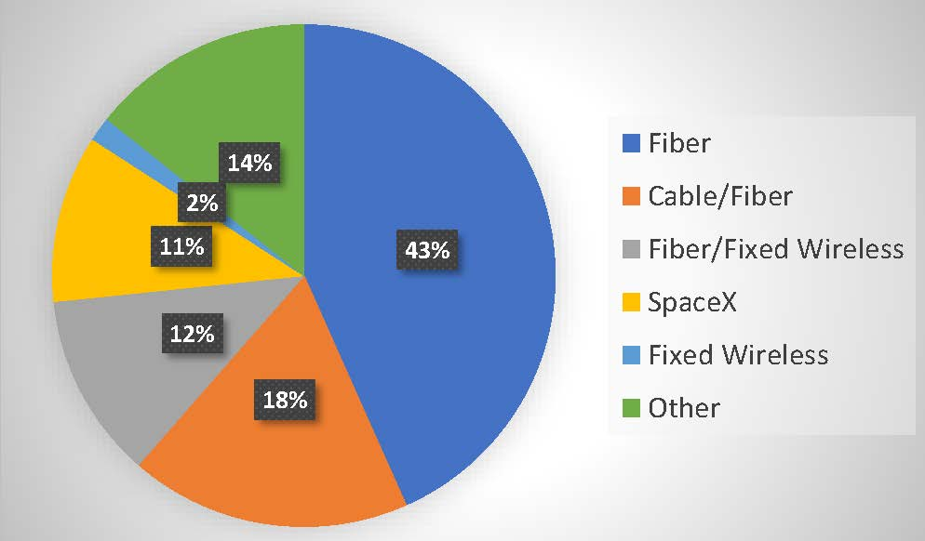
Rural Digital Opportunity Fund (RDOF) - 2020
Old (pre-1996) model: incumbent is obligated to provide “universal service”
  even if economically inefficient
  “carrier of last resort” (COLR)
Transition model: large incumbent telephone companies get money
  based on cost estimates → often upgrade DSL from really slow to slow
New model: reverse auction → lowest subsidy wins support
  non-traditional providers, new entrants, satellite, …

Slide 34
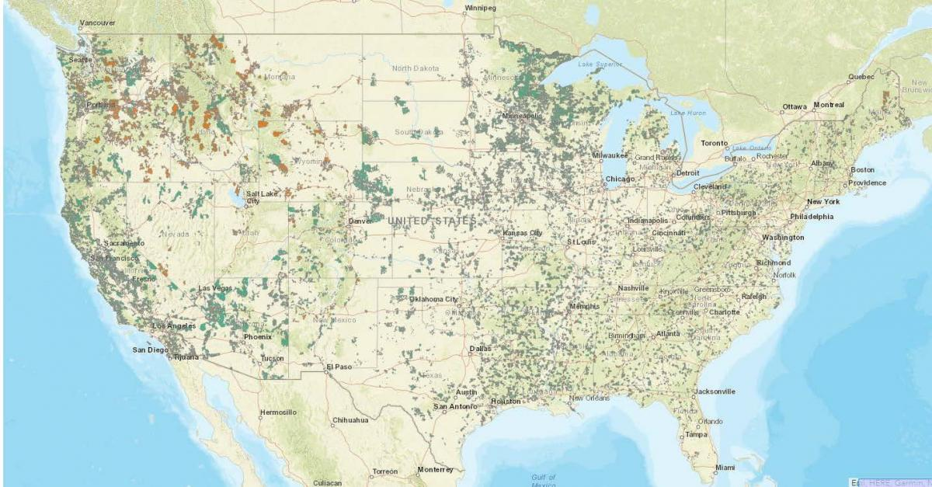
RDOF (2020) outcome
https://www.ctcnet.us/analytics/rdof-winners/

Slide 35
2021 Infrastructure Investment & Jobs Act
Broadband Equity, Access, and Deployment (BEAD)
  $42.45B: NTIA → states → providers
    distributed to states based on their fraction of unserved locations
    competitive bidding, reverse auction, …?
    first, unserved (≤ 25/3 Mb/s), then underserved (≤ 100/20, i.e., no HFC territory), then community anchors ≤ 1 Gb/s
    build-out of ≥ 100 Mb/s download, 20 Mb/s upload (→ FWA or fiber)
    ≤ 48 hour outage per year (99.5% reliability)
    must offer low-cost broadband service option
DATA Act → broadband ”Fabric”
  street-level, geo-coded database of broadband availability
Enabling Middle Mile Broadband Infrastructure Program ($1B)
Tribal Broadband Connectivity Program ($2B)

Slide 36
Affordability

Slide 37
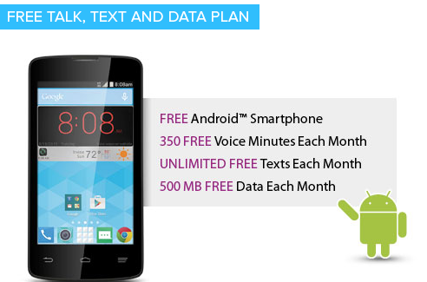
Lifeline
Established in 1985 by the FCC and mandated by Congress in the Telecommunications Act of 1996
  used to be mostly local phone, now mostly mobile
Federal program that lowers the monthly cost of phone and internet for qualified low income consumers
  Program qualification based on income or participation in a qualifying assistance program (e.g., SNAP, Medicaid, SSI, Public Housing Assistance)
  Basic support amount is $9.25 per month and up to $34.25 for consumers living on Tribal lands
    e.g., 1,000 minutes of voice, 4.5 GB of data
Concerns about fraud
  unused phones
  multiple phones in one household
  phones to ineligible consumers

Slide 38
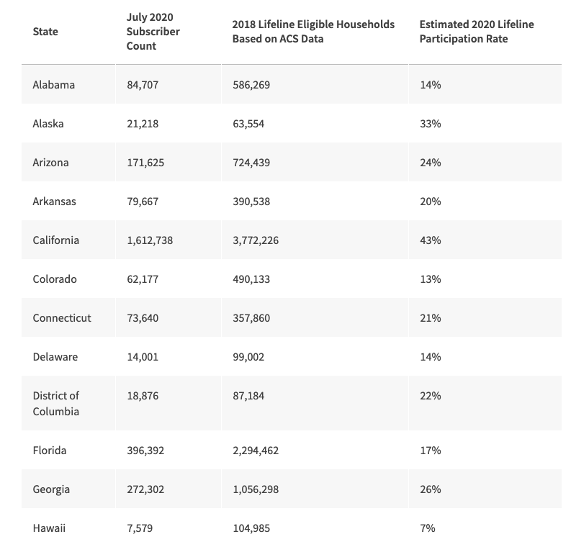
But Lifeline has reached (mostly) the end of its line
one per household – who gets the phone?
too little data even if tethering enabled
  3 hours of Zoom per month
not all children can get access
Notes:
https://www.usac.org/lifeline/learn/program-data/

Slide 39
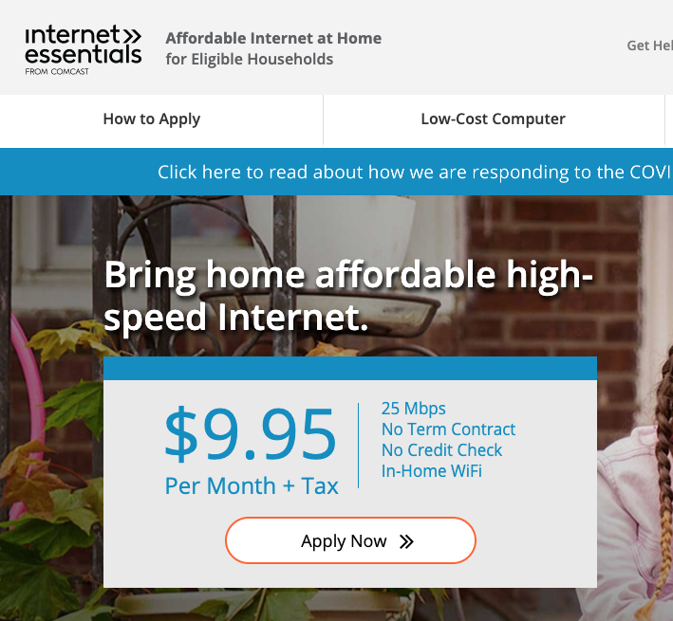

Provider-based: Comcast Internet Essentials
Some school districts give out bulk
vouchers
Fear of bills
It’s free – must be a scam
Not available in 58% of households
”have not subscribed within 90 days”
“no overdue bill within 12 months”
see also

Slide 40
COVID-19 changed thinking
Pre-COVID-19
With COVID-19
Biggest problem: no broadband in small parts of rural America
Low income households have Lifeline for basic connectivity
Need to solve mapping problem first to understand scope of unavailability
10-year programs (USF CAF II, RDOF)
Can always go to the local library or school
25/3 is plenty fast
Biggest problem: lots of people can’t afford broadband
  and quality of supposedly-covered areas is low
  no 25/3 broadband in urban areas
    only 1.5%, but that’s 3.9 M people
    vs. 11.1 M rural
    “digital redlining”
  or cannot afford devices
Students cannot wait 10 years
Local library (and school) is closed
Multiple video conferences bust 3 Mb/s upstream

Slide 41
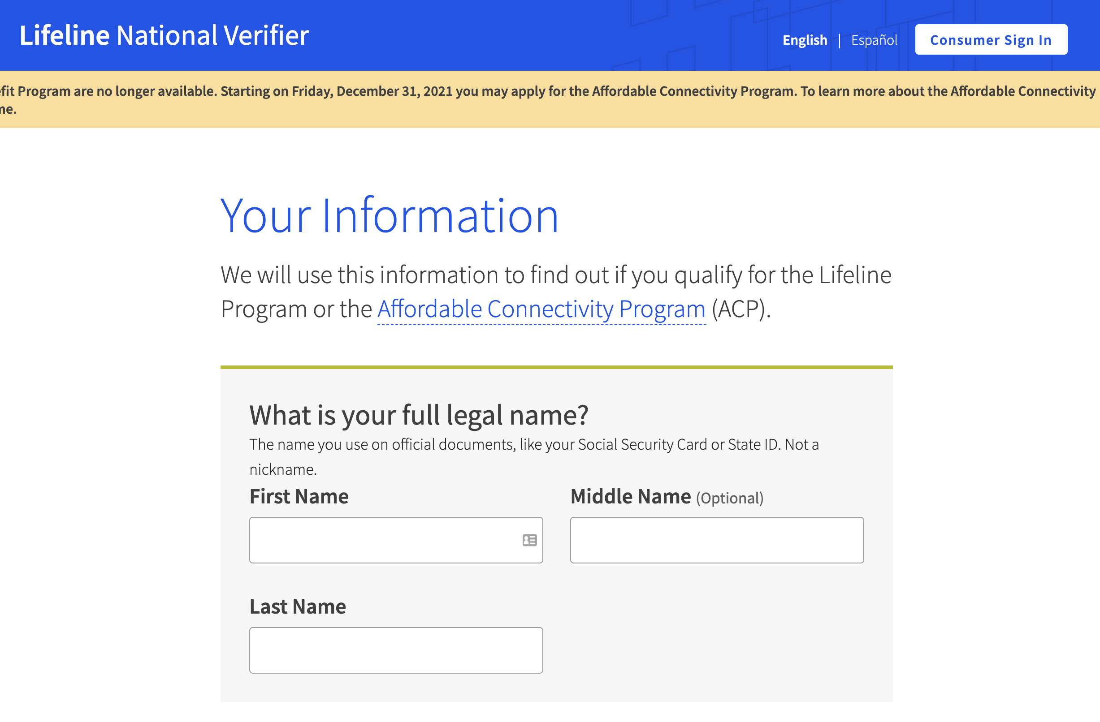
IIJA Affordable Connectivity Program
$30/month subsidy
  + $100 subsidy for laptop, tablet, desktop computer
eligibility:
  income must be at or below 200% of the Federal Poverty Guidelines
    e.g., $25.6k for single person, $53k for family of 4
    cf. median family household income: $86k
  receive benefits from Medicaid, Supplemental Nutrition Assistance Program, Supplemental Security Income, Federal Public Housing Assistance, or Veterans and Survivors Pension Benefit
  student on free and reduced-price lunch program or the school breakfast program (including the Community Eligibility Provision)
  has received a Federal Pell Grant in the current award year
National Lifeline Verifier
EBB: about 20% participation
Notes:
https://www.benton.org/blog/how-infrastructure-investment-and-jobs-act-will-make-broadband-more-affordable
https://www.census.gov/library/publications/2021/demo/p60-273.html

Slide 42
NTIA Digital Equity Act Programs ($2.75B)
“digital inclusion and equity to ensure that all individuals and communities have the skills, technology, and capacity needed to reap the full benefits of our digital economy. The goal of these programs is to promote the meaningful adoption and use of broadband services across the targeted populations in the Act, including low-income households, aging populations, incarcerated individuals, veterans, individuals with disabilities, individuals with a language barrier, racial and ethnic minorities, and rural inhabitants.”

Slide 43
Conclusion
Availability, affordability & relevance
Except for large cable companies, challenging economics for ISPs
Introducing competitive fiber speeds is difficult everywhere
Who should subsidize high-cost and low-income areas? Taxes or fees?
Emphasis on automation (+ staff cuts) and simplified service structure
  not new services, protocols, speeds
Research directions:
  why do certain regions not get (subsidized) broadband
  fully autonomous, self-configuring networks

