Slide 1
How do we close the digital divide? It requires more than routers and protocols!
Henning Schulzrinne
Columbia University

Slide 2
Itinerary
Background: Making laws in practice
Background: What do Congressional offices do all day?
Making broadband available to useful to everyone → closing the “digital divide”

Slide 3
The kinds of law
Constitutional law (1787)
  relationship between
    president and Congress
    federal government and states
  bill of rights (1791) + 17 amendments
  short compared to other constitutions
Criminal law
  “Homicide means conduct which causes the death of a person or an unborn child with which a female has been pregnant for more than twenty-four weeks under circumstances constituting murder, manslaughter in the first degree, manslaughter in the second degree, criminally negligent homicide, abortion in the first degree or self-abortion in the first degree.” (NYS S125.00)
  "Person," when referring to the victim of a homicide, means a human being who has been born and is alive.
Civil law
  contract, uniform commercial code, labor laws, …
Administrative law
  e.g., how can regulations be made and enforced

Slide 4
The US hierarchy of laws
Constitution
Commerce clause
Law
Telecom Act 1934 & 1996
47 CFR
Narrative
reasonable network management
Article I, Section 8: To regulate Commerce with foreign Nations, and among the several States, and with the Indian Tribes (1787)
SEC. 706. ADVANCED TELECOMMUNICATIONS INCENTIVES. (a) IN GENERAL- The Commission … shall encourage the deployment on a reasonable and timely basis of advanced telecommunications capability to all Americans (including, in particular, elementary and secondary schools and classrooms) by utilizing, in a manner consistent with the public interest, convenience, and necessity, …, or other regulating methods that remove barriers to infrastructure investment.

Slide 5
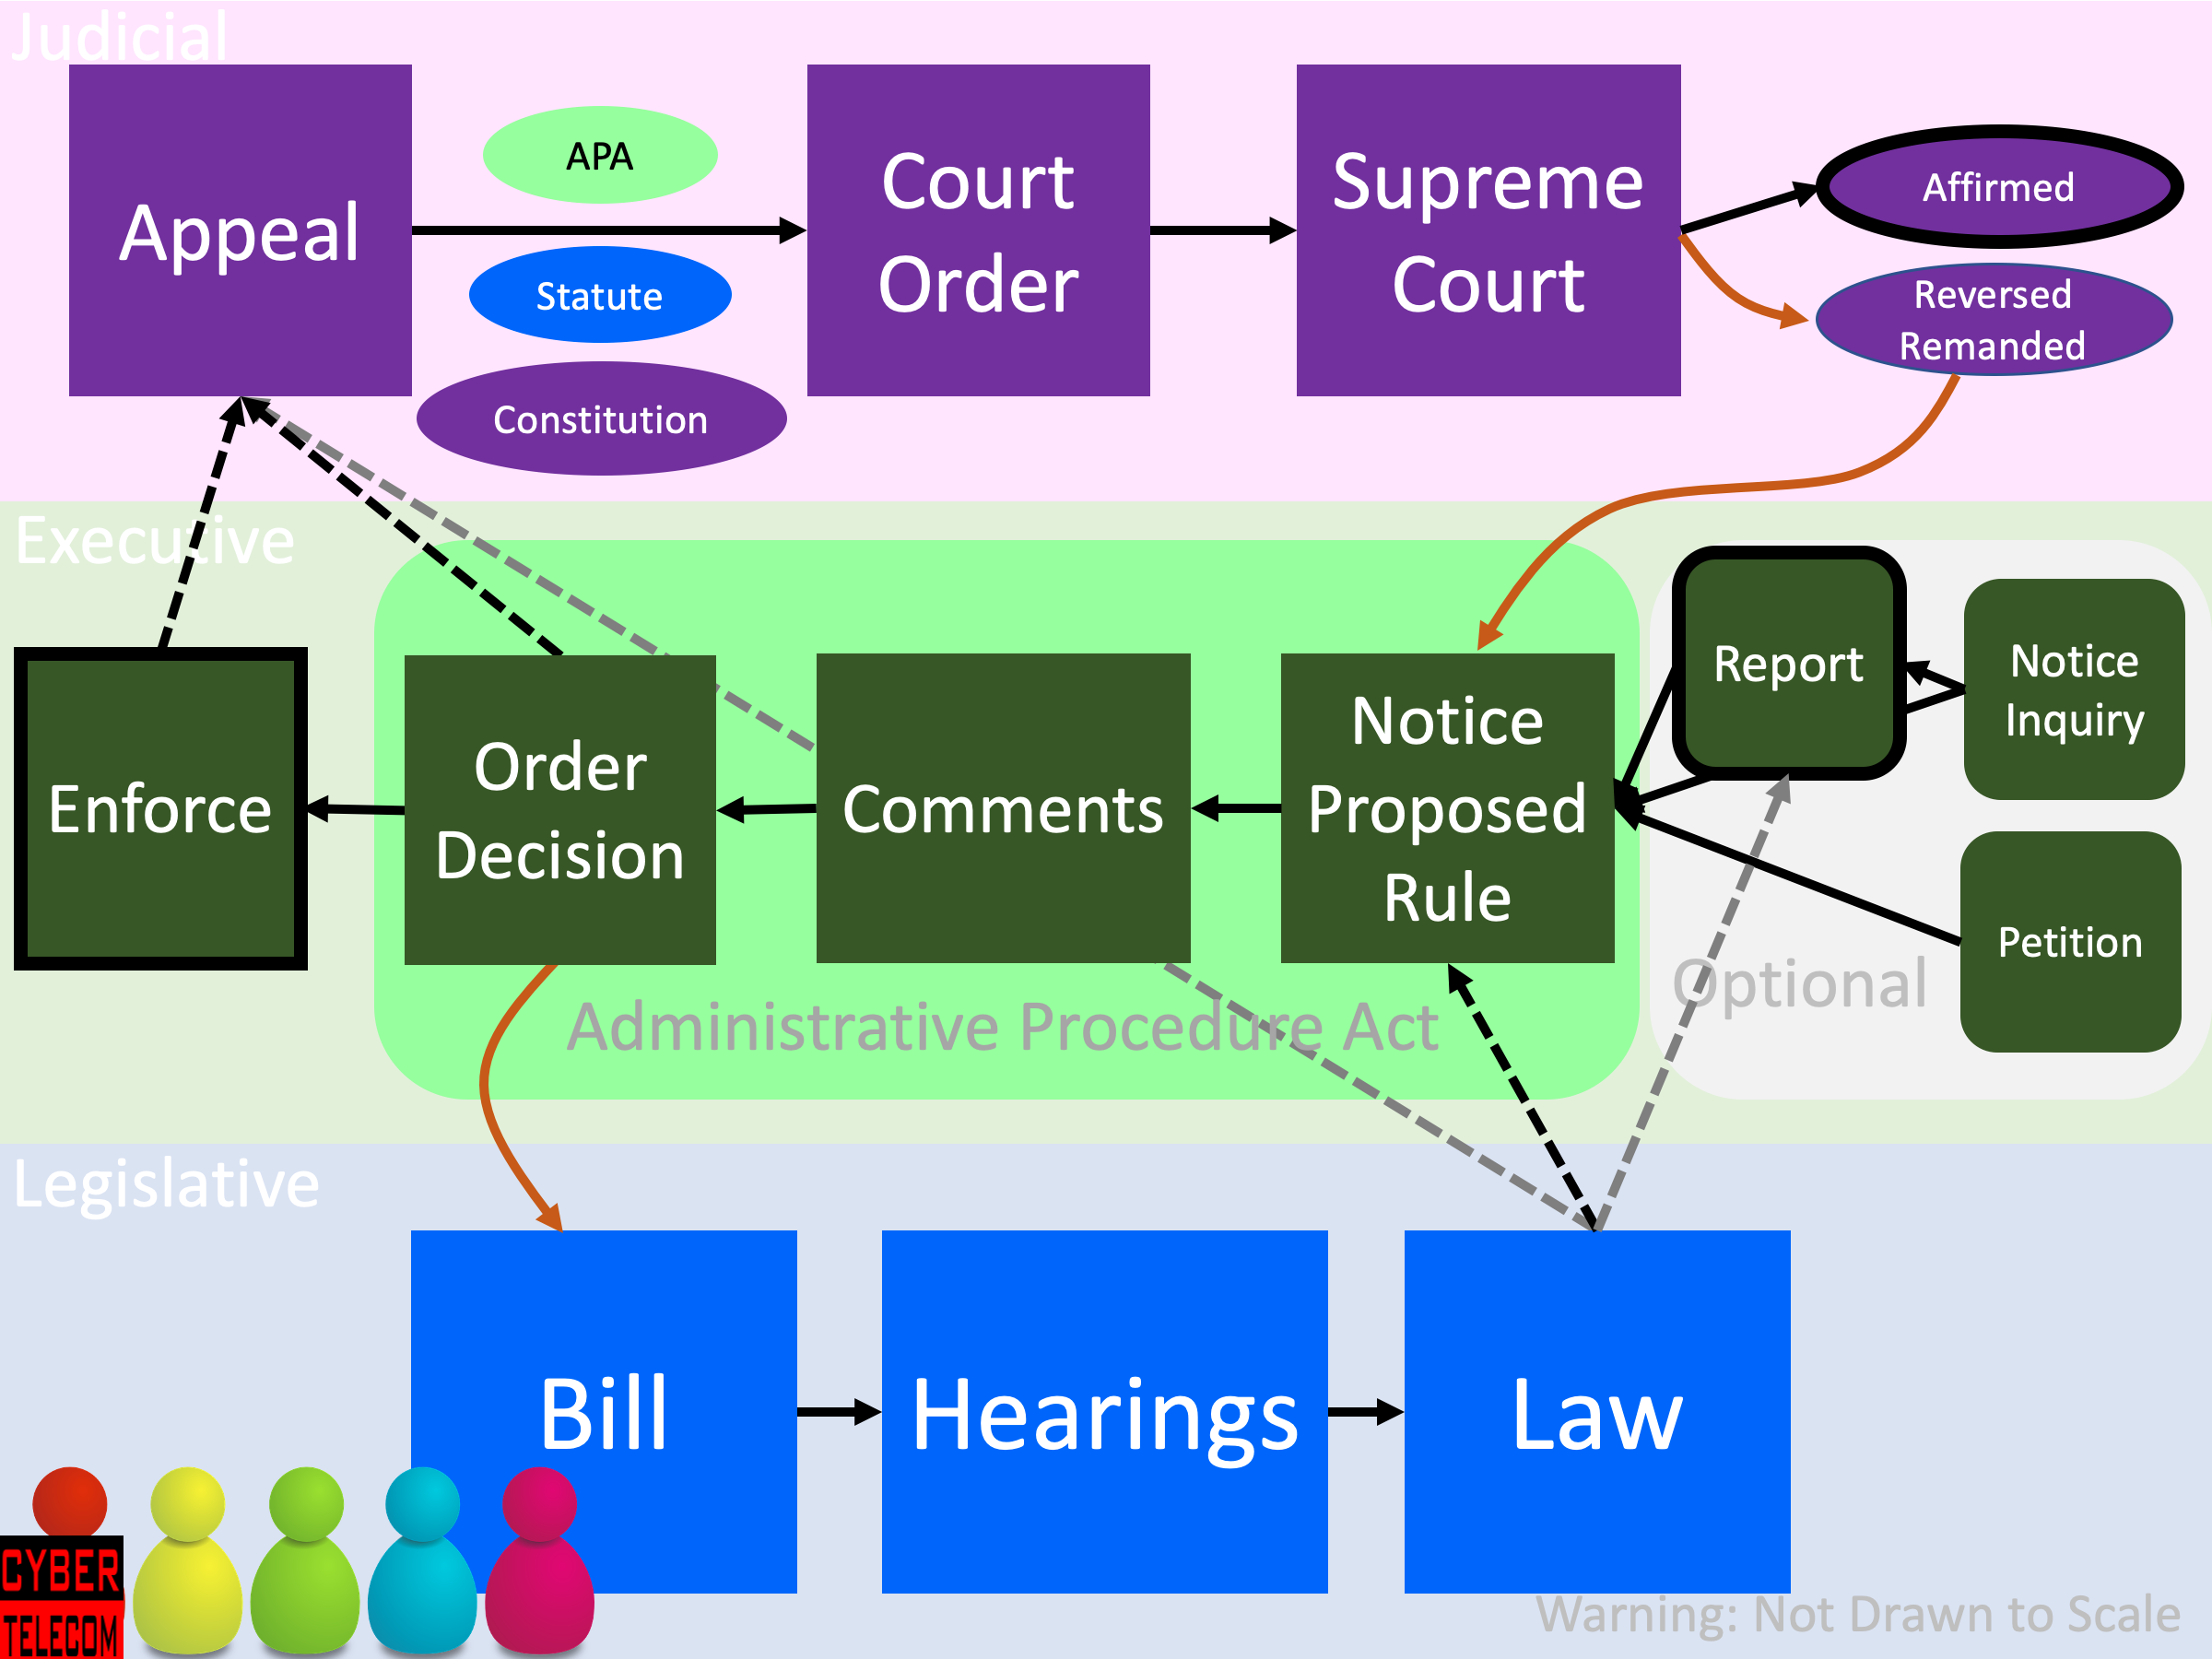
Three branches, intertwined
Credit: Bob Cannon
Notes:
https://www.thesprucecrafts.com/chutes-and-ladders-snakes-and-ladders-411609

Slide 6
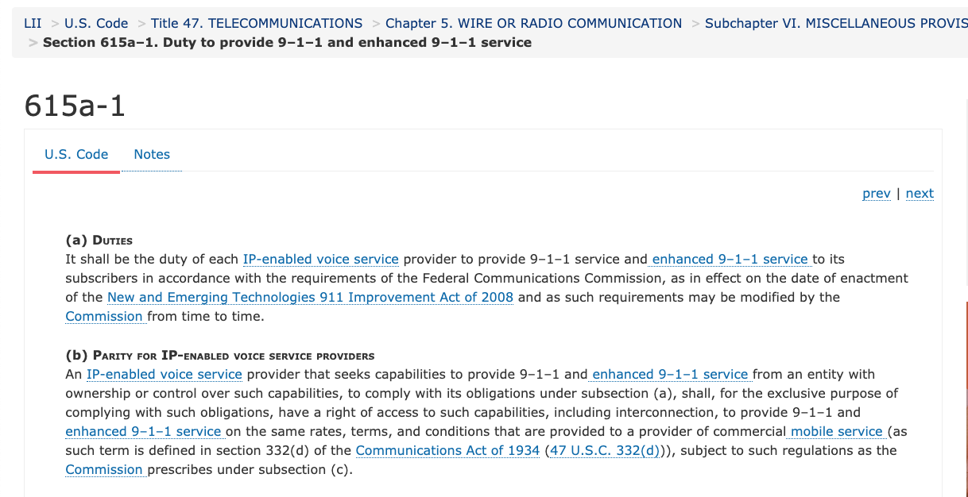
Example: Law requiring 911

Slide 7
Example of rule – 47 CFR 20.18
§ 20.18 911 Service.
(a) Scope of section. The following requirements are only applicable to CMRS providers, excluding mobile satellite service (MSS) operators, to the extent that they:
  (1) Offer real-time, two way switched voice service that is interconnected with the public switched network; and
  (2) Utilize an in-network switching facility that enables the provider to reuse frequencies and accomplish seamless hand-offs of subscriber calls. These requirements are applicable to entities that offer voice service to consumers by purchasing airtime or capacity at wholesale rates from CMRS licensees.
(b) Basic 911 Service. CMRS providers subject to this section must transmit all wireless 911 calls without respect to their call validation process to a Public Safety Answering Point, or, where no Public Safety Answering Point has been designated, to a designated statewide default answering point or appropriate local emergency authority pursuant to § 64.3001 of this chapter, provided that “all wireless 911 calls” is defined as “any call initiated by a wireless user dialing 911 on a phone using a compliant radio frequency protocol of the serving carrier.”

Slide 8
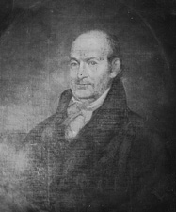
What does a Congressional office do?
Member
Administrative
assistant
Chief of Staff
Legislative Director (LD)
LA Health
LA Finance
LCs
Media/press
Staff assistant
Scheduler
Legislation
  research, draft, submit, manage
  mostly done by LAs, LD
Oversight
  letters, hearings
Constituent correspondence
  semi-automated via LCs
Constituent service
  case workers
Media
House member: 15 staff (incl. field)
Senator: 41 staff (incl. field)
+ staff for committees (majority & minority)
Notes:
https://crsreports.congress.gov/product/pdf/R/R43947
https://voxeu.org/article/optimal-number-representatives-democracy - unusually small House

Slide 9
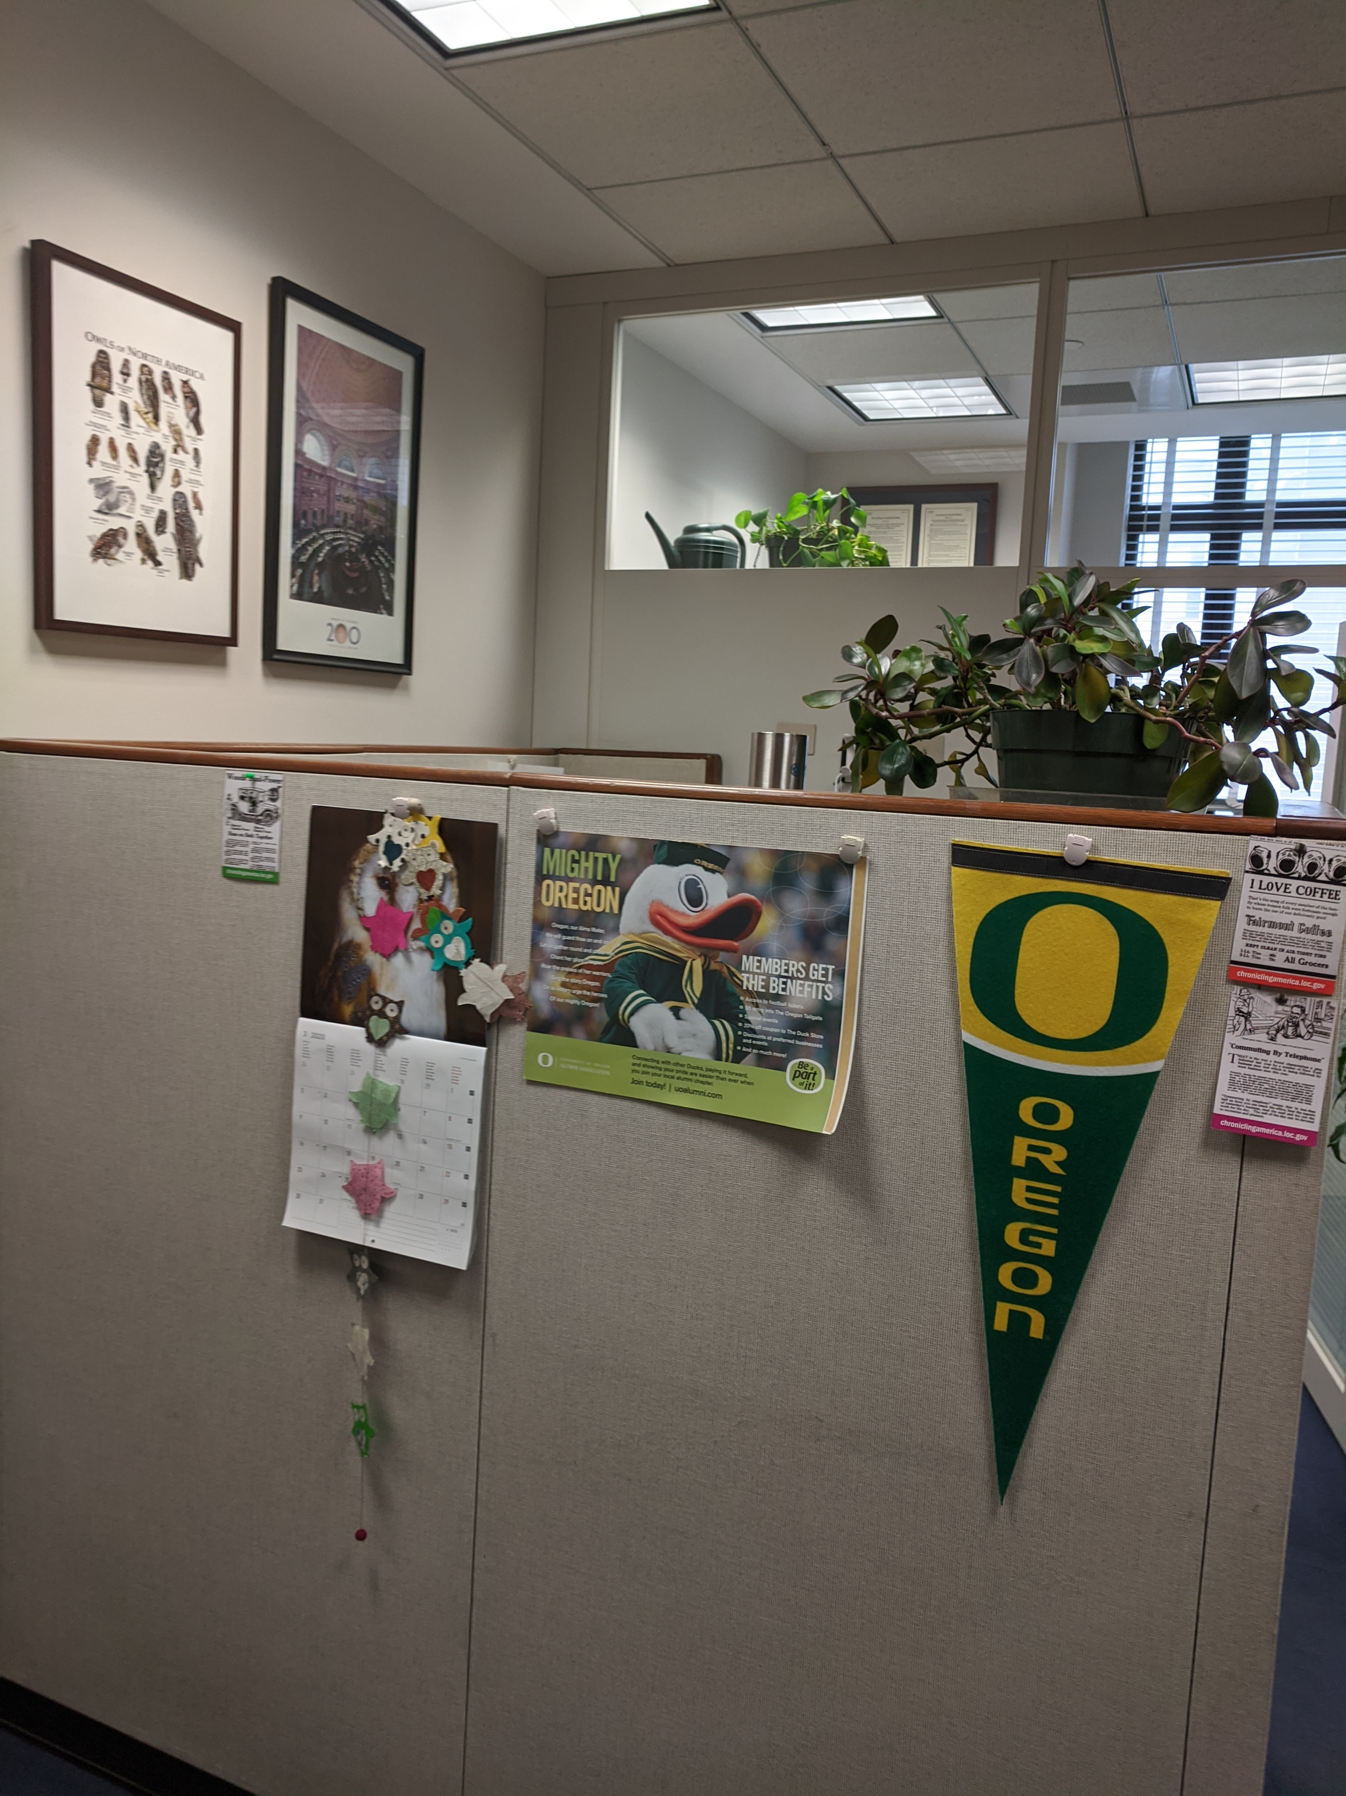
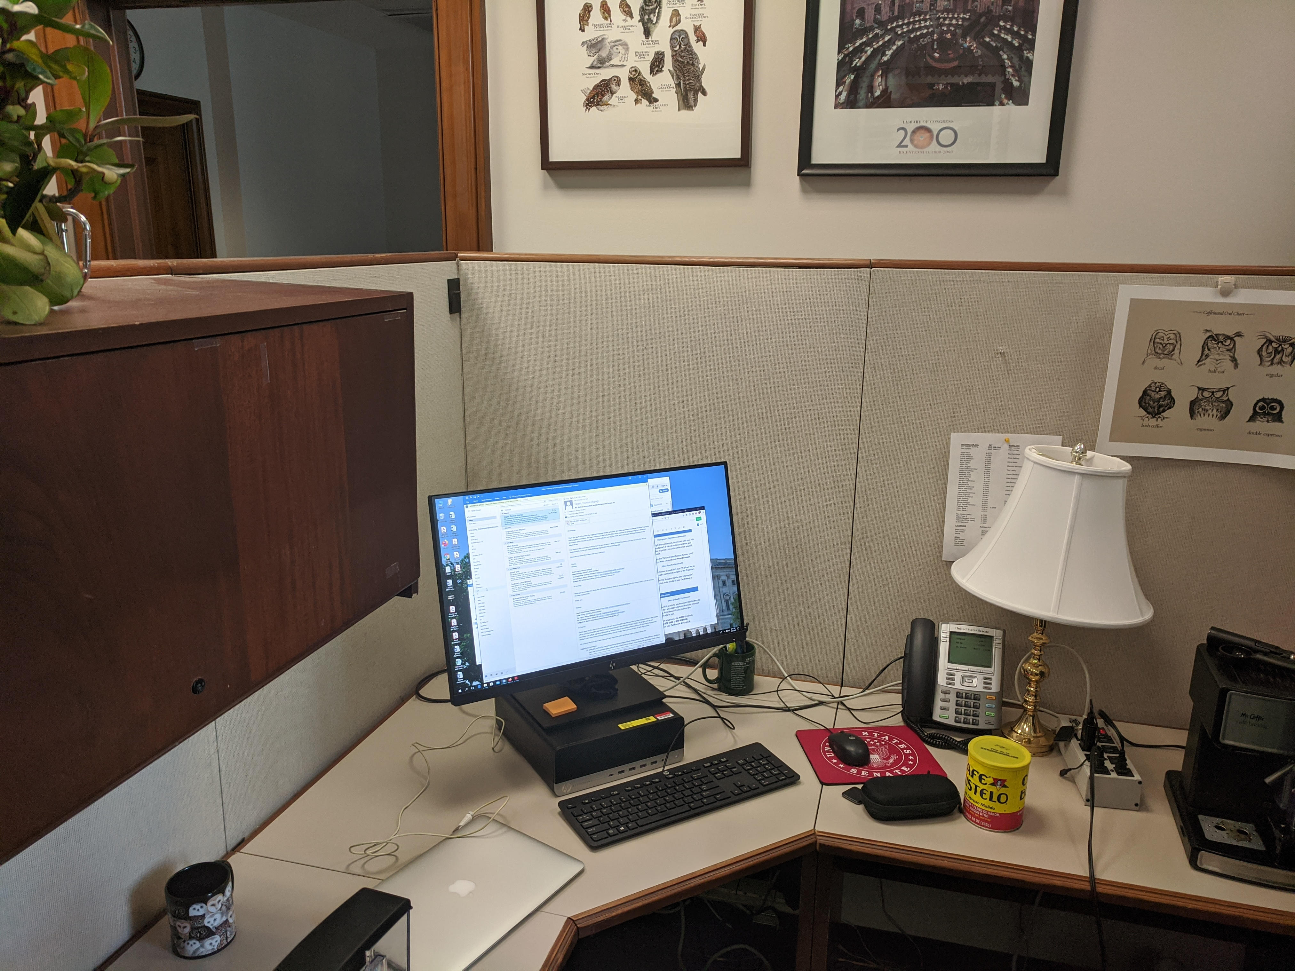
Congress during a pandemic
March 12: Wyden office switches to home mode
March 12: Capitol closed to visitors
But each office makes own decision
  the political becomes personal
Senate still votes in person; House has proxy voting
Minimal personal staff remain on-site
Staff geographically distributed
Congress designed for in-person hearings, votes, negotiation, visits, …
  normally, anybody can walk into a Member front office
Spring dominated completely by CV-19 packages and home state support

Slide 10
Closing the Digital Divide

Slide 11
Overview
Availability, affordability and relevance
What makes deploying fixed broadband necessary & expensive?
Technology may help – if it can dig trenches & automate operations
Affordability may become a larger problem than availability
Government is likely to play a major role
Mostly focus on United States, but basic problems similar elsewhere

Slide 12
How bad is the problem?

Slide 13
Global Internet users
Notes:
Internet Trends 2019 (Mary Meeker)

Slide 14
Global internet growth – 2009–2018
Notes:
Internet Trends 2019 (Mary Meeker)

Slide 15
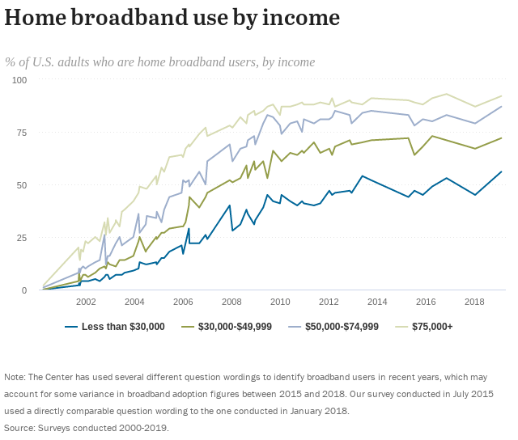
US: Income plays a major role
Pew Research
Notes:
https://www.pewresearch.org/internet/fact-sheet/internet-broadband/

Slide 16
Rural broadband US
Notes:
https://fivethirtyeight.com/features/the-worst-internet-in-america/

Slide 17
By race, too

Slide 18
% of U.S. adults who do not use broadband at home but own smartphones
Smartphones = mostly consumption devices
+ TikTok!
Hard to do homework on a smartphone
Hard to do telework
Notes:
https://www.pewresearch.org/internet/2019/06/13/mobile-technology-and-home-broadband-2019/

Slide 19
Broadband access by speed & geography
15% of US population

Slide 20
What are the causes?

Slide 21
Availability, affordability and relevance are coupled
Availability
Relevance
Affordability
carriers don’t build or improve in low-income areas (“digital redlining”)
not available – don’t know what
you don’t have
if not relevant, low on spending priority
if can’t afford, easier to claim “don’t want it”

Slide 22
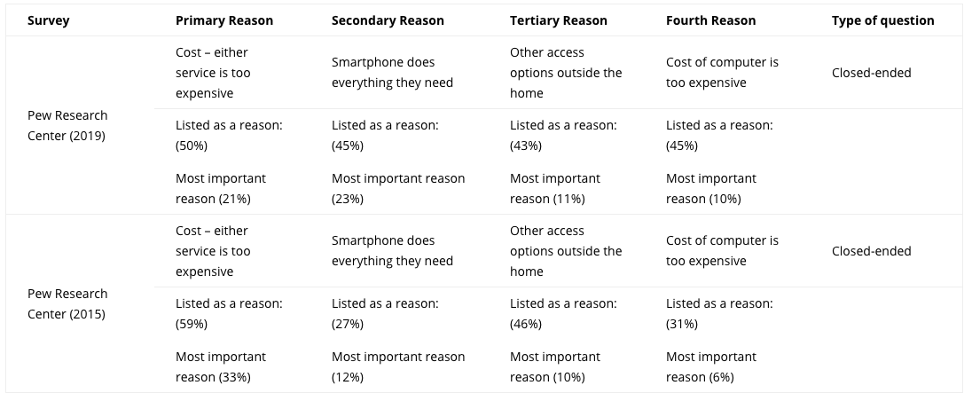
Reason for non-adoption
https://www.digitalinclusion.org/measuring-the-gap/

Slide 23
Lower population density, easier broadband
32.45/km²
2.91/km²
3.49/km²
to be covered requires
Deloitte, 2017

Slide 24
It all depends on your (network) roots

Slide 25













Who runs communication systems and networks?
incumbent local exchange carriers
(“ILEC”)
competitive local exchange carriers
(“CLEC”)
cable companies
(“MVPD”)
cellular providers (3-4)
~6
rural local exchange carriers
(“RLEC”)
wholesaler providers
(“carriers’ carrier”)
satellite providers
~1,000
communities & cooperatives (“muni networks”, REC)
~2
# with ~90% marketshare

Slide 26
But a few large carriers dominate

Slide 27
Accidental broadband
94.2% of US
households have
phone service
G.992.2
ADSL
DSL patents
1988-1991
1993
1999
62.1 million US
households have
cable TV
“peak CATV”:
82% of HH
DOCSIS 3.1
(10G/1G)
16 million
US subscribers
DOCSIS 1.0
(40M/1M)
1980
1995
1997
2008
2016
➔ DSL and cable infrastructure near-universally or widely available well before use as Internet access
Notes:
1997_Mar_Trends.pdf
https://www.calcable.org/learn/history-of-cable/

Slide 28
FTTH internationally
Notes:
http://www.oecd.org/sti/broadband/broadband-statistics/

Slide 29
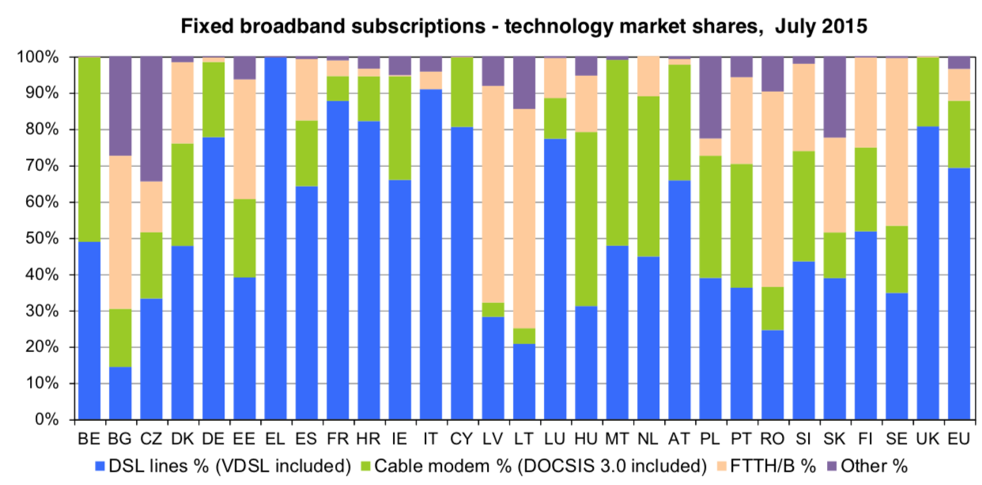
Technology path dependence
Notes:
https://www.ibei.org/en/broadband-developments-in-europe-a-retrospective-review-of-the-determinants-of-supply-and-demand_84571

Slide 30
Improving availability

Slide 31
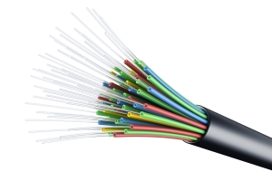
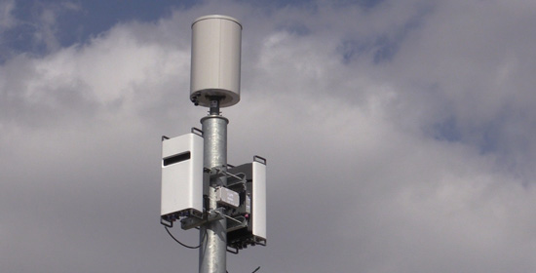
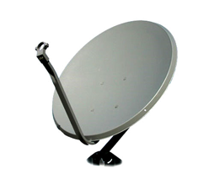
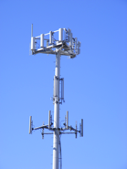
Metrics: not Gb/s or b/s/Hz, but $/GB and $/year
$/month
in-building cells
switch to small cells
2nd GEO satellite
GB/subscriber or GB/square mile

Slide 32
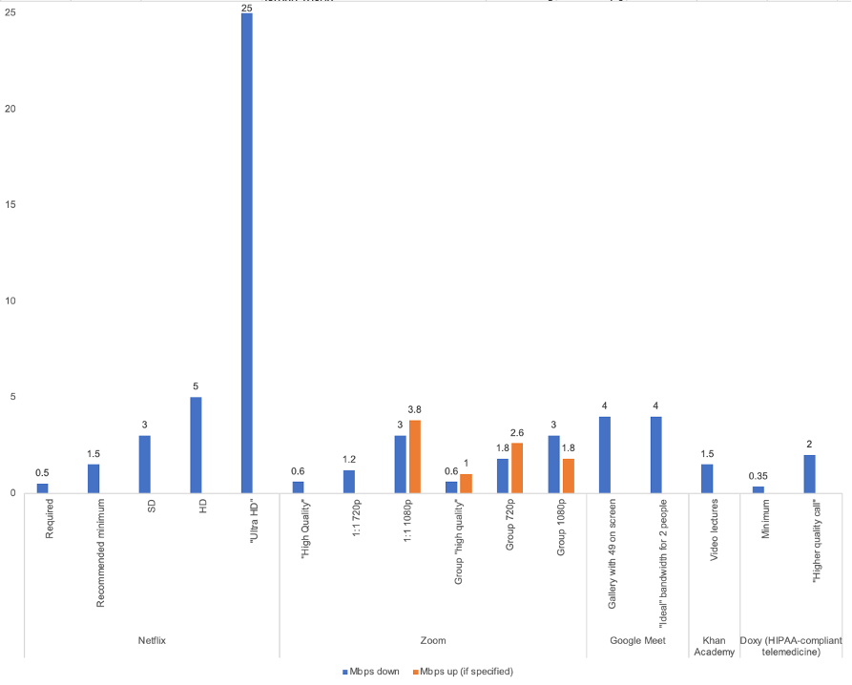
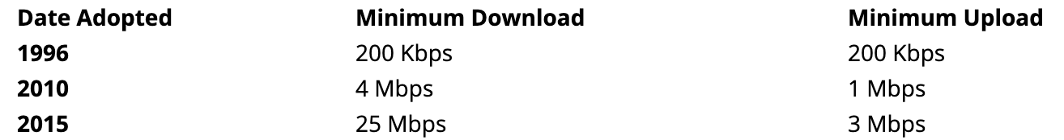
How much speed do we need?
industry: most applications don’t need lots of bandwidth
advocates: but we want future-proof networks!
Technology Policy Institute, 3/21
Notes:
https://techpolicyinstitute.org/2021/03/29/youve-been-served/

Slide 33
For non-fiber networks, problem is likely capacity, not speed
Notes:
https://www.xfinity.com/support/articles/data-usage-average-network-usage

Slide 34
Policy levers for rural broadband
Decrease cost of serving
  “dig once” – bury conduit or fiber during street (or other utility) repair & construction
  pole attachment: make-ready, rates, shot clocks, …
Provide funding
  US: Universal Service Fund
  and Department of Agriculture
  and NSF
microtrenching

Slide 35
History: rural electrification
Early 1920s, between 2 and 3% of farms (likely less)
  1921: DC had 98.2%, MA 97.8%
“In 1935, only 10.9% of American farms (744,000) enjoyed central station power, compared with Germany and Japan at 90%, France between 90 and 95%, and New Zealand at 60%.”
“In 1940, just four and a half years after Roosevelt signed Executive Order No. 7037 (followed by 1936 ”Rural Electrification Act”), 25% of American farms had been electrified.”
1950: 90% had been electrified nationally
Today: 850 distribution coops serving 14 M homes
Notes:
http://remagazine.coop/flashbacks-rural-electrification-cartogram-numbers/

Slide 36
Rural electrification
“In 1935, Morris Llewellyn Cooke, a mechanical engineer … appointed by Roosevelt as the REA's first administrator, Cooke applied an engineer's approach to the problem, instituting what was known at the time as "scientific management"—essentially systems engineering. … By 1939 the cost of a mile of rural line had dropped from $2,000 to $600. Almost half of all farms were wired by 1942 and virtually all of them by the 1950s.”
Cost of aerial fiber installation: $14k/mile material, $39k/mile installation ^{(Singer, 2017)}
USDA loans at 2.81% for 30 years
$10,958 in 2017
Notes:
“Assessing the Impact of Removing Regulatory Barriers on Next Generation Wireless and Wireline Broadband Infrastructure Investment”, 2017
http://www.greatachievements.org/?id=2990 (rural electric)
https://fas.org/sgp/crs/misc/RL33816.pdf

Slide 37
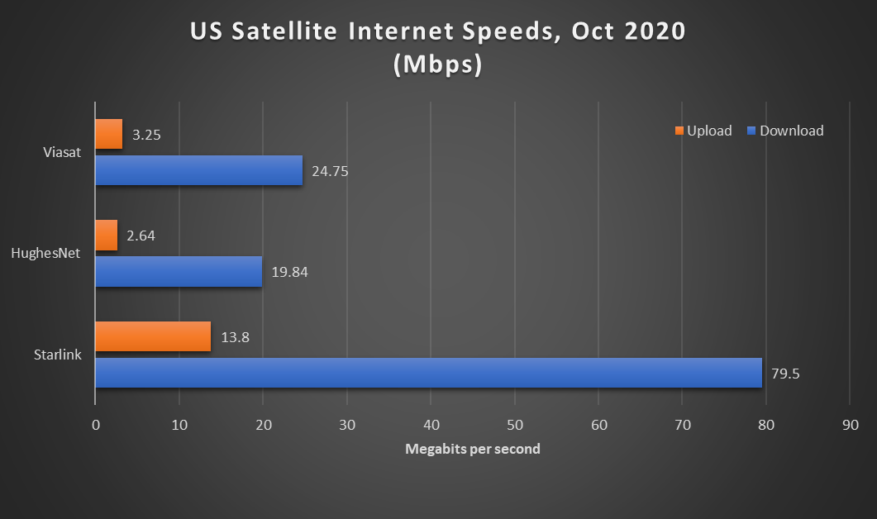
Density determines network choices
REC
cable
satellite
DSL (common)
FTTH
WISP
HH/road mile
1454
1
7
10
20
50
100
1000
Alaska roadmiles
Notes:
Manhattan: 508 road miles - http://venus.fcny.org/cmgp/streets/pages/2001PDF/Report/DFMN.pdf ; Wikipedia: 738,644 households in Manhattan
Alaska: 15,178 miles; 741,894 population
https://www.pcmag.com/news/tested-spacexs-starlink-satellite-internet-service-is-fast-but-itll-cost

Slide 38
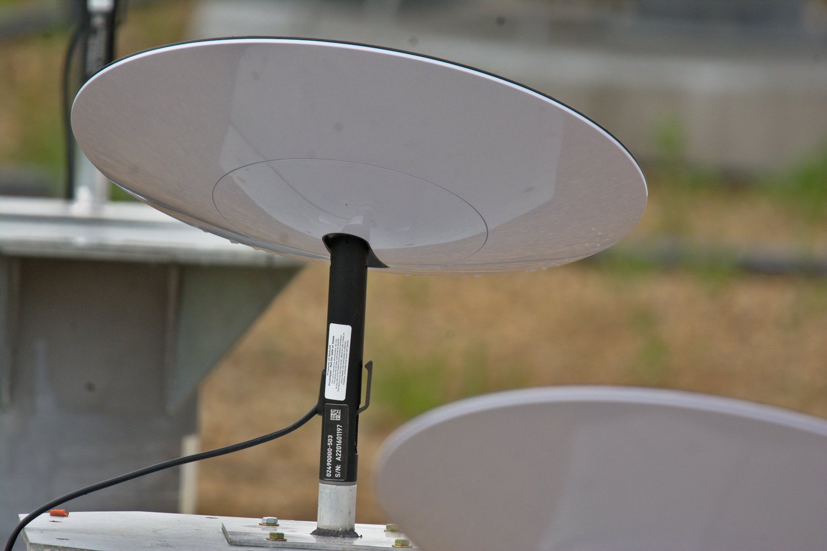
Challenges for rural broadband
Who is going to build out?
  some incumbent local exchange carriers (ILECs) are not interested
  municipalities may be prohibited by state laws
    or hurdle is extremely high
  rural electric cooperatives – serve 14M homes in US (out of ~110M)
    average, 5.8 electric meters per mile
Upgrade copper or new infrastructure?
  fiber closer to the home (“FTTN”) OR
  fiber to the home (FTTH) or fixed wireless or LEO
Who is going to pay for broadband?
  subsidize once, for N years, or forever?
Are non-landline approaches scalable?
  TV white spaces, HAPS
  satellite – NGS like OneWeb (600 satellites) or StarLink
    currently, about 500k residential satellite subscribers
      ”better than nothing”
      lacking capacity, high delay, low reliability, expensive
    LEOs change the picture
50-150 Mb/s, 40 ms RTT
$99/month
$499 antenna
Notes:
https://www.tesmanian.com/blogs/tesmanian-blog/ufo-starlink-terminal

Slide 39
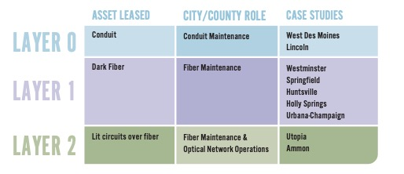
Public-private partnerships
open access or single provider
Benton Institute, Oct. 2020
Notes:
https://www.benton.org/sites/default/files/PPP3_final.pdf

Slide 40
How do we pay for this?

Slide 41

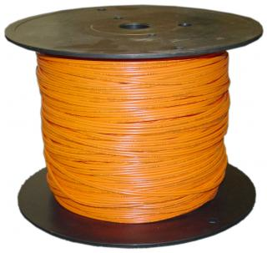
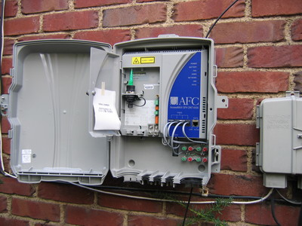
Network economics, (over)simplified
70%
30%
traditional: 12-15 staff/10k customers
Iliad, FR: 3-4 staff/10k
Notes:
opex ratios: Deloitte

Slide 42
More fiber observations
Fiber middle-mile cost: $50-70k/mile
Fiber cost: 144 strands = $10k/mile, 48 strands = $4.7k/mile
Common characteristics:
  avoid active elements in network → power, maintenance → PON
  recently: avoid anything except fiber (including splitters)
    cf. wireless last mile approach
  fiber home run, even if PON (Google Fiber, Stockholm)
Fiber cost higher for buried, but cheaper if conduit or aerial
Recent FTTH:
  avoid indoor installation (cf. Verizon FiOS)
  one box in home (ONT + 802.11ac), not ONT + MoCa STB

Slide 43
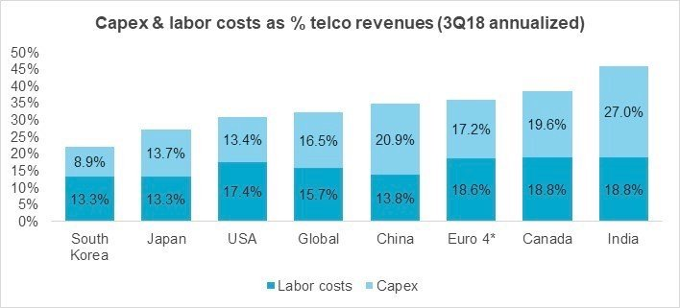
Labor and capital expenditures
Notes:
https://www.giiresearch.com/report/mtn761326-telecommunications-network-operators-3q18-market.html
https://www.fiercetelecom.com/operators/industry-voices-walker-hidden-truth-about-5g-layoffs

Slide 44
Rural wireline ILECs lack resources
Wireline share of voice revenue:
2005: 79%
2015: 15%
ARPU(fiber) = ARPU(DSL) + 𝝐
cost(fiber) >> cost(DSL)
Notes:
Deloitte

Slide 45
Universal Service Fund (USF)
Contributions from telecom providers
(assessment of ~18% on their interstate end-user revenues)
wireline telco
wireless telco
Universal Service Fund
lifeline
e-rate
(schools & libraries)
disbursement of funds to eligible entities
reduce costs for rural telcos
reduce costs for low-income consumers
cable
high-cost
rural health care
reduce costs for schools & libraries
reduces costs for rural health providers
Allison Baker, 2017

Slide 46
We’ve tried this for a while: Connect America Fund (CAF) and off-spring
Connect America Fund
RDOF
Fixed Services
Mobile Services
Legacy Competitive ETCs
Price Cap Area
Rate-of-Return Areas
Mobility Fund Phase I
CAF Phase I
CAF - ACAM
Frozen High Cost Support
Alaska Plan (Mobile)
CAF Phase II
CAF-BLS (ICLS)
Mobility Fund Phase II
CAF ICC (PC)
HCLS (SNA, SVS)
5.0B for 2019
Rural Broadband Experiments
Alaska Plan (RoR)
CAF Phase II (Auction)
Key
CAF ICC (RoR)
CAF Programs
Remote Areas Fund (Auction)
Future Programs
Legacy Programs
Notes:
https://docs.fcc.gov/public/attachments/DOC-362272A1.pdf

Slide 47
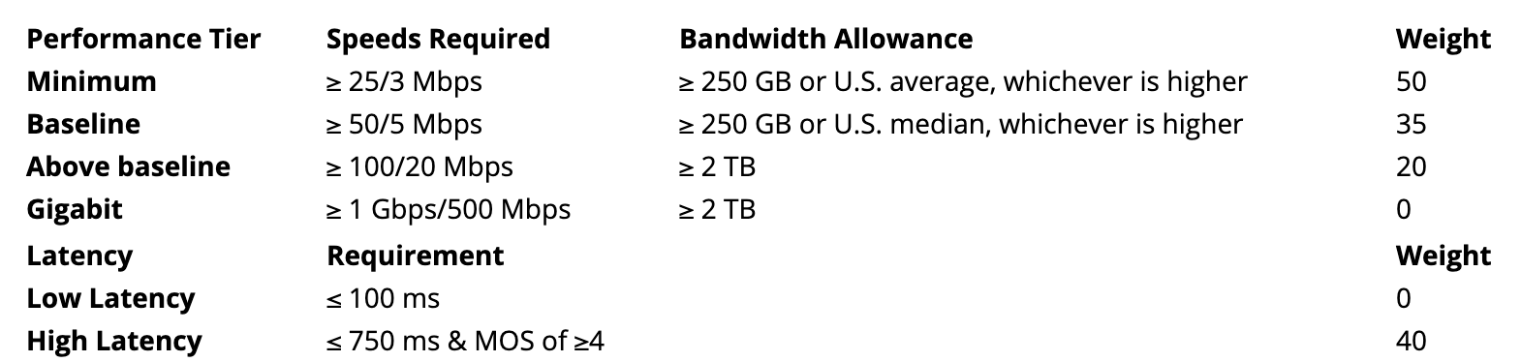
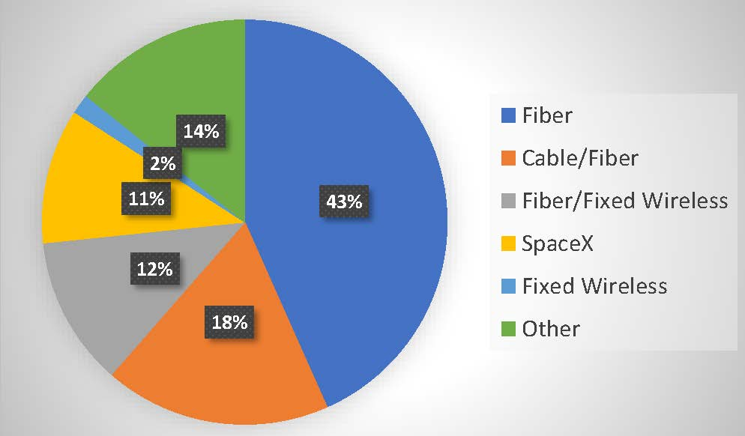
Rural Digital Opportunity Fund (RDOF) - 2020
Old (pre-1996) model: incumbent is obligated to provide “universal service”
  even if economically inefficient
  “carrier of last resort” (COLR)
Transition model: large incumbent telephone companies get money
  based on cost estimates → often upgrade DSL from really slow to slow
New model: reverse auction → lowest subsidy wins support
  non-traditional providers, new entrants, satellite, …

Slide 48
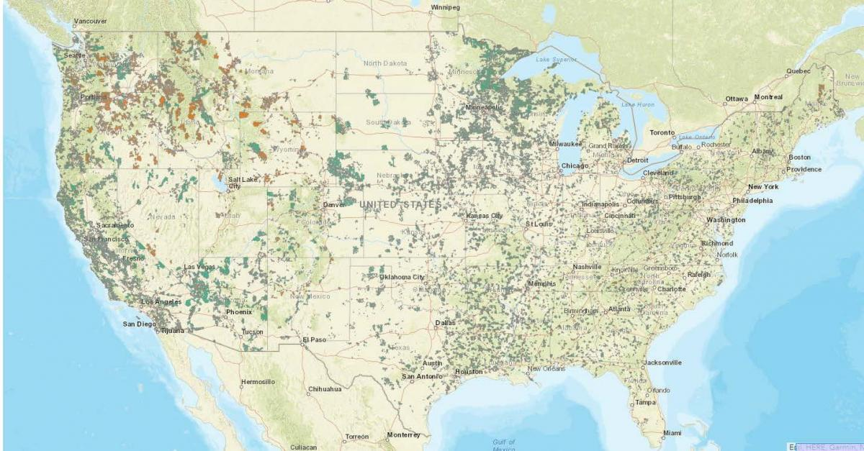
RDOF (2020) outcome
https://www.ctcnet.us/analytics/rdof-winners/

Slide 49
Your phone, video & Internet bill
911 fee (by county)
state video franchise (NJ)
subsidy (high-cost, low-income, e-Rate)
Verizon long distance
funds the FCC

Slide 50
Investment calculation
$50/month per subscriber → 15% for investment
  assume 10% for end user investment, rest for backbone, data centers, …
$5 per month → $60/year → 16.6 years payback for $1,000
Expected lifetime of fiber: 20 years
Carriers want ROIC of 10-12%
cf. Apple iPhone financial model (2.77 years, $300 avg. → $9/month)
Verizon

Slide 51
Trade-offs across the world?
If new deployment, predicted return on investment
  with unbundling: what is the wholesale price going to be?
  no magic algorithm --- margin squeeze
Allow infrastructure owner to provide services?
Impact on consumer surplus
US: pole attachment problems
  if incumbents are pole owners

Slide 52
Long-running arguments
Who should fund universal service?
  Old model: interstate communication – now, 27%
  New model (Congressional bills): general revenue
  Other models: connection-based, number-based, include BIAS revenue, …
Balance between rural (build-out, provider subsidy) and urban (consumer subsidy)?
  cf. farm bills -- agricultural subsidies vs. SNAP
Build for today’s perceived minimum need or tomorrow?
  subsidies paid over seven to ten years
  AT&T 2014: 4 Mbps “Given the pace at which the industry is investing in advanced capabilities, there is no present need to redefine “advanced” capabilities”
Minimum usable speed or closer to “urban” (cable) speeds?
Notes:
https://ecfsapi.fcc.gov/file/7522902902.pdf
https://ecfsapi.fcc.gov/file/7521827885.pdf

Slide 53
Affordability

Slide 54
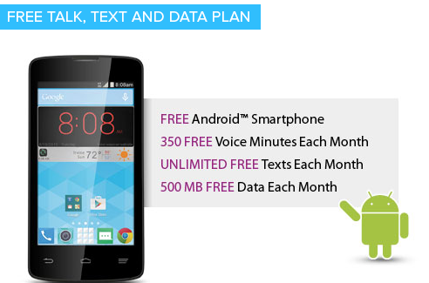
Lifeline
Established in 1985 by the FCC and mandated by Congress in the Telecommunications Act of 1996
  used to be mostly local phone, now mostly mobile
Federal program that lowers the monthly cost of phone and internet for qualified low income consumers
  Program qualification based on income or participation in a qualifying assistance program (e.g., SNAP, Medicaid, SSI, Public Housing Assistance)
  Basic support amount is $9.25 per month and up to $34.25 for consumers living on Tribal lands
    e.g., 1,000 minutes of voice, 3 GB of data
Concerns about fraud
  unused phones
  multiple phones in one household
  phones to ineligible consumers

Slide 55
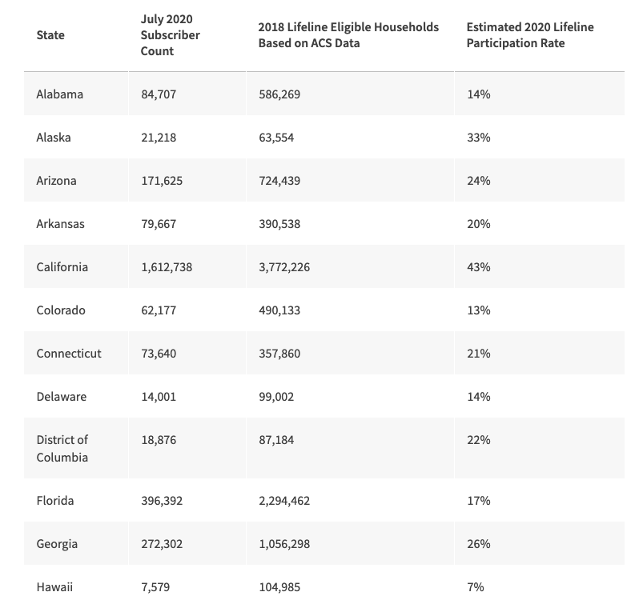
But Lifeline has reached (mostly) the end of its line
one per household – who gets the phone?
too little data even if tethering enabled
  3 hours of Zoom per month
not all children can get access
Notes:
https://www.usac.org/lifeline/learn/program-data/

Slide 56
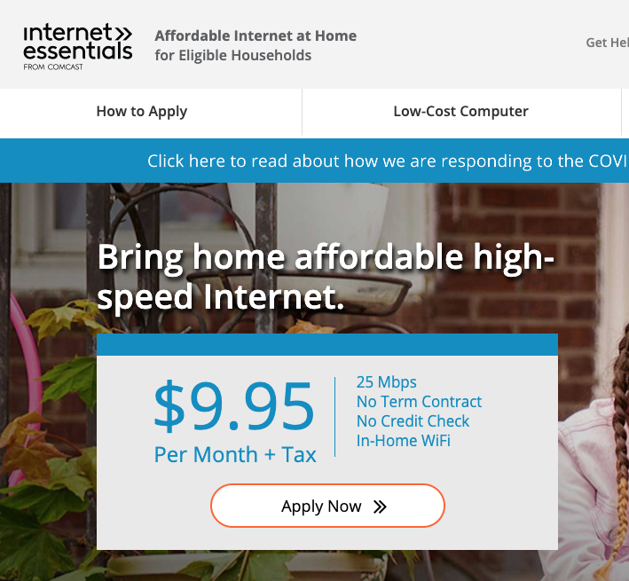

Provider-based: Comcast Internet Essentials
Some school districts give out bulk
vouchers
Fear of bills
It’s free – must be a scam
Not available in 58% of households
”have not subscribed within 90 days”
“no overdue bill within 12 months”
see also

Slide 57
COVID-19 changed thinking
Pre-COVID-19
With COVID-19
Biggest problem: no broadband in small parts of rural America
Low income households have Lifeline for basic connectivity
Need to solve mapping problem first to understand scope of unavailability
10-year programs (USF CAF II, RDOF)
Can always go to the local library or school
25/3 is plenty fast
Biggest problem: lots of people can’t afford broadband
  and quality of supposedly-covered areas is low
  no 25/3 broadband in urban areas
    only 1.5%, but that’s 3.9 M people
    vs. 11.1 M rural
    “digital redlining”
  or cannot afford devices
Students cannot wait 10 years
Local library (and school) is closed
Multiple video conferences bust 3 Mb/s upstream

Slide 58
Emergency broadband benefit (2021)
$50 discount on broadband access during pandemic
$3.2B program → ~64 M “discount months”
one-time discount of $100 for a device (e.g., Chromebook)
eligible:
  “Qualifies for the Lifeline program (e.g., about 21 M households get SNAP)
  Receives benefits under the free and reduced-price school lunch program or the school breakfast program, including through the USDA Community Eligibility Provision, or did so in the 2019-2020 school year;
  Received a Federal Pell Grant during the current award year;
  Experienced a substantial loss of income since February 29, 2020 and the household had a total income in 2020 below $99,000 for single filers and $198,000 for joint filers; or
  Meets the eligibility criteria for a participating providers' existing low-income or COVID-19 program.”
Notes:
https://appropriations.house.gov/news/press-releases/house-democrats-release-updated-version-of-the-heroes-act
https://www.fcc.gov/broadbandbenefit

Slide 59
Conclusion
Availability, affordability & relevance
Except for large cable companies, challenging economics for ISPs
Introducing competitive fiber speeds is difficult everywhere
Who should subsidize high-cost and low-income areas? Taxes or fees?
Emphasis on automation (+ staff cuts) and simplified service structure
  not new services, protocols, speeds
Research directions:
  fully autonomous, self-configuring networks

Slide 60
And in closing
Technology now plays a central role in key policy debates
Hot topics: privacy, algorithmic fairness, broadband access, IT modernization, autonomous/electric vehicles
Congress is not well engineered to get things done in a time of polarization and divided government
  US has an unusually high number of veto points
But computer science has significant roles to play:
  build, design and advise on better IT infrastructure
  advise decision makers – both in Congress and in federal agencies
    consider internships for students
More likely as part of an organization than as an individual

