Slide 1
A Platform for Experimental Research in Critical Voice Communications
PSCR 2020: The Digital Experience
Jan Janak, Artiom Baloian, Dan Rubenstein, Henning Schulzrinne
(with Norman Groner & Charles Jennings - John Jay College)

Slide 2
Disclaimer
This presentation was produced by guest speaker(s) and presented at the National Institute of Standards and Technology’s PSCR 2020: The Digital Experience. The contents of this presentation do not necessarily reflect the views or policies of the National Institute of Standards and Technology or the U.S. Government.
Posted with permission

Slide 3
Project Objectives
How does the quality of the communication channel affect first responder communications?
Four phase approach:
Build a communication testbed
Emulate real mission critical voice (MCV) systems
Configurable audio & network impairments
Experiment with trained first responders
Communicate using the testbed in a controlled environment
Measure communication performance
Analyze data collected during experiments
Build mathematical models
Channel conditions -> performance measures

Slide 4
Quality of Experience (QoE) Measures
Comprehension errors
e.g., repeat transmitted messages
Task errors
e.g., wrong information recorded
Usage errors
e.g., pressing push-to-talk (PTT) button too early or too late
Length and latency of responses
e.g., pauses between requests and start of transmission
Subjective ratings of user experience
e.g., rated frustration with radios

Slide 5
Testbed Overview
Open hardware & software
Affordable off-the-shelf components (Raspberry Pi for user terminals)
Scalable design (up to 10 user terminals)
Emulates analog & digital MCV systems (including P.25)
Programmable audio & network impairments
Testbed & experiment management from the browser
APIs for experiment evaluation & analysis
Allow for limited remote (at-home) experiments

Slide 6
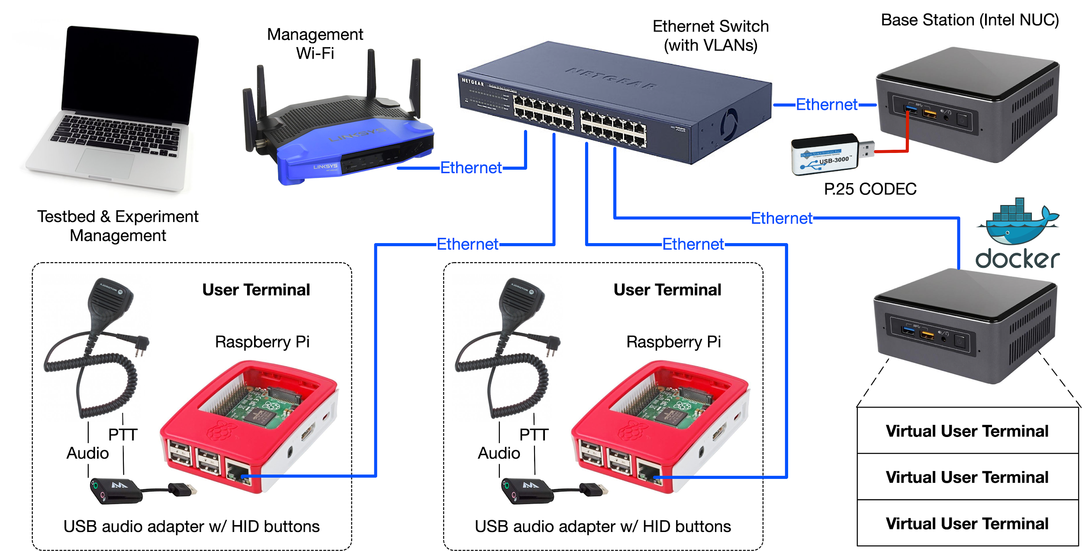
Testbed Architecture (May 2020)

Slide 7
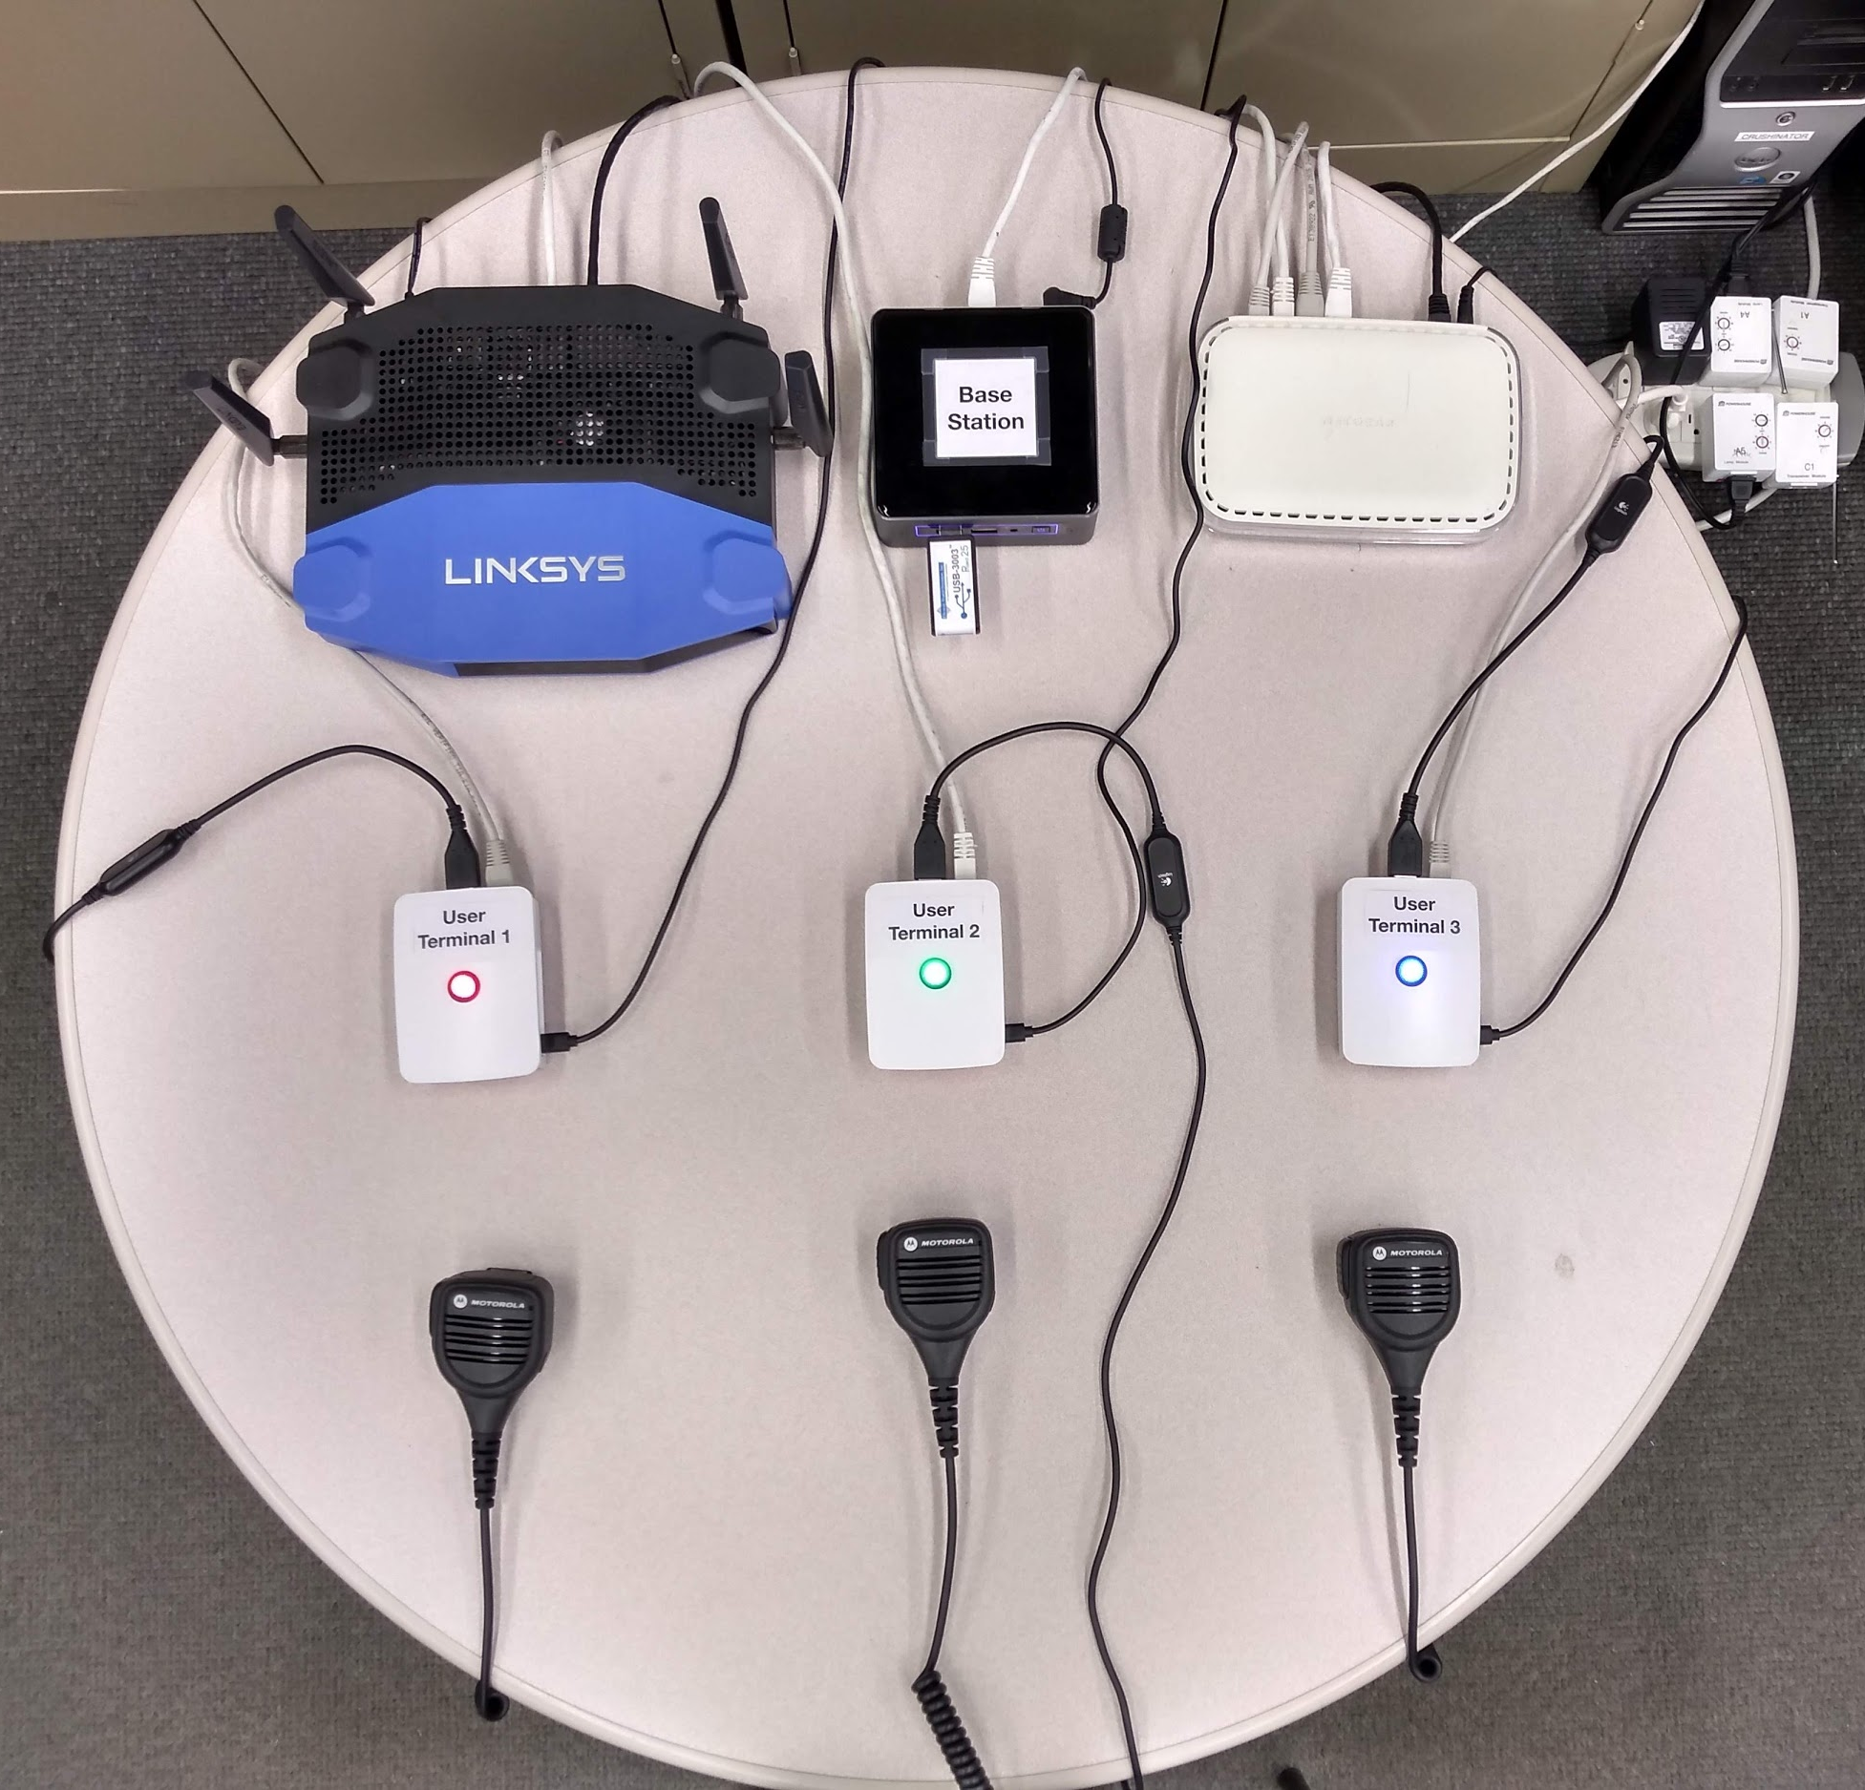
Testbed Architecture (May 2020)

Slide 8
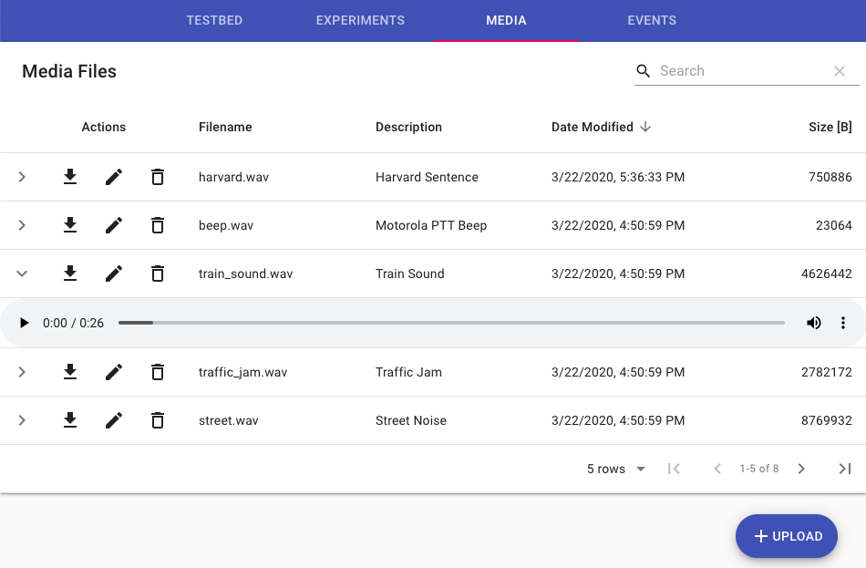
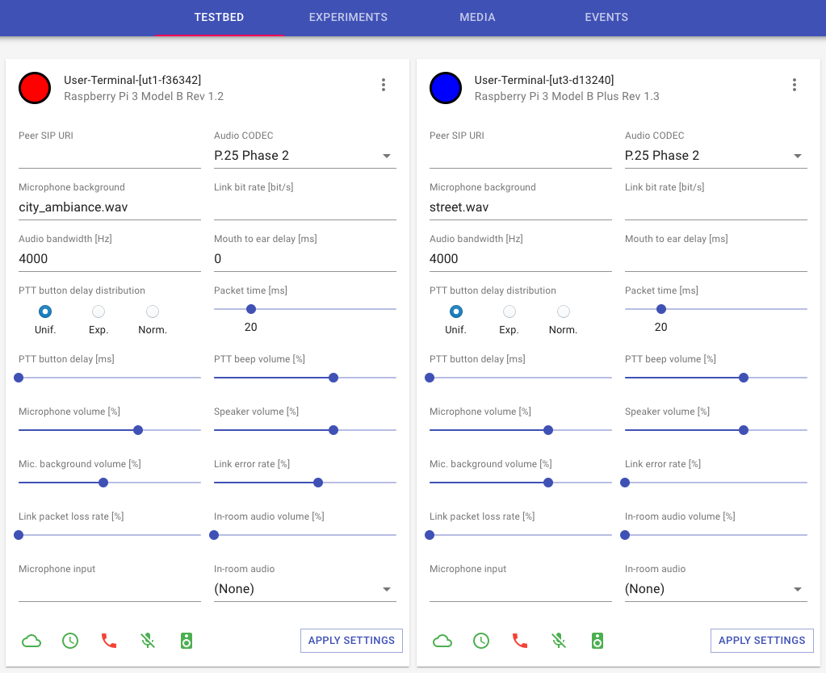
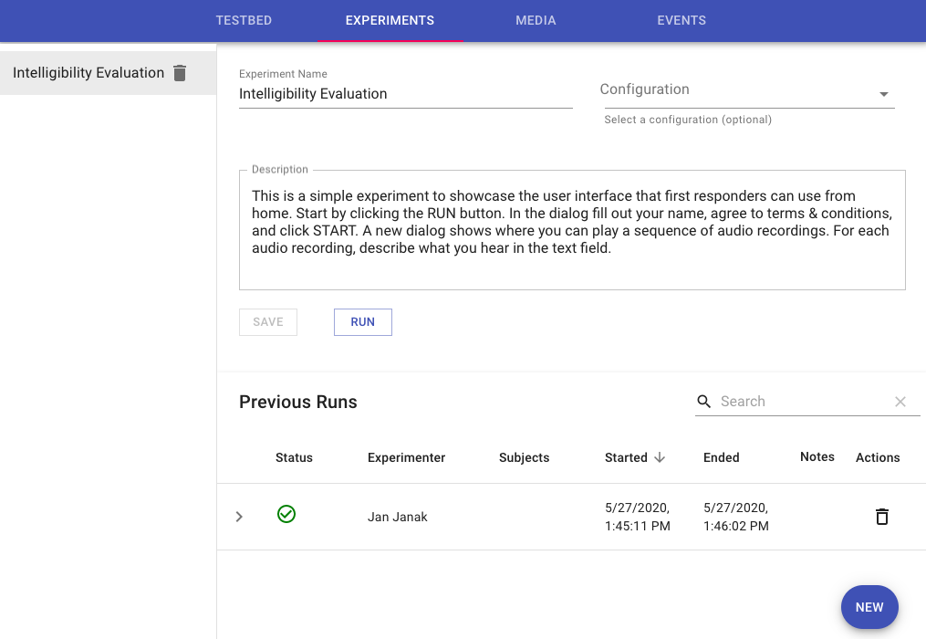
Testbed User Interface
Audio Recordings
User Terminal Control
Experiment Management

Slide 9
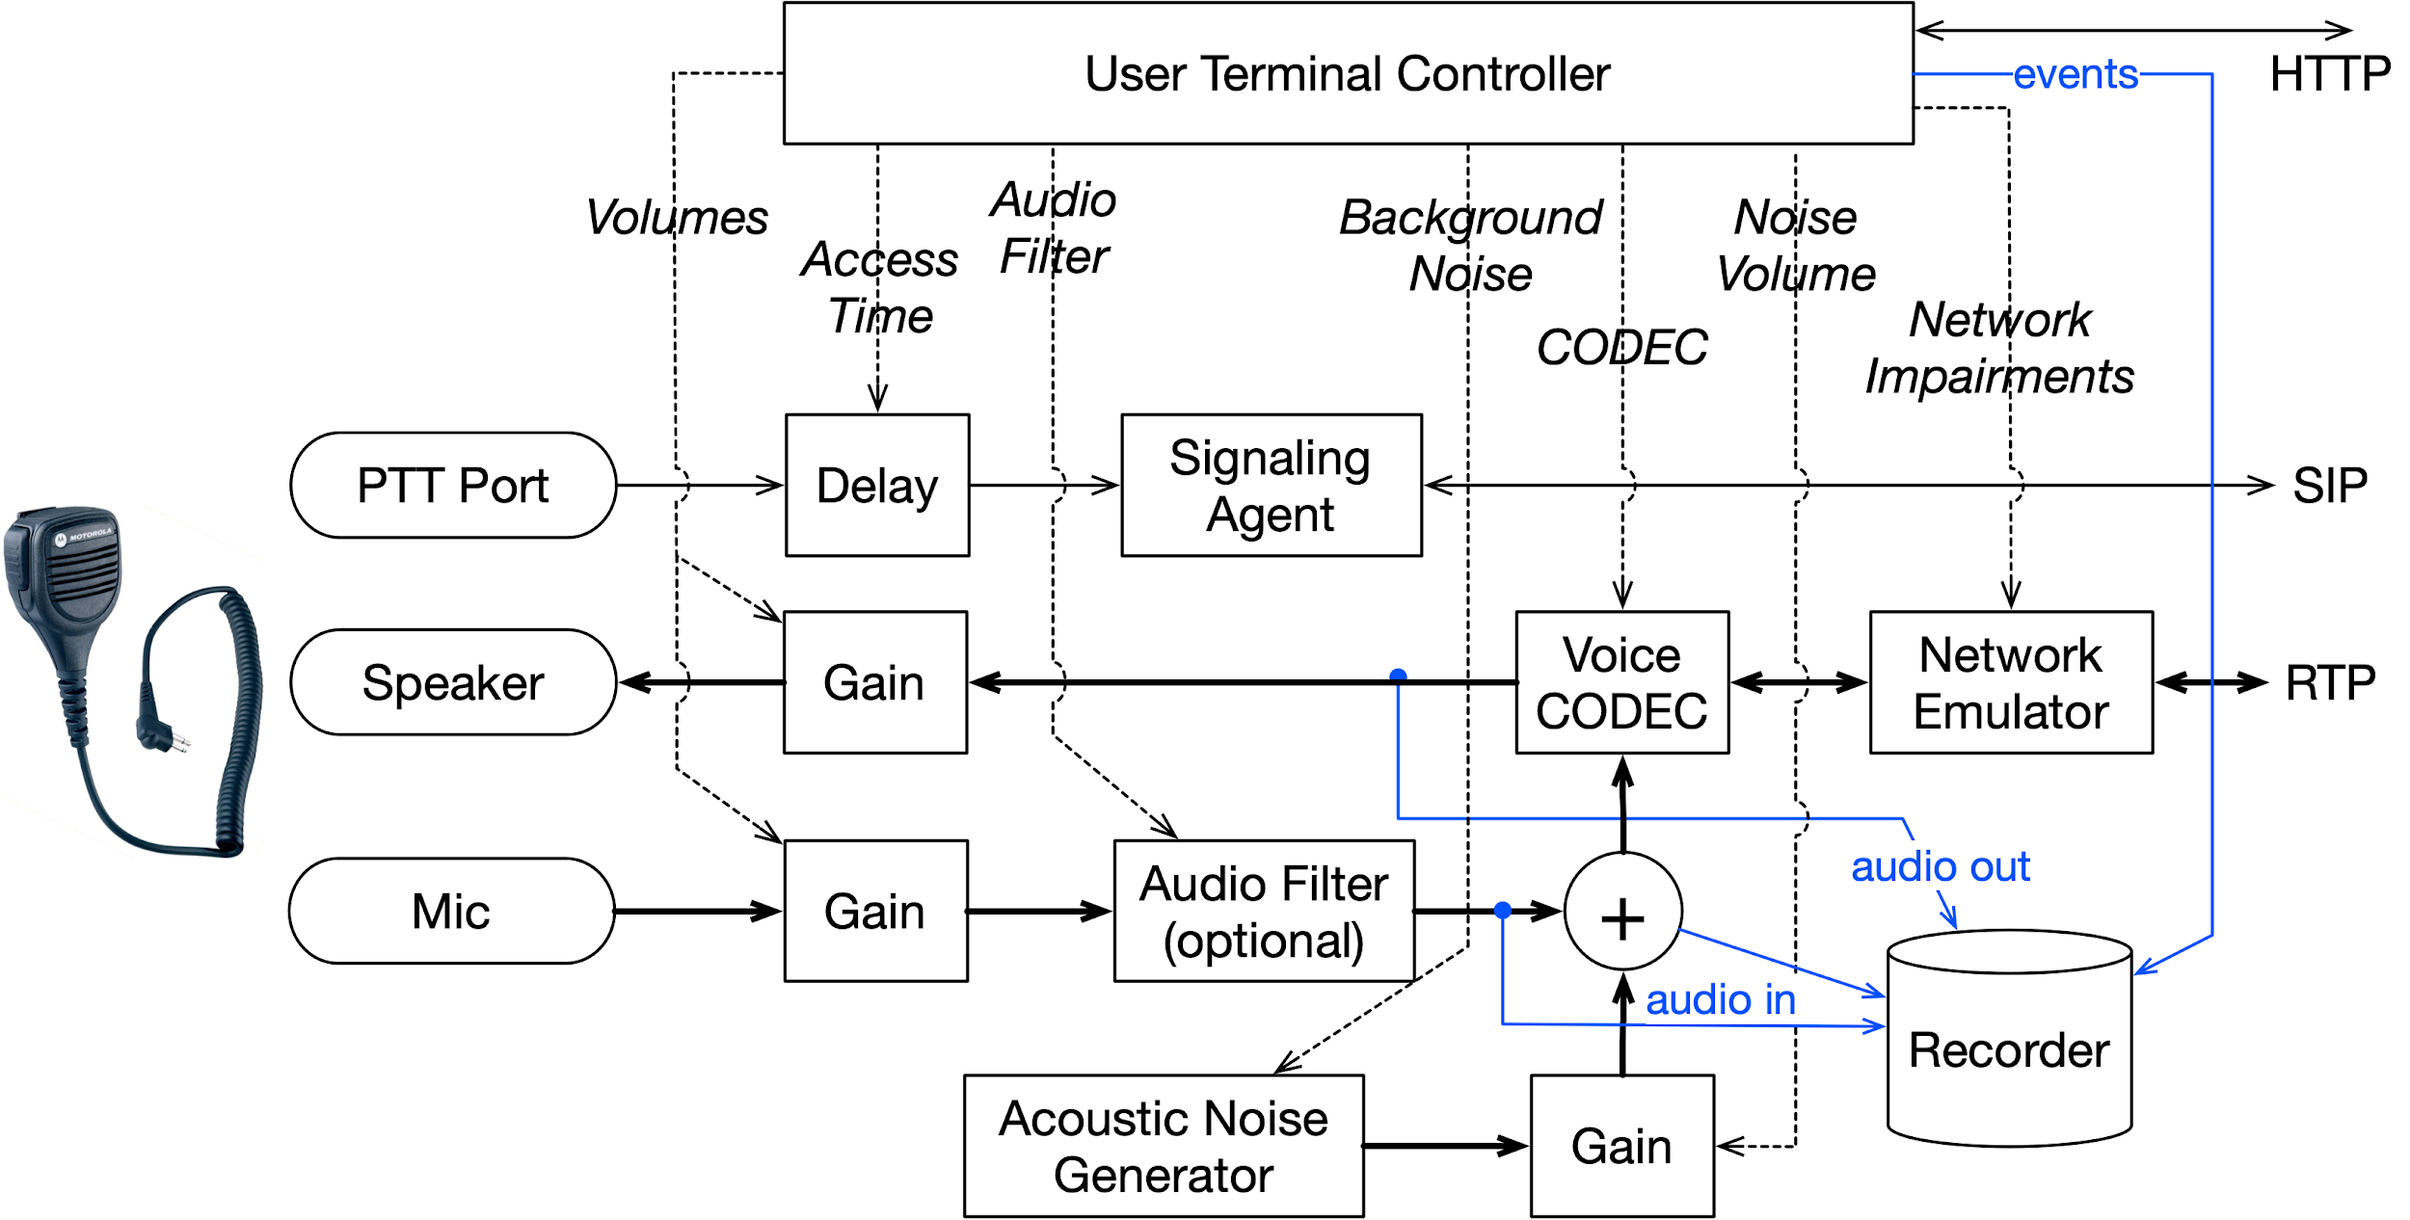
User Terminal: Block Diagram

Slide 10
User Terminal: Services
Custom controller application
NodeJS, TypeScript, HTTP, WebSocket
PulseAudio for audio processing
Mixing, volume control, audio filtering
Baresip SIP user agent (custom P.25 codec)
Linux kernel network emulator
delay, bandwidth, packet loss, error rate
Custom event & audio recorder
Time-synchronized events & audio recordings
Uploaded to base station for processing

Slide 11
User Terminal: Supported Impairments
Audio
Network
Configurable mouth-to-ear delay
Maximum bandwidth limitation
Modulation rate (baud rate)
Packet loss
Bit error injection
Background noise injection
Fine-grained volume control
Audio filtering (bandwidth, low-pass)
Variable PTT delay (mic audio cut-off)
Voice compression (CODEC selection)

Slide 12
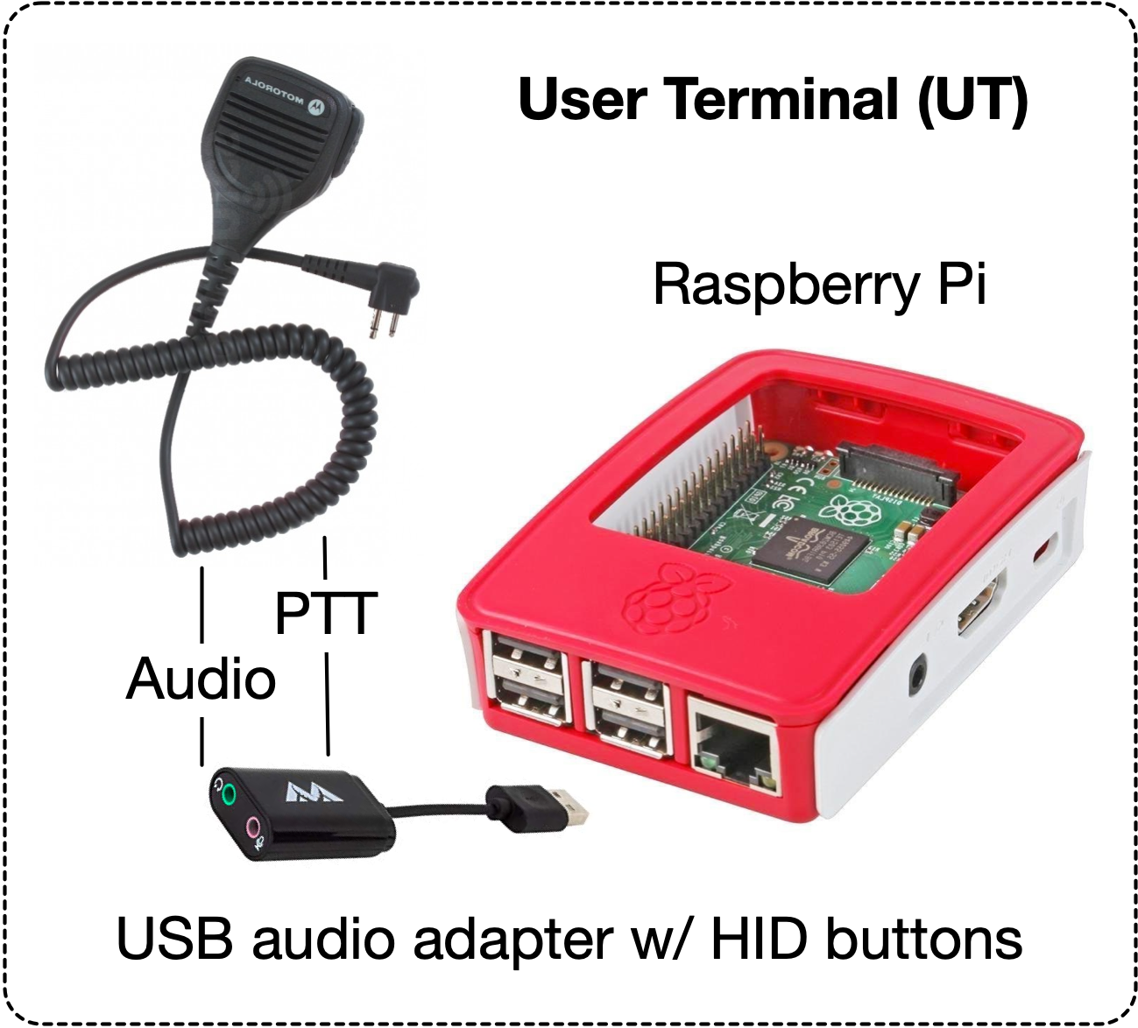
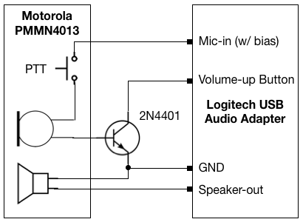
User Terminal: Custom Hardware
Connect Motorola speaker to Raspberry Pi
USB soundcard with volume buttons
Connect PTT to volume up button
Custom circuit with a transistor
Access via the Linux input subsystem
Challenges
Speaker power limited by USB power (5V, 1A)
Speaker PA needed to match real radios

Slide 13
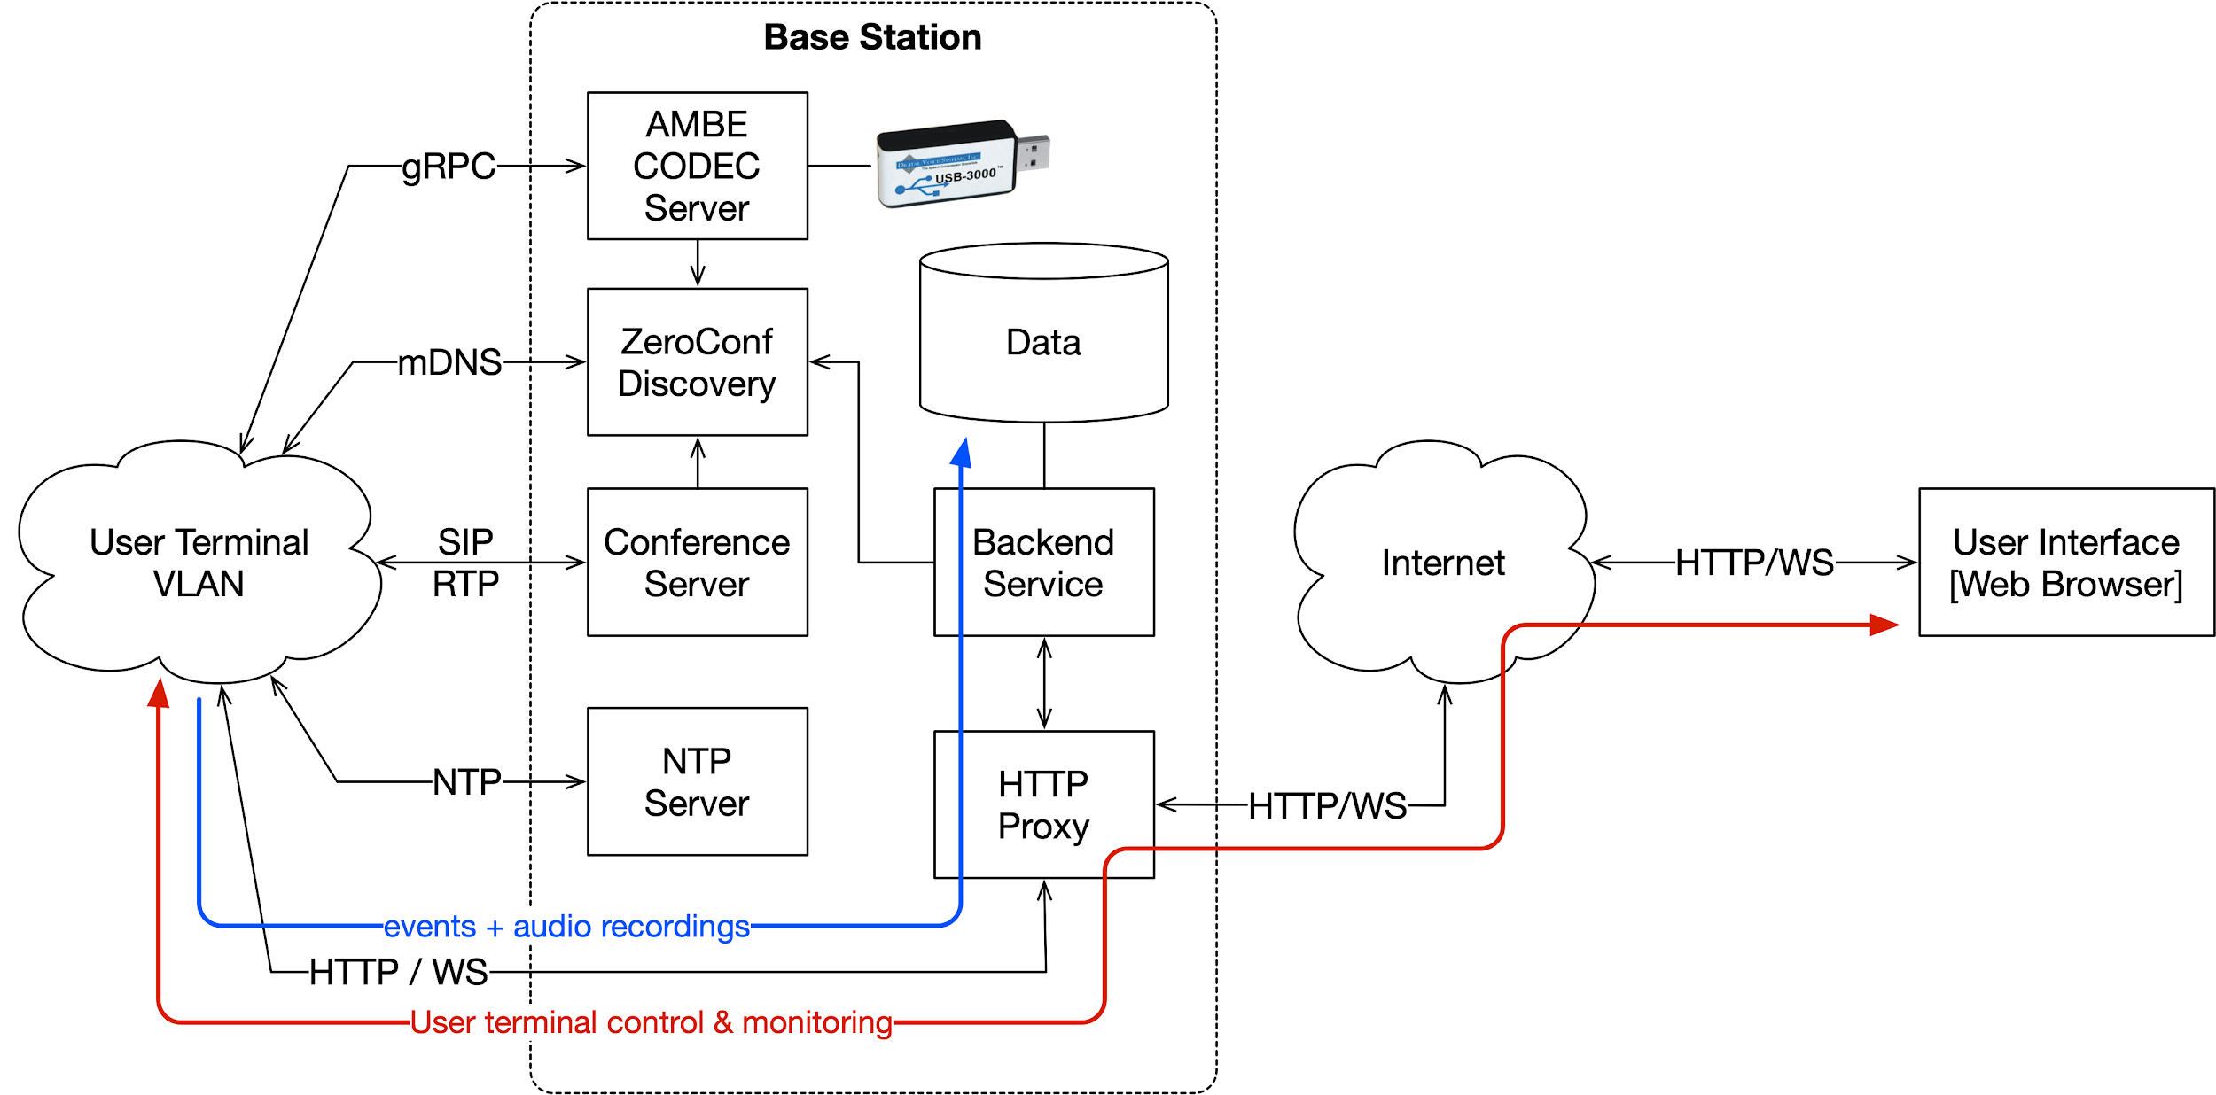
Base Station: Block Diagram

Slide 14
Base Station: Services
Custom AMBE CODEC server
ZeroConf for service discovery
SIP conference server emulates RF channels
NTP for user terminal time synchronization
Millisecond-level accuracy
Global event ordering
Data storage
MongoDB (configuration, events, other data)
Local filesystem for audio recordings
Backend services
User terminal configuration & management
Experiment management & data collection
Experiment analysis & evaluation

Slide 15
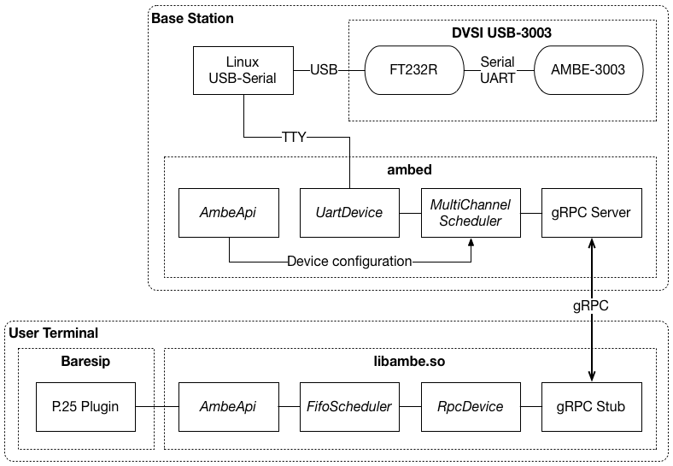
AMBE CODEC Integration
P.25 systems use DVSI’s AMBE codec
Available only as hardware (USB dongle)
USB-3000: One channel
USB-3003: Three channels
Supporting USB-3003 is challenging:
Share the device across LAN
Near real-time operation
Fair request scheduling
Solution:
CODEC service
Accessed remotely from terminals
Uses the gRPC protocol

Slide 16
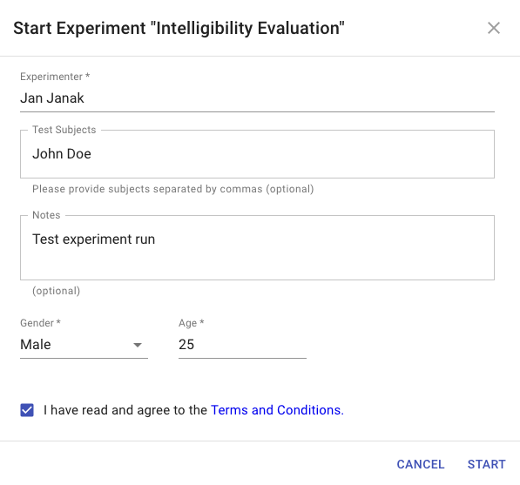
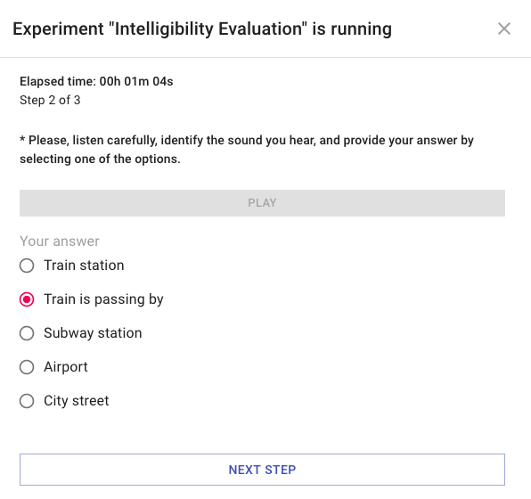
Support for Remote Experiments
Execute experiments remotely from home
Browser UI for playback and data collection
Pre-recorded audio clips with impairments:
CODECs, noise, PTT delay, loss & errors
Anti-cheat design (play once only, no pause)
Collect subject’s answers:
Free-form text
Single-choice
Multiple-choice
Accessible over the Internet

Slide 17
Support for Remote Experiments
Execute experiments remotely from home
Browser UI for playback and data collection
Pre-recorded audio clips with impairments:
CODECs, noise, PTT delay, loss & errors
Anti-cheat design (play once only, no pause)
Collect subject’s answers:
Free-form text
Single-choice
Multiple-choice
Accessible over the Internet

Slide 18
Initial Human Subject QoE Intelligibility Metrics
One way, no delay impairment
MRT as baseline
License plates as semi-realistic use case of low-context information transfer
Street addresses as medium context
“A burglary has been reported at 539 Zachary Lane”
Which of the following addresses must closely matches what you heard?
Thackery Lane
Zachary Lane
Tannery Lane
Saxony Lane

Slide 19
Future QoE Metrics: Multi-person
Task performance when faced with voice impairments
Key metric: PTT delay (fixed and variable) & mouth-to-ear delay
Requires (at least) two parties
Need to identify both naturalistic and artificial scenarios
Naturalistic scenario example: DHS active shooter training (EDGE)?
Artificial scenario example: e.g., Fischer & Mosier (2014) using space craft controls or Krauss & Bricker (1967) using picture identification
Notes:
https://www.youtube.com/watch?v=v5pBdwkXd70

Slide 20
Ongoing Work & Next Steps
Offline mode for running listening experiments from home
Environment for experiment evaluation & analysis
Integration with third-party tools (Google speech-to-text, Dragon Audio)
Optional integration with cloud services (Google Cloud, AWS, Jupyter Notebooks)
Calibrate speaker & microphone levels
Measure true mouth-to-ear delay
Collect background noise recordings from real MCV systems
Initial experiments with Columbia University students
IRB approved
Validate tools & methodology

