Slide 1

Do We Still Need Wi-Fi in the 6G Era?
This material is based upon work supported by the National Science Foundation under Grant No. 1702967. Any opinions, findings, and conclusions or recommendations expressed in this material are those of the author(s) and do not necessarily reflect the views of the National Science Foundation.
Henning Schulzrinne
Columbia University

Slide 2



Classical ecological niches
pairing
profiles
mesh
low energy
smartphones
international roaming
voice
IoT WAN
laptops
Wi-Fi offload
voice
mobility
international roaming
speed
authentication
peripherals
lowest-end
devices

Slide 3
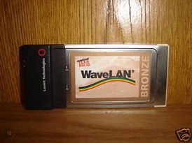
Parallel timelines
realistic top speeds
< 0.1 Mb/s
0.1-1.5 Mb/s
5-50 Mb/s
150-200 Mb/s
1G
2G
3G
4G
5G
1980
1985
1990
1995
2000
2005
2010
2015
2020
2.4 GHz
ISM
802.11g
~20 Mb/s
802.11ax
~1 Gb/s
802.11a
~20 Mb/s
802.11n
~100 Mb/s
802.11ac
~200 Mb/s
802.11
~2 Mb/s
802.11b
~6 Mb/s
approximate standardization
or first deployment
Notes:
https://www.tomsguide.com/us/best-mobile-network,review-2942.html
https://kenstechtips.com/index.php/download-speeds-2g-3g-and-4g-actual-meaning

Slide 4
But it’s looking like a Wi-Fi vs. 4G/5G (+ LoRA?) fight
cheaper data
0¢/MB
(incr.)
NB-IoT
LTE-M
industrial
IoT
peripherals
33¢/MB
($330/GB)
Similar PHY: OFDM, OFDMA, QAM, MIMO, etc.

Slide 5
What kind of communication networks today?
Dominant challenge | Example | solution
Fixed-function peripherals | earphones, mouse, keyboard | Bluetooth
Low monthly bandwidth cost | Residential | Wi-Fi
High bandwidth outdoors | Stadium (spectators, cameras) | 5G mmWave
High bandwidth indoors | University lecture hall | Wi-Fi
Outdoor, but regional or urban | Public transit, metering, traffic signage | NB-IoT, LoRAWAN
Outdoor, on major roads | Connected vehicles | DSRC + LTE?
Outdoor (land-based) 100% coverage, small antenna | Agriculture sensors | Iridium NEXT?
Outdoor (including oceans) 100% coverage, antenna size not limited | Agriculture machinery, construction, pipelines, shipping, logistics | LEO satellites?

Slide 6
What made Wi-Fi successful?
Scalable complexity – 802.11b/g/n to 802.11ax
Architectural flexibility
  peer-to-peer, access point, mesh, long haul Pt2MP & Pt2Pt
  re-use cheap local wired network and shared (managed & firewalled) access
Multiple authentication models
  from open access to federated 802.1x RADIUS
Minimal viable network functionality
  Ethernet frames + IP
  local multicast
International usability
  universal “bootstrap” band (2.4 GHz)
  locally-discoverable spectrum availability

Slide 7
What didn’t work so well?
Authentication has had repeated security problems
More complex authentication (802.1x) seems rarely used
  separate L2 confidentiality from access authorization
Captive portal model cumbersome and doesn’t work for IoT devices
Unlicensed-only model decreases reliability
  interference & insufficient capacity in dense urban areas
QoS degradation is still hard to diagnose

Slide 8

Why have Zigbee and Bluetooth remained niche?
Most home IoT devices are probably Wi-Fi, not Zigbee
Need for gateway to home network
Smart home speakers
Mostly relegated to headphones, car audio systems, keyboards, mice and fitness watches
  good functional interoperability
Never quite got IP or IoT
Pairing remains awkward and error-prone

Slide 9
Classical (5G) requirements pyramid
mostly PHY requirements!

Slide 10

5G can, theoretically, replace Wi-Fi

Slide 11
What’s bad about having both Wi-Fi and (nG) cellular?
System hardware complexity (e.g., for IoT devices)
No seamless roaming
Maintain multiple user identities
Difficult to do consistent traffic restriction
  cellular bypasses corporate firewall
Inconsistent network behavior
  e.g., IPv6 support
More limited competition

Slide 12
But network value is (much) more than PHY
Property | Requirements? | Example
Universality | Can I operate my system (almost) anywhere in the world? | Adaptive frequency use by region (device knows location)
Incremental system cost | How much does it cost to add the functionality to the system? | < $5 for IoT devices
Data cost | Can I build “free” data systems, even if restricted? Can I leverage cheap landline BW? | < $0.10/GB for in-home use
Network architecture | Can I build my own network? | peer-to-peer → mesh → access point → cellular → long-range
User management | Can I design my own user management? | database + credential device-based model coupled to other systems (e.g., combined with other services)
System management | Can the system largely manage itself? | Frequencies & power, but also users and traffic restrictions

Slide 13
Wi-Fi (and BT & LoRa) ”won” by integration
$6.95
ESP8266
Arduino MKR1000
$36
Arduino Uno WiFi R2
$45
Wi-Fi + computer
Wi‑Fi 802.11b/g/n
$7.84
Adafruit Feather M0 with RFM95 LoRa Radio - 900MHz – RadioFruit $35

Slide 14
Currently, 3G/4G is ~10-15x expensive – why?
Cellular LTE Transceiver Module 700MHz, 850MHz, 1.7GHz, 1.9GHz
$104
Bluetooth, Cellular 4G LTE CAT-M1 (AT&T/Verizon) Transceiver Module
$69
Cellular 3G (AT&T) Transceiver Module 850MHz, 900MHz, 1.8GHz, 1.9GHz, 2.1GHz
$69
AT&T: >72¢ /MB
Notes:
https://www.multitech.com/brands/multiconnect-dragonfly-nano
Digi XBee3 Cellular

Slide 15
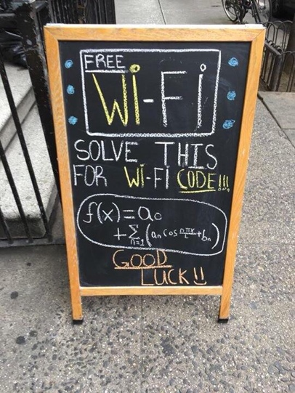

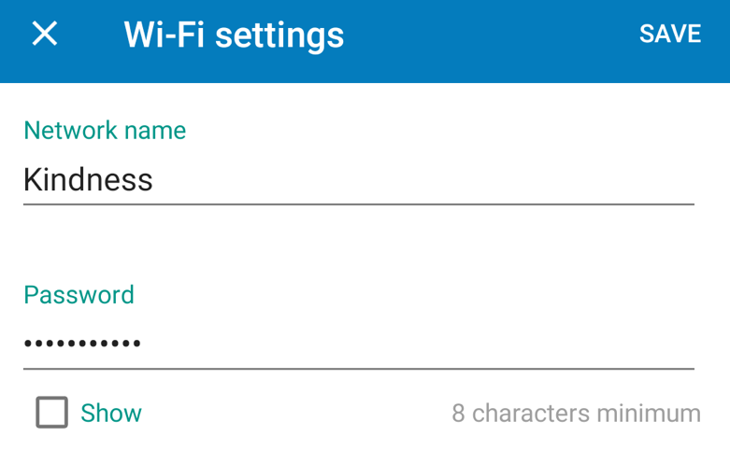

Current authentication models
picket fence security
802.1x
international roaming
hard to scale
to IoT
federated (RADIUS, DIAMETER)
WPA2-Personal

Slide 16
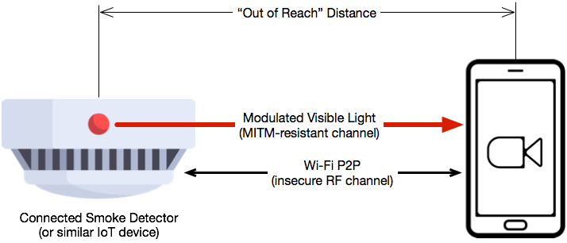
New (additional) authentication model
Old model assumed human-at-machine
Or opaque 802.1x certificate model
Add hardware admission model
  “Should I admit the Smart Teapot blinking red and blue?”
  “Here’s a list of device manifests – add them to the network”
  “Admit the device I just touched”
  ”Admit the blinking device I’m pointing the camera at”
  “Admit the device playing a melody”

Slide 17
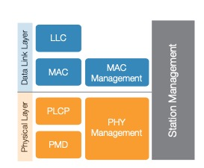
Stacks always focus on data – complexity is in control

Slide 18




Two evolutionary paths
mostly not a PHY problem
like 4G & 5G, just more
highest mobility
lowest bandwidth cost

Slide 19

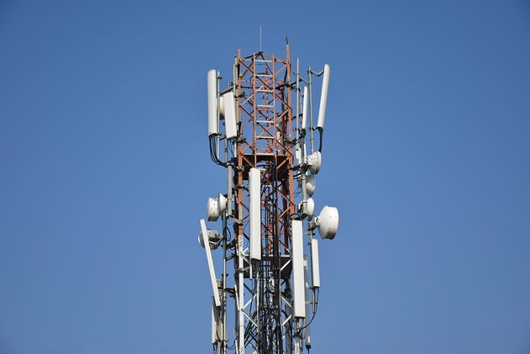
A 6G architecture that combines Wi-Fi and cell models?
Let’s assume IPv6 everywhere
user
control
upper layers
(UDP, TCP, QUIC, HTTP/2)
upper layers
(UDP, TCP, QUIC, HTTP/2)
user cloud
services
IPv6
avoid dozens of
complex control
protocols!
MAC (Ethernet-like)
many PHYs
(light, fiber, CAT7, …)
PHY
low complexity & power
PHY
high bandwidth & efficiency

Slide 20
Conclusion
6G needs an architecture re-think, not (only) better PHY
Cleaner separation between media/complexity-dependent layers, common data transport and control planes
Design scalable, IP-based control plane for everything from peer-to-peer mode to managed national cellular network
Cleanly separate access from backbone
  since likely continue to be both locally (enterprise) and third-party managed
Opportunity to bridge the Wi-Fi - cellular chasm

